Slide 1

FTS3 – Updates, status and roadmap

Slide 2
Reviewing 3.3
3 new bugs required patch releases
  [FTS-265] Duplicated inner fields when polling multiple jobs
  [FTS-269] Connection leaks
  [FTS-351] –debug flag ignored by fts_url_copy

Slide 3
Reviewing 3.3
Other bugs (not new) found after hitting production
  Disappearing wsgi processes (not ours)
  Other previously undiscovered bugs, but not new
  High memory consumption due to Python watermark

Slide 4
Reviewing 3.3
Upgrade procedure perhaps not as smooth as it should have been
  More on this later
  Reminder:
    http://fts3-service.web.cern.ch/documentation/releases
    https://dmc-docs.web.cern.ch/dmc-docs/

Slide 5
New documentation link
http://fts3-docs.web.cern.ch/fts3-docs/
  Generated using GitBook (same as Config Docs)
  Can be tracked, versioned, tagged…
    https://gitlab.cern.ch/fts/documentation

Slide 6
Known standing issues
[FTS-261] REST API Bindings leaks
  Cause trouble to LHCb
  Underlying cause is a bug in NSS
[FTS-343] Stalled connections
  HTTPD Worker should fix the issue, to be followed
[FTS-359] Pairs with >1M files slow down the full server
[FTS-366] Database connectivity issues
  Probably just a configuration change (increase pool size)

Slide 7
Known standing issues
Messaging and database overload
  Require re-thinking FTS3 inners
  Both restrict the scalability of the service

Slide 8
CentOS7
fts-devel.cern.ch has had one CentOS7 node for > 1 year
IT-PES plans moving the Pilot to CentOS7
  Within ~2 weeks
  If it works, Production will eventually be migrated too

Slide 9
CentOS7
There will be an interval with both CentOS7 and SL6
Need pilot services for *both*. Either
  Test instance @ RAL good candidate to keep running SL6 for validation as long as there are production SL6
  Or Pilot@CERN with a mix of nodes

Slide 10
FTS 3.3.3 (Pilot@CERN)
[FTS-336] Check if a transfer was already picked before running it
[FTS-351] fts_url_copy ignored –debug
[FTS-338] Allow to configure backup bulk size
[FTS-352] Memory check before spawning fts_url_copy

Slide 11
Next release: 3.4
Bugfixes, some of them were backported to 3.3
[FTS-281] Expose recoverable/non recoverable via messaging
[FTS-309] Reduce bring online bulk size to 1K
[FTS-335] Remove Google coredumper, use system facilities instead
[FTS-306] Show fixed values configurations
[FTS-283] & [FTS-287] Removed ftsdb Python wrappers

Slide 12
Next release: 3.4
[FTS-291] Forbid reuse jobs with different endpoints involved
[FTS-296] Use SHA256 for signing cert requests (proxies)
[FTS-247] Use sqlalchemy 0.8
[FTS-300] Allow to modify a job priority
[FTS-312] When using the host cert, grant all
[FTS-365] Query jobs canceled via gSOAP
[FTS-221] Allow to retrieve jobs with a given destination surl
[FTS-272] Activity shares in the web config UI
[FTS-316] New algorithms for best replica on submission

Slide 13
Next release: 3.4
CLI will be able to figure out if using REST or SOAP by itself
  --rest will be obsolete
It will start printing ‘please, use REST’

Slide 14
Next release: 3.4
SOAP Python bindings will trigger a ‘Warning’ with a deprecation message
  They aren’t even installed in lxplus
  Is anyone using them?

Slide 15
New selection strategies
Implemented by our Openlab Summer Student Hamza Zafar
  Improving File Transfer Service

Slide 16
New selection strategies
orderly
  Same order as in submission
queue / auto
  Pair with lower number of queued transfers
success
  Pair with higher success rate last hour
Throughput
  Pair with higher aggregated throughput during the last hour
file-throughput
  Pair with higher average throughput per file

Slide 17
New selection strategies
pending-data
  Pair with less queued data
waiting-time
  Pair with less estimated waiting time (pending data / aggregated throughput)
waiting-time-with-error
  As waiting-time, penalizing with the failure rate
duration
  waiting-time-with-error + file size / average file throughput

Slide 18
New selection strategies
Rank is cached to reduce database overhead
Only available at submission time

Slide 19
Medium term plans for 3.5
Code cleanup
Code refactoring
Required steps towards the longer term plans
  In any case, facilitates maintainability

Slide 20
Longer term plans
Drop SOAP support in the FTS3 CLI
  <= 1 year
Drop SOAP support in the server
  >= 1 year
  gLite clients will stop working

Slide 21
Longer term plans
Why dropping gSOAP?
  (AFAIK) Those that are moving towards FTS3 specific stuff, do it via REST
  gSOAP is hard and cumbersome to modify
    And we aren’t many
  Better keep one single entry point
    For free: no user-facing code in the daemon!

Slide 22
[Very] Longer term plans
Improve and increase test coverage
Move load away from the database
Reduce internal messaging latency
Reduce submission latency
Improve FTS3 scheduler and optimizer

Slide 23
[Very] Longer term plans
May require evaluating alternative technologies
  Use the tool for the job
  Need to know how willing are sites to run additional services (i.e. message queue, in-memory databases…)

Slide 24
[Very] Longer term plans
Necessary if we want to increase the scalability
Also, necessary for non-trivial updates
  Better scheduler, better optimizer

Slide 25
Flume + ES + Kibana
Still lacking service level monitoring
We do have a setup in fts3-devel which we would like to see in the Pilot, and later production
  And eventually, all FTS3

Slide 26
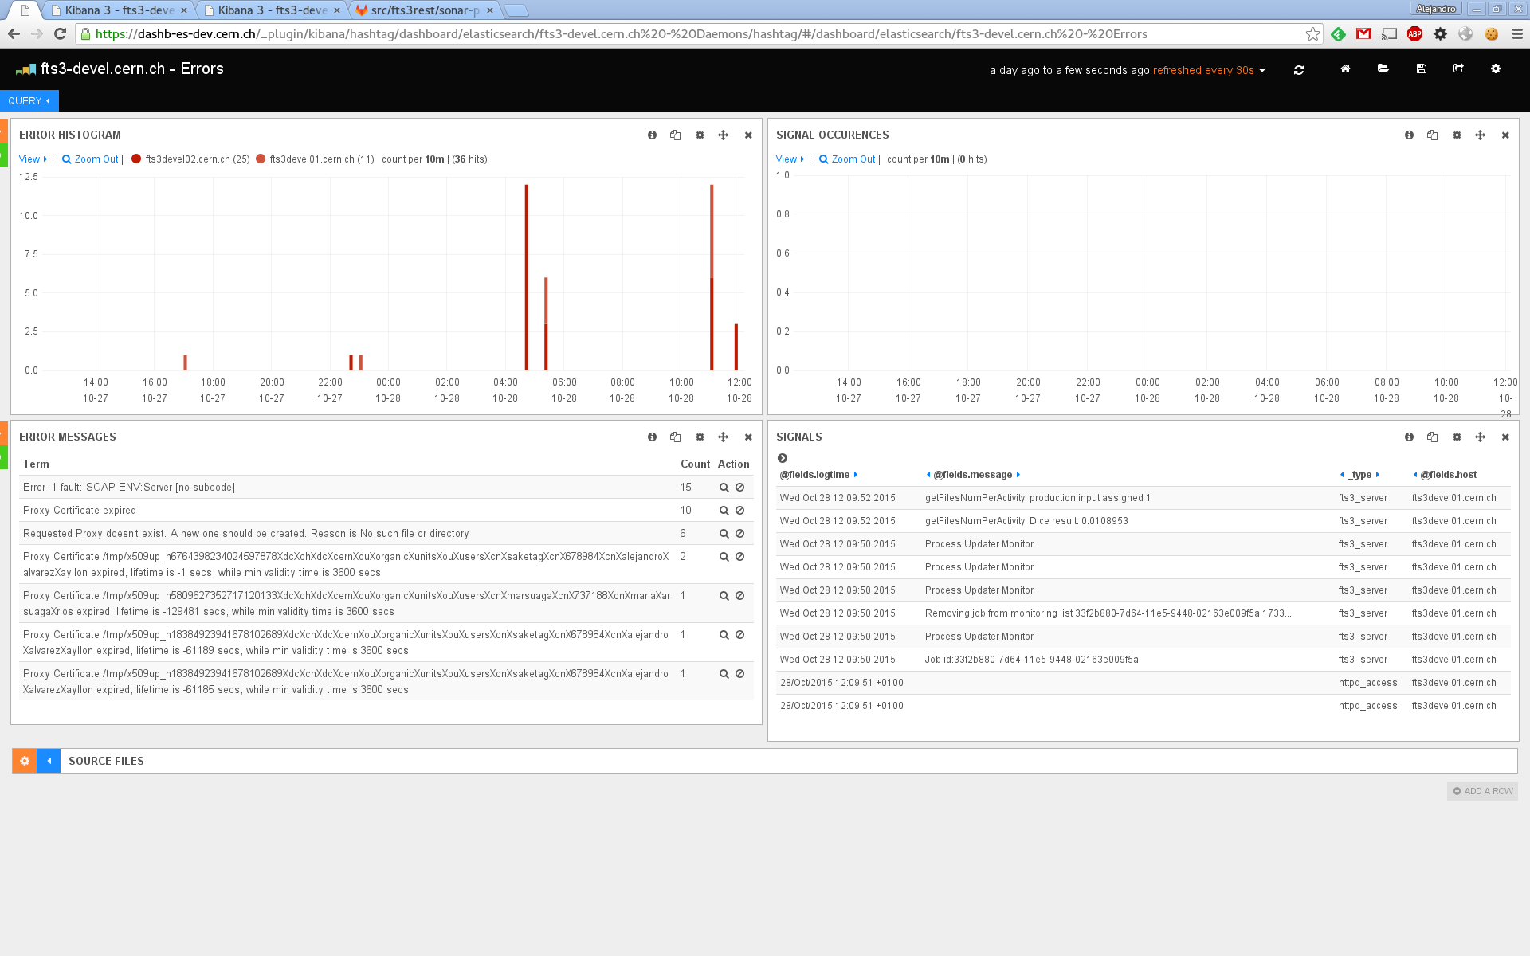
Flume + ES + Kibana

Slide 27
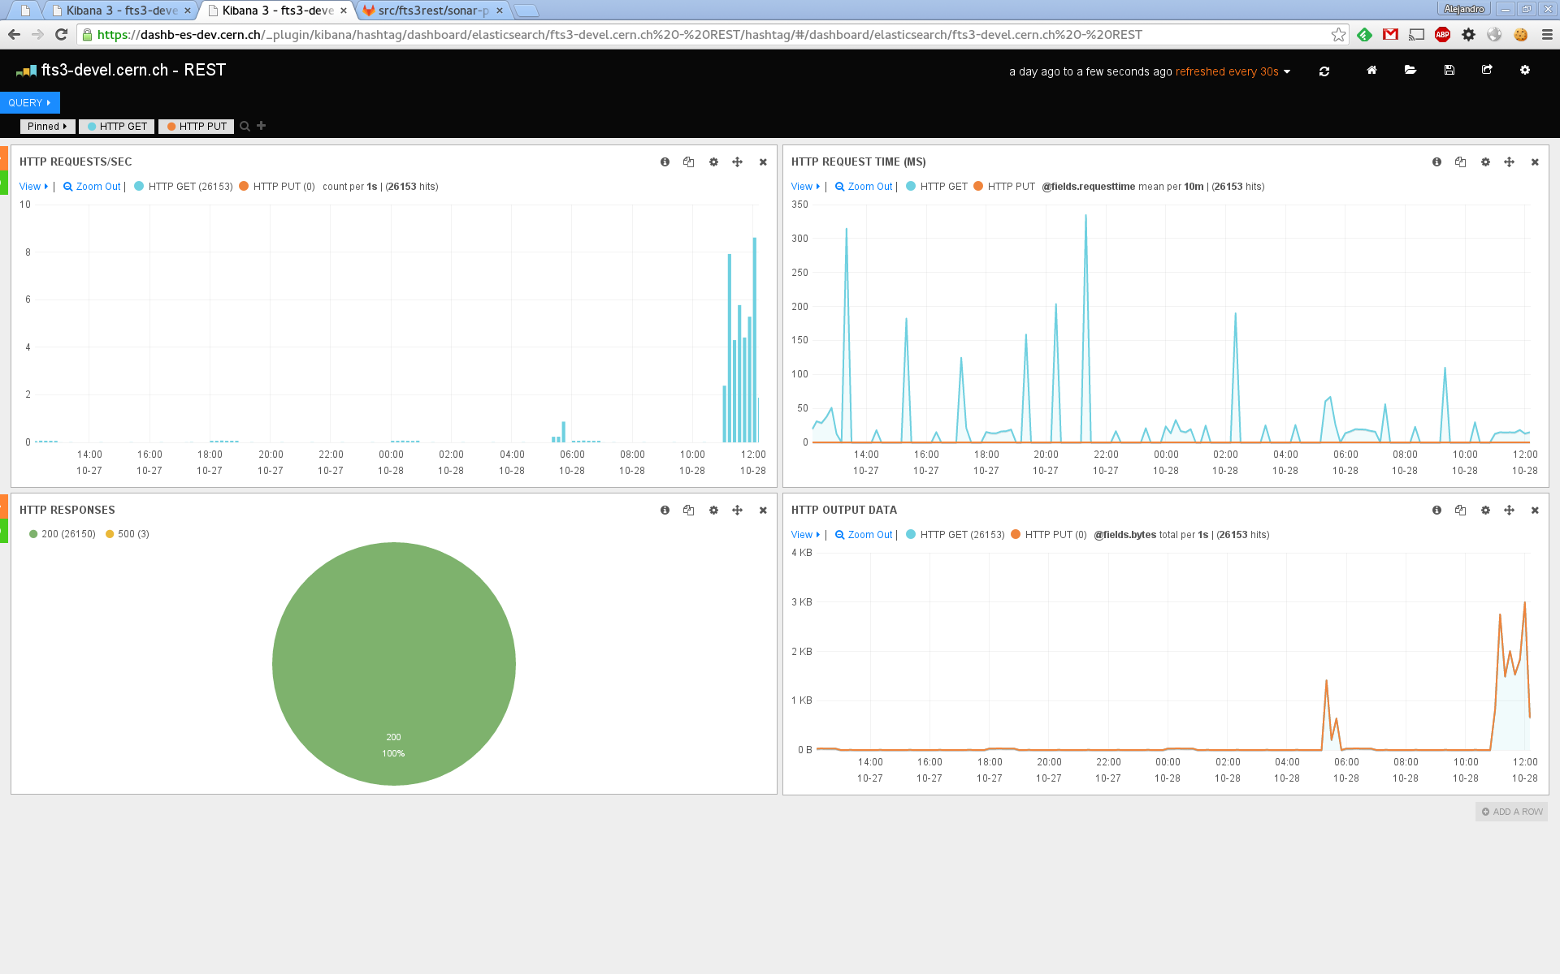
Flume + ES + Kibana

Slide 28
Flume + ES + Kibana
These views help identifying server load, request time, latency…
Can measure if improvements changed anything
Basically ‘help us to help you’

Slide 29
Consistent configuration
Versions still triggered by experiments
  Up to the patch level?
Developers need some control to communicate
  Configuration recommendations, dependencies versions, etc.

Slide 30
Consistent configuration
Mailing list is… complicated
  Easy to lose track
  Noisy
  People that doesn’t need to be aware, ends being in the middle
  Ratio noise/signal actually low for some parties?

Slide 31
Consistent configuration
Possibilities:
  Yet another mailing list only for sysadmins
    Personally, I vote no
    Will end being a clone of fts3-steering
  Ticket tracker
    GGUS, JIRA…
    Still need a KB somewhere (!)

Slide 32
Consistent configuration
Ideally
  All share puppet modules
    Revision control
    Exact same base configuration for all
    Quite some work, but very reproducible and with an excellent history track

Slide 33
FTS3 Steering Meetings
How often should these meetings take?
  1/month sounds reasonable

