Slide 1


The New CLIC Detector Simulation Model
Nikiforos Nikiforou
CERN/PH-LCD
on behalf of the CLICdp collaboration
LCWS2015:
International Workshop on Future Linear Colliders
Whistler BC Canada,
November 2nd 2015

Slide 2
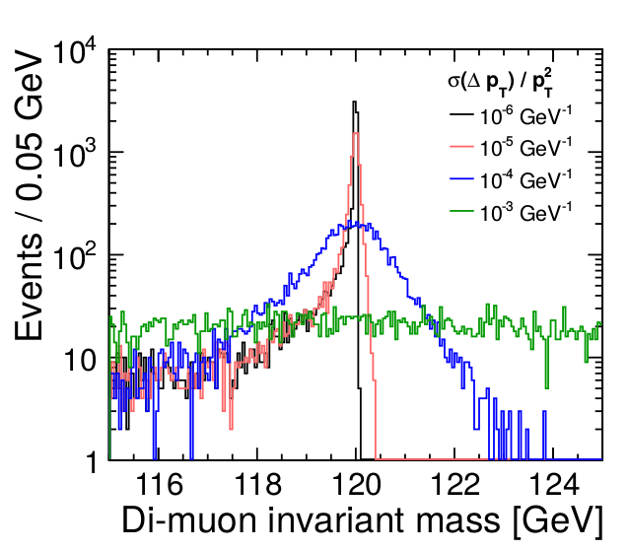
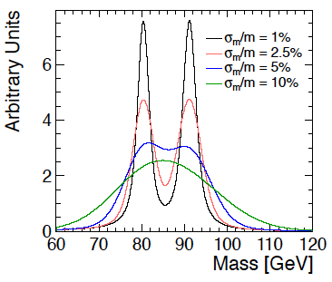

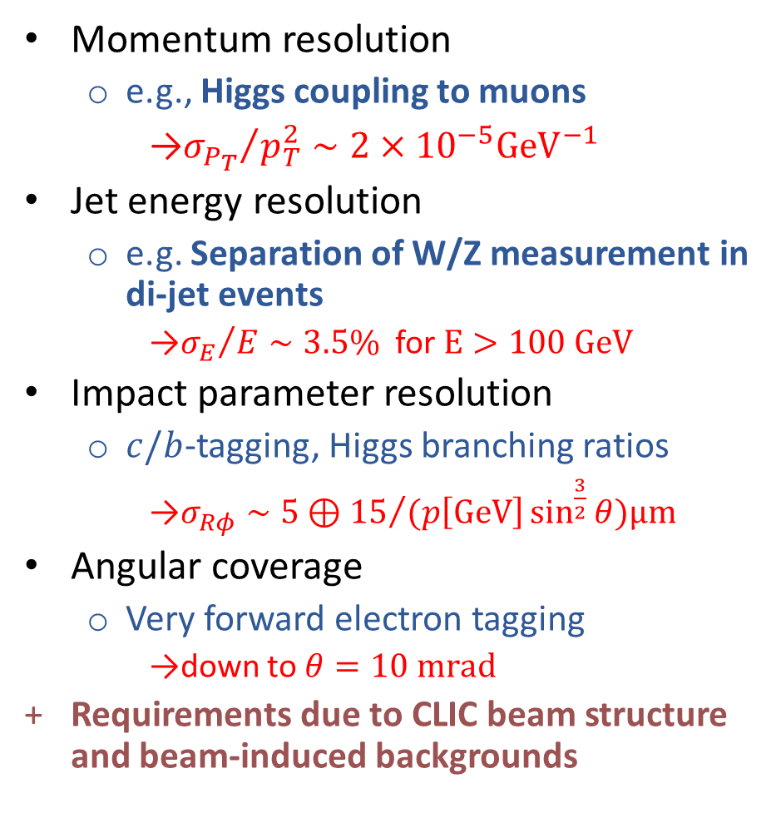

CLIC Physics Goals $→$ Detector Requirements
Momentum resolution
  e.g., Higgs coupling to muons
    ${σ_{P_{T}}}/{p_{T}^{2}}∼2×{10}^{−5}{GeV}^{−1}$
Jet energy resolution
  e.g. Separation of W/Z measurement in di-jet events
    ${σ_{E}}/{E∼3.5\% }$ for $E>100 GeV$
Impact parameter resolution
  $c/b$-tagging, Higgs branching ratios
    $σ_{Rφ}∼5⊕{15}/{(p\left[GeV\right]\sin^{\frac{3}{2}}{θ})μm }$
Angular coverage
  Very forward electron tagging
    down to $θ=10 mrad$
Requirements due to CLIC beam structure and beam-induced backgrounds
e.g. $H→μμ$
e.g. W/Z
separation

Slide 3
Evolution of Detector Designs
For the CLIC CDR (2012): Two general-purpose CLIC detector concepts
Based on initial ILC concepts (ILD and SiD) but optimized and adapted to CLIC conditions
Concept\Key param. | ILD (ILC) | CLIC_ILD | SiD (ILC) | CLIC_SiD | CLICdet_2015 (3 TeV) | CMS
Tracker | TPC/Silicon | TPC/Silicon | Silicon | Silicon | Silicon | Silicon
Solenoid Field [T] | 3.5 | 4 | 5 | 5 | 4 | 3.8
Solenoid Free Bore [m] | 3.3 | 3.4 | 2.6 | 2.7 | 3.4 | 3.0
Solenoid Length [m] | 8 | 8.3 | 6 | 6.5 | 8.3 | 13
VTX Inner Radius [mm] | 16 | 31* | 14 | 27* | 31* | 40
ECAL Inner Radius [m] | 1.8 | 1.8 | 1.3 | 1.3 | 1.5 | 1.3
ECAL ∆R [mm] | 172 | 172 | 135 | 135 | 159 | 500
HCAL Absorber B / E | Fe | W / Fe | Fe | W / Fe | Fe | Brass
HCAL λ_{I} | 5.5 | 7.5 | 4.8 | 7.5 | 7.55 | 5.8 Barrel/10 EC
Overall Height [m] | 14 | 14 | 12 | 14 | 12.8 | 14.6
Overall Length [m] | 13.2 | 12.8 | 11.2 | 12.8 | 11.4 | 21.6
* For $\sqrt{s}≲500 GeV$ a variant with a VTX inner radius smaller by 6 mm is foreseen

Slide 4
Simulation Model in Software
New detector model implemented and being refined in DD4hep with relative flexibility/scalability
  New package LCgeo holds model implementation
Developing simulation and reconstruction software based on DD4hep in collaboration with ILD
  Other relevant talks:
    Joint ILD/ SiD/CLICdp session on simulation tools and reconstruction algorithms: Tuesday afternoon
    Simulation/Performance/Reconstruction sessions: Tuesday morning
    Vertex/tracking joint session with Simulation/Performance/Reco: Thursday afternoon
See talk by M. Petric
(Thursday morning)

Slide 5
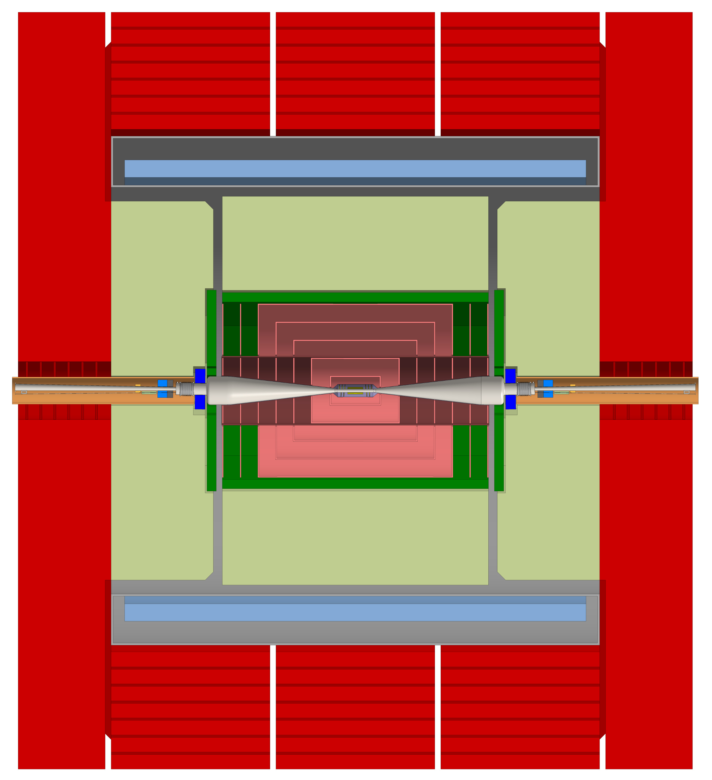
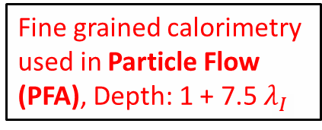
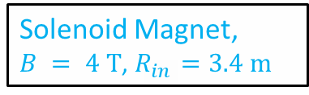
Proposed Layout in New Detector Model
Ultra low-mass
vertex detector
with 25 μm pixels
Main tracker, silicon-based (large pixels and/or strips)
Solenoid Magnet, $B = 4 T$, $R_{in}=3.4 m$
Forward region with LumiCal and BeamCal
Return yoke (Fe) with detectors
for muon ID
Fine grained calorimetry used in Particle Flow (PFA), Depth: 1 + 7.5 $λ_{I}$
11.4 m

Slide 6
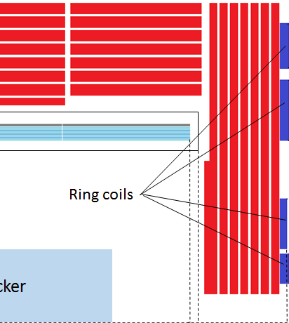
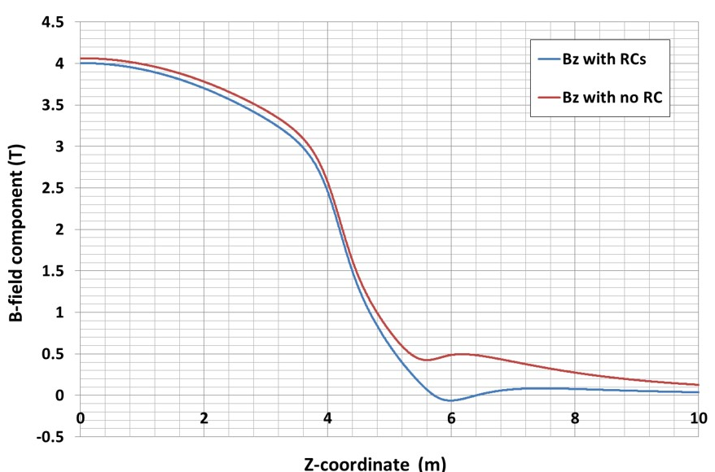
Magnet System Layout
To be added
Tracker
Quarter view of the magnet system with “thin” yoke Endcaps
Note 4 concentric ring end coils in blue
B-field axial component with and without end coils as function of z
Use the end coils to compensate for thin endcaps

Slide 7
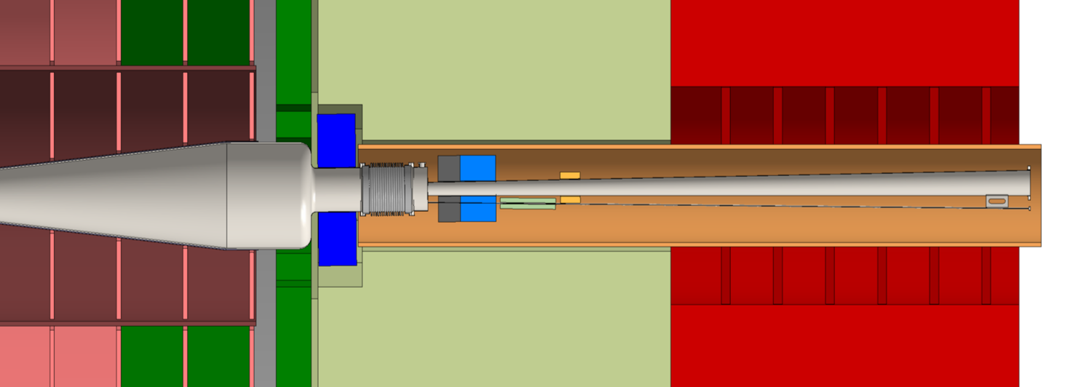
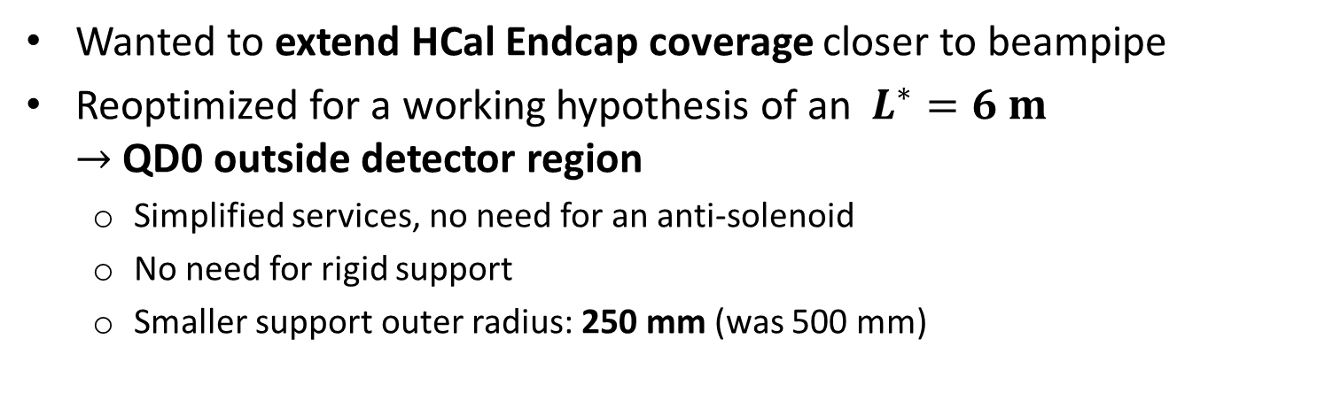
Forward Region Layout in the New Model
ECAL plug
LumiCal
500 mm
1000 mm in old design!
BeamCal
(incl. graphite)
HCal
(with cutout for LumiCal)
Wanted to extend HCal Endcap coverage closer to beampipe
Reoptimized for a working hypothesis of an $L^{∗}=6 m$ $→$ QD0 outside detector region
  Simplified services, no need for an anti-solenoid
  No need for rigid support
  Smaller support outer radius: 250 mm (was 500 mm)

Slide 8
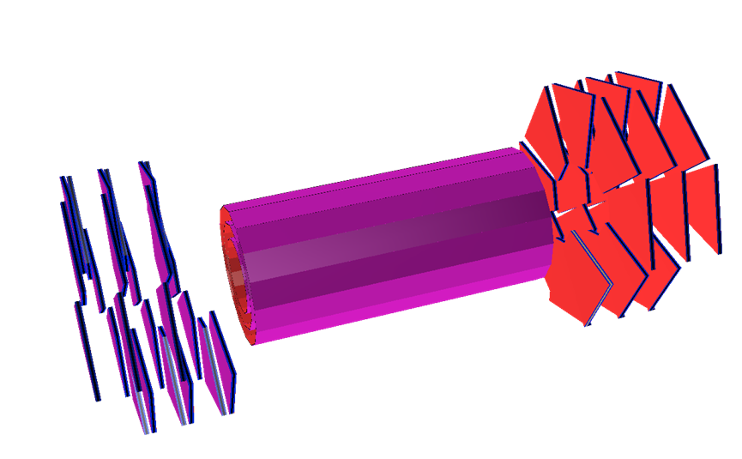
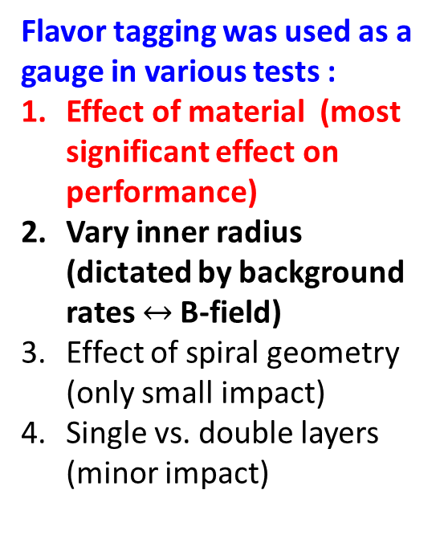
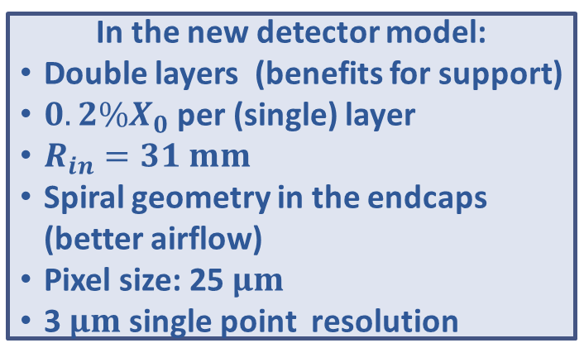
Vertex Detector: Reminder
Flavor tagging was used as a gauge in various tests :
Effect of material (most significant effect on performance)
Vary inner radius (dictated by background rates $↔$B-field)
Effect of spiral geometry (only small impact)
Single vs. double layers (minor impact)
In the new detector model:
Double layers (benefits for support)
$0.2\%X_{0}$per (single) layer
$R_{in}=31 mm$
Spiral geometry in the endcaps (better airflow)
Pixel size: 25 $μm$
3$μm$single point resolution
See talks during CLICdp meeting with emphasis on Vertex/Tracking (Thursday morning)

Slide 9
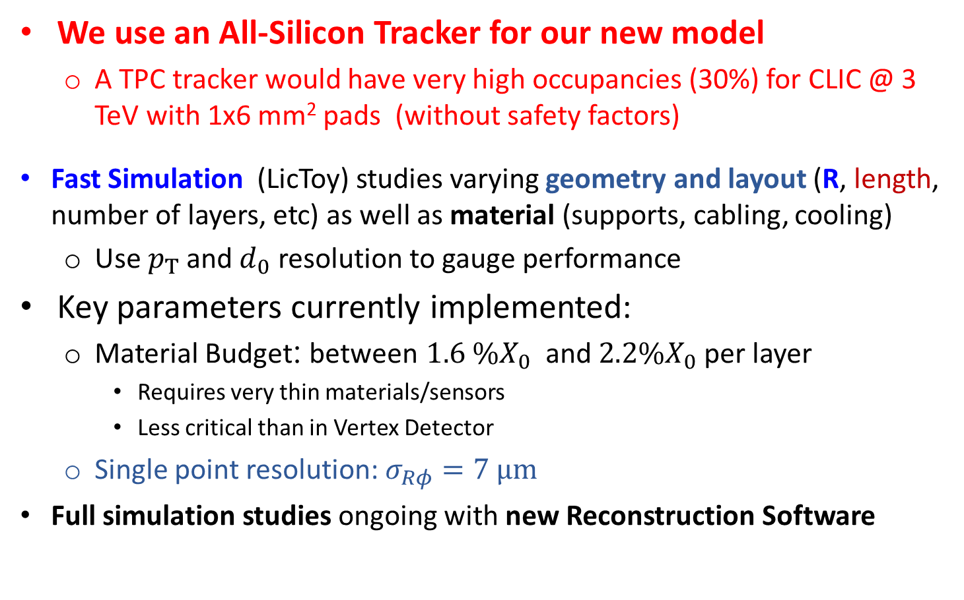
Silicon Tracker
We use an All-Silicon Tracker for our new model
  A TPC tracker would have very high occupancies (30%) for CLIC @ 3 TeV with 1x6 mm² pads (without safety factors)
Fast Simulation (LicToy) studies varying geometry and layout (R, length, number of layers, etc) as well as material (supports, cabling, cooling)
  Use $p_{T}$ and $d_{0}$ resolution to gauge performance
Key parameters currently implemented:
  Material Budget: between $1.6 \%X_{0}$ and $2.2\%X_{0}$ per layer
    Requires very thin materials/sensors
    Less critical than in Vertex Detector
  Single point resolution: $σ_{Rφ}=7 μm$
Full simulation studies ongoing with new Reconstruction Software
See talk by R. Simoniello
(Thursday afternoon)

Slide 10
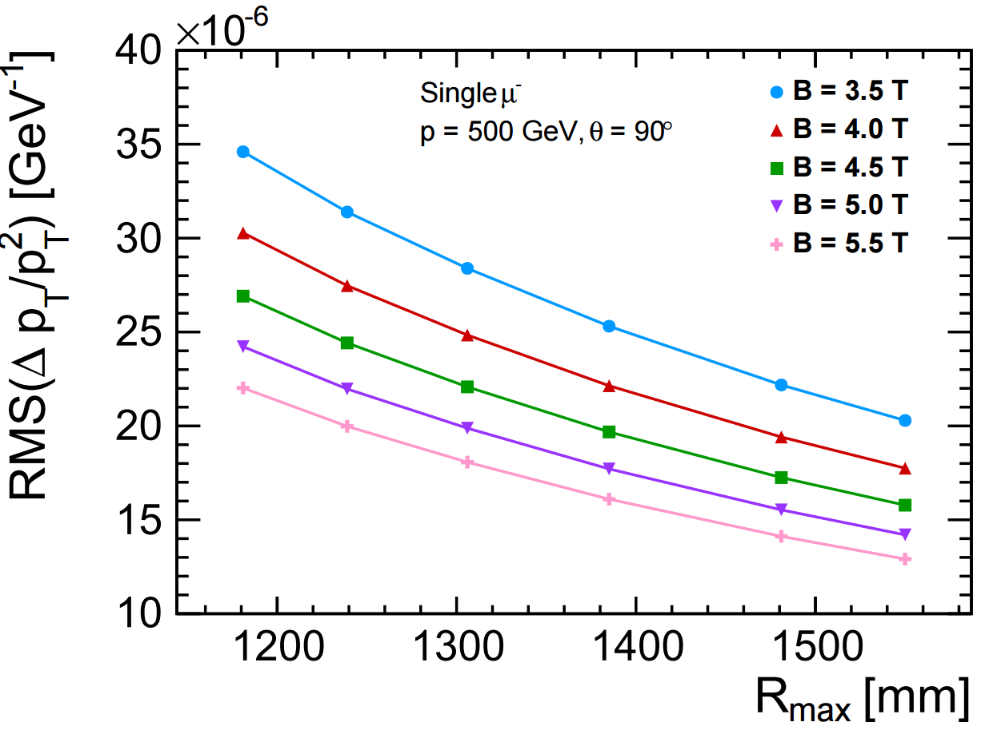
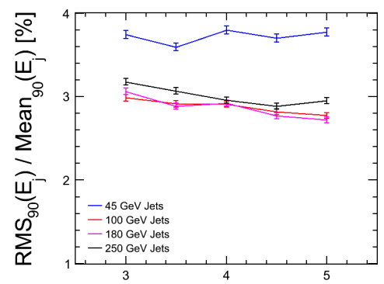
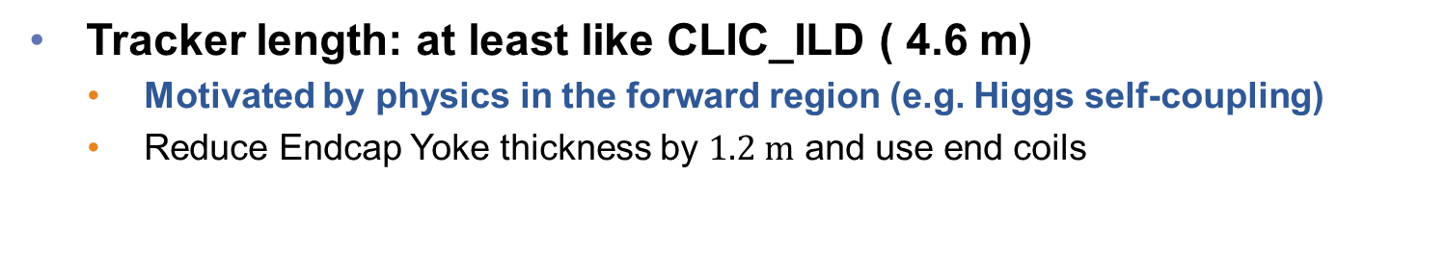
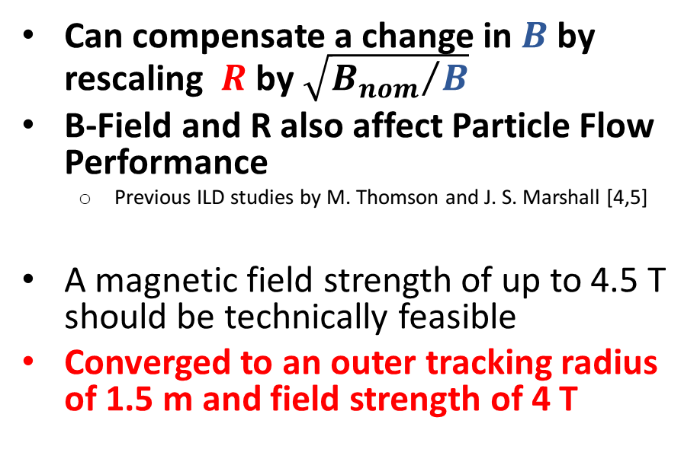
Silicon Tracker Radius/ B-field
Can compensate a change in $B$ by rescaling $R$ by $\sqrt{{B_{nom}}/B}$
B-Field and R also affect Particle Flow Performance
  Previous ILD studies by M. Thomson and J. S. Marshall [4,5]
A magnetic field strength of up to 4.5 T should be technically feasible
Converged to an outer tracking radius of 1.5 m and field strength of 4 T
CLIC_SiD
CLICdet_2015
CLICdp Work In Progress
Tracker length: at least like CLIC_ILD ( 4.6 m)
    Motivated by physics in the forward region (e.g. Higgs self-coupling)
    Reduce Endcap Yoke thickness by $1.2 m$ and use end coils
B [T]

Slide 11
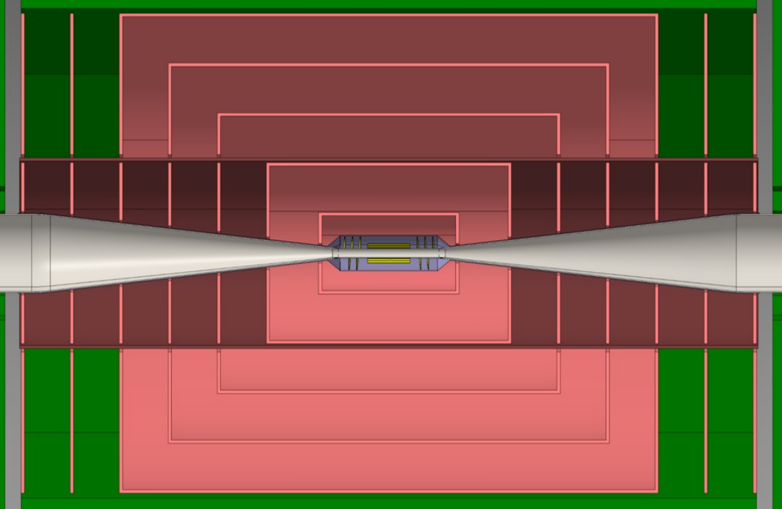
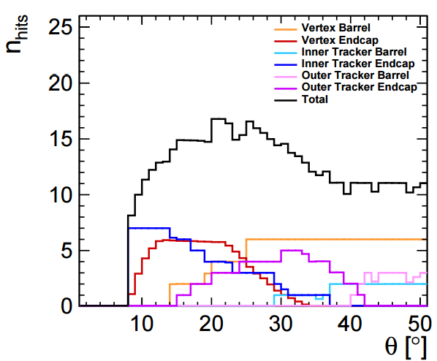

Si Tracker Layout
5 “short” Barrel layers
  First layer at $R=230 mm$
7 “flat” Endcap disks (full $R$)
  New First disk at $z=430 mm$
Arranged in an Inner and Outer Tracker
  Support tube for extraction with beampipe assembly
2.9 m
4.6 m
At least 8 hits (Vertex + Tracker) for θ> 8^{ο}
Module arrangement and overlap still under investigation
Cell size should vary from layer to layer
  Motivated by occupancy (next slide)
CLICdp Work In Progress

Slide 12
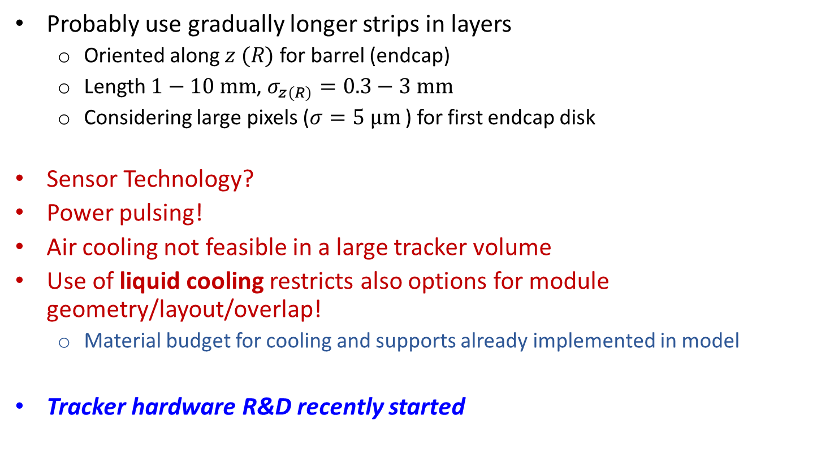
Tracker: Open Issues
Probably use gradually longer strips in layers
  Oriented along $z (R)$ for barrel (endcap)
  Length $1−10 mm$, $σ_{z(R)}=0.3−3 mm$
  Considering large pixels ($σ=5 μm$) for first endcap disk
Sensor Technology?
Power pulsing!
Air cooling not feasible in a large tracker volume
Use of liquid cooling restricts also options for module geometry/layout/overlap!
  Material budget for cooling and supports already implemented in model
Tracker hardware R&D recently started
See talk by A. Nurnberg (Thursday afternoon) and talks in the CLICdp meeting (Thursday morning)

Slide 13
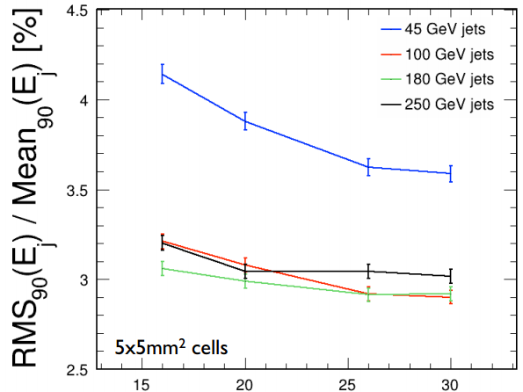
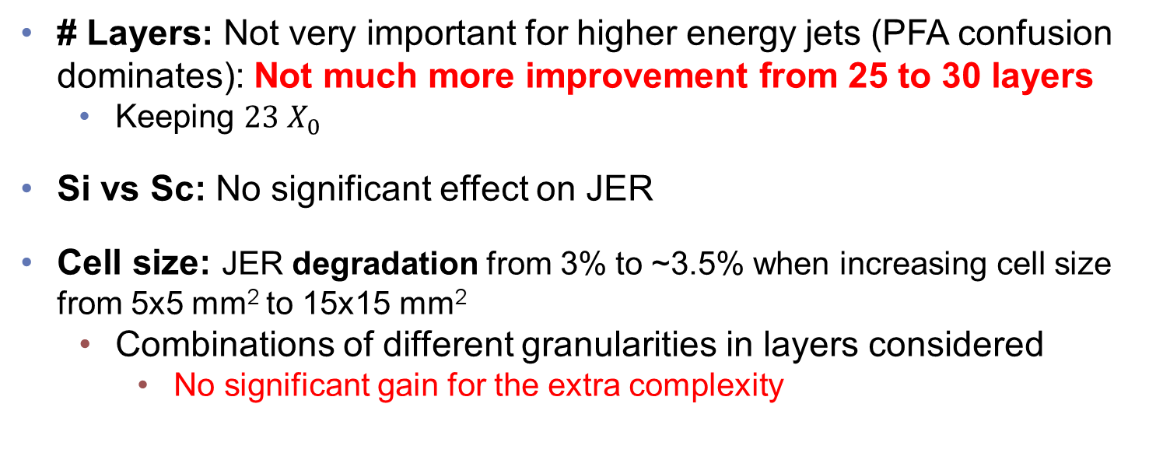

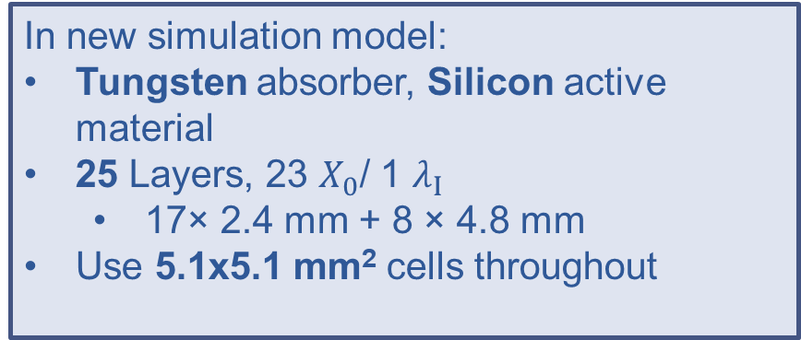
ECal Optimization
# Layers: Not very important for higher energy jets (PFA confusion dominates): Not much more improvement from 25 to 30 layers
  Keeping $23 X_{0}$
Si vs Sc: No significant effect on JER
Cell size: JER degradation from 3% to ~3.5% when increasing cell size from 5x5 mm² to 15x15 mm²
  Combinations of different granularities in layers considered
    No significant gain for the extra complexity
$$Z→uds$$
In new simulation model:
Tungsten absorber, Silicon active material
25 Layers, 23 $X_{0}$/ 1 $λ_{Ι}$
  17× 2.4 mm + 8 × 4.8 mm
Use 5.1x5.1 mm² cells throughout
M. Thomson, J. S. Marshall [5,7]
(Scintillator)
nLayers

Slide 14
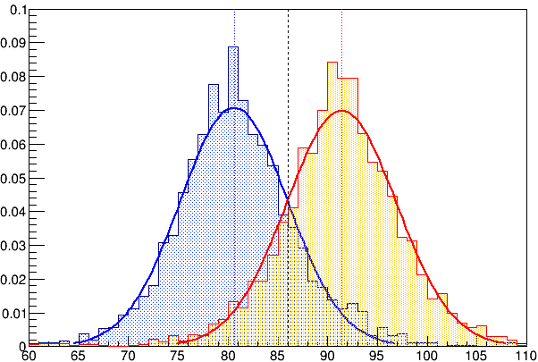
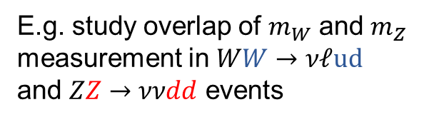




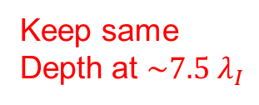

HCal Optimization
E.g. study overlap of $m_{W}$ and $m_{Z}$ measurement in $WW→νℓud$ and $ZZ→ννdd$ events
Example: HCal Barrel Absorber
  10 mm Tungsten (W)
  19 mm Steel (Fe)
Full Geant4 detector simulation + PandoraPFA + FastJet
JER Performance shown to be similar for tungsten and steel
  Steel is cheaper and easier to process
19 mm Fe
No Overlay
Keep same
Depth at $\sim 7.5 λ_{I}$
Entries/1 GeV
$$\sqrt{s}=1 TeV$$
W
Z
$m_{JJ}$ [GeV]
The shaded area gives one of the points on the plot below. Repeat for both models, all energies. Do also with background.
$⇒$ Use Steel as an absorber for the entire HCal
  60 layers
  20 mm Steel (1 mm in cassette)
  3 mm Scintillator
  30x30 mm² Cell size
Adding background
CLICdp Work In Progress

Slide 15
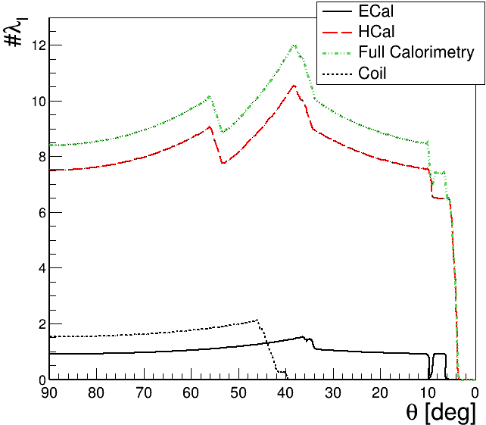
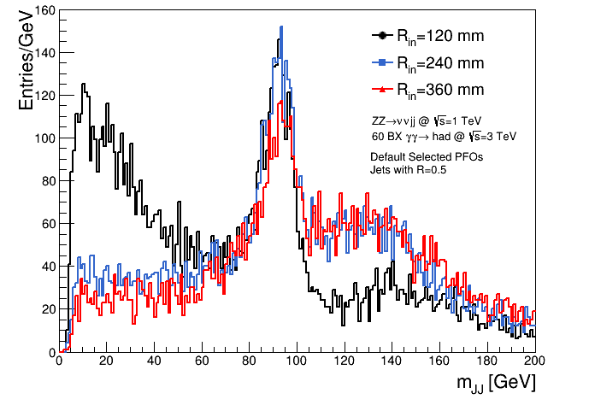
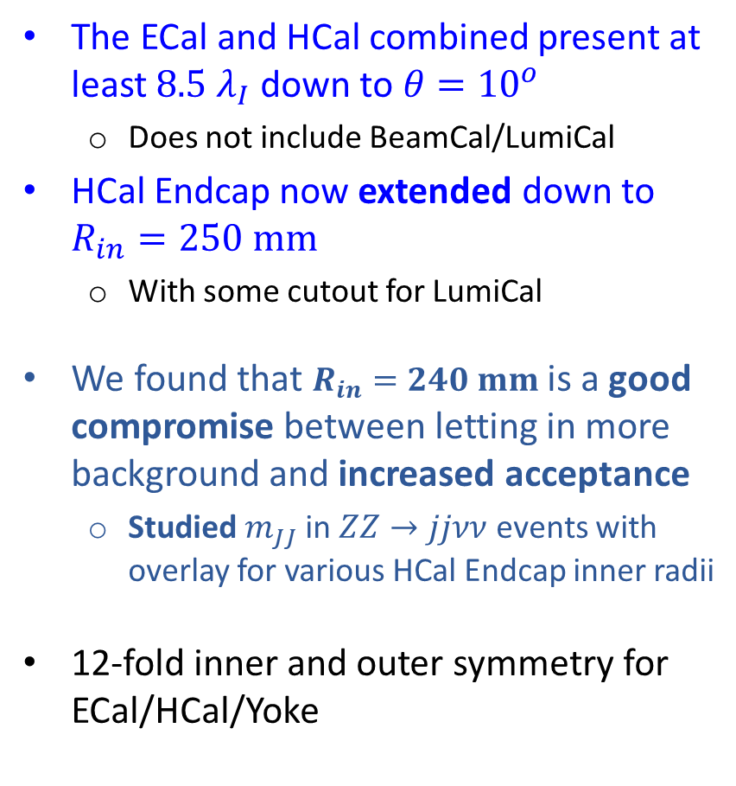
More Calorimetry
The ECal and HCal combined present at least $8.5 λ_{I}$ down to $θ={10}^{o}$
  Does not include BeamCal/LumiCal
HCal Endcap now extended down to $R_{in}=250 mm$
  With some cutout for LumiCal
We found that $R_{in}=240 mm$ is a good compromise between letting in more background and increased acceptance
  Studied $m_{JJ}$ in $ZZ→jjνν$ events with overlay for various HCal Endcap inner radii
12-fold inner and outer symmetry for ECal/HCal/Yoke
CLICdp Work In Progress
CLICdp Work In Progress

Slide 16
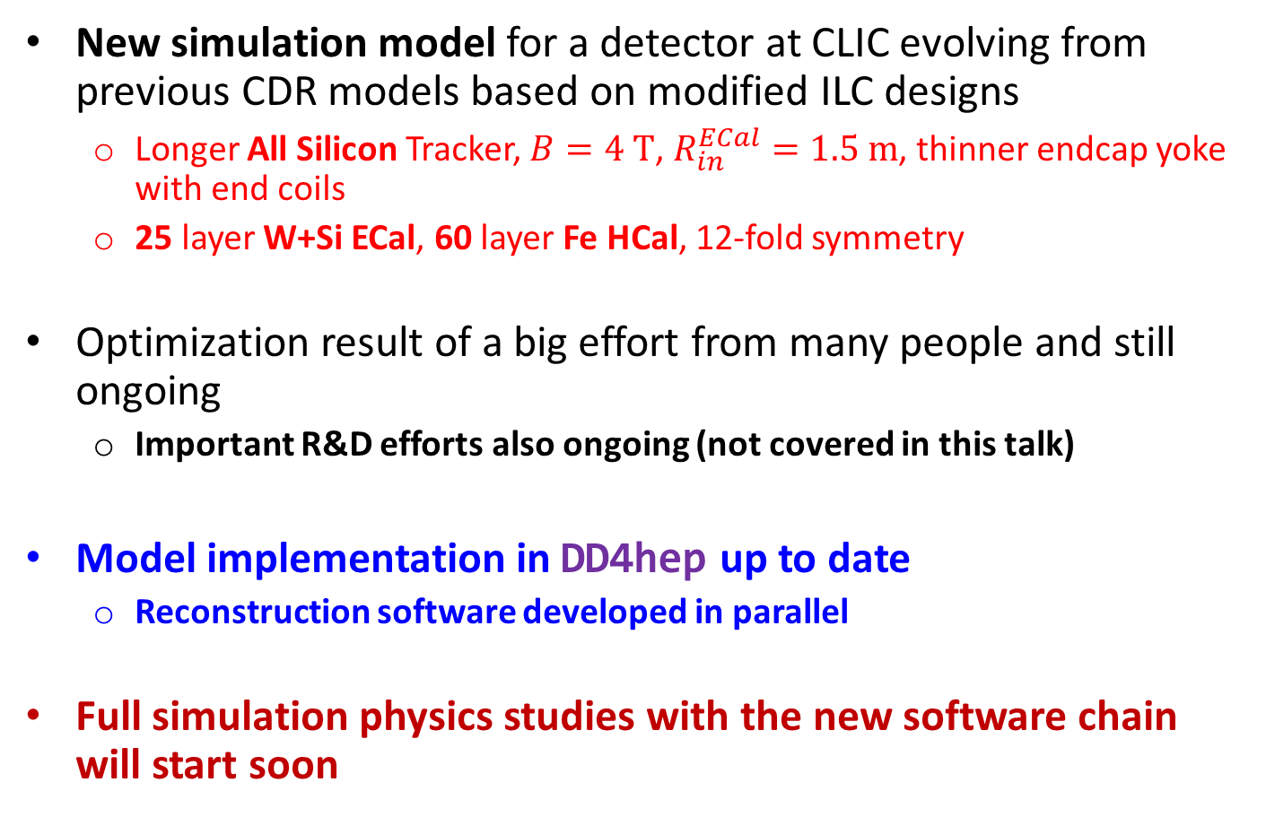
Summary
New simulation model for a detector at CLIC evolving from previous CDR models based on modified ILC designs
  Longer All Silicon Tracker, $B=4 T$, $R_{in}^{ECal}=1.5 m$, thinner endcap yoke with end coils
  25 layer W+Si ECal, 60 layer Fe HCal, 12-fold symmetry
Optimization result of a big effort from many people and still ongoing
  Important R&D efforts also ongoing (not covered in this talk)
Model implementation in DD4hep up to date
  Reconstruction software developed in parallel
Full simulation physics studies with the new software chain will start soon

Slide 17
Backup Material

Slide 18
References
L. Linssen et al., Physics and Detectors at CLIC : CLIC Conceptual Design Report, CERN-2012-003
N.Alipour Tehrani and P. Roloff, Optimisation Studies for the CLIC Vertex-Detector Geometry, CLICdp-Note-2014-002
D. Dannheim et al., Slides at https://indico.cern.ch/event/309925/contribution/2/material/slides/0.pdf
M. Thomson, Nucl.Instrum.Meth. A611 (2009)
J. Marshall, Slides at http://indico.cern.ch/event/309926/contribution/1/material/slides/0.pdf
B. Cure, Slides at https://indico.cern.ch/event/314325/contribution/1/material/slides/1.pdf
M. Thomson, Slides at http://indico.cern.ch/event/309926/contribution/1/material/slides/0.pdf
M. Valentan et al, LiC Detector Toy Fast Simulation
R. Simoniello, Slides at https://indico.cern.ch/event/376800/session/3/contribution/5/material/slides/0.pdf
A. Nurnberg, Slides at https://indico.cern.ch/event/376800/session/2/contribution/28/material/slides/0.pdf
M. Killenberg, LCD-Note-2011-029
J. S. Marshall, Slides at https://indico.cern.ch/event/336335/session/6/contribution/5/material/slides/0.pdf
F. Gaede, Slides at https://indico.cern.ch/event/376800/session/0/contribution/12/material/slides/0.pdf
M. Petric, Slides at https://indico.cern.ch/event/376800/session/0/contribution/11/material/slides/0.pdf
D. Dannheim, A. Sailer, Beam-Induced Backgrounds in the CLIC detectors, LCD-Note-2011-021
E. van Der Kraaij, Detector challenges at CLIC, contrasted with the LHC case, slides at http://indico.cern.ch/event/210720/

Slide 19
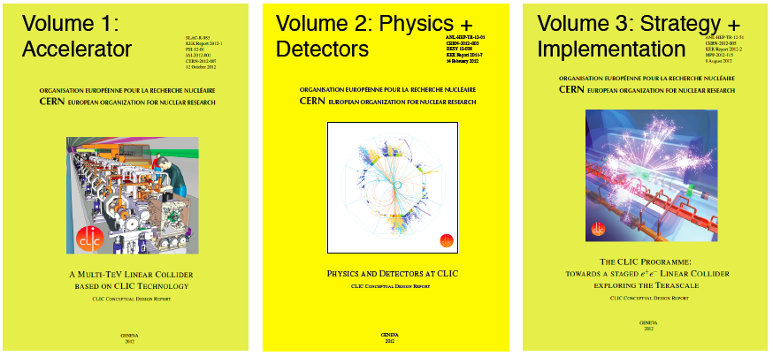
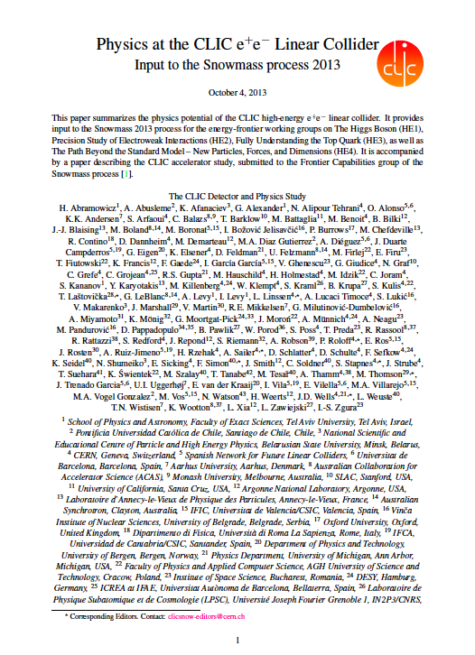
CLIC and Detector Documentation
2012: CLIC Conceptual Design Report published
2012: CLIC detector and physics collaboration (CLICdp) was set up
2012/2013: CLIC input to the European strategy and the Snowmass Process in the US
CERN-2012-007
CERN-2012-003
CERN-2012-005
arXiv:1307.5288

Slide 20
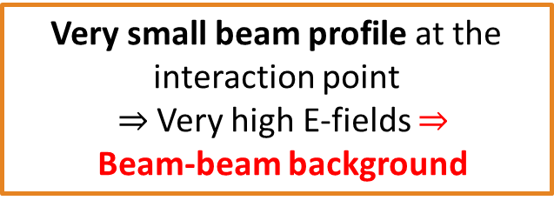
The CLIC Experimental Environment
 | CLIC at 3 TeV
Luminosity | 5.9×10³⁴ cm⁻²s⁻¹
Bunch separation | 0.5 ns
#Bunches per train | 312
Train duration | 156 ns
Train repetition rate | 50 Hz
Particles per bunch | 3.72 ×10⁹
Crossing angle | 20 mrad
σ_{x} / σ_{y} [nm] | ≈ 45 / 1
σ_{z} [μm] | 44
Drive timing requirements for the CLIC detector
Low duty cycle
  Triggerless readout
  Power pulsing (turning power off when not needed)
Very small beam profile at the interaction point
$⇒$Very high E-fields $⇒$
Beam-beam background
156 ns
20 ms
CLIC bunch structure
- not to scale -
1 train = 312 bunches, 0.5 ns apart

Slide 21
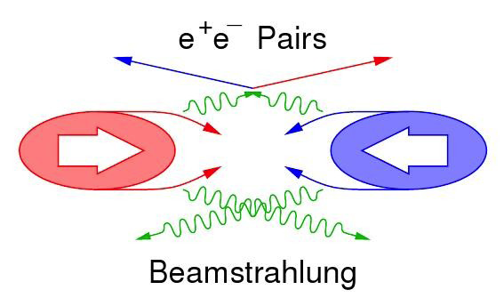
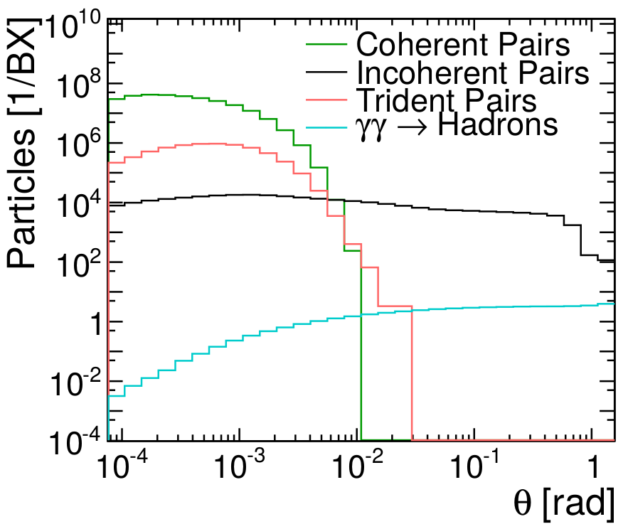
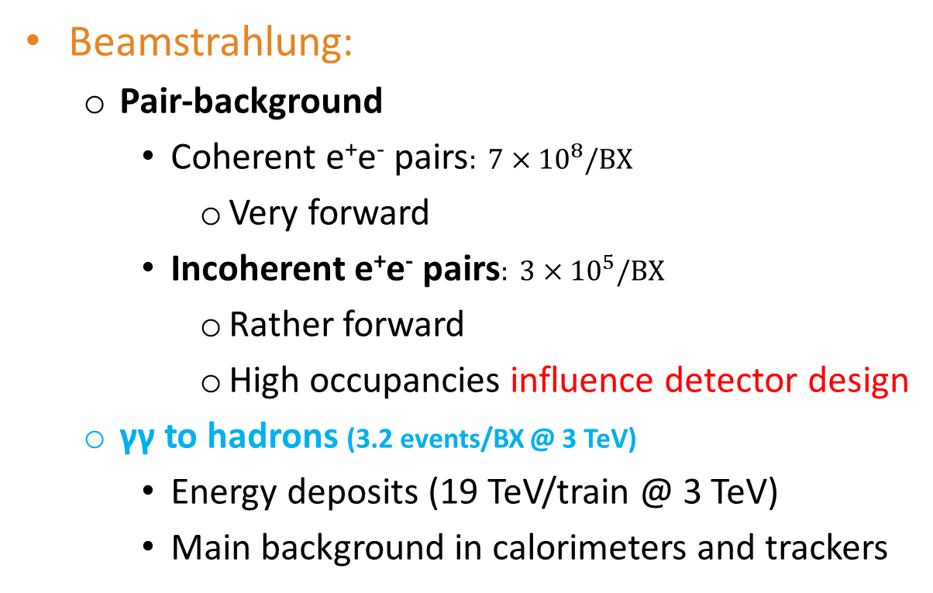
Beam-Induced Backgrounds
Beamstrahlung:
  Pair-background
    Coherent e⁺e⁻ pairs$: 7×10^{8}/BX$
      Very forward
    Incoherent e⁺e⁻ pairs$: 3×10^{5}/BX$
      Rather forward
      High occupancies influence detector design
  γγ to hadrons (3.2 events/BX @ 3 TeV)
    Energy deposits (19 TeV/train @ 3 TeV)
    Main background in calorimeters and trackers
tracker

Slide 22
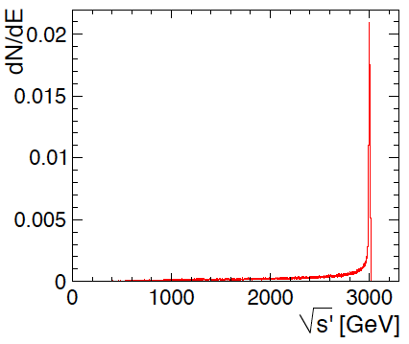
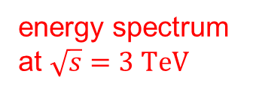
More on Beam-Beam Effects
Beamstrahlung can cause important energy losses
right at the interaction point
E.g. full luminosity at 3 TeV:
5.9 × 10³⁴ cm⁻²s⁻¹
Of which in the 1% most energetic part:
2.0 × 10³⁴ cm⁻²s⁻¹
Most physics processes are studied well above production threshold => profit from full luminosity
energy spectrum at $\sqrt{s}=3 TeV$

Slide 23
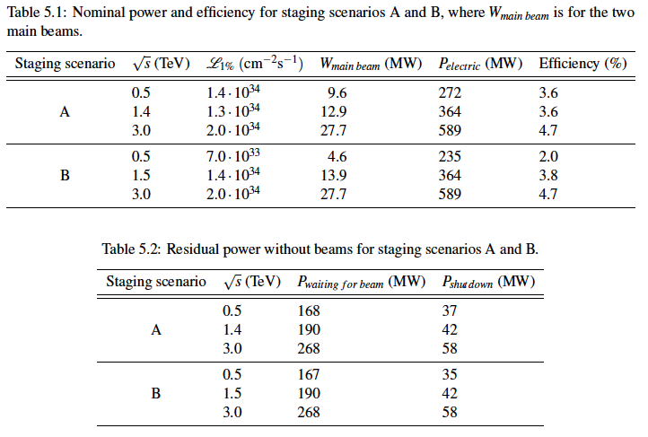
CLIC power and energy consumption

Slide 24
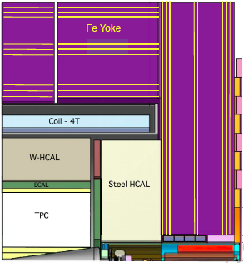
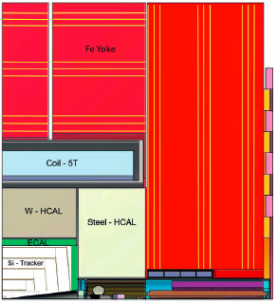
CLIC_ILD and CLIC_SiD
For the CLIC CDR (2012):
Two general-purpose CLIC detector concepts
Based on initial ILC concepts (ILD and SiD)
Optimized and adapted to CLIC conditions
CLIC_ILD
CLIC_SiD
7 m

Slide 25
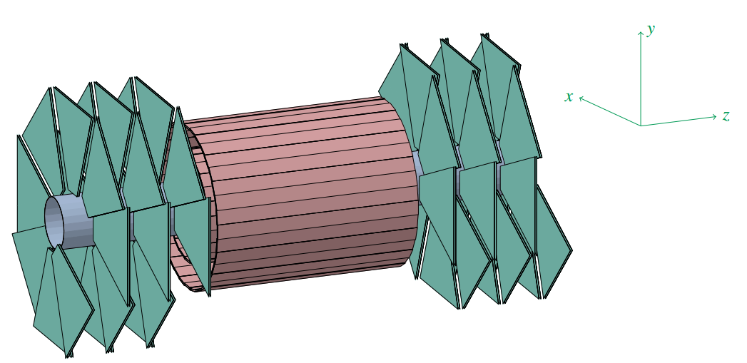

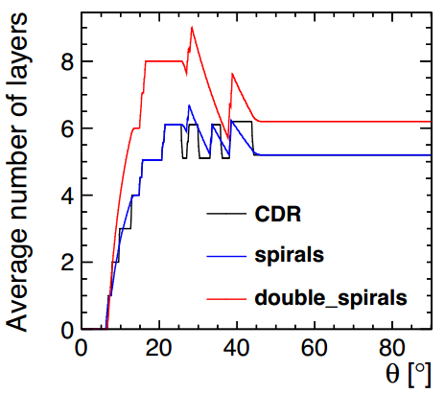
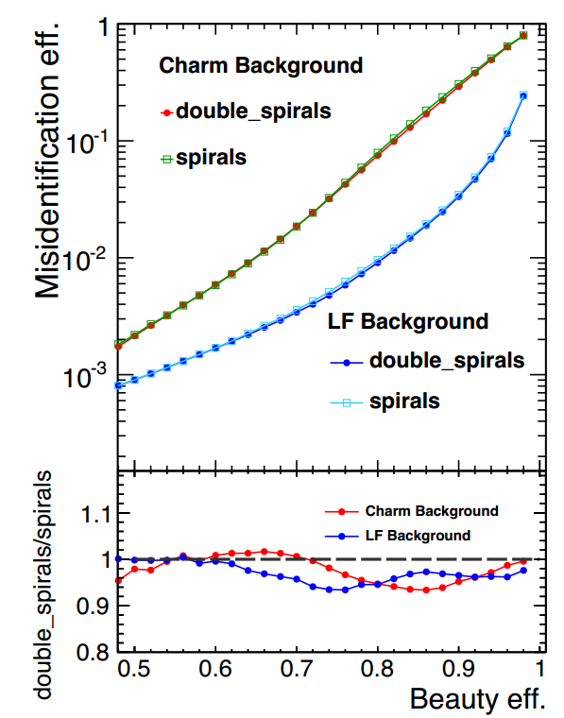
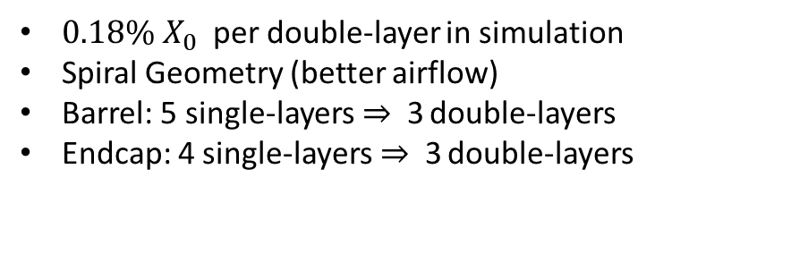


Vertex Detector: double layers
$0.18\% X_{0}$ per double-layer in simulation
Spiral Geometry (better airflow)
Barrel: 5 single-layers$⇒$3 double-layers
Endcap: 4 single-layers$⇒$3 double-layers
Estimate changes in performance due to layout by studying the flavor-tagging performance (N. Alipour Tehrani, P. Roloff [2])
$b$-quark misidentification as a function of $b$-quark Identification efficiency with a background rich in $c$-quarks (Top lines) or Light-Flavored quarks (bottom lines). Similar study performed for $c$-tagging
Lower panel shows ratio of double-layer over the single-layer geometries
  Almost the same as single-layer layout
Dijet events at $\sqrt{s}=200 GeV$

Slide 26
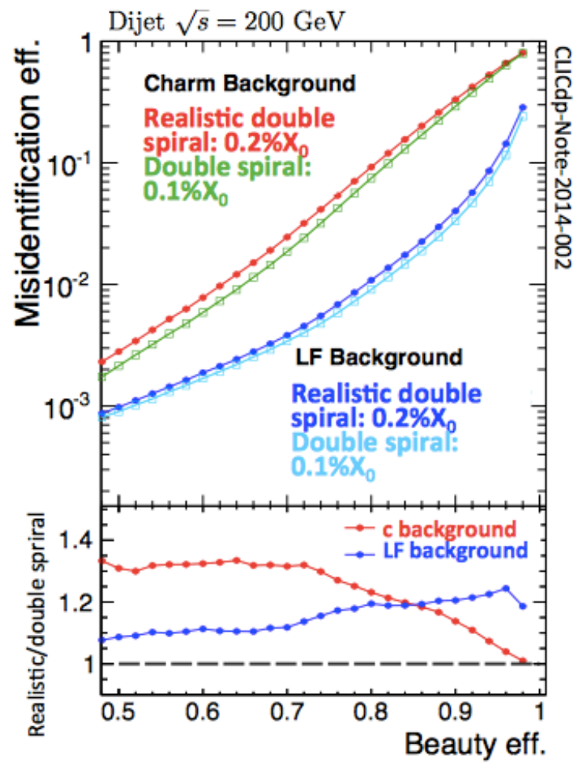

Vertex Detector Optimization
Spiral Geometry (better airflow)
Use flavor tagging as a gauge in various tests:
Effect of material (most significant effect on performance)
Test single vs. double layers
Vary inner radius (for 4 T or 5 T B-field)
In the new detector model: Use double layers with spirals and modules with $0.2\%X_{0}$per (single) layer, $R_{in}=31 mm$
Effect of extra material:
Ratio > 1 means worse performance for more material
(N.Alipour Tehrani, P. Roloff [2])

Slide 27




Vertex Detector : Effect of Inner Radius /Material
Dijet events at $\sqrt{s}=200 GeV$
(N.Alipour Tehrani, P. Roloff [2])
Inner Radius from 27 mm to 31 mm
Compensates for increase in the rate of Incoherent e-pair background if B-field is reduced
Small effect in flavor-tagging performance
Double-layer modules were simulated with twice as much material
Extra material leads to undesirable increase of fake rate
In the new detector model: Use double layers with spirals and modules with $0.2\%X_{0}$per (single) layer

Slide 28


Slide 29


More Tracker Optimization (R. Simoniello[9])
Fast Simulation (LicToy) Study varying geometry and layout (R, length, number of layers, etc) as well as material (supports, cabling, cooling)
  Use $p_{T}$ and $d_{0}$ resolution to gauge performance
Full simulation studies also ongoing with new Reconstruction Software

Slide 30



Silicon Tracker
A TPC tracker would have very high occupancies (30%) for CLIC @ 3 TeV with 1x6 mm² pads (without safety factors)
  We use an All-Silicon Tracker for our new model
See CDR and [11]
Fast Simulation studies (LicToy) to determine optimal parameters
Material Budget$→\sim 1\%X_{0}$ per layer
  Requires very thin materials/sensors
  Less critical than in Vertex Detector
Single point resolution: $\sim 7 μm$
  Critical for high-momentum tracks
Fast simulation studies (LicToy) with CLIC_SID_CDR geometry (D. Dannheim et al. [3])

Slide 31
TPC Occupancy in CLIC_ILD
From CDR. See also LCD-Note-2011-029 [11]

Slide 32



Occupancy in the Main Tracker
High occupancies in certain regions
Full Mokka-based (Geant4) simulation using a modified CLIC_ILD detector driver (TPC replaced with Si Layers) – DDSim-based study ongoing
Assume $100 mm×50 μm$strips, avg. cluster size 2.6 , safety factors 5 (pairs) and 2 ($γγ→had$)
(Recent study by A. Nurnberg[10]. See also LCD-Note-2011-021[15])
  Need for large pixels and/or short-strips
  Maximal strip length to be below 3% limit depends on layer (2 – 50 mm in barrel)

Slide 33




Silicon Tracker Radius/ B-field
Fast simulation studies (LicToy) with CLIC_SID_CDR geometry (D. Dannheim et al. [3])
Tracking performance depends on tracker radius and magnetic field
$$\frac{σ\left(p_{T}\right)}{p_{T}^{2}}∝\frac{σ^{meas}}{\sqrt{N}B⋅R^{2}}$$
Can compensate reduction of $B$ in new detector by rescaling $R$ by $\sqrt{{B_{nom}}/B}$
Increase from 1.3 m (CLIC_SID) but not much gain by going to 1.8 m (CLIC_ILD) -> Converged to 1.5 m for new model
Stronger dependence on $R$

Slide 34

Extended Tracker: Momentum Resolution Vs B-Field

Slide 35


Tracking in an All Si-Tracker
F. Gaede [13]
R. Simoniello [9]
The (>19000) tracking surfaces in the CLIC model
Based on DD4hep/DDRec
Track Fitting Strategy:
  Fit inside-out starting with vertex pixel hits
    1D hits in main tracker (strips) provide no constraint in$z$so cannot be used to initialize tracks
  Finally smooth back to third hit and fit inside from there
Current pattern recognition being developed from ILD Celloular Automaton-based Vertex patt. Rec.

Slide 36




Calorimeters
<detector name="ECalBarrel" type="ECalBarrel_o1_v01" readout="ECalBarrelHits">
<detector name="HCalBarrel" type="HCalBarrel_o1_v01" readout="HCalBarrelHits">
<detector name=“Solenoid" type=“Solenoid_o1_v01"
<detector name="ECalEncap" type="ECalEndcap_o1_v01" readout="ECalEndcapHits">
<detector name="HCalEncap" type="HCalEndcap_o1_v01" readout="HCalEndcapHits">
Fairly scalable drivers
Radii, Layer/module composition in compact xml
Simulated 10 GeV $μ^{−}$, uniform in $φ$
<detector ...>
...
<dimensions numsides=“HCal_symmetry" rmin="HCal_inner_R" z="HCal_half_L*2“ />
<layer repeat="(int) HCal_layers" >
<slice material="Steel235" thickness="0.5*mm“/>
<slice material="Steel235" thickness=“19*mm“/>
<slice material=“Polysterene" thickness=“3*mm“ sensitive=“yes“/>
<slice material=“PCB" thickness=“0.7*mm“/>
<slice material=“Steel235" thickness=“0.5*mm“/>
<slice material=“Air" thickness=“2.7*mm“/>
</layer>
</detector>
Fit to a single Landau Distribution
Fit to a sum of two Landau Distributions
Second MIP from secondaries
Simulation and reconstruction under validation

Slide 37

Background Suppression
Triggerless readout of entire train:
t₀ of physics event
Identify $t_{0}$of physics event offline
  Correct for shower development and TOF, define reconstruction window around $t_{0}$
  Pass all calorimeter hits and tracks within window to reconstruction
  $→$ Obtain physics objects with precise $p_{T}$ and cluster time information
Then apply cluster-based timing cuts
  Cuts depend on particle type, $p_{T}$ and detector region
  $→$Protects high-$p_{T}$ physics objects
Also: use hadron collider-type jet algorithms (FastJet)
tCluster

Slide 38

General Requirements on Detector Technologies
CLIC conditions $⇒$ impact on detector technologies:
  High tracker occupancies $⇒$ need small cell sizes (beyond what is needed for resolution)
    Small vertex pixels
    Large pixels / short strips in the tracker
  Background suppression
    Need high-granularity calorimetry
    $1 ns$accuracy for calorimeter hits
    $\sim 10 ns$hit time-stamping in tracking
  Low duty cycle
    Triggerless readout
    Allows for power pulsing
      less mass and high precision in tracking
      high density for calorimetry

Slide 39

Calorimeter Optimization
High granularity imaging calorimeters to use with Pandora Particle Flow Algorithms
Variations on Number and Layout of Layers, Cell size, absorber material and thickness, active material and thickness, total depth, …
Optimization performed also in collaboration with ILD
  Used mainly ILD-based Mokka drivers and ILD software chain
Need to recalibrate detector response with each variation
  Developed a quasi-automatic calibration procedure
Gauge model performance using:
  Single particle response
  Jet Energy Resolution ($Z→uds$, $WW→νℓud,$ $ZZ→ννdd$)

Slide 40

ECal Optimization (J.S. Marshall [12])

Slide 41



ECal Optimization: Active Material, Number of Layers, Granularity
ILD-based baseline model: SiW ECal with 29 layers (23 $X_{0}$ / 1 $λ_{I}$):
    Tungsten absorber: 20x2.1 mm + 9x 4.2 mm
    Silicon Active material, 500 μm thickness, 5x5 mm² cells
Scintillator instead of silicon may give a slightly better resolution
  Depends on active element thickness
  Also considered Si/Sc combinations
Stronger dependence on number of layers ($\sim 1/{\sqrt{N}}$)
10 GeV photons
(ILD)
(2 mm)
(0.5 mm)
M. Thomson, J. S. Marshall [5,7]

Slide 42




Extending the HCal coverage: $m_{JJ}$
ZZ @ $\sqrt{s}$= 1 TeV -> $E_{j}\sim 250 GeV$
CLICdp Work In Progress
The peak is resolved better with smaller HCal inner radius
However, at 120 mm probably the increased background spoils the efficiency
  Investigated more the peak below $m_{JJ}<50 GeV$

