Slide 1
Status of Fluka coupling to Sixtrack
Tracking for Collimation Workshop (WP5)
5th Joint HiLumi LHC-LARP Annual Meeting
CERN, 26-30 October 2015
Vasilis.Vlachoudis@cern.ch
on behalf of the FLUKA & Collimation team

Slide 2
Introduction
SixTrack and FLUKA are simulation tools regularly used at CERN to perform LHC collimation studies.
  SixTrack → Single particle 6D tracking code for long term
  tracking in high energy rings
  FLUKA → General purpose particle physics MonteCarlo code
  used for machine protection, design studies, R2E,
  activation, collimation,…
Collimation studies requiring energy deposition calculations, description of EM showers,...
as well multi-turn effects need synergy between the two codes.
Standard work path for collimation loss maps up to now:
  SixTrack, complemented with dedicated interaction routines, predicts losses in collimators.
  FLUKA simulates the respective inelastic interaction (= loss) and transports the products.
Prediction of losses depends on physics models!

Slide 3
History
2006 Network port communication between FLUKA and a toy tracker (single-turn matrix) with a dedicated server to displace in multiple SixTrack/FLUKA clients (V.Vlachoudis)
2007 First implementation (S.Gilardoni & R.Bruce)
use IcoSim by H.Braun (MatLab based):
  4D tracking
  only up to sextuples included: no higher order multipoles, no skew elements / solenoids / crab cavities…
  a FLUKA job per every turn
  I/O through files
2010 FlukaIO library (V.Vlachoudis & D.Sinuela Pastor) first study case: SPS scrapers by F.Cerutti & A.Mereghetti with IcoSim
>2010 SixTrack first implementation (V.Vlachoudis, D.Sinuela Pastor, A.Meregheti, P.Garcia Ortega) with tests on β-beams, 4D tracking in thick lenses

Slide 4
Motivation
The Coupling defines a clean separation line between both codes:
  Particle tracking → SIXTRACK
  Beam-machine interaction → FLUKA
What the coupling can provide
  Efficient simulation of beam-machine interactions in a realistic multiturn approach with a state-of-art account of physics processes
  → More accurate predictions: the best of the two codes is used.
  Avoid simplifications in the modelling of physics processes, in particular for complex interactions such as single diffractive scattering or ion interactions
  Limit human intervention (no need to manually check files, units, etc.) → Overall process less error-prone.
  Handle moving beam intercepting devices runtime (Already used in Standard SixTrack for SPS in 2006. Now, possibility to use any roto-translation of 3D geometry)
  Deal with energy ramping
  More accurate heating calculations of collimators
  Benefit from further development from both codes and their tools
Notes:
Why -> motivation.
Where it comes from? -> Some historical remarks, Roderik with Icosim, Vasilis,...
How it works? -> Not too detailed, a general overview. With apabilities: Relevant for ions, improves the physics model, takes advantage from \textsc{Fluka} physics models, materials... no need to add a new module to the code each time we want to test a new material, everything is in the database. Advantage from full 3D models from FEDB...
Last upgrades -> Online aperture check
Some validation results -> loss map comparison
Final remarks -> Important for ions,

Slide 5
Heavy ions
Cross sections are energy dependent and ionization plays for ions a not negligible role in changing their energy along their path in matter
energy loss evaluation needs a treatment significantly more sophisticated than the Bethe formula adopted in ICOSIM (e.g. including Mott corrections as well as pair production
moreover, Landau fluctuations have to be taken into account
it's not enough to know the probability for generating a given fragment, since its momentum is altered in the interaction; this makes fragments nominally far from the beam rigidity to fall in reality inside the machine acceptance (e.g. tritium)
all fragments can re-interact in the collimator material
→ the coupling would intrinsically overcome all these issues

Slide 6
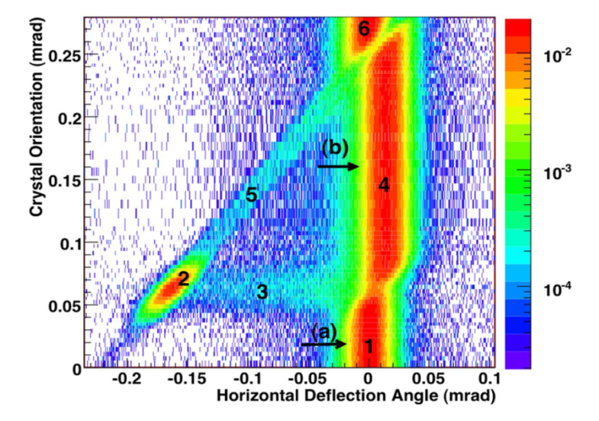
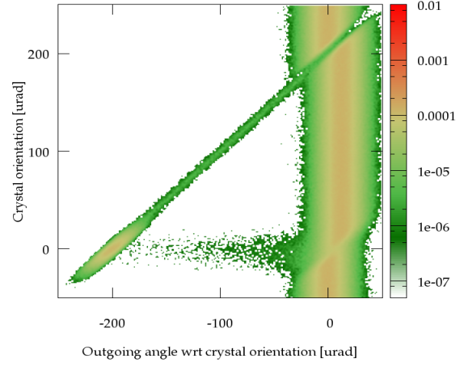
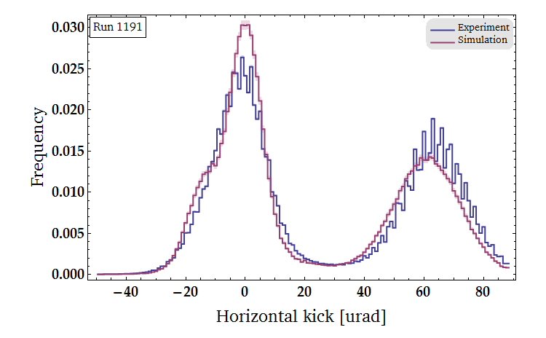
Crystal Channeling in FLUKA
Benchmark against UA9 Experiment data (protons only)
Qualitatively :
Quantitatively :
Experiment Simulation
LHC strip 1191 | VR/AM μ [urad] | VR/AM σ [urad] | CH σ [urad] | CH rate [%] | DC rate [%]
Experiment | -6.39(2) | 9.97(1) | 8.81(1) | 39.58(6) | 2.78(20)
Simulation | -3.32(4) | 9.46(3) | 10.90(4) | 37.03(15) | 2.80(5)
P.Schoofs
Notes:
Planar Channeling of any positively charged particle
Crystal torsion, miscut taken into account
Classical channeling condition, Moliere screening + thermal motion of the lattice
Interactions handled by FLUKA, with reduced rates for nuclear events reflecting the travel « far » from the atomic lattice
Single Coulomb scatt. + rejection according to minimum impact parameter, leads to dechanneling
Possibility to get captured or reflected by a channel in the middle of the crystal region
Current work on the implementation of a specific energy loss to channeled particles

Slide 7
Efficient CPU time usage
FLUKA simulations can be sometimes very CPU-intensive
  For detailed energy deposition studies for large LHC geometries and TeV beam energies
    where one applies low secondary production and transport cuts down to MeV energies or less (for a detailed description of shower development, particularly e⁻/e⁺,γ),
    and many fine-grained scoring meshes (to calculate point-like quantities necessary to estimate e.g. quench levels),
  It can be optimized
    if one applies high cuts and/or if one switches off unnecessary physics processes (e⁻/e⁺, γ prod. and transport, generation of all inelastic collision products and their transport)
When applied to the LHC, the coupling is meant to work in the latter mode
  Focusing on particles which can still propagate in machine (able to create a lossmap) and not in the local shower development

Slide 8
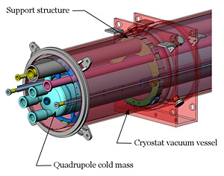
The Fluka Element DataBase (FEDB)
Fluka Element DataBase
Database of Fluka models:
flexibility: ease of modelling accelerator components, crucial when adding relevant details, following the evolution of the design of future devices, comparing different technical solutions...
consistency: a common and shared resource where to keep track and monitor implementation details (SubVersioN repository);
portability: prompt propagation of updates, with improvements being inherited by all the people involved;

Slide 9
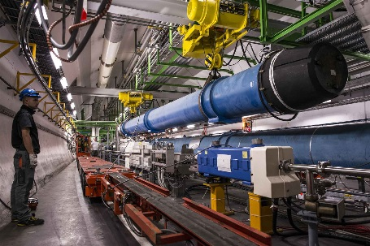
The Line Builder (LB)
Fluka Element DataBase
Line Builder
Assembler of geometries of actual beam lines:
flexibility: automatic synchronization with the machine optics, essential ingredient for sound modelling of the line;
consistency: protection against wrong settings of the beam line, e.g. misplacements, wrong orientations, mismatches in magnetic fields and collimator apertures…
portability: the last updates of the FEDB are automatically used;

Slide 10
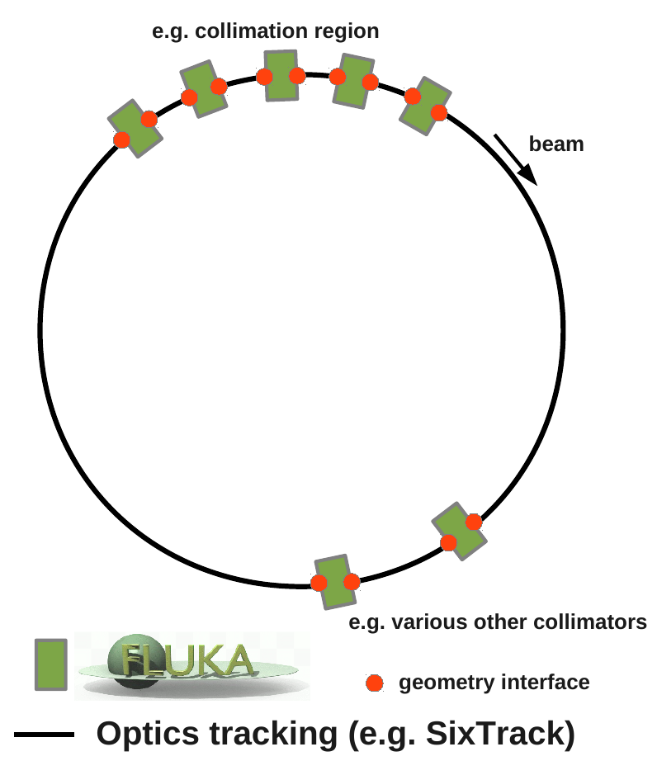
How
FLUKA and SixTrack run at the same time, talking to each other.
Exchange of particles at run-time, through a network port (dedicated FlukaIO library, TCP/IP)
One or more portions of the accelerator lattice are labelled for transport in FLUKA the rest is handled by SixTrack.
Primary particles are transported turn by turn by SixTrack throughout the lattice.
When they reach a labelled element, they are transferred to
FLUKA for transport in its 3D geometry and for simulating the interaction with accelerator components.
At the end of the FLUKA insert, marked as a geometry interface, particles are sent back to SixTrack

Slide 11
Present Status
Code
coupling in both thin and thick lens, 4D, 6D (+acceleration)
multiple elements can be flagged as FLUKA
on-line aperture checks (native LIMI block) + addition of LHC aperture type (RECTELLIPSE)
external generator of the beam to be tracked
unique ID of new particles
heavy ion exchange information
Additional
dynamic kicks in SixTrack (magnetic bumps)
moving FLUKA bodies run-time
useful dumps for monitoring the simulation process
could even be used to model complicated 3D magnetic fields

Slide 12
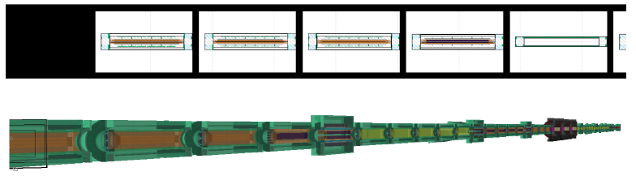
FLUKA Input
Geometry: List of B2 collimators built in a sequence and isolated with BLACKHOLE regions.
Fluka builder.py: Python script that automatically generates the Fluka input from FEDB and Collimation Database file (CollDB or Collgaps), developed in the framework of the LineBuilder.
Available at the Coupling SVN Repository.
Apertures, angles, jaw tilting, off-center deviations can be easily evaluated.
Particles injected close to the beginning of the collimator tank.
Plane that separates the collimator geometry from BLACKHOLE region used as the extraction plane.

Slide 13
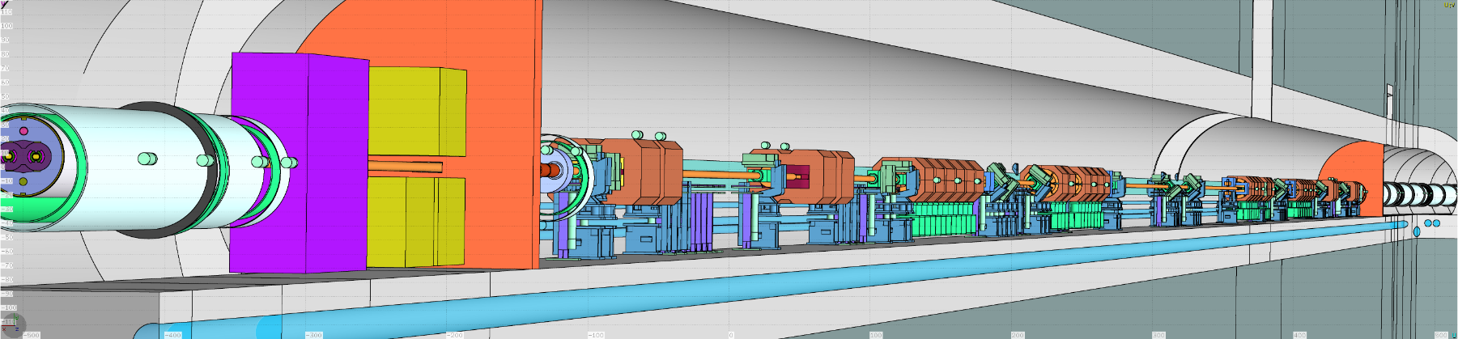
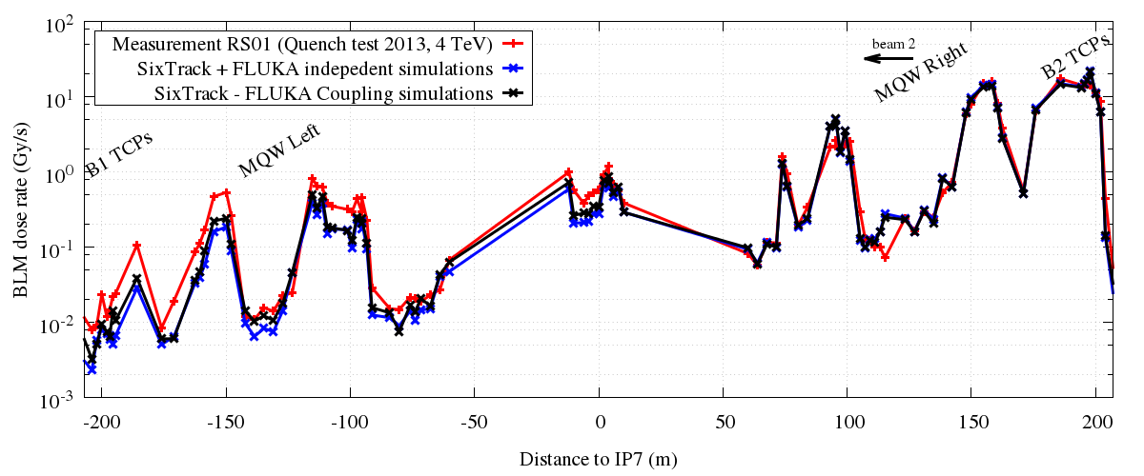
Some results
Simulation Benchmark / BLM Signal comparison
4 TeV 2013 Collimation Quench Test IR7 LSS

Slide 14
Summary and Future
Prospects of integrated FLUKA/SixTrack calculations
Offers realistic multi-turn simulations including sophisticated physics models (particularly for single diffractive scattering and ion interactions)
CPU time appears not to be an issue for application to LHC
(first feasibility tests)
Coupling routines not only limited to SixTrack but also to other tracking codes: IcoSim, IcoSim++,…
Further Improvements
Replace the user routines in FLUKA and integrate them as FLUKA cards
Possible re-introduce the external server mechanism to handle anisotropic computation times between SixTrack-Fluka
Use FLUKA as external beam generator (for beam-beam interactions)
Heavy ions (further developments)

Slide 16
Present Status - Accessibility
Online Aperture Check
essential ingredient for both loss maps around the ring and energy deposition onto beam-intercepting devices
based on the SixTrack LIMI block
the quality of the results relies on the slicing algorithm
→ limited advantage from thick lens tracking…
Repository
Everything is accessible on lxplus (and svn)
/afs/cern.ch/project/fluka
Protected via an access list
  Coupling
  Fluka (development version)
  LineBuilder
  Flair

Slide 17
The user’s point of view
SixTrack
activation and settings in fort.3
FLUK
bpm_scrh_b2m bpm_scrh_b2m 1 4.0
bpm_scrh_beg bpm_scrh_end 2 1.0
DEBU
NEXT
/
LIMI
qf.10010..1_AP EL 76.0000 19.1500
mba.10030..1_AP RE 71.2000 17.2500
NEXT
FLUKA
Isolate the each element geometry (BLCKHOLE)
dedicated source and fluscw.f routines
insertion.txt (define the transformation)
1 INROT_1 OUTROT_1
2 INROT_2 OUTROT_2
it’s the user’s responsibility to guarantee the integrity of
transformations from the local SixTrack refrence system to the FLUKA and vise-versa
the synchronous length declared in fort.3 and the extension of the FLUKA geometry

