Slide 1
Nextef results
CLIC09, Oct. 12-16
T. Higo (KEK)

Slide 2
Contents
Quadrant high gradient test status
  Initial processing and power limit
  VAC characteristics with Q-mass
  Dark current
  BD position
  Light emission
Change in T18 by high gradient processing
  RF
  Optical inspection
Nextef plan

Slide 3
Quad #5 status and near future plan

Slide 4
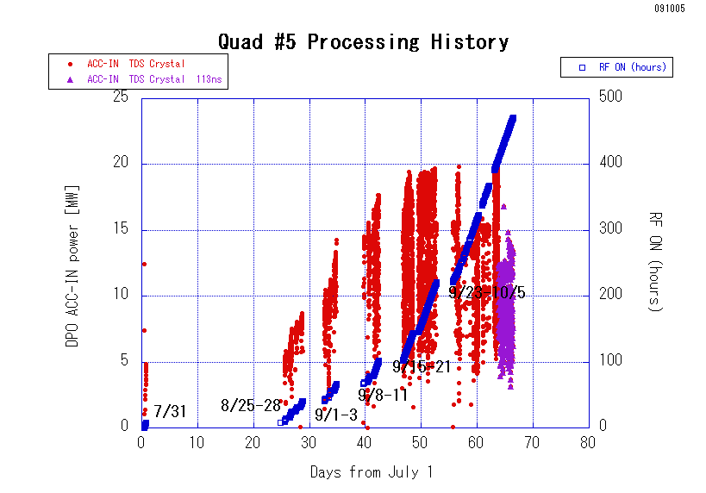

Slide 5
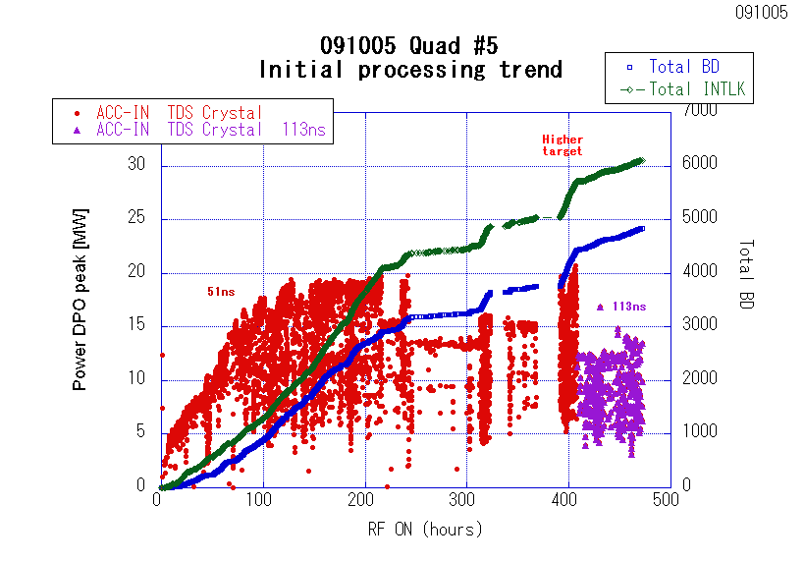

Slide 6
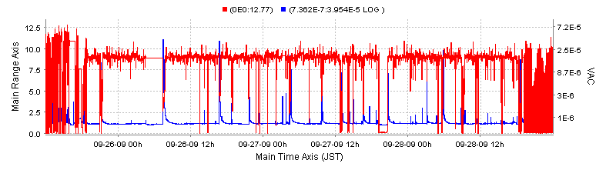
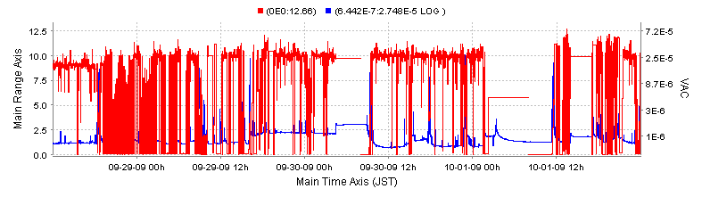
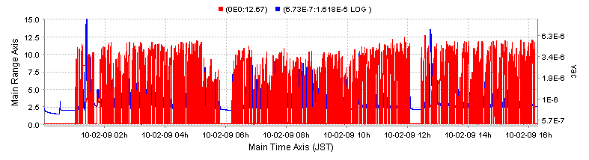
So-called 9MW run
Red=power (arbitrary unit)
Blue = Chamber vacuum [Pa]
So-called 10MW run
Higher target
Target = 15MW

Slide 7
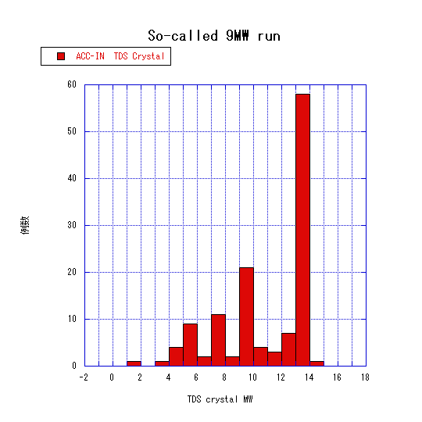
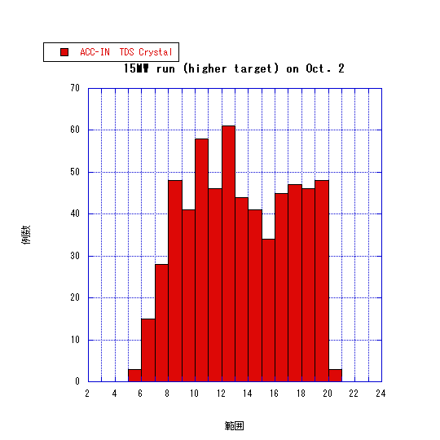
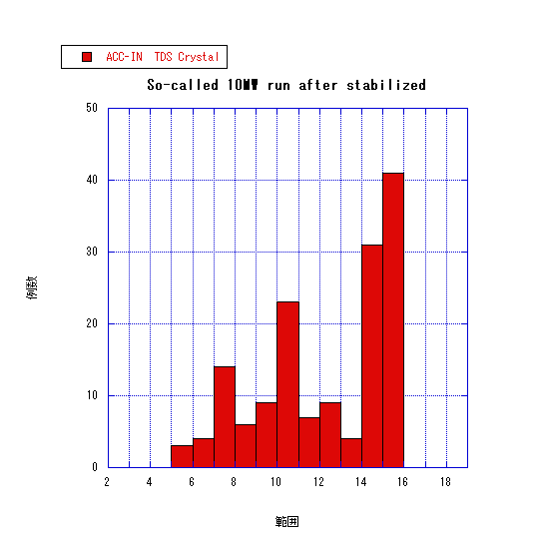
Gradient limit at 50ns
So-called 9MW run
Higher target
So-called 10MW run
Hard limit at 19MW, 59MV/m, 50ns

Slide 8
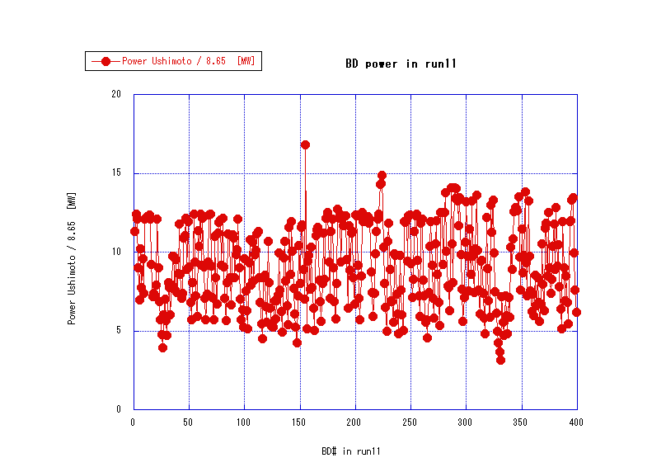
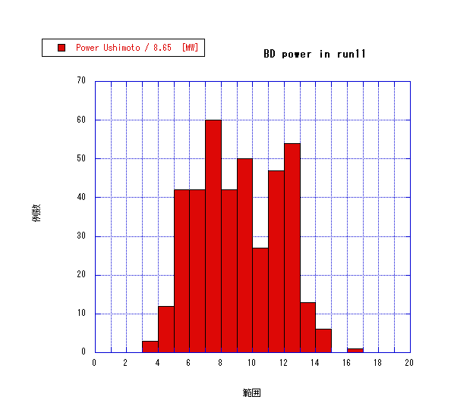
Run11 with higher target at 113ns
Powers at breakdown with 113ns pulse width for 60 hours
Hard limit at 14MW for 113ns pulse

Slide 9
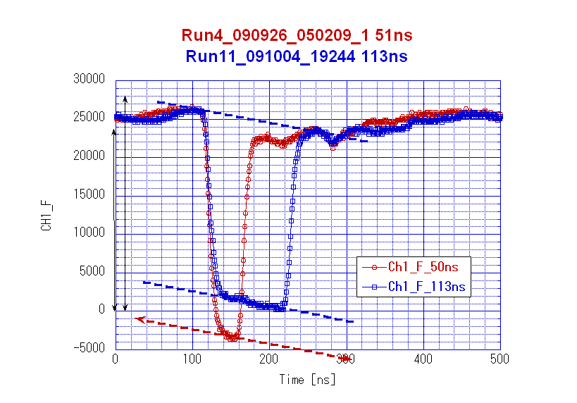
ACC-IN pulse at hard limit
Tp(ns)
51 113
Power (MW)
19 14
Ea (MV/m)
59 50
Sqrt(Tp)*Power
135 147
Limit at similar pulse heating temperature, but more precise comparison is needed.

Slide 10
Vacuum characteristics
Vacuum total pressure
  Base pressure at <10⁻⁶Pa
  Typically processing below 10⁻⁵Pa
  Increases every time at few to 5MW range if after RF-OFF for more than several hours
Mass spectrum
  M=2, 28 and 44 increase with RF-ON, but not M=18
    Especially when reaching power limit
  M=2 becomes dominant residual gas after an hour or so run
  M=27 and 28 change in a similar manner as time, indicating hydrocarbon-origin surface contamination

Slide 11
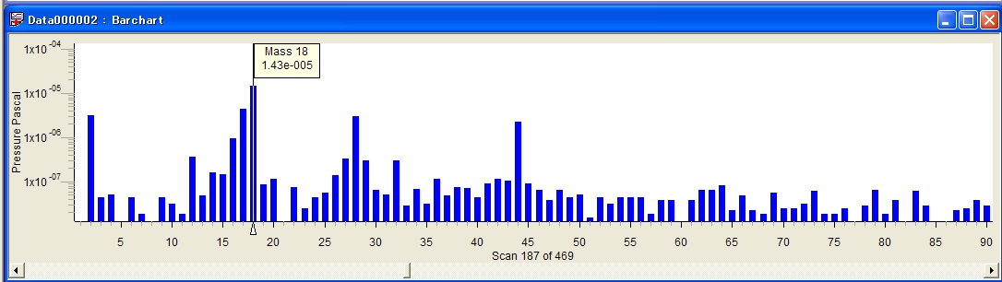
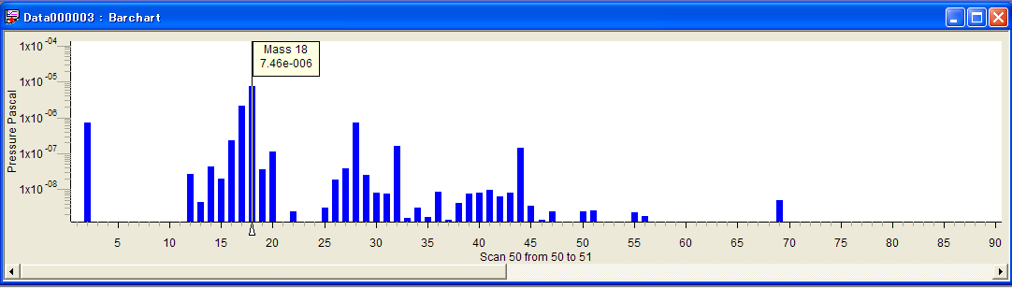
First and Second QMA observations.
Check QMA vacuum. QMA-Acc Chamber valve closed.
Large Peak at M=18 (Water). Need more Q mass baking.
090918
All peaks are lowered. After Q mass baked (200deg, 2.5days).
2
28
32
44
090924

Slide 12
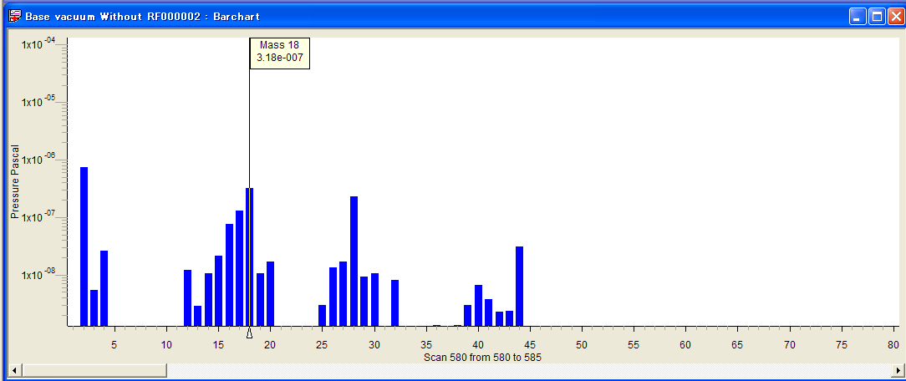
First QMA observation with RF OFF.
QMA- ACC Chamber valve opened.
Peak at M=2 (H2) largest. Water (18) becomes moderate. Others are M=28 (CO) and 44(CO2).
090924

Slide 13
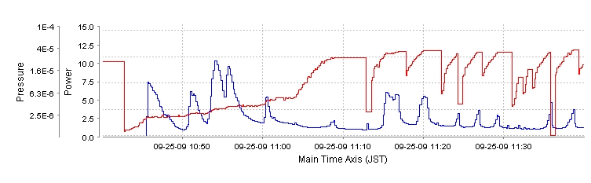
QMS (1) :RF Power and gases
Pressure of H₂ dominated. Pressure of water is inactive.
2
18
28
44
RF Power into Acc
ACC Chamber CCG

Slide 14

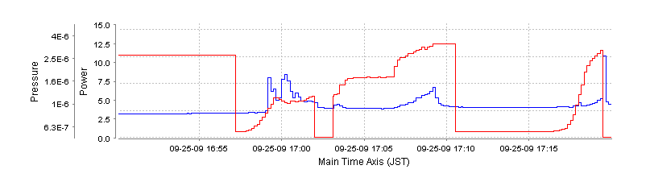
QMS (2): Cu and Zr
No signal of Cu(M=63) nor Zr (M=89) .
BD
Power Acc In
Acc Chamber CCG

Slide 15
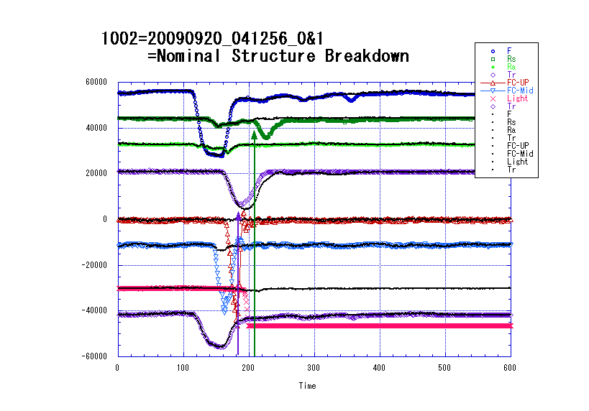
Breakdown pulse analysis

Slide 16
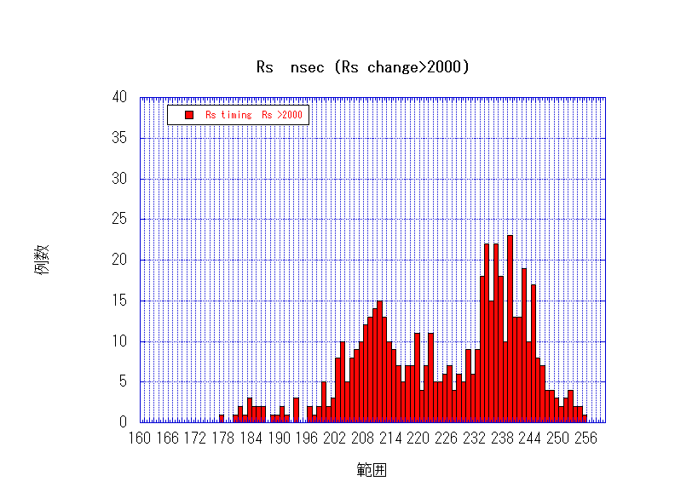
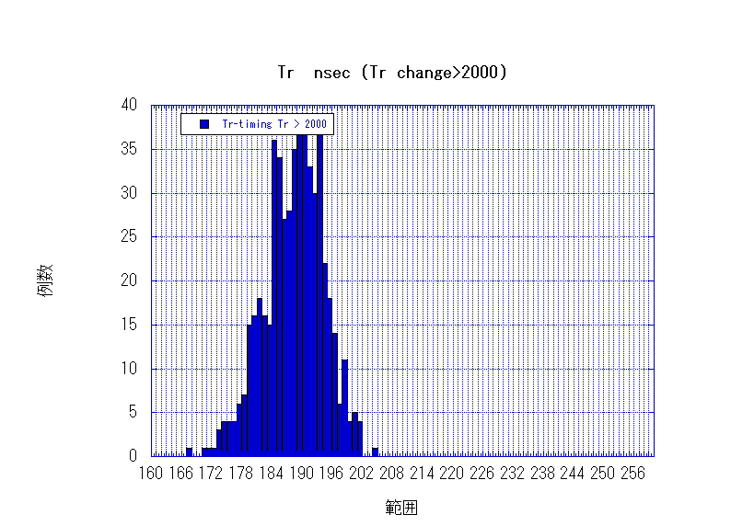
Timing distribution for change>2000

Slide 17
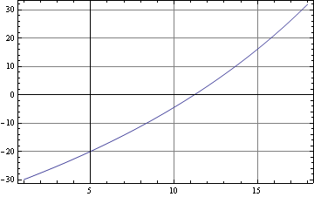
T18 structure Function F[z]
Use time difference Rs(rise)-Tr(fall) to calculate BD position.
Function F(z) is calculated from design vg(z).

Slide 18
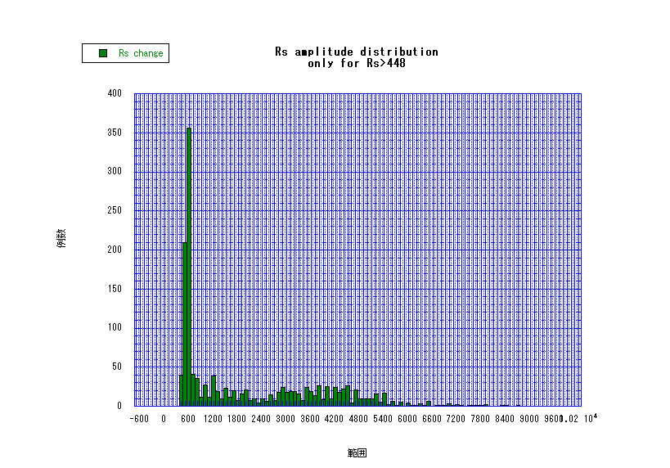
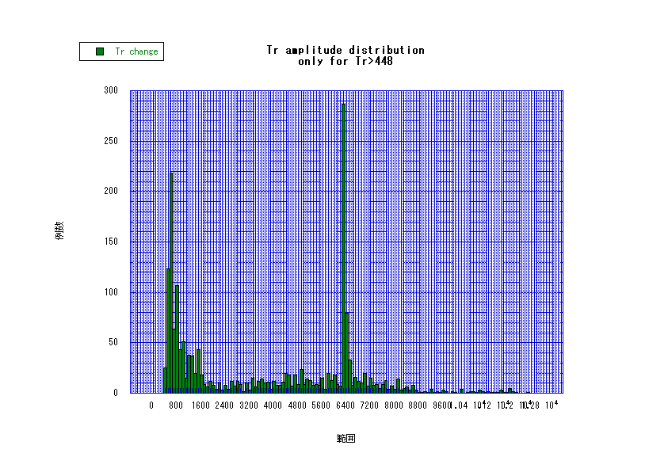
Pick up large Rs, Tr change with 50ns
Sampling cut at 448
Sampling cut at 448
Cut at 1000 or 2000 for timing analysis from next page.

Slide 19
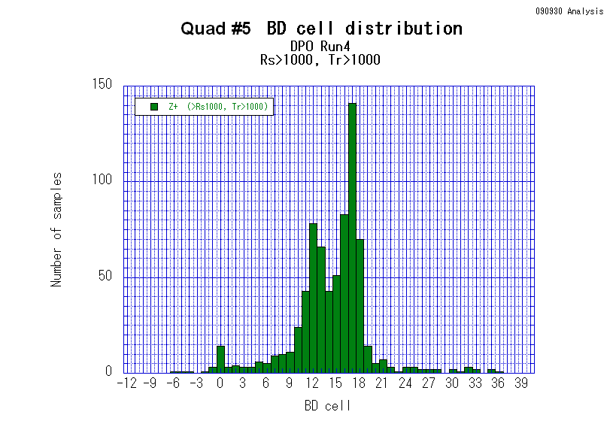
Breakdown cell distribution >1000
50ns higher target run
713 events were analyzed out of 1919 INTLK.

Slide 20
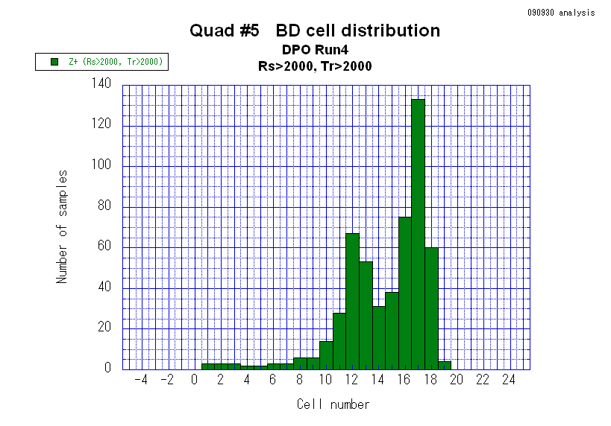
Breakdown cell distribution >2000
50ns higher target run
Mostly downstream half.
Simply increasing toward output end.
Indication of BD following some field gradient.
534 events were analyzed out of 1919 INTLK.

Slide 21
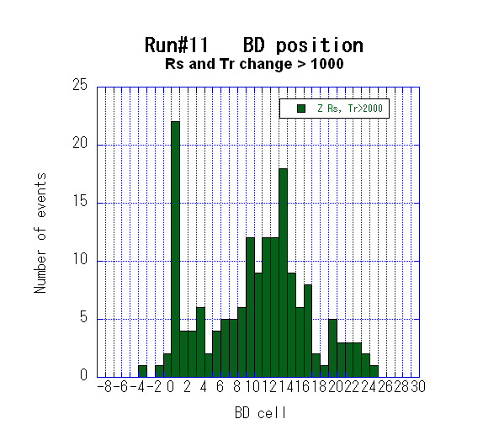
BD position of run11 113ns, MW
113ns higher target run
It is evident that there is difference than 50ns.
Not increasing toward output side.
Need to check the peak at cell#0.
Need to check those outside structure cell region.
2000

Slide 22
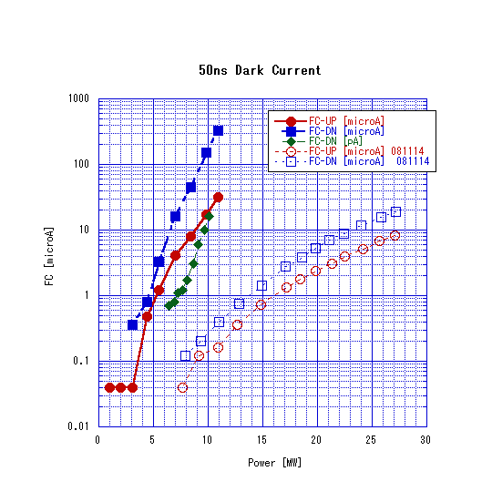
Quad dark current much larger than T18
Quad
T18
(Note: Power is just the value in the control program panel. Read 12MW as 19MW, though relative comparison between quad and T18_disk is OK without this.)

Slide 23
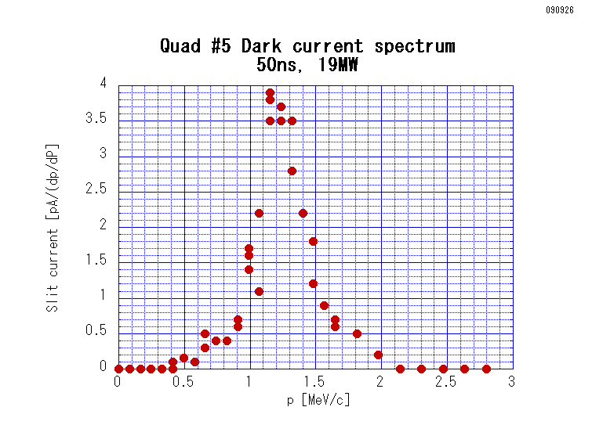
Spectrum peak at very low energy
T18_Disk
Peaks at 8MeV/c and 4MeV/c with 108MV/m
Present quad
Peak at 1.2MeV/c
with 19MW → 59MV/m

Slide 24
Possible cause of high dark current
Field enhancement due to round chamfer
Simulation of field enhancement
  1.4 ~ 1.6 at radius
  with gap<radius/5, step<radius/2.5
Only a few tool passes
  to shape 50 micron radius
  with radius tool of 2mm
    If three passed → tangential discontinuity by about 30 degree
    Can be relaxed by such as EP in future

Slide 25
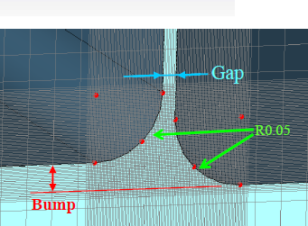
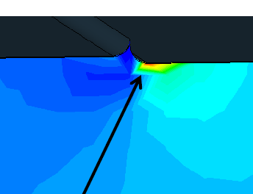
Electric field enhancement in a shallow channel with round chamfer
Calculation done by T. Abe by CST MS. Waveguide field.
Gap (micron) | Bump (micron) | Emax / Enominal
0 | 0 | 1.39
0 | 20 | 1.57
10 | 20 | 1.58

Slide 26
Other monitors for quad
PM
Mirror + camera
AM
PM
Quad
Qmass
FC-UP
FC-Mid
Camera
FC-DN

Slide 27
Light emission observed by usual camera
From side window
  Can see several cells near center of structure
  Found some BD events with a light emission from a particular cell
View from upstream beam axis
  Found a light emission
  Pattern interpretation is not straightforward
  Some event showed bright spot smaller than cell size
Need better optical setup
  Time gating, wider view, space resolution, etc.

Slide 28
Possible future program for quad #5
NEG installation in progress in this week
Further run
  Longer pulse run at 173ns
  Evolution of dark current
Finish high gradient and --
  RF check
  Mechanical check
  Optical inspection
  SEM at CERN?
Further treatment?
  EP ?
Further high gradient test
  Improved optical inspection
  Change in dark current
  Possibly higher field?
These become good lessons for us to understand breakdown phenomena.

Slide 29
Change in T18 through high gradient test?

Slide 30
Whole history of processing of T18_VG2.4_Disk #2

Slide 31
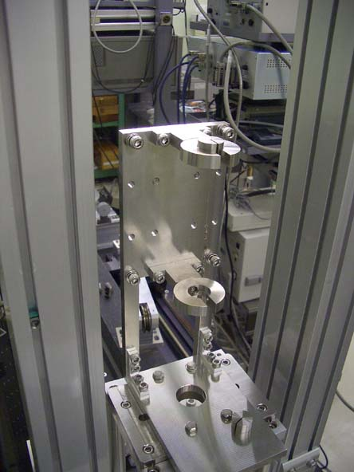
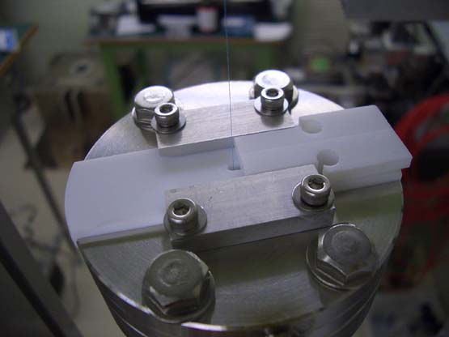
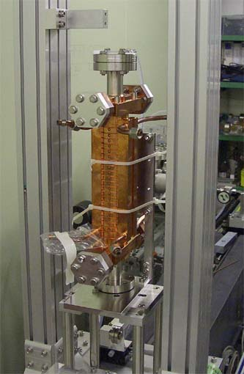
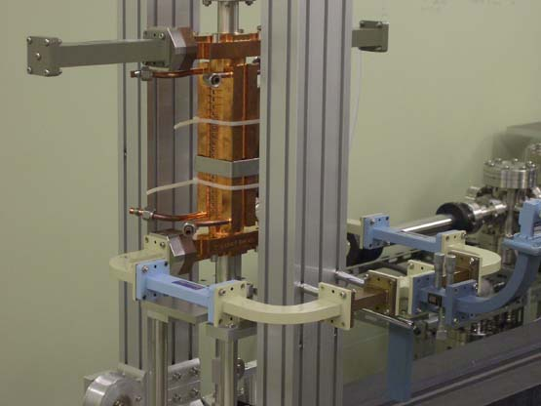
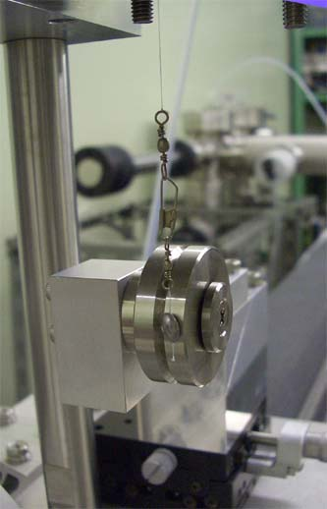
RF check setup

Slide 32
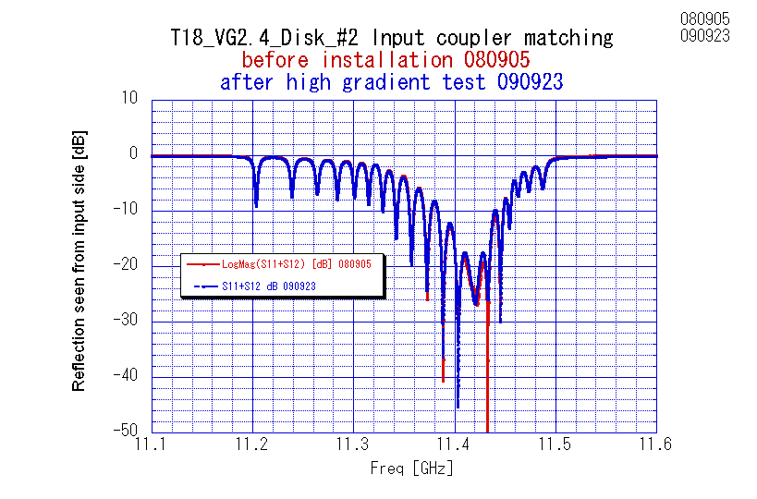
Input match not changed

Slide 33
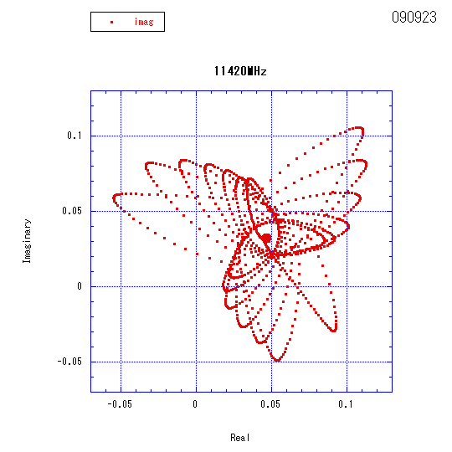
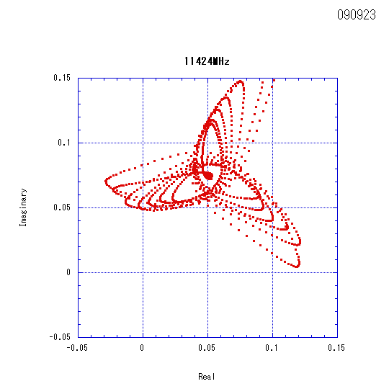
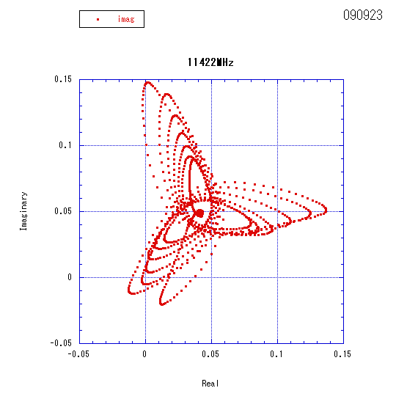
Bead pull raw data on Sep. 23

Slide 34
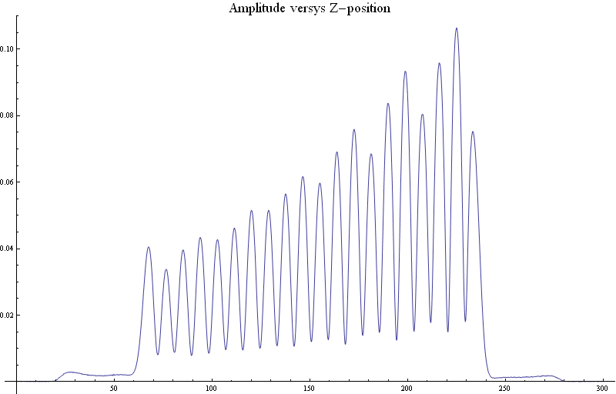
Bead pull amplitude plot 11422MHz
Correspond to ripple of +-4% in Ea at output end.
Which was not before test.
Input side
Output side

Slide 35
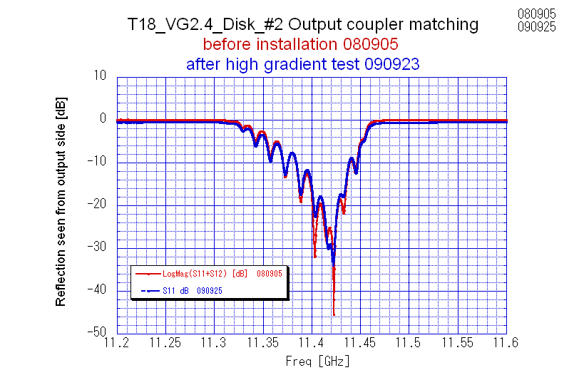
Output match some change
Speculation:
Reflection changed around 11424MHz by Γ=0.05 level??
Can be source of field staggering

Slide 36
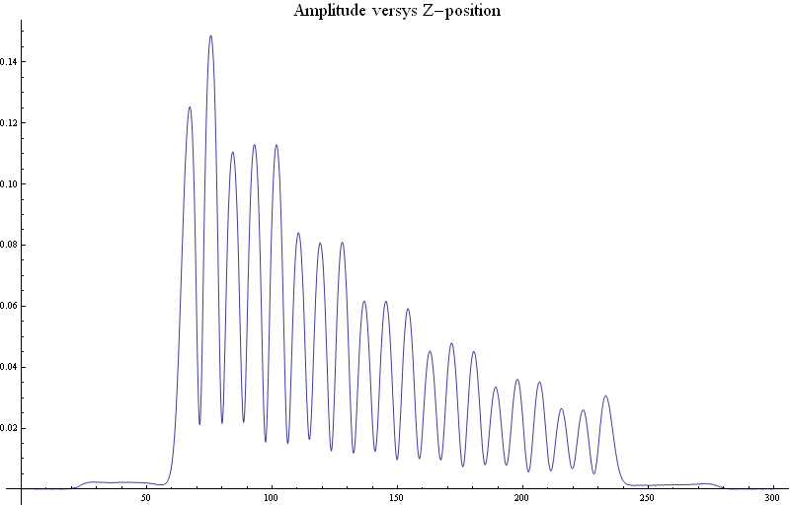
Bead pull feeding from output side
Output side
Input side

Slide 37
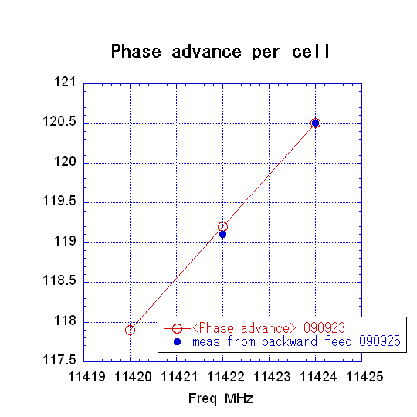
Phase advance per cell
Condition
at 22.7degC in Nitrogen
Bead pull result:
11423.2MHz → 120deg/cell
delF 22.7 →30C -1.38MHz
delF N2 → VAC +3.12
delF string → no string +0.2MHz
Total delF = 1.94MHz
The structure now shows
120deg/cell at 11425.1MHz
Changed by 1.1MHz through high gradient test!?!?
Should confirm carefully with SLAC tuning result.

Slide 38
View direction 45deg
φ4.1mm
View area 60deg
Focus within 5mm to infinity

Slide 39
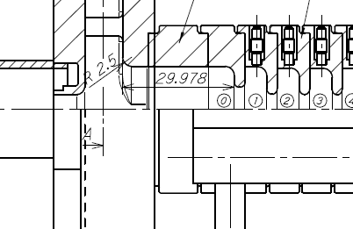
98
60.3
７９
101
110
118.6
127.4
60.9
７1

Slide 40
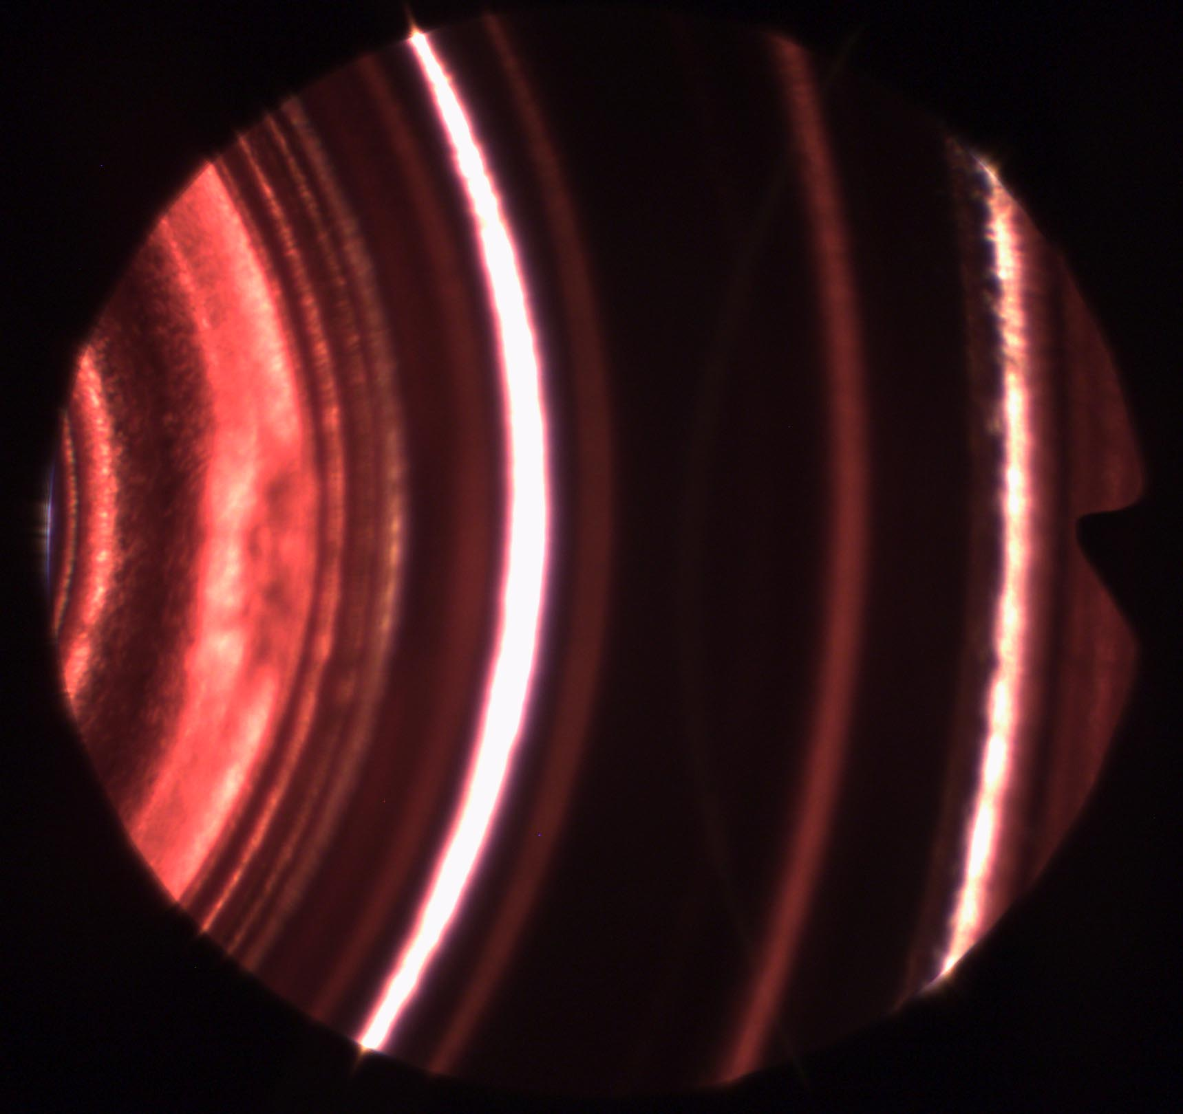
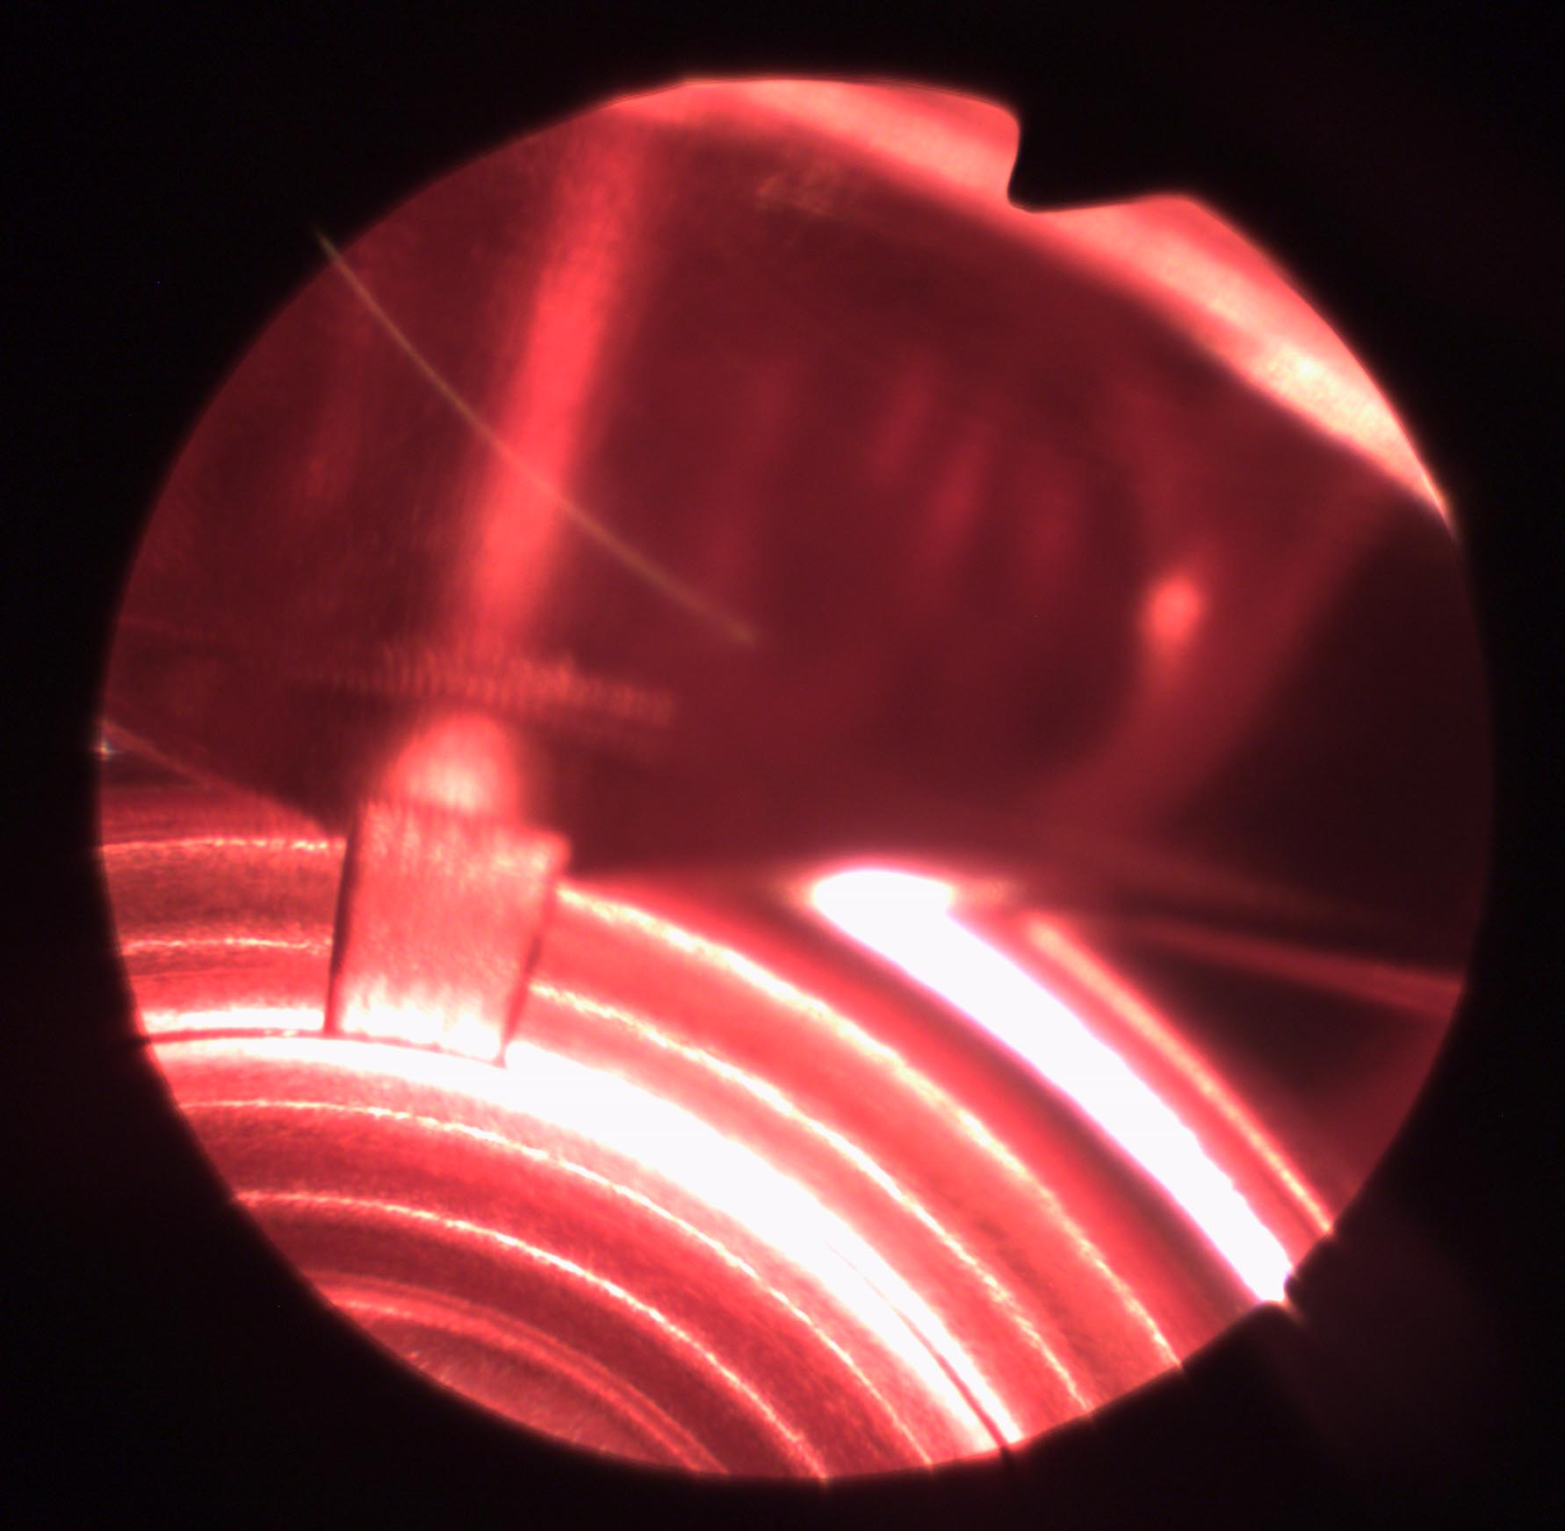
Optical inspection upstream
Up → WG direct.
Beam axis
Iris #2
Match cell
March Iris
Iris #1
60.3mm
Input coupler to cylindrical TM01 line
Insertion 98.0mm for observing Iris #2.
This is the best we can now, only the forward iris at an enough distance.

Slide 41
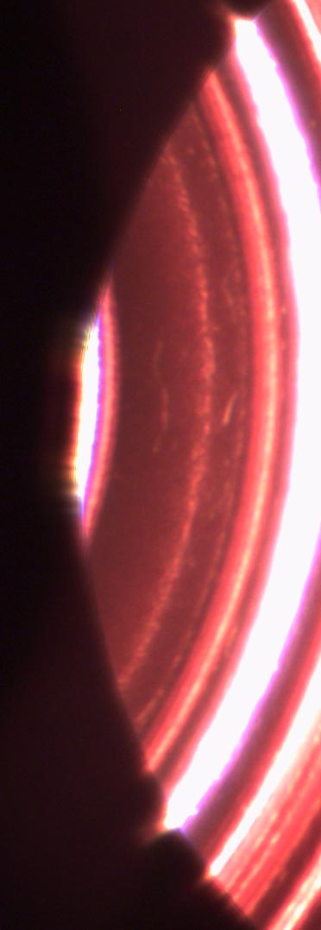
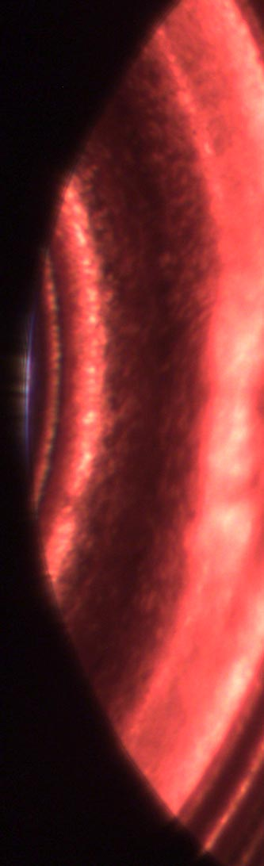
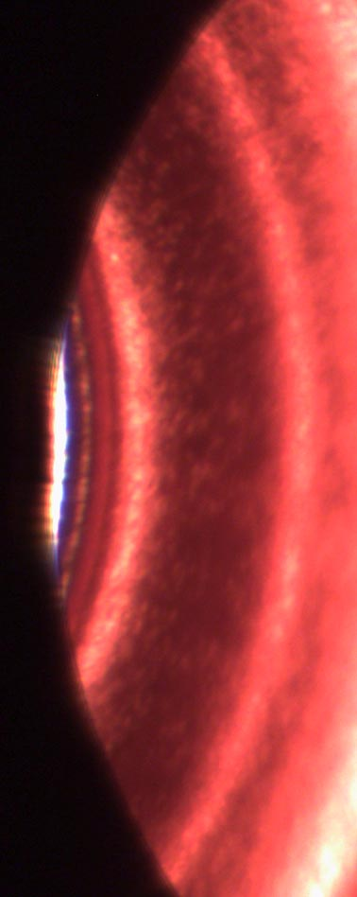
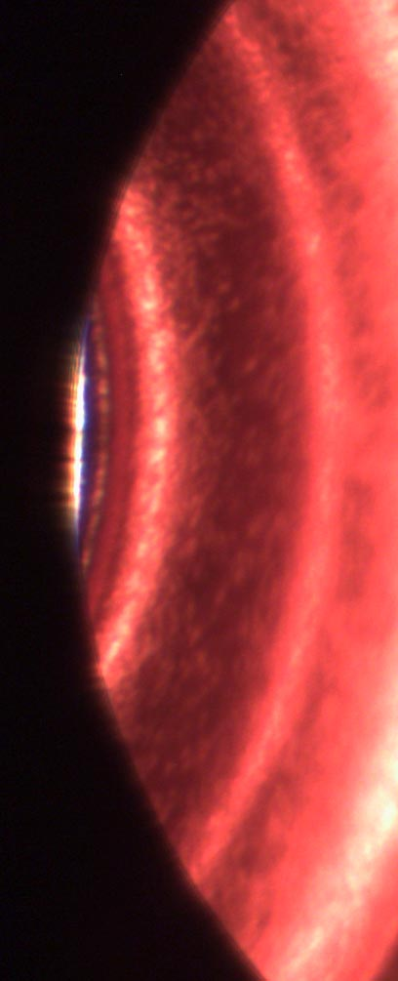
Optical inspection upstream and middle
Insertion 82.7mm
Iris #1 at match cell
Insertion 98.0mm
Iris #2 at first regular cell
161.9mm Iris #9
170.9mm Iris #10

Slide 42
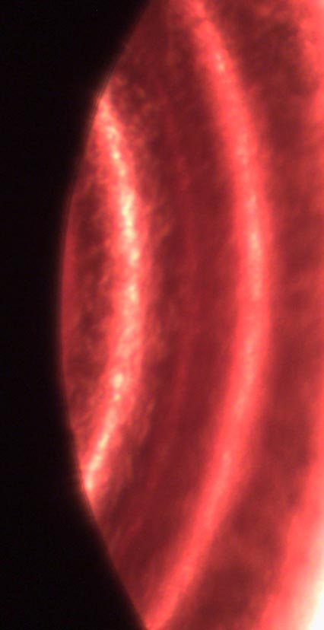


Optical inspection downstream end
243.2mm Iris #18
Upside iris of last regular cell
252.2mm Iris #19
Down side iris of last regular cell
261.3mm
Last regular cell iris #20

Slide 43
Optical inspection result and future
No significant variation was observed
  Comparing input to output but
Need to inspect with better resolution
  Change to straight bore scope?
  Adjust focal plane?
  Should be improved

Slide 44
T18_Disk_#2 after high gradient test tentative conclusion
RF evaluated after high gradient test.
  Input matching was kept.
  Output matching changed by Γ=0.05 level.
  Average frequency increased by 1.1MHz.
  Field ripple±4.4% near output end.
Some change in RF performance was observed.
  Need to compare carefully with SLAC data.

Slide 45
Summary and next plan
Quad
  Similar performance as quads tested at SLAC
  More test in a few weeks
  Inspection and think about the further test
T18
  Measurable change was observed
  We need to remind this
Next plan
  TD18 is top priority
  Then T24_Disk, TD24_Disk before CDR
  followed by T18_Disk#4, ……

Slide 46
Nextef Planning revised as of CLIC09
2009 2010 2011
9 10 11 12 1 2 3 4 5 6 7 8 9 10 11 12 1 2
TD18_Quad #5
TD24_Disk #?
TD18_Disk #3
T18_Disk #4
A
T24_Disk #?
??
PC test
PC test and system construction
B
Nextef → B construction?
X-band studies
C-band Structure Test
????
Construction to shield-B
NWG Cu-005
Load, WGValve
KT-1
PPM6b
Component, etc. tests or serving shield-B

Slide 47

Nextef Configuration
Nextef
X-band
KT-1
X-band
B
A
KT-2
C-band

Slide 48
Conclusion
Nextef will run fully dedicated for the feasibility study of CLIC 100MV/m
Nextef will boost peak power and high power stability by introducing pulse compression system
We try to construct a test area in addition to Nextef for key studies

