Slide 1
Status of the Beam-Based Feedback for the CLIC main linac
Jürgen Pfingstner
14th of October 2009

Slide 2
Content
Ri & gmi
Review of the work on the BBF
Idea of an adaptive controller
Problems with an adaptive scheme and possible solutions
Controller
design
System
identification
Param.
ri
ui+1
Controller
Accelerator
R
yi
Adaptive Controller (STR)
System

Slide 3
The model of the main linac
1.) Perfect aligned beam line
a.) 2 times xi -> 2 times amplitude
-> 2 times yj
b.) xi and xj are independent
Linear system without ‘memory’
Laser-straight
beam
QPi
BPMi
2.) One misaligned QP
Betatron- oscillation
(given by the beta function of the lattice)
y … vector of BPM readings
x … vector of the QP displacements
R … response matrix
xi
yi
xj(=0)
yj

Slide 4

The matrix R
N’s Columns correspond to the measured beam motion in the linac, created by the N’s QP
Motion is characterized by phase advance , beta function and Landau damping
R is ‘nearly’ triangular and the elemets close to the diagonal are most important.
-1
-1
0
…
-1

Slide 5
Robustness study and properties of the system
Robustness study [1]:
Feedback with nominal R applied to not-nominal accelerator
Simulations of the feedback performance in PLACET [2]
Feedback was the dead-beat controller (see next slide)
Results:
Outcome was a table of still valid accelerator parameters
Message:
  System is by itself very robust against imperfect system knowledge
  Stability is not an big issue
System properties summarized:
Main linac is a discrete memoryless FIFO system (simple), but MIMO
The system in in principal easy to control, since there is no inner dynamic (dynamic just by feedback).
Character of the control problem:
Classical feedback design objectives as stability and set point following are not important issues,
Minimal steady state error, due to noise and disturbances and very good system knowledge matters.
Focus is more on precision and not on robustness

Slide 6
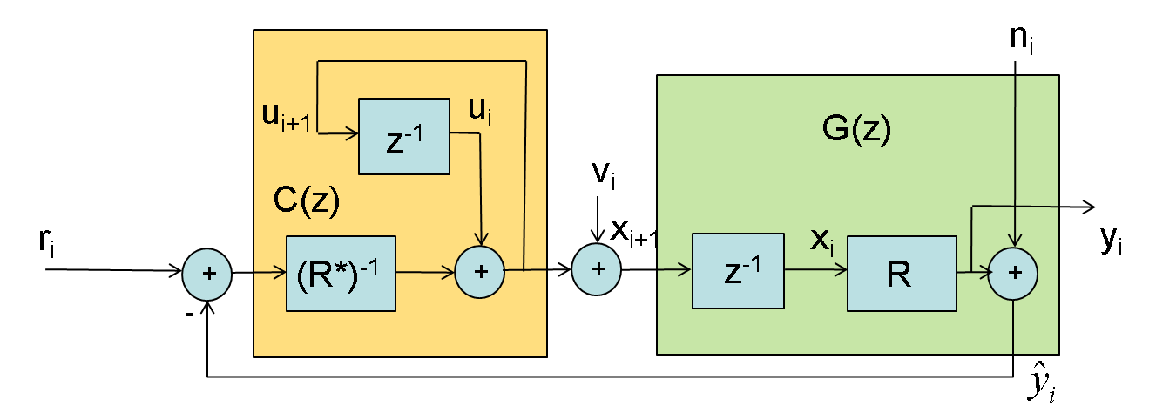



State controller
Idea: Calculate the QP positions of the last step and correct them [3].
Corresponds to a state controller [4], that puts all poles to zero (deadbeat contr.)
Alternative state controller:
Apply not full correction
but
Factor g balances between speed and noise, by moving to poles further away from zero
Set point transfer function:
Deadbeat controller [5]:
- Very fast ground motion rejection and set point following
- but introduces a lot of noise from the
BPMs in the system

Slide 7

Emittance based controller [6]
Idea: Emittance as a function of normalized beam macro particle coordinates at the end of the linac
Optimizing feedback for min. emittance growth and min. BPM offset (quadratic sense)
Result is a 10 times smaller growth rate.
Design uses SVD decomposition but is not a SVD controller (no diagonalization).
Problem: Controller design uses macro particle coordinates that cannot be measured in reality.
Controller has to rely on simulated data.
Practical usefulness is questionable and has to be verified, by robust performance evaluation.

Slide 8
Idea of an adaptive controller
Previous designs do not take into account system changes.
Idea: Tackle problem of system changes by an online system identification
Lear about the system by:
- Input data
- Output data
- Guess about the system structure
Usage:
- For system diagnostics and input for different feedbacks (keep R as it was)
- Input for an online controller design
3 adaptive control schema [7]:
- Model-Reference Adapt. Sys. (MRAS)
- Self-tuning Regulators (STR)
- Dual Control
STR
Ri & gmi
Controller
design
System
identification
Param.
ri
ui+1
Controller
Accelerator
R
yi
Adaptive Controller (STR)
System

Slide 9




System identification
Real system:
Model system:
Goal:
Fit the model system in some sense to the real system,
using and
... Input data
… Output data
… Ground motion
… white and gaussian noise (always here)

Slide 10





RLS algorithm and derivative
can e.g. be formalized as
Offline solution to this Least Square problem by pseudo inverse (Gauss):
LS calculation can be modified for recursive calculation (RLS):
is a forgetting factor for time varying systems
Derivatives (easier to calculate)
- Projection algorithm (PA)
- Stochastic approximation (SA)
- Least Mean Square (LMS)
... Estimated parameter
… Input data
… Output data

Slide 11
Computational effort
Normally the computational effort for RLS is very high.
For most general form of linac problem size:
- Matrix inversion (1005x1005)
- Storage of matrix P (1 TByte)
Therefore often just simplifications as PA, SA and LMS are used.
For the linac system and
have a simple diagonal form.
The computational effort can be reduced strongly
- Matrix inversion becomes scalar inversion
- P (few kByte)
- Parallelization is possible
Full RLS can be calculated easily

Slide 12




Modeling of the system change
Noise/Drift generation
Parameter of noise (for similar emittance growth; ΔT = 5s):
- BPM noise: white noise (k = 5x10⁻⁸)
- RF disturbance: 1/f² drift (k = 7x10⁻⁴) + white noise (k = 1.5x10⁻²)
- QP gradient errors: 1/f² drift (k = 4x10⁻⁶) + white noise (k = 3x10⁻⁴)
- Ground motion: According to Model A of A. Sery [8]
RF drift much more visible in parameter changes than QP errors
Random number
k
z⁻¹
z⁻¹
+
+
white and gaussian
white noise
1/f noise
1/f² noise

Slide 13
First simulation results
ΔT = 5s
λ = 0.85
R changes according to last slide
Ground motion as by A. Seri (model A [8])
Identification of one line of R and the gm-vector d
Simulation data from PLACET

Slide 14
Forgetting factor λ
d₁₀: λ to big (overreacting)
d₅₀₀: λ fits
d₁₀₀₀: λ is to small
=> Different positions in the linac should use a different λ (work)

Slide 15
Problems with the basic approach
Problem 1: Excitation
Particles with different energies move differently
If beam is excited, these different movements lead to filamentation in the phase space (Landau Damping)
This increases the emittance
=> Excitation cannot be arbitrary
Problem 2: Nature of changes
No systematic in system change
Adding up of many indep. Changes
Occurs after long excitation

Slide 16
Semi-analytic identification scheme
Excitation Strategy:
Necessary excitation can not be arbitrary, due to emittance increase
Strategy: beam is just excited over short distance and caught again.
Beam Bump with min. 3 kickers is necessary
Practical system identification:
Just parts of R can be identified
Rest has to be interpolated
  - Transient landau damping model
  - Algorithm to calculate phase advance from BPM/R data
-1
-1
0
…
-1
Δx’1
Δ x’2
Δ x’3

Slide 17
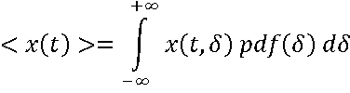

Model of the transient Landau Damping
Result: (Kick at 390 and 6350m)
Approach [9]:
Envelope by peak detection algorithm
Limitation: Works just for time independent energy distribution
Not the case at injection into linac => fit to data

Slide 18
Open questions
Strategy of determine in an way, that the knowledge about the disturbance signals is best possible used.
Gaining knowledge of the best possible excitation of the beam without loosing to much beam quality.
Getting more detailed information about the nature of many disturbances to tailor the algorithm accordingly (not only RLS is possible).
Resume
The approach of an adaptive controller is in principle good, but
There are many accumulating inaccuracies as:
  - Landau Model
  - Phase advance reconstruction
  - Remaining Jitter in the estimated model
  - Undeterministic propagation of disturbances
Hopefully these inaccuracies do not destroy the practical usability!!!

Slide 19
References
[1] J. Pfingstner, W. http://indico.cern.ch/conferenceDisplay.py?confId=54934. Beam-based feedback for the main linac, CLIC Stabilisation Meeting 5, 30th March 2009.
[2] E. T. dAmico, G. Guignard, N. Leros, and D. Schulte. Simulation Package based on PLACET. In Proceedings of the 2001 Particle Accelerator Converence (PAC01), volume 1, pages 3033–3035, 2001.
[3] A. Latina and R. Tomas G. Rumolo, D. Schulte. Feedback studies. Technical report, EUROTeV, 2007. EUROTeV Report 2007 065.
[4] Otto Föllinger. Einführung in die Methoden und ihre Anwendung. Hüthig Buch Verlag Heidelberg, 1994. ISBN: 3-7785-2915-3.
[5] Nicolaos Dourdoumas and Martin Horn. Regelungstechnik. Pearson Studium, 2003. ISBN: 3-8273-7059-0.
[6] Peder Eliasson. Dynamic imperfections and optimized feedback design in the compact linear collider main linac. Phys. Rev. Spec. Top. Accel. Beams, 11:51003, 2008.
[7] K. J. Åström and B. Wittenmark. Adaptive Control. Dover Publications, Inc., 2008. ISBN: 0-486-46278-1.
[8] Andrey Sery and Olivier Napoly. Influence of ground motion on the time evolution of beams in linear colliders. Phys. Rev. E, 53:5323, 1996.
[9] Alexander W. Chao. Physics of Collective Beam Instabilities in High Energy Accelerators. John Wiley & Sons, Inc., 1993. ISBN: 0-471-55184-8.

Slide 20
Thank you for your attention!

