Slide 1
Breakdown experiments
CLIC09 workshop
15.10.2009
Jan Kovermann

Slide 2
Outline
1. The quantitative approach to high gradients, an introduction
2. Which diagnostic methods are used?
3. Overview of measurable parameters
4. Results from comparative RF and DC breakdown studies
5. Details from optical breakdown spectroscopy
6. A proposal for RF breakdown detection
7. The DC breakdown movie
8. Summary

Slide 3
The quantitative approach to high gradients
DC
measurements
High-power scaling laws
(RF and materials)
Breakdown diagnostics
Comprehensive
RF design
Breakdown simulation
RF
measurements

Slide 4
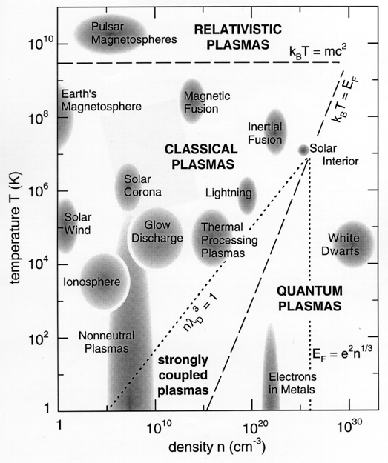
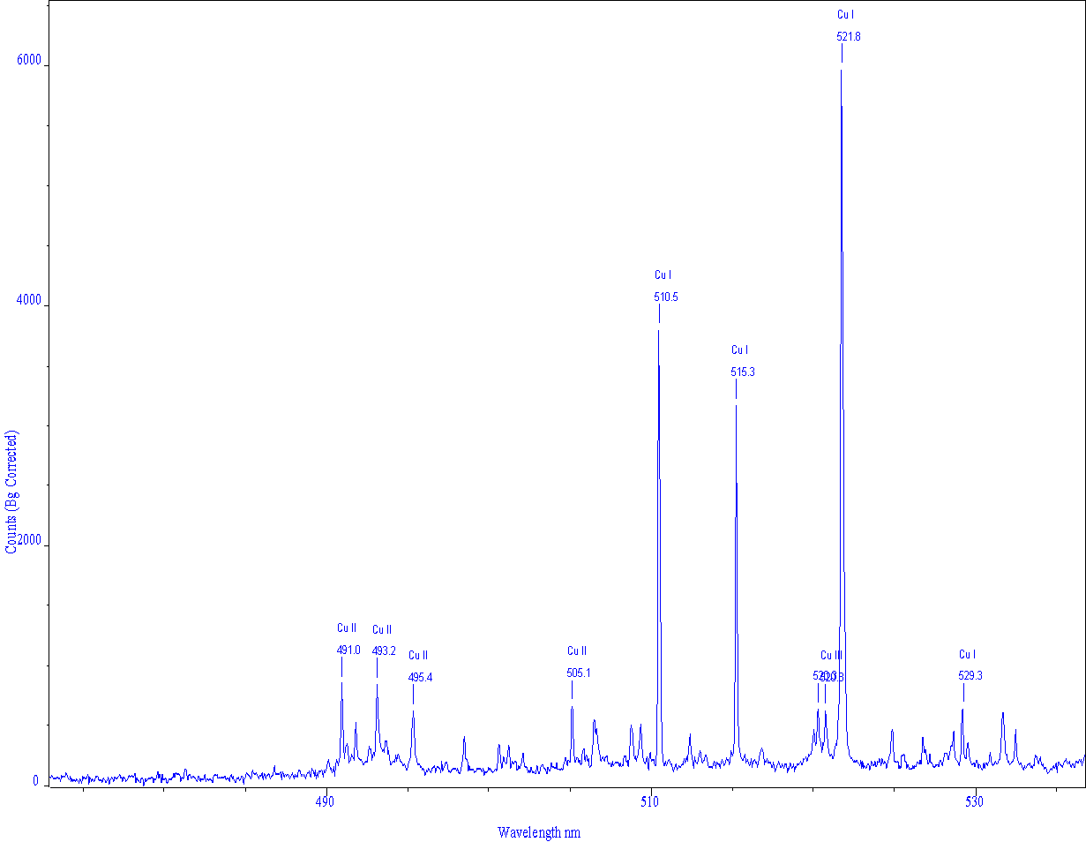
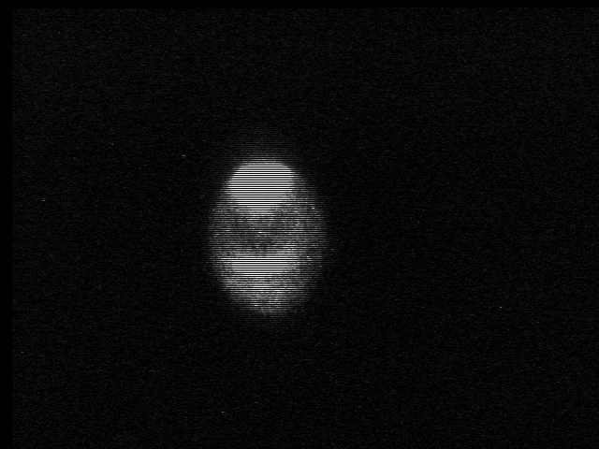
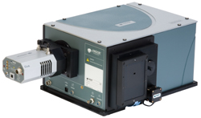
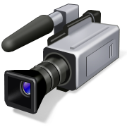
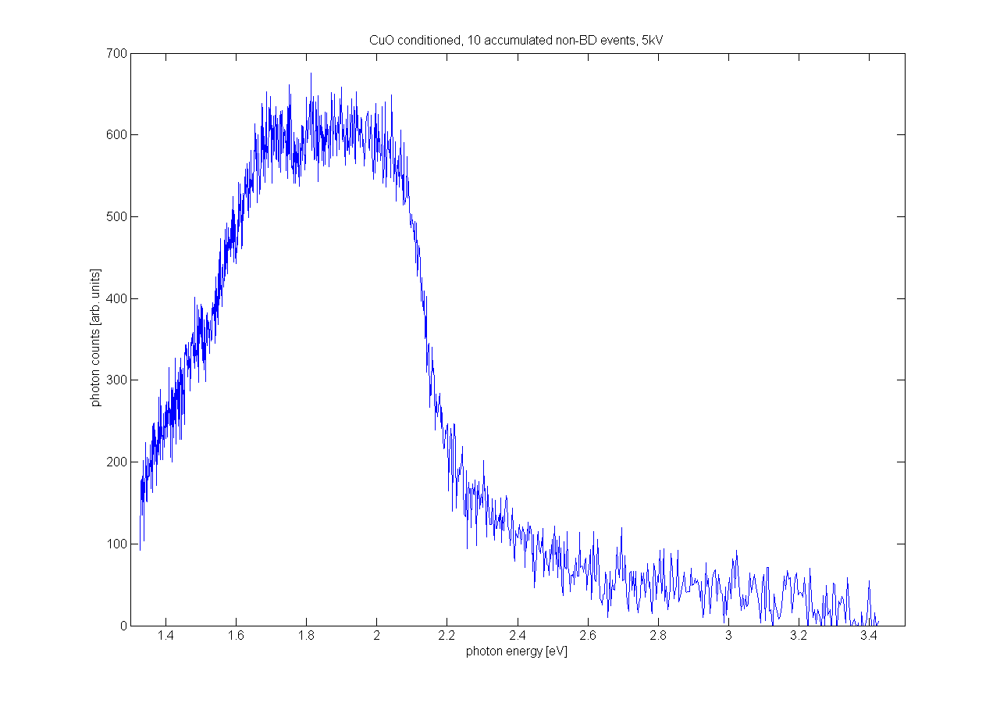
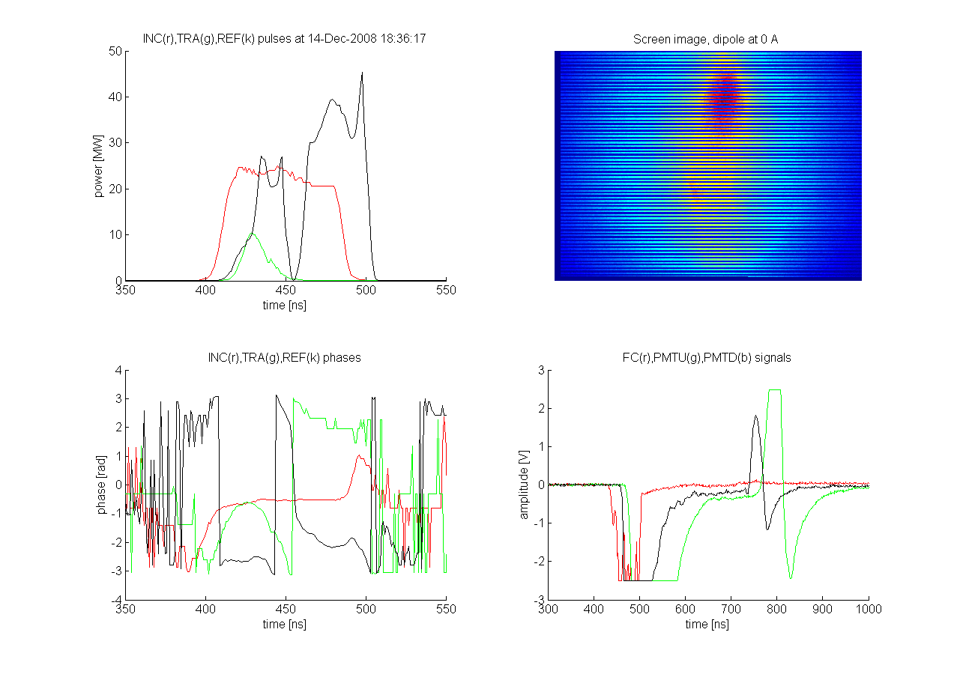
The quantitative approach to high gradients
Breakdown source identification
Plasma composition➔ simulation and mat.sci. input
Plasma size/position ➔ simulation and design input
Plasma parameters➔ simulation input
Spectroscopy
BREAKDOWN
DIAGNOSTICS
RF measurements, FC, XRAY ➔ simulation and design input
Machine protection
Conditioning
Missing energy ?
OTR in nominal pulses ➔ simulation and machine parameter input
SEM ➔
simulation and design input

Slide 5
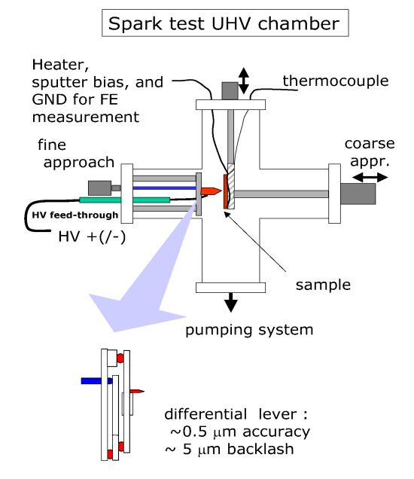
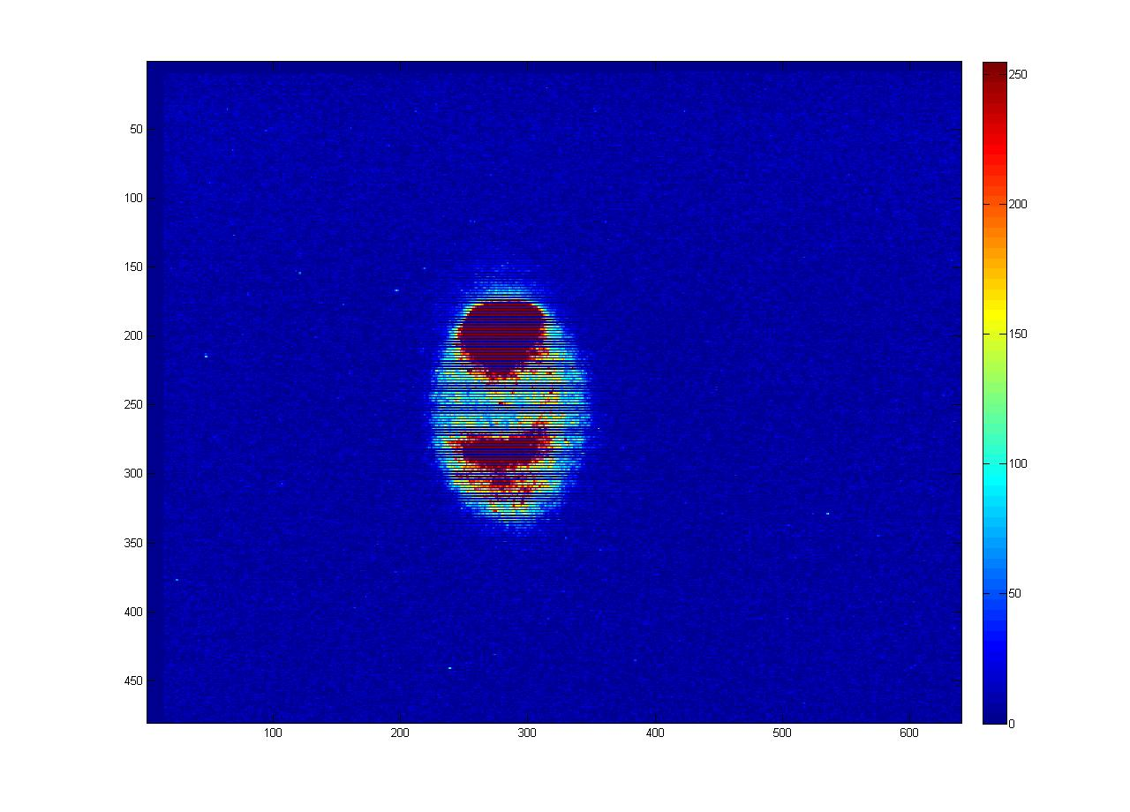
The connection between simulation and experiment
Emitted currents
Dark current spectrum
OTR
X-rays
Trigger mechanism
Missing energy
Breakdown rate
Ion currents
Fowler-Nordheim distribution
Plasma characteristics
-Time structure
-Physical dimension (imaging)
-Ion species (opt. spectroscopy)
-Ion currents
-Vacuum behaviour
Surfaces
-Crater morphology
-Material diagnostics
-Fatigue process

Slide 6
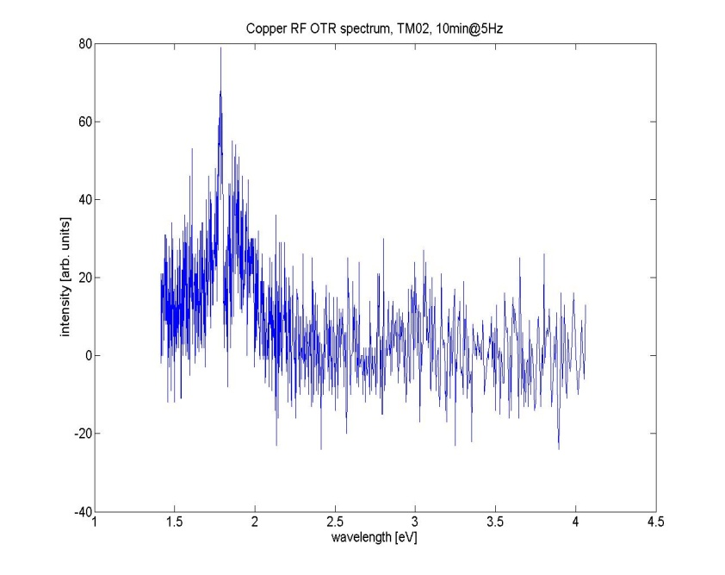
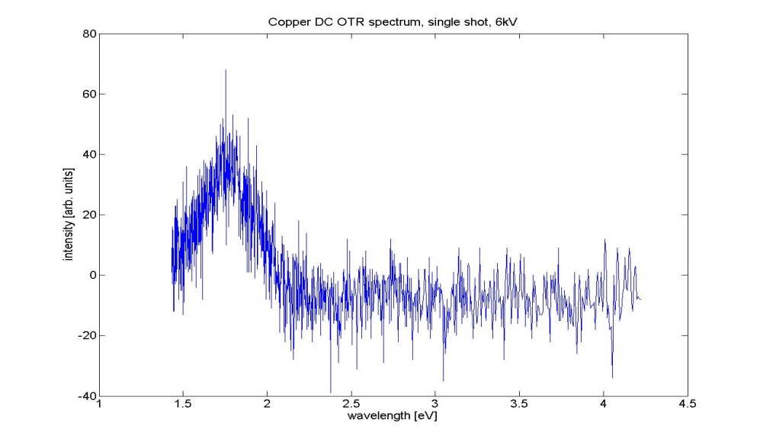
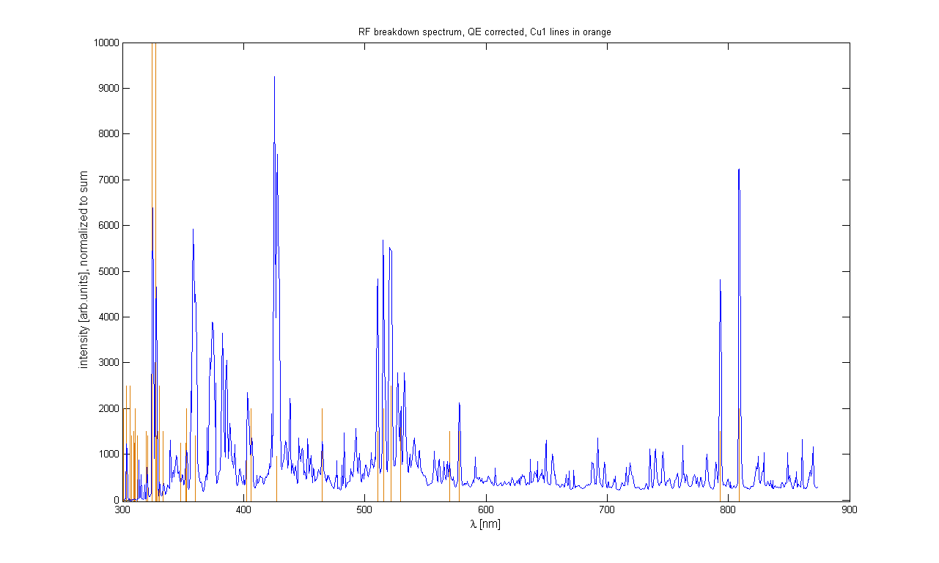
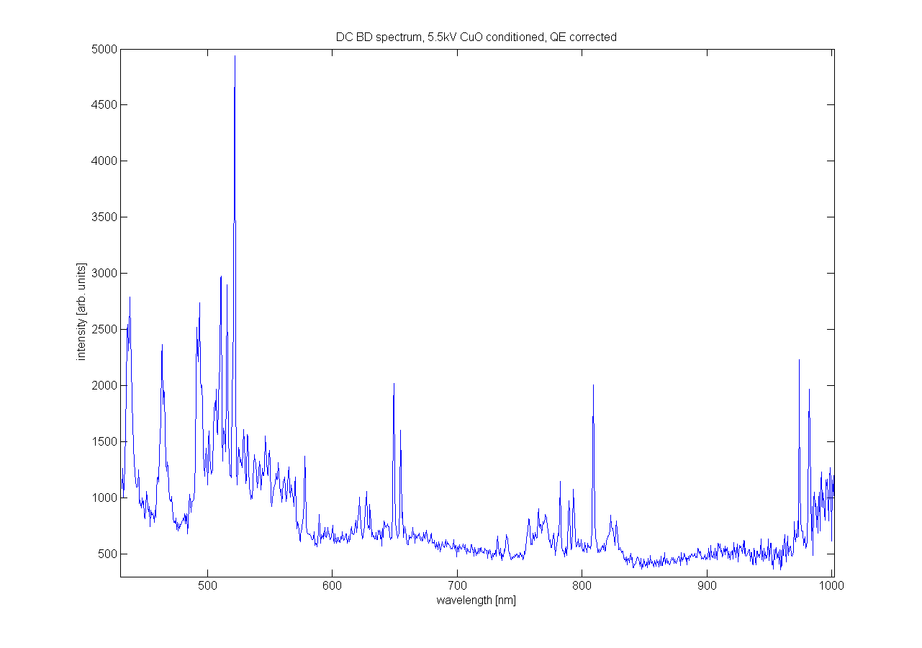

RF and DC diagnostics: some results
RF
DC
OTR (Cu), no BD
Cu interband transition (@2.1eV) spectrum
Opt. BD spectroscopy
Cu I (7.7eV), Cu II (20eV), Cu III (36eV ) ions
Notes:
This absorption edge, which is due to the d-band to Fermi level transition

Slide 7

RF and DC diagnostics: some results
Spectrum typical for OTR in Cu (interband transition @ 2.1eV)
Beta measurements possible close to the breakdown limit (~105)
OTR sometimes seems to rise before a breakdown
Oxide layers suppress OTR
An estimation of the energy absorbed by electrons in 30GHz structures: 0.1MW @ 14MW RF input power
OTR (Cu), no BD
found very little traces of O,H,C,S probably no contribution to breakdown physics in this sample
Estimated temperature from two-line-method: 1-5eV, but Cu III (T>36eV) seen, plasma is a non-LTE plasma!
Intensity waveform for different lines highly non-reproducible (clusters? Different plasma? just geometry?)
Opt. BD spectroscopy

Slide 8
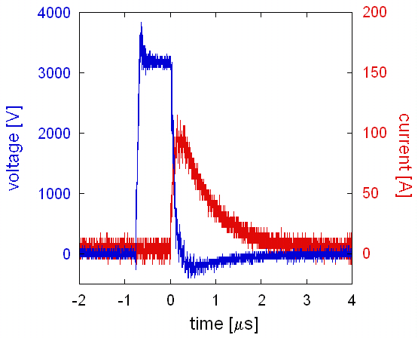
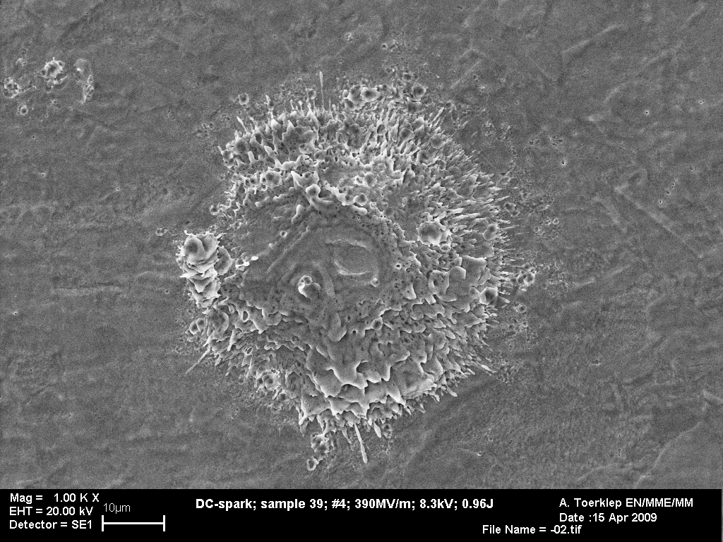
RF and DC additional diagnostics
RF
DC
RF (I,Q), Xray, FC @30GHz
Current, voltage and delay
?
SEM of single breakdowns
SEM of single breakdowns

Slide 9
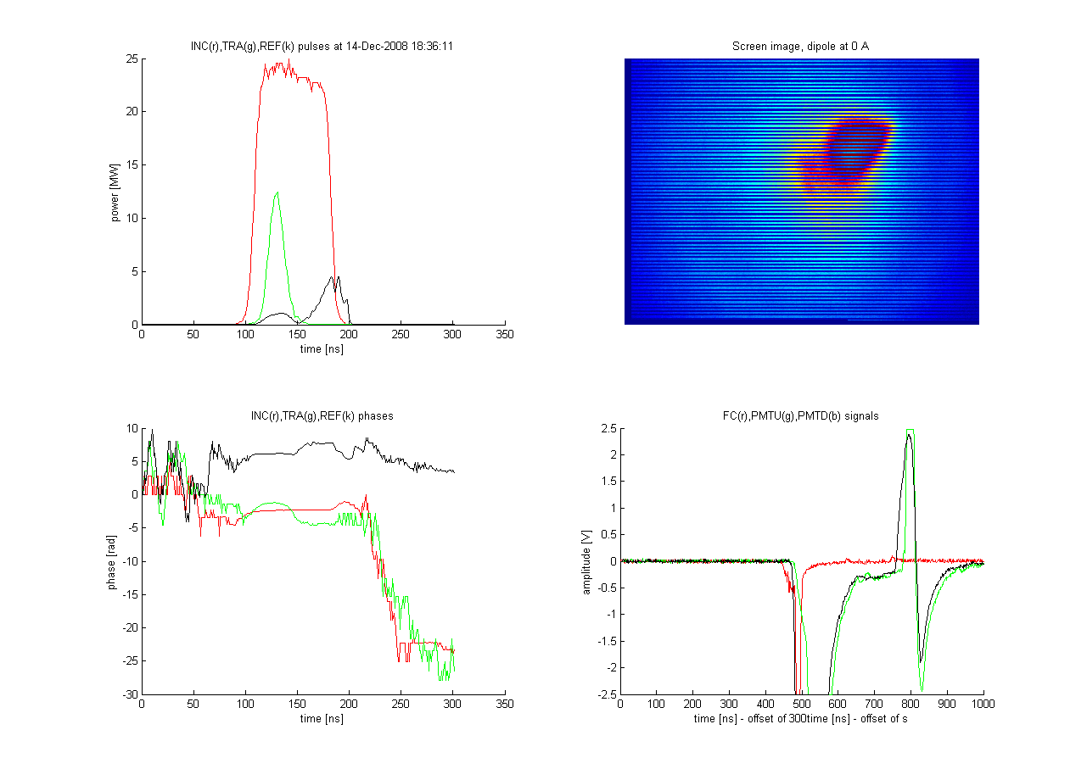
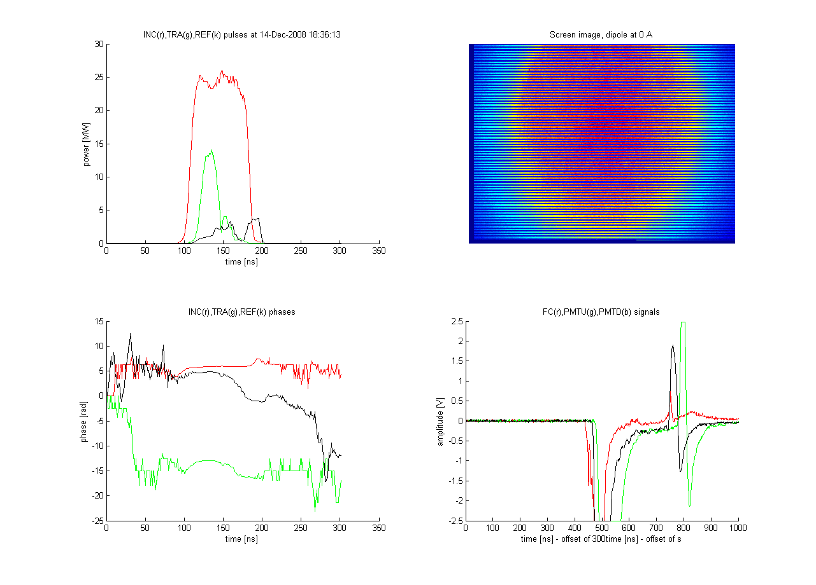
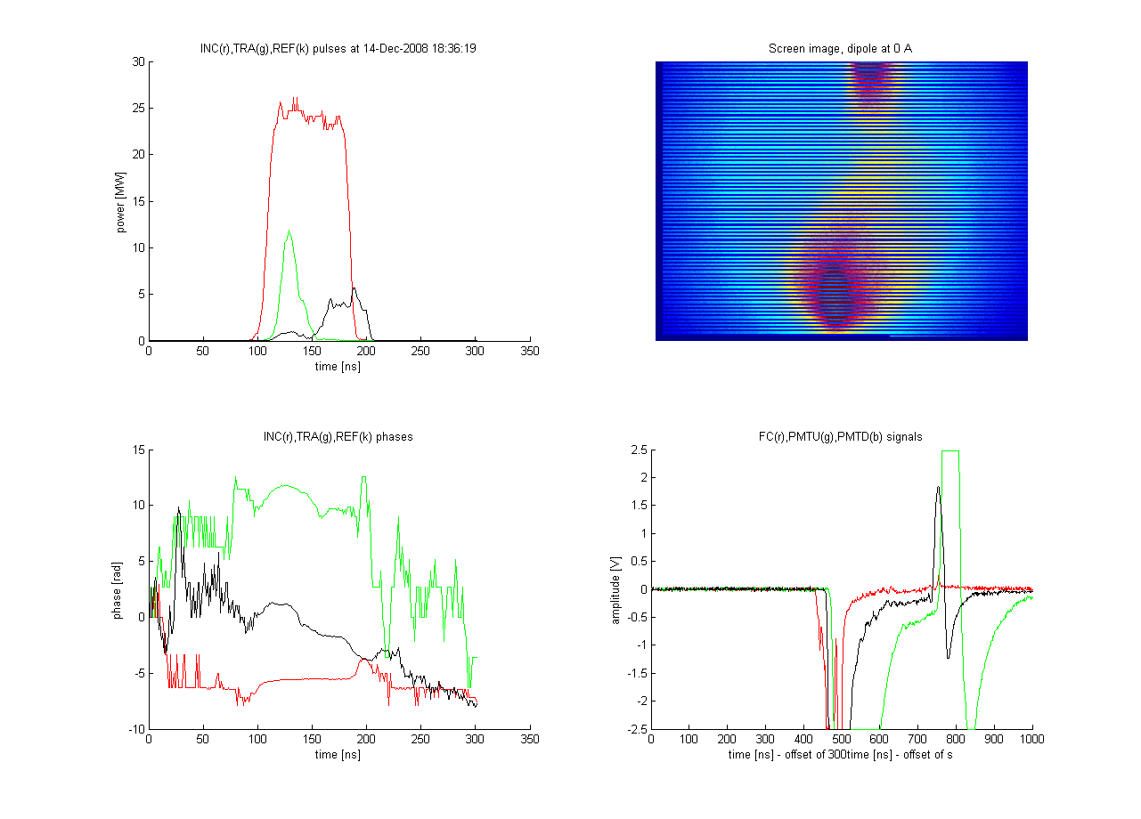
RF and DC diagnostics: BDs are never the same
BDs are very fast (~ns) transient phenomena
BD parameters change over orders of magnitude (e.g. dark current vs. BD current)
BDs are never the same (in RF!)
BDs affect S-parameters (RF) / current and voltage (DC)
random BD current emission (RF)
working on BD-plane formalism for position dependent missing E calculation
optimization of DC setup for fast transients ongoing
development of high dynamic range diagnostic tools (LogAmps etc.)
fast single-shot multi-channel equipment necessary
30GHz speedbump structure

Slide 10
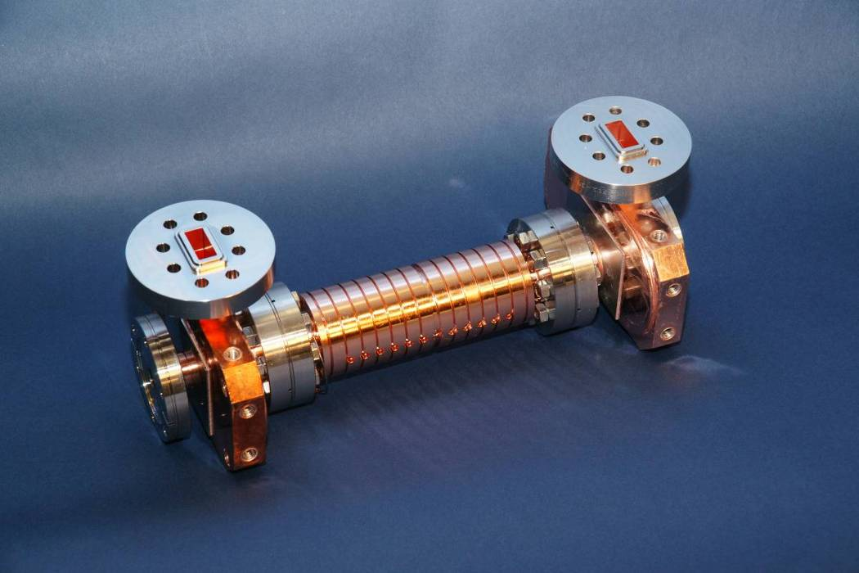
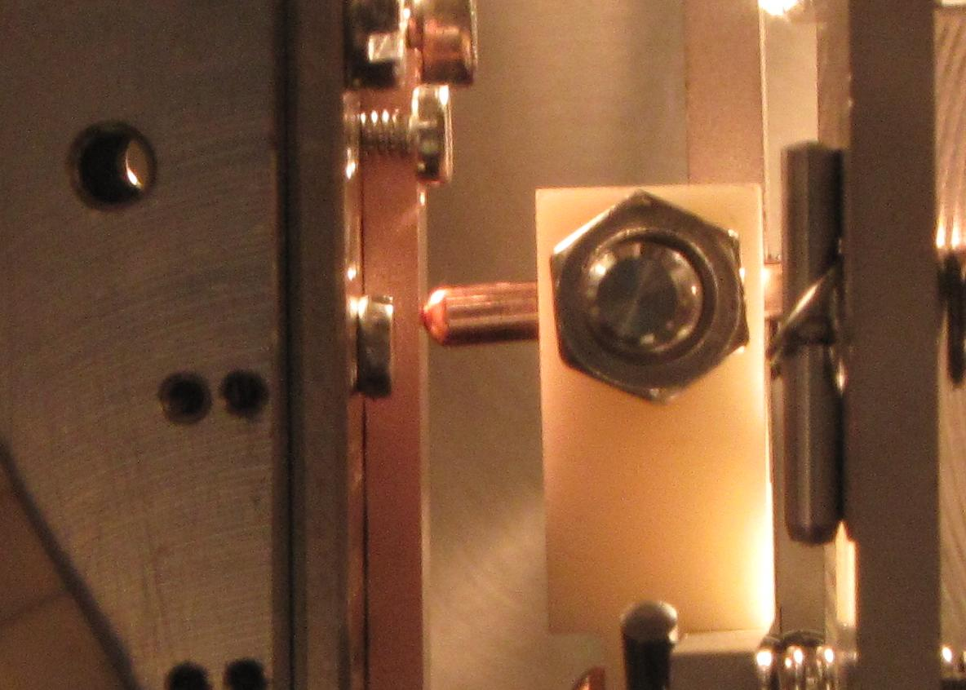
Optical spectroscopy in RF and DC
RF
DC
SLAC C10 (vg 1.35) structure in ASTA, running at 100MV/m (@48MW), 200ns pulse length
CERN DC test stand, 6kV DC, OFE Cu sample, 300MV/m surface field

Slide 11
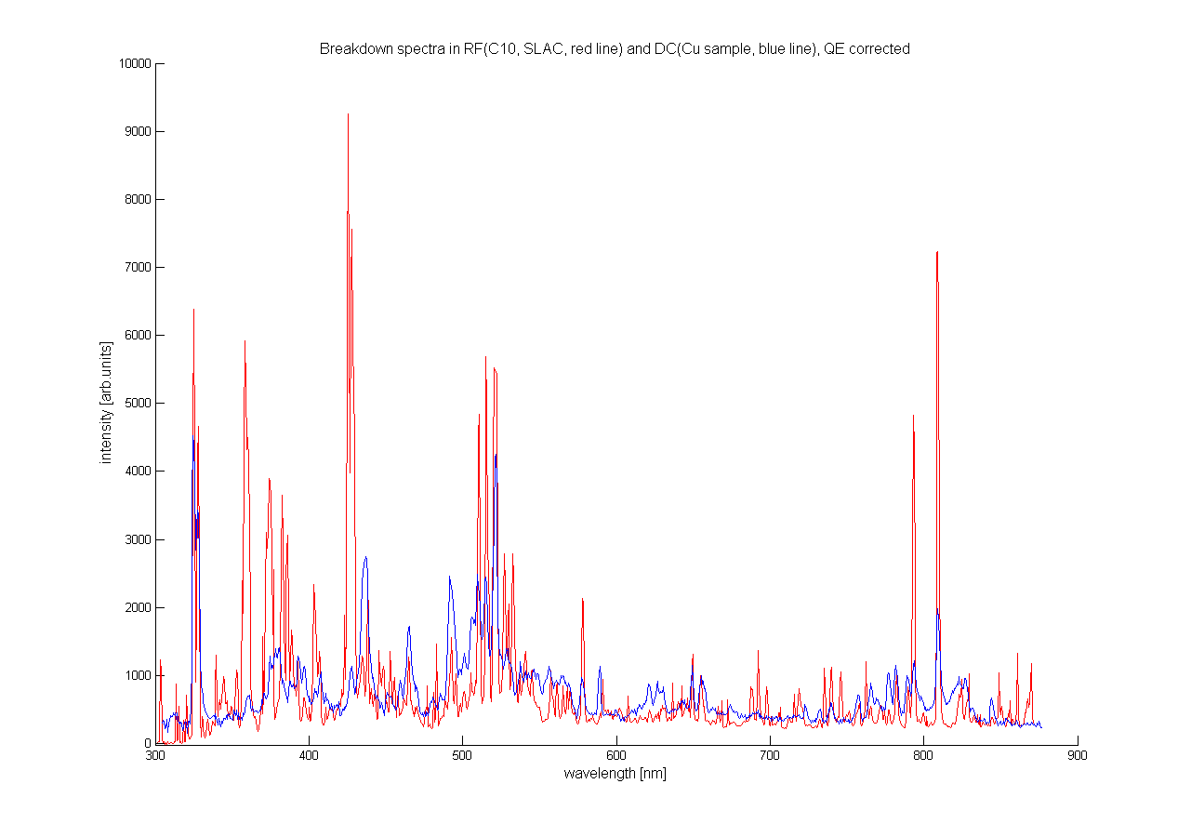
RF and DC BD spectroscopy in detail
Typical Cu-plasma spectrum for RF and DC, but there is a problem in the RF spectrum…
CuII ???

Slide 12
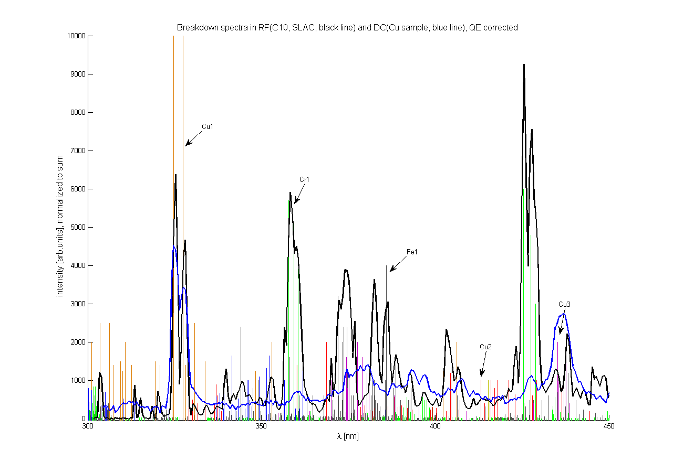
RF and DC BD spectroscopy in detail
… stainless steel! Looks like a BD between copper gasket and flange (confirmed recently by SLAC).

Slide 13
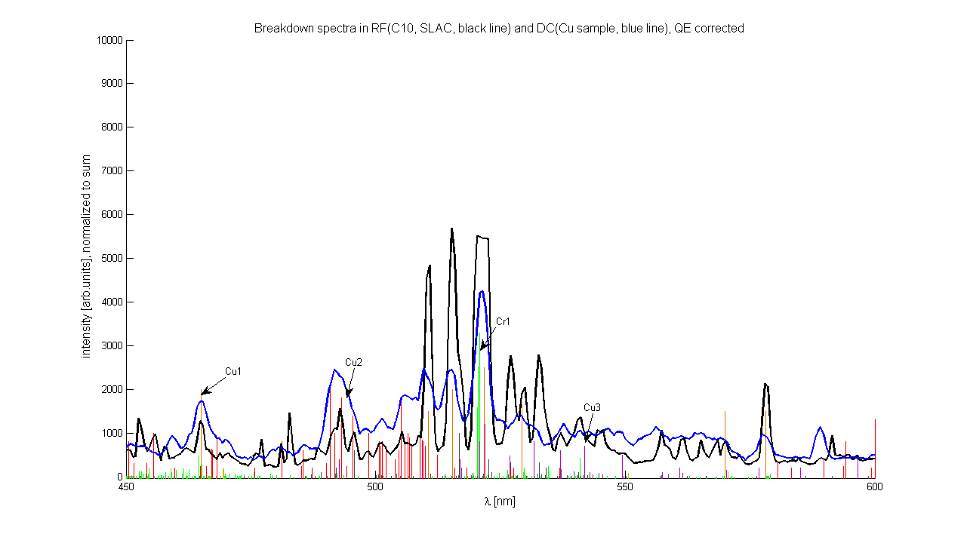
RF and DC BD spectroscopy in detail
Unfortunately this is not a pure Cu-BD spectrum anymore (there is literature on StSt arc welding diagnostics, to be checked)…
Cu I temperature is ~1-3eV depending on line pairs

Slide 14
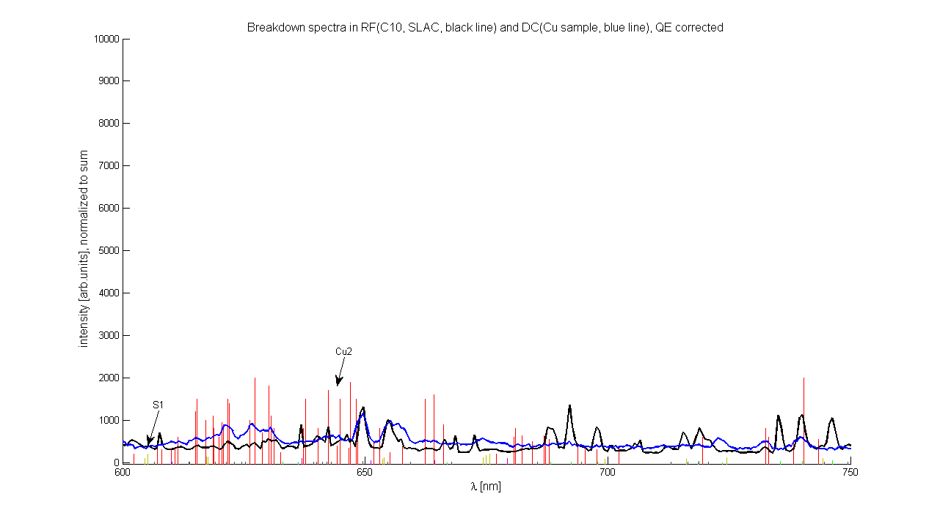
RF and DC BD spectroscopy in detail
I you can‘t beat it, use it!
RF structures are getting more and more complex, not only in terms of geometry, they might contain one day:
New and alternative structure materials (e.g. CuZr)
Surface treatment and coatings (e.g. oxide layers, NEG)
Brazing alloys (e.g. Ag)
Joints and flanges (e.g. StSt, Al)
Damping material (e.g. SiC)
Impurities from production and handling (e.g. dust & dirt)

Slide 15
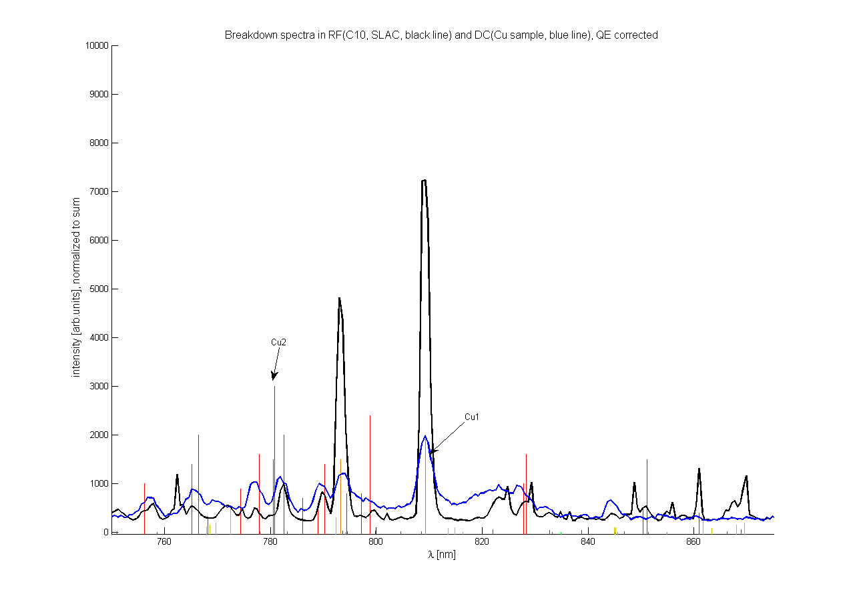
RF and DC BD spectroscopy in detail
Proposal: (Simplified) spectroscopy system as standard diagnostic tool for future structure tests to save time of trembling uncertanty before you cut the structure…
Surprisingly the intensity ratio of Cu lines does not change from BD to BD, still looking for power or pulse length dependency…

Slide 16
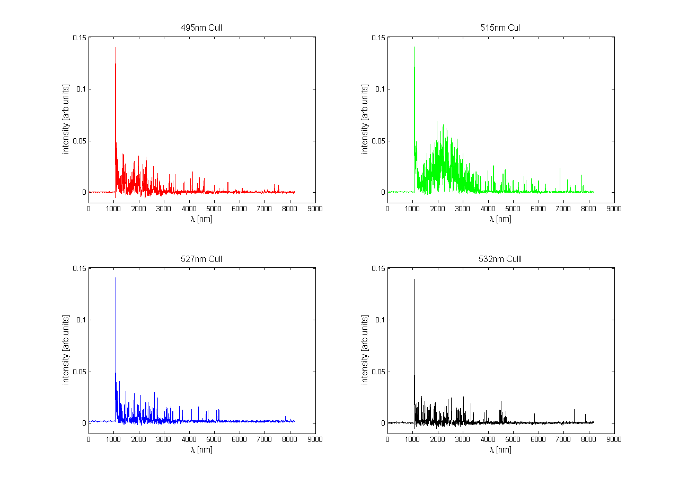
RF and DC BD spectroscopy in detail
Time resolved spectroscopy of selected lines in RF (SLAC C10@100MV/m, 200ns)
200ns RF pulse
Initial peak similar for all Cu species
Hight density and/or Stark/Zeeman effects
White background in spectra
T [ns]
T [ns]
T [ns]
T [ns]

Slide 17
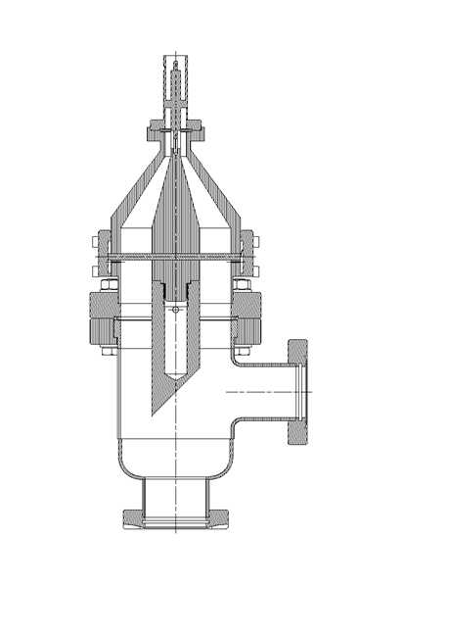
RF faraday cup measurements
High currents (5V in 50Ohms, 100mA, 50ns) of electrons hit the FC in each BD event, X-rays are produced by these electrons (30GHz CERN speedbump structure)
FC covers 1/200 of solid angle
approx. 10E13 electrons per BD
X-rays pass vacuum window and Al-foils
at least 10keV to be detectable,
for 10E13 electrons dissipated energy
is around 20mJ
X-rays pass 14mm Cu and 5mm Fe
➔ at least 100keV to be detectable,
for 10E13 electrons dissipated energy
is around 180mJ
In total:
~200mJ
Very similar to measured missing Energy in RF, but no direct correlation!
X-rays
Electrons from BD

Slide 18
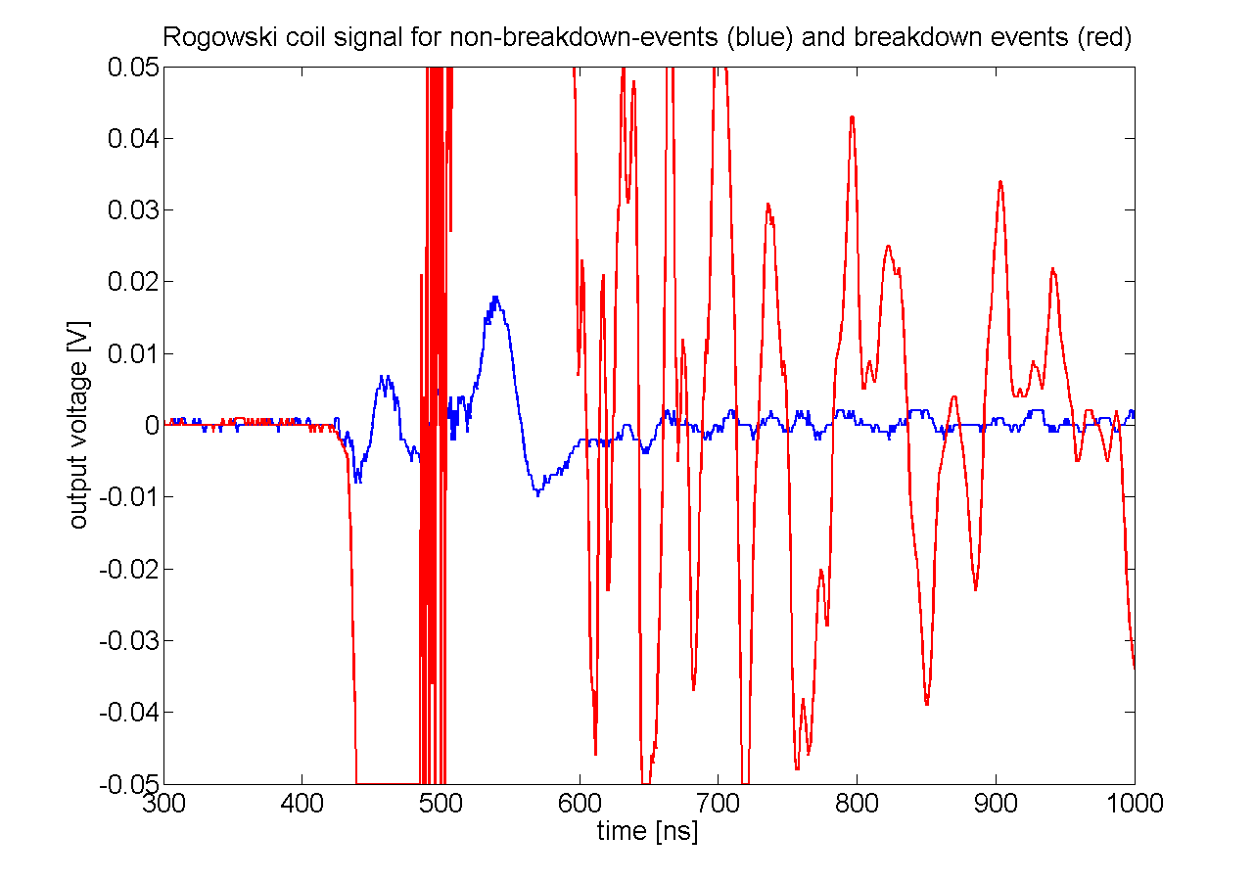
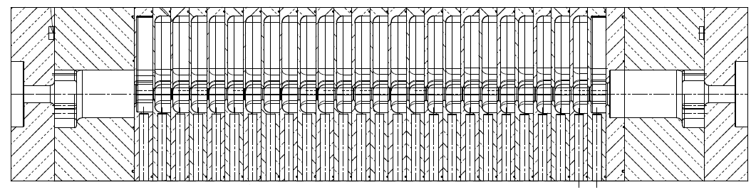
RF diagnostics spin-off
Breakdown detection for CLIC accelerating structures
Breakdown detection using pairs of Rogowski-coils:
+ easy suppression of main beam signal
+ simple electronics
+ no reference needed
+ can resolve dark current and breakdown current
+ radiation hard
+ cheap feed-throughs
needs space between structures
beam impedance matching necessary
First test with one coil in 30GHz test stand
volts
time
volts
volts
DiffAmp
time
time
Main
beam
Breakdown current

Slide 19
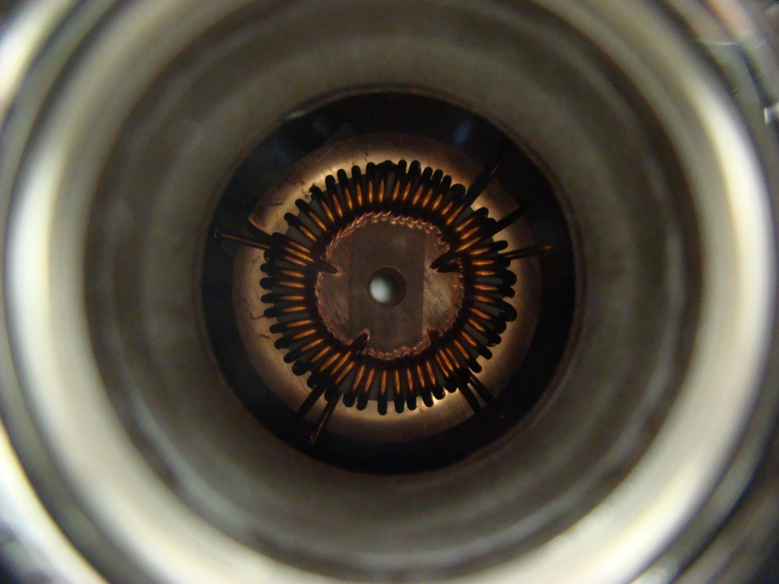
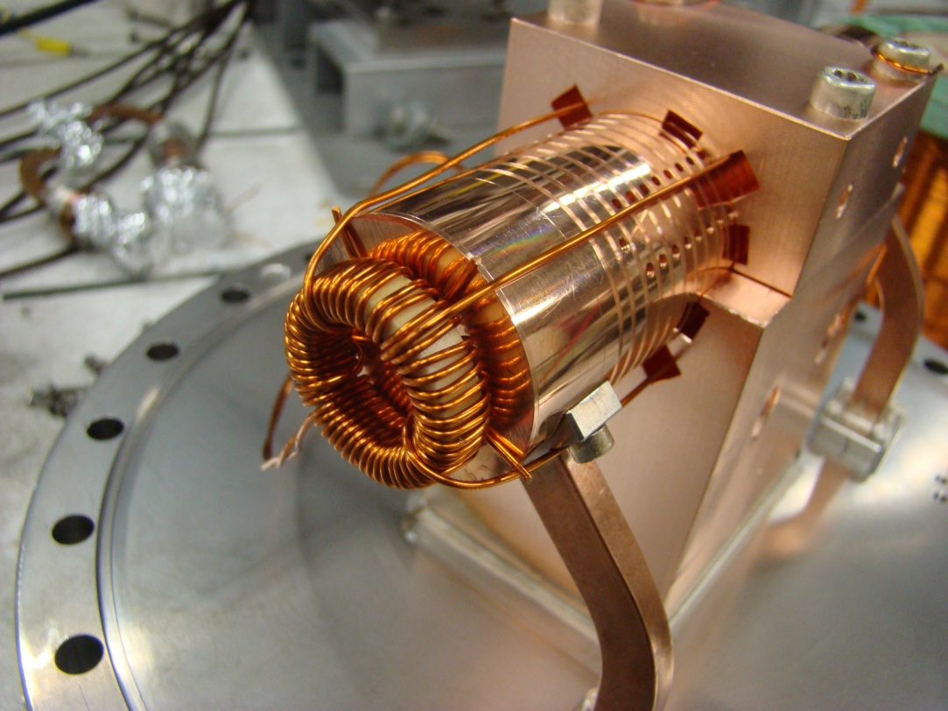
RF diagnostics spin-off
And how (cheap) it looks like doing the first tests…
But now coming back to DC again!

Slide 20
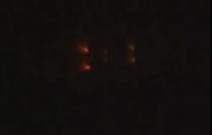

DC breakdown
The motion picture
TIP
Featuring: DC breakdown, 12kV, OFE Copper, 20um gap (500MV/m).
Storyline: Capacitor is discharged through the sparc, but the PSU stays connected with high impedance for seconds...
SAMPLE

Slide 21

Summary
Breakdown diagnostics offer a new way of approaching the understanding of the breakdown mechanism and its possible feedback to high gradient designs
The experiments give input to breakdown simulation (plasma and transient behavior)
Breakdown detection methods besides RF signals and faraday cup were developed (which are under consideration for CLIC now)
Fast diagnostics for abnormal structure BD behavior have been presented and will be implemented in structure test stands
THANK YOU!

