Slide 1
DRIVE BEAM
From LINAC to DECELERATOR
C. Biscari, D. Alesini, A. Ghigo, F. Marcellini,
LNF-INFN, Frascati, Italy
B. Jeanneret, F. Stulle, CERN, Geneva, Switzerland
L. Falbo, CNAO, Pavia, Italy

Slide 2
Beam temporal structure along the frequency multiplication system
100 A
4A
E=2.37 GeV, Emittance ~ 100 μm rad
Energy spread < 1%, Bunch length 2mm
Bunch charge = 8.4 nC Final bunch separation = 2.5 cm

Slide 3
CLIC Drive Beam generation
Drive Beam Accelerator
efficient acceleration in fully loaded linac
Delay Loop × 2
gap creation, pulse compression & frequency multiplication
RF Transverse Deflectors
Combiner Ring × 3
pulse compression &
frequency multiplication
Combiner Ring × 4
pulse compression &
frequency multiplication
CLIC RF POWER SOURCE LAYOUT
Drive Beam Decelerator Section (2 × 24 in total)
Power Extraction
Drive beam time structure - initial
Drive beam time structure - final
240 ns
240 ns
5.8 μs
140 μs train length - 24 × 24 sub-pulses
4.2 A - 2.4 GeV – 60 cm between bunches
24 pulses – 101 A – 2.5 cm between bunches

Slide 4
Main issues for drive beam recombination and
transportation from Linac to decelerator:
Drive beam at decelerator input:
Emittance preservation
Beam loading in rf deflectors (David Alesini – next talk)
ISR energy loss
CSR induced energy spread and energy loss
Longitudinal and transverse acceptance
Isochronicity of successive stages
Achromaticity of Injection bumps in the rings
Final bunch compression
…
From yesterday Erik’s talk

Slide 5
Main parameters of the rings
Parameter |  | DL | TA | CR1 | CR2
L | m | 73.05 | 146 + 73 | 146.09 | 438.28
Combination factor |  | 2 | 2 | 3 | 4
RF deflector frequency | GHz | 1.5 | 1.5 | 2. | 3.
N of dipoles |  | 12 | 12 | 12 | 16
ρ | m | 4.7 | 4.7 | 4.7 | 12
B | T | 1.7 | 1.7 | 1.7 | 0.7
N of quadrupoles / families |  | 18 / 9 | 44/17 | 48 / 9 | 64 + fodo quads
l_{q} * dB/dx max | T | 10 | 11 | 6 | 6
For decreasing ISR energy losses

Slide 6
Energy loss per turn (Incoherent Synchrotron Radiation)
Number of turns
@CR2
0 -1.1
0.5 - 1.5 - 2.5
0.5 -1.5 - 2.5 - 3.5
From 1 turn to 7.1 turns: energy loss from 0.42 to 3 MeV
Spread between the minimum and maximum lost: ΔE/E ~ 0.1 %

Slide 7
SPIDER-2 PROGRAM (L. Falbo)
The program SPIDER (Simulation Program for Impedances Distributed along Electron Rings) was created to simulate the longitudinal single bunch dynamics in a ring where the bunch length is not constant along the ring. To study such a phenomenon the code studies the longitudinal phase space evolution along an arbitrary section of a ring. As a consequence it can be easily used to study bunch dynamics in a transfer line.
The effects that can be studied are:
Interaction with the vacuum chamber (Pipe wakefield)
Incoherent synchrotron radiation
Several aspects of Coherent synchrotron radiation (CSR) : in a “Long” dipole, in a dipole in which the entrance and/or the exit effects are important, in a dipole with the pipe shielding effect, in a wiggler.
Space charge effects
The code reproduced DAFNE dynamics and was used to study lattices
characterised by bunch length modulation.
The code has been recently upgraded (SPIDER2) to study also effects in hadron rings.

Slide 8
FMS layout
October 08
Delay Loop as in CTF3

Slide 9
FMS layout
TA arc = CR1 arc with 99°
Turn Around Loop
June 09

Slide 10
DL against TA
DELAY LOOP
L = 73 m
Total bending angle = 2p
Low number of elements
1 rf deflector
High element density
Higher T566 (-55m, sext off)
TURN AROUND
L = 73 * 2 + 73 m
Total bending angle > 10%
High number of elements
2 rf deflectors
Low element density
Lower T566 (-35, sext off)
Better tunability

Slide 11
ADDING a Dquad between the rf deflector and the septum
The odd and even bunches are separated and vertically focused on the septum position
QF
Dipole
QD
5 ° Septum
101 mrad
14 mrad
RF deflector
5 mrad
7.5 mrad
5.2 cm
2.5 mrad
SEPTUM position

Slide 12
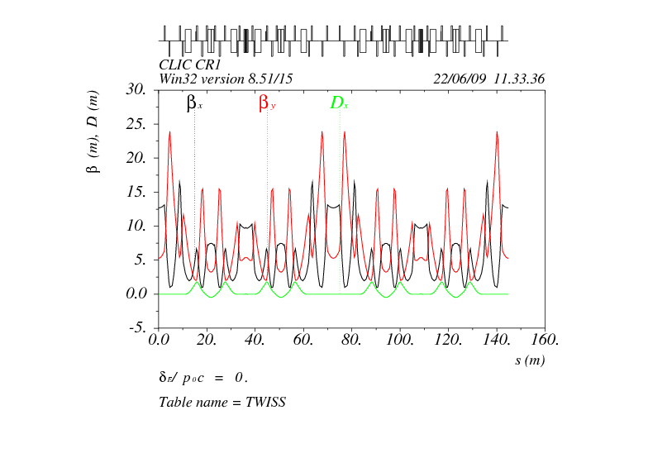
1° combiner ring

Slide 13
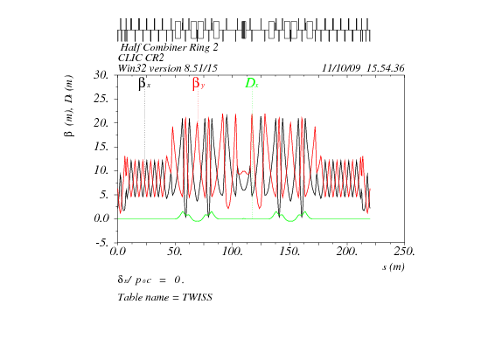
2° combiner ring

Slide 14
Tracking 6d particle distribution along fms with two different energy spread values – mad8
Optimisation of 2° order chromaticity terms
Beam energy spread is the parameter mostly influencing the three phase spaces.
Correcting the 2° term isochronicity by sextupoles can be harmful for the transverse planes.
Up to ± 1% of energy spread 3 emittances are easily preserved.
Particles with higher energy deviations can be lost transversely when sextupoles are not carefully optimised
Dp/p = 1% -> 3.5 mm
 | TA | CR1 | CR2
T566 sext off | -34.6 | -19.2 | -13.4
T566 sext on | -4.4 | -0.6 | 0.2
T166 sext off | -42. | -4.5 | 22.6
T166 sext on | 5.8 | -0.5 | -48.

Slide 15
10
(Dp/p)rms = ±0.6 %
(Dp/p)max = ± 2 %
0
CR2 x 4
-10
-20
-30
CR1 x 3
-40
-50
vertical
DL x 2
-60
chicane
-70
-80
-90
-100
INPUT of Turn Around Loop
-80
-60
-40
-20
0
20
40
60
80

Slide 16
(Dp/p)rms = ±0.6 %
(Dp/p)max = ± 2 %
10
0
CR2 x 4
-10
-20
-30
CR1 x 3
OUTPUT of Turn Around Loop
-40
-50
vertical
DL x 2
-60
chicane
-70
-80
-90
-100
-80
-60
-40
-20
0
20
40
60
80
(Dp/p)rms = ±0.3 %
(Dp/p)max = ± 1 %

Slide 17
(Dp/p)rms = ±0.6 %
(Dp/p)max = ± 2 %
10
0
CR2 x 4
-10
-20
-30
CR1 x 3
-40
-50
vertical
DL x 2
-60
chicane
OUTPUT of CR1
After 3 turns
-70
-80
-90
-100
-80
-60
-40
-20
0
20
40
60
80
(Dp/p)rms = ±0.3 %
(Dp/p)max = ± 1 %

Slide 18
(Dp/p)rms = ±0.6 %
(Dp/p)max = ± 2 %
10
0
CR2 x 4
-10
-20
-30
CR1 x 3
-40
-50
vertical
DL x 2
-60
chicane
OUTPUT of CR2 – after 4 turrns
-70
-80
-90
-100
-80
-60
-40
-20
0
20
40
60
80
(Dp/p)rms = ±0.3 %
(Dp/p)max = ± 1 %

Slide 19
TRACKING IN CR1
With MADX

Slide 20
MAD X
Correction for CR1 : one sextupole family
T566 = 0
Q'x = -9.8 sext off, and -2.1 sext on
Q'y = -10.4 sext off, and -13.6 sext on
Δβ/β < 0.22 for 2% of δp.
Tracking particles of amplitudes A_{x,y} = 1,2,3 σ_{x;y} evenly spaced in phase and covering the momentum range ± 2% over three turns:
no significative deformation of the vertical phase-space
the horizontal phase-space is preserved up to δp = ±1.2 %
Qualitatively and quantitatively same results of Mad8, but with different sextupole strengths
May 09

Slide 21
MadX – Mad8
Different values for chromaticity evaluation
2° order longitudinal correction slightly different
Use ctf3 combiner ring as benchmark:
Apply sextupole corrections for bunch length and chromaticity optimisation
Measurements of bunch length and of beam emittances in TL2

Slide 22
Turn Around to the decelerator
Energy chirp
Energy spread up to 0.5%
Bunch length from 2 to 1 mm

Slide 23
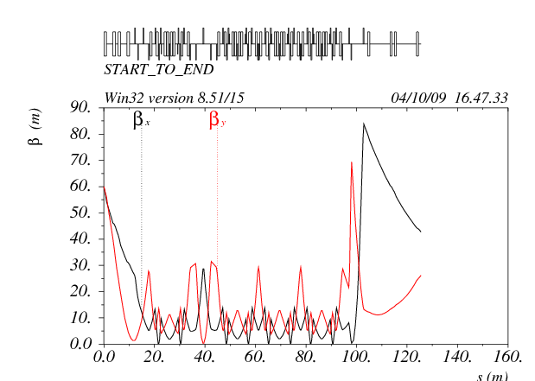
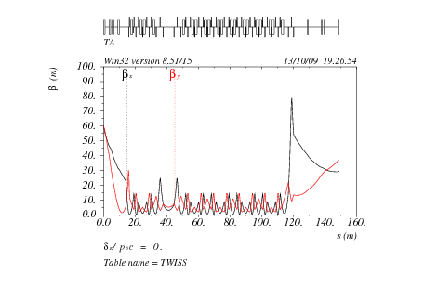
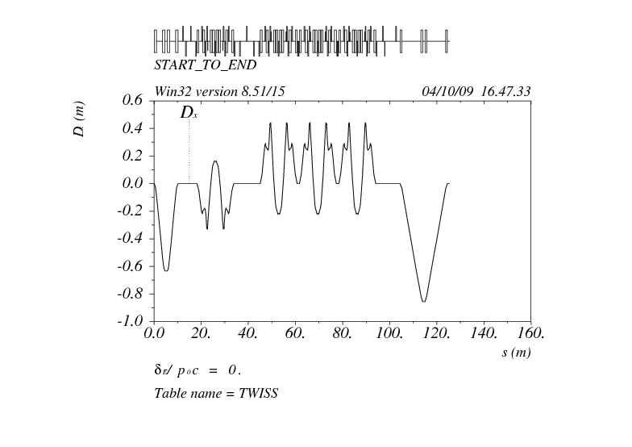
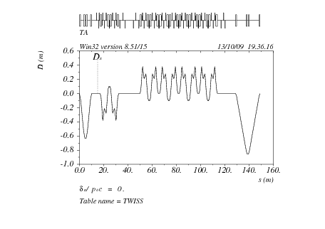
‘Short’ TA
‘Long’ TA
Ch1 isochr TA Ch2

Slide 24
Whole system from Linac to Linac

Slide 25
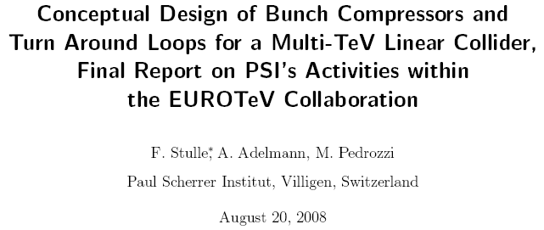
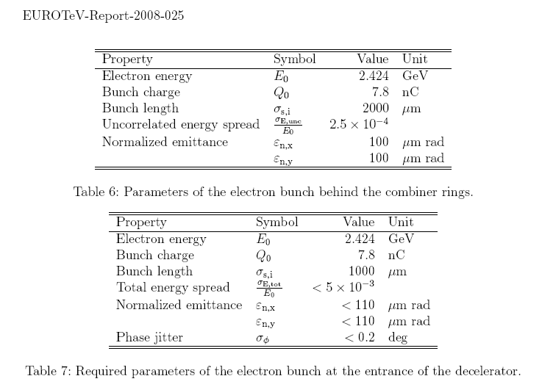
Uncorrelated energy spread 0.1% accounting for ISR effects

Slide 26
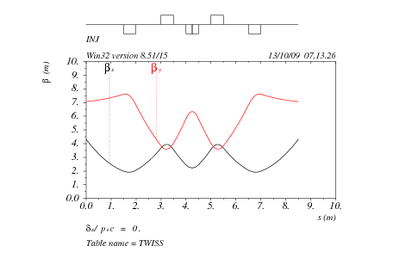
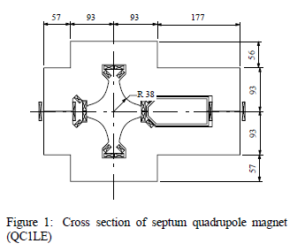
INJECTION BUMPS
Low h β at rf deflectors
(see David’s talk)
QD
QF
CR1
SEPTUM Quadrupole
CR2

Slide 27
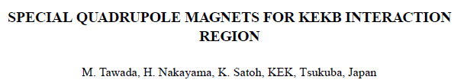
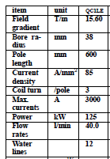
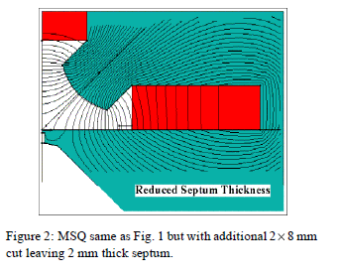


Slide 28
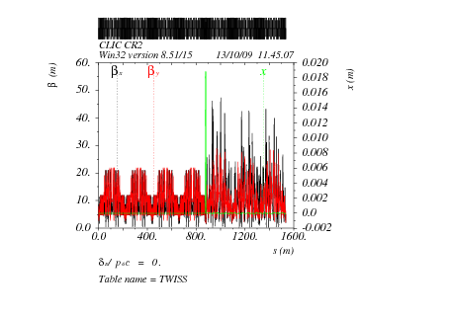
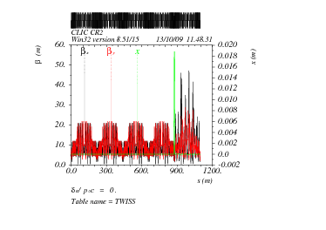
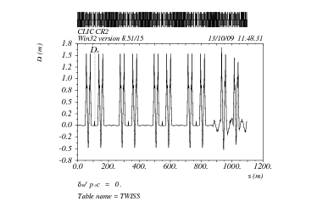
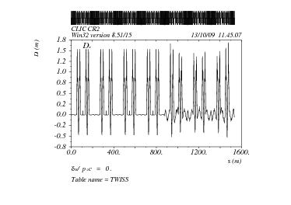
CR2 optical functions
Injection bump
Mismatch of betatron and dispersion functions after the bump passage
2.5 turns
3.5 turns

Slide 29
Tracking through Delay Loop (TA) +
through CR1 (3 turns neglecting bump effects) +
Through CR2 (four different trains) + energy chirp +
Through Turn Around

Slide 30
Superposition of the 4 distributions of different trains
Emittance of different trains
Increase of normalized horizontal emittance from 100 to 150 μrad (average).
CR1 bump not taken into account – to be added

Slide 31
Where does the emittance increase come from?
End of Turn Around – 3.5 turns in CR2 – no energy chirp:
Horizontal emittance increase negligible (0.027 instead of 0.035 mm mrad)
The maximum ‘emittance’ increase comes from the bump residual dispersion when the beam energy spread is increased before the last turn around.
Possible cures: use a lower energy chirp and larger R56
(now 0.36 m total - 2 chicanes)
Find a solution for an achromatic injection bump

Slide 32
Lower energy in drive beam: higher emittance
Nominal energy and emittance

Slide 33
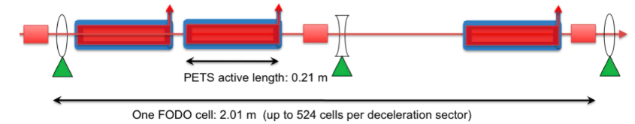
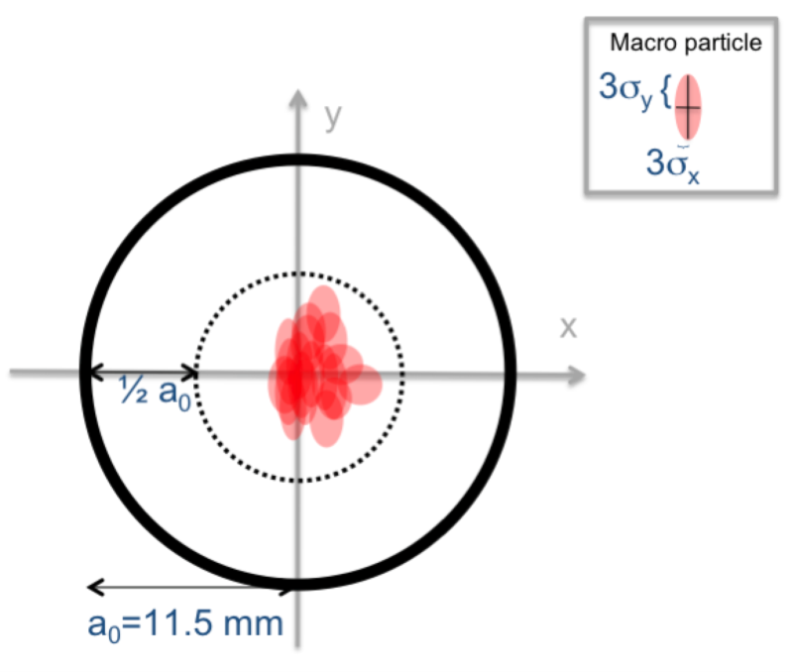
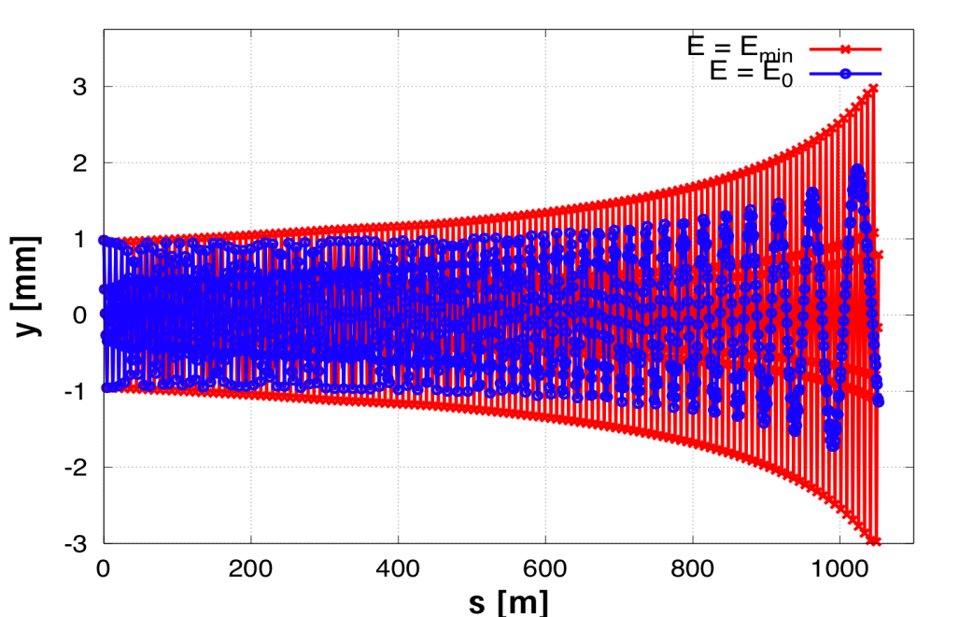
Decelerator beam transport
ERIK’s talk
Uniform power production implies that the beam must be transported to the end with very small losses (< 1 % level). We require robust transport of the entire beam through the ~1 km decelerator sectors.
PLACET simulations are the main tool for the decelerator studies.
Simulation criterion:
3σ of all beam slices < ½ aperture (5.8 mm)
Beam transport along lattice, for ideal injection into a perfect machine : minimum envelope ~ 3 mm

Slide 34
Conclusions
FMS and TA Layout and first order optics defined
2° order chromaticity compensation in CR1 and CR2 satisfactory for nominal beam energy spread
Rf deflector main parameters defined taking into account beam loading simulations
Optimisation of injection bump in progress
Start to end simulations in progress
CSR computation tools
Start to end from Linac + FMS + TA + Decelerator needed
Misalignment and field error tolerances, correction schemes, diagnostics to be defined.

