Slide 1
Beam Physics Studies
D. Schulte for the CLIC Beam Physics Team
CLIC Workshop 2009

Slide 2
Introduction
Theory and simulations
  Modelling of the machine, the imperfections and mitigation techniques
  Benchmarking
System design
  Lattice
  Hardware specifications
  Instabilities and losses
  Mitigation of imperfections
Main beam emittance target (multi-pulse)
  Damping ring exit: ε_{y} ≤ 5nm, ε_{x} ≤ 500nm
  Ring to main linac exit: ε_{y} ≤ 10nm, ε_{x} ≤ 600nm
  Main linac exit: ε_{y} ≤ 20nm, ε_{x} ≤ 660nm
  Beam is not Gaussian at IP
For drive beam integrated studies to show little losses, simplified drive beam emittance target
  100μm at injector
  150μm at entrance of decelerator
Interaction region and drive beam decelerator are covered in the next presentations
I can only show a selection of the most important results and will have to rush
  Much work will not be included here

Slide 3
CLIC Main Beam Injector Complex in 2009
L. Rinolfi et al.
IP
e⁺ Main Linac
e⁻ Main Linac
e⁻ BC2
12 GHz
e⁺ BC2
12 GHz
9 GeV
48 km
3 TeV
Base line configuration
Booster Linac
6.14 GeV
4 GHz
4 GHz
e⁺ BC1
e⁻ BC1
4 GHz
2.86 GeV
2.86 GeV
e⁺ DR
e⁻ DR
unpolarized e⁺
polarized e⁻
e⁺ PDR
e⁻ PDR
2.86 GeV
2.86 GeV
Spin rotator
Injector Linac
2.66 GeV
2 GHz
Primary beam
Linac for e⁻
5 GeV
e⁻/γ
Target
γ/e⁺
Target
Pre-injector
Linac for e⁺
200 MeV
Pre-injector
Linac for e⁻
200 MeV
Laser
DC gun
Polarized e⁻
e⁻ gun
2 GHz
AMD
2 GHz
2 GHz
J. Clarke WG 2, S. Riemann WG 2 L. Rinolfi WG 2

Slide 4
Main Beam Injectors
Electron source:
Gun experiments at JLAB (M. Poelker, WG2) and SLAC (J. Sheppard, WG2). Simulations of a bunching system done up to 20 MeV. Full injector to be demonstrated after 2010. The (double) charge for 500 GeV remains to be investigated.
O. Mete, M. Petrarca WG 2
Positron source (Unpolarized):
No lattice yet for the 5 GeV primary linac
Simulations for e⁺ hybrid targets promising for 3TeV (O. Dadoun, WG2) Lattice and RF capture done for the Pre-Injector Linac at 200 MeV (F. Poirier, A. Vivoli, WG2)
Positron source (Polarized):
Compton Ring simulations underway for a design at 1 GeV (E. Bulyak) Study for an ERL source and 2 Storage Rings at 1 GeV after the target (A. Variola, T. Omori, L. Rinolfi, WG2)
Study for a Compton Linac at 6 GeV (V. Yakimenko WG 2) Study for an undulator at 250 GeV (W. Gai, W. Liu, I. Bailey, L. Zang, WG2)
Injector Linac
Previously done: Injector Linac up to 2.4 GeV (A. Ferrari, A. Latina, L. Rinolfi) Spin rotators not covered.

Slide 5
Collaborations for the CLIC Main Beam Injector Complex
Alphabetic order for countries
Countries | Institutes | Contact person | Collaborators | Subject
France | LAL | A. Variola | O. Dadoun, F. Poirier | e⁺ studies
France | IPNL | R. Chehab | X. Artru, V. Stakhovenko | Channeling studies
Germany | FZR Rossendorf | J. Teichert |  | Compton sources
Japan | Hiroshima Uni. | M. Kuriki | T. Takahashi | Experiments at KEKB
Japan | KEK | T. Omori |  | e⁺ studies
Japan | KEK | J. Urakawa | T. Kamitani | R&D on targets systems
Turkey | Uludag University | A.Kenan Çiftçi | E. Eroglu, E. Pilicer, I.Tapan | FLUKA simulations
Ukraine | Kharkov Institute | E. Bulyak | P. Gladkikh | Compton Rings
United Kingdom | Cockcroft Institute | J. Clarke | I. Bailey, L. Zang | e⁺ studies
USA | ANL | W. Gai | W. Liu | Undulator e⁺ studies
USA | BNL | V. Yakimenko | I. Pogorelski | Compton Linac
USA | JLAB | M. Poelker |  | Polarized e-
USA | SLAC | J. Sheppard | A. Brachmann, T. Maryama, F. Zhou | Polarized e-

Slide 6
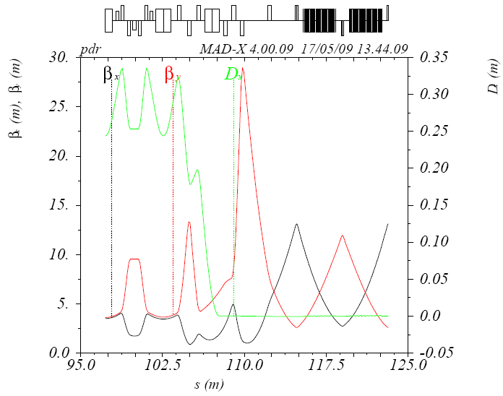
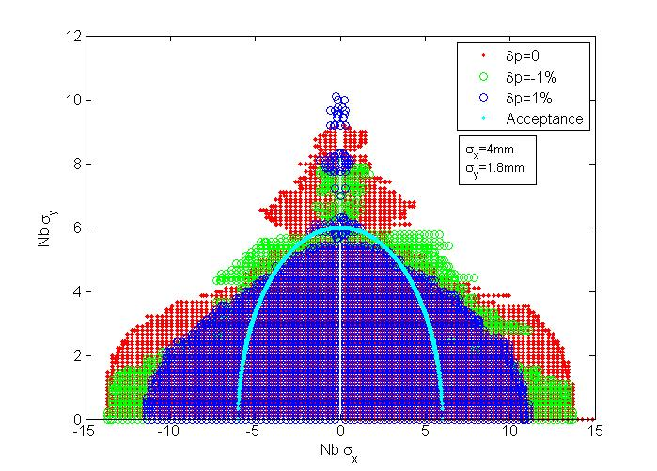
Pre-Damping Ring Design
F. Antoniou, et al., 2009, WG2
Injected Parameters | e⁻ | e⁺
Bunch population [10⁹] | 4.4 | 6.4
Bunch length [mm] | 1 | 10
Energy Spread [%] | 0.1 | 8
Hor.,Ver Norm. emittance [nm] | 100 x 10³ | 7 x 10⁶
Main challenge: Large input emittances especially for positrons to be damped by several orders of magnitude
Design optimization following analytical parameterization of TME cells
Target emittance reached with the help of conventional high-field wigglers (PETRA3)
Non linear optimization based on phase advance scan (minimization of resonance driving terms and tune-shift with amplitude)
F. Antoniou WG 2

Slide 7
New DR Parameters and Design
Lattice version | Original | New
Energy [GeV] | 2.42 | 2.86
Circumference [m] | 365.21 | 493.05
Coupling | 0.0013
Energy loss/turn [Me] | 3.86 | 5.8
RF voltage [MV] | 5.0 | 7.4
Natural chromaticity x / y | -103 / -136 | -149 / -79
Compaction factor | 8E-05 | 6e-5
Damping time x / s [ms] | 1.53 / 0.76 | 1.6 / 0.8
Dynamic aperture x / y [σ_{inj}] | ±3.5 / 6 | ±12 / 50
Number of arc cells | 100
Number of wigglers | 76
Cell /dipole length [m] | 1.729/0.545 | 2.30 / 0.4
Bend field [T] | 0.93 | 1.27
Bend gradient [1/m²] | 0 | -1.10
Max. Quad. gradient [T/m] | 220 | 60.3
Max. Sext. strength [T/m² 10³] | 80 | 6.6
Phase advance x / z | 0.58 / 0.25 | 0.44/0.05
Bunch population, [10⁹] | 4.1
IBS growth factor | 5.4 | 1.5
Hor. Norm. Emittance [nm.rad] | 470 | 390
Ver. Norm. Emittance [nm.rad] | 4.3 | 4.9
Bunch length [mm] | 1.4 | 1.4
Longitudinal emittance [keVm] | 3.5 | 3.8
New DR increased circumference by 30% and energy by 20%
DA significantly increased
Magnet strength reduced to reasonable levels (magnet models already studied)
Combined function bend increases significantly vertical beta on dipoles
TME optics modification and energy increase reduces IBS growth factor to 1.5 (as compared to 5.4)
Further optimization with respect to IBS (F. Antoniou PhD thesis)
Y. Papaphilppou et al. WG 2

Slide 8
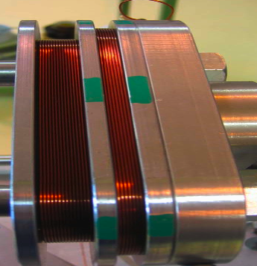
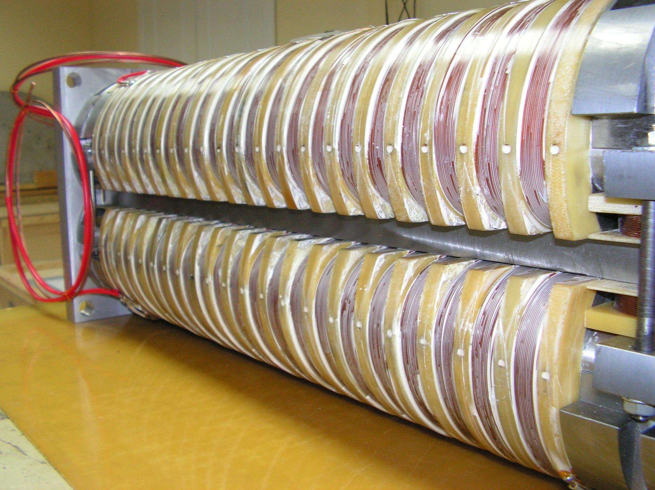
Wigglers Effect with IBS
Collaboration BINP – CERN – Un. Karlsruhe/ANKA
Stronger wiggler fields and shorter wavelengths necessary to reach target emittance due to strong IBS effect
Two wiggler prototypes
  2.5T, 5cm period, built and currently tested by BINP
  2.8T, 4cm period, designed by CERN/Un. Karlsruhe
Current density can be increased by using different conductor type
Prototypes built and magnetically tested (at least one by CDR)
Installed in a storage ring (ANKA, CESR-TA, ATF) for beam measurements (IBS/wiggler dominated regime)
Major DR performance item
K. Zolotarev WG 2, R. Maccaferri WG 2,
S. Bettoni & D. Schoerling WG 2

Slide 9
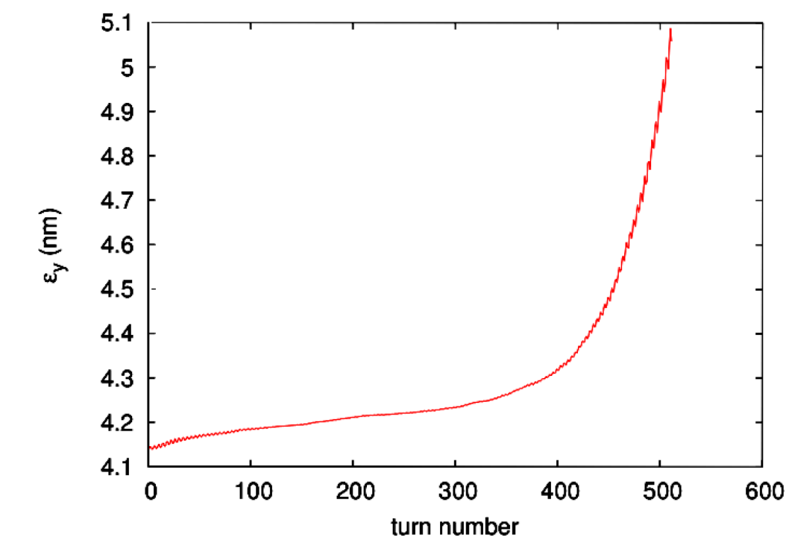
Collective Effects in the DR
Electron cloud in the e⁺ DR
  SEY below 1.3
  99.9% of synchrotron radiation must be absorbed in the wigglers
  Cured with special chamber coatings (amorphous C chamber tested in CESR-TA)
Fast ion instability in e⁻ DR
  vacuum pressure of 0.1nTorr
Other collective effects in DR
  Space charge (large vertical tune spread of 0.19 and 10% emittance growth)
  Single bunch instabilities avoided with smooth impedance design (a few Ohms in longitudinal and MOhms in transverse are acceptable for stability)
  Resistive wall coupled bunch controlled with feedback (1ms rise time)
G. Rumolo et al., EPAC08
Chambers | PEY | SEY | ρ [10¹² e⁻/m³]
Dipole | 0.000576 | 1.3 | 0.04
 |  | 1.8 | 2
 | 0.0576 | 1.3 | 7
 |  | 1.8 | 40
Wiggler | 0.00109 | 1.3 | 0.6
 | 0.109 | 1.3 | 45
 |  | 1.5 | 70
 |  | 1.8 | 80
ρ_{wig} = 5x10¹² m⁻³, ρ_{dip} = 3x10¹¹ m⁻³
J. Crittenden WG 2, M. Taborelli WG 2,
G. Rumolo WG 2
Notes:
9

Slide 10


Intra-Beam Scattering
A. Vivoli, M. Martini, WG 5
Multiple Coulomb scattering in a bunch
Important uncertainty of emittance in damping ring
Evolution of the emittance:
WITH IBS
NO IBS
IBS
Radiation Damping
Quantum Excitation
Energy [GeV]
SIRE: IBS calculated with the Zenkevich-Bolshakov algorithm (from MOCAC)
Damping und simplified quantum excitation added

Slide 11
Other Damping Ring Issues
Y. Papaphilippou et al
RF system present challenges with respect to transients and power source
Stability of kickers tight but similar as for ILC, light sources (D. Alisini WG 2, M. Barnes WG 2)
Beam instrumentation wish-list and crude specs established
Scaled design of DR for CLIC @ 500GeV produced
Formed group on CLIC/ILC common issues for DR (e-cloud and low emittance tuning)
Y. Papaphilippou WG 2, S. Guiducce WG 5, K. Zolotarev WG 5

Slide 12
Ring to Main Linac Transport System (RTML)
F. Stulle et al. WG 3
BC2 RF and Chicane
IP
Main Linac
Spin Rotator
Long Transfer Line
Vertical Transfer
Return arc
Turn Around Loop
Booster Linac
BC1 RF and Chicane
Damping Rings
not shown: Diagnostics, Collimation, Dispersion Correction, Coupling Correction, Spectrometers and Dumps

Slide 13
RTML (cont.)
• RTML @CLIC500,
requirements evaluated and decided to use same as nominal RTML
  Bunch compression system, i.e. BC1 and BC2,
  lattice existing, optimized to reduce RF wake fields and CSR
• Booster Linac,
lattice existing, optimized with respect to wake fields (D. Wang, IHEP Beijing)
• Vertical transfer and return arc (K. Zengin?, Ankara University)
• Long transfer line, lattice created
• Turn around loop, lattice existing, revised due to beam dynamics issues
• Spin rotator, still open (N. Solyak, A. Latina?)
  Diagnostics sections, matching sections, collimation sections
• Simplified lattices for integrated studies available
  Tolerance and misalignment studies (S. Malloy, RHUL)
  Phase feedback concept
  People are missing

Slide 14
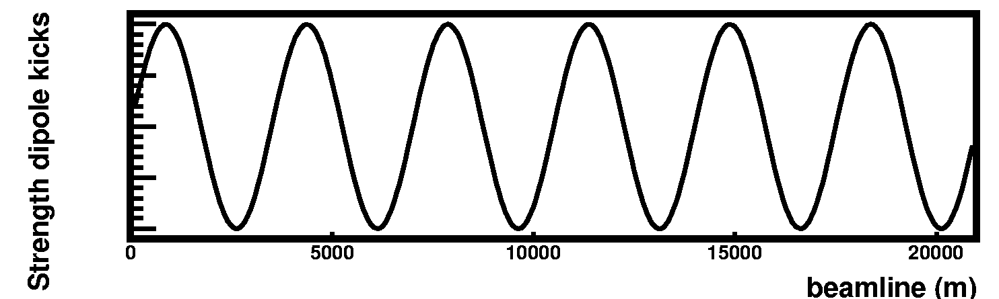
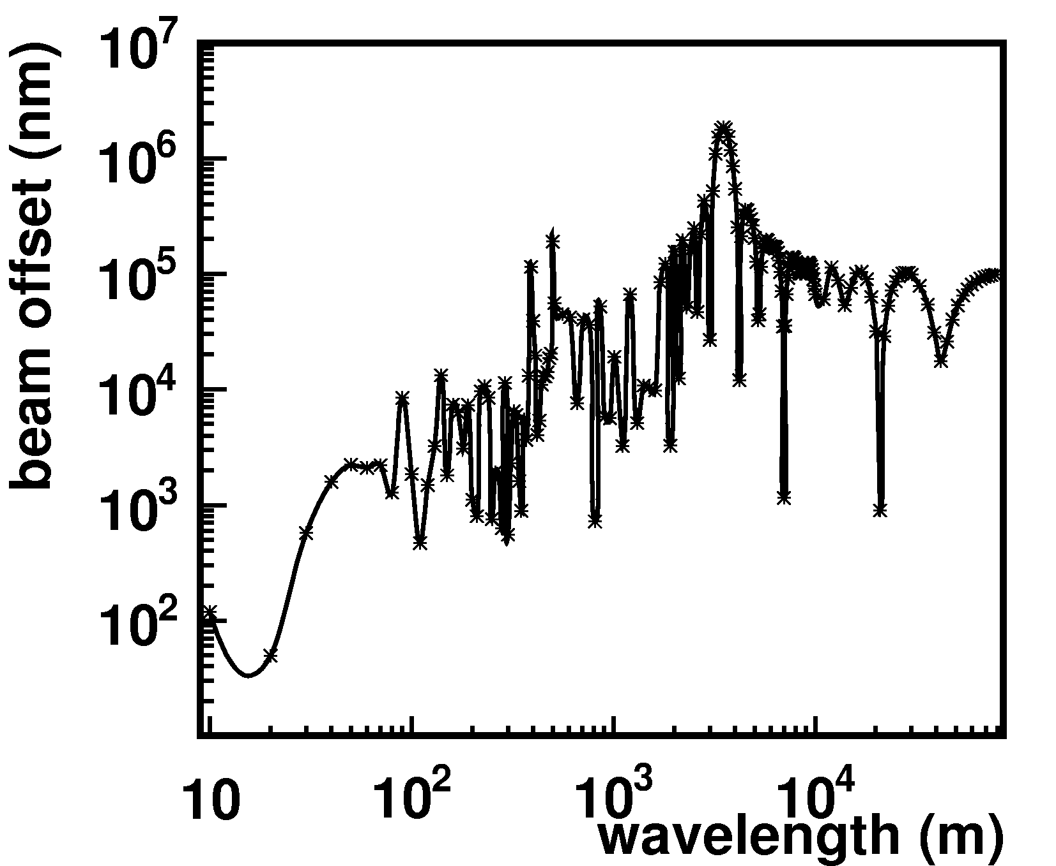
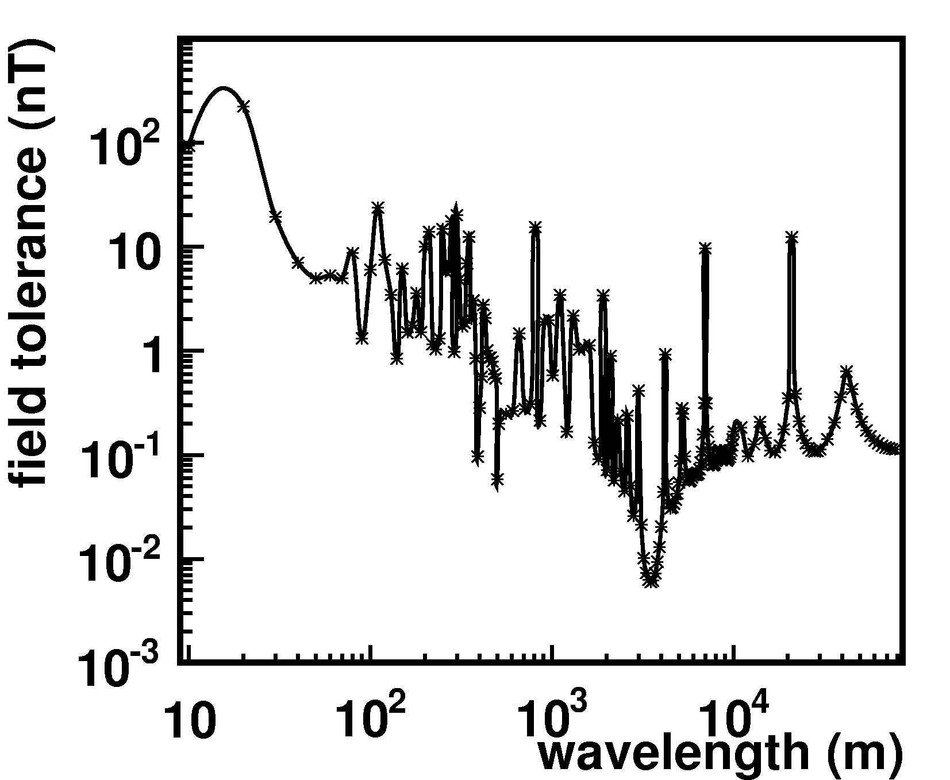
Stray Fields in RTML
J. Snuverink, B. Jeanneret
Simulated by grid of
dipole kickers with
1m distance
See also C. Jach, WG3
Tolerance beam offset:
10% of geometrical emittance
Started to collaborate with FNAL on measurements

Slide 15
Main Linac Pre-Alignment
Prealignment tolerances are tight due to strong focusing -> high bunch charge -> high efficiency
Simulations of reference line determination with wires by T. Touze (contains only long-range misalignments)
Files are loaded into PLACET and full beam-based correction performed
Impact on beam emittance is small
  wire sensor resolution is relevant
  number of pits for alignment with differential GPS is not important
More studies to be done with improved wire modelling
See also S. Guillaume WG 3, T. Touze WG 5, H. Mainaud Durand WG 5

Slide 16
Main Linac Static Imperfections
K. Kubo
Main linac predictions for emittance growth have been updated
  Detailed definition of pre-alignment procedure
  simulations of beam-based alignment
Benchmarking of main linac results is ongoing
  agreement seems good

Slide 17
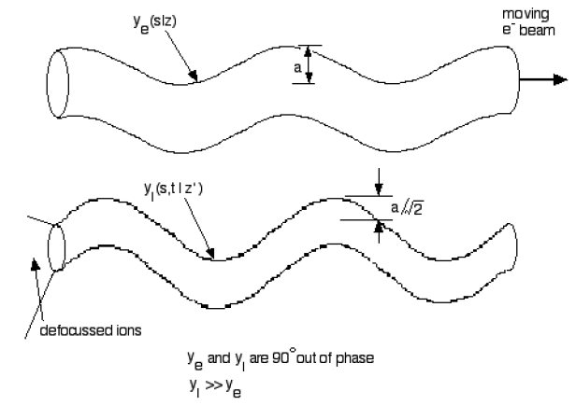
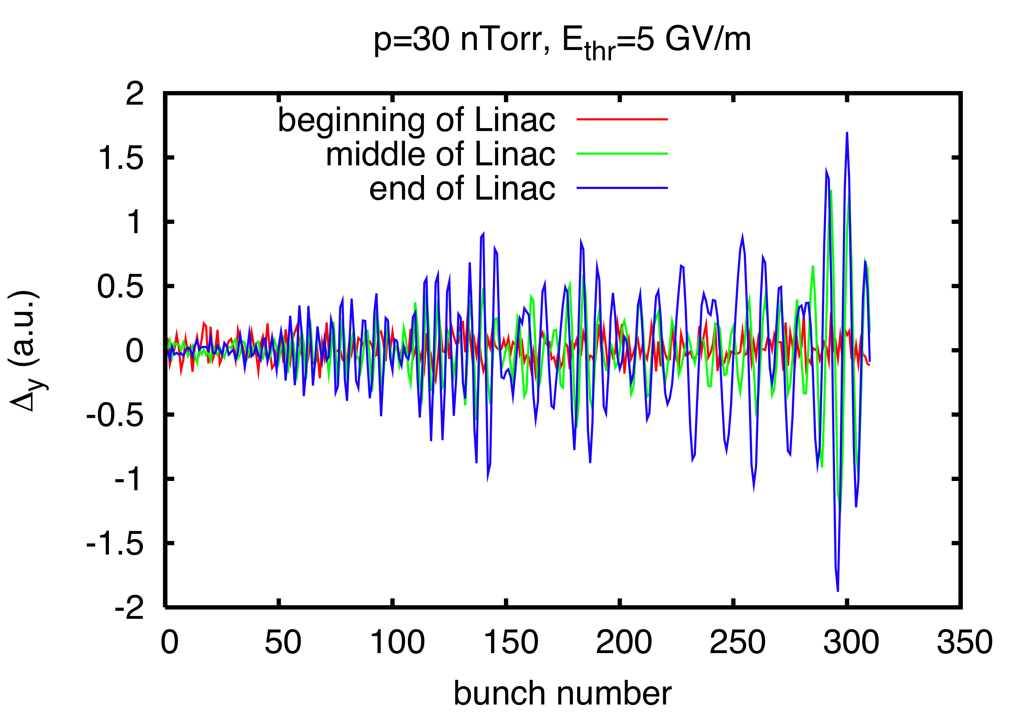
Fast Ion Instability in the CLIC Main Linac
Ions from rest gas can be trapped in the beam and can yield multi-bunch instability
  Save value is 0.1nTorr
  Can be done but difficult in main linac
Studies with new FASTION code
Scattering ionization:
  CO, CO₂, H₂O vacuum pressure of 50nTorr is on the limit
  we specify 10nTorr
Field ionization: simplified model implemented
  Pressure needs to be reduced by a factor 2 (see right)
  Need improved model
  Vacuum specification may change
See G. Rumolo WG 2, 3 and 4

Slide 18
326 klystrons
33 MW, 139 μs
326 klystrons
33 MW, 139 μs
drive beam accelerator
2.38 GeV, 1.0 GHz
combiner rings
Circumferences
delay loop 72.4 m
CR1 144.8 m
CR2 434.3 m
drive beam accelerator
2.38 GeV, 1.0 GHz
1 km
1 km
delay
loop
delay
loop
CR2
CR2
CR1
CR1
decelerator, 24 sectors of 868 m
BDS
2.75 km
BDS
2.75 km
e⁻ main linac , 12 GHz, 100 MV/m, 20.85
km
IP1
e⁺ main linac
Drive beam injector, no design
Drive beam accelerator, in work
Bunch compression system, to come
Delay loop, in work
1rst combiner ring, advanced
2nd combiner ring, optimisation needed
Tranfer to tunnel
Long transfer line
Turn-around, improvements needed
Decelerator
Extraction
Phase feedback system
Longitudinal dynamics
Imperfections
People are missing

Slide 19
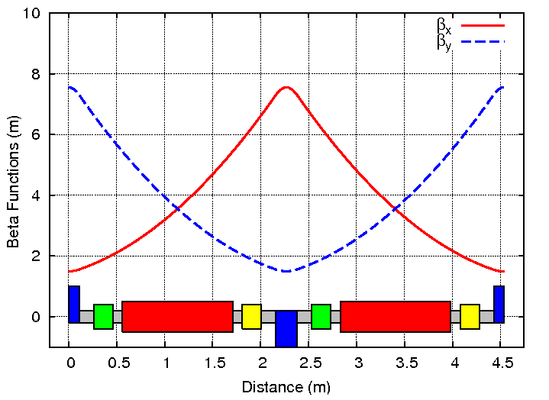
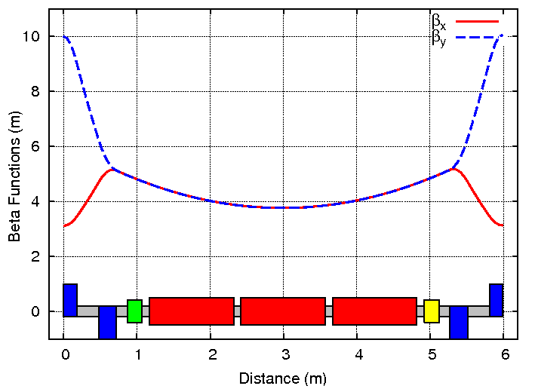
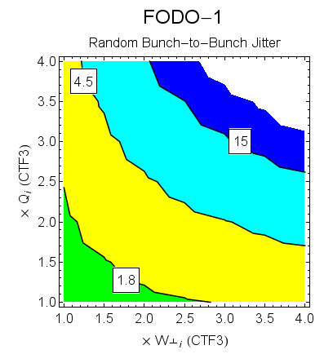
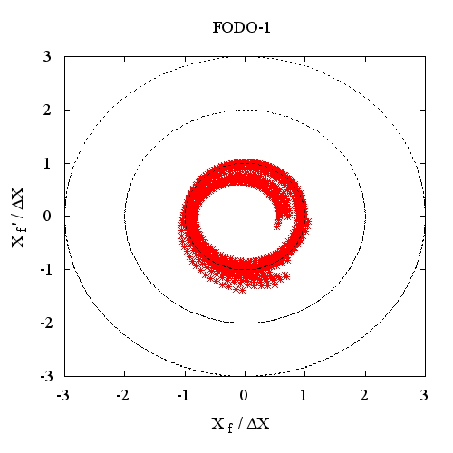
Drive Beam Linac Design
Avni Aksoy WG 3
Requires close interaction of RF (R. Wegner, E. Jensen et al.) and linac design
Strong coupling of longitudinal and transverse requirements
Last Design made many years ago for different parameters
Important design activity that is starting again
First put the tools into place
4 different type of lattices are taken into account

Slide 20
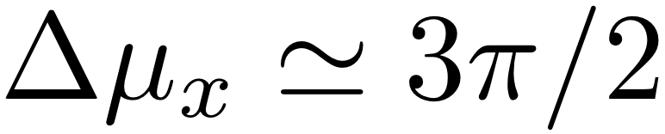
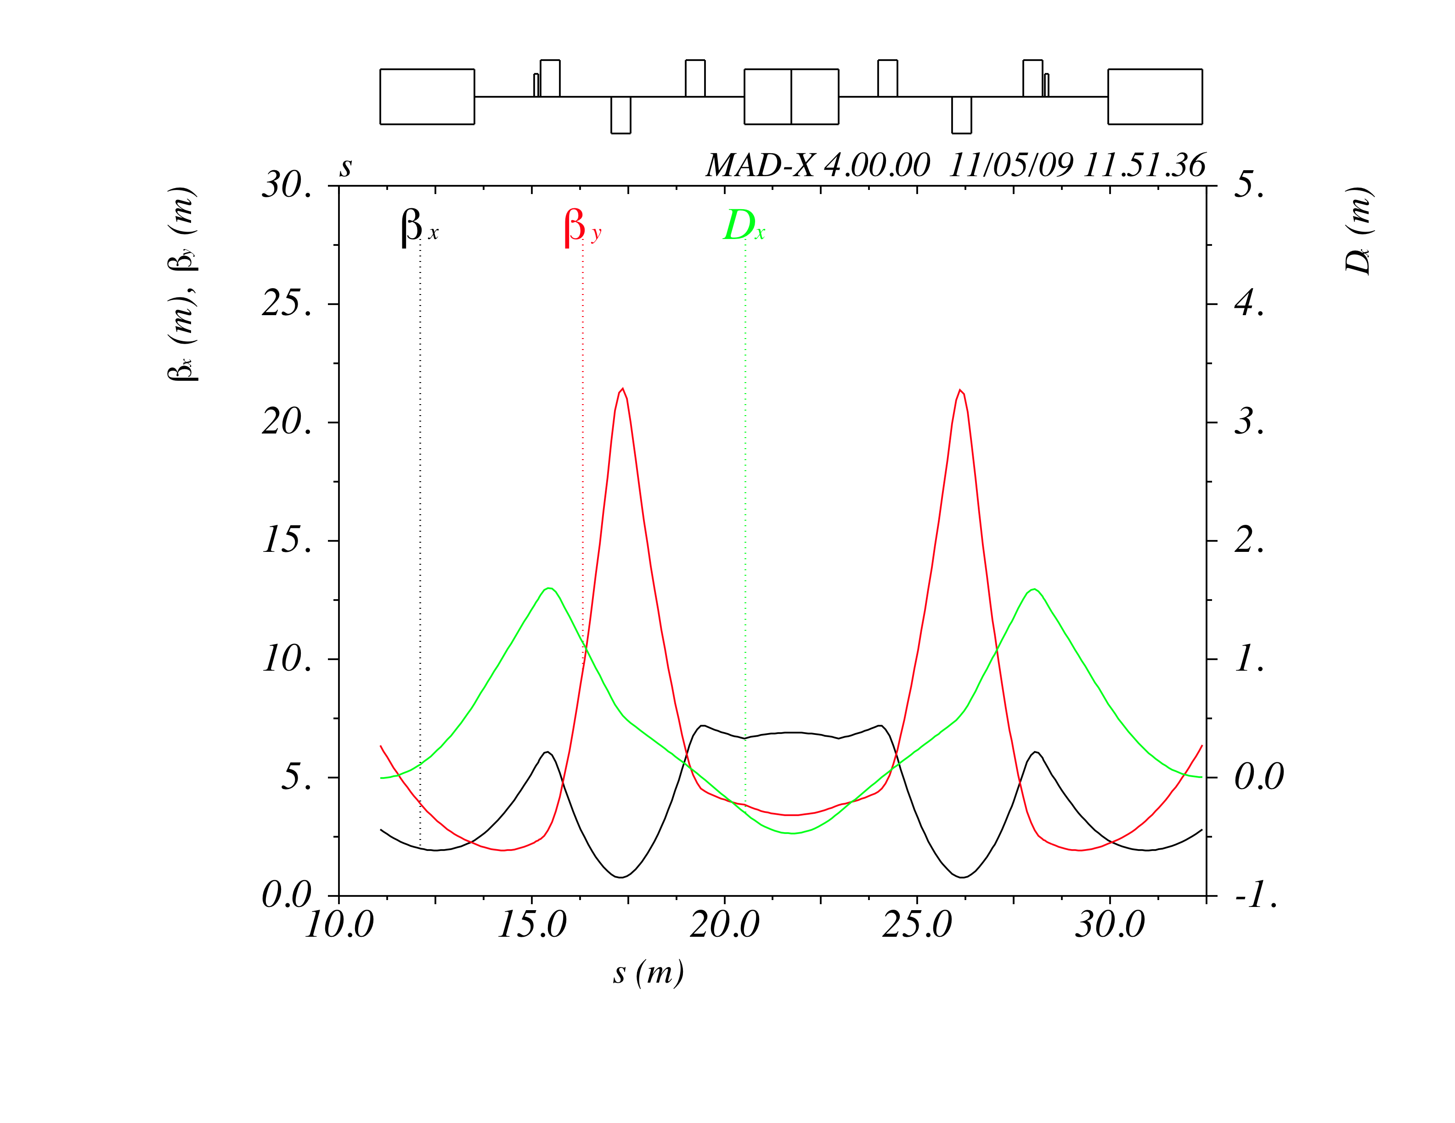
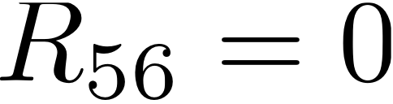
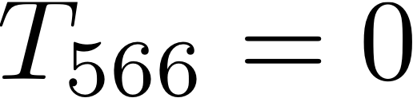
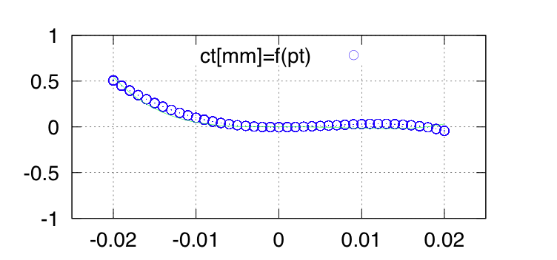
CR1 Arc Cell
C. Biscari, B. Jeanneret PAC09
Dipoles and Quad-triplet :
Sextupoles : this optics allows one family :
With good cancellation of
geometric abberations and
Q’_{x} = -2 OK, Q’_{y} = -13 barely OK
But remains a quite large
3rd order δ_{p}- path length error :
More work , either:
Run off-momentum
more flexible lattice
Smaller δ_{p}- band
…
3-turn tracking

Slide 21
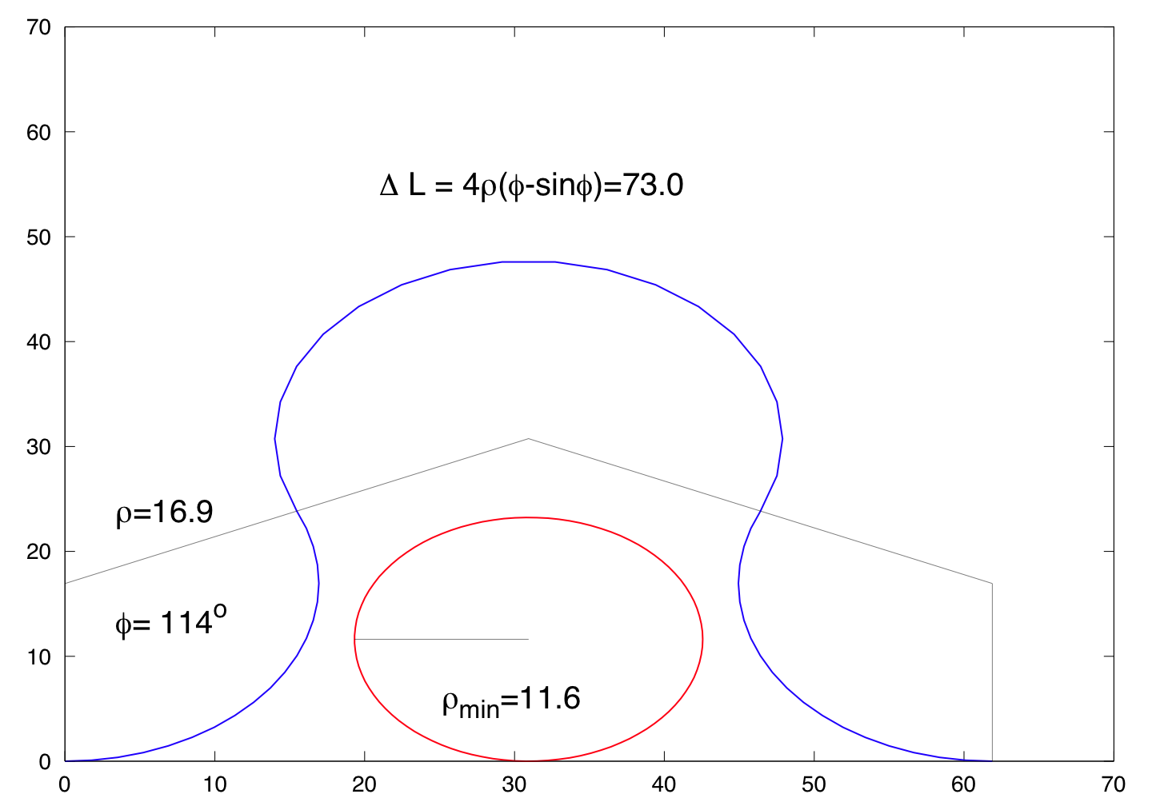
Delay Line and Turn-Around
C. Biscari, B. Jeanneret, F. Stulle
Turn-around : Present length L=80m does not allow adequate chromatic correction in the transverse plane
→ length must grow to L_{TA} ≅ L_{CR1} = 146m
Delay line : Presently : Layout is a ring
  Constraint : L_{DL} = 73 m (beam train length)
  As with TA : transverse chromatic effects
  SAME CURE :
    longer length , with ΔL_{DL} = 73 m
Go to a ‘Ω’ – shape :
L_{loop} = 135m
L_{straight} = 62 m
Ω – shape :
- 2 variables : ρ and ϕ
- 1 constraint ΔL_{DL}
From Linac
To CR1

Slide 22
Dynamic Imperfections and Feedback
Dynamic imperfections are an important concern of CLIC
  The direct luminosity loss
  Difficult to tune a machine that is moving all the time

Slide 23
RF Phase Jitter
Drive beam phase and current tolerance in decelerator
  Luminosity loss due to main beam (0.2° and 0.075% per fill time)
  Drive beam losses (approx 0.2% fluctuation bunch to bunch for 10 sigma)
  CTF3 shows about 0.1% current stability
D.S. & R.Tomas
Tolerance before feed-forward
Assume phase noise reduction by factor 10
Required capture range 10°=0.7mm
Charge tolerance unchanged
Need
Timing reference (J. Sladen et al., need more)
Feedback design
Phase monitor (EUCARD)
Kickers and amplifiers (Phil Burrows et al.)
F. Stulle
See talks this workshop :
WG3 : M. Felber, O.Ilday, V. Arsov, F. Stulle
WG5 : A. Anderson, B.Jeanneret

Slide 24
Drive Beam Phase Stabilization
Final Re-compression,
Phase Correction
PETS
DBA 2
First Re-compression,
Phase and Energy
Measurement
CR
Uncompression
Final compression,
Phase Correction
DBA 1
Gun
First Compression,
Phase and Energy
Measurement
Example of conceptual simple design of drive beam compression system
  Gradient tolerance 0.5 10⁻⁴
  Current tolerance 10⁻³
  Phase tolerance 0.2°
Need to choose conceptual design and make full design
Have to optimise for feed-forward or feedback between DBA1 and DBA 2
Tradeoff between different jitter sources
klystron phase and amplitude, beam phase and intensity

Slide 25
More Phase Stabilization
Other sources of phase noise need to be investigated
e.g. magnet strength jitter
Energy jitter from booster linac is a concern
Main beam phase tolerance in ML 0.1°
Can be addressed by using two-stage compression system (as proposed for drive beam CLIC-Note-598)
This system can be tuned to decouple final phase from initial energy
But still can get compression
F. Stulle, WG 3
Realistic system needs to be investigated (non-linearities)

Slide 26
Orbit Stability and Feedback
Orbit stability is a concern for the main beam
Ground motion, technical noise, dynamic stray fields, RF jitter etc.
Integrated study is essential
Open issue for RTML
Main linac feedback system defined
Some simplified studies for BDS feedback system
Some work on beam-beam feedback
Some work on intra-pulse feedback
Close collaboration with stabilisation working group (C. Colette, B. Bolzon et al.) layers of feedback
Feedbacks help at some frequencies but do harm at others
Optimal control required
But uncertainty of system knowledge is important

Slide 27
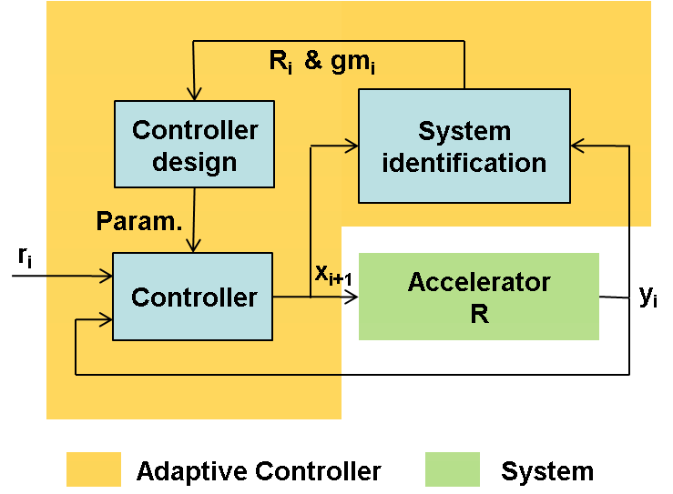
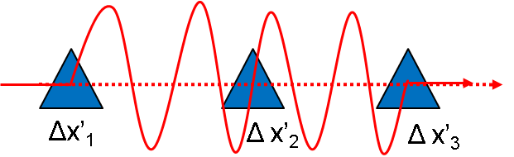
Progress of the Beam-Based Feedback
J. Pfingstner, WG 5
Adaptive control:
Previous approaches balance very well noise and correction speed.
However, system changes are not taken into account.
Adaptive controller scheme (STR)
Just parts of R can be estimated. Rest has to be interpolated
Transient Landau damping model
- Algorithm to calculate phase advance from BPM/R data

Slide 28
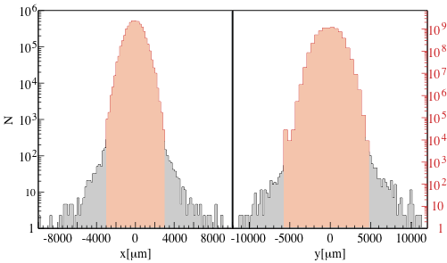
Halo and Tail HTGEN
HTGEN : code repository, standalone + fully integrated in PLACET
all relevant information and manual on http://hbu.home.cern.ch/hbu/HTGEN.html
2009 : major upgrade and rewrite of the HTGEN-PLACET interface
now allows halo generation for sliced beams
by Miriam Fitterer, Erik Adli, Barbara Dalena, Helmut Burkhardt
x
y
in addition to LINAC and BDS
now possible to apply halo generation to the CLIC drive beam
core
core
halo
halo
Plans:
Revisit muon background
Benchmarking at CTF3
Hep needed
Transverse profiles at the end of the CLIC decelerator
for 10 nTorr rest gas
Only 10⁻⁷ of the particles are lost
H. Burkhardt, WG3

Slide 29
PLACET Main Updates
Improvements of existing routines and documentation:
  Benchmarking of tracking in post collision line with DIMAD (I. Ahmed A. Ferrari)
  Benchmarking of bunch compressor with ELEGANT (F. Stulle)
  Output files and routines improved (header, columns) (A, Latina, J. Pfingstner, B. Dalena)
  Documentation, last update 9th April 2009 (B. Dalena)
  Placet_BC2_Example in the distributed version ( F. Stulle )
Improved modelling and interface
  Collimator wakefield fixed (B. Dalena-J. Snuverink) and A. Toader wakefield method added (B. Dalena)
  Command PhaseAdvance (J. Pfingstner)
  TestRFAlignment and 6d transport matrixes (A. Latina)
  Girder pitch optimization (ILC), placet-octave (A. Latina)
  RF-kick and wakefield kicks from couplers (ILC) (A. Latina)
  Tracking of the halo particles in PETS and Cavity, interface improved (M. Fitterer, H. Burkhardt)
  Tracking in solenoid field exists as stand-alone program, integration is ongoing (B. Dalena)
Other improvements and bug fixes
  Placet-htgen-octave binary (B. Dalena)
  AML interface (A. Latina)
  Placet-development and placet-htgen makefile separated (B. Dalena)
  Fixed gcc compiler warning (J. Snuverink)

Slide 30
Conclusion
Many topics left unmentioned, e.g.
  BDS and drive beam decelerator come next
  Participation into definition of 500GeV machine(s)
  Parameter specifications, contributions to costing and system optimisation
  Luminosity spectrum and background studies (WG 1+3)
  Multi-bunch studies (e.g. resistive wall …)
  Contributions to machine protection (mainly future see M. Jonker et al. WG 5)
  Running the 3TeV version of CLIC at lower energies (WG 1+3)
  Finalisation of EUROTeV
  ILC collaboration not detailed
Excellent progress after last workshop
A number of outstanding issues
  Tough to address them all before end of 2010
Excellent team
  But too few people
    Continued work in all areas
    Full drive beam design
    Full RTML design
    Phase feedback
    Integrated orbit feedback
  You are invited to join

Slide 31
software availability
In /afs/cern.ch/eng/sl/clic-code/software:
bin
env.csh
env.sh
gp
gsl-1.9
htgen
octave-3.0.1
placet-development
placetinstaller
repository
binary: guinea, placet-htgen, placet-development, placet-octave, placet-htgen-octave, grid, ground, mad2gp
To set up the enviroment
Guinea-Pig compiled with fftw-2.1.5
GSL library version 1.9
https://savannah.cern.ch/cvs/?group=htgen
Octave library version 3.0.1
latest version of placet
Placet/GSL/Octave/Htgen installer
Placet, GSL, Octave tarball
All the binary are exported in your $PATH by typing: #> source /afs/cern.ch/eng/sl/clic-code/software/env.(c)sh on your desk at CERN
Latest PLACET and GUINEA-PIG tarball can be download by this web site: http://project-placet.web.cern.ch/project-placet/
The head version can be downloaded from CVS PLACET repository https://savannah.cern.ch/projects/placet/

Slide 32
Halo and Tail HTGEN (cont.)
Plans :
Revisit muon background
check the need for muon stoppers / tunnel fillers
question of betatron / momentum collimation first
combined study HTGEN + PLACET + BDSIM
Looking for help / collaboration --> more details, talk by H.B. on Wednesday.
Benchmarking with CTF3 measurements, collaboration with MPI HD
Recent HTGEN related references :
PAC 2009, Halo and Tail Simulations with Application to the CLIC Drive Beam, M. Fitterer et al. WE6PFP085
PRSTAB 12.081001 Agapov et al., Tracking studies of the Compact Linear Collider collimation system
Miriam Fitterer Diploma Thesis, University of Karlsruhe, Sept. 2009
Modelling of Halo and Tail Generation in Electron Beams

