Slide 1
Very Forward Region and
Beam-Beam-Background
André Sailer (CERN-PH-LCD)
CLIC09: MDI/Physics&Detectors
October 14, 2009

Slide 2
Content
Beam-Beam-Background Simulations
Forward Region of a CLIC Detector
Background in the Vertex Detector
Summary and Conclusions

Slide 3
Beam-Beam-Background
See Barbara’s Talk for Beam-Beam-Effect etc.
This Talk: Full Detector Simulation (Geant4, Mokka) with Beam-Beam-Background
  Considering only incoherent Pairs: ≈3*10⁵ /BX
  10 BX for some statistics
What is the Background in the Detector?
  Focus on the Vertex Detector
    But must take the rest of the Detector into account
  How do Changes in the Forward Region affect Background levels
  How can Background be reduced

Slide 4
CLIC_ILD: Vertex and Forward Trackers
Vertex Detector: 3 double Layers of Silicon Sensors
  At: 31, 46, 60 mm Radius, each 25 cm long (Z=±12.5cm)
Forward Tracking: 7 Disks
  Inner Radius: Beam pipe
  Outer Radius: ~30 cm (For last 5 Disks)
Beam pipe: Conical shape up to LumiCal
LumiCal
60 cm
0.0 m
2.5 m

Slide 5
Vertex Detector
3 Double Layers
In Z from -12.5 to +12.5 cm
R = 31, 46, 60
50 micron Silicon
  Threshold: 3.4 keV
+ Electronics + Support

Slide 6
Forward Region of a CLIC Detector
LumiCal
BeamCal
Based on Forward Calorimetry for ILC (ILD)
LumiCal >= 40 mrad
BeamCal >= 10 mrad
Changes ILC→CLIC
  QD0 3.5 m (instead 3.9 m @ILC)
  Larger Opening for outgoing beam (Coherent Pairs)
  No Anti-DID, only 4T Solenoid Field
(Present Status)
Vacuum Tube
QD0
2.5 m
3.5 m

Slide 7
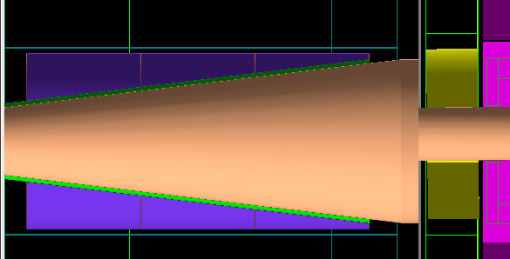
LumiCal
Silicon-Tungsten (Si-W) Sandwich Calorimeter
Counts Bhabha events to measure Luminosity
Centered on Outgoing Beam axis
Inner radius: 10 cm
  Incoherent Pairs
No material supposed to be between LumiCal and IP
LumiCal
60 cm
2.5 m
3.5 m
60 cm
Notes:
Picture of the Detector, or right away close up of the interesting parts, and a table detailing numbers, as well as the numbers for the SID like detector…

Slide 8
BeamCal
BeamCal
(with 10cm graphite)
(?)-Tungsten Sandwich Calorimeter
  Centered on outgoing beam pipe
  ≈3.5 cm inner radius
  Outer radius to complement LumiCal coverage (≈ 20 cm)
Dump for incoherent pairs
  Collision/Luminosity Monitoring?
Masking against back-scattering particles from post-collision line
Electron Veto for 2-Photon events
  Smaller inner radius desirable
60 cm
2.5 m
3.5 m
Side
Graphite – (?) - W
Front
Notes:
Picture of the Detector, or right away close up of the interesting parts, and a table detailing numbers, as well as the numbers for the SID like detector…

Slide 9
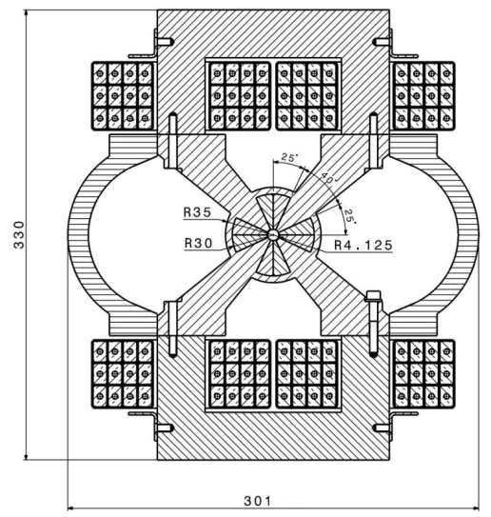
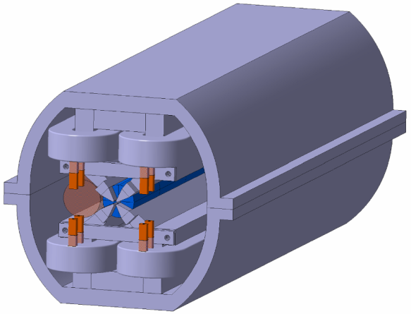
QD0
(See Talk by M. Modena)
QD0
R=35mm
QD0 Prototype
  33cm height
  Should fit into forward region
  How far do the coils extend beyond 3.5 m?
  Move BeamCal Forward
    Allow Space for Intra-Train-Feedback
60 cm
2.5 m
3.5 m
33 cm

Slide 10
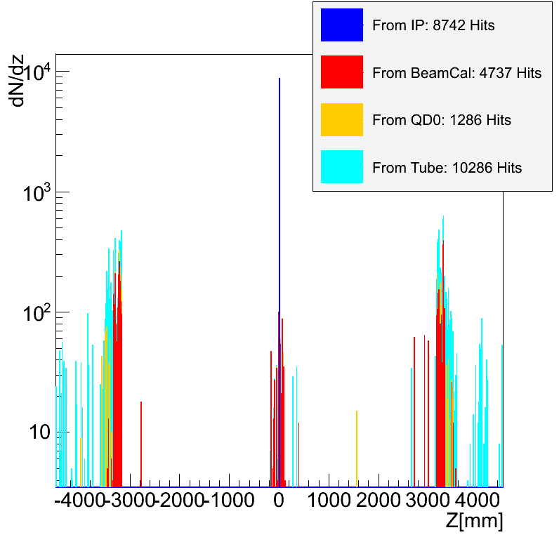
Background in the Vertex Detector (I)
Roughly 25k Hits in the VXD
One third directly from IP
  Reduce with higher B-Field
  Larger Inner Radius
5k from BeamCal
  Larger Inner Radius
10k from “Tube”
  Mostly back-scattering from behind/inside BeamCal
0.02 Hits /mm² /BX

Slide 11
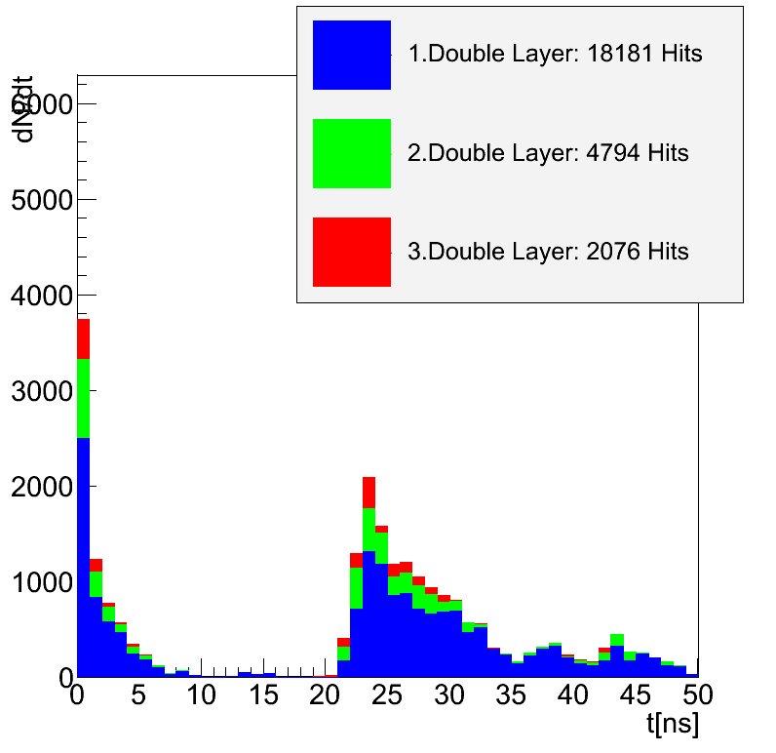
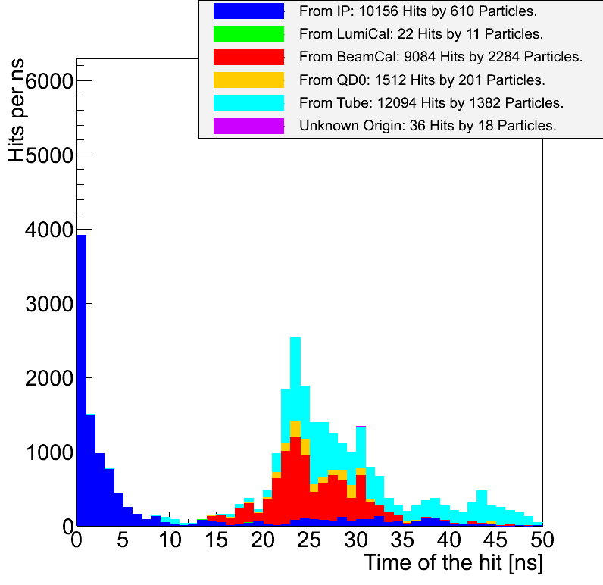
Background in the Vertex Detector (II)
Time separation between direct Hits and back-scattered Hits
As expected from time of flight
This is for Hits in all Detectors!

Slide 12
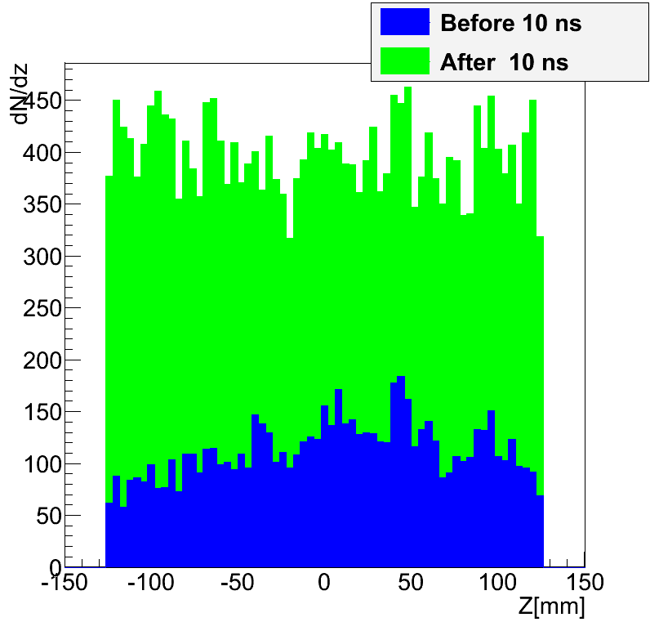
Background in the Vertex Detector (III)
Not touching envelope of Incoherent Pairs
Reduction in Length does not change hit density
  Reduces Tracking Coverage
Hit Distribution along Length of VXD

Slide 13
Background in the Vertex Detector (IV)
Hits in First Layer of Vertex Detector
  0.02 Hits per mm² /BX
  6 Hits per mm² /Train
  6 times higher than prior estimate (Barbara’s Talk)
Includes Back-scattered particles
Particles from IP hit VXD more than 3 times
Hits per BX similar to ILC (at smaller radius)

Slide 14
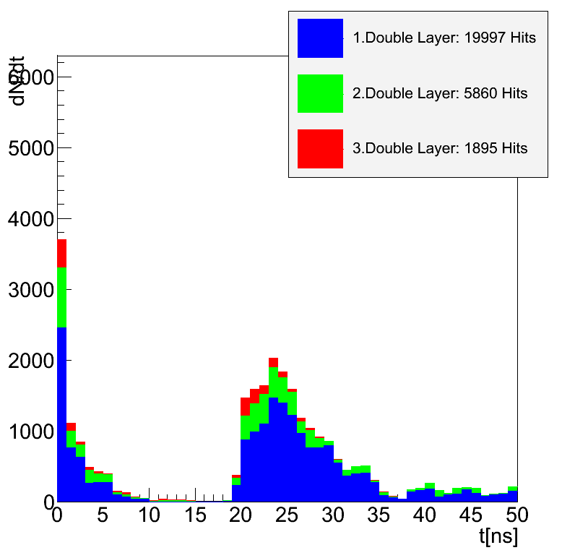
BeamCal closer to IP
Work done few days ago
Very preliminary
Moved BeamCal 30 cm closer to IP
  3.2 cm inner Radius (vs. 3.5 cm)
Make some Space for Intra-Train-Feedback
Larger Distance to QD0
10% more Hits in inner-most VXD Layer

Slide 15
Input from Beam Physics Team needed
What is the expected Bunch to Bunch fluctuation in Beam-Beam-Background?
  Expected Beam Offsets
  Simulate Full Bunch Train
Need this to understand Electron tagging efficiency of BeamCal
  Not only the deposited Energy is the issue, but also the fluctuations
Better estimation of Background in Detectors

Slide 16
Summary and Outlook
Using a fairly realistic Simulation of Forward Region
Simulated 10 BX of Incoherent Pairs
Large background in Vertex Detector (6Hits/mm²/Train)
Further Studies regarding Layout of Forward Region
  Add Intra-Train-Feedback System
  Better Model of QD0 Prototype
Simulate a full and realistic Bunch Train, including fluctuations

