Slide 1
Large Momentum Acceptance Superconducting and Permanent Magnet
Non-Scaling FFAG Gantries
Dr. Dejan Trbojevic
Brookhaven National Laboratory

Slide 2
OUTLINE:
- Requests and Challenges
- Introduction: NS-FFAG?
- Carbon Gantries
- Proposal to the DOE
- Summary: smaller, less weight, simpler, large δp/p
- Proton Gantries
- Permanent Magnet Gantry

Slide 3
INTRODUCTION
Future gantries for the ion cancer therapy need to have large momentum acceptance - longitudinal scanning - conclusions from the ion cancer workshop organized in January 2013, by NIH (US National Institute of Health), NCI (US-National Cancer Institute), DOE. Efforts should be put on: reducing the gantry cost, size, and complexity of operation.
Work on markers to be used for in city during the real time of treatment to provide information on ion-tumor interaction but also on the very low intensity beam measurements: precise dose, beam position, profile, and energy. There are some simple ideas at BNL of using the vacuum windows for determining the beam position, beam transverse profile and even the intensity (dose). For the reduction of size in both carbon or proton gantries the superconducting magnets are clearly needed. The larger the field the smaller the size.
S.A.D (Virtual–Source–to patient distance) without large magnets (Except the second scanner magnet still large 20 (30) cm aperture.

Slide 4
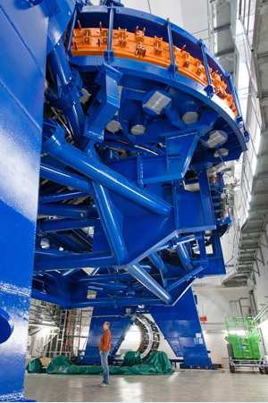
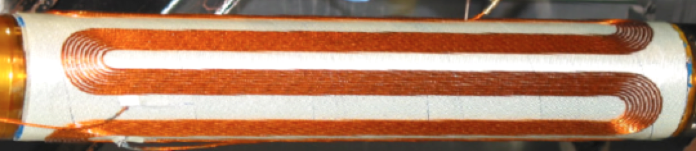
What is the OBJECTIVE?
- Reduce the size of the gantry
- Improve its performance
- Reduce the cost
- Allow large energy range
The NEW carbon ion gantry replaces the 135 ton magnets of the Heidelberg gantry with smaller BNL superconducting magnets.

Slide 5
Range of momentum = range kinetic energy
ΔE_{k carbon}=400-195.4 MeV/u [27.3-8.2 cm]
ΔE_{k carbon}=195.4-91.5 MeV/u [8.2–2.2 cm]
ΔE_{k proton}=250-118.81 MeV [37.8-10.4 cm]
ΔE_{k proton}=118.81-54.6 MeV [10.4-2.6 cm]
Permanent proton gantry
Superconducting
carbon/proton gantry

Slide 6
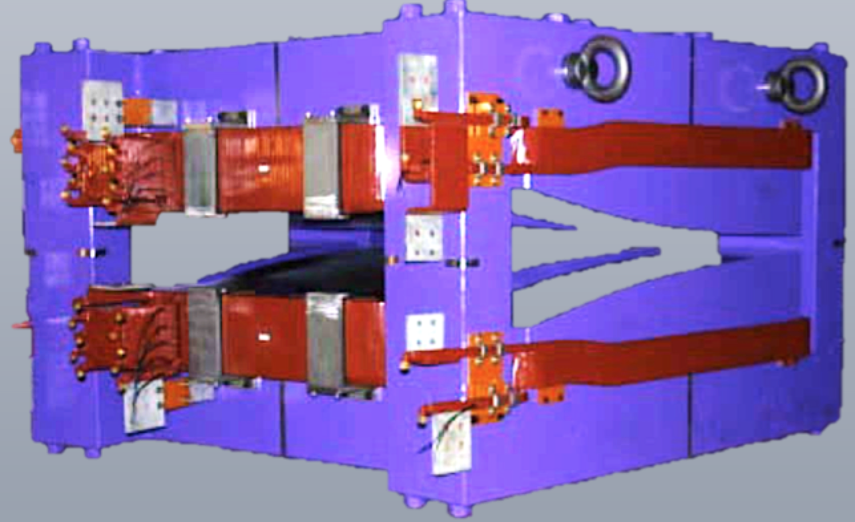
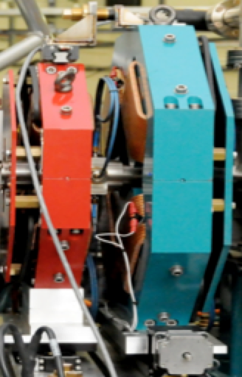
MAKE IT SMALLER YET HIGHLY EFFECTIVE!
Δx = D_{x} • δp/p
Two properties were annoying:
VERY LARGE MAGNET SIZE
30% OPPOSITE BEND - INNEFICIENT
?

Slide 7
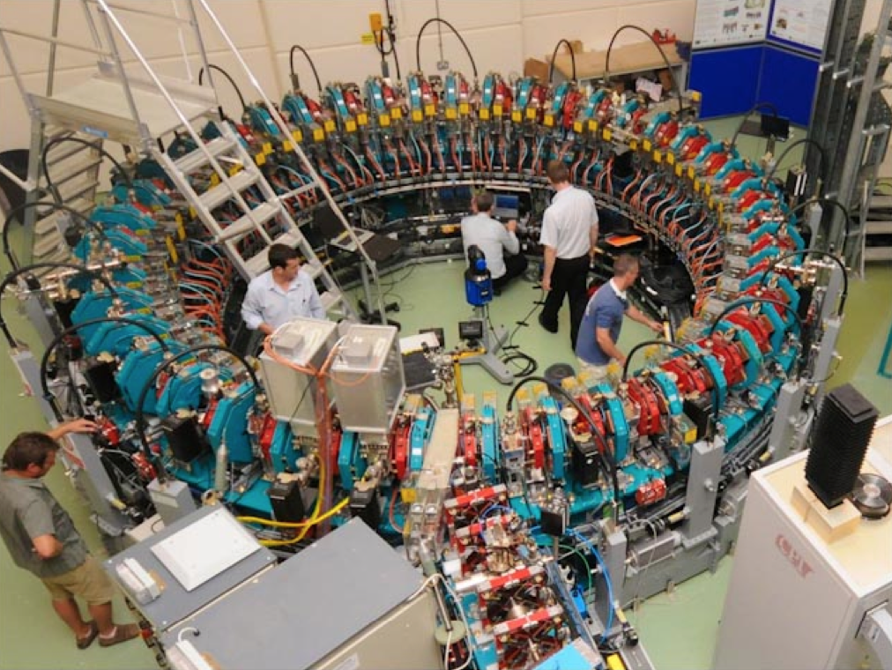
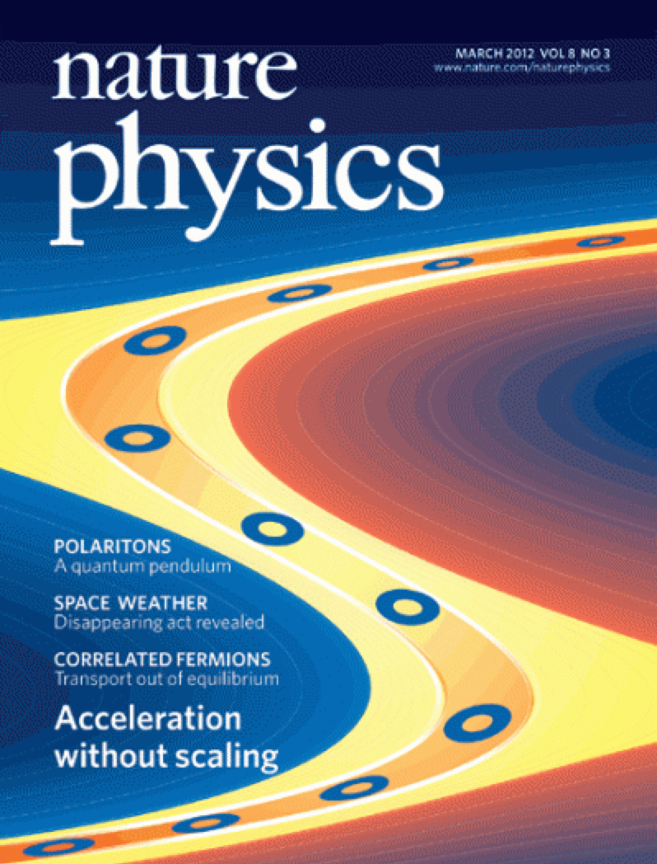
EMMA the first Non-Scaling FFAG
(Electron Model for Many Applications)
Daresbury Laboratory
LEARNING FROM PREVIOUS EXPERIENCE FROM WORKING NON-SCALING FFAG “EMMA”
(Being aware that EMMA is a much more difficult application of FFAG than eRHIC in many ways)
ELECTRON ENERGY RANGE IN EMMA WAS BUILT TO SIMULATE MUON ACCELERATION 10 – 20 GeV

Slide 8
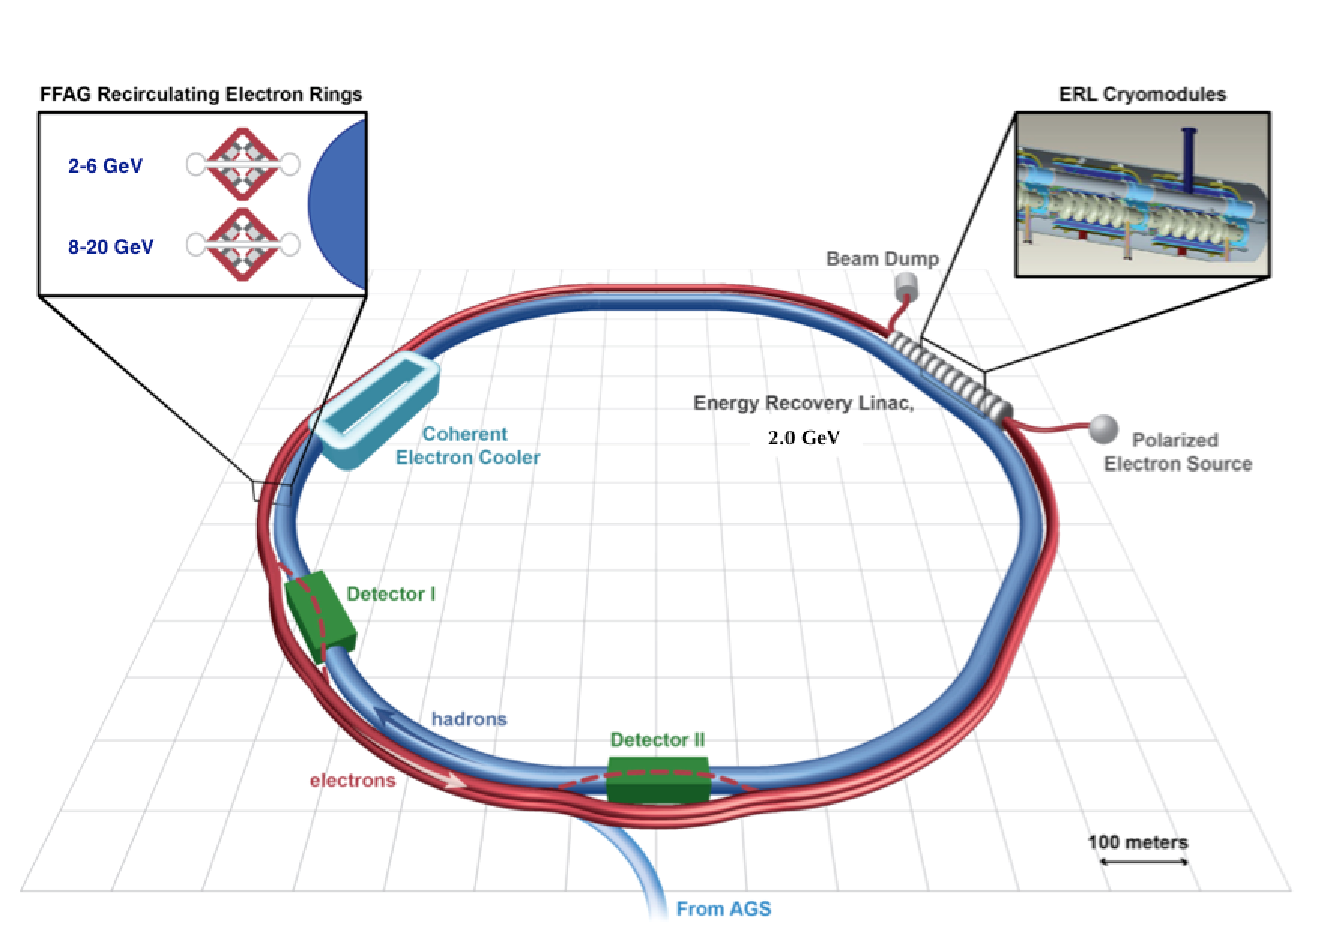
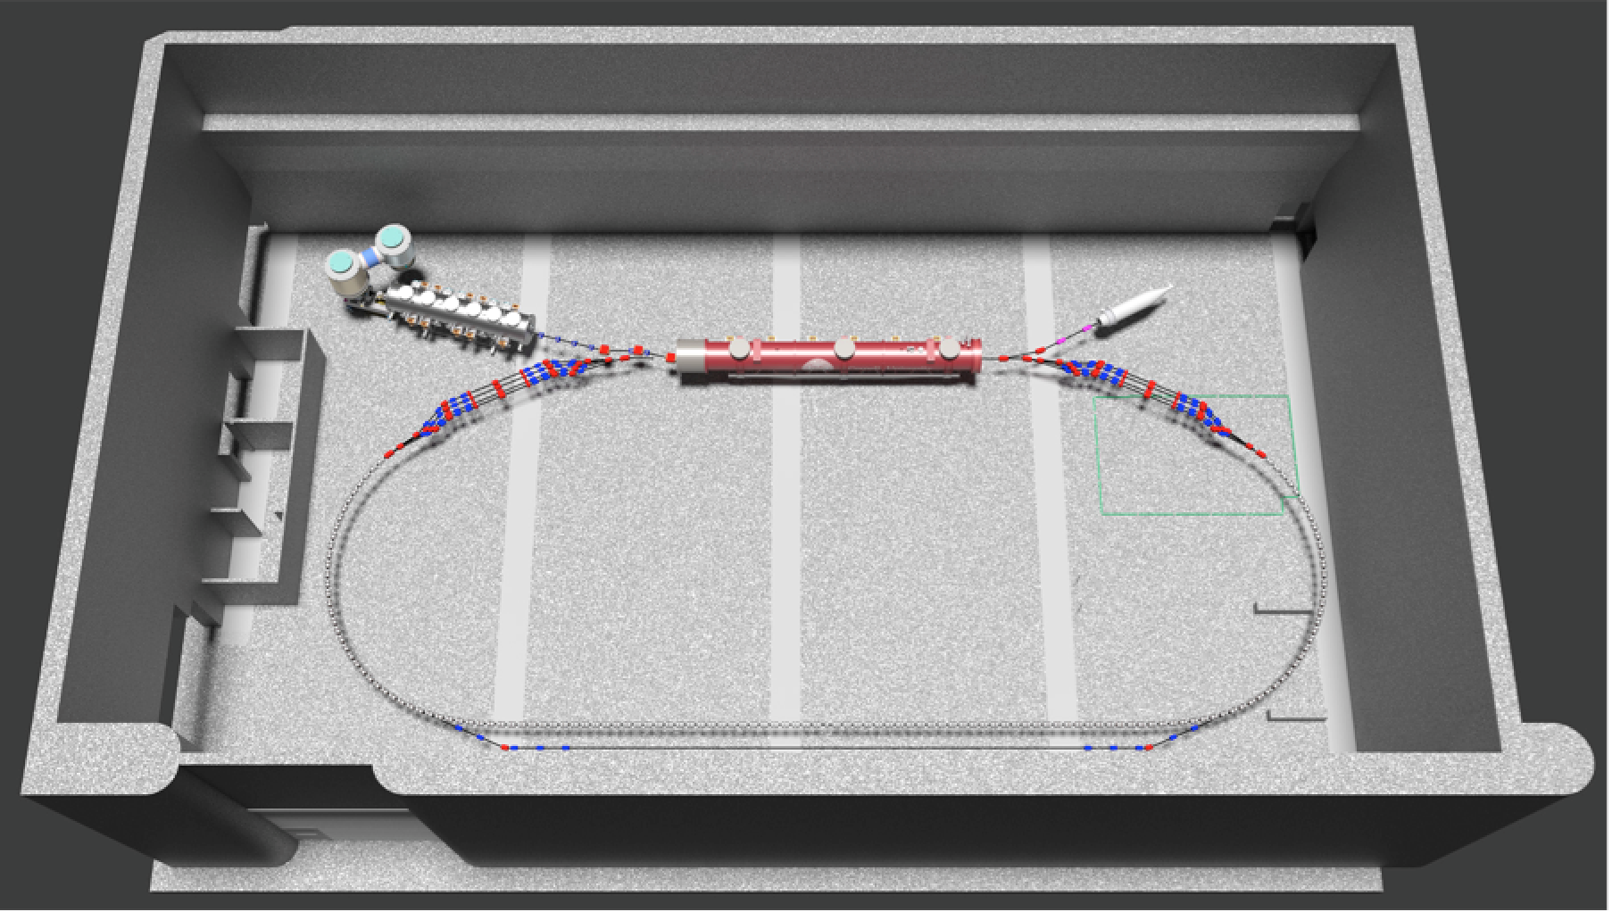
A new Energy Recovery Linac with the Non-Scaling Fixed Field Alternating Gradient arcs and straight sections is to be built at Cornell University Physics Department an eRHIC prototype
The Principle of NS-FFAG-Used here for Hadron Therapy Gantry
has been selected for the Future Electron-Ion Collider
eRHIC at BNL
N

Slide 9
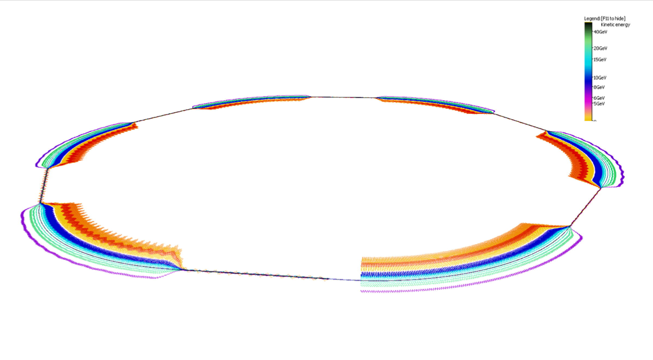
eRHIC FFAG Rings in Perspective
Orbits exaggerated transversely 5000x, shape of hexagonal RHIC is evident
© Stephen Brooks

Slide 10
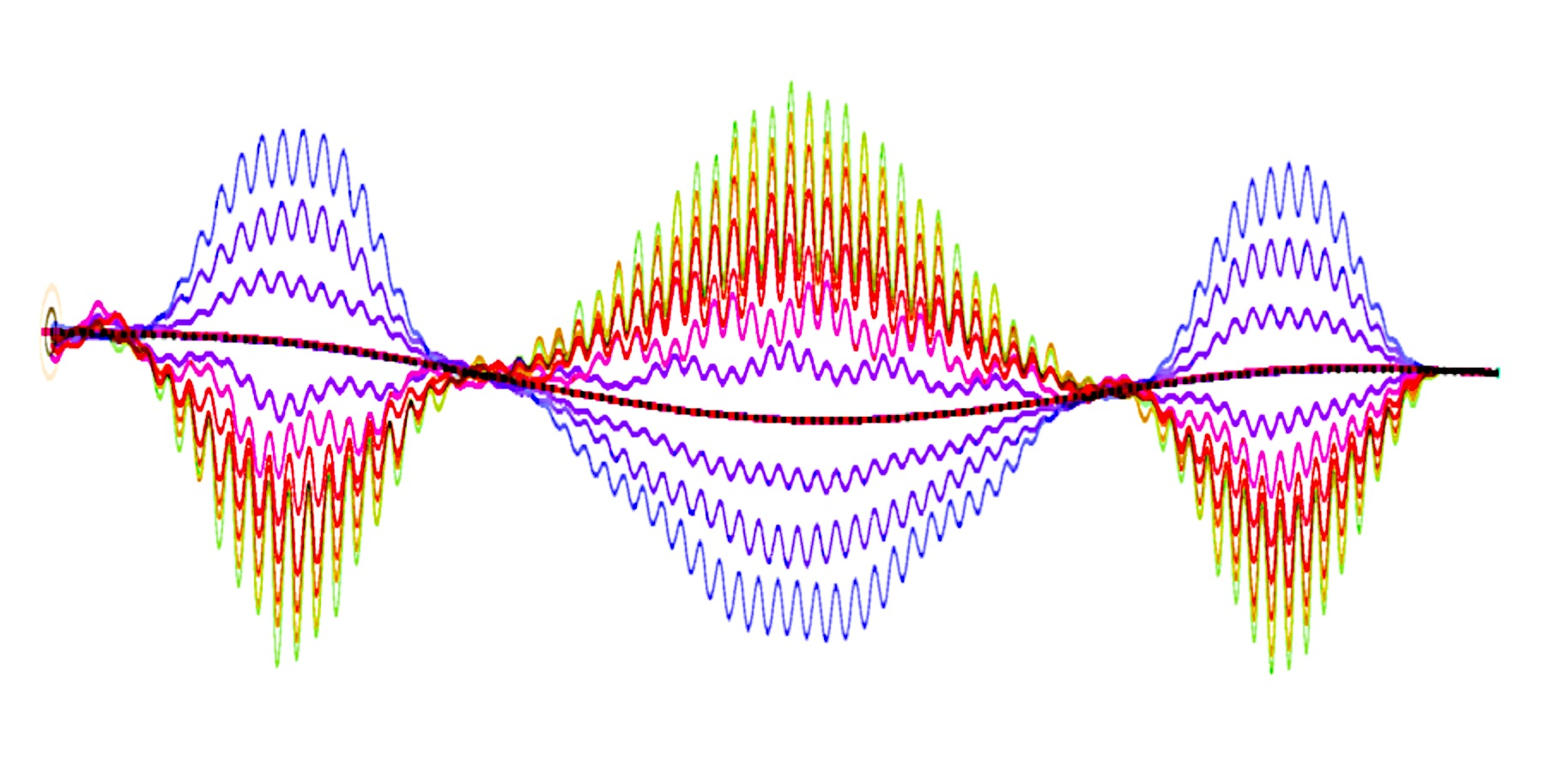
Detector Bypass Scheme: a Flexible FFAG
−Δθ
Curvature
Bypass straight
Normal straight
Angle
−2Δθ
Δθ
Δθ
Δθ
Displacement
3
9
9
17
17
9
9
3
90.3m
76 cells
3.08m

Slide 11
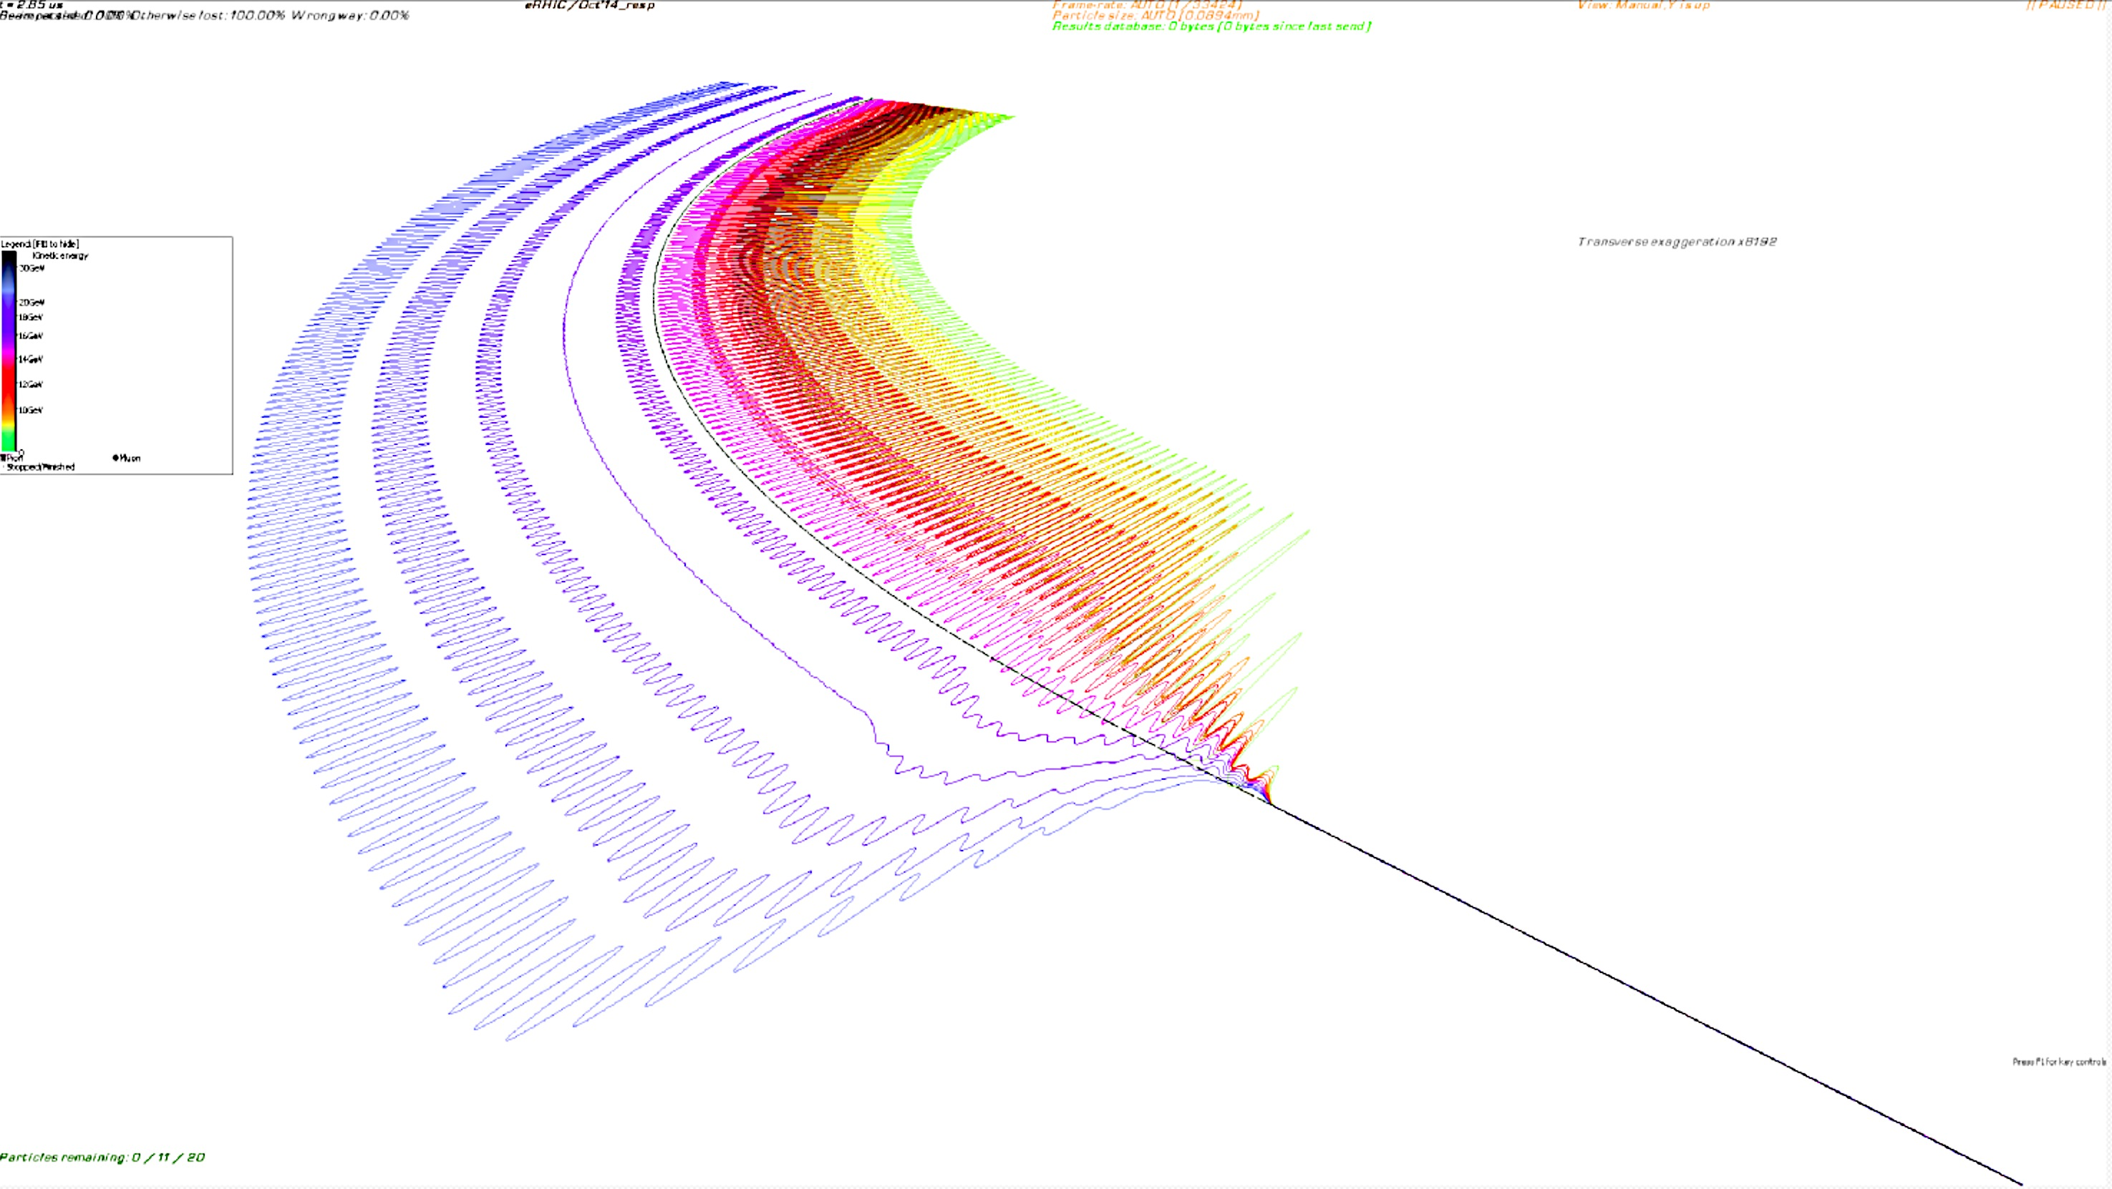
Merging FFAG arcs to the straight section in eRHIC
7.75 mm

Slide 12
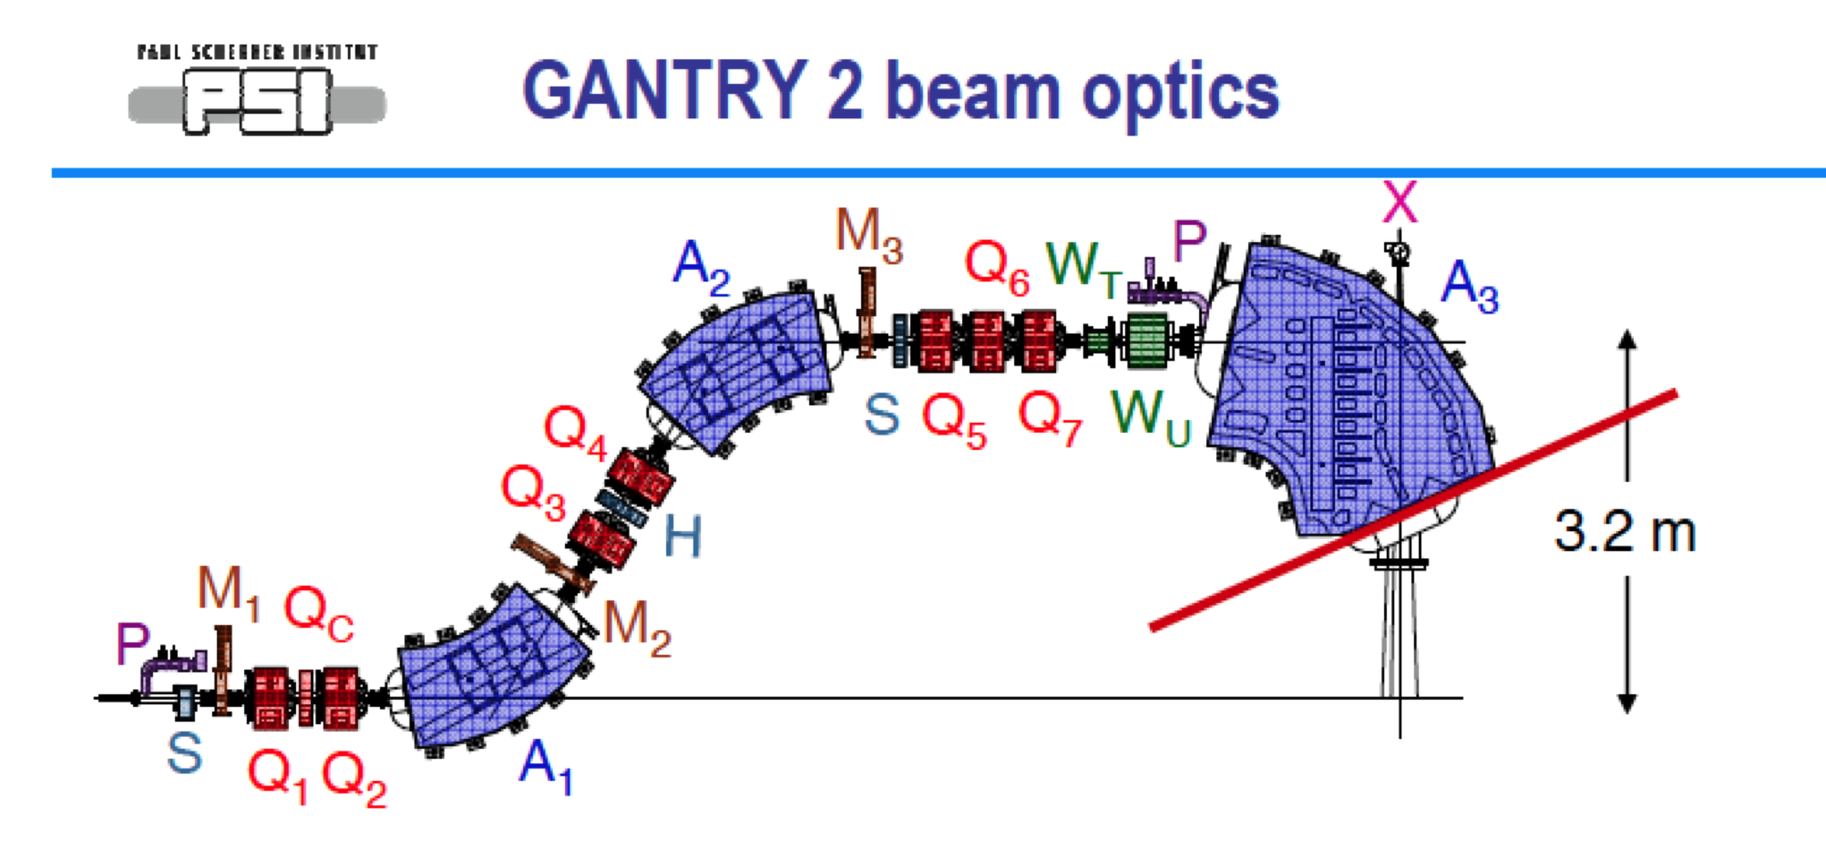
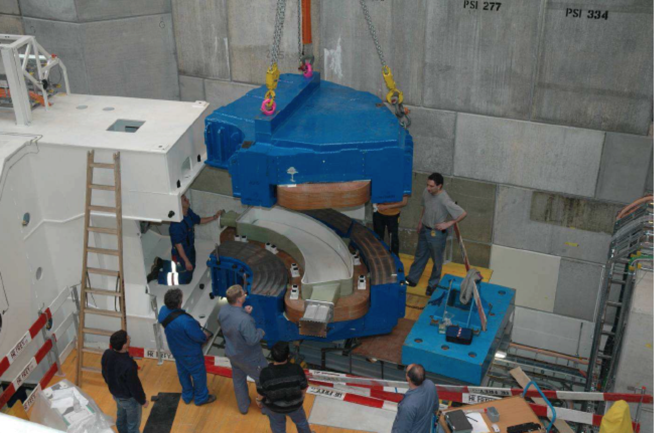
The state of the art proton gantry at PSI
3.2 m
3.2 m

Slide 13
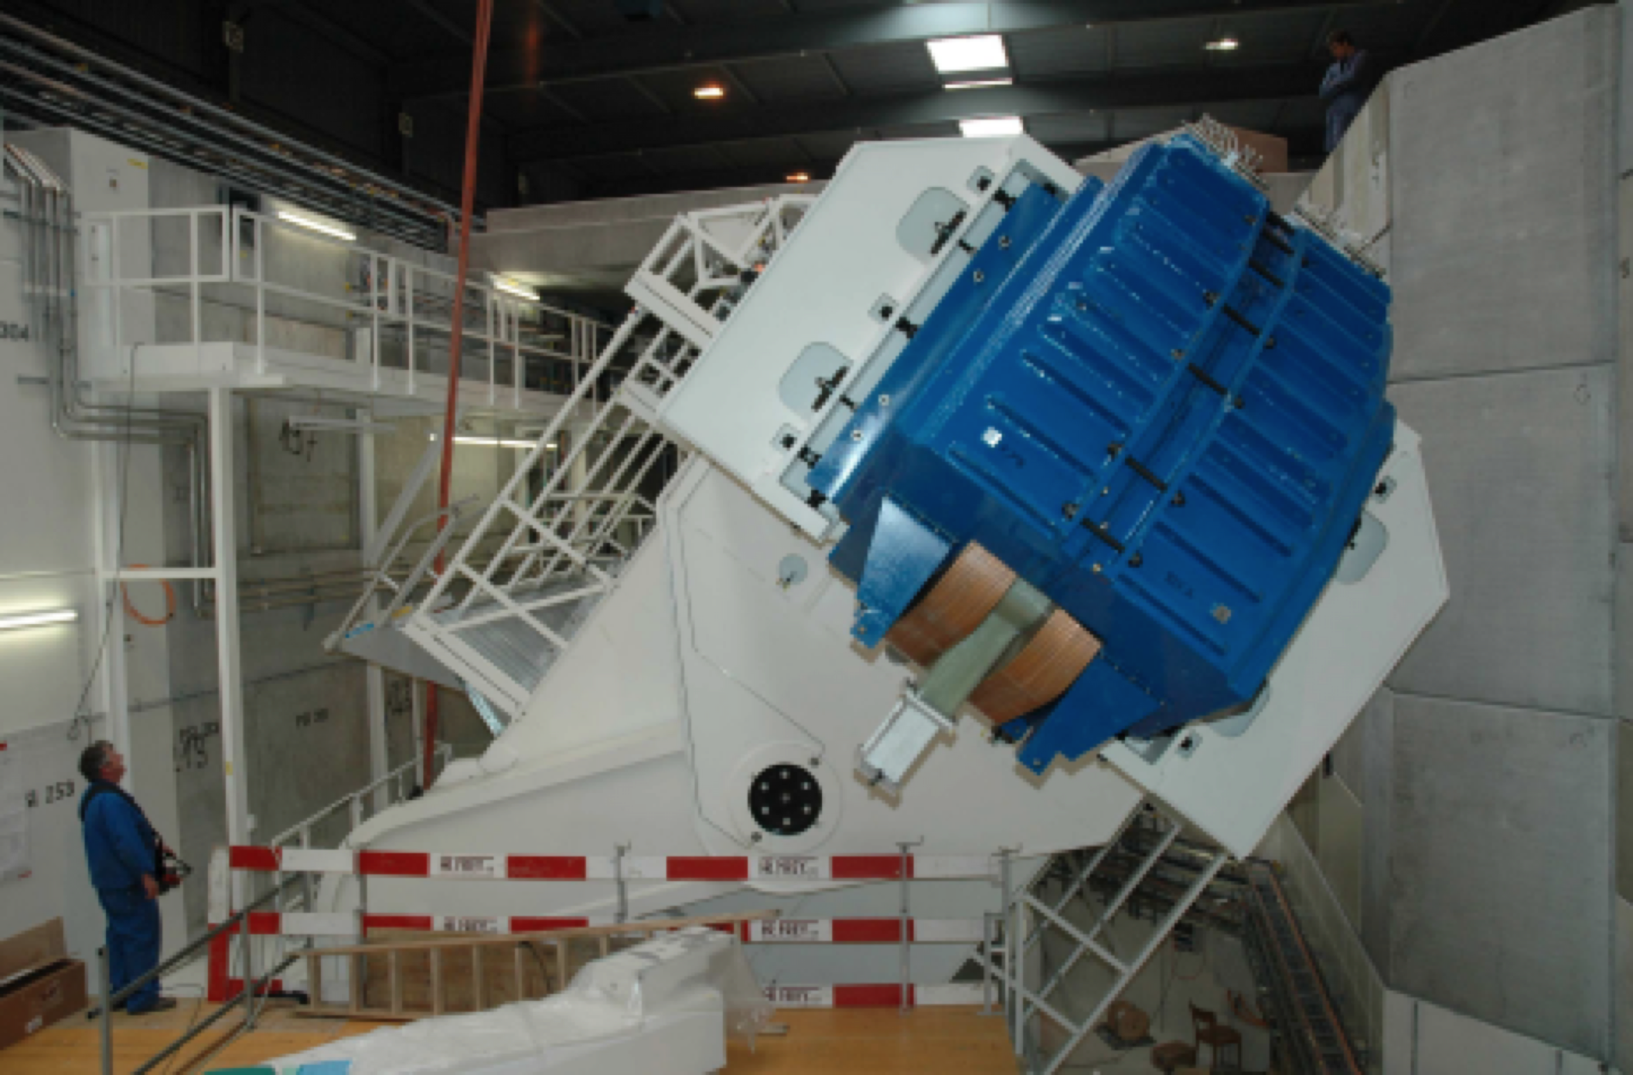
The state of the art proton gantry at PSI

Slide 14
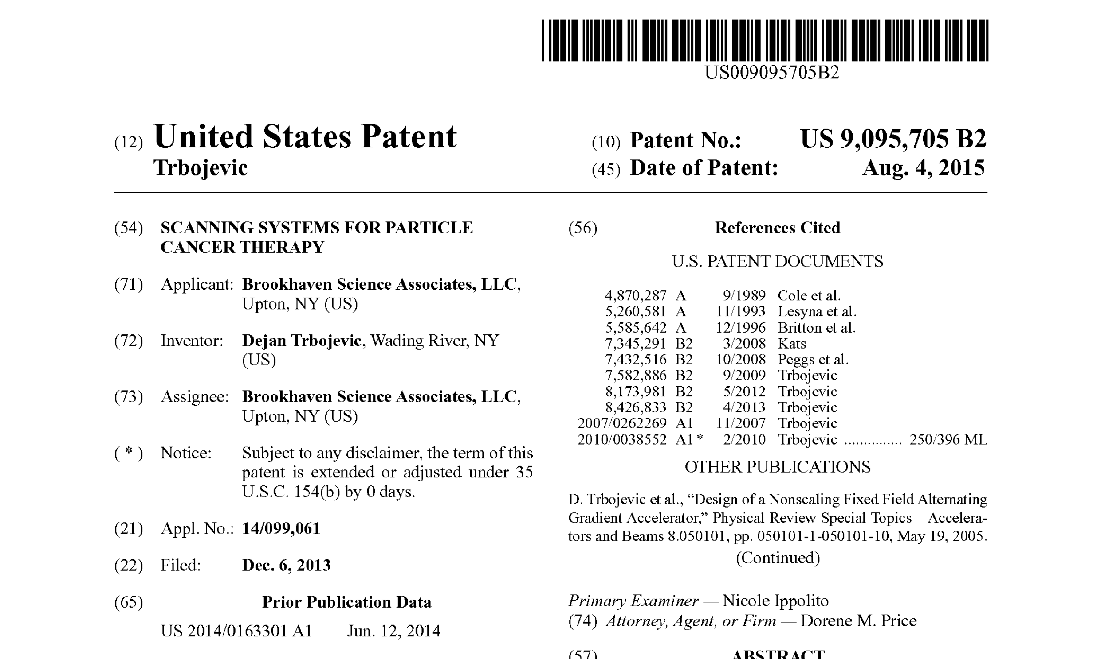
SAD – SOURCE-TO-AXIS-DISTANCE
VIRTUAL Source to Patient Distance
Scanning system: patented by BNL
The maximum dose to the patient surface relative to the dose in the SOBP
increases as the effective source-to-axis distance (SAD) decreases. For a fixed,
horizontal beam, large SAD's are easy to achieve; but not for gantry beam lines. A smaller gantry with a physical outer diameter of less than 2 meters may have important cost implications. Such a gantry would require magnetic optics to ensure that the effective source-to-axis distance is large enough to provide adequate skin sparing.
S
S
S
S
Axis
Axis
Axis
Axis

Slide 15
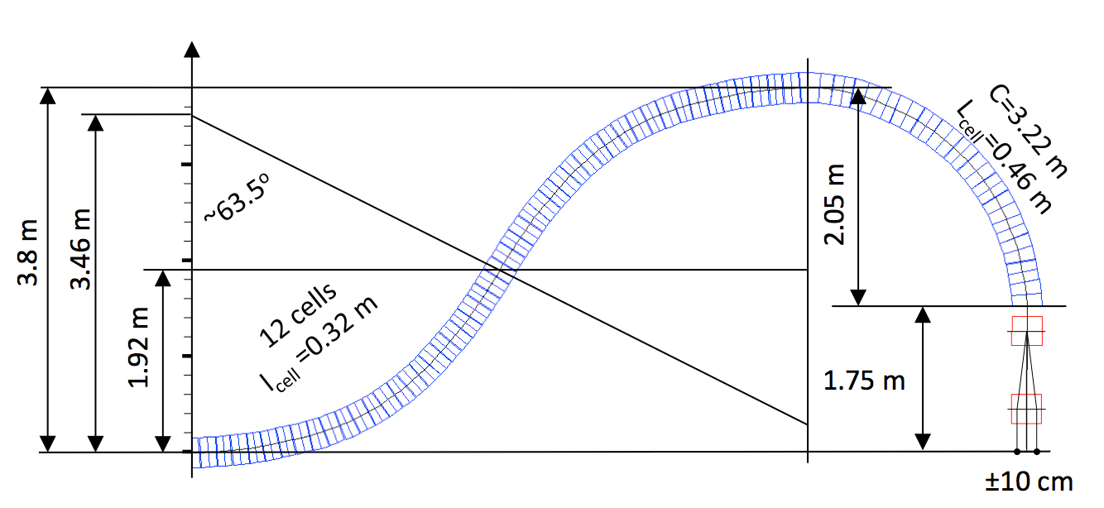
Permanent Halbach Magnet
NS-FFAG Proton Gantry 35-250 MeV

Slide 16
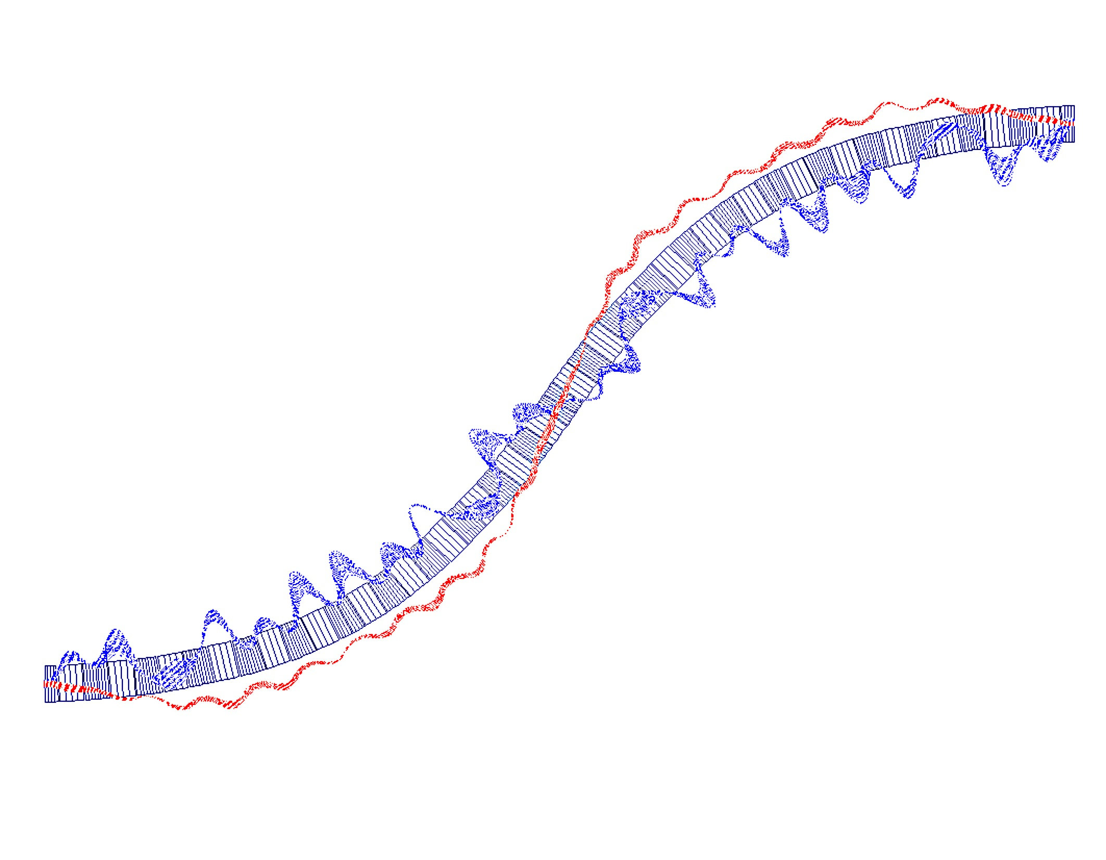
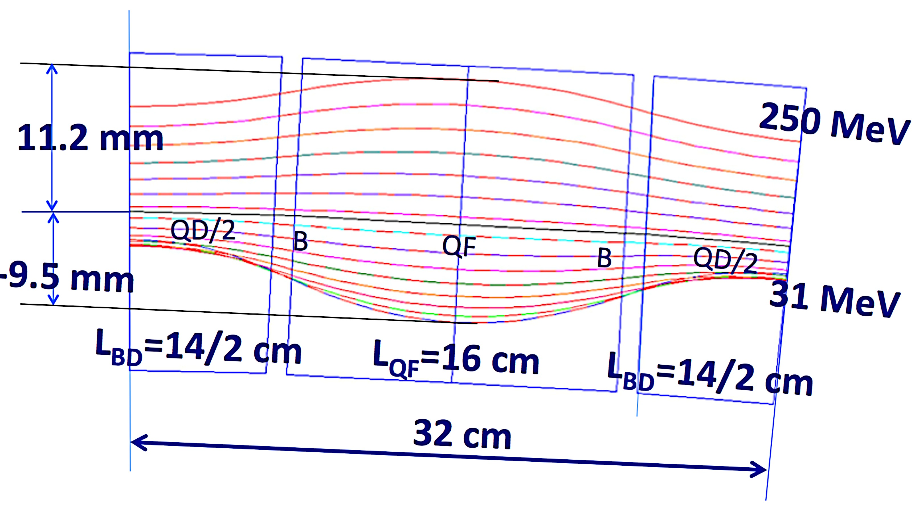
Halbach Permanent Magnet Gantry
The Basic Cell
Magnified Orbit Offset for
35 MeV – 250 MeV protons
63.4º
3.8 m

Slide 17
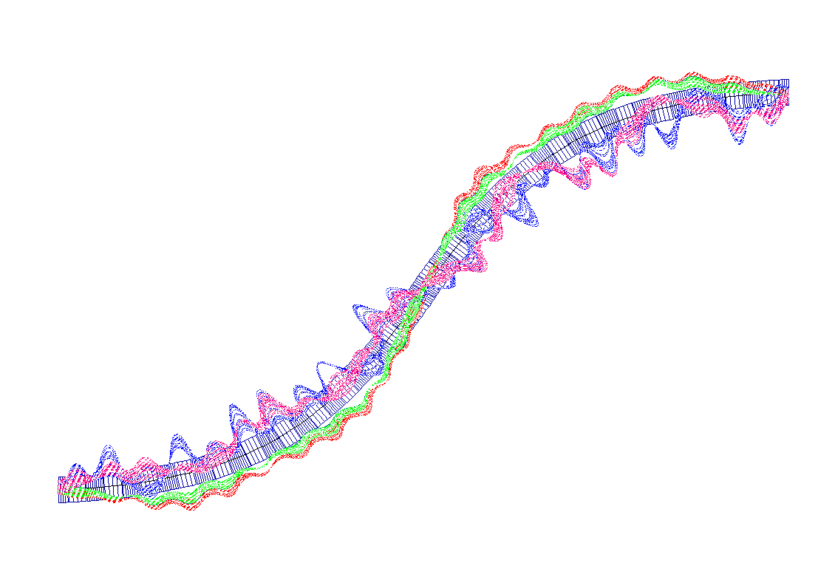
Permanent Halbach Magnet
NS-FFAG Proton Gantry
35 MeV
250 MeV

Slide 18
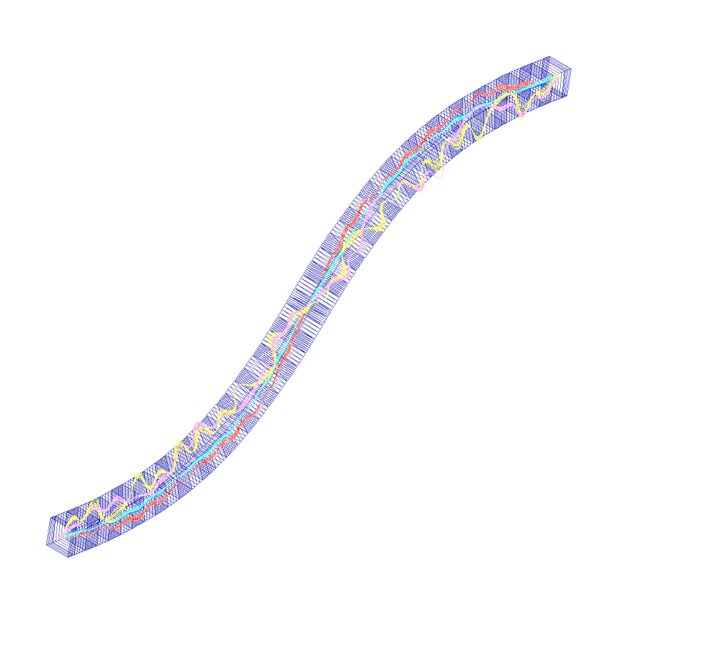
Orbits in 3D in half of the Superconducting Gantry

Slide 19
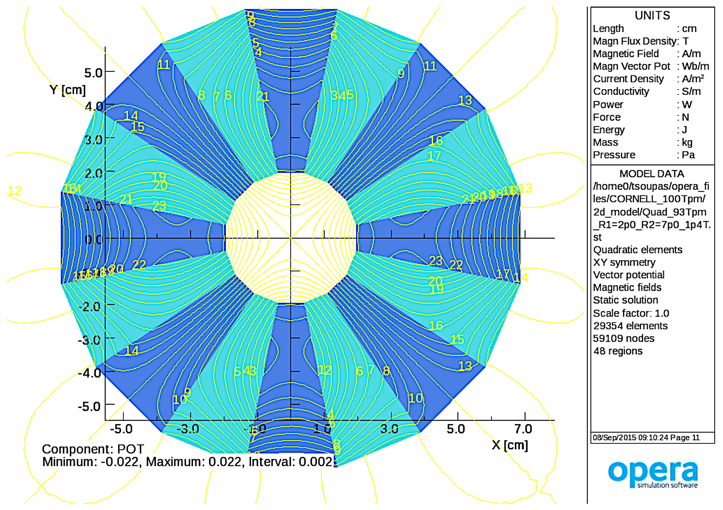
Gantry Halbach Magnet Design (Nick Tsoupas –BNL)
G=100 T/m

Slide 20
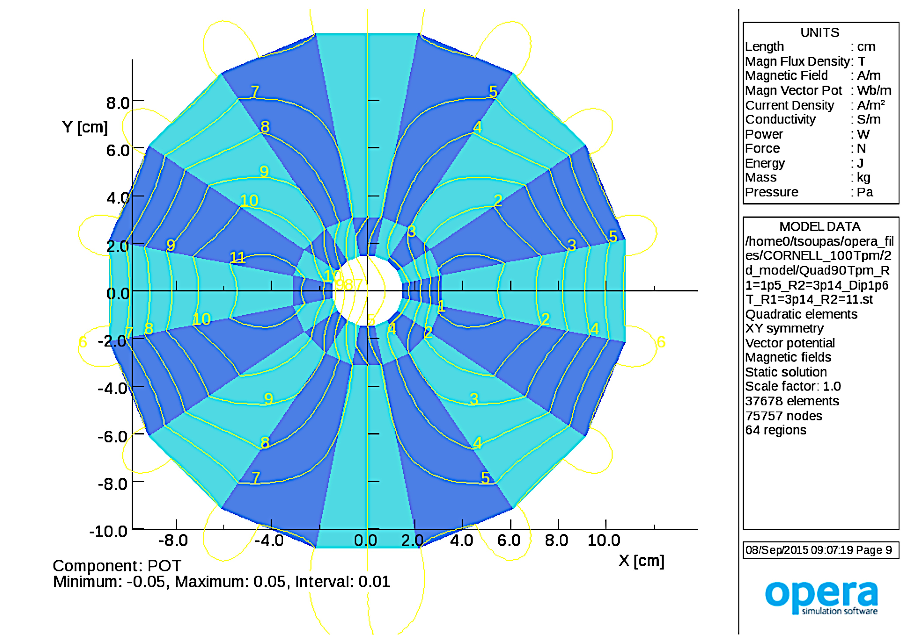
Gantry Halbach Magnet Design
(Nick Tsoupas-BNL)
G_{D}=-90 T/m
B_{D}=1.63 T
30mm

Slide 21
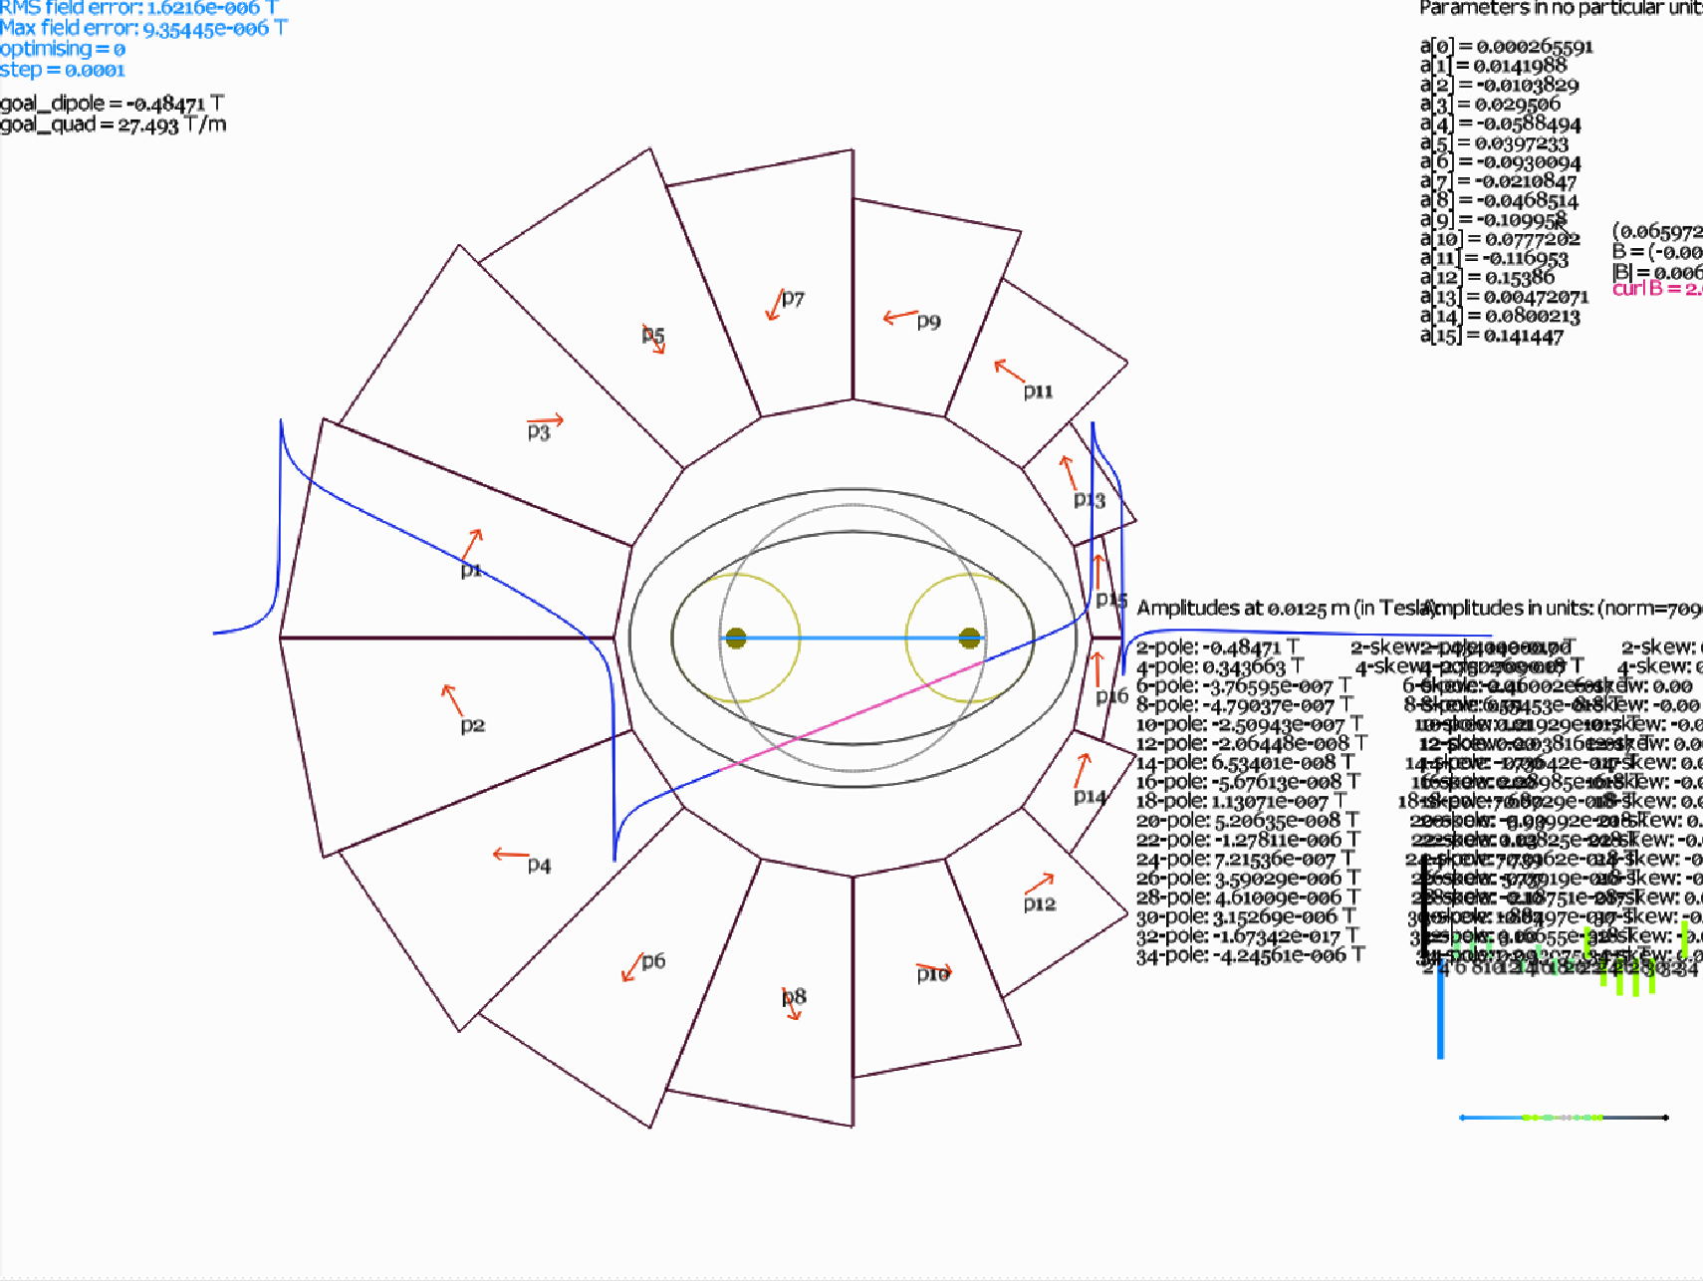
Gantry New Halbach type Magnet Design (Stephen Brooks)
R_{outside}=13.7 cm
R_{inside} =1.17 cm
B_{dipole} =1.6 T
G_{D} = 90 T/m

Slide 22
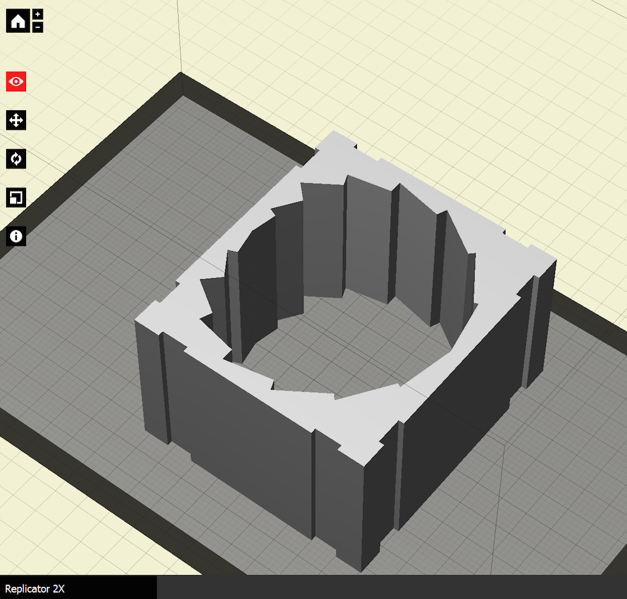
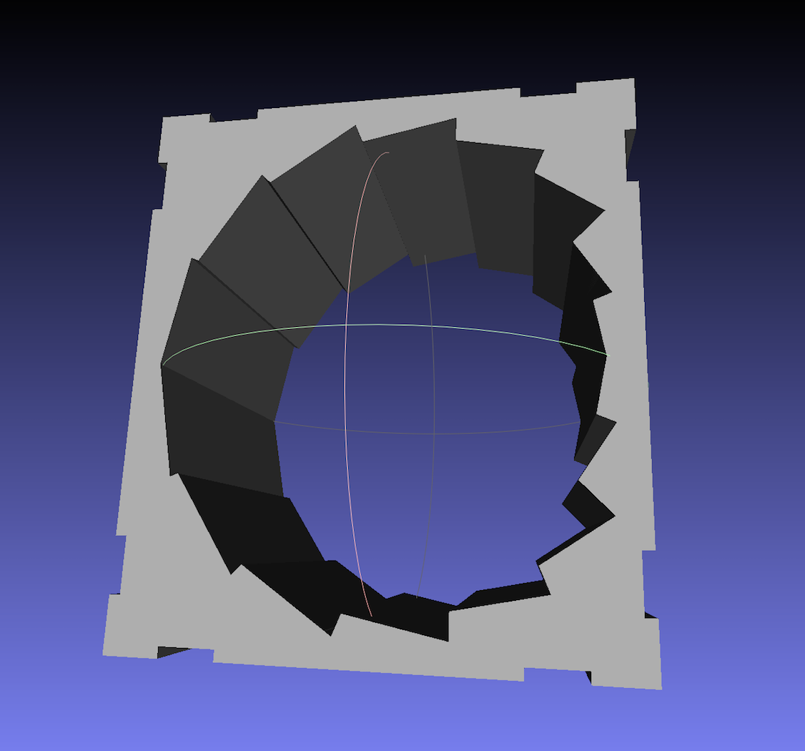
Built Models of Defocusing Modified Halbach Magnet

Slide 23
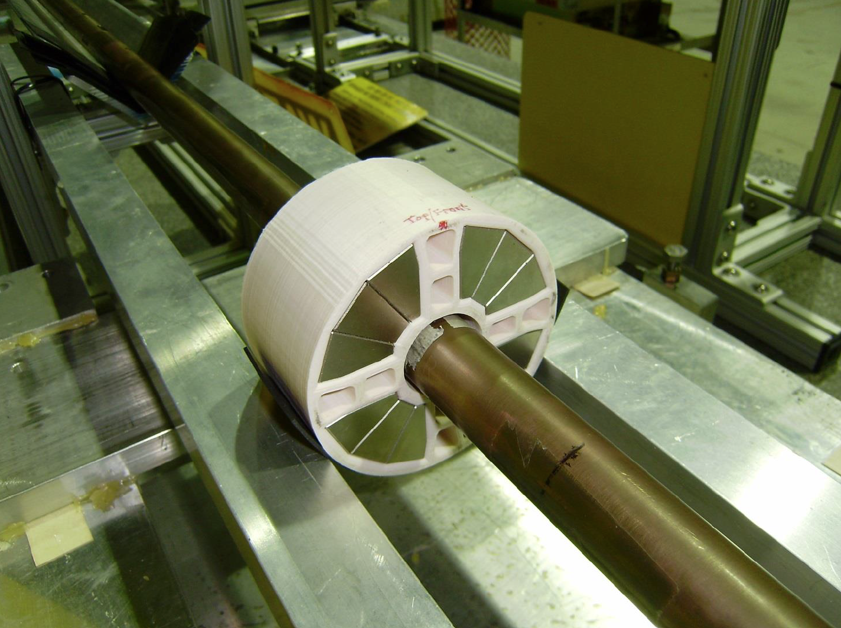
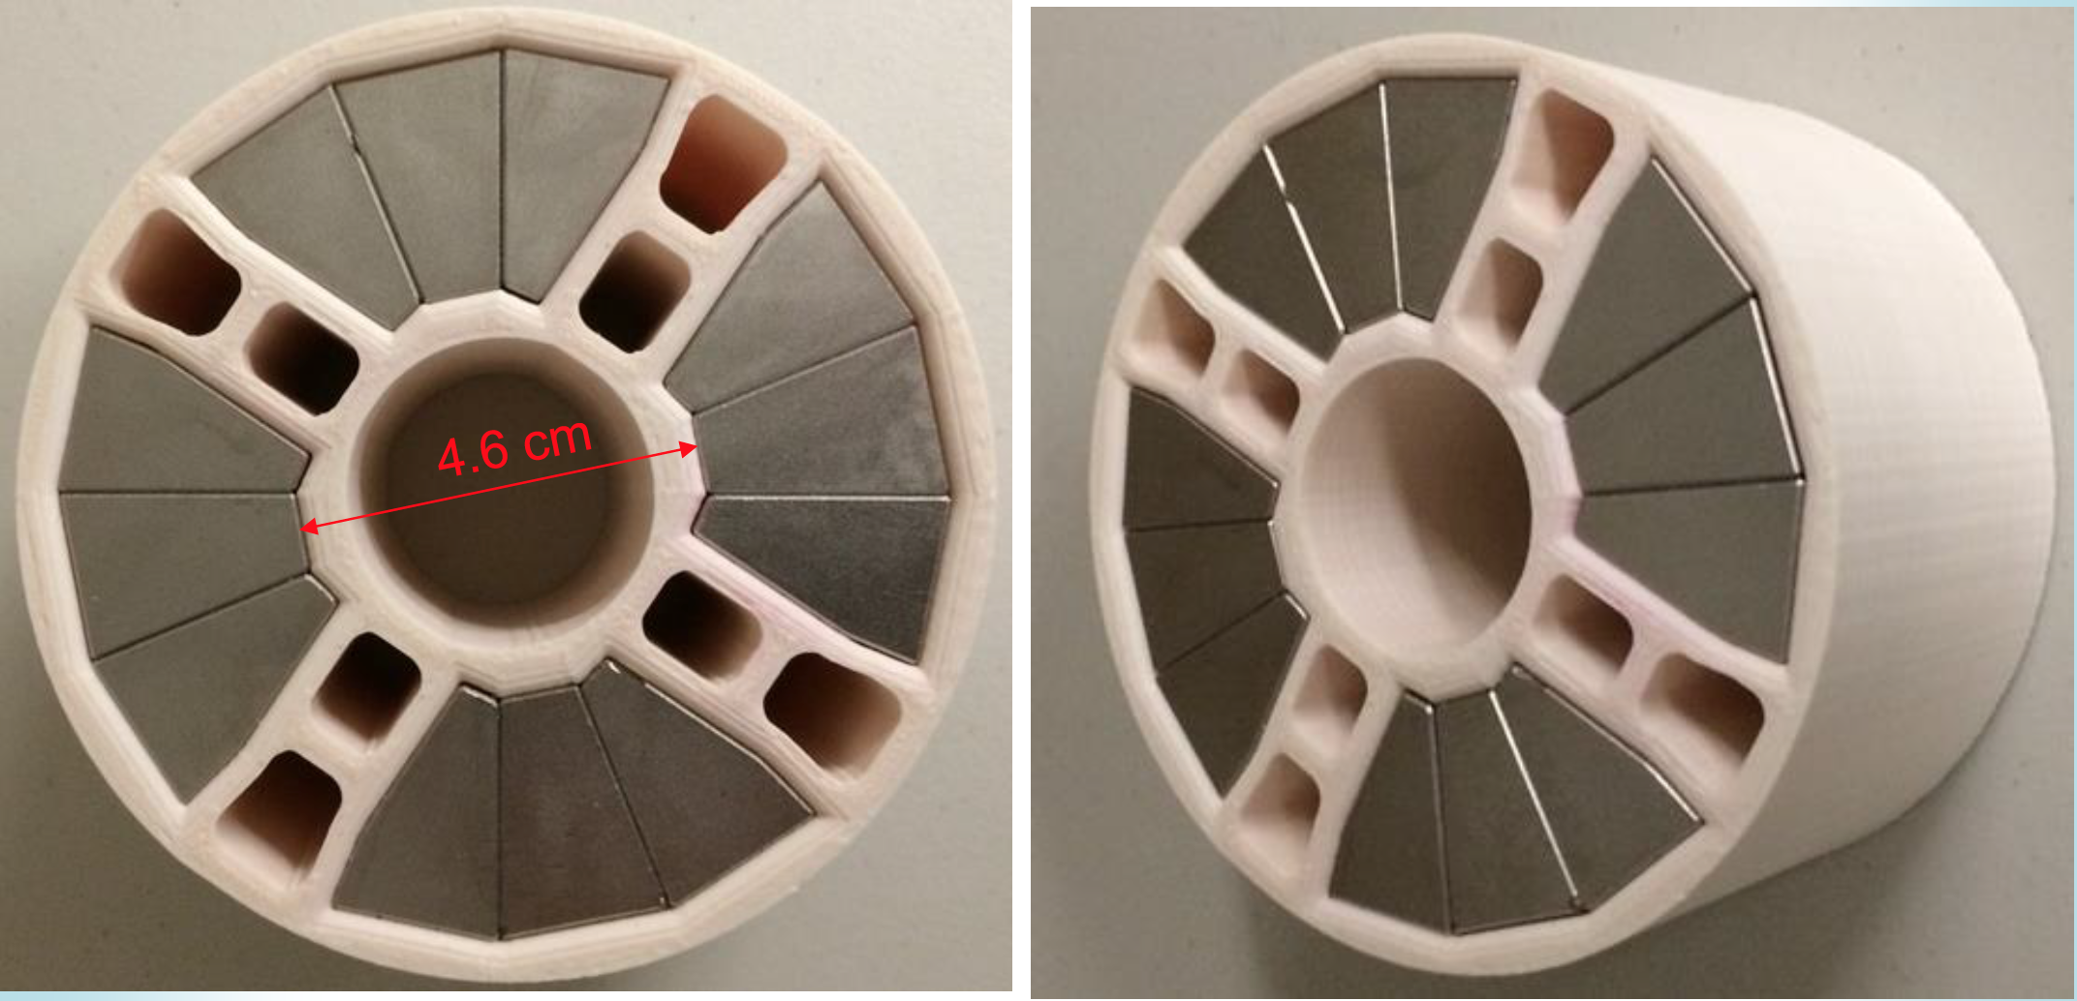
Modified Halbach magnets for BNL eRHIC

Slide 24
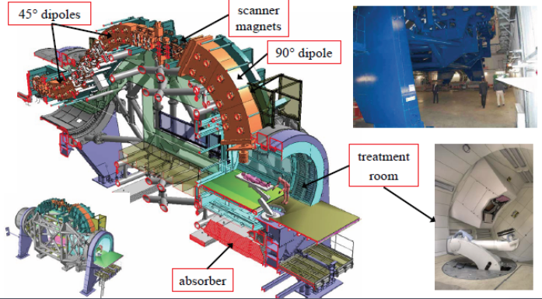
State of the art C-gantry at Heidelberg
Weight of the transport components – 135 tons
Total weight = 630 tons - 19 m long. WEIGHT and SIZE

Slide 25
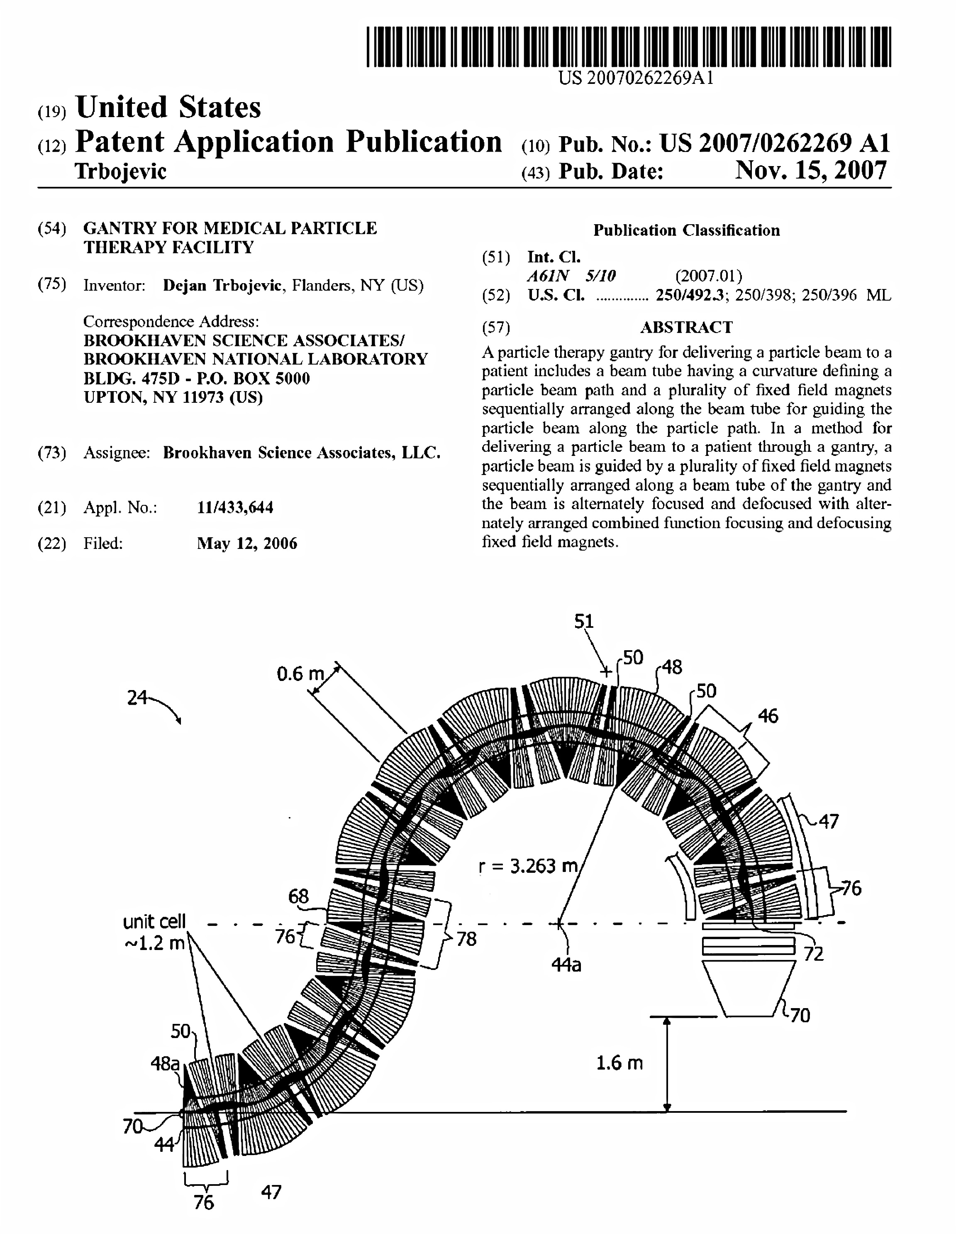
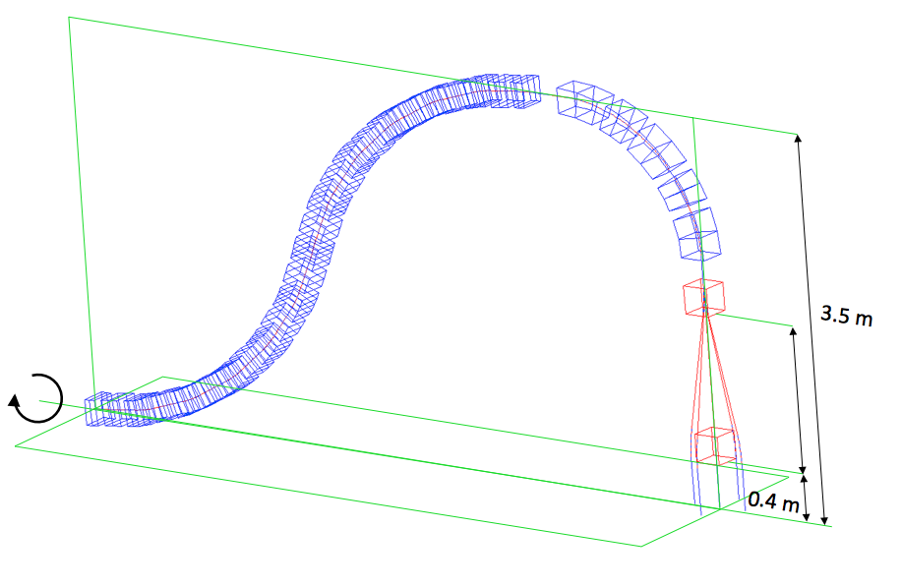
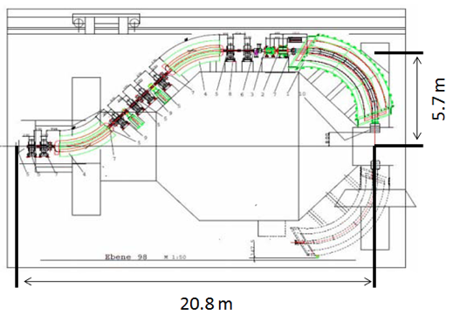
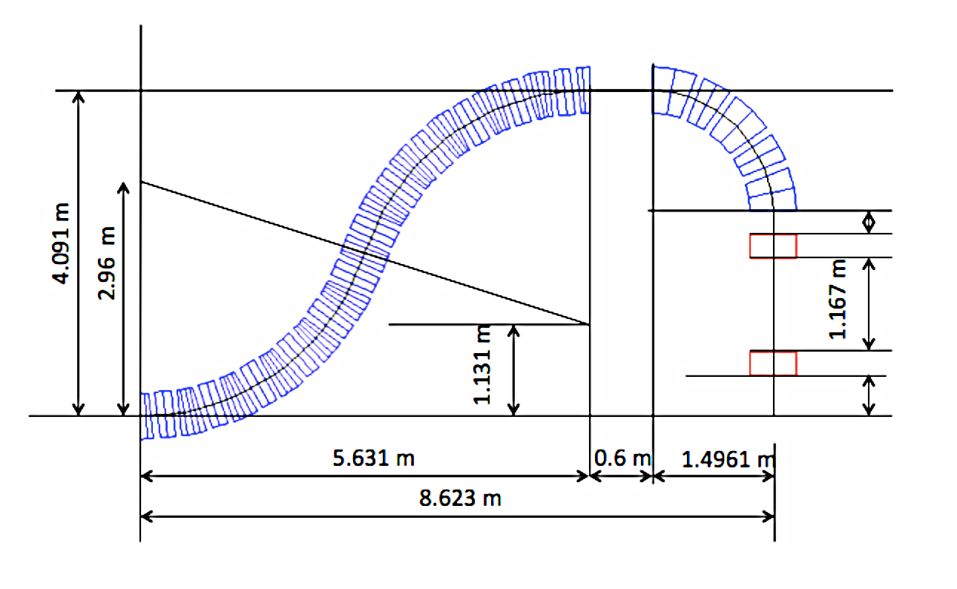
Carbon E_{k}=400 MeV/u → Bρ = 6.35 Tm ( θ= Bl/Bρ )
Warm iron magnets: B=1.6 T then ρ ~ 4.0 m Superconducting magnets B=3.2 T then ρ ~ 2.0 m
DIMENSIONS of the CARBON GANTRY
4.1 m
8.6 m
4.09 m
20.8

Slide 26
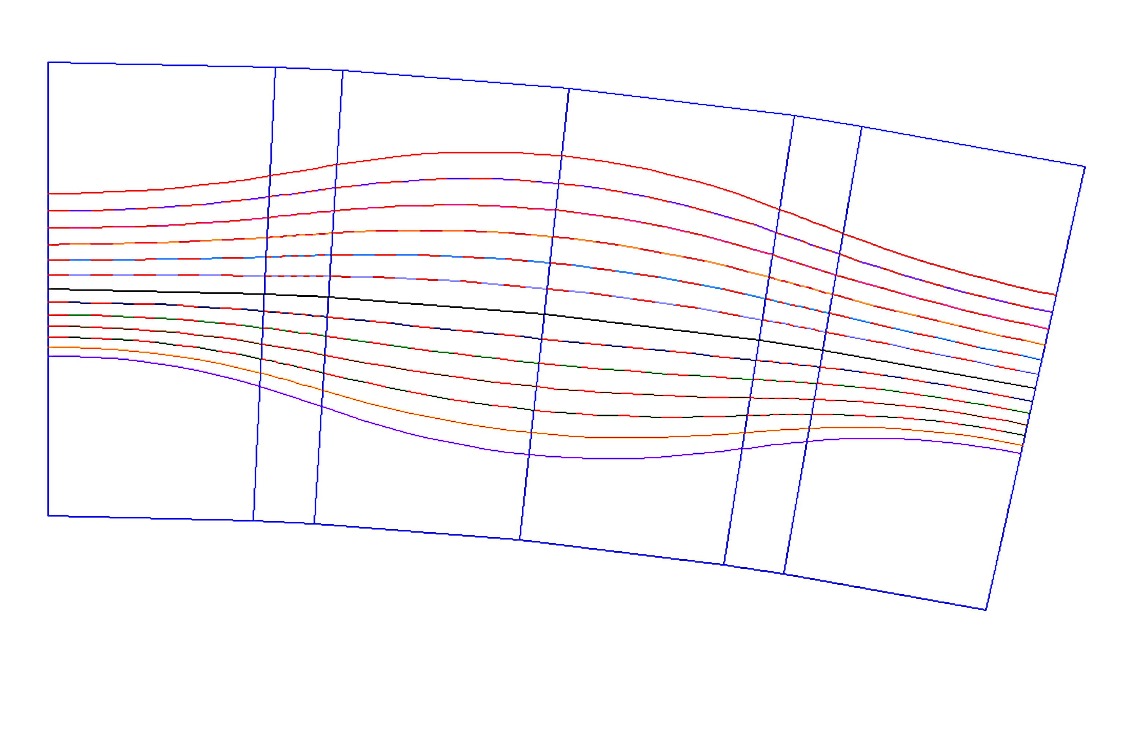
Very strong focusing Basic Cell
QD/2
QF
10.1 mm
QD/2
δp/p=18%
5.9 mm
400 MeV/u
-4.6 mm
δp/p=-18%
B
9.4 mm
210 MeV/u
4 cm
B
L_{BD}=27/2 cm
4 cm
L_{QF}=27 cm
62 cm
L_{BD}=27/2 cm

Slide 27
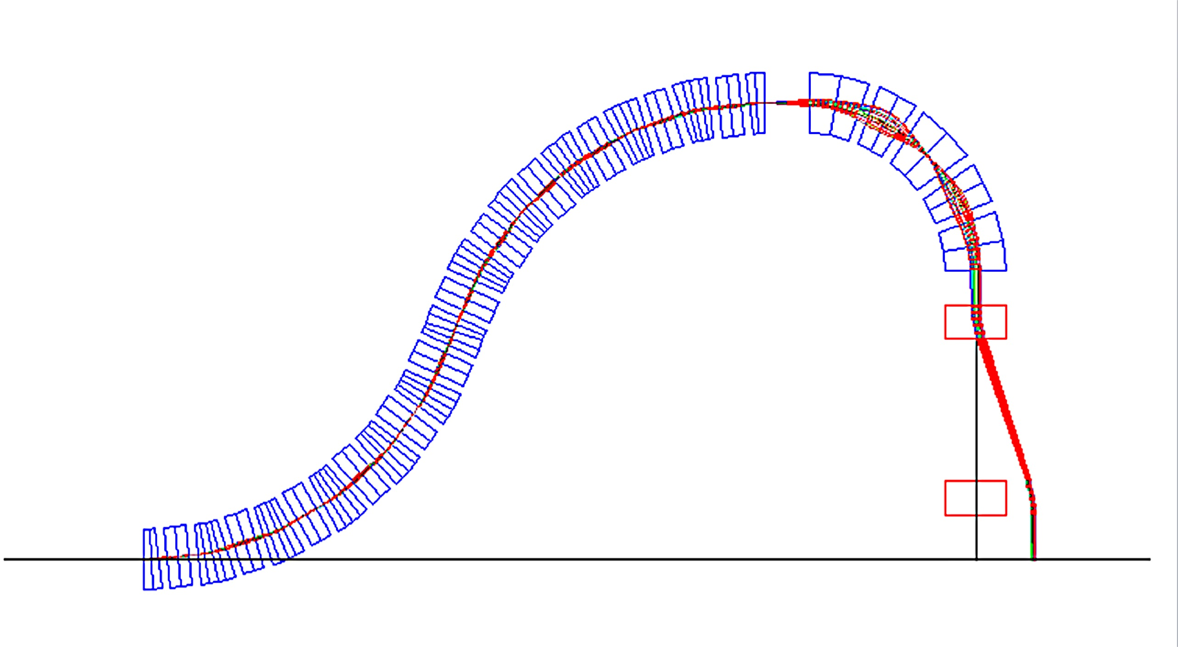
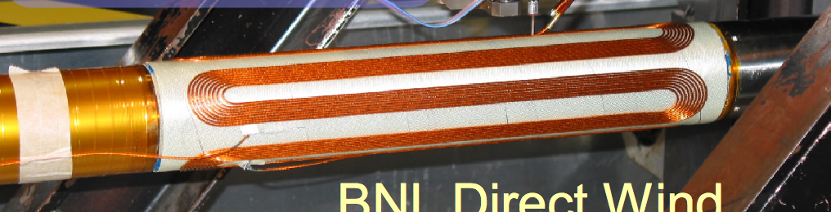
Reducing the size and weight from:
135 tons → to 3 tons
h
c.
0.4
b.
1.49 m
72º
2.9603 m
4.09 m
0.3
2.9603 m
a.
d.
2.6 m
2.3 m
0.3
0.41
Magnified 10 cm
7.52 m

Slide 28

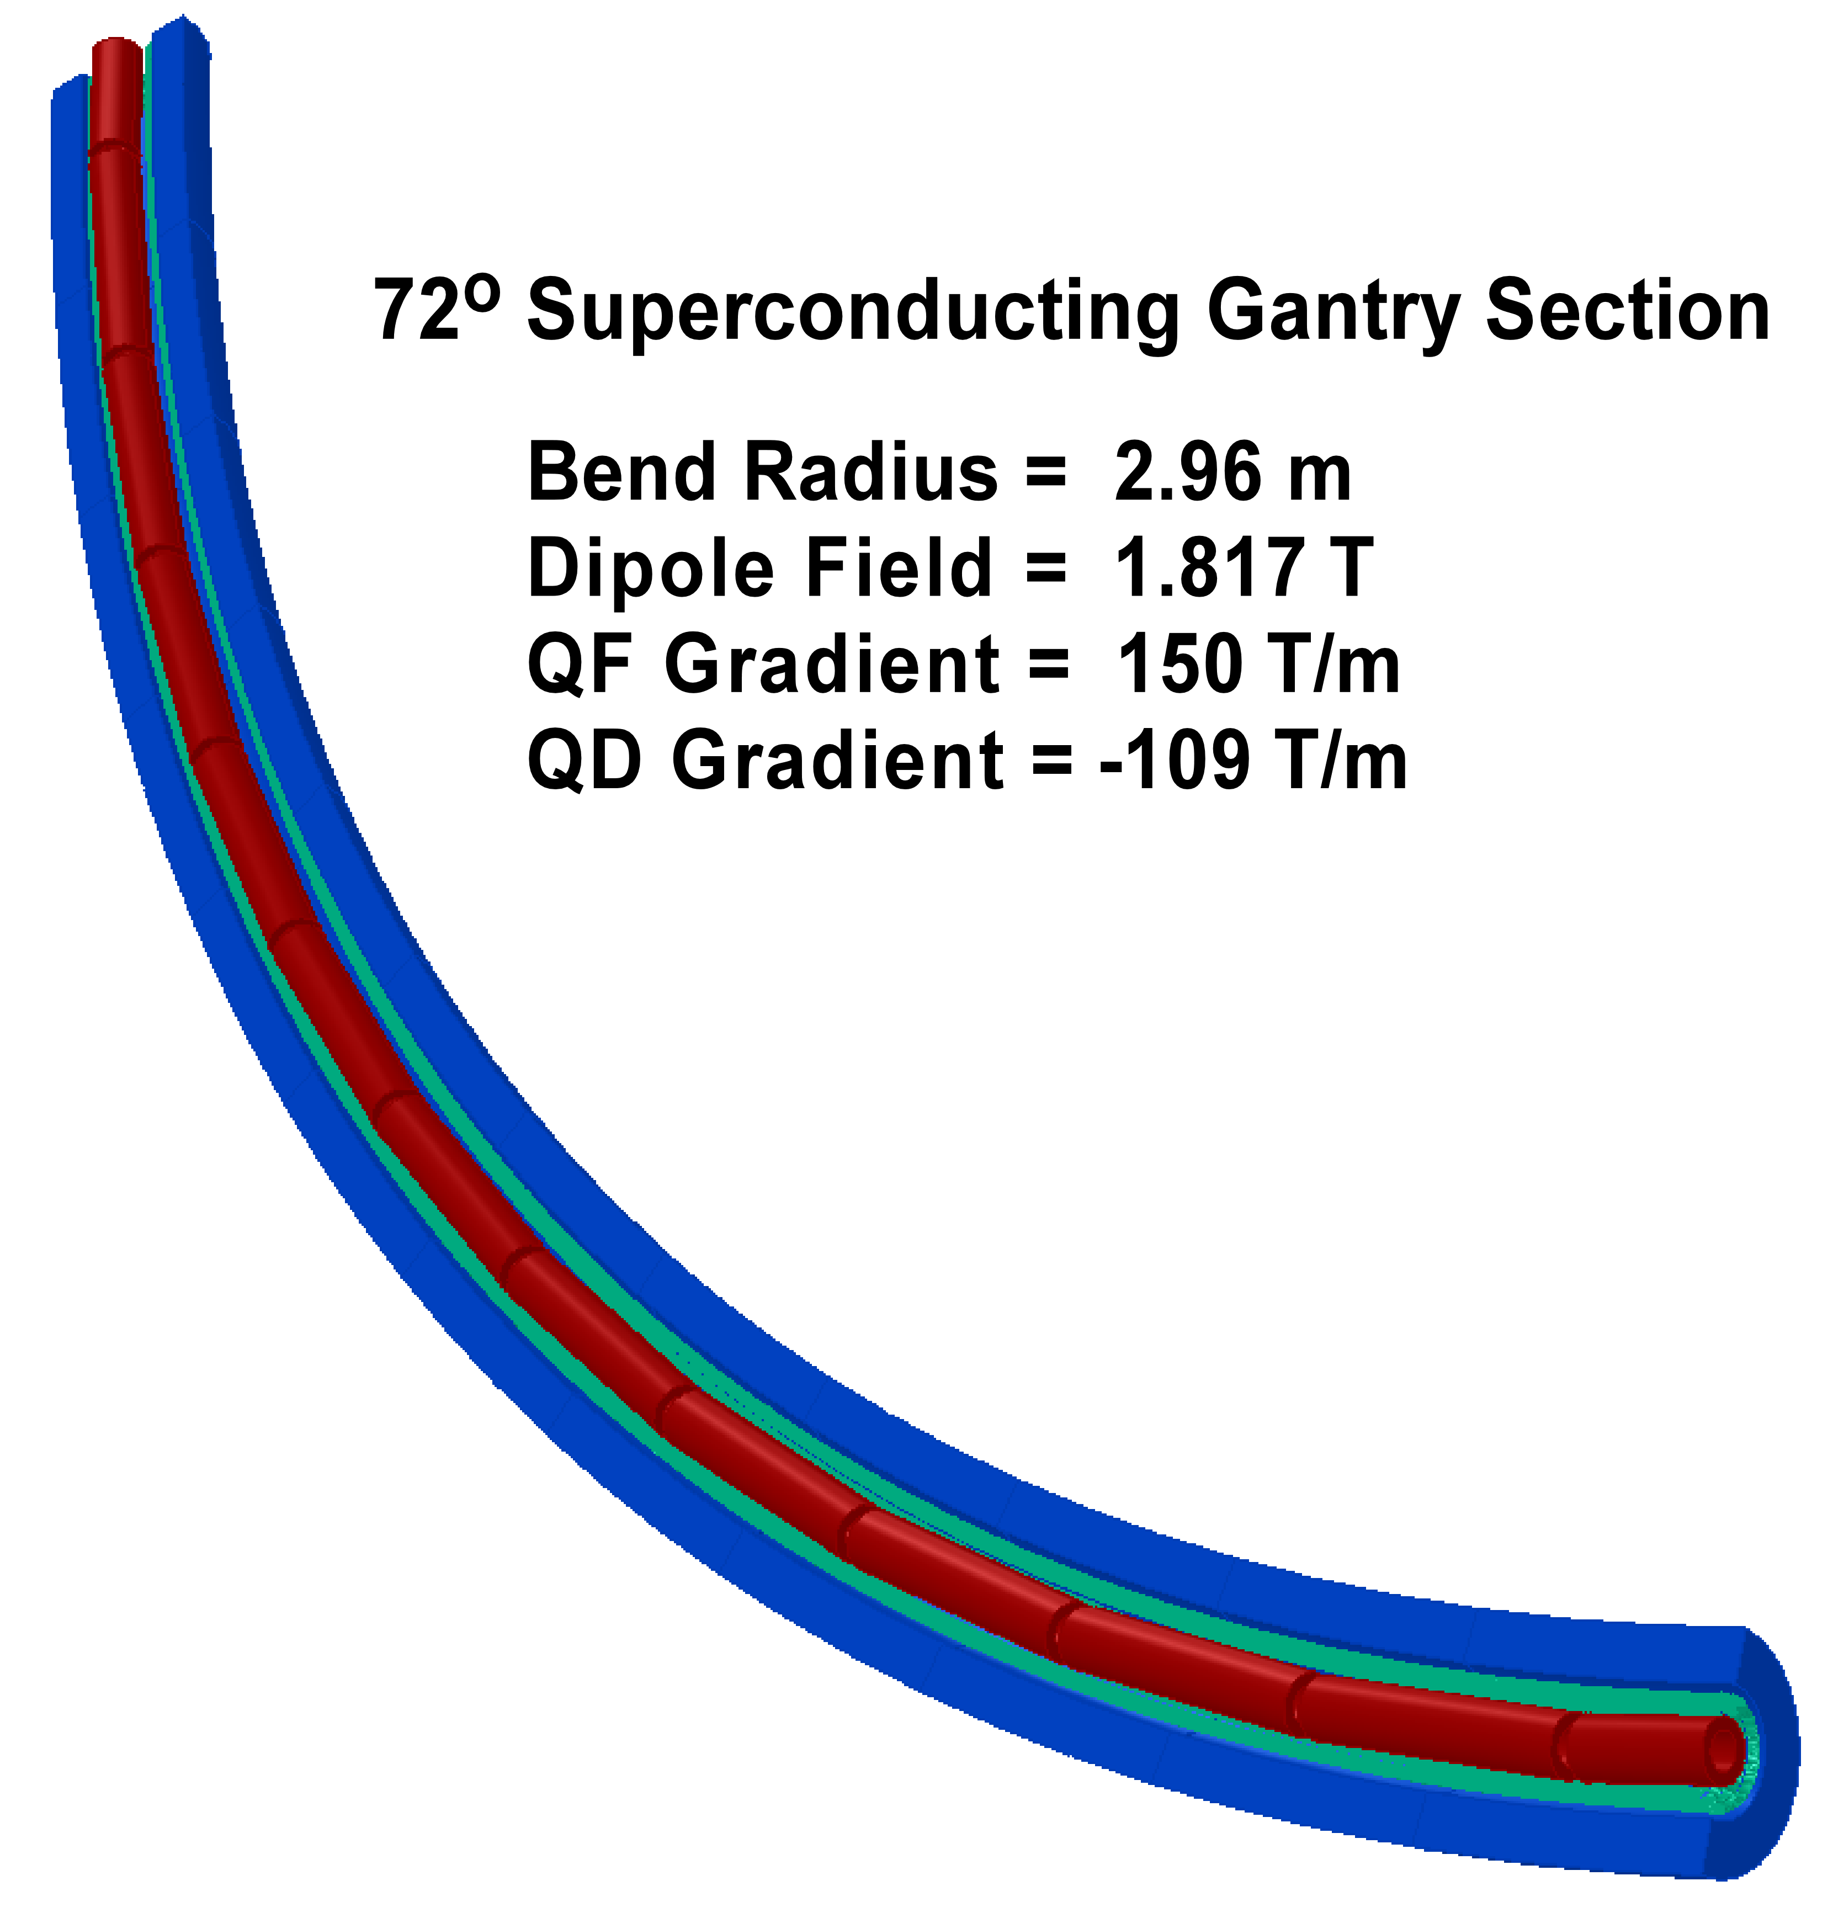
72º Achromatic part of the Superconducting Gantry
Brett Parker - BNL
62 cm

Slide 29
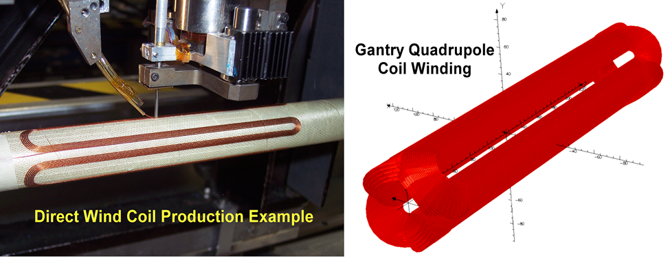
Tools and quadrupole windings
(Brett Parker – BNL)

Slide 30
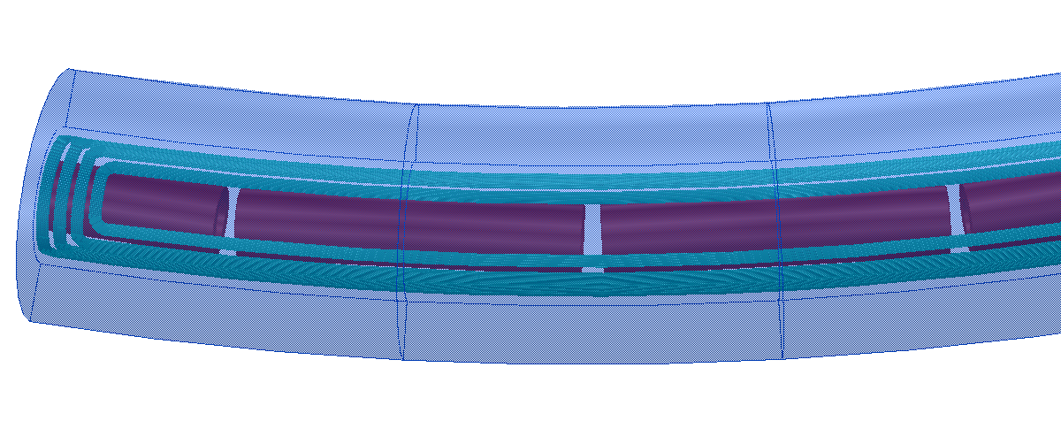
Achromatic Part of the Superconducting Gantry
(Brett Parker – BNL)

Slide 31
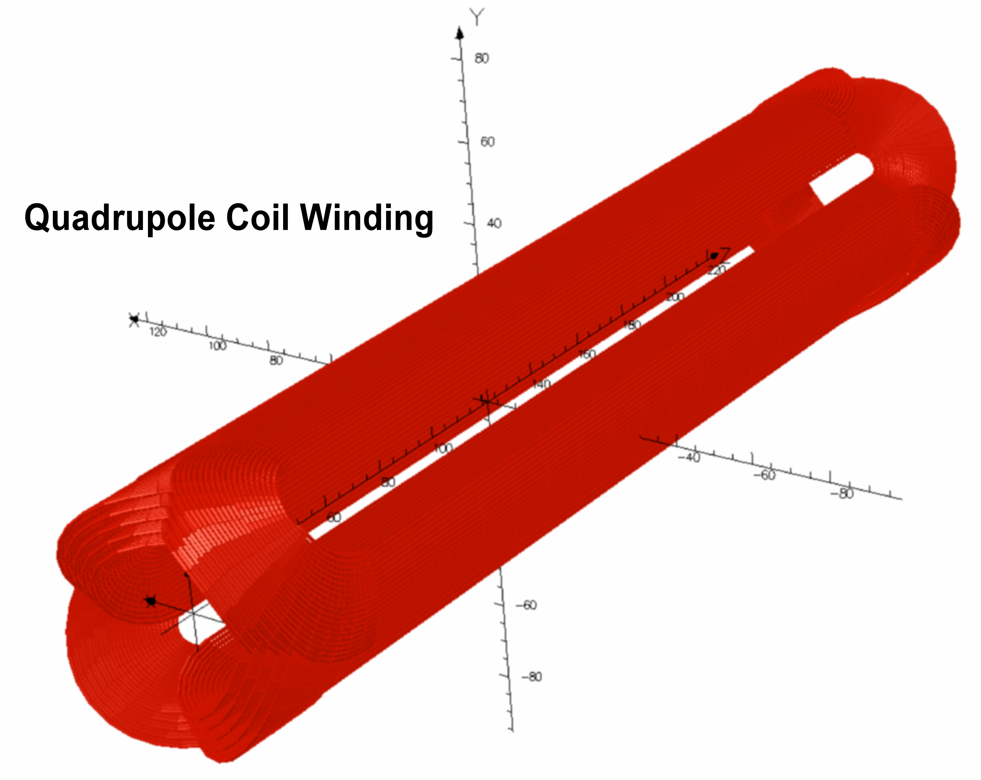
Brett Parker -BNL

Slide 32

Dipole winding (close-up) (Brett Parker – BNL)

Slide 33
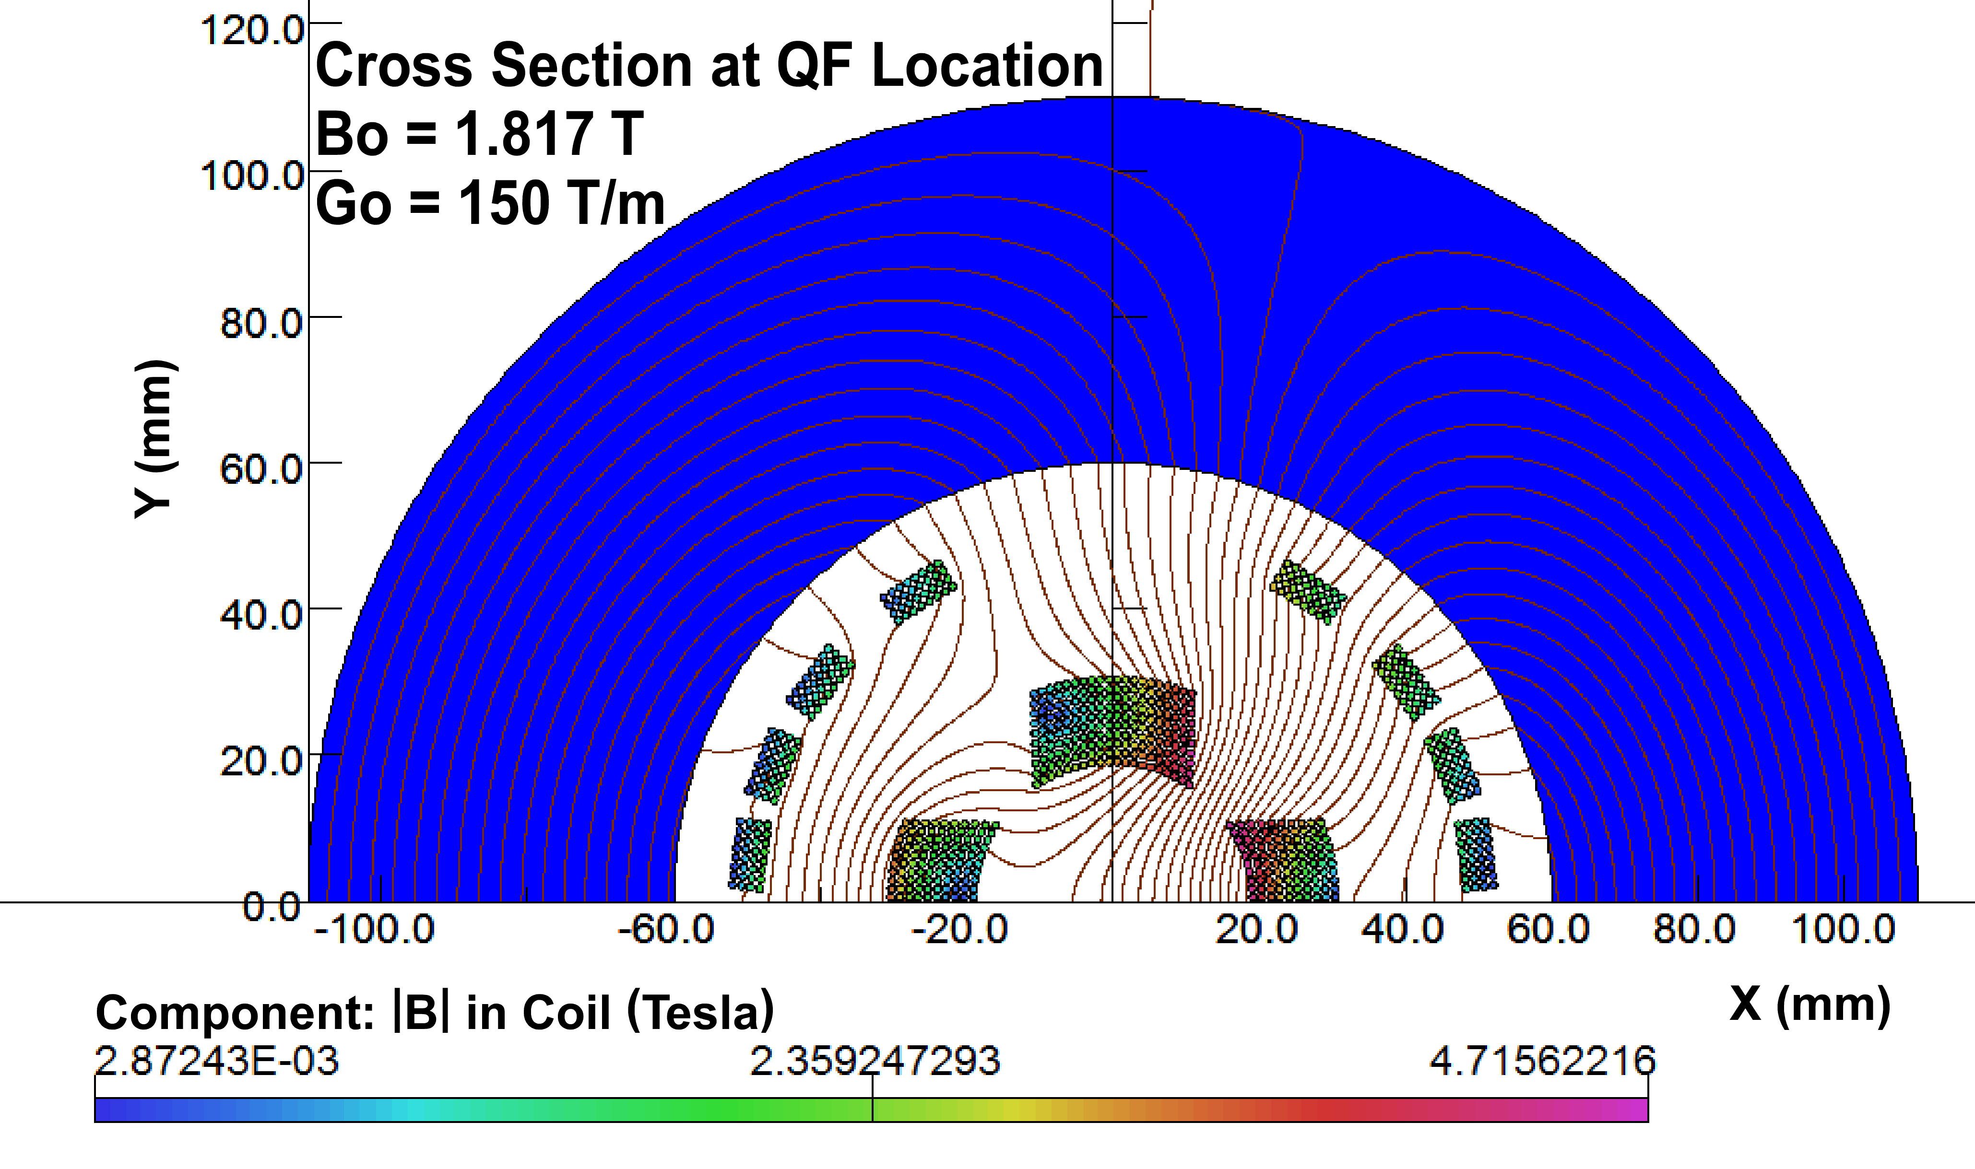
Magnetic field of the Superconducting Gantry
(Brett Parker – BNL)
Total volume of iron
V₁=0.2611 m³
ρ=7870 kg/m³
Weight~2.055 tons
+ ~1 ton for cryostat

Slide 34
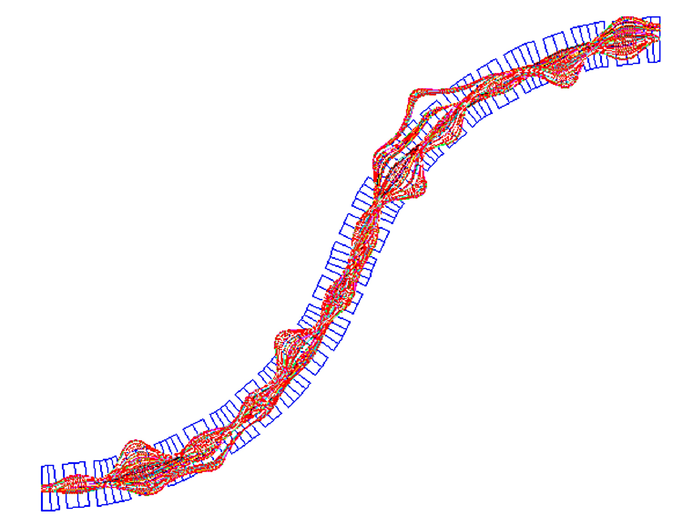
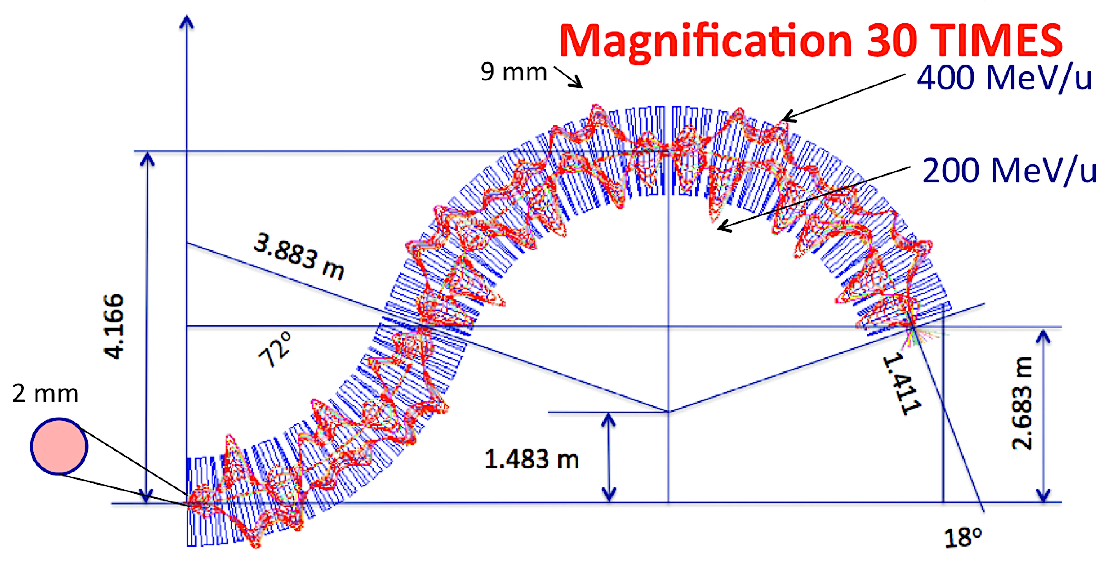

Slide 35
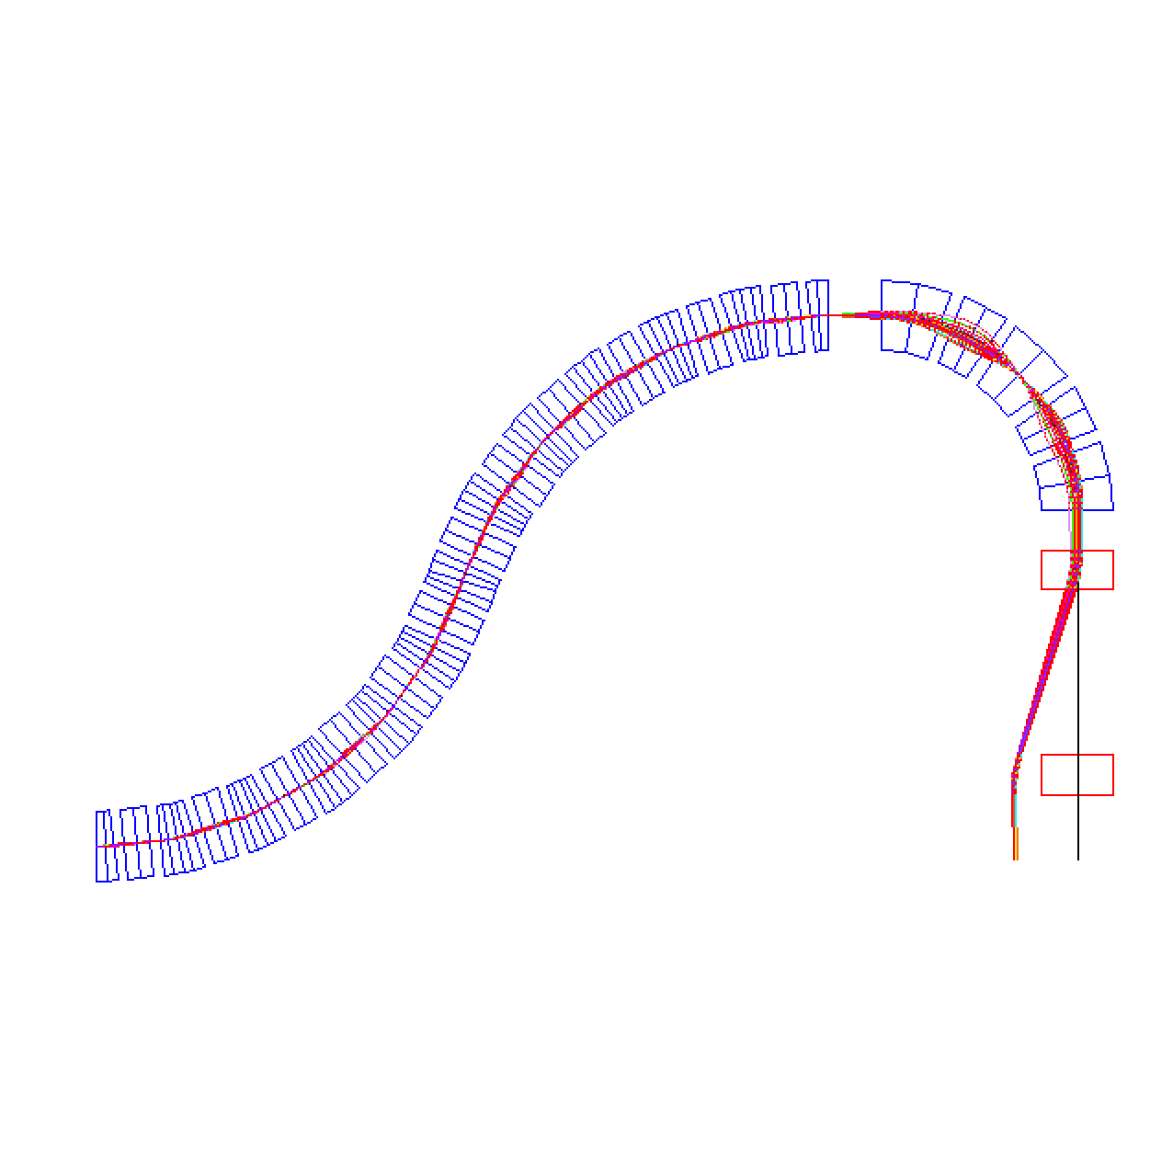
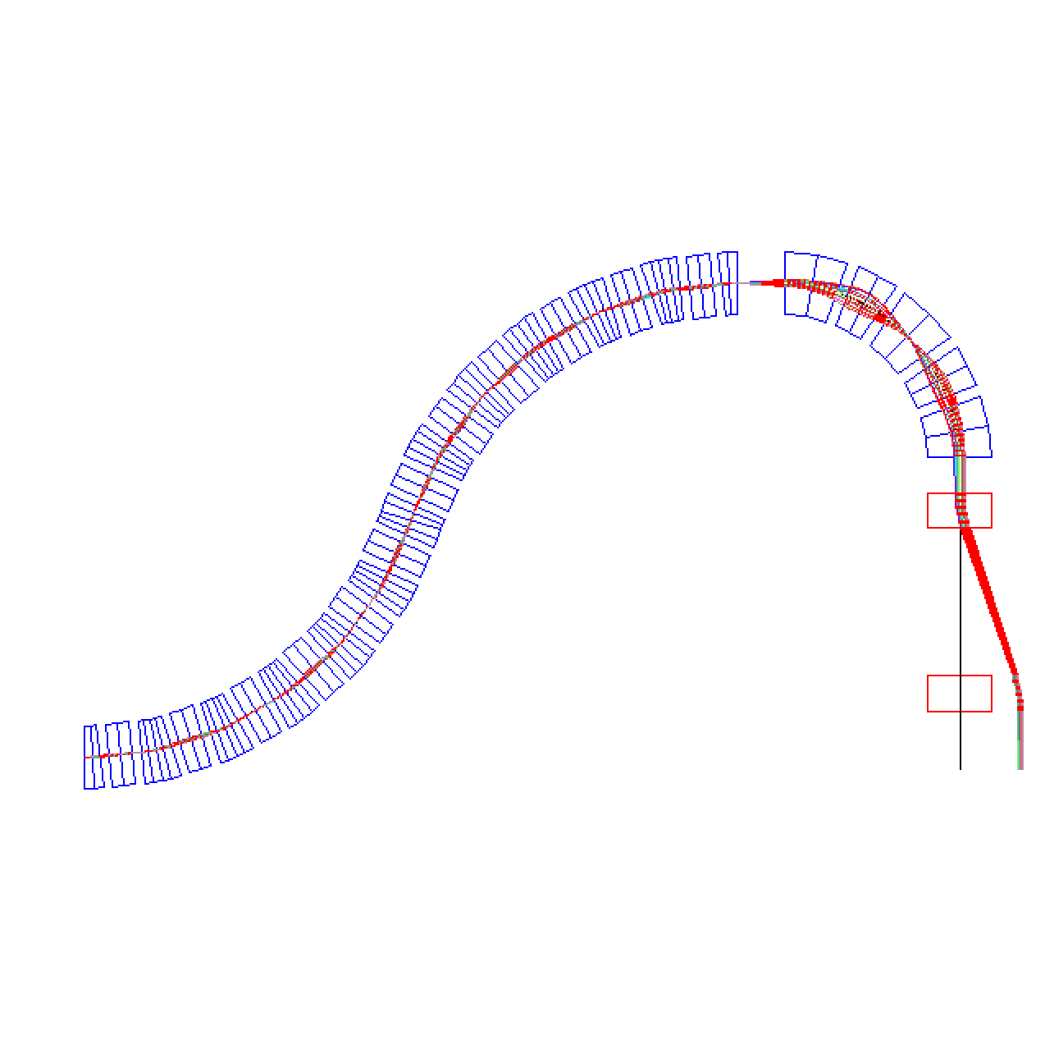
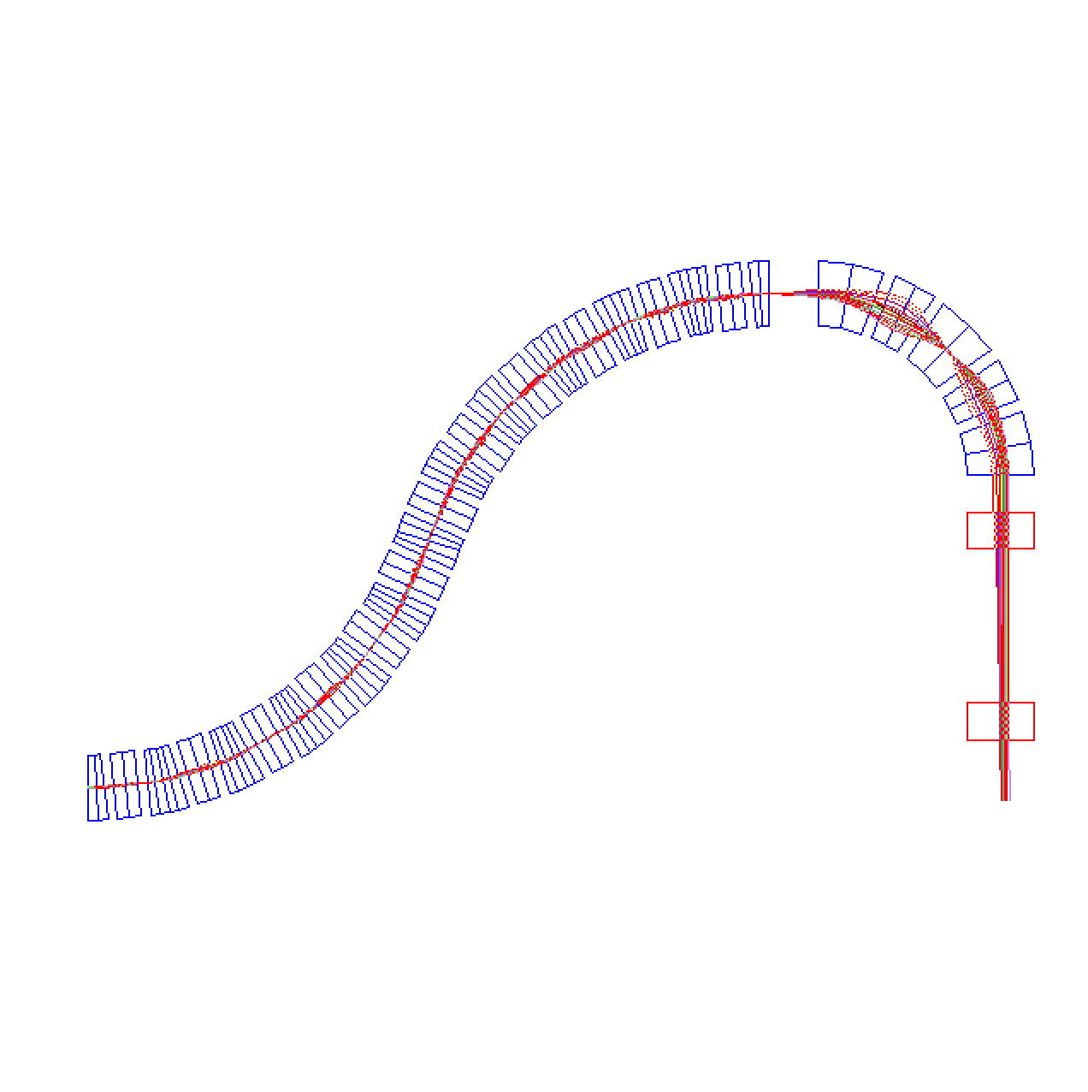
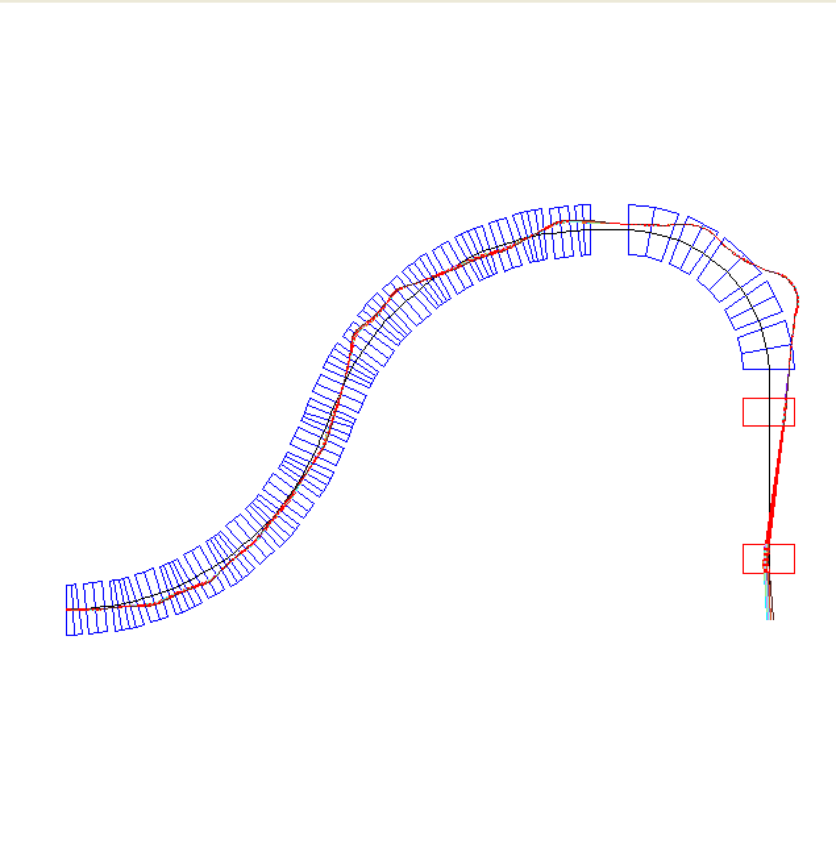
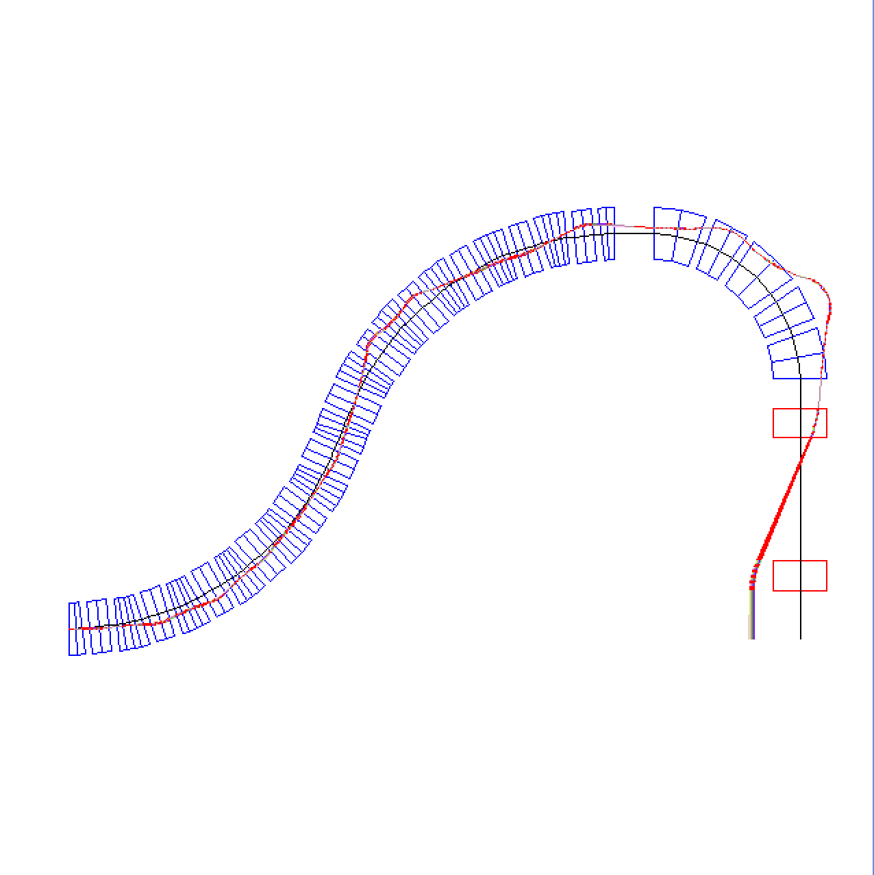
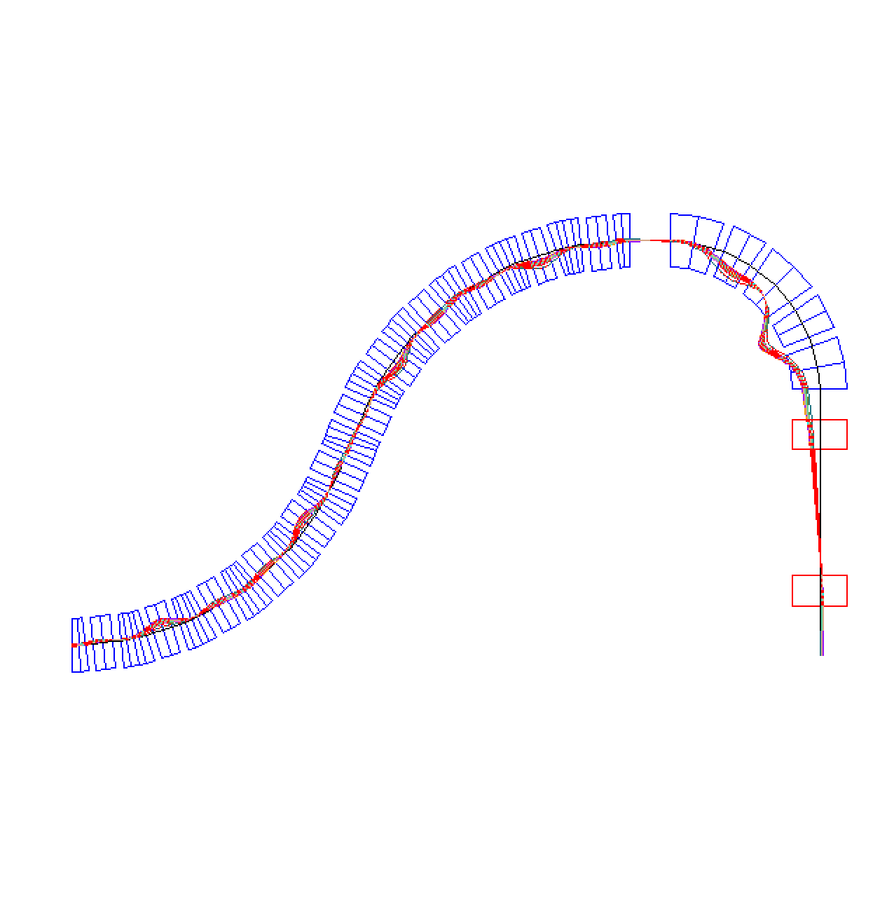
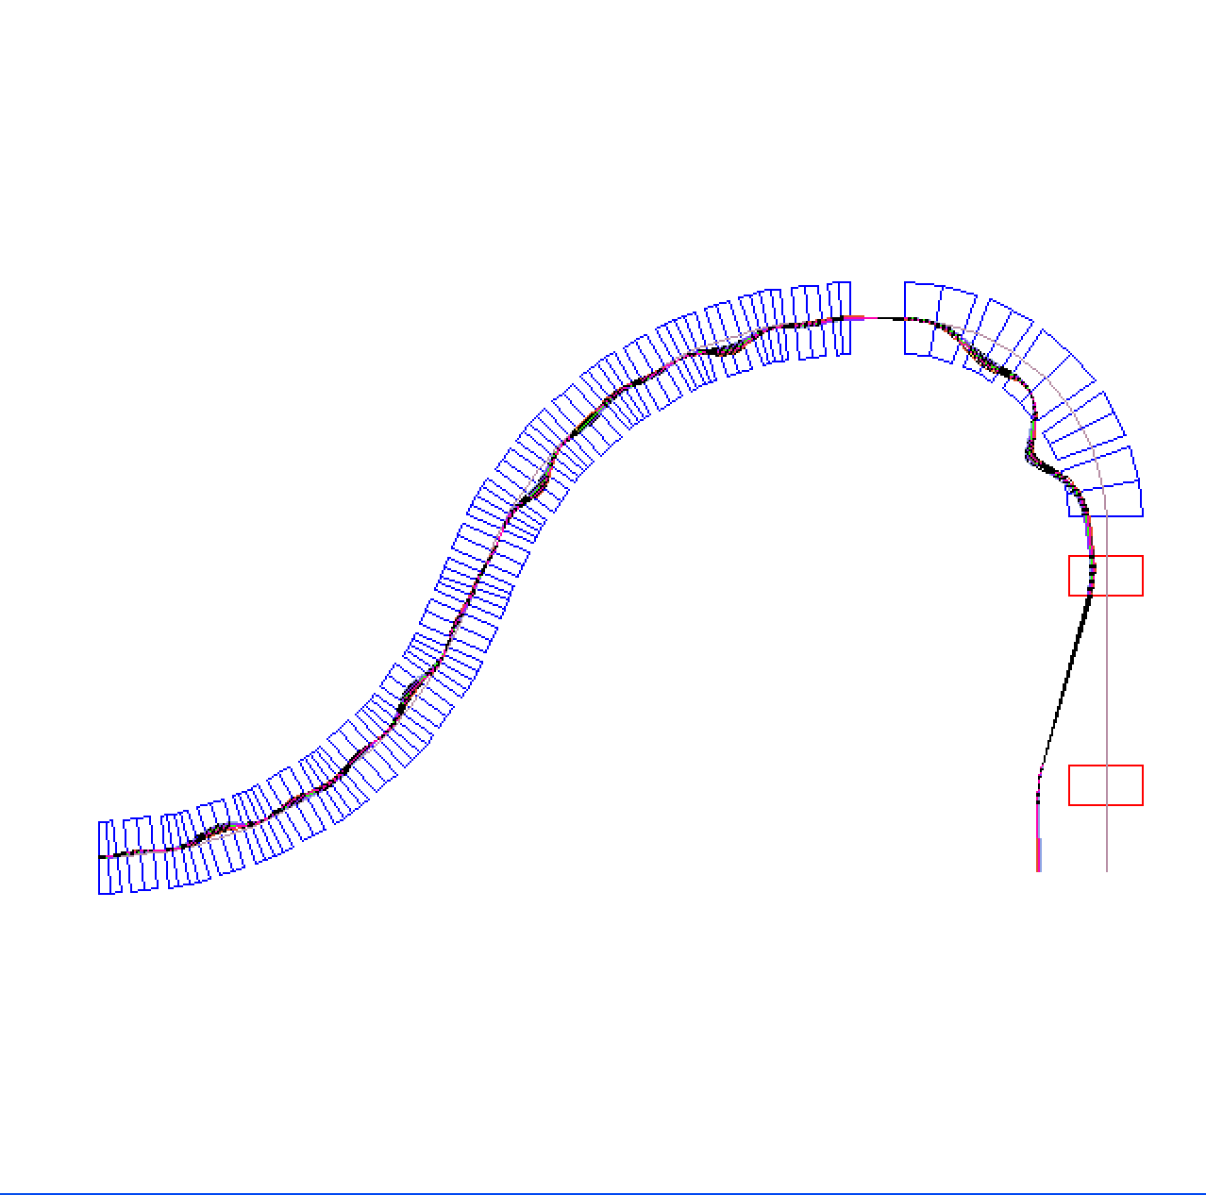
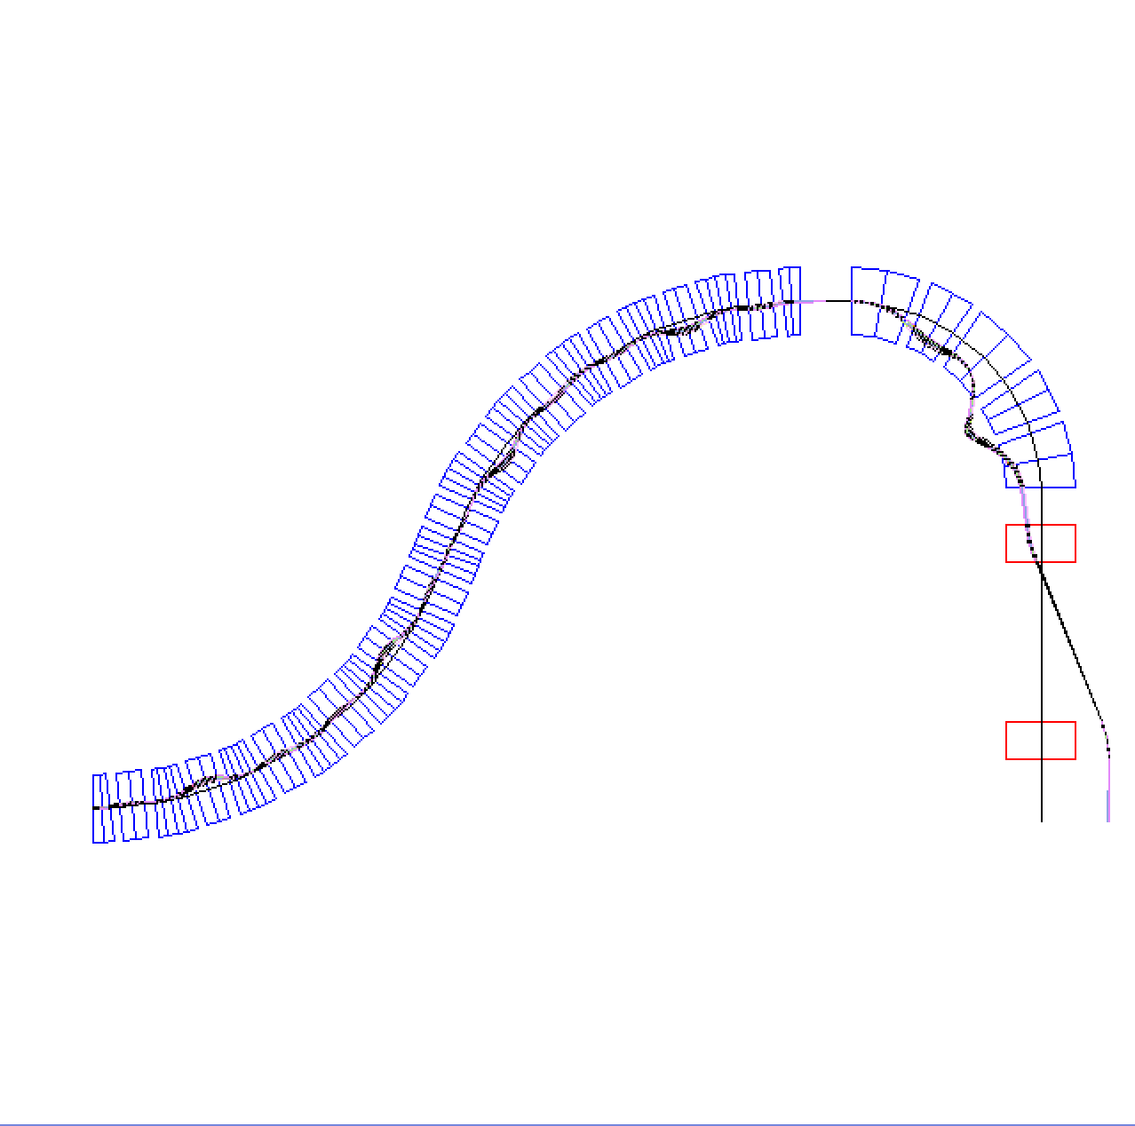

CARBON GANTRY h=4.091m without magnification
400 MeV/u
292 MeV/u
216 MeV/u

Slide 36

3.0503 m
6.84166 m
3.7913 m
2.7607 m
0.5 m
Magnified x10 =±10cm

Slide 37


Slide 38



CRYO-COOLERS: reliable, maintenance free, easy to operate

Slide 39
SUMMARY

Slide 40
SUMMARY:
NS-FFAG gantries provide transfer of carbon ions with large momentum range: δp/p=± 20% (200-400 MeV–or-100-200 MeV) allowing longitudinal scanning as fast as the front accelerator can change the energy of the beam because the magnetic field is fixed for the required energy range
Weight is reduced for one or two orders of magnitude
Size of NS-FFAG the carbon gantry is of PSI proton one
Operation is simplified as the magnetic field is fixed
Scanning system is with SAD=∞
Beam size is adjustable with the triplet magnets
Triplet magnets do not need to be superconducting

