Slide 1
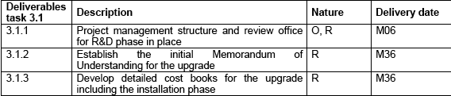
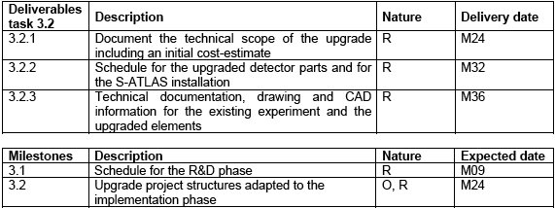
WP 3 – ATLAS upgrade, report Nov08
This year:
D3.1.1 passed – report sent in
M3.1 will be ok, end of the year (schedule exists)
Next deliverables and milestones March 2010 require new documents:
Have agreed with LHCC to prepare a TDR for phase I changes to ATLAS, and a Letter of Intent for phase II changes in 2009 (towards the end). These documents will cover: D3.2.1 and D3.2.2 and M3.2.
The rest will be March 2011, more detailed IMoU, Cost Books and Technical Information needed – linked to a Technical Proposal

