Slide 1
SLHC-PP
Reporting Status
WP1
M.Capeans, N.Knoors, C.Montagnier, K.Ross

Slide 2
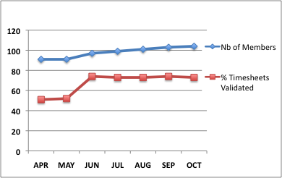
Membership & Timesheet Collection through PPT
Managed by Nathalie Knoors
Collection is working well (average of 15 TS/month submitted after deadline)
Difference is explained by:
  CEA and CNRS do not fill timesheets in PPT (15 members)
  Not all registered members work for SLHC-PP all months

Slide 3
SLHC-PP Expenses
Personnel (6 months)
From Hours reported in PPT (* except for CEA & CNRS, budgeted values used)
Assumption: flat spending profile
WP | P-M | P-M reported / P-M budgeted for Period1
1 | 9.7 | 60%
2* | 4.7 | 27%
3 | 18 | 53%
4 | 5.5 | 18%
5 | 6.5 | 17%
6* | 42.7 | 66%
7* | 17.7 | 30%
8 | 19.3 | 30%
SUM | 124 | 38% of 2008 budget
13% of total budget

Slide 4
CERN SLHC-PP Material Expenses (April-Nov 08)
Material expenses as reported in CERN accounting systems
Material Budget 2008: 433.5 kCHf
Total Material budget: 3127 kCHf
WP | Paid kCHf | 2008 SLHC-PP CERN Budget % | Total SLHC-PP CERN Budget %
1 | 2.3 | 9 % | 1.3 %
2 | 0 | 0 % | 0 %
3 | 0 | 0 % | 0 %
4 | 18.7 | 130 % | 15 %
5 | 0 | 0 % | 0 %
6 | 10.4 | 6 % | 1 %
7 | 4.2 | 11 % | 0.4 %
8 | 17.9 | 23 % | 5.5 %
SUM | 54 | 13 % | 1.7%

Slide 5
CERN costing
It will take place in December
SLHC-PP CERN members need to fill the December TS around Dec 5th with an estimated work effort. Significant adjustments can be done later. (Nathalie will send an Email)

Slide 6
Next Steps: YEAR 1 REPORT to EC
Financial Statement (Form C) of each Beneficiary sent to CERN
Consolidation all Financial information by CERN PO
WP progress reports available to Management
Draft available for comments to all beneficiaries
WP leaders must have collected and edited:
Summary of progress
Highlight significant results
List of publications/conferences/media…
Explain delays, failed milestones/deliverables
Explain use of resources
Submission to EC

