Slide 1
Status of BBLR compensation within HiLumi project
LRBB Workshop, Lyon, December 2015; Oliver Brüning CERN
1

Slide 2
LRBB Compensation & HL-LHC
HL-LHC Challanges
  LHC IR Layout & geometry imply virtual encounters for 25ns
  Crossing angle transforms these to Parasitic encounters
  Non-linearity and HL-LHC bunch intensities imply > 12 σ
  Large aperture and loss in instantaneous Luminosity

Slide 3
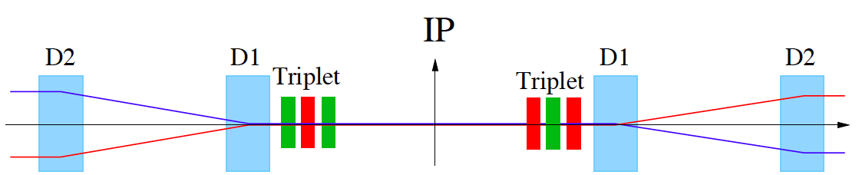
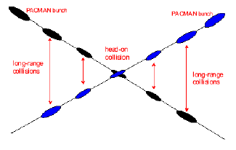
HL-LHC Challenges: Crossing Angle I
Insertion Layout:
ca.130m
ca.50m
Parasitic bunch encounters:
Operation with ca. 2800 bunches @ 25ns spacing ➔ approximately 30 unwanted collision per
Interaction Region (IR).
➔ Operation requires crossing angle
non-linear fields from long-range beam-beam interaction:
efficient operation requires large beam separation at unwanted collision points
  Separation of 10 -12 σ ➔ large triplet apertures & Luminosity loss!!

Slide 4
LRBB Compensation & HL-LHC
HL-LHC Challanges
  LHC IR Layout & geometry imply virtual encounters for 25ns
  Crossing angle transforms these to Parasitic encounters
  Non-linearity and HL-LHC bunch intensities imply > 12 σ
  Large aperture and loss in instantaneous Luminosity
HL-LHC Baseline
  Adopted Crab-Cavities and large aperture magnets!

Slide 5
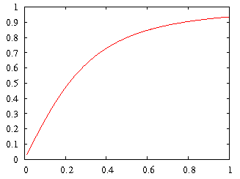
HL-LHC Upgrade Ingredients: Crab Cavities
Geometric Luminosity
Reduction Factor:
Crab Cavities:
Reduces the effect of geometrical reduction factor
Independent for each IP
Noise from cavities to beam?!?
Impedance?
Reliability & failure rate?
effective cross section
HL-LHC

Slide 6
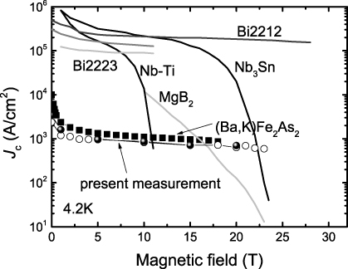
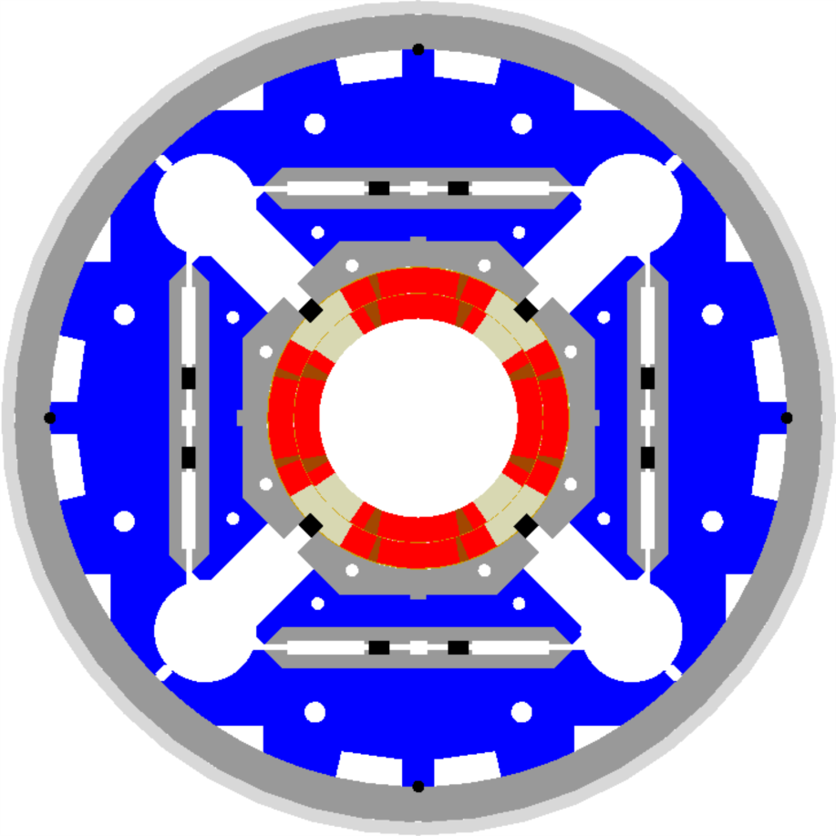
HL-LHC Magnets:
1.8K
LHC triplet:
210 T/m, 70 mm bore aperture
➔ 8 T @ coil (limit of NbTi tech.)
HL-LHC triplet:
140 T/m, 150 mm coil aperture
(shielding, β* and crossing angle)
➔ ca. 12 T @ coil ➔ 30% longer
  Requires Nb₃Sn technology
  ➔ ceramic type material (fragile)
  ➔ ca. 25 year development for this
  new magnet technology!
  US-LARP – CERN collaboration
US-LARP MQXF magnet design
Based on Nb₃Sn
technology

Slide 7
LRBB Compensation & HL-LHC
HL-LHC Challanges
  LHC IR Layout & geometry: Virtual encounters for 25ns
  Crossing angle transforms these to Parasitic encounters
  Non-linearity and HL-LHC bunch intensities imply > 12 σ
  Large aperture and loss in instantaneous Luminosity
HL-LHC Baseline
  Adopted Crab-Cavities and large aperture magnets!
  But LRBB compensation is still very interesting for HL-LHC:
    RLIUP: Plan B with flat beams
    Reduced X-in: relaxed CC parameters and additional options
      …Phased Crab Cavity installation

