Slide 1
Beam lifetime under various Luminosity conditions
F. Antoniou, M. Hostettler, Y. Papaphilippou, S.Papadopoulou, G. Papotti
Acknowledgements:
Beam-Beam and Luminosity studies working group, G. Arduini, G. Iadarola, G. Trad
Simulations and measurements of Long Range Beam-Beam effects in the LHC
30/11 to 1/12 2015, Lyon

Slide 2
Outline
Introduction: Luminosity
The Luminosity model components
Run I Vs Run II Luminosity decay
Observations from RunI data
Observations from RunII data
Summary and Conclusions

Slide 3
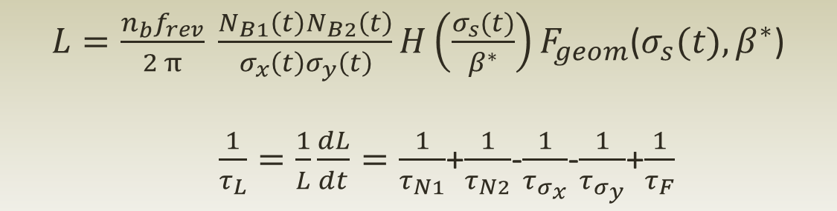
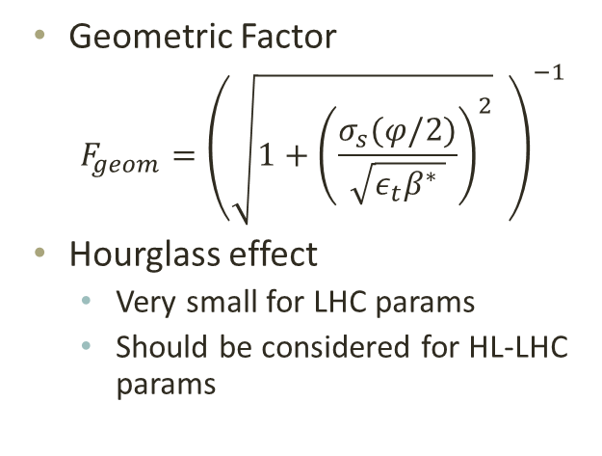
Introduction: Luminosity
Model components :
  Beam current decay with time
  Beam size (or emittance) evolution with time

Slide 4
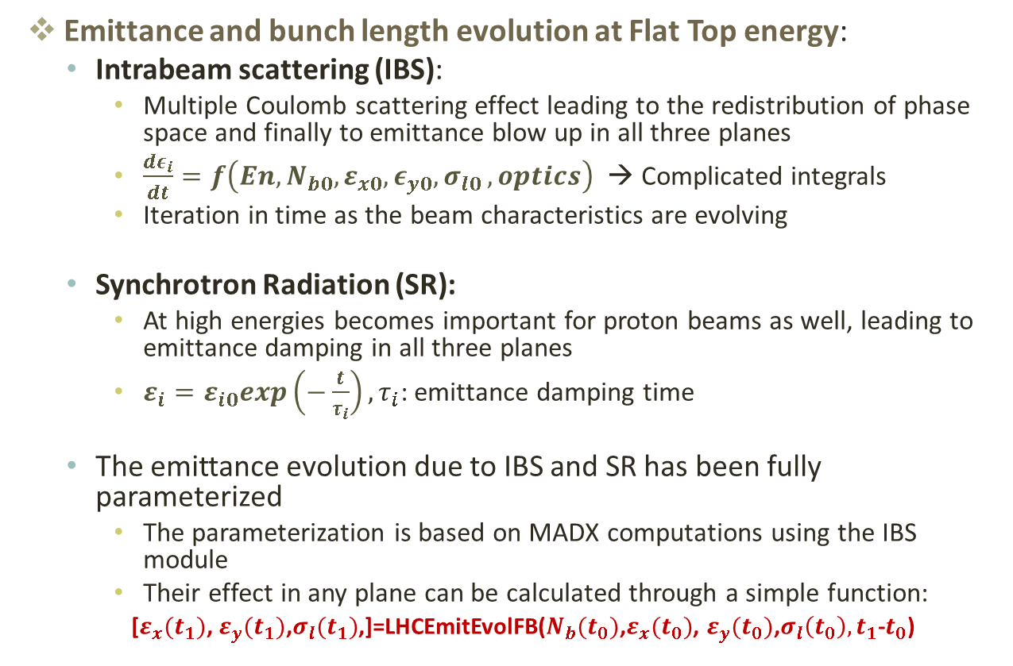
Model components (1)
Emittance and bunch length evolution at Flat Top energy:
  Intrabeam scattering (IBS):
    Multiple Coulomb scattering effect leading to the redistribution of phase space and finally to emittance blow up in all three planes
    $\frac{dε_{i}}{dt}=f\left({En,N_{b0},ε}_{x0},ε_{y0}{,σ}_{l0},optics\right)$ → Complicated integrals
    Iteration in time as the beam characteristics are evolving
  Synchrotron Radiation (SR):
    At high energies becomes important for proton beams as well, leading to emittance damping in all three planes
    $ε_{i}=ε_{i0}exp\left(−\frac{t}{τ_{i}}\right),τ_{i}$: emittance damping time
  The emittance evolution due to IBS and SR has been fully parameterized
    The parameterization is based on MADX computations using the IBS module
    Their effect in any plane can be calculated through a simple function:
    [$ε_{x}(t_{1})$, $ε_{y}(t_{1})$,$σ_{l}(t_{1})$,]=LHCEmitEvolFB(${N_{b}(t_{0})\text{,}ε}_{x}(t_{0})$, $ε_{y}(t_{0})$,$σ_{l}\left(t_{0}\right),t_{1}$-$t_{0}$)

Slide 5
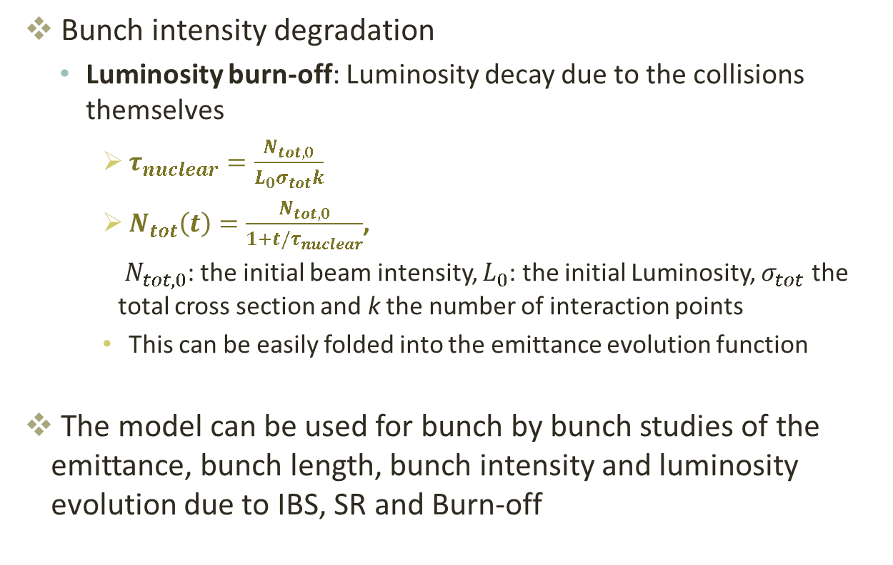
Model components (2)
Bunch intensity degradation
  Luminosity burn-off: Luminosity decay due to the collisions themselves
    $τ_{nuclear}=\frac{N_{tot,0}}{L_{0}σ_{tot}k}$
    $N_{tot}\left(t\right)=\frac{N_{tot,0}}{1+t/τ_{nuclear}}$,
    $N_{tot,0}$: the initial beam intensity, $L_{0}$: the initial Luminosity, $σ_{tot}$ the total cross section and k the number of interaction points
    This can be easily folded into the emittance evolution function
The model can be used for bunch by bunch studies of the emittance, bunch length, bunch intensity and luminosity evolution due to IBS, SR and Burn-off

Slide 6
Other components
Other sources need to be considered
  Non-linearities of the machine
  Noise effects
  Scattering on residual gas
  …
Understanding the behavior of the machine analyzing the data from RunI and RunII
  On going effort to find correlations from the data from average and bunch by bunch behavior

Slide 7
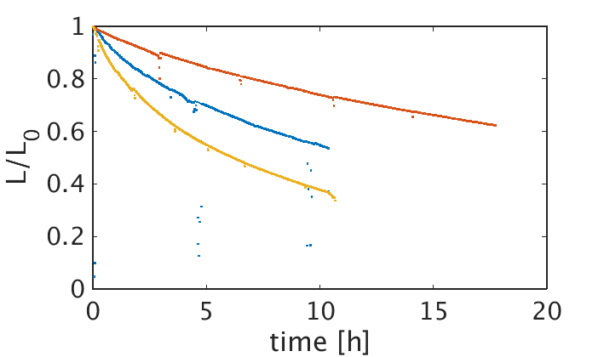
Run I Vs Run II Lumi decay
Mean bunch characteristics at the beginning of Stable Beams:
  Fill 4440
    N_{b0} =1.08e11ppb
    ε₀ = 3.08 μm-rad
  Fill 4246
    N_{b0} =1.2e11 ppb
    ε₀ = 2.1 μm-rad
  Fill 3232
    N_{b0} =1.6e11ppb
    ε₀ = 2.8 μm-rad
Fill 4440 (25ns 2015)
Fill 4246 (50ns 2015)
Fill 3232 (50ns 2012)
Luminosity decay from ATLAS data
The luminosity decay is much slower for the current runs
  Lower bunch brightness
  Weaker beam-beam effect

Slide 8
Observations from run I

Slide 9
Observations from Run 1 data
Fills with WS data at Flat Bottom
  Not always data for both beams and both plane
  The convoluted emittance is used
The IBS model from injection to the beginning of collisions is applied
  The expected conv. emittance of the selected 144 bunches (with WS data) at the beginning of collisions is calculated
  Comparison with the measured one
The data from many Fills are put together

Slide 10
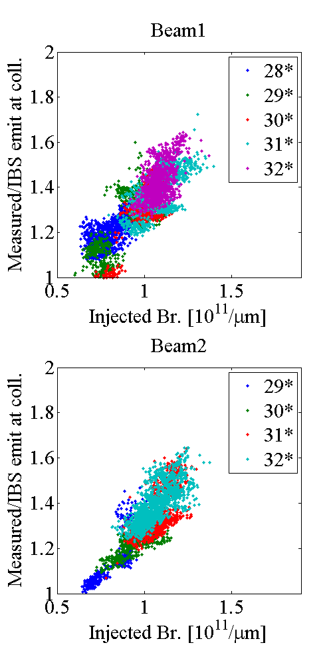
Data to model comparison
28* → Fills 2800-2900, etc.
Only stable bunches are used
Linear dependence of the emittance ratio (or blow up factor) with the injected brightness

Slide 11
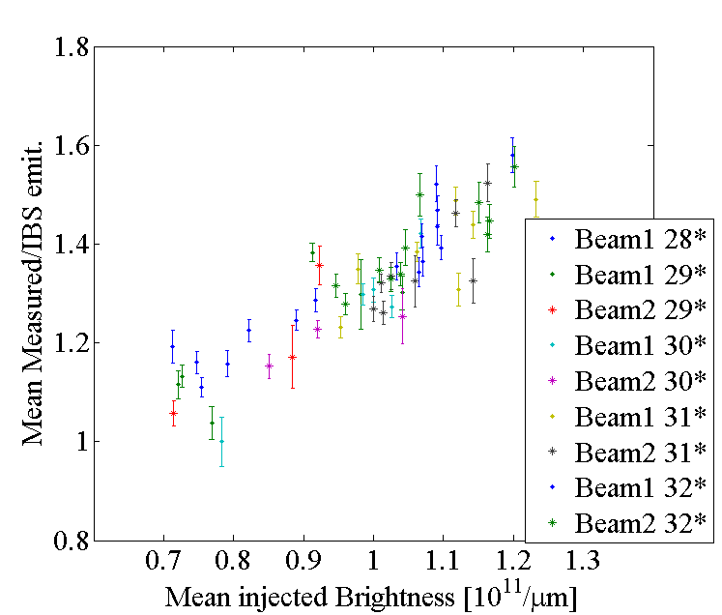
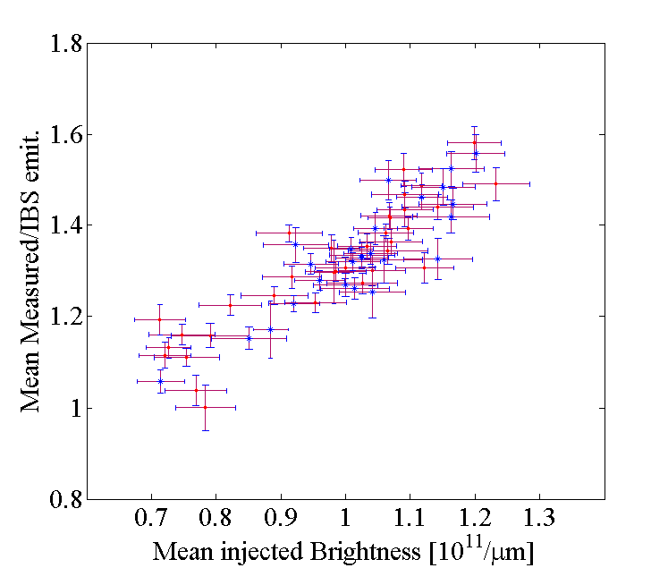
Data to model comparison
The same exercise is repeated using the mean values for each Fill
The errorbars show the std from the mean for each Fill

Slide 12
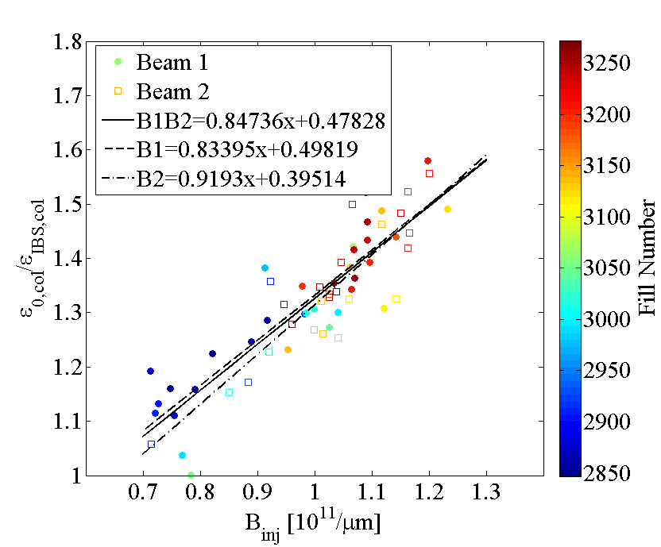
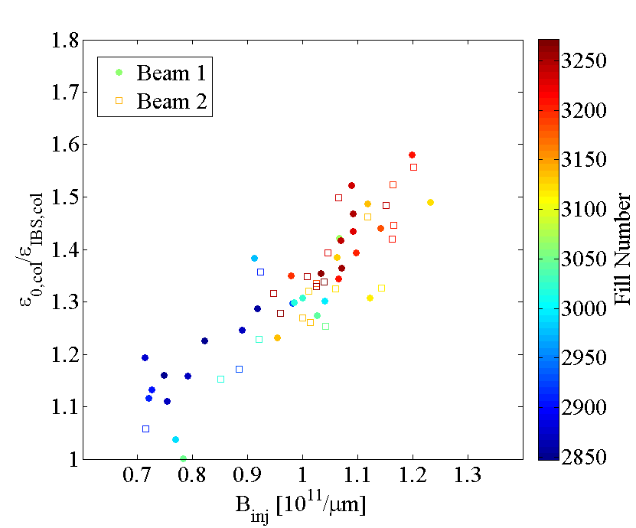
Data to model comparison
  Similar slope for both beams
  Can we use a global fit?

Slide 13
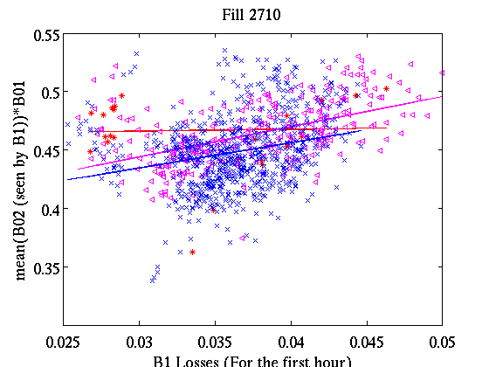
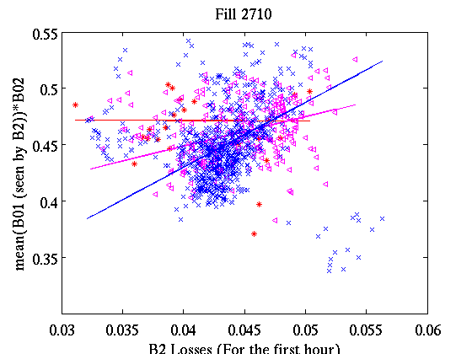
Correlations with long range
The plots show the product of the mean brightness of the longrange encounters seen by B1 (top) or B2 (bottom) and the brightness of B1 (top) or B2 (bottom) versus the Beam losses after 1h of run
The bunches with 8, 12 and 16 longrange encounters are plotted with different colors
Linear correlation is observed with different slope for different number of longrange encounters
  The slope is steeper for larger longrange encounters
  Same trend for both B1 and B2
LR=8
LR=12
LR=16
LR=8
LR=12
LR=16

Slide 14
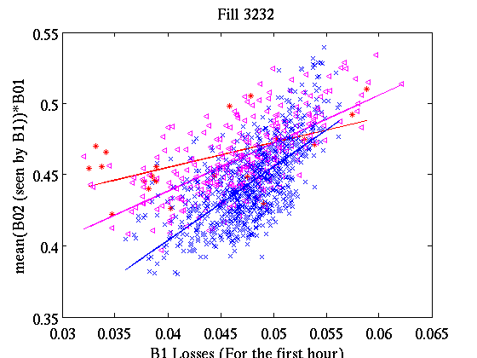
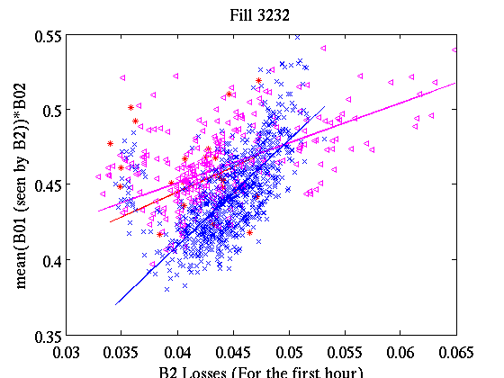
Correlations with long range
The same analysis is applied to Fill3232
Exactly the same trend is observed for both beams
  Steeper slopes in this case
LR=8
LR=12
LR=16
LR=8
LR=12
LR=16

Slide 15
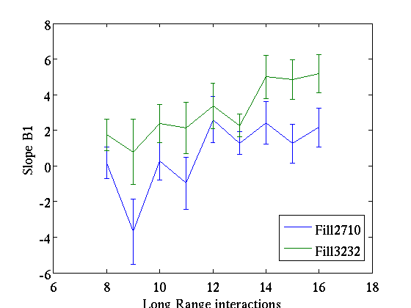
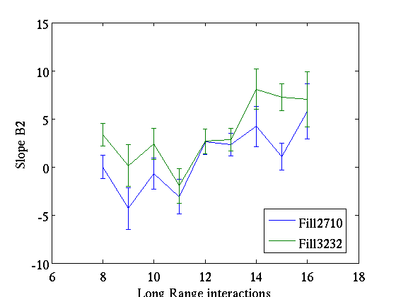
Correlations with long range
Calculating the slope for each of those curves for all different cases of long-range encounters (8-16)
  Clear trend of slope increase with the number of long-range encounters
  The effect is enhanced for Fill3232 where the brightness is higher
  Need to generalize the observation for other fills
    Data need carefull cleaning (unstable bunches,…)
  The brightness estimation is not accurate because the convoluted emittance (from luminosity) is used
    Necessity for bunch-by-bunch transverse emittance diagnostics
    Some first analysis can be done using luminous region data

Slide 16
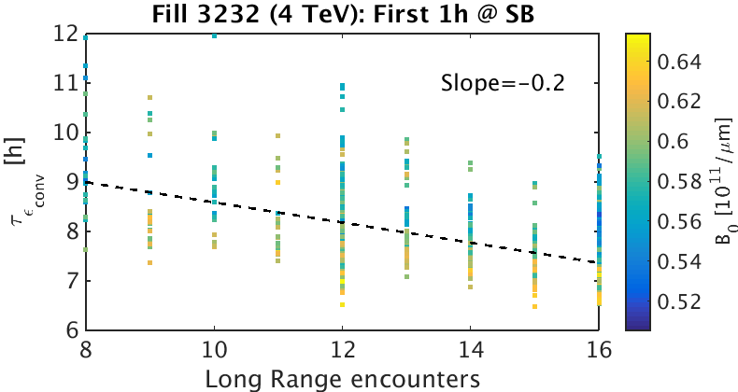
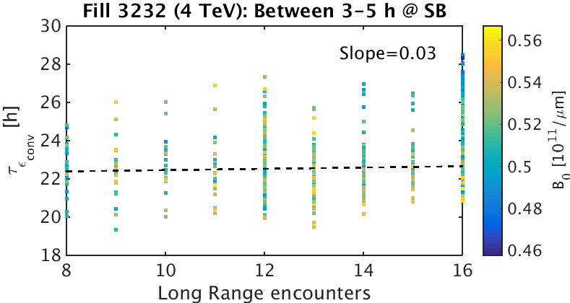
Effect of number of LRs on emittance lifetime
A bunch-by-bunch exponential fit was applied for different time intervals at SB:
  Left: The bbb emittance growth time vs the number of LRs and colorcoded with the injected bunch brightness
  → Dependence on both the number of LRs and the bunch brightness
  Right: The bbb emittance growth time for the time interval between 3 and 5 h at SB
  → Dependence on LRs is lost

Slide 17
Observations from run ii

Slide 18
Analyzing RunII data (1)
Most of the Fills that arrived at Stable Beams have been analyzed
In this Run we have emittance measurements both at Flat Bottom and Flat Top
  BSRT data for both beams and both planes
  Convoluted emittance from luminosity
  Convoluted horizontal and vertical emittance from OP scans
Comparisons between the different methods not always in good agreement
  Work in progress to understand the data
Bunch by bunch analysis can guide our model and add missing pieces

Slide 19
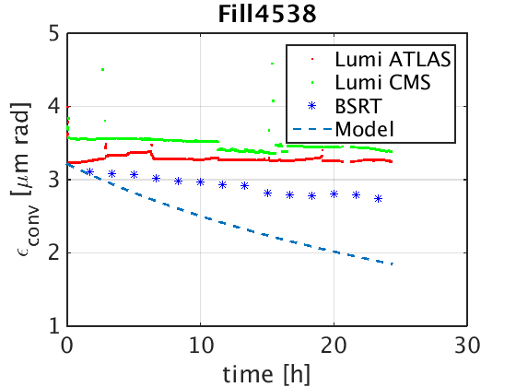
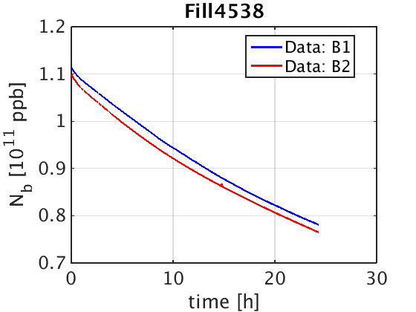
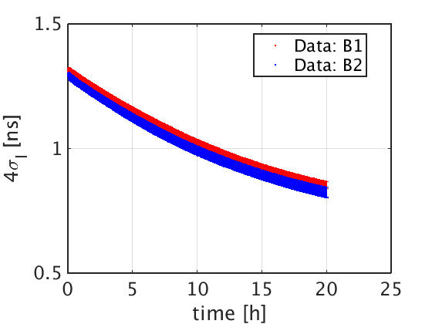
Lumi model predictions Vs RunII data: Emittance @ SB
Fill 4538 is used as an example here
Emittance evolution during SB from BSRT, Lumi ATLAS and Lumi CMS show different evolution
IBS+SR+Burn-off prediction is shown with thw blue dashed line
The Bunch length and mean bunch current evolution is shown on the bottom plots
Blow up is observed in both planes, with respect to the model
We need to understand the data and include other sources of emittance blow-up

Slide 20
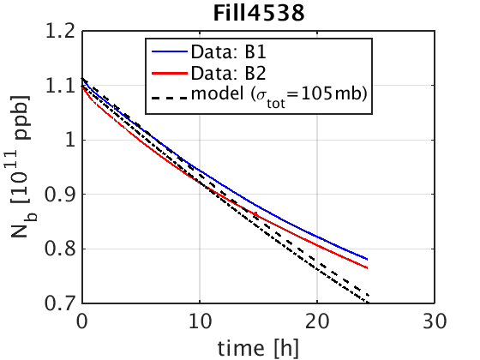
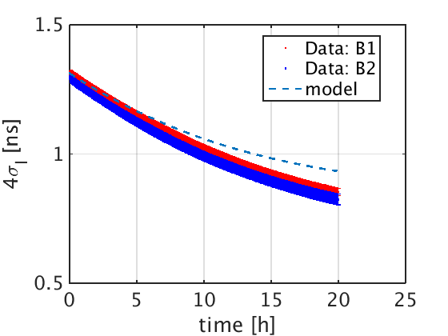
Lumi model predictions Vs RunII data: Bunch current & bunch length @ SB
Looking at the other two observables (Top: Bunch current, Bottom: bunch length)
Smoother current decay and more bunch length damping is observed with respect to the model prediction
Same analysis is done for all the Fills that arrived at SB
  Similar behavior with the same or more pronounced divergence from the model is observed in all the Fills

Slide 21
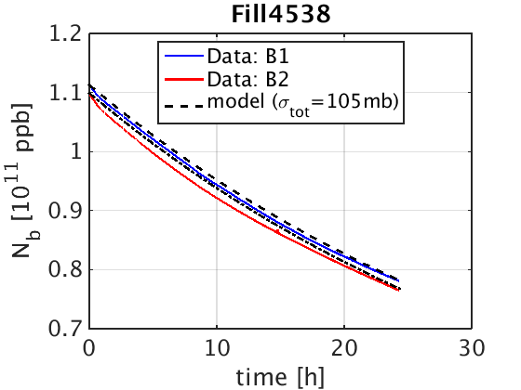

Lumi model comparison with RunII data: Bunch current & bunch length
Using the emittance evolution from the data and recalculating the current decay and bunch length evolution from model → the agreement is much better
Modeling the emittance evolution at Stable beams correctly is crucial for the luminosity model
  Need to understand the data!
  Need to understand and add other sources of emittance blow up to our model

Slide 22
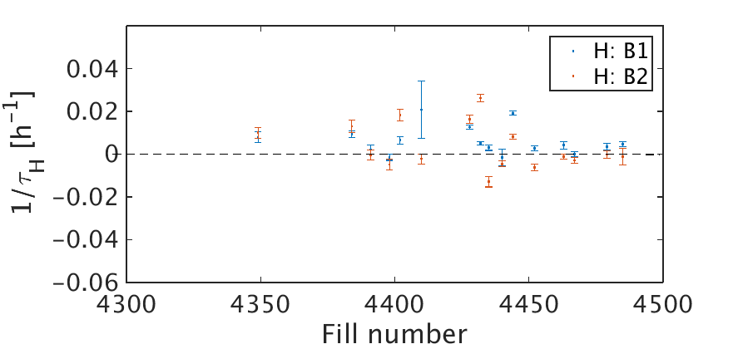
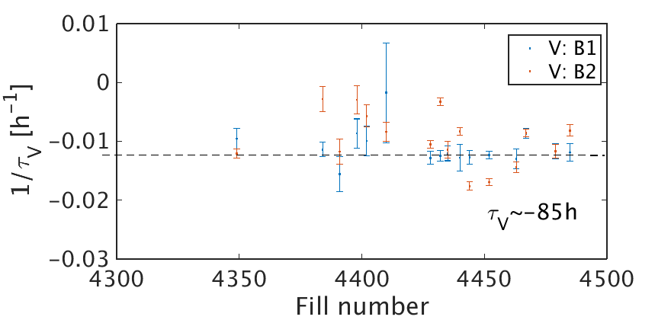
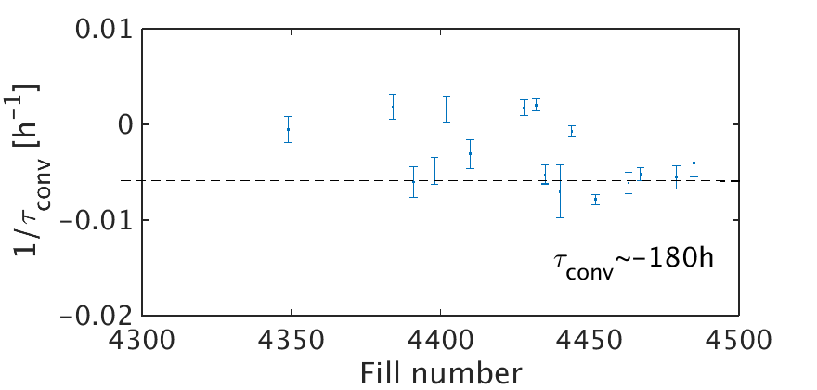
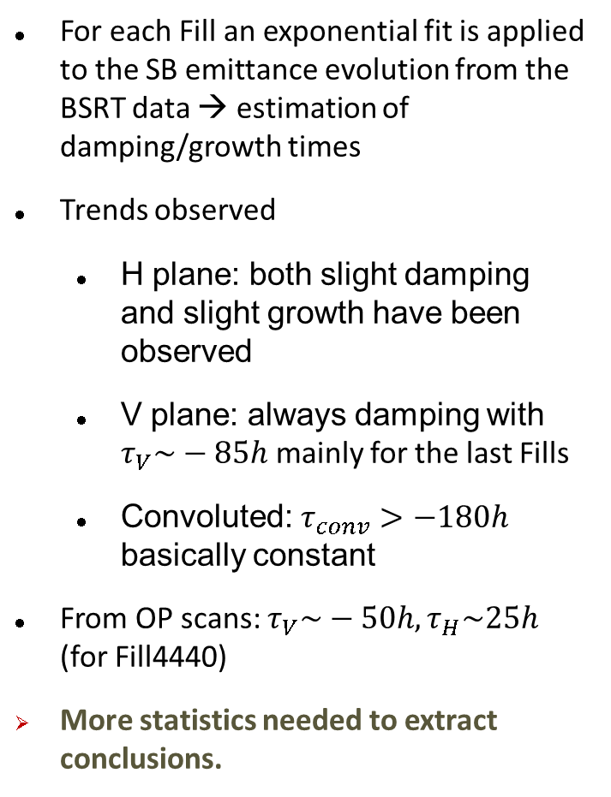
Emittance evolution during SB
For each Fill an exponential fit is applied to the SB emittance evolution from the BSRT data → estimation of damping/growth times
Trends observed
  H plane: both slight damping and slight growth have been observed
  V plane: always damping with $τ_{V}\sim −85h$ mainly for the last Fills
  Convoluted: $τ_{conv}>−180h$ basically constant
From OP scans: $τ_{V}\sim −50h,τ_{H}\sim 25h$ (for Fill4440)
More statistics needed to extract conclusions.

Slide 23
Summary and Outlook
A model including IBS, SR and Burn-off at Flat Top (4TeV, 6.5TeV and 7TeV) and Flat Bottom energy & is ready
  A full parameterization has been performed and we can describe the evolution with a function (per energy)
  Bunch-by-bunch
Observations from RunI data
  Emittance blow up and bunch current decay at the beginning of stable beams correlated with the number of LRs and bunch brightness
  The effect is more pronounced for higher brightness
  Simulations needed in order to verify and quantify the effect in order to be added as a component to our Lumi model
Observations from RunII data
  Differences have been observed on the emittance evolution from the different methods of measurement → Needs to be understood
    Modeling the emittance evolution is a very important component of the model
    Using the emittance from the data, good prediction for the bunch length and bunch current evolution
  No emittance blow up or bunch current decay correlated with the long range encounters have been observed for the moment
    More relaxed conditions for 2015 with relatively low bunch brightness

