Slide 1
The RHIC Discoveries in Perspective
presentation at the CERN symposium
30 Years of Heavy Ions…What Next?
November 9th, 2016
W.A. Zajc
Columbia University

Slide 2
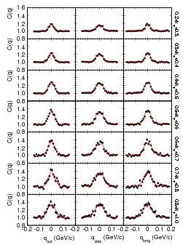
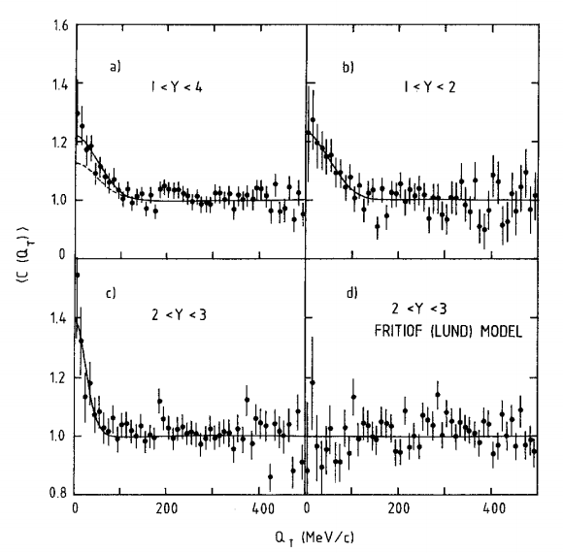
Original Title
“From Phenomenology to Precision”
Certainly has been the path in 30 years
of heavy ion physics at CERN:
NA35, Z.Phys. C38, 79 (1988)
ALICE Phys Lett. B696, 328 (2011)

Slide 3
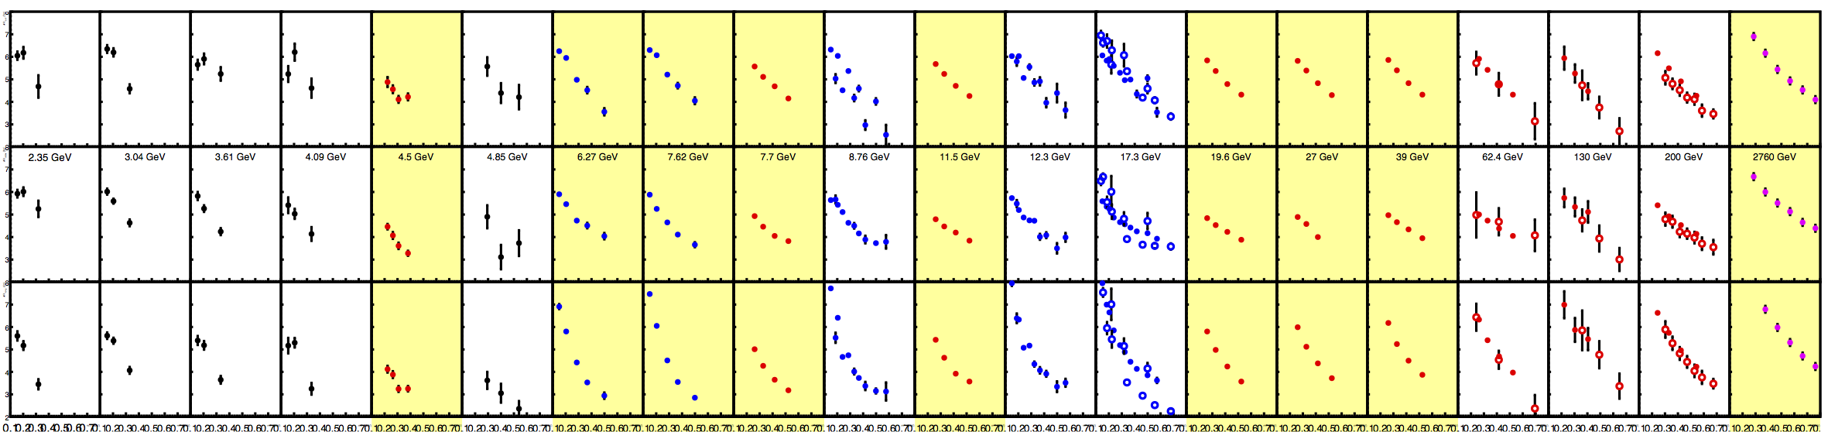
On An Even Finer Scale
As an example:
  Progress in HBT measurements over 30 years
(Adopted from a slide by Mike Lisa, QM 2015)
1986-2016 : Dynamic range in √s = 10³
STAR
Fixed Target
NA49 Scan
RHIC BES
ALICE

Slide 4
On An Even Finer Scale
As an example:
  Progress in HBT measurements over 30 years
(Adopted from a slide by Mike Lisa, QM 2015)
1986-2016 : Dynamic range in √s = 10³
STAR
Fixed Target
R H I C
NA49 Scan
RHIC BES
ALICE

Slide 5
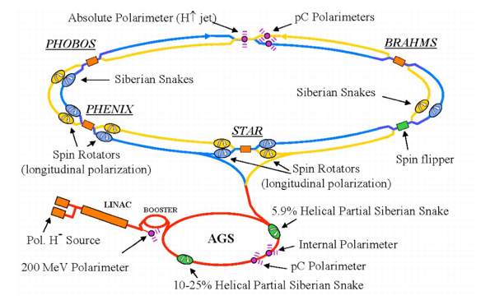
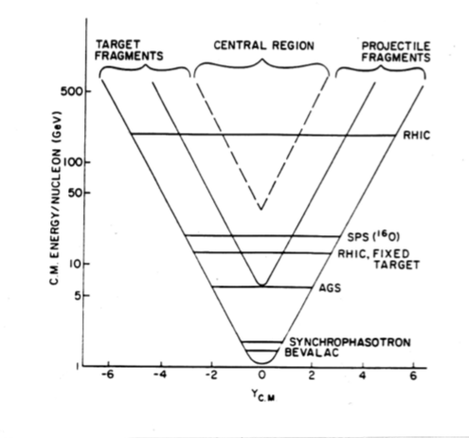
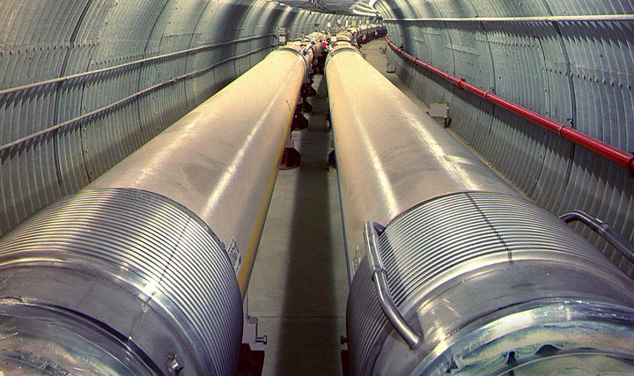
RHIC
The world’s first purpose-built heavy ion collider

Slide 6
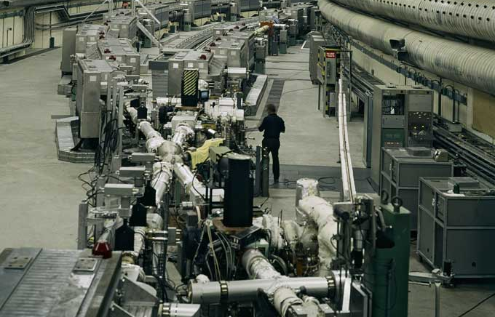
The CERN ISR
The world’s first light ion collider

Slide 7
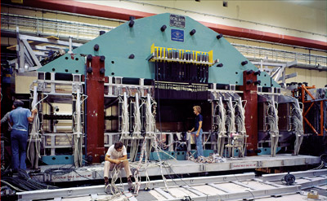
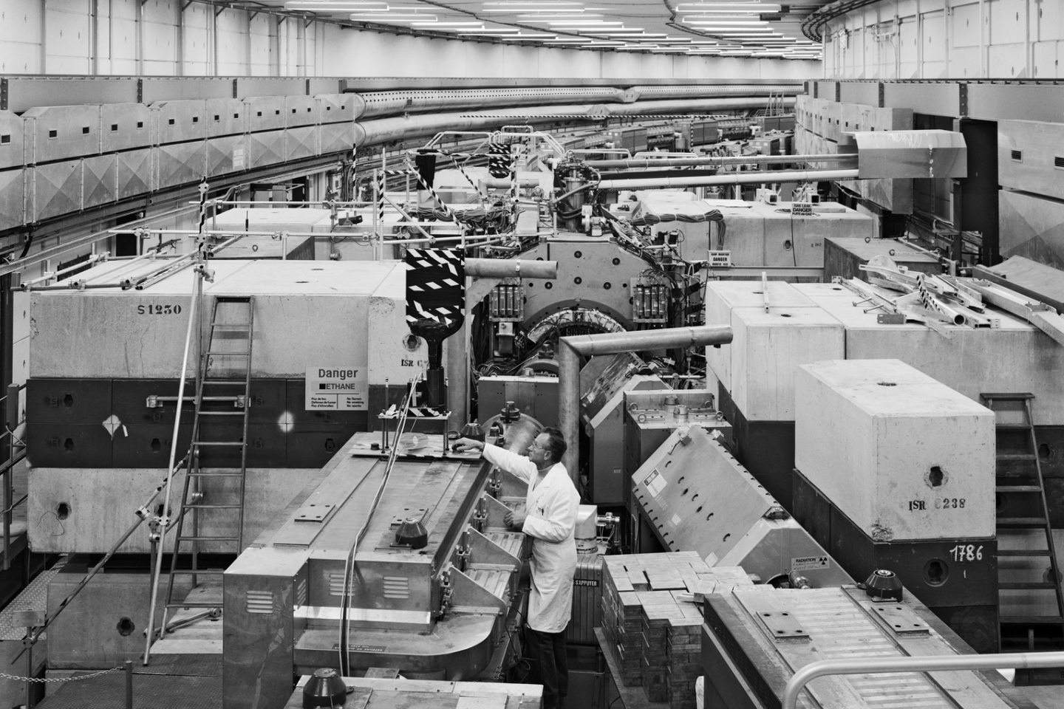
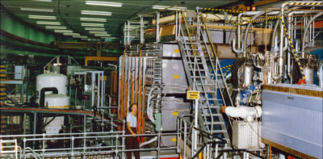
The CERN ISR
The world’s first light ion collider
(and first hadron collider detectors)

Slide 8
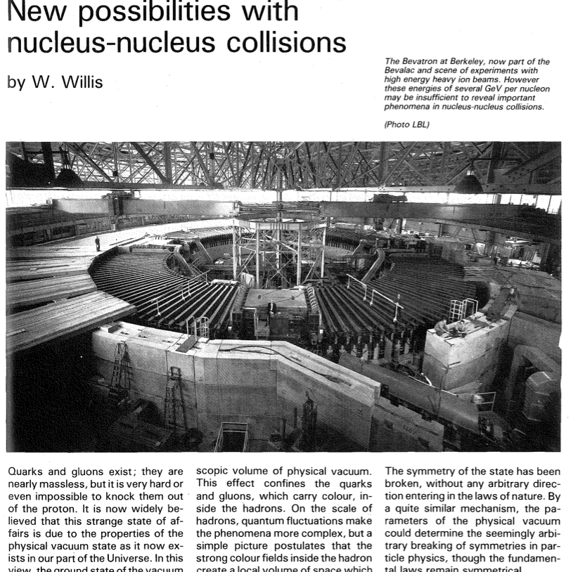
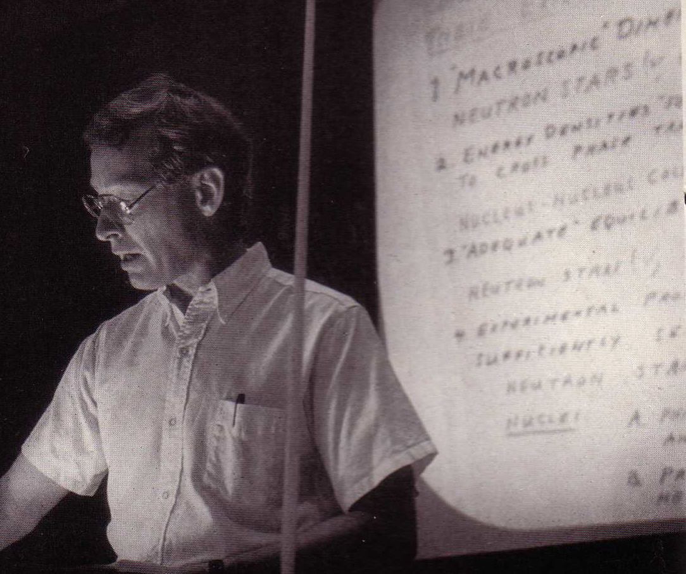
Beginnings
CERN Courier,
January 1982,
pp. 17-20

Slide 9

RHIC Beginnings

Slide 10
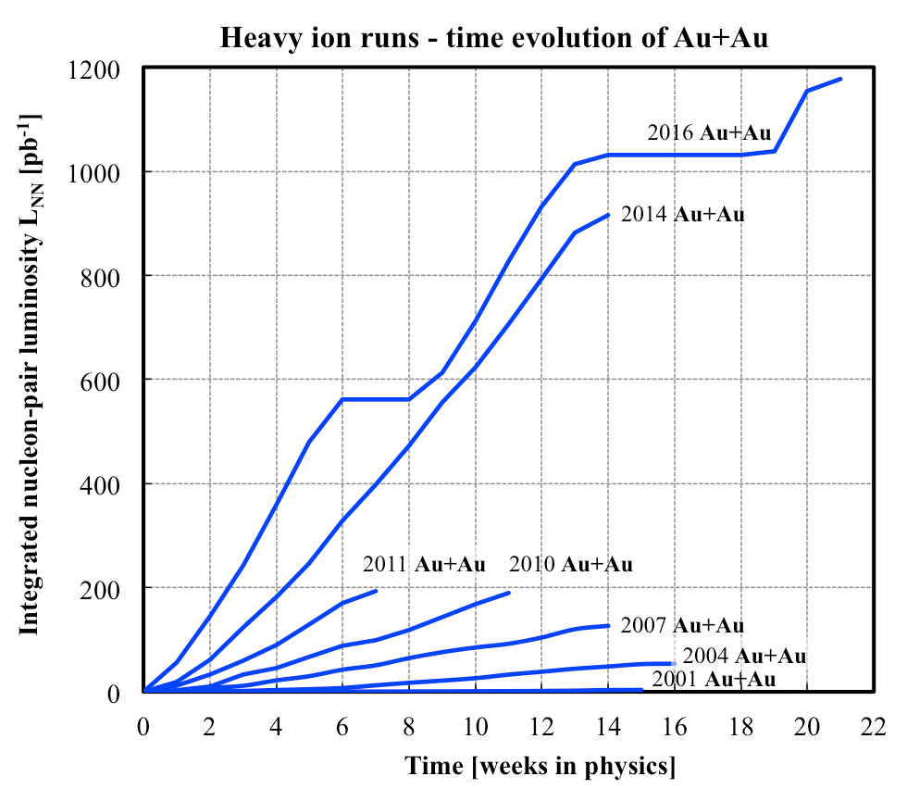
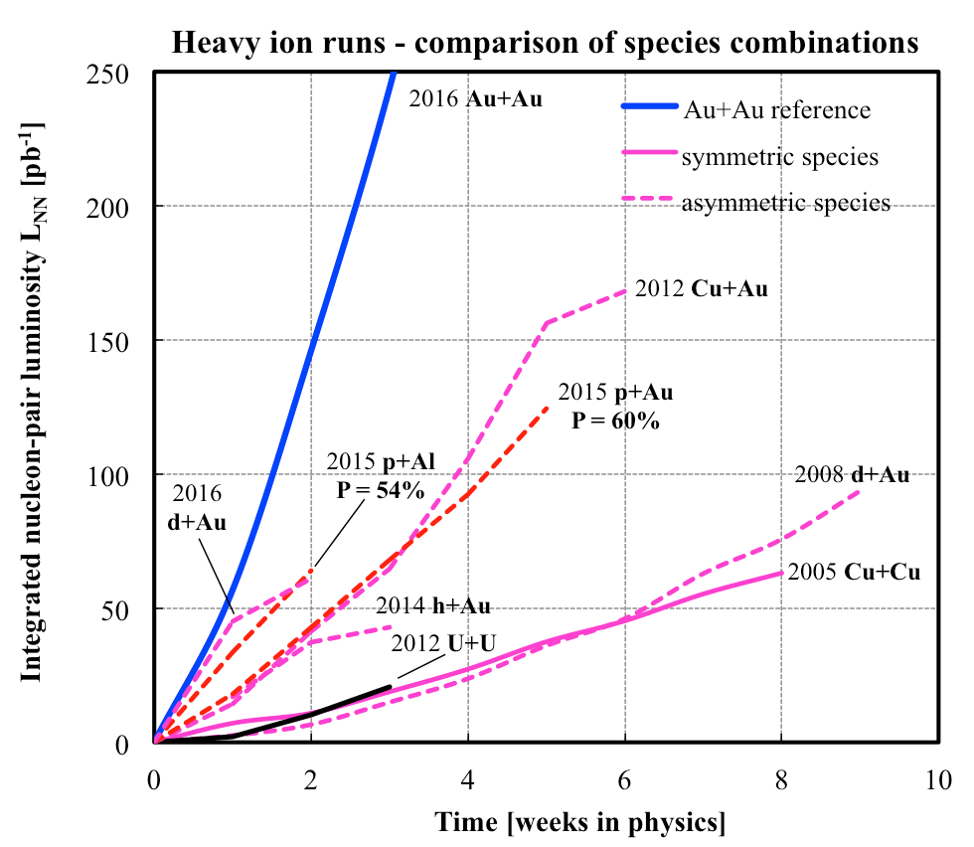
RHIC
The world’s first purpose-built heavy ion collider
  Has demonstrated its enormous flexibility
  Has enabled a decade+ of fundamental discoveries
Notes:
Run-1 = 20/mub Au+Au = 0.8 /pb p+p equivalent
http://www.rhichome.bnl.gov/RHIC/Runs/

Slide 11
RHIC
The world’s first purpose-built heavy ion collider
  Has demonstrated its enormous flexibility
  Has enabled a decade+ of fundamental discoveries

Slide 12
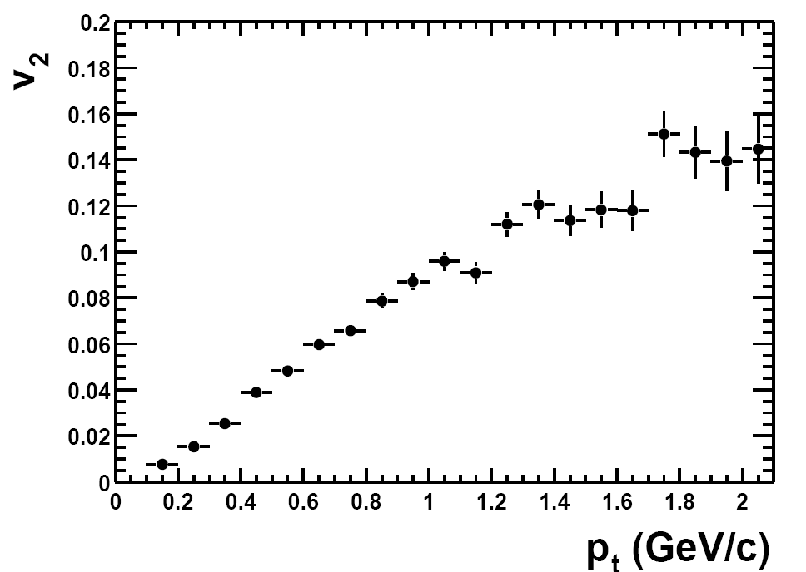
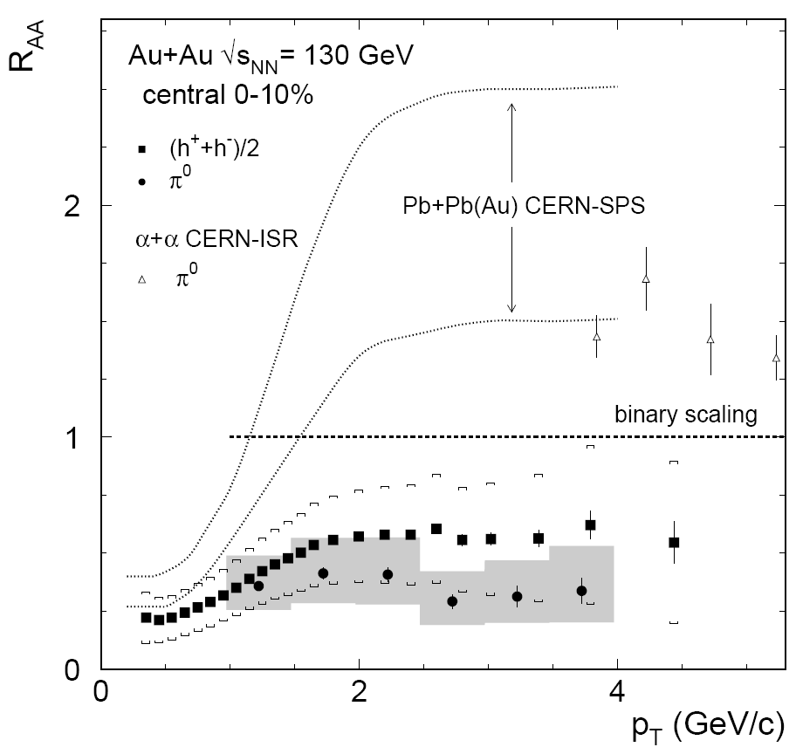
RHIC’s First Two Major Discoveries
Discovery of
strong “elliptic” flow:
  Elliptic flow in Au+Au collisions
  at √s_{NN}= 130 GeV,
  STAR Collaboration,
  Phys.Rev.Lett.86:402-407,2001
  630 citations
Discovery of
“jet quenching”
  Suppression of hadrons with large transverse momentum in central Au+Au collisions at √s_{NN} = 130 GeV,
  PHENIX Collaboration, Phys.Rev.Lett.88:022301,2002
  940 citations

Slide 13
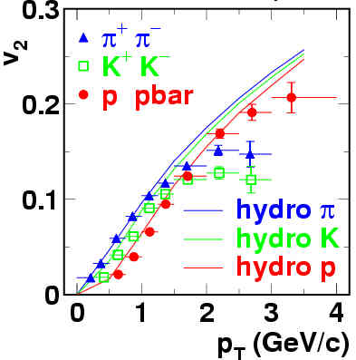

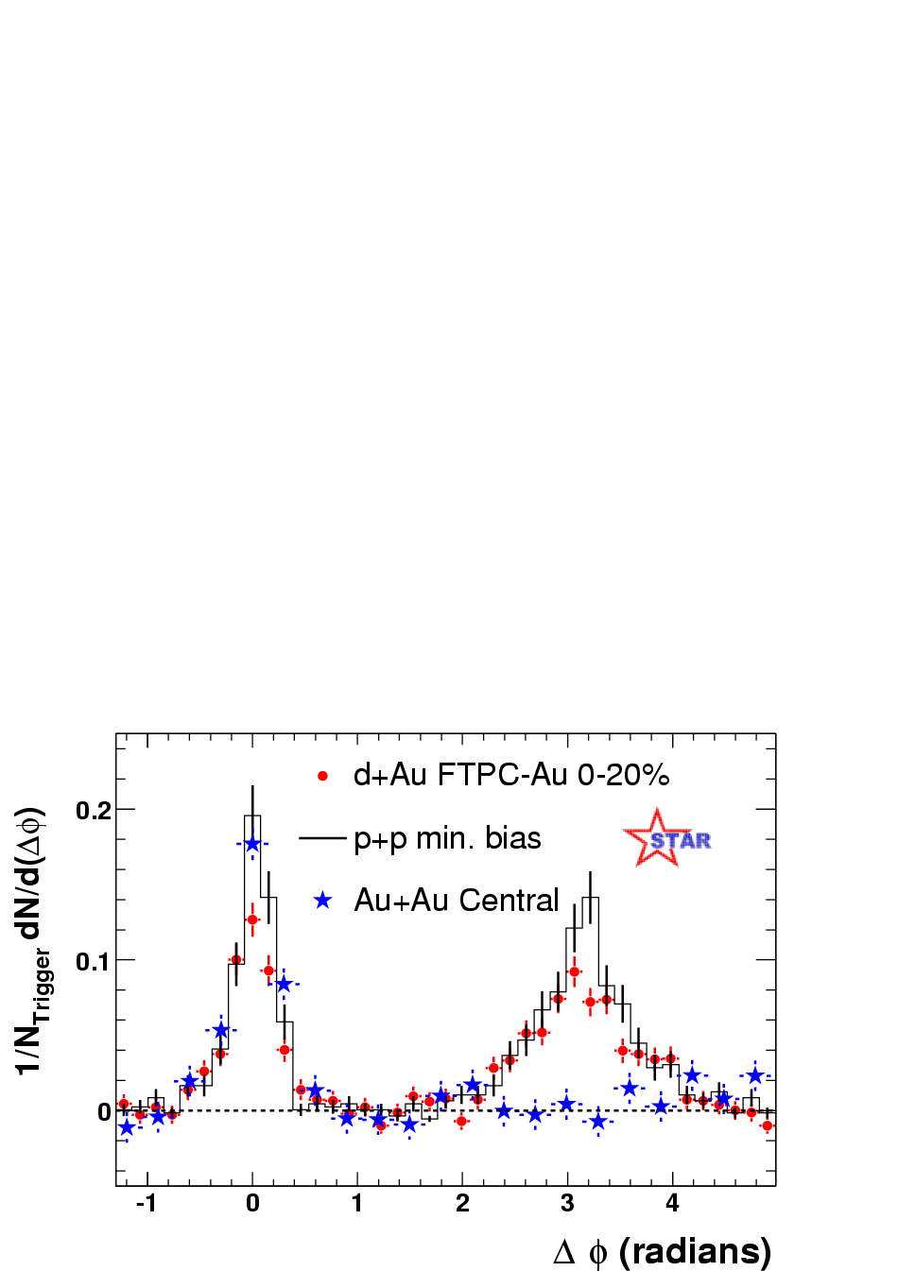
Extending Those Major Discoveries
Hydro from P. Huovinen et al., Phys. Lett. B503, 58 (2001)
“Fine structure”
in elliptic flow:
  Elliptic flow of identified hadrons
  in Au+Au collisions at √s_{NN}= 200 GeV,
  PHENIX Collaboration,
  Phys.Rev.Lett.91:182301,2003
  694 citations
Disappearance of
away-side “jet”
  Disappearance of back-to-back
  high p_{T} correlations in central
  Au+Au collisions at √s_{NN} = 200 GeV,
  STAR Collaboration,
  Phys.Rev.Lett.90:082302,2003
  731 citations
Pedestal&flow subtracted

Slide 14

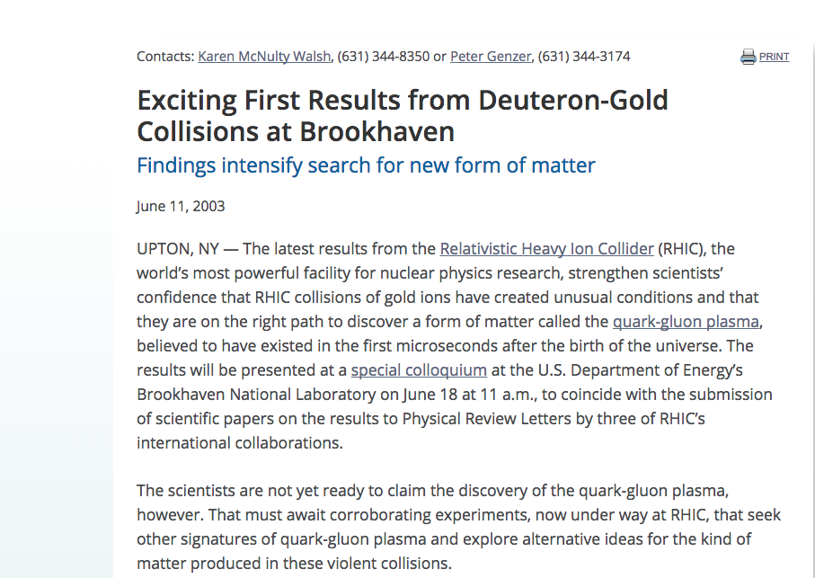
Critical in situ Control Measurement
2000 – first collisions
2001 – major results
from all 4 collaborations
2002 – first full-energy
Au+Au run
2003 – d+Au
control run

Slide 15
Critical in situ Control Measurement
2000 – first collisions
2001 – major results
from all 4 collaborations
2002 – first full-energy
Au+Au run
2003 – d+Au
control run

Slide 16
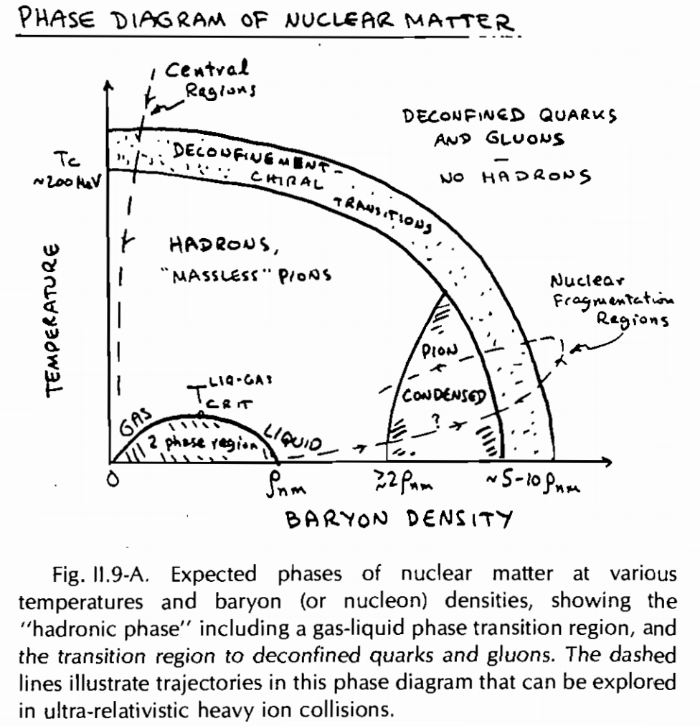
Theoretical Guidance
1983: “an extended quark-gluon plasma within which the quarks are deconfined and move independently”

Slide 17
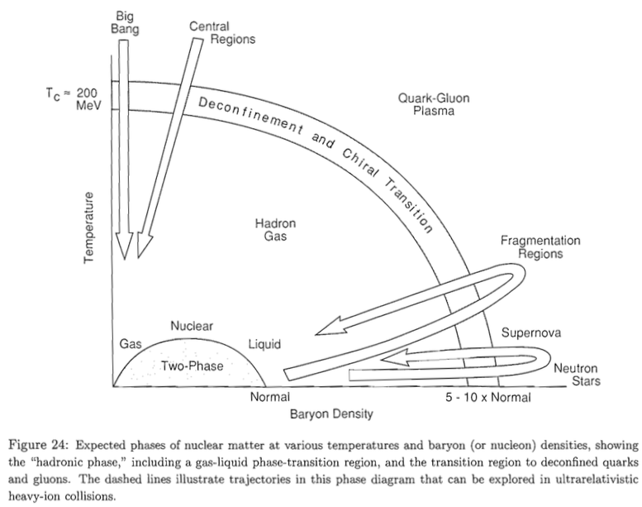
Theoretical Guidance
1983: “an extended quark-gluon plasma within which the quarks are deconfined and move independently”
1989: “quark-gluon plasma, in which hadrons dissolve into a plasma of quarks and gluons, which are then free to move over a large volume.”

Slide 18
Theoretical Guidance
1983: “an extended quark-gluon plasma within which the quarks are deconfined and move independently”
1989: “quark-gluon plasma, in which hadrons dissolve into a plasma of quarks and gluons, which are then free to move over a large volume.”
2000: “Quarks and gluons would then freely roam within the volume of the fireball created by the collision.”

Slide 19
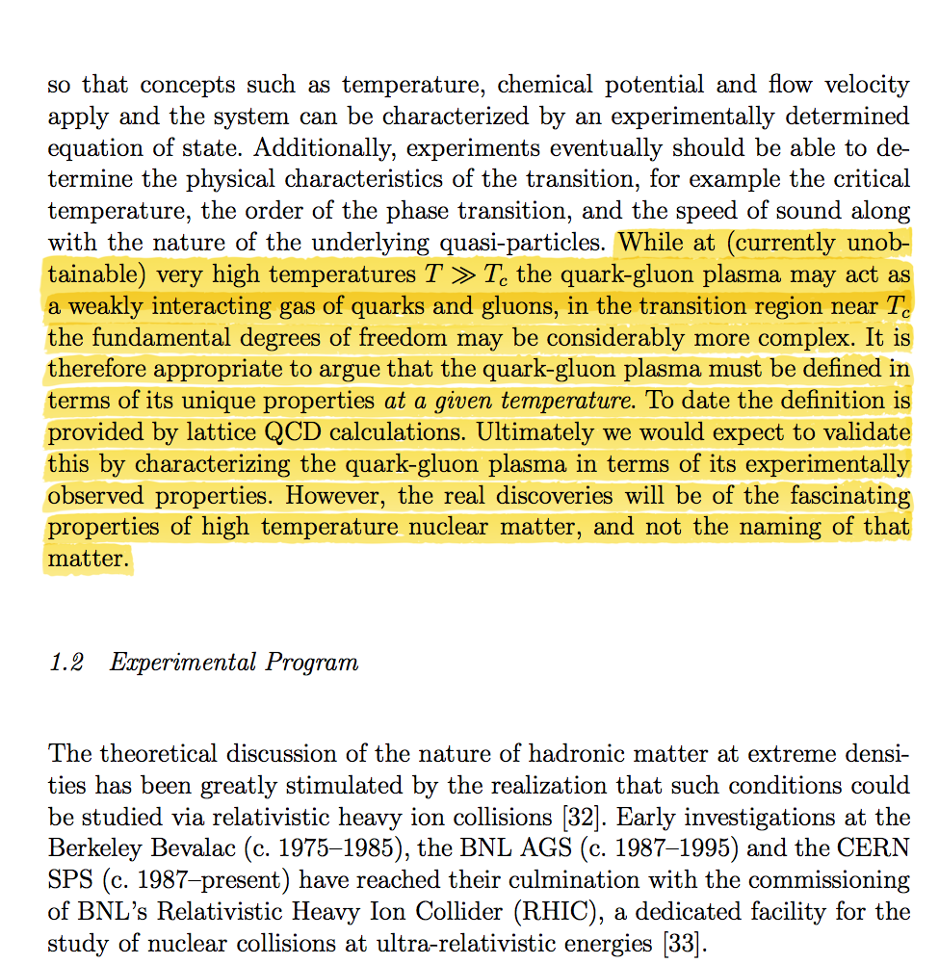
Addressing the nature of QGP discovery
From the PHENIX “White Paper”
nucl-ex/0410003
(2254 citations)
Q: What is the most
relevant
“experimentally
observed property”?
A. Viscosity
(suitably normalized)

Slide 20
The Papers
Quark gluon plasma and color glass condensate at RHIC? The Perspective from the BRAHMS experiment,
Nucl.Phys. A757 (2005) 1-27, nucl-ex/0410020
Formation of dense partonic matter in relativistic nucleus-nucleus collisions at RHIC: Experimental evaluation by the PHENIX collaboration,
Nucl.Phys. A757 (2005) 184-283, nucl-ex/0410003
The PHOBOS perspective on discoveries at RHIC,
Nucl.Phys. A757 (2005) 28-101, nucl-ex/0410022
Experimental and theoretical challenges in the search for the quark gluon plasma: The STAR Collaboration's critical assessment of the evidence from RHIC collisions,
Nucl.Phys. A757 (2005) 102-183, nucl-ex/0501009

Slide 21
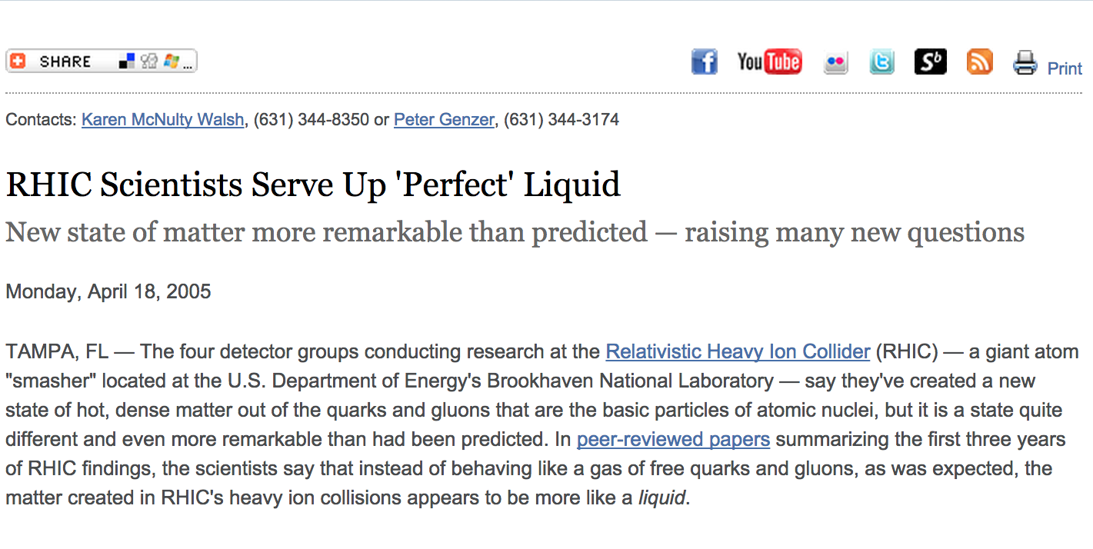
RHIC Scientists Serve Up ‘Perfect’ Liquid

Slide 22
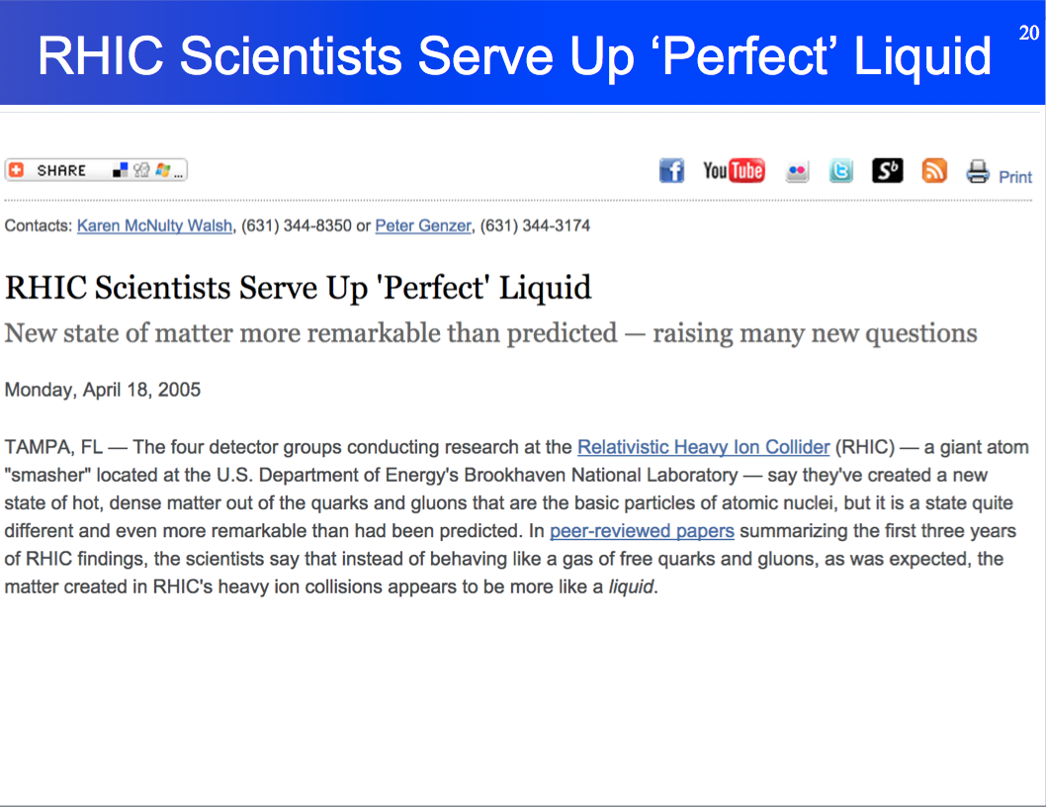
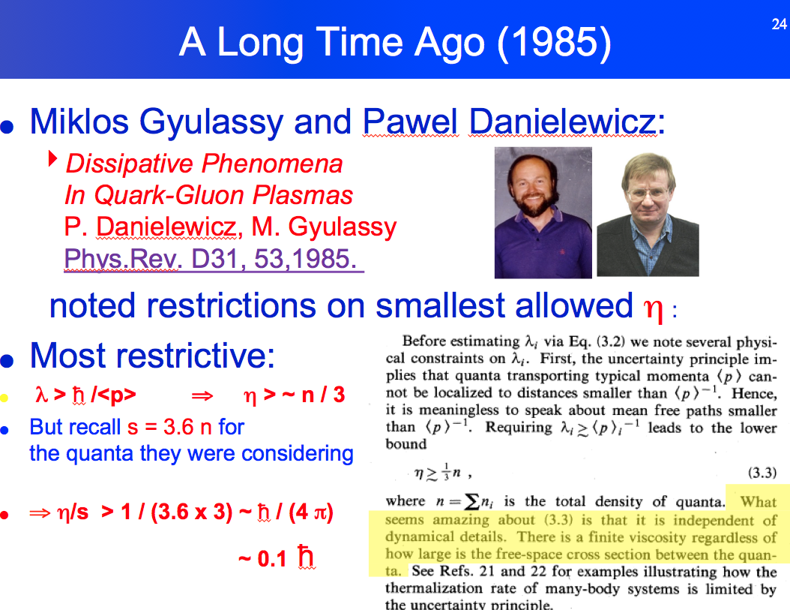
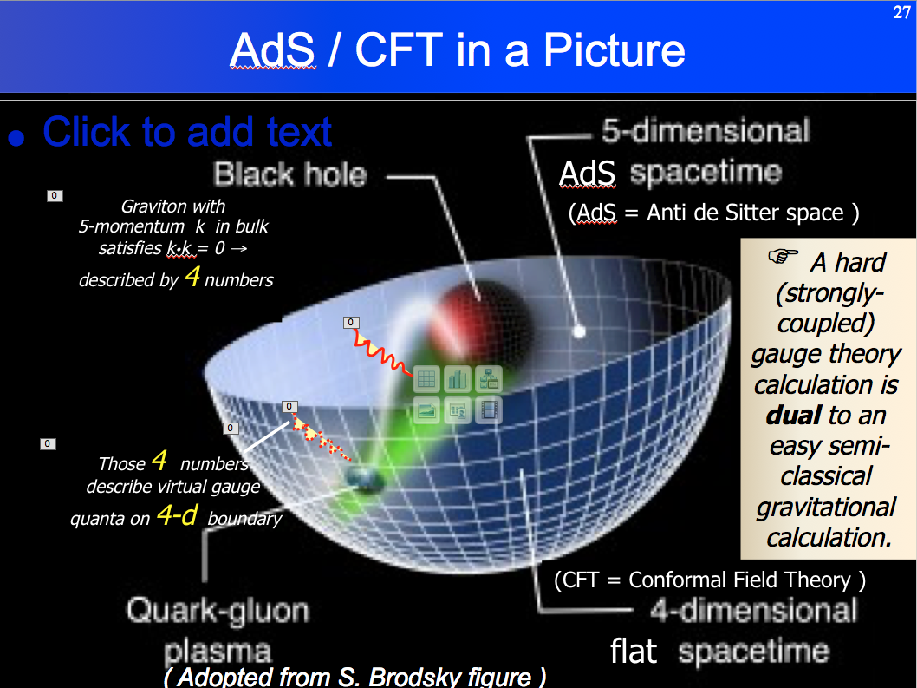
Paradigm Shift
+
+
☞The realization that the key property of the quark-gluon plasma is its “near-perfect liquidity”,
as quantified by η/s
being at or near the quantum bound of ¼π

Slide 23
Paradigm Shift
inSPIRE query for all publications with
“QGP” and related words in their title:
  Find date 2005 and (t QGP or SQGP or QUARK-GLUON PLASMA or QCD PLASMA
  or STRONGLY COUPLED PLASMA or STRONGLY-COUPLED PLASMA or RHIC PLASMA)
Notes:
find date 2012 and (t QGP or SQGP or QUARK-GLUON PLASMA or QCD PLASMA or STRONGLY-COUPLED PLASMA or STRONGLY COUPLED PLASMA or RHIC PLASMA)
2010 103
2011 142
2012 149
2013 111
2014 124
2015 113

Slide 24
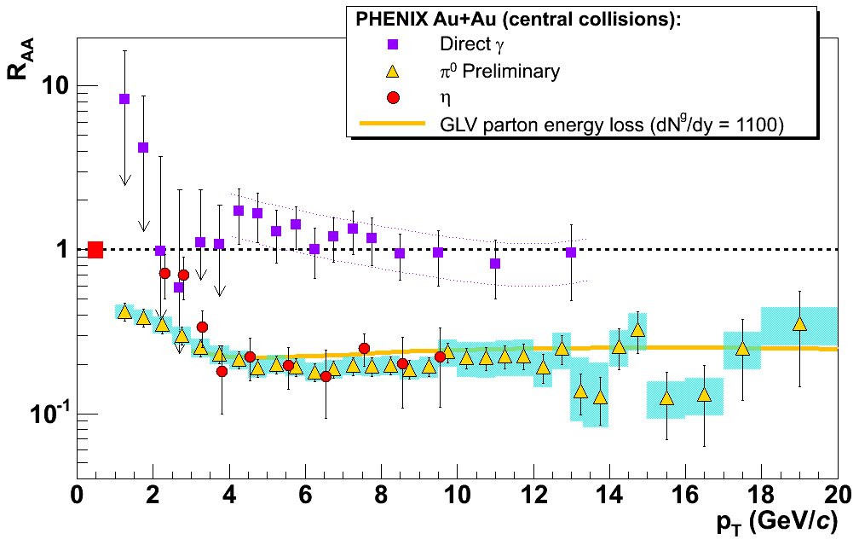
Consistency Checks
Perturbative primordial yields in Au+Au collisions absorbed in strongly-coupled
dense, opaque medium

Slide 25
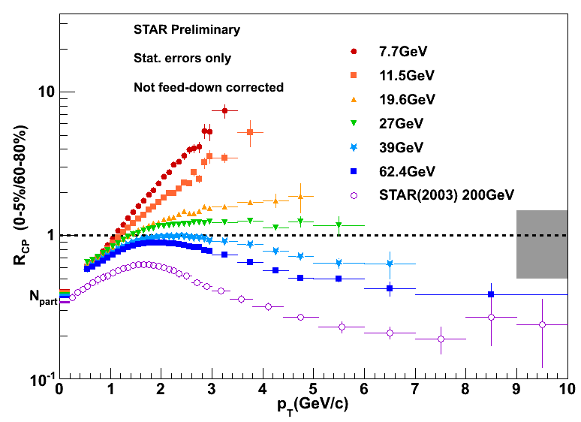
Consistency Checks
Suppression effect not present at lower √s ’s

Slide 26
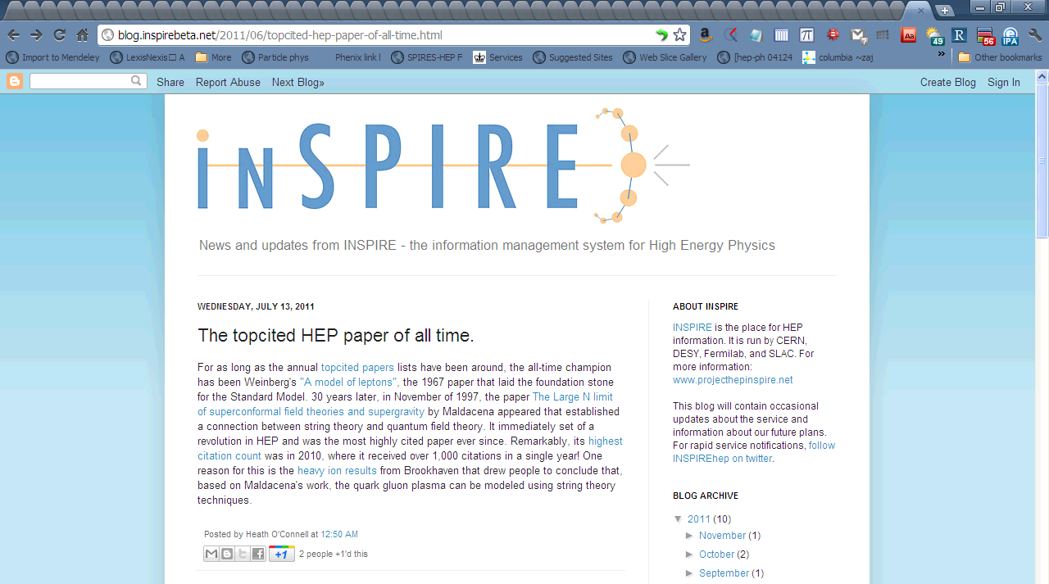
A Nice Surprise

Slide 27
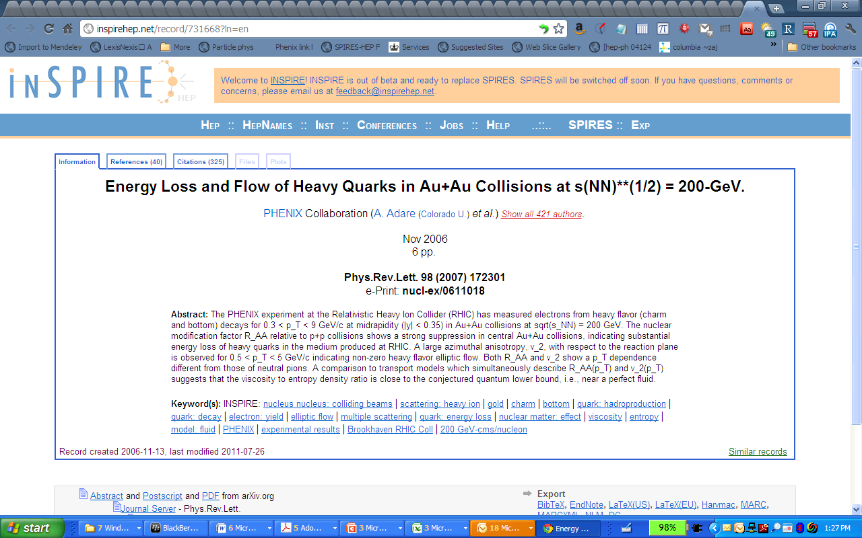
A Nice Surprise

Slide 28
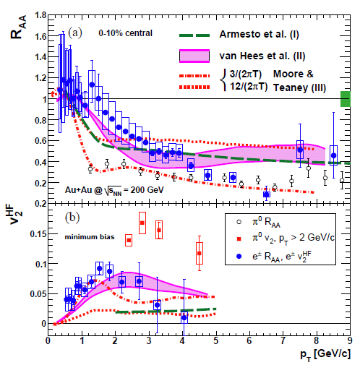
The Real Surprise
Charm quarks
  Lose significant energy
  and
  Flow

Slide 29
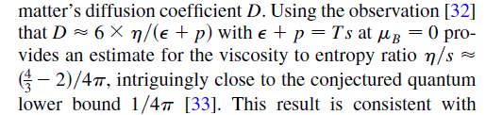
The Real Surprise
Charm quarks
  Lose significant energy
  and
  Flow
provides η/s estimate

Slide 30
Circa 2006 - The Difficulties with Hydro
Seemingly straightforward :

Slide 31
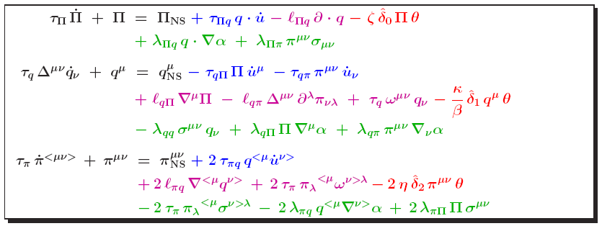
Circa 2006 - The Difficulties with Hydro
Seemingly insurmountable:
  Unknown Initial Conditions
  Eccentricity fluctuations
  Unknown equation of state
  Instabilities, acausal effects
  in relativistic viscous hydro
  Hadronic rescattering effects
  Bulk viscosity
  Numerical viscosity
  Finite size, core/corona effects

Slide 32
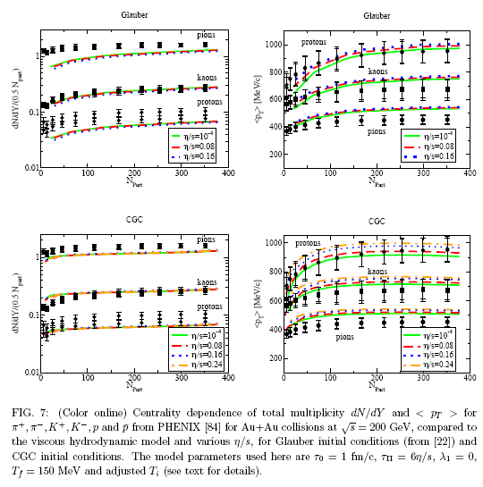
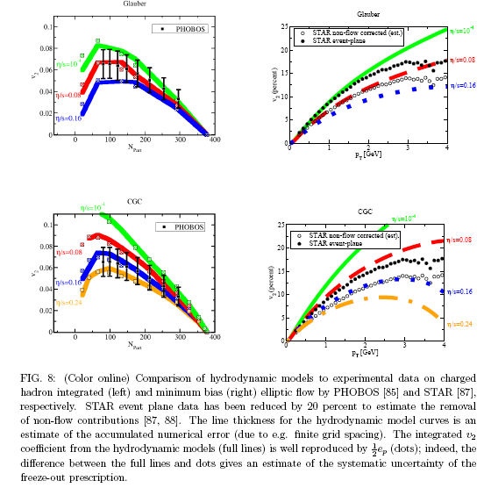
2008 - Concordance
BNL, April 2008:
  Workshop on Viscous Hydrodynamics and Transport Models in Heavy Ion Collisions
  Workshop Summary
See also Song and Heinz, Phys. Rev. C77, 064901, 222301 (2008)
Luzum and Romatschke, arXiv:0804.4015

Slide 33
The First LHC Heavy Ion Discovery
The matter produced in LHC collisions exhibits the same qualitative features discovered at RHIC:
  Strong
  hydrodynamic flow
  Strong
  quenching of high momentum particles

Slide 34
Strong Hydrodynamic Flow
“Fine structure” (mass ordering) in hydrodynamic response predicted for π, K, p, Ξ, Ω :

Slide 35
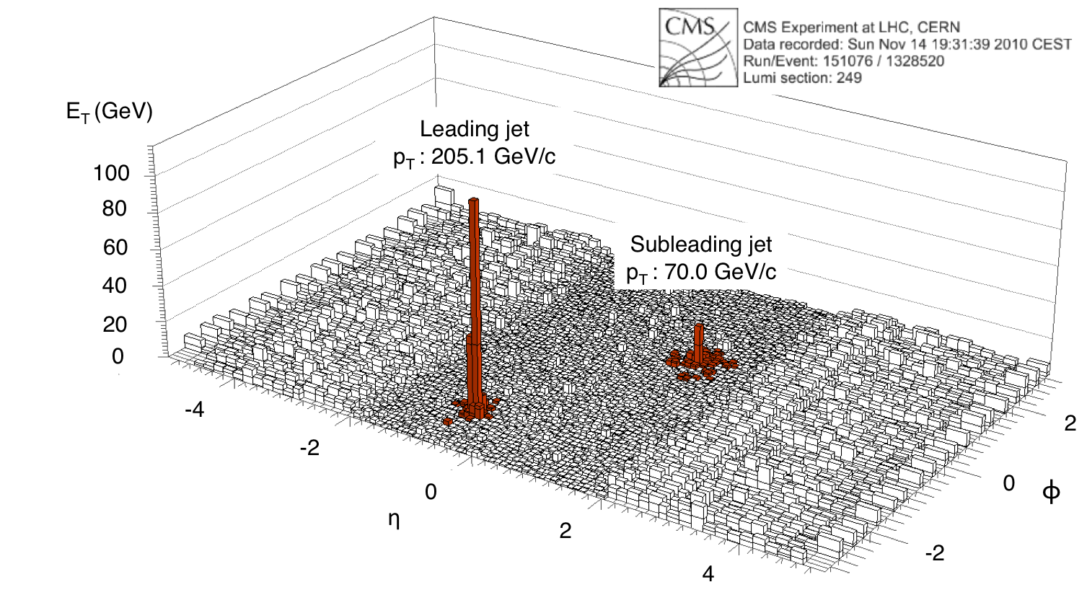
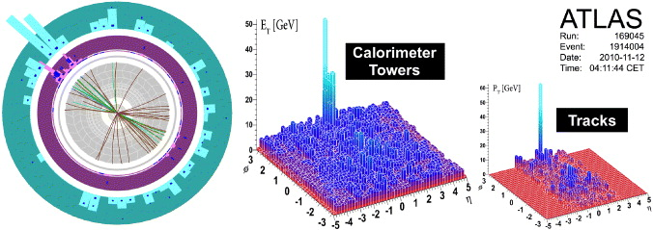
New Heavy Ion Physics at the LHC
Huge
(and hugely visible)
modifications to jets
in Pb+Pb collisions

Slide 36
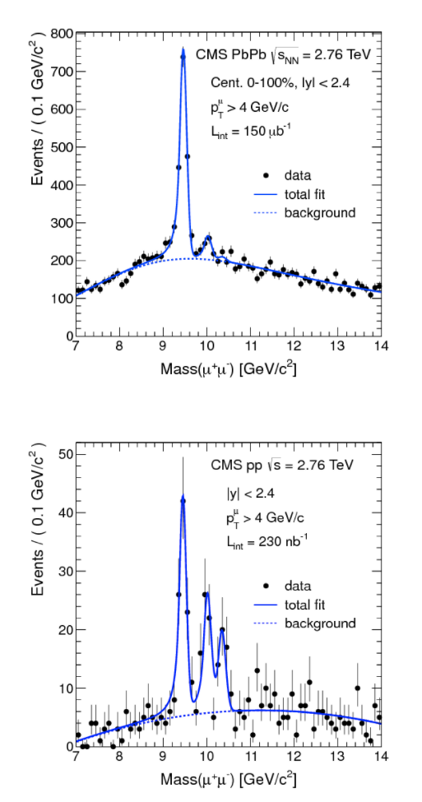
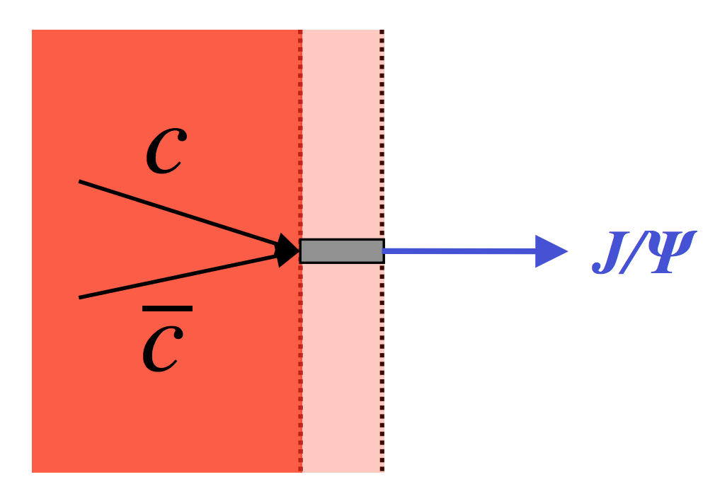
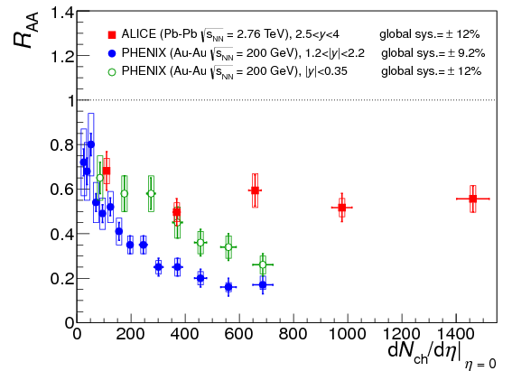
New Heavy Ion Physics at the LHC
Sequential Υ
suppression
Evidence for
recombination
CMS, , Phys. Rev. Lett. 109, 222301 (2012)
ALICE, Phys. Rev. Lett. 109, 072301 (2012)

Slide 37
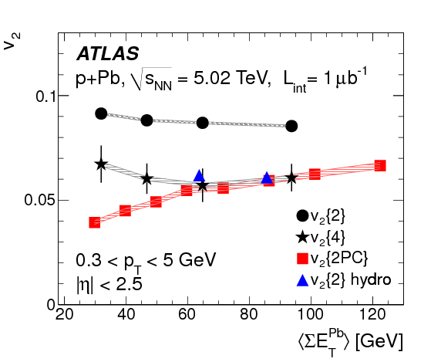
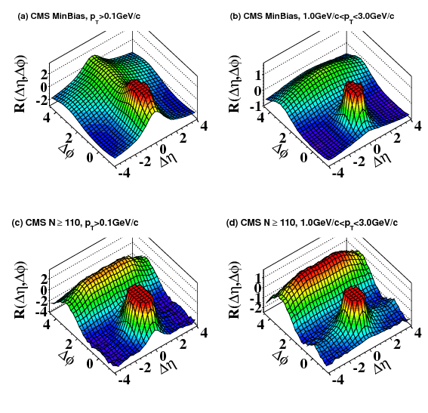
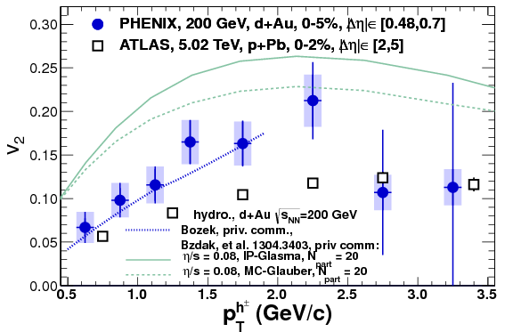
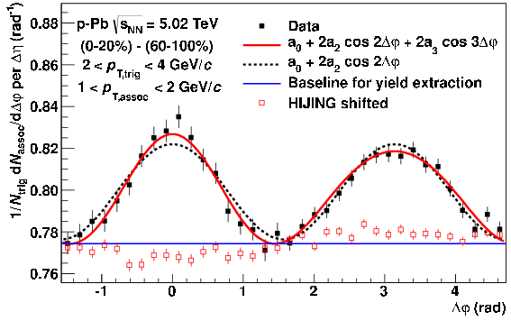
Hydrodynamic Ubiquity – An Embarrassment of Riches
Flow signatures
observed
in smallest
flecks of matter!
Collisions of:
  p+p
  p+Pb,
  d+Au
CMS, JHEP 1009, 091 (2010)
ATLAS, Phys. Lett. B725, 60 (2013)
PHENIX, Phys. Rev. Lett. 111, 21 (2013)
ALICE, Phys. Lett. B719, 29 (2013)

Slide 38
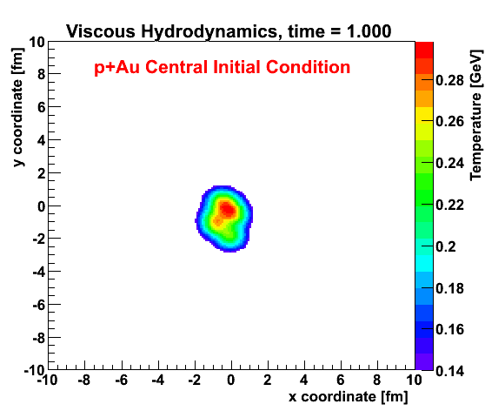
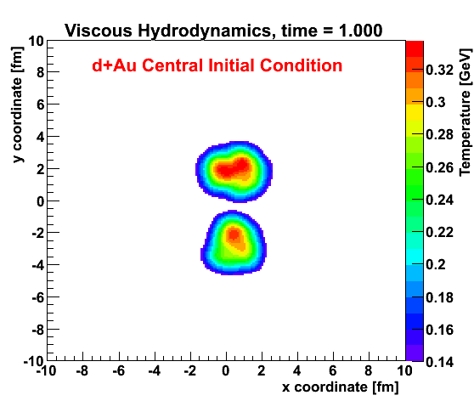
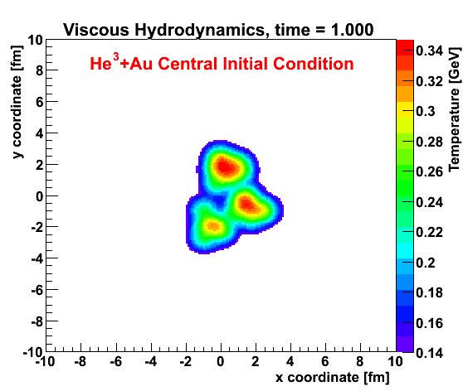
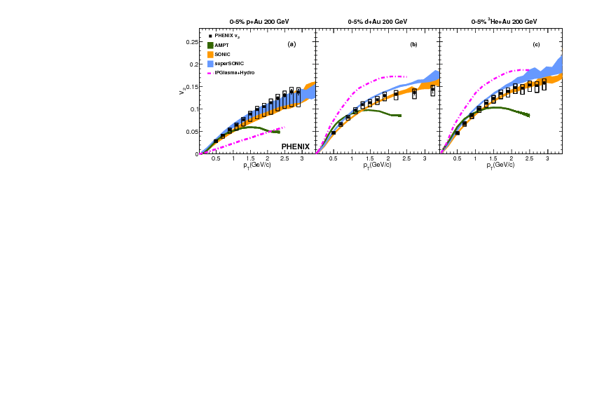
Controlled Injections of Asymmetry
Enabled by RHIC versatility
J. Nagle et al., PRL 113, 112301 (2014)
V₂
V₂
V₂
PHENIX, arXiv:1609.02894

Slide 39

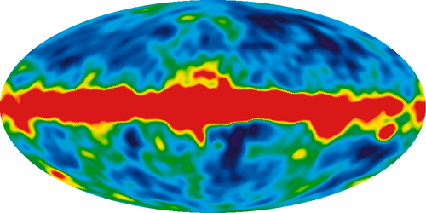
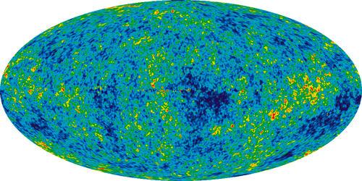




A (Valid) Analogy
Penzias/Wilson 1965
COBE
2003
WMAP
2007
Planck
2012
D I S C O V E R Y…..
….. P R E C I S I O N
2001
2004
2008
2012
Notes:
P/W 1965
COBE
WMAP 2007 7-year image, 2008
Planck, 1-year 2010

Slide 40





Recognition

Slide 41

Connections to Other Fields
This famous picture used to illustrate
elliptic flow …
is actually a real picture of cold atoms
expanding as a nearly perfect fluid
with η/s ~ (4-5)/4π .
John Thomas and collaborators
Observation of a Strongly-Interacting Degenerate Fermi Gas of Atoms,
K.M. O’Hara et al., Science 298 2179 (2002) 27, arXiv:cond-mat/0212463

Slide 42
QGP Remains the Winner…

Slide 43

QGP Remains the Winner…
Compelling need
to establish
T-dependence!

Slide 44
Not Mentioned
So much more:
  Recombination
  Direct photon yields
  Thermal photons
  Photon flow
  Soft di-lepton measurements
  Beam Energy Scan program
  Chiral Magnetic Effect signatures
  Cold nuclear matter studies
  HBT measurements
  Higher flow harmonics
  Fluctuations and susceptibilities
  still more…

Slide 45
There’s More To Be Done
The remarkable properties of liquid QGP have penetrated to the larger scientific community
We now know that the QGP is
  A thermal state of matter
  that is a true quantum liquid
  in that its fundamental transport properties
  (nearly) saturate the quantum mechanical bound
Understanding the origin of these properties is a fundamental goal for future experiments at both
  RHIC: STAR Beam Energy Scan, sPHENIX program
  and
  the LHC

Slide 46
Thank You!

Slide 47
Back-up

Slide 48
1983 Long Range Plan for Nuclear Physics
…a spectacular transition to a new phase of matter, a quark-gluon plasma, may occur…
It is the opinion of this Committee that the United States should proceed with the planning for the construction of this relativistic heavy ion collider facility expeditiously, and we see it as the
highest priority new scientific opportunity within the purview of our science.

Slide 49
1989 Long Range for Nuclear Physics
We strongly reaffirm the very high scientific importance of the Relativistic Heavy Ion Collider (RHIC). Since the last LRP, theoretical progress has strengthened the case of the existence of a quark-gluon plasma…
RHIC has the highest priority for new construction in the nuclear physics program.

Slide 50


Slide 51

2010: The Noise Is The Signal
Importance of higher harmonics
dn/dφ ~ 1 + 2 v₂(p_{T}) cos (2 φ) + ...
B. Alver and G. Roland, Phys. Rev. C81, 054905 (2010)

Slide 52
2010: The Noise Is The Signal
Importance of higher harmonics
dn/dφ ~ 1 + 2 v₂(p_{T}) cos (2 φ)
+ 2 v₃(p_{T}) cos (3 φ)
+ 2 v₄(p_{T}) cos (4 φ) + …
Fluctuations critical for determining
allowed range of η/s .
Persistence of “bumps”➔small η/s !
B. Alver and G. Roland, Phys. Rev. C81, 054905 (2010)

Slide 53
Small Viscosity Compared to What ?
Various measures lead to
This is small.
It implies damping time ~ 1 / 0.1 =10 x longer than natural thermal time ~ 1 / (Temperature)
~ ħ / (Temperature)

Slide 54
Small Viscosity Compared to What ?
Various measures lead to
This is small.
It implies damping time ~ 1 / 0.1 =10 x longer than natural thermal time ~ 1 / (Temperature)
~ ħ / (Temperature)
ħ

Slide 55


A Long Time Ago (1985)
Miklos Gyulassy and Pawel Danielewicz:
  Dissipative Phenomena
  In Quark-Gluon Plasmas
  P. Danielewicz, M. Gyulassy
  Phys.Rev. D31, 53,1985.
noted restrictions on smallest allowed η :
Most restrictive:
λ > ħ /<p> ⇒ η > ~ n / 3
But recall s = 3.6 n for
the quanta they were considering
⇒ η/s > 1 / (3.6 x 3) ~ ħ / (4 π)
~ 0.1 ħ

Slide 56
Alternative History
So the “perfect fluid” observed at RHIC with
was immediately recognized as confirming the 1985 uncertainty principle estimate of Danielewicz and Gyulassy
Except that’s not what happened…
ħ

Slide 57
Instead …
In 2003-4 a new estimate (bound?) appeared from the AdS/CFT correspondence
in string theory (!):
  A Viscosity Bound Conjecture,
  P. Kovtun, D.T. Son, A.O. Starinets,
  hep-th/0405231
in a rigorous calculation with no (apparent)
appeal to the uncertainty principle.

Slide 58
Theoretical Discovery 2003-4
An estimate (bound?) on viscosity appeared from string theory’s AdS/CFT correspondence:
  A Viscosity Bound Conjecture,
  P. Kovtun, D.T. Son, A.O. Starinets,
  hep-th/0405231 (1300+ citations!)
Fundamental measure of strong coupling
Cleanest result from gauge/gravity duality
A measure of “quantum liquidity”

Slide 59


Expectations circa 2000
RHIC would create
a quark-gluon plasma;
a “gas”
of weakly coupled
quarks and gluons
As encoded in the Nuclear Physics Wall Chart,
http://www.lbl.gov/abc/wallchart/
Notes:
0.15 GeV/fm^3 x 10^45 fm^3/m^3 x 10^-3 gm / 6 x 10^23 = 2.5 x 10^17 kg/m^3 Check.

Slide 60

2010 – Measurement of Thermal Photons
Low p_{T} excess observed in Au+Au collisions
Not observed in p+p baseline or d+Au control
T_{i} ~ 300-500 MeV
PRL 104:132301, 2010

Slide 61









Boulder Workshop Mar-05

Slide 62
Strongly Coupled Plasmas
Recently, much interest in the “strongly interacting” (i.e., non-ideal) behavior of the matter produced at RHIC
This property has been known long enough to be forgotten several times:
  1982: Gordon Baym, proceedings of Quark Matter ‘82:
    A hint of trouble can be seem from the first order result for the entropy density (N_{f} = 3)
    which turns negative for α_{s} > 1.1
  1992: Berndt Mueller, Proc. of NATO Advanced Study Institute
    For plasma conditions realistically obtainable in the nuclear collisions
    (T ~250 MeV, g = √(4πα_{s}) = 2) the effective gluon mass m_{g}* ~ 300 MeV. We must conclude, therefore, that the notion of almost free gluons (and quarks) in the high temperature phase of QCD is quite far from the truth. Certainly one has m_{g}* << T when g <<1, but this condition is never really satisfied in QCD, because g ~ 1/2 even at the Planck scale (10¹⁹ GeV), and g<1 only at energies above 100 GeV.
  2002: Ulrich Heinz, Proceedings of PANIC conference:
    Perturbative mechanisms seem unable to explain the phenomenologically
    required very short thermalization time scale, pointing to strong non-perturbative dynamics in the QGP even at or above 2Tc.... The quark-hadron phase transition is arguably the most strongly coupled regime of QCD.

Slide 63



Where Is η/s Minimal ?
What conditions produce the most nearly perfect liquid behavior?
  We know (only) two points in √s :
RHIC
R. Lacey et al., Phys. Rev. Lett. 112, 082302 (2014)

Slide 64

AdS / CFT in a Picture
AdS
Graviton with
5-momentum k in bulk satisfies k•k = 0 → described by 4 numbers
(AdS = Anti de Sitter space )
A hard (strongly-coupled) gauge theory calculation is dual to an easy semi-classical gravitational calculation.
Those 4 numbers describe virtual gauge quanta on 4-d boundary
(CFT = Conformal Field Theory )
flat
( Adopted from S. Brodsky figure )

Slide 65
Challenges to the Paradigm?
Does the appearance of “hydro-like” features in small “perturbative” systems call into question the “standard model” of heavy ion collisions?
  We should keep an open mind….
  While biasing our Bayesian prior on the enormous descriptive power of the current formalism
My guess for small systems
  {Confinement+Strong Fields+Color Recombination+ }
  will look a lot like hydro (see Fermi+Landau)
  (Vaguely related: “Canonical Typicality”, S. Goldstein et al. Phys. Rev. Lett. 96, 050403, 2006)
  Beware the tyranny of asymptotic freedom!

Slide 66

Nobel Lecture 2004

Slide 67
Asymptotic Freedom Redux
The colloquial is not the physical:
QCD potential
But: QCD number density
So – in a thermal system,
the slow log(T/Λ) decrease in α_{S}
is overwhelmed by
the fast increase in 1/r ~ T
➔ asymptotic freedom is asymptotic indeed !

Slide 68

The Key Technique
Working at the
strongest
possible
coupling
Tune B-field
to produce
~infinite scattering length
Cross sections as large as allowed by unitarity
Magnetic Field Control of Elastic Scattering in a Cold Gas of Fermionic Lithium Atoms, S. Jochim et al., Phys. Rev. Lett. 89 273202 (2002), arXiv:physics/0207098

Slide 69
The Key Technique
Working at the
strongest
possible
coupling
Tune B-field
to produce
~infinite scattering length
Cross sections as large as allowed by unitarity
Magnetic Field Control of Elastic Scattering in a Cold Gas of Fermionic Lithium Atoms, S. Jochim et al., Phys. Rev. Lett. 89 273202 (2002), arXiv:physics/0207098

Slide 70

The Key Technique
Working at the
strongest
possible
coupling
Tune temperature
to produce
~”most liquid” QGP
Cross sections as large as allowed by unitarity
(?)
RHIC
The Equation of State in 2+1 QCD, A. Bazavov et al., Phys. Rev. D90 094503 (2014), arXiv:1407.6387

Slide 71

The Key Technique
Working at the
strongest
possible
coupling
Tune temperature
to produce
~”most liquid” QGP
Cross sections as large as allowed by unitarity
(?)
RHIC
The Equation of State in 2+1 QCD, A. Bazavov et al., Phys. Rev. D90 094503 (2014), arXiv:1407.6387
Notes:
Infinite nuclear matter 0.16 GeV/fm^3 → 16 GeV/fm^3
T~ 320 MeV since 12*(0.32^4)/0.2^3 ~ 16 GeV/fm^3 (~270 MeV for 8 GeV/fm^3)

Slide 72

Current State of the Art
p(Φ_{n},Φ_{m}) and p(Φ_{n},Φ_{m,}Φ_{L})
Event-by-Event
flow observables
Event shape
engineering
Longitudinal
fluctuations
Event-Plane
correlations
Multi-particle
observables
^{H. Niemia, K.J. Eskola and} R. Paatelainen arXiv:1505.02677
From June 9, 2015 Talk by Jiangyong Jia at Workshop on
“Quantifying the Properties of the Perfect Fluid”

Slide 73

Higher Harmonics Used to Determine η/s
The fundamental matter formed at RHIC and the LHC is within a factor of 3 of KSS bound(!)
≈ 1.5 x KSS Bound
≈ 2.5 x KSS Bound
C. Gale, S. Jeon, B. Schenke, P. Tribedy, R. Venugopalan, Phys. Rev. Lett. 110, 012302 (2013)

Slide 74

May 15, 2004 Talk at RBRC Workshop on
“New Discoveries at RHIC”

Slide 75

June 9, 2015 Talk (Jonah Bernhard) at Workshop
“Quantifying the Properties of the Perfect Fluid”

