Slide 1
Answers to the referees questions
to the baby MIND proposal submitted to the SPSC on October, 6, 2015
Baby MIND at WAGASCI: There is no run mentioned behind WA105 in the run plan of
paragraph 1.3. Should we infer that the main "physics goal" of the baby MIND is to
complement the WAGASCI setup?

Slide 2
In November 2014, A. Rubbia (P.I.) and myself wrote the following in our grant proposal:
“The primary goal of the Baby-MIND is a detailed characterisation of its performance, studying charge identication efficiencies for muon momenta between 0.3 and 5 GeV/c on a dedicated beamline. MIND-type detectors are not usually associated with such low energy ranges, because their efficiencies drop sharply below 1 GeV/c due to multiple scattering in the steel plates. We plan to demonstrate their applicability below 1 GeV/c. The Baby-MIND is recognized as an independent activity within the newly created CERN Neutrino Platform.
A Memorandum of Understanding (MoU) has been drafted, describing the project and the relationship between the collaborating institutes and CERN. It is currently undergoing a review before signature by all parties.
In addition to tests as a standalone detector, there are two scenarios currently being considered for the use of the MIND as a downstream muon spectrometer :
• the DLAr demonstrator planned for the WA105 project.
• the WAGASCI detector, an approved experiment at J-PARC, which will provide precision measurements of the ratio of cross-sections in water and plastic to reduce systematics for T2K.”

Slide 3
Since then there has been a strong interest from the WAGASCI experiment but little from WA105, the main priority being obviously to get the double phase working.
Indeed: the MOU of WA105 with CERN only includes the institutes working on DLarg.
As a consequence, and given the clear physics motivation for T2K of the WAGASCI measurements, we have concentrated on the WAGASCI goal, which is more ‘physics’ and also more constraining!
We have made sure at all times that the detector is able to work adequately for WA105, when we come back to CERN after the WAGASCI measurements.

Slide 4
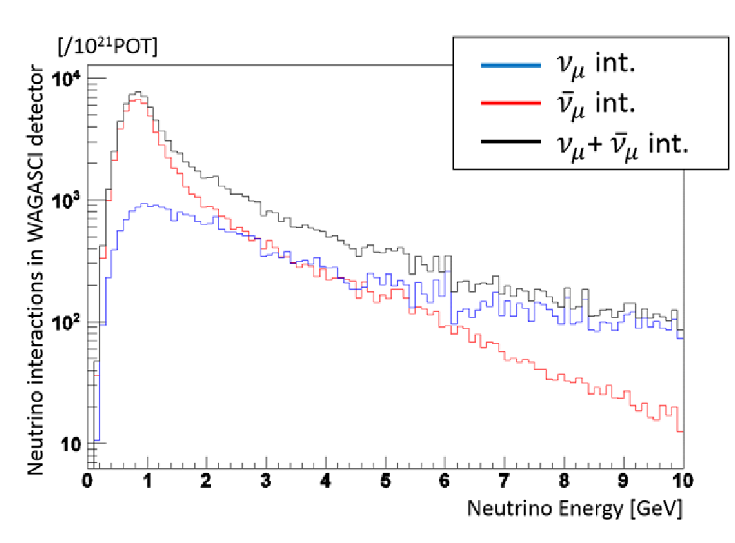
Can you show the expected spectra of muons impinging in the baby MIND detector in the WAGASCI setup, both in neutrino and antineutrino running?
We expect this spectrum to be peaked at very low energy around 100 - 200 MeV.
Below are the spectra of neutrino and antineutrino events in the anti-neutrino exposure
and on the right the spectrum of muons in the forward acceptance,
where the magnetized MRD is located:
the wrong sign muons are quite energetic. We expect to do a go job at charge separation
starting at 500-700 MeV.

Slide 5
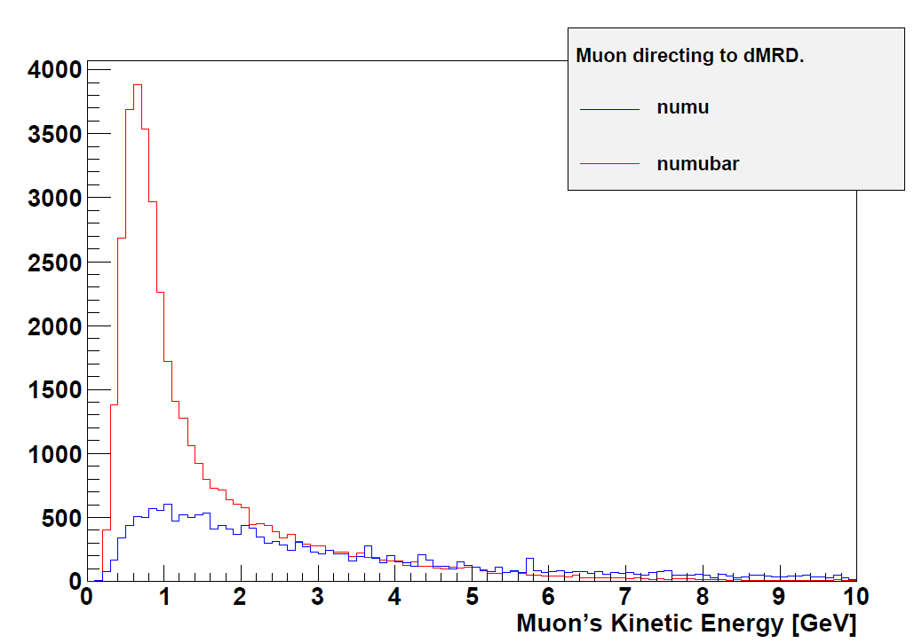

Slide 6
Wouldn´t a TASD detector in an external magnet be more efficient to tag muon signs in this energy range?
There is no doubt that the ideal detector would be a Water target embedded in a
magnetic field and surrounded by tracking chambers (e.g. TPC).
This is presently the object of an upgrade study for the T2K near detector
within the UA1/NOMAD/T2K-ND280 magnet.
However for what concerns WAGASCI on a shorter time-scale (and for an interestingly higher
energy spectrum), the construction of an air-core magnet would be
1. much more expensive
2. much more power hungry (we are strongly limited in the ND280 pit)
and for this reason has not been proposed.

Slide 7
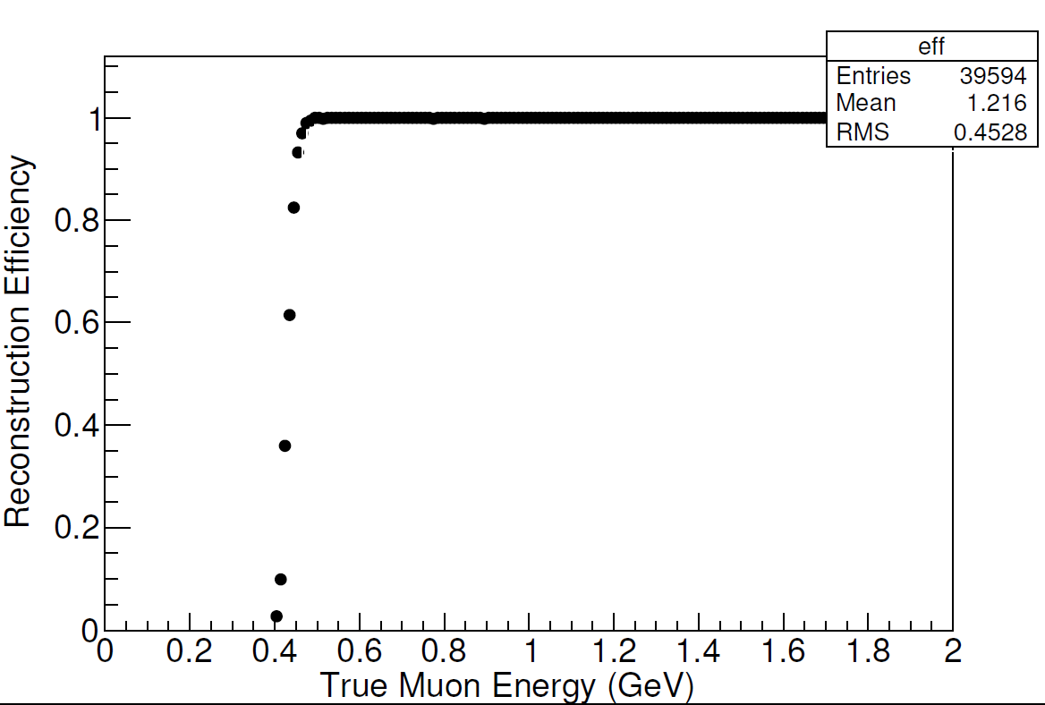
Figure 7 shows a dip in efficiency below 1 GeV. We understand this region to be the critical one for WAGASCI. Could you provide the same plots with a zoom in the region below 1 GeV?
This is the plot for normal incidence in the original MIND set-up:
(Homogeneous, 3cm iron plates, 1.5 T, 1.5 cm thick scintillator ).
The cut-off is due to the number of points required for track reconstruction.
More important is charge reconstruction and neutrino /antineutrino separation →

Slide 8
Multiple scattering vs bending
Δθ_{MS} = 0.015/P . √ L/X₀ = 0.034/P for 9cm of iron
θ_{B} = L x 0.3x B /P = 0.04/P for 9cm of magnetized iron at 1.5 T.
same scaling with P
Improves when L increases
➔ provided angles are measured before and after the iron plate.

Slide 9
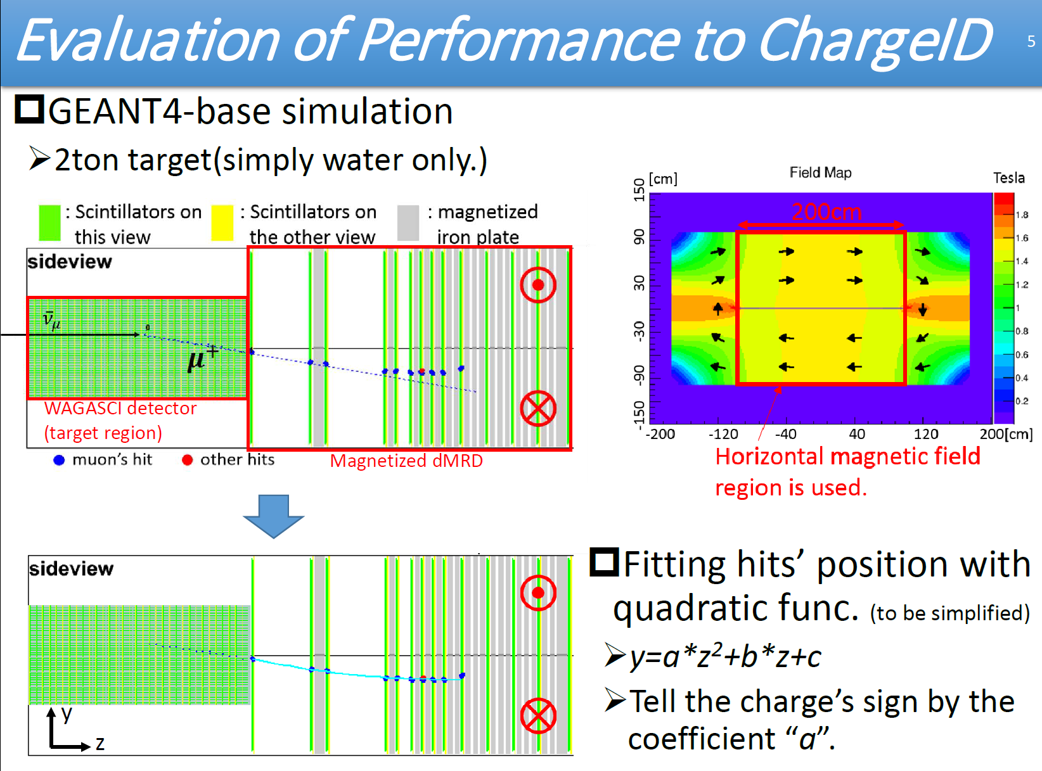

Slide 10
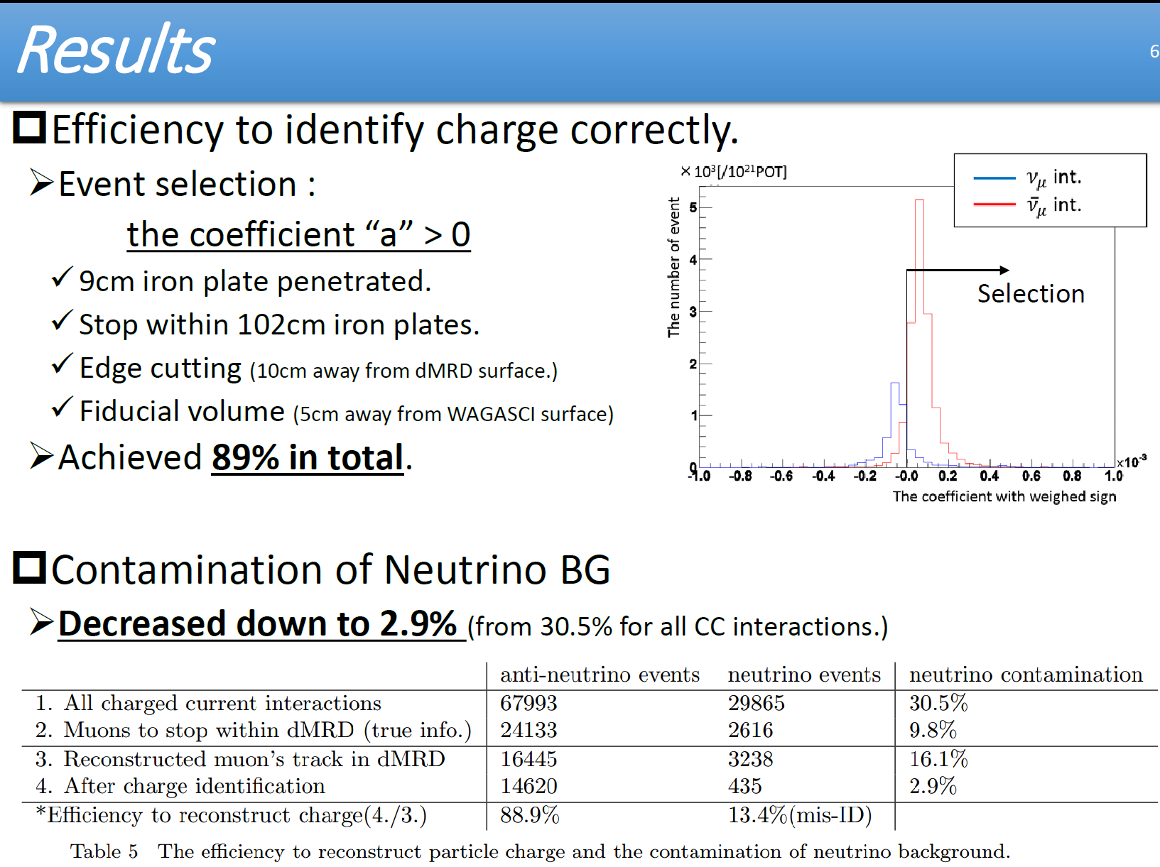

Slide 11
Is the average 90% efficiency given in paragraph 4.2 the WAGASCI muon spectrum averaged efficiency? It is the charge ID efficiency in the antineutrino exposure
How does this averaged efficiency changes from neutrino to antineutrino mode? How well is it controlled considering that it is strongly decreasing at low energy?
The neutrino mode is much less critical. There is a factor ~2 in pi- to pi+ ratio in the
production and then a factor 3 in neutrino vs antineutrino cross-sections. Therefore the antineutrino event contamination in the neutrino beam is very small (<2%) and easily corrected
The thinner the iron plates, the higher the efficiency at low energy.
This is only true because the simulation is made with more planes of scintillator if the iron is thinner. At given scintillator cost, the thicker iron is preferred.
Why did you choose 3cm thick iron plates for baby MIND, whereas 2cm thick plates would provide a higher efficiency according to figure 7?
In fact we have chosen an even higher thickness for the first plane given that we have a limited amount of scintillator: the ratio of magnetic bending to multiple scattering actually increases with iron thickness t as √t
See the actual layout in next slides →

Slide 12
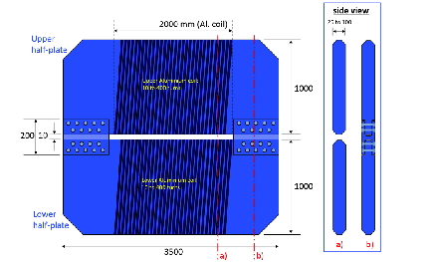
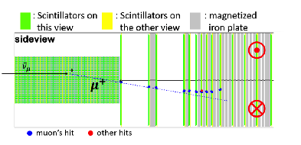
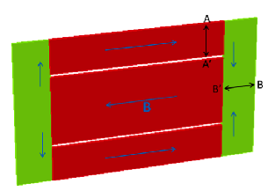
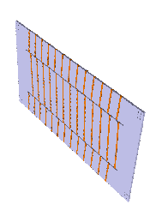
The magnetic design has been elaborated in collaboration with CERN (A. Dudarev);
Requirements in magnetic field (1.5 T), space and power consumption.
Both layouts are power efficient and
provide homogeneous field.
Latest one improves
-- dead space in end plates
-- sign symmetry between
μ⁺ and μ⁻
91% sign separation for
muons entering front face of
Baby-MIND
(will improve further by fiducial cuts)
2015,
A. Dudarev

Slide 13
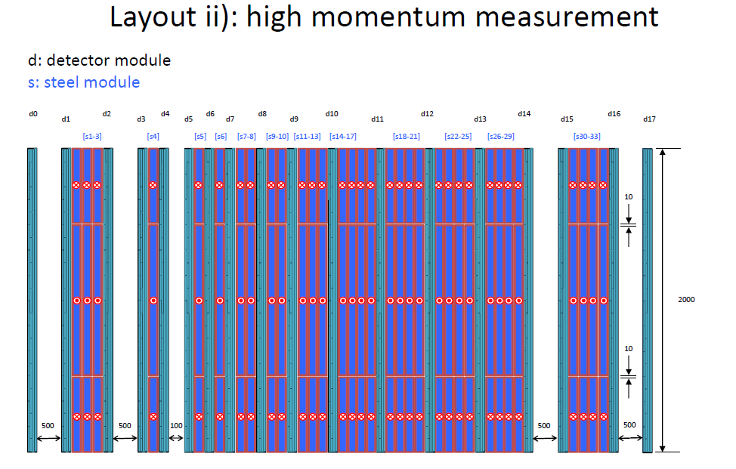
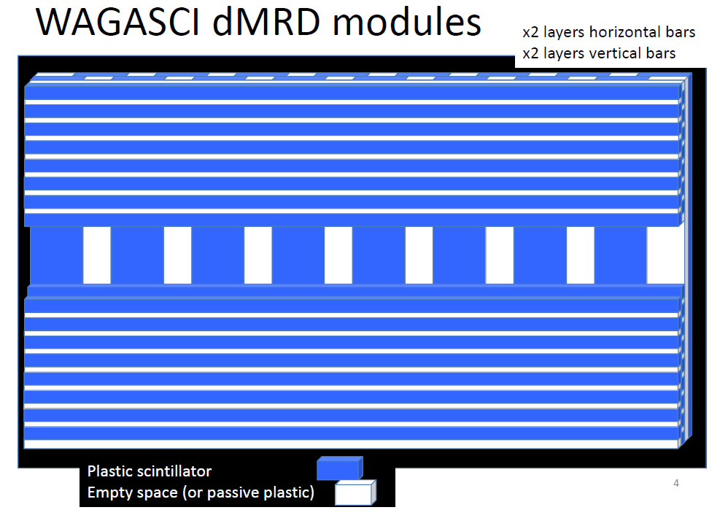
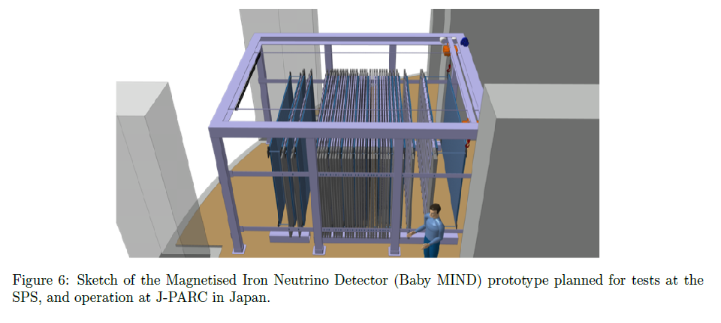
first part:
measure direction before and after 9cm thick plate
(maximizes low momentum resolution)
another direction measurement in the back
ensures good measurement for
high momentum muons.
dedicated scintillators will be built
reduced transverse size allows
installation in ND280 pit.

Slide 14
TASD: Nova is a totally active scintillation detector concept already taking data. What are the common/dissimilar features you have with the Nova detector? Can you profit from the experience already collected in Nova to improve your simulations, tracking and event
reconstruction codes?
NOvA is made of 4x6 cm cross-section tubes with close to 30% dead material.
In fact our partner has rather been MINERvA which uses the same scintillator
as our EMR detector on MICE at RAL, with nearly 98% active material.
We have been interacting with them for track reconstruction issues.
(Our measurement of the range vs momentum relationship is useful to them)

Slide 15
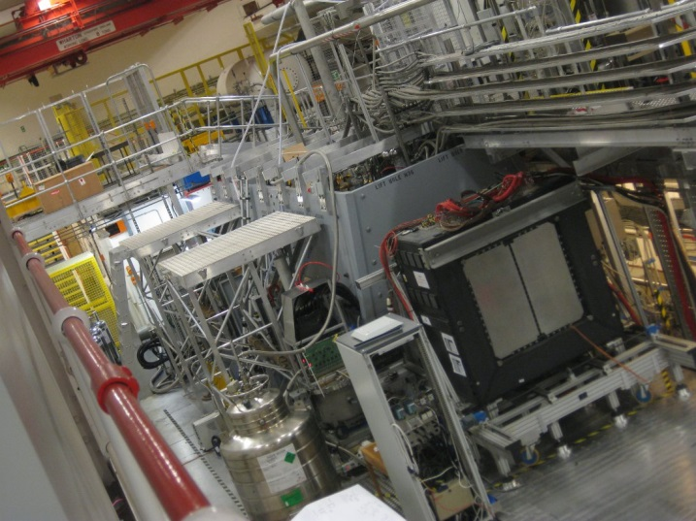
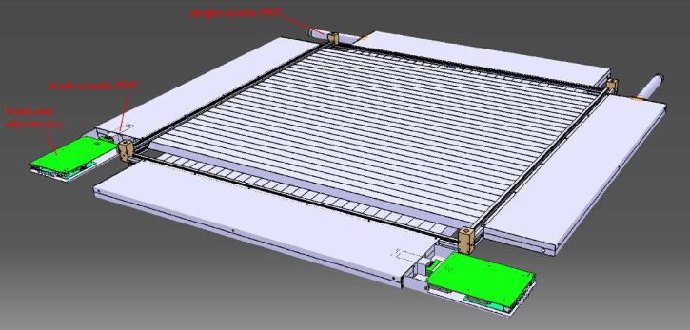
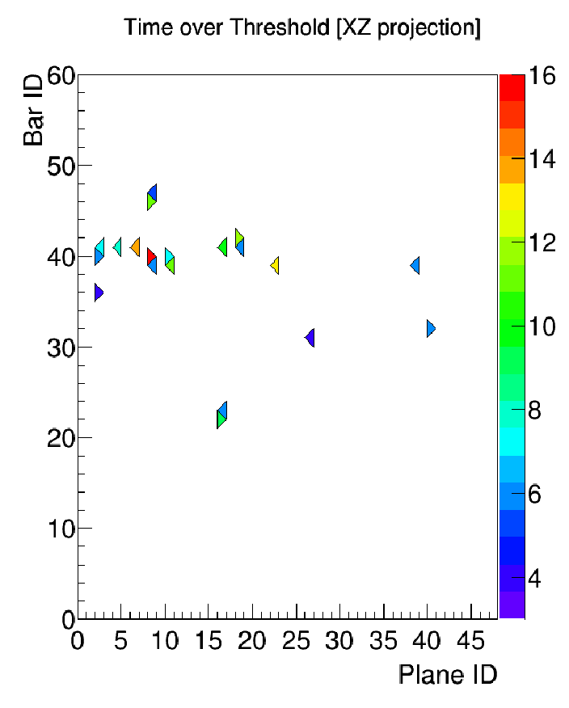
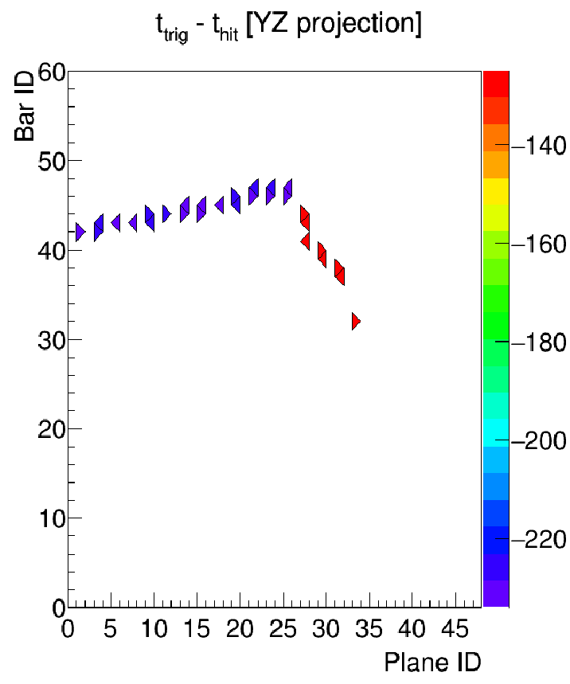
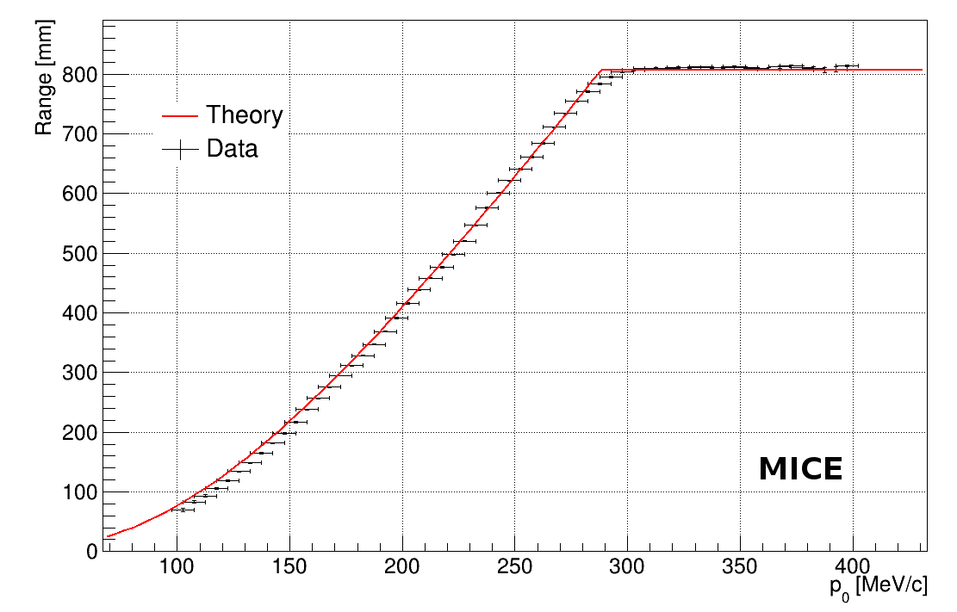
PREAMBLE: EMR detector for MICE at RAL
100-400 MeV/c
Same batch as MINERvA
atFermilab -- 98% active
24 x-y modules (48 planes)
2015: MICE hall
Step IV cooling expt
and EMR
➔Δp/p ~3% at 200 MeV/c
from range measurement
«electron» «muon with μ→eνν decay» ~2.5 μs
at 200 MeV/c : 99% muon eff. with 2% e-> mu prob.
MICE note 466, to appear in JINST

Slide 16
For the TASD option, the support mechanics is designed to fit inside the Morpurgo magnet. Do you have a contingency plan in case this magnet is not available in the time scale requested in your project?
Excellent question!
➔ We have not yet developed a fully satisfactory contingency plan.
The whole TASD project is designed for the Morpurgo Magnet. The magnet has shown limitations recently: Presently the field it is limited to 0.7-0.8T and this is enough for us.
If that magnet were to fail or be closed for repair we could possibly use the CMS magnet on beamline H2 or the GOLIATH magnet. This could imply some surgery on our TASD modules ☹, or delay the TASD tests, but would not affect the Baby-MIND-to-Wagasci project.

Slide 17
Magnetized modules: Paragraph 5.2 can you show a transverse view of the plates,
including the Al coil, to allow us a better understanding of the overall topology?
see next slide
Is the figure 15 right setup agreed as final?
Yes
What is the added value of building these magnets compared to the state of the art knowledge of such detectors (MINOS, etc…)?
The MINOS group could not give us a figure for the charge separation, the charge reconstruction being difficult due to the material distribution (big coils) and inhomogeneous
magnetic field. The set-up we have developped has a more homogeneous magnetic field, and
offers a dipole field that is easier for reconstruction (and systematics) etc…
It was already observed when we designed the MIND for LBNO that a toroidal geometry would be inefficient, it was therefore interesting to develop a geometry that is more adapted to rectangular or square shapes.
There were some interesting by-products to this study, namely that CERN realized that one could obtain steel with relatively bette magnetic properties at a better cost (following research done for this project and on the MICE return yoke).

Slide 18
B
I
I
B
B

Slide 19
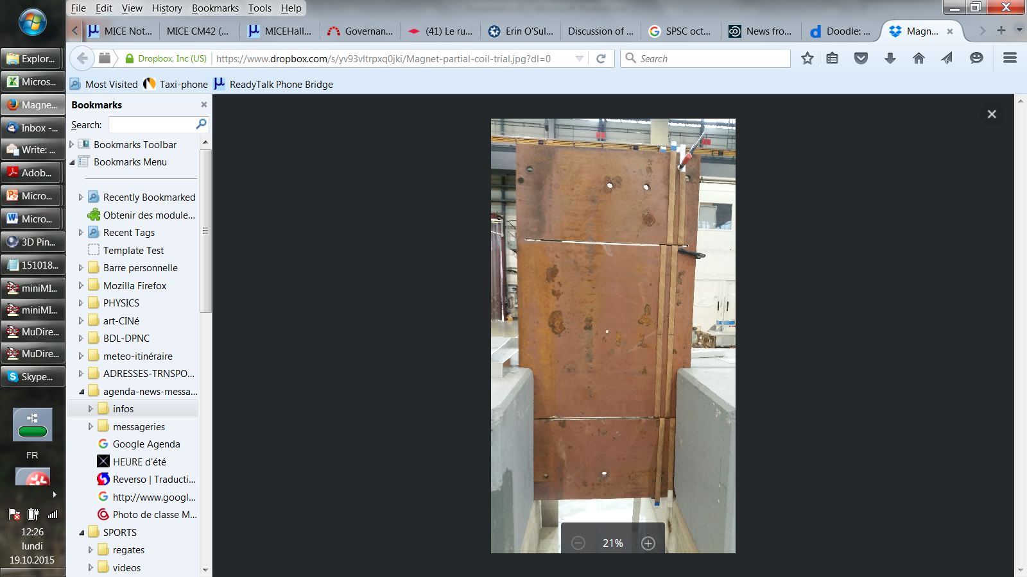
test in Bdg 180.

Slide 20
Beam test plan: What is the minimum energy achievable at H8? Should you not
concentrate on the low energy region to understand the detector for WAGASCI? Is the PS not more adequate for this?
We have discussed the test beam plans with Ilias Efthymiopoulos, and concluded that
we can carry out our beam test in the north area.
We are worried about the stated transfer rate of 2.44s/event (0.4Hz). This will result in a
very inefficient use of the beam. Do you think more work is needed on the DAQ aspect, so you can make efficient use of the delivered particles? It is not clear either how this is
factored in beam time estimates in Table 4.
This is a misunderstanding, probably due to a typo on our side. 2.44 s is the transfer rate for the date accumulated in VRB to computer, once the spill is finished. This is short compared to the time between SPS spills and will not lead to a loss of data. See next slide

Slide 21
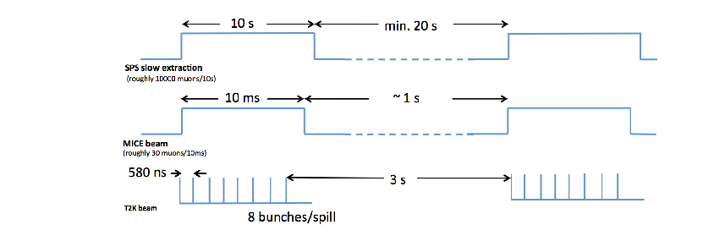
Electronics
The electronics is designed to adapt to the time structures of
-- SPS test beam (typically 10 second slow spill every 0.5 to 1 minute)
-- MICE beam ( 2 ms every 1 to 2.6 second)
-- T2K fast extraction with 8 bunches separated by 580 ns every 2.6 to 1 seconds.
In test beam mode, can record up to 10⁴ events per spill -- or ~10⁷ on a good day.
In MICE or T2K mode, can record all data without dead time.

Slide 22
Resources: can you quantify the manpower (FTE x YEARS) required to CERN to study
and build the magnets?
There is an WP prepared by CERN see next pages
Can you quantify the manpower (FTE x YEARS) devoted by the Collaboration to this project?
Not including CERN and non-Baby-MIND WAGASCI collaborators: > 50 FTE.yrs
With considerable caution required : some are master students, some are engineers, duration of project is renormalised to 4 years, some is beyond AB’s retirement.
Glasgow 4.8 FTE.yrs
INR 20 FTE.yrs
Sofia 8 FTE.yrs
UNIGE 20 FTE.yrs
Valencia 4 FTE.yrs

Slide 23
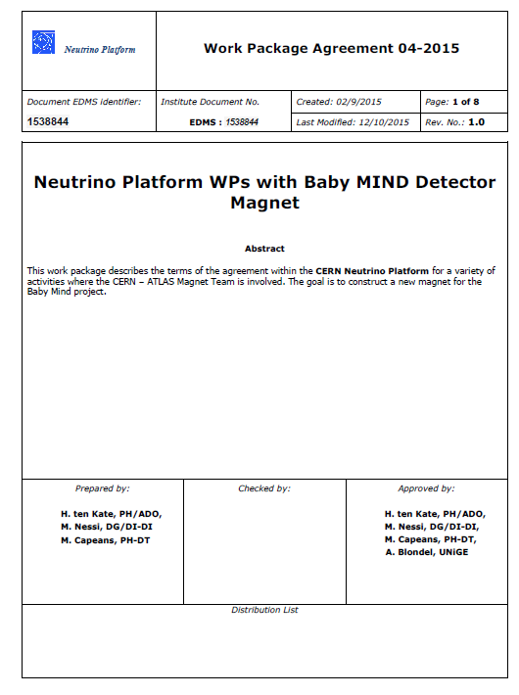

Slide 24
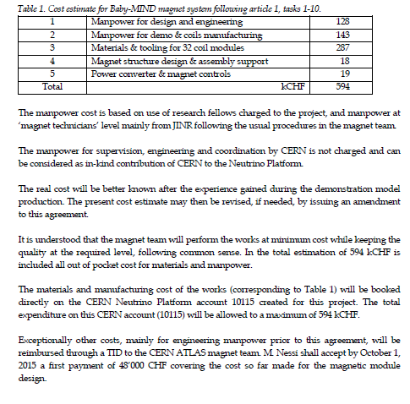
NB a larger contribution
in material is provided
by the collaboration
Scintillators
MPPCs
Electronics
DAQ etc...

Slide 25
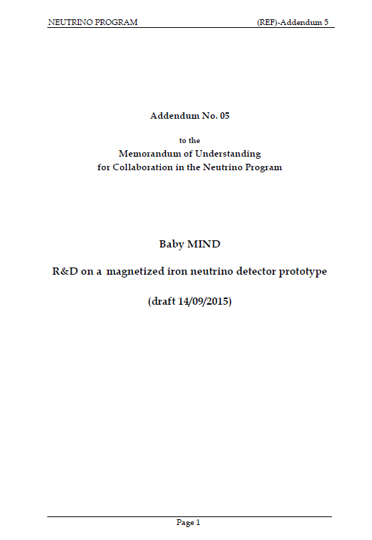
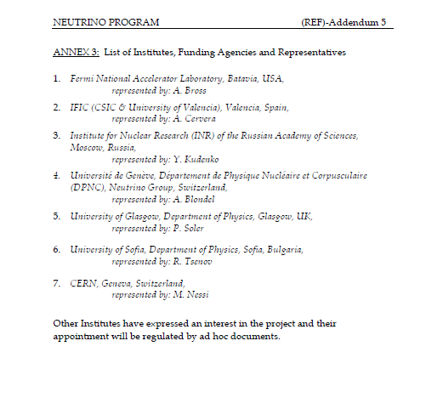

Slide 26
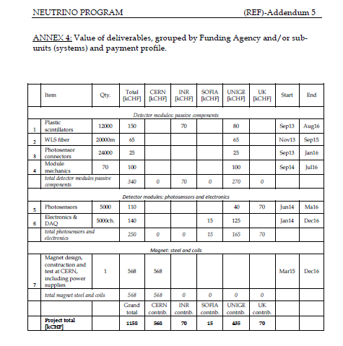

Slide 27
Collaboration: What is the past and present formal status of AIDA (I and II) agreements
around the BabyMIND project (deliverables, schedules)?
see slides by Etam
Is the BabyMIND formally part of the approved WAGASCI experiment or is it a proposed improvement? Could you provide the proposal/TDR of the WAGASCI experiment ?
As can be seen INR Tokyo and Kyoto are part of the original WAGASCI group, Geneva has been added since.
Baby-MIND is included as part of the program and UNIGE as part of the collaborators
in the public presentations.
Pr. Minamino (spokesperson of WAGASCI) has sent a letter to Claude Vallée to this effect

Slide 28

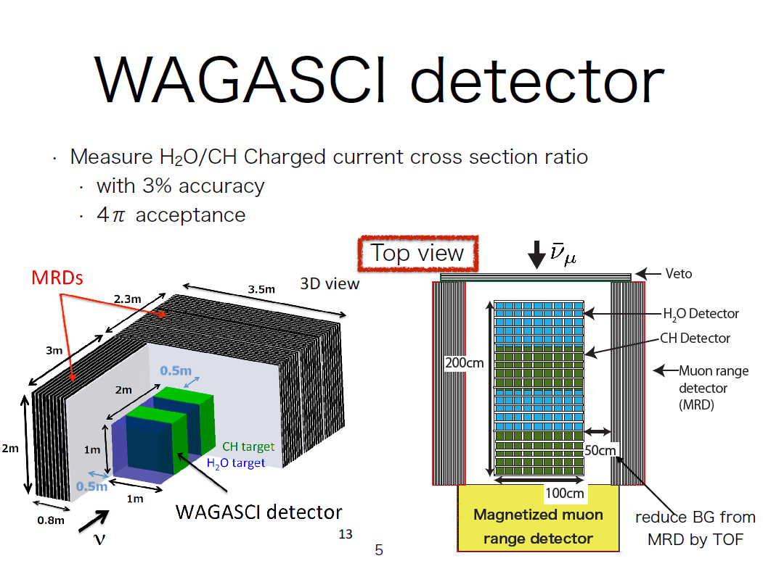
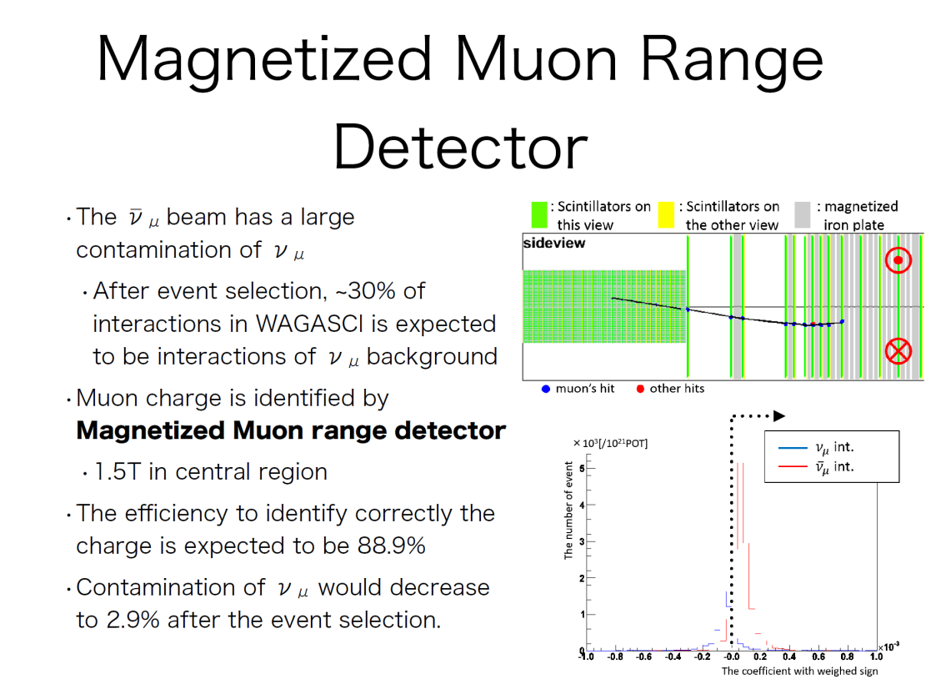
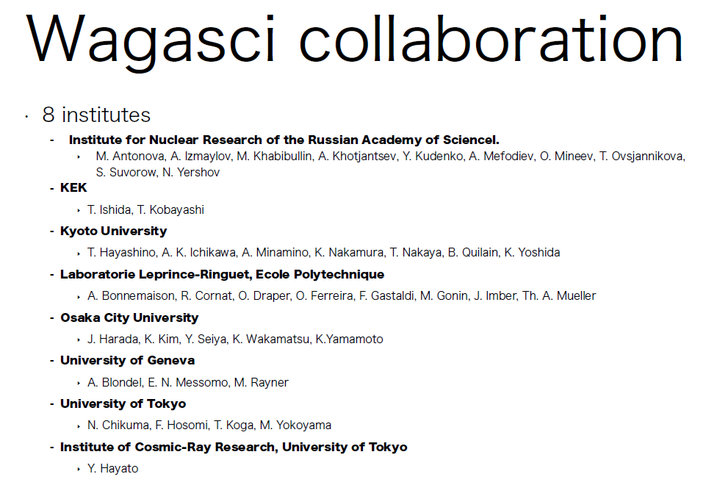

Slide 29
