Slide 1
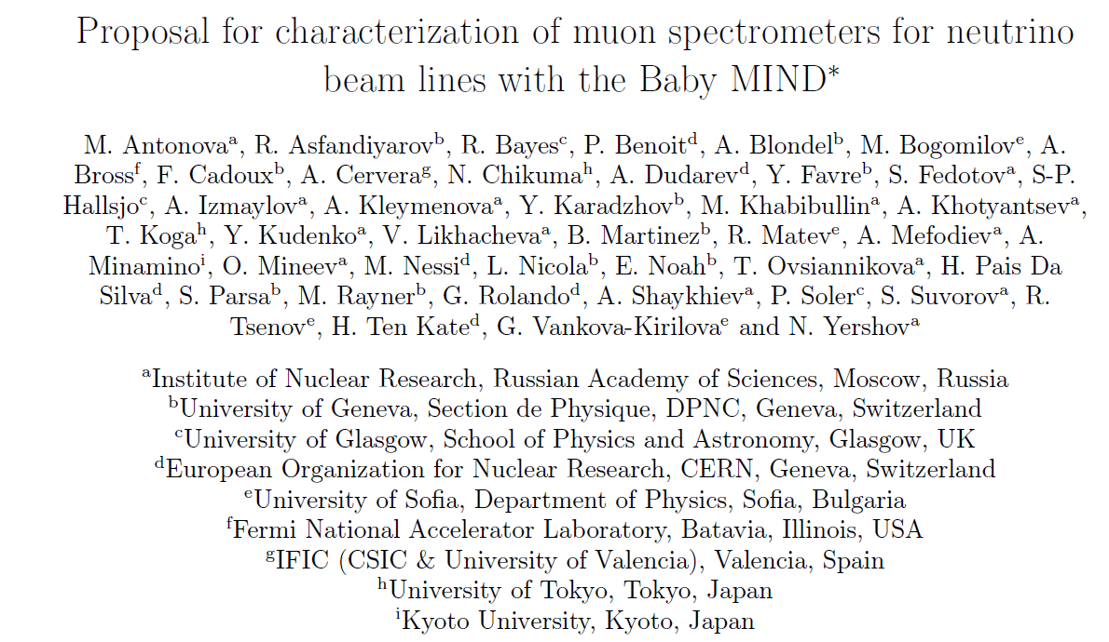
Tests of TASD and MIND prototypes at CERN

Slide 2
Motivation
AIDA integrated infrastructure program for neutrinos: beyond the state of the art
‘study of lepton identification and charge discrimination’ in view of neutrino factory
with a a ~1m deep Totally Active Scintillator Detector (TASD).
and a 50 ton prototype of a Magnetized Iron Neutrino Detector (Baby-MIND)
The experimental program at CERN main aims are:
1. test of electron/positron charge separation vs momentum in TASD immersed in magnetic field.
➔ a 0.9x0.9x0.9/ρ m³ prototype with variable density ρ has been built to be inserted in the Morpurgo Magnet in the H8 beam line.
2. test of muon charge separation as function of momentum down to 10⁻⁴ separation
above 1 GeV/c in a suitable test beam.
➔ a 2x3x1 m³ Baby-MIND is under construction with 3cm iron plates magnetized at 1.5 T.
Following this, further opportunities will be offered to use the Baby-MIND
-- in the T2K beam line, the WAGASCI project has expressed strong interest to use baby-MIND for precision measurement of water to scintillator ratio of anti-neutrino cross-sections.
We are planning to do this, which gives unique opportunity within a real neutrino beam.

Slide 3
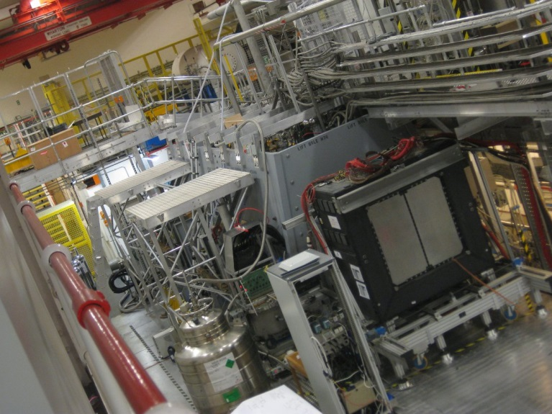
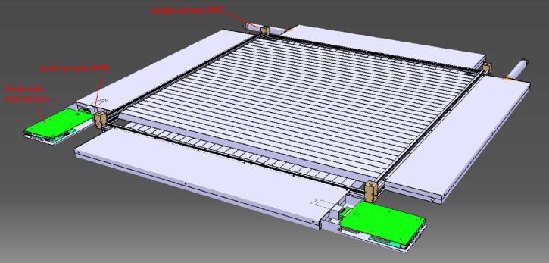
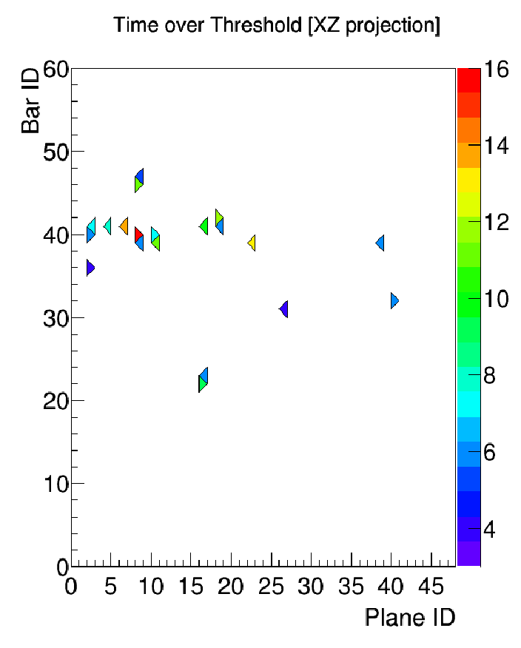
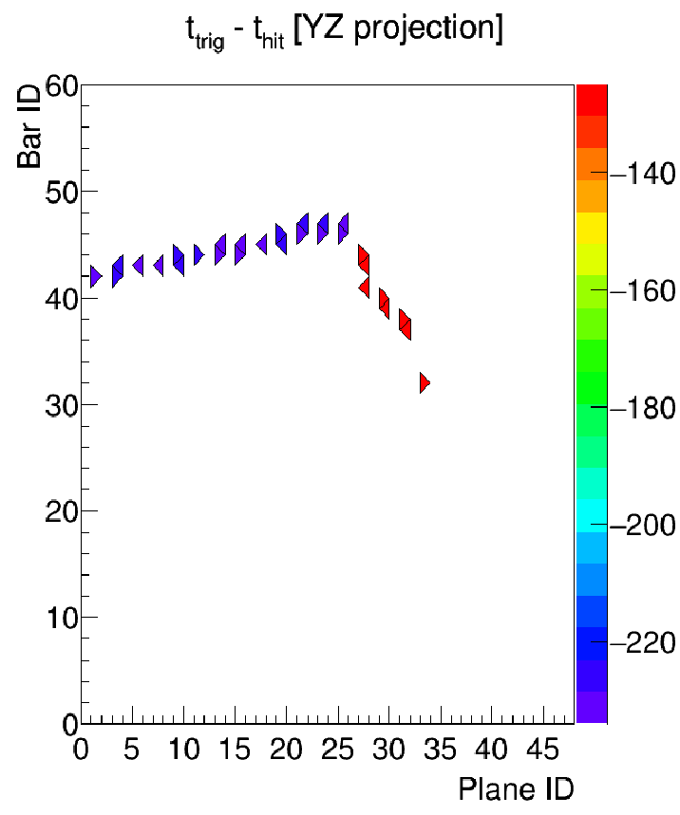
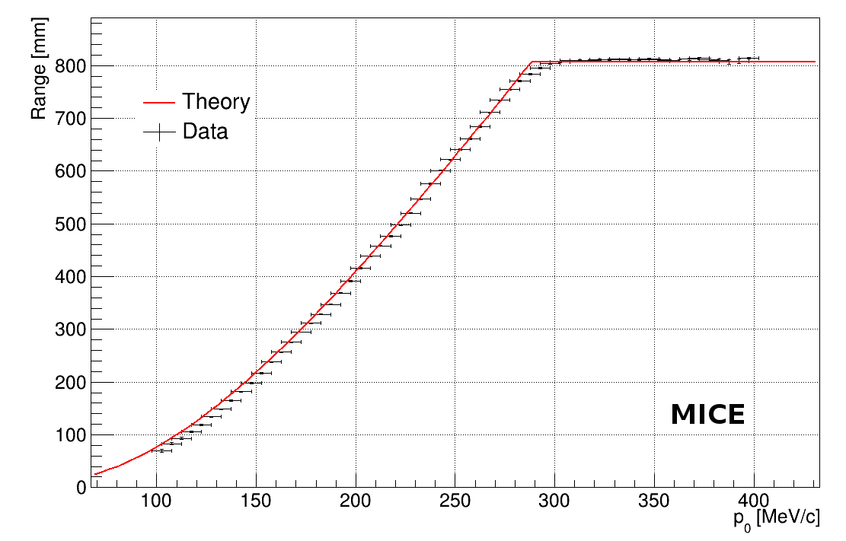
PREAMBLE: EMR detector for MICE at RAL
100-400 MeV/c
2015: MICE hall
Step IV cooling expt
and EMR
Same batch as MINERvA
at Fermilab -- 98% active
24 x-y modules (48 planes)
p.h.
range vs momentum meast.
electron
μ→eνν
➔Δp/p ~3% at 200 MeV/c
from range measurement
at 200 MeV/c : 99% muon eff. with 2% e-> mu prob.
MICE note 466, to appear in JINST

Slide 4
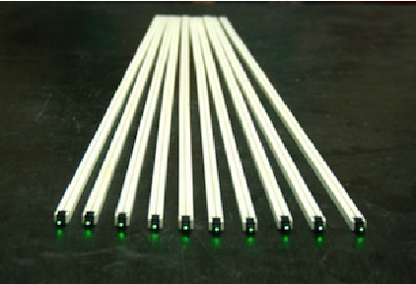
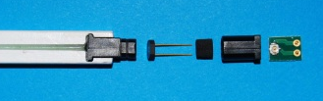
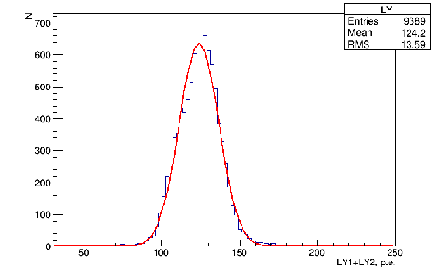
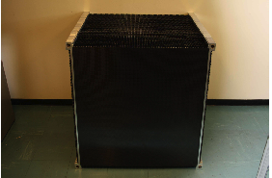
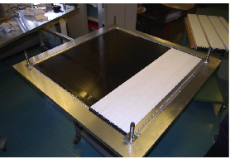
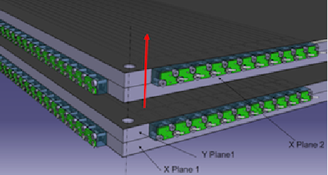
TASD detector
9000 bars of 0.7 x 1.0 x 900 mm³ manufactured & tested
at INR with WLS (Kurarai Y11) fiber and custom designed
connectors to MPPCs
Assembled in 50 alternating x and y planes
readout by 3000 Hammamatsu S12571-025C MPPC
Will read out part of the detector (on beam path)
Mechanical assembly allows for extensible design
with air gaps between planes
-- a cheap way to increase radiation length!
These modules will also serve for 1st test of Baby-MIND
construction ~ complete
← 50 modules in bdg 595
Light yield at INR (70 p.e. /mip)

Slide 5
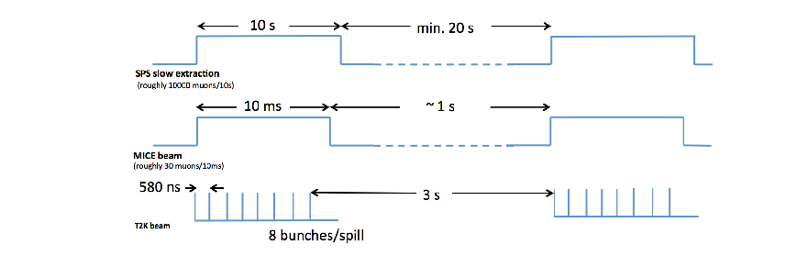
Electronics
The electronics is designed to adapt to the time structures of
-- SPS test beam (typically 10 second slow spill every 0.5 to 1 minute)
-- MICE beam ( 2 ms every 1 to 2.6 second)
-- T2K fast extraction with 8 bunches separated by 580 ns every 2.6 to 1 seconds.
In test beam mode, can record up to 10⁴ events per spill -- or ~10⁷ on a good day.
In MICE or T2K mode, can record all data without dead time.

Slide 6
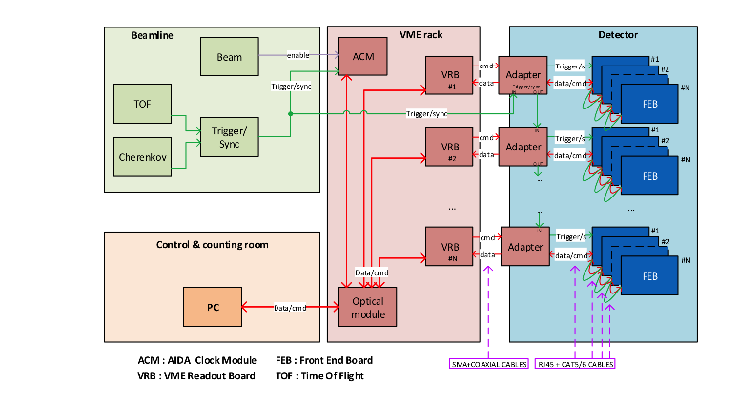
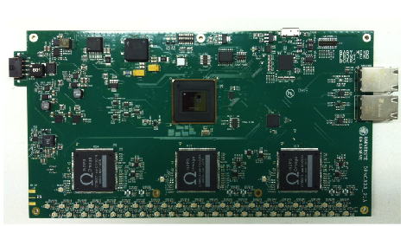
MPPCs
Front-end board
These electronics are
proposed as common tool
for neutrino platform
experiments
(ref. Y. Favre, Neutrino
platform, 3-09-2015)

Slide 7
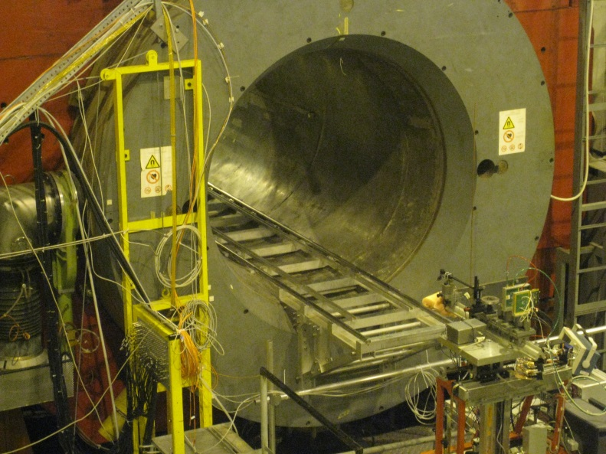
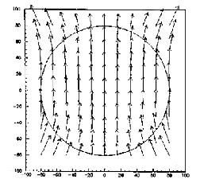
TASD tests
Field map
0.7 T OK.
Will expose TASD to electron or muon beam of 0.5 to 10 GeV
For momenta lower than ~4 GeV this requires a degrader.
H8
B
TASD
He Ckov
lead
degrader
1 or 2 trim coils
beam chambers
+ beam halo veto and trigger, not indicated

Slide 8
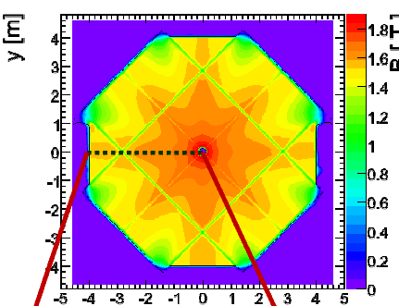
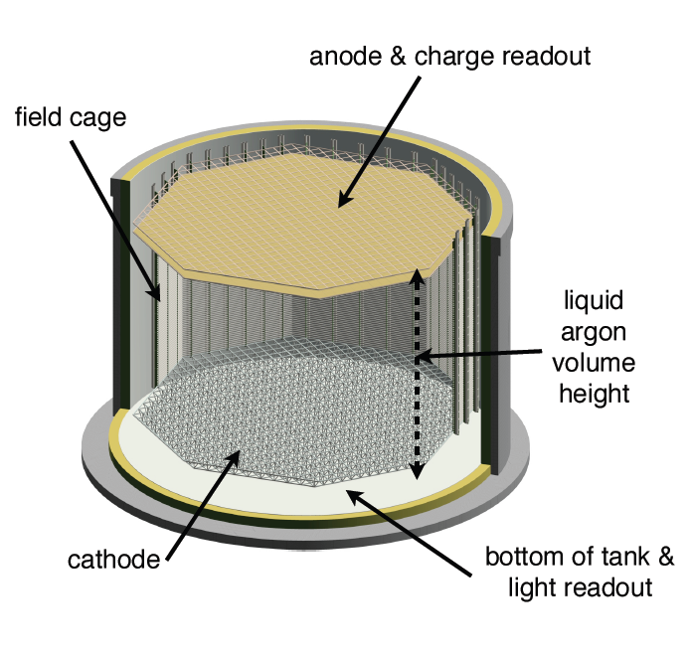
Baby-MIND
charge separation for MINOS was not measured to better than ~1%
due to anti-neutrino contamination and uncertainties in magnetic field
close to the central coil.
➔ requirement for test beam and a more homogeneous magnetic field
Pure toroidal geometry is inadequate for e.g. muon filter behind LBNO Liquid Argon detector
10m
B
B
20m
I
40m
We settled on the requirements related to the WAGASCI experiment.

Slide 9
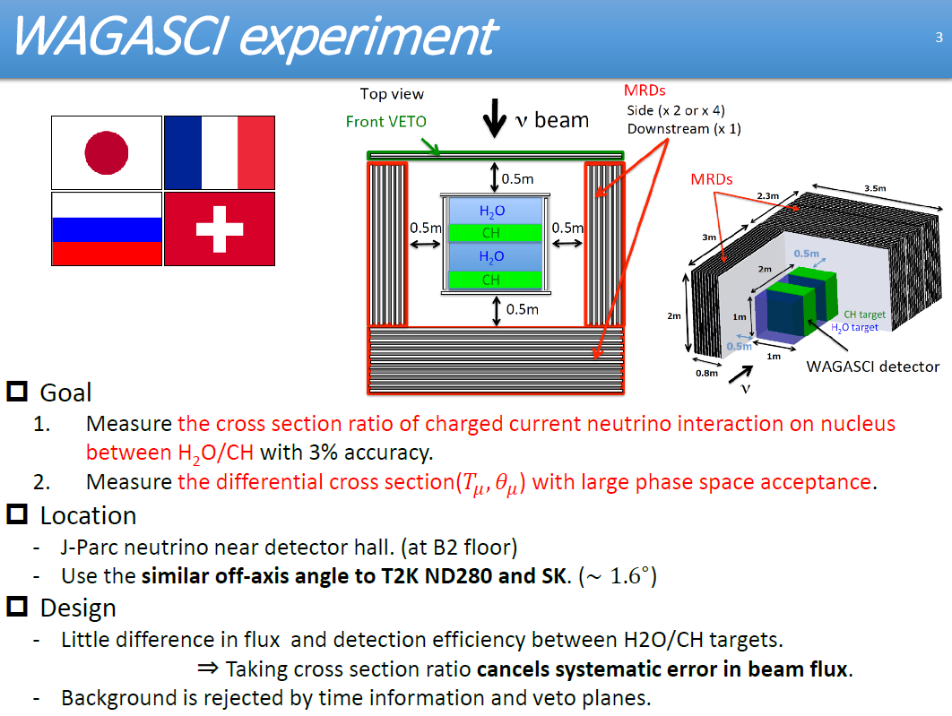
Baby-MIND
+ more
>2 ton target
Magnetized MRD
(Baby-MIND)

Slide 10
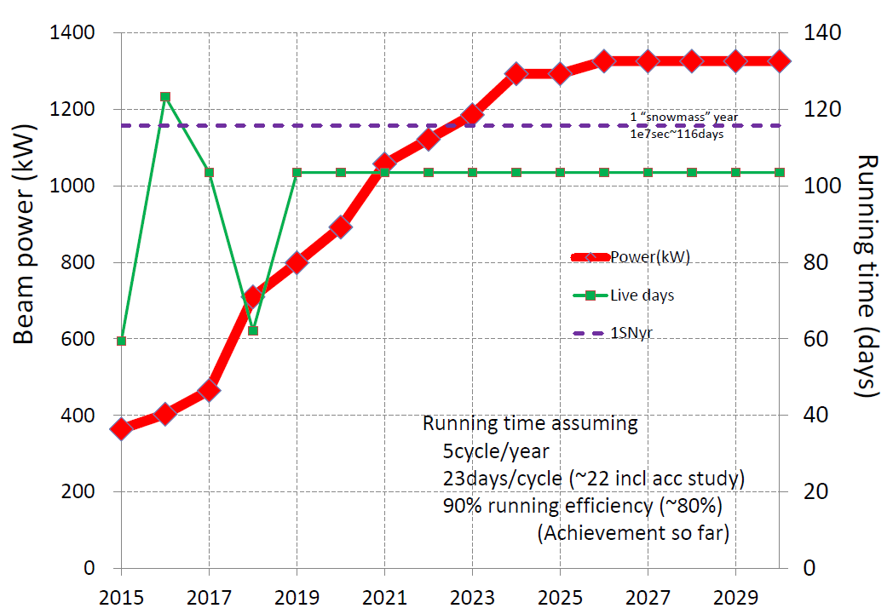
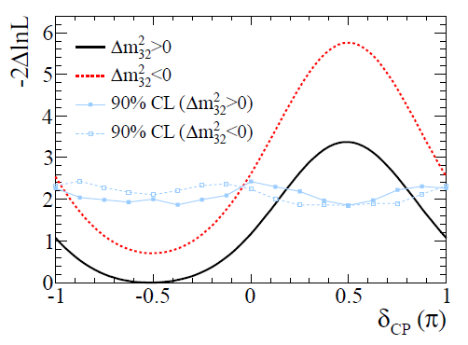
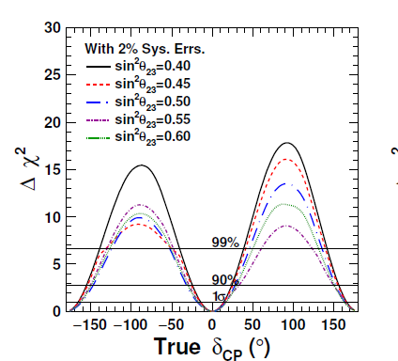
Workshop for Neutrino Programs with facilities in Japan (4-8 Aug-2015)
https://kds.kek.jp/indico/event/19079/
MR PS
upgrade
T2K, PRL 112 (2014) 061802
T2K
T2HK (proposed)
T2K is proposing to run until 2025 with beam power progressively increasing up to 1.3 MW
➔ 3-4 s.d. evidence for CP violation is possible
if the presently preferred point is correct.
This requires systematic errors at 3% level.

Slide 11
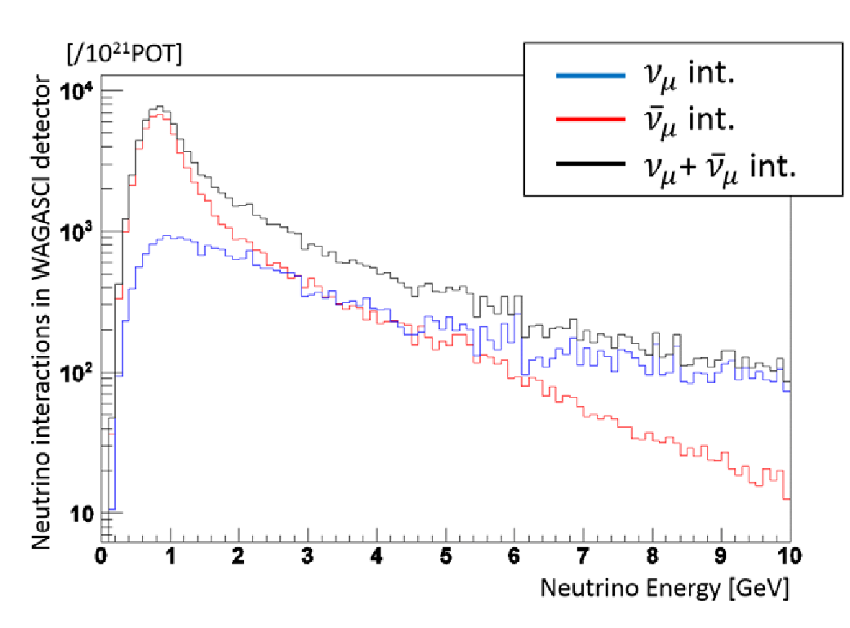
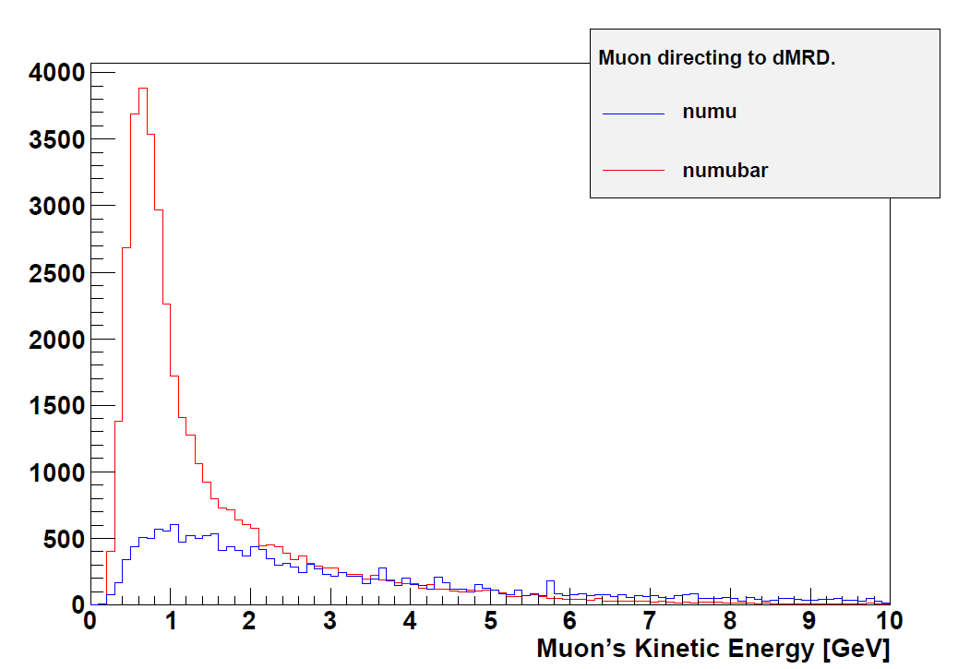
Since the main emphasis of T2K is now to measure the CP asymmetry, it is essential to
be able to predict ν_{μ} →ν_{e} and ‾ν_{μ} →‾ν_{e} appearance events for any set of osc. parameters.
One of the dominant systematics : ND280 is mainly C_{n}H_{2n} while far detector (SK) is Water.
The large fraction of neutrino events (integrated 30%) in the antineutrino running
requires charge separation of -- mostly high energy & forward -- muons.

Slide 12
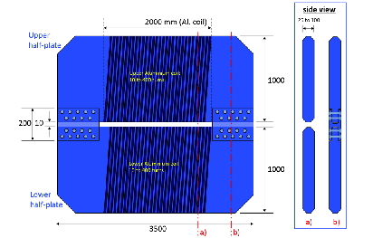
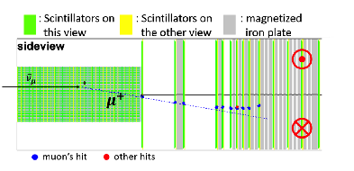
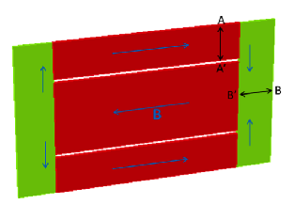
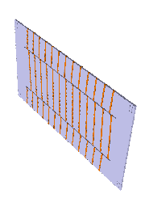
The magnetic design has been elaborated in collaboration with CERN (A. Dudarev);
Requirements in magnetic field (1.5 T), space and power consumption.
Both layouts are power efficient and
provide homogeneous field.
Latest one improves
-- dead space in end plates
-- sign symmetry between
μ⁺ and μ⁻
89% sign separation for
muons entering front face of
Baby-MIND
(will improve further by fiducial cuts)
2015,
A. Dudarev

Slide 13
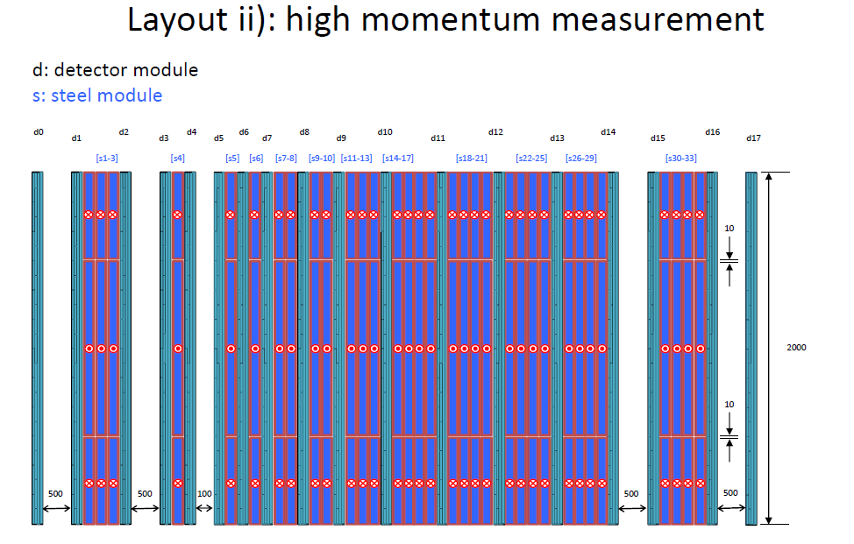
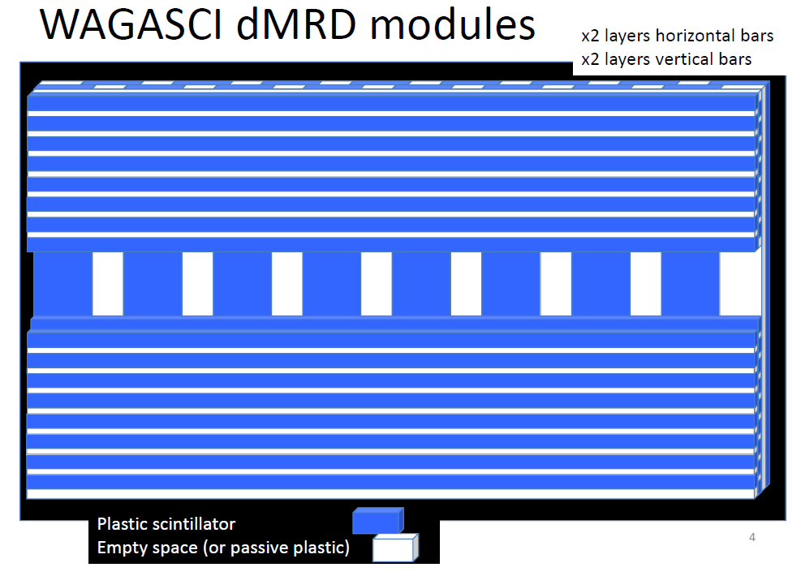
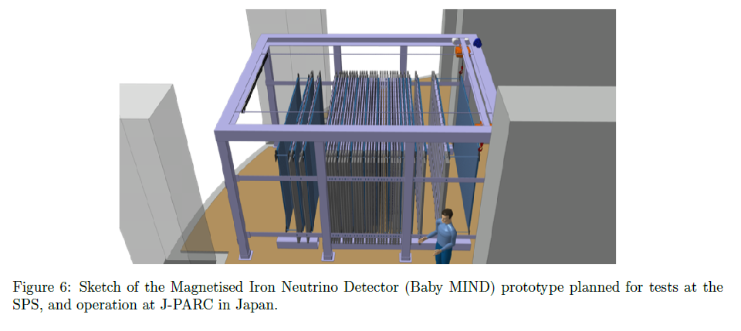
first part:
measure direction before and after 9cm thick plate
(maximizes low momentum resolution)
another direction measurement in the back
ensures good measurement for
high momentum muons.
dedicated scintillators will be built
reduced transverse size allows
installation in ND280 pit.

Slide 14
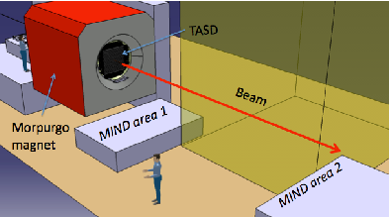
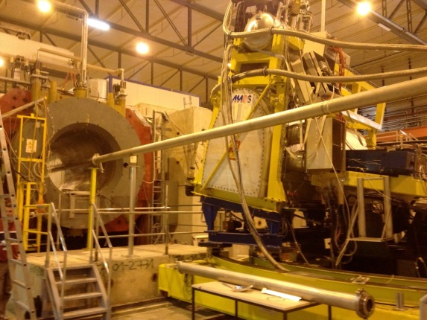
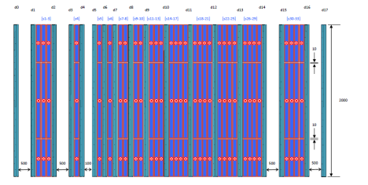
Baby-MIND tests
Phase 1. will use the scintillators MPPCs, cables and electronics from TASD
Phase 2. will use dedicated scintillators+ TASD MPPCs, cables and electronics
Will expose Baby-MIND to pion/muon beam of 0.5 to 10 GeV
B2
H8
B1
1 or 2 trim coils
beam chambers
+ beam halo veto and trigger, not indicated.

Slide 15
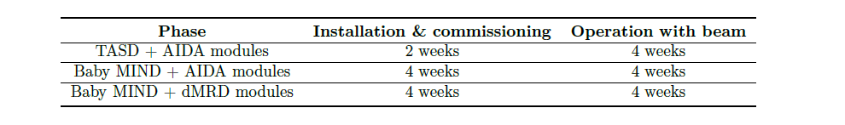
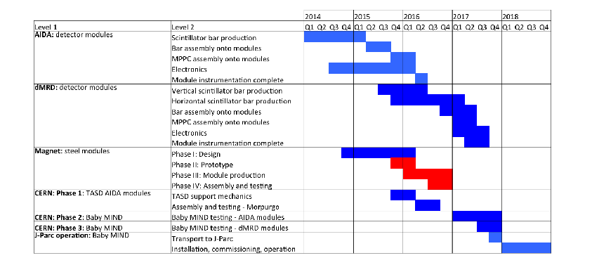
Requested beam test periods
1
2
3
1
2
3

Slide 16
Conclusions
We have built a 9000 channel extensible TASD to test the electron charge reconstruction
of electrons in dense medium and magnetic field
A Baby-MIND (60 tons) detector has been designed to test the muon charge separation with
high precision and to extend it below 1 GeV, and construction has begun.
This Baby-MIND is part of a measurement of water to scintillator cross-section ratio
in the neutrino and antineutrino beam at T2K within the WAGASCI experiment
in view of a reduction of systematic errors for T2K CP asymmetry measurements.
Tests of these detectors in beams are requested at CERN in several steps
-- 1 -- TASD tests in the MORPURGO magnet using dedicated TASD scintillators and
a set of MPPCs, connectors, and electronics
-- 2 -- Baby-MIND tests using the magnetized iron plates with the same detectors and electronics as the TASD tests above.
-- 3 -- Baby-MIND tests using the final scintillator configuration to calibrate the charge
separation and momentum measurement performance of the final detector.

