Slide 1
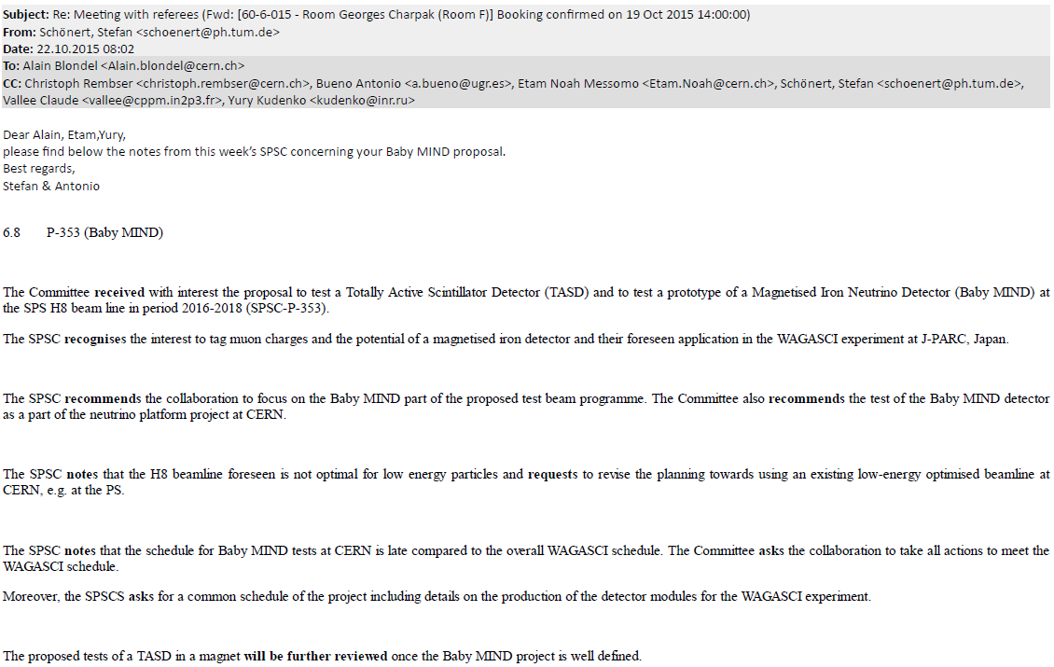

Slide 2
Dear Alain, Etam and Yury, Thanks for your responding attitude to our questions. Our recommendations (which wording may still be tuned without changing the content) will be discussed at the Research Board on 9th December, and hopefully the BabyMIND part of your project approved as new neutino platform subproject at this occasion. Afterwards you will be regularly reviewed at each SPSC meeting, with a more thorough annual review once per year, the first or which will most likely be in April (to be confirmed). So I would advise you to prepare right now a document describing a well defined BabyMIND test setup at CERN, a realistic schedule and beam requests, as well as the other pieces of information requested in the recommendations. Wishing you the best for the next steps ! Cheers, Claude.

Slide 3
Next steps
1. revisit availability (time and conditions) of Morpurgo magnet
-- if it is impossible to use it in 2016, propose to proceed with test beam of TASD
without magnetic field, as a test of electronics and DAQ.
2. T9 is a better area for low energy muons than North area.
-- suggest to use T9 for test of Baby MIND
3. dates of test beam availability
2016: 18 April to 16 November
the shut down: we can build/install Baby MIND in T9 test area during that time
2017 beam restart in may 2017.

Slide 4
➔ an obvious schedule:
-- plan to install and cosmic-test Baby-MIND in T9 during winter 2016-2017
-- take beam in May 2017
pack and ship in June 2017, install in Japan asap.
consequences:
1. we need to apply for funding for the cost of the transport, installation and shipping
➔ transport cost estimate requested by 12 November 2015.
(deadline for submission of grant proposal is 15 November
-- some final document can be sent afterwards if announced in advance )
2. need to be sure the above schedule is realistic.
3. inform SPSC chair, if possible before RB of 9 December 2015

