Slide 1
Magnet construction
update

Slide 2
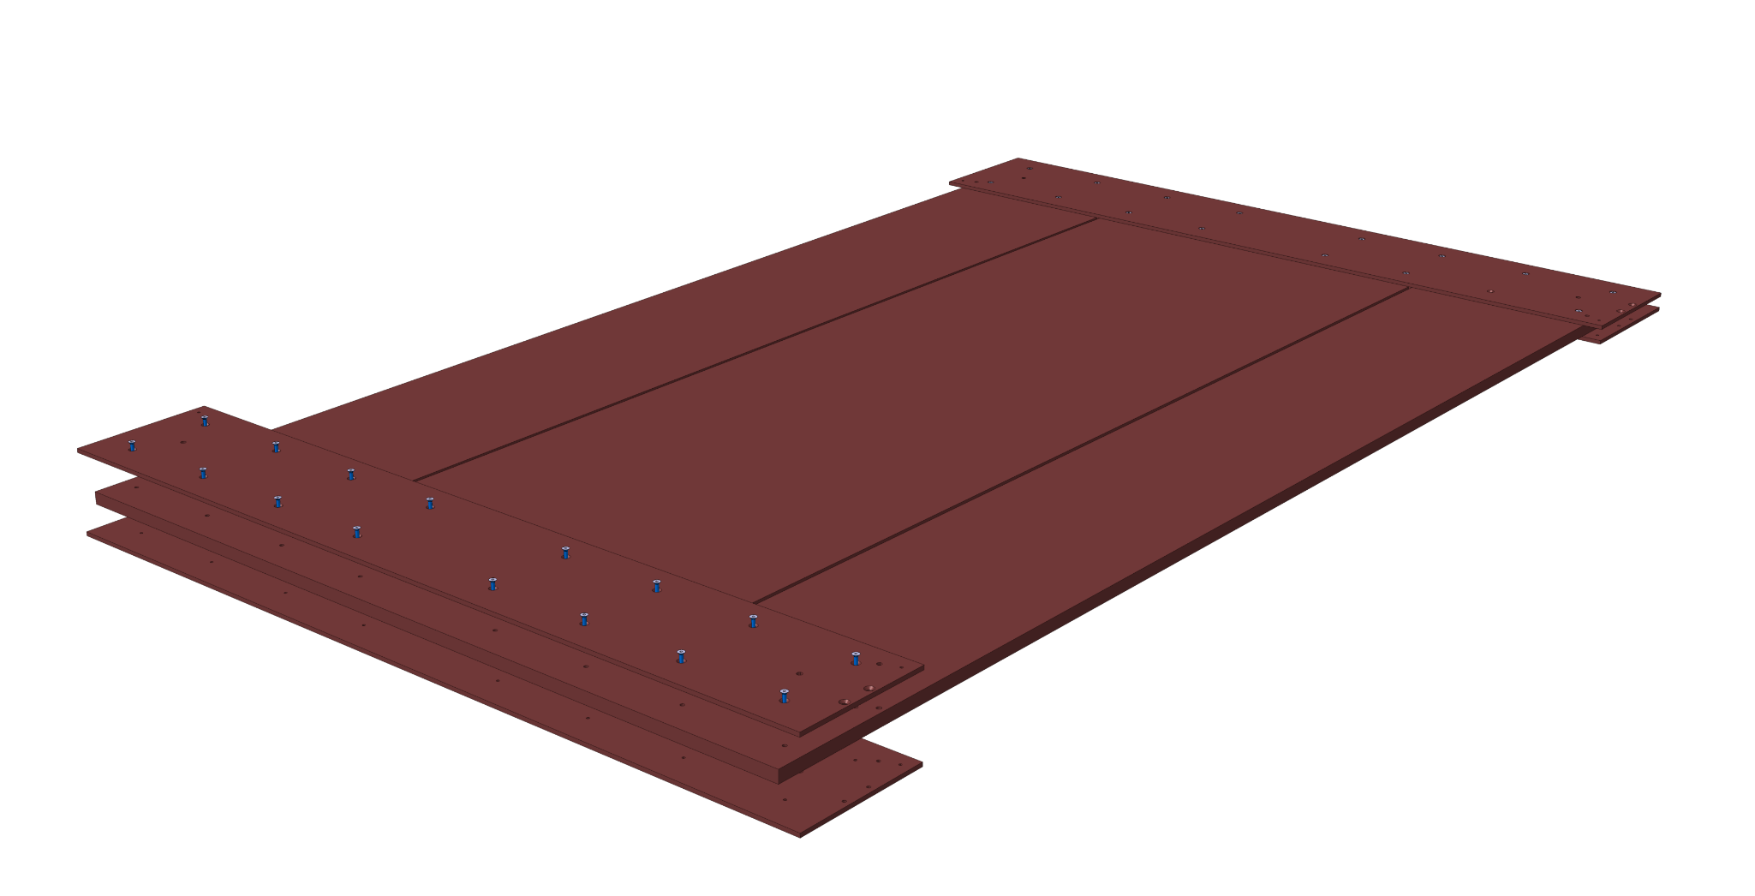
Prototype plates are under machining in Lausanne. Expected in two weeks.

Slide 3
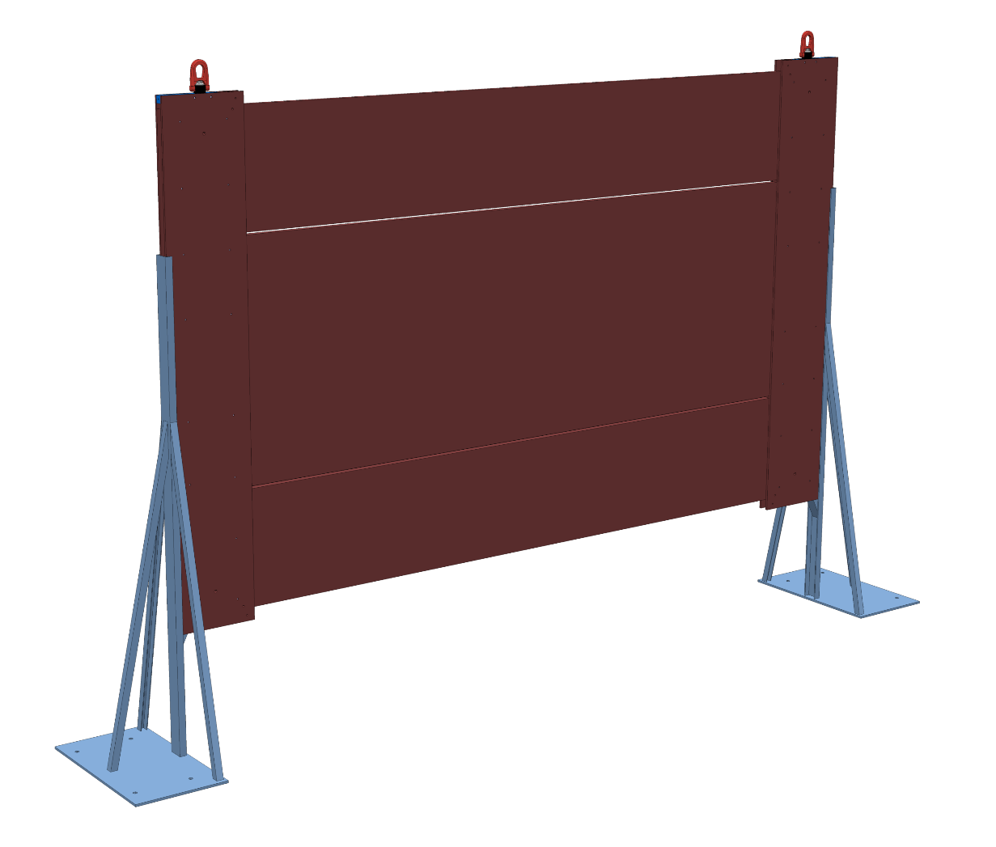
Material for the supports is ordered and construction will start in a week when two technicians from Dubna are present.

Slide 4
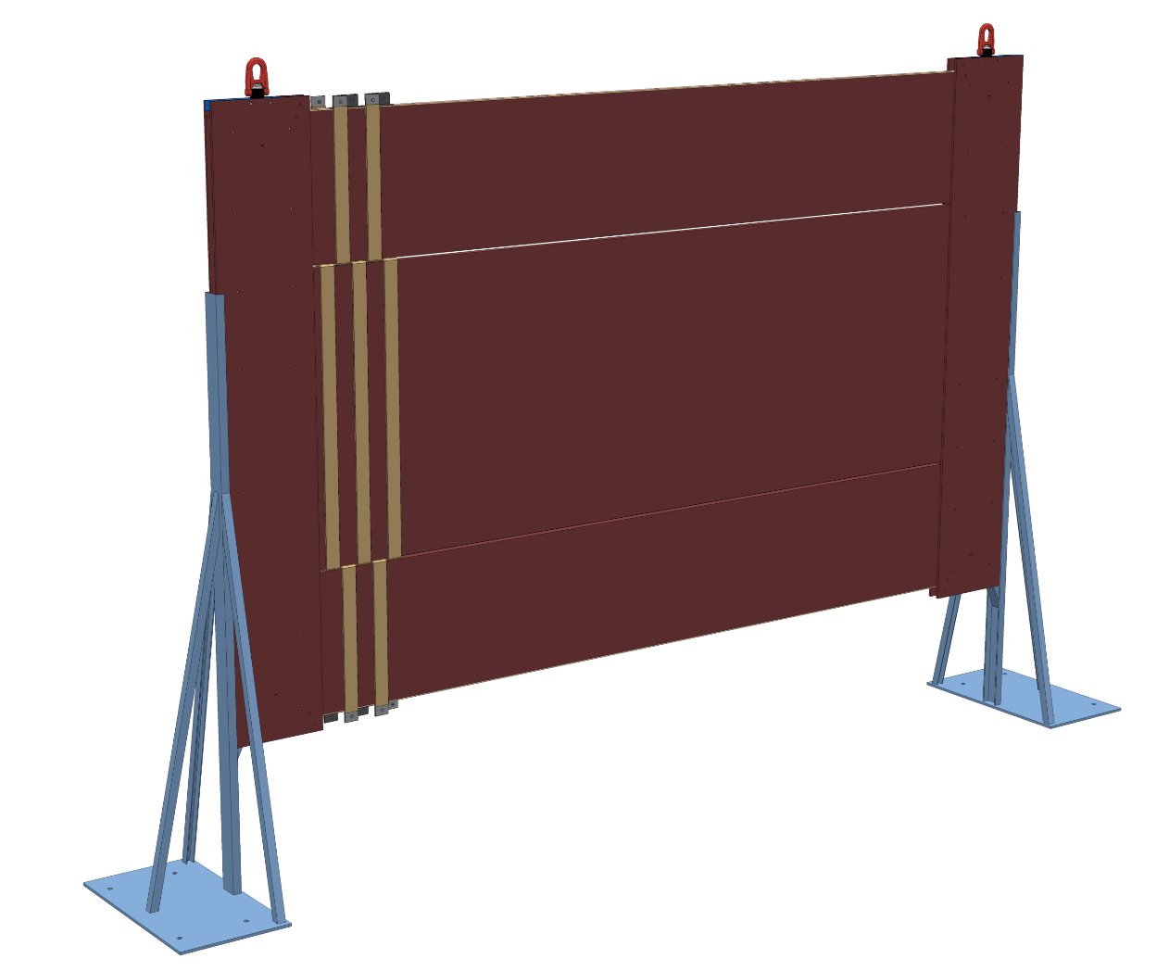
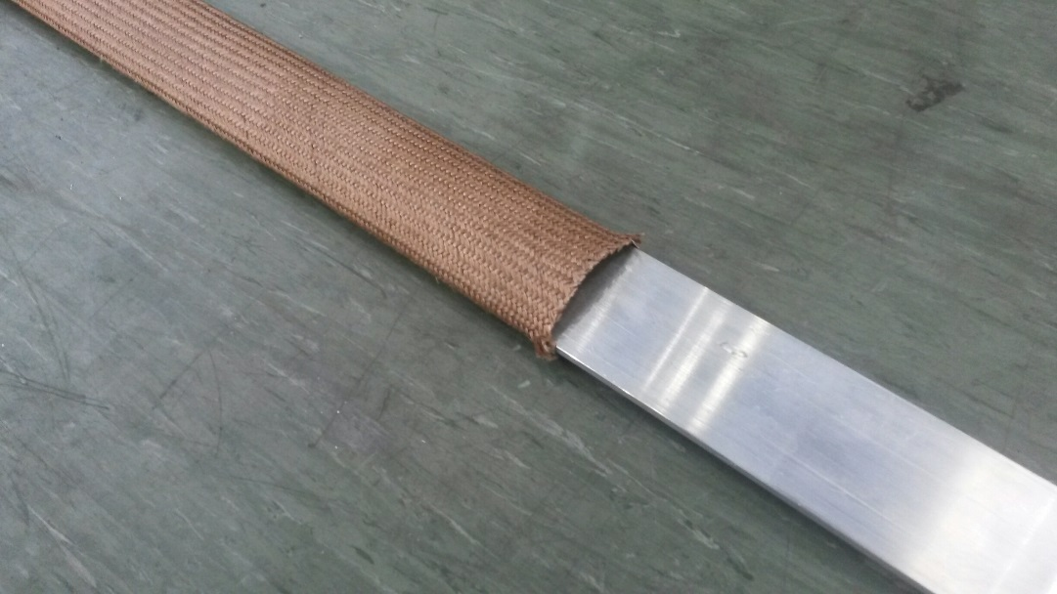
The conductor (200 m) is ordered. It is 50x4 mm² aluminium strip. The isolation is also chosen.

Slide 5
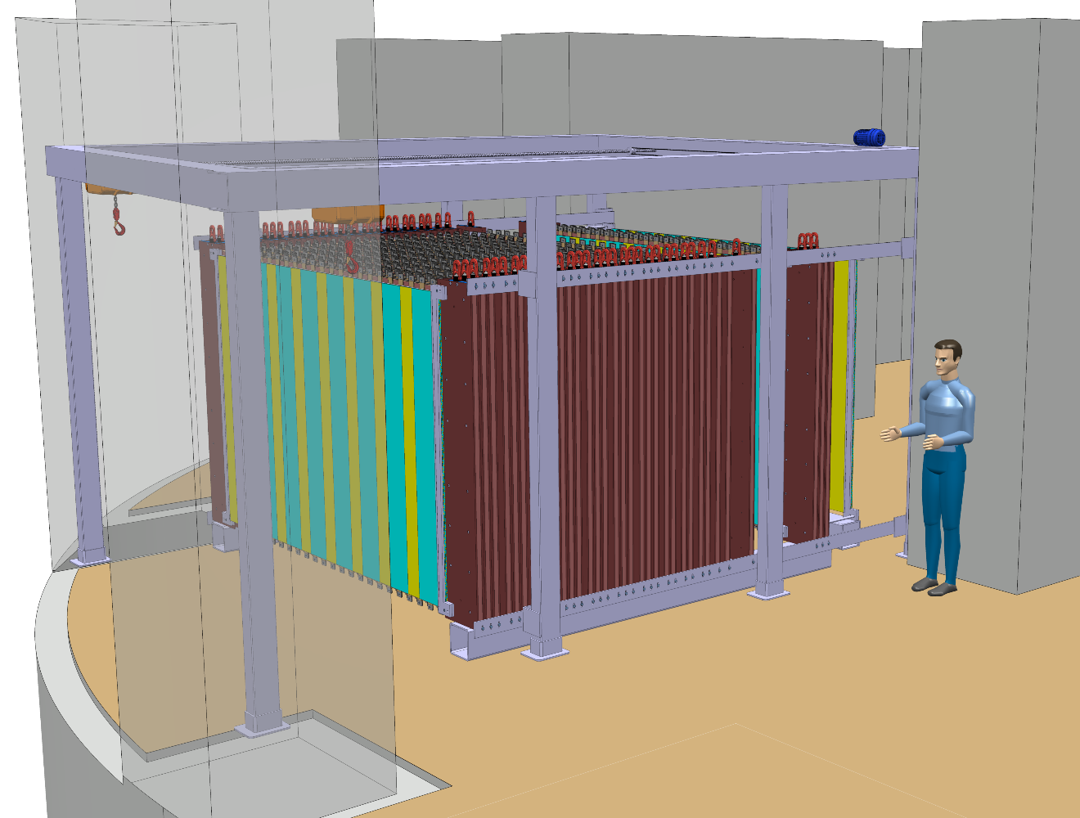
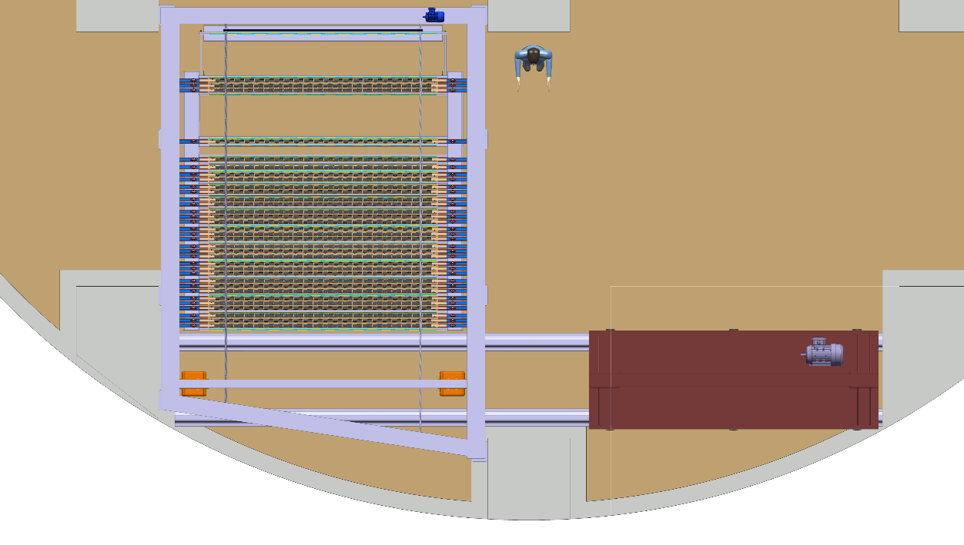
The concept of the detector, its assembly and installation in Japan seems to be OK but has to be finalised.

