Slide 1
Introduction to Linear Colliders
D. Schulte

Slide 2
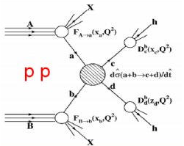
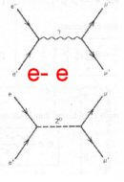
Collider Choices
Hadron collisions: compound particles
  Mix of quarks, anti-quarks and gluons: variety of processes
  Parton energy spread
  QCD processes large background sources
  Hadron collisions ⇒ large discovery range
Lepton collisions: elementary particles
  Collision process known
  Well defined energy
  Other physics background limited
  Lepton collisions ⇒ precision measurements
Lepton-hadron is also possible

Slide 3
Past/Existing High Energy Frontier Colliders
Only referring to the highest energy
Lepton colliders:
LEP (Large Electron Positron Colliders)
  Z₀ factory at 90GeV electron-positron cms energy
  W⁺W⁻ factory at 160GeV
  Above 200GeV for higgs search
  Closed in
SLC (Standford Linear Collider)
  Z₀ factory at 90GeV electron-positron cms energy
Hadron colliders
LHC (Large Hadron Collider):
  Proton-proton with 13TeV
  Ion-ion operation
  Still operating

Slide 4
Considered Future High Energy Frontier Colliders
Circular colliders:
FCC (Future Circular Collider)
  FCC-hh: 100TeV proton-proton cms energy, ion operation possible
  FCC-ee: Potential intermediate step 90-350 GeV lepton collider
  FCC-he: Lepton-hadron option
CEPC / SppC (Circular Electron-positron Collider/Super Proton-proton Collider)
  CepC : e⁺e⁻ 240GeV cms
  SppC : pp 70TeV cms
Linear colliders
ILC (International Linear Collider): e⁺e⁻, 500 GeV cms energy, Japan considers hosting project
CLIC (Compact Linear Collider): e⁺e⁻, 380GeV-3TeV cms energy, CERN hosts collaboration
Mentioned
Muon collider, has been supported in the US but effort strongly reduced
Plasma acceleration in linear collider
Photon-photon collider
LHeC

Slide 5
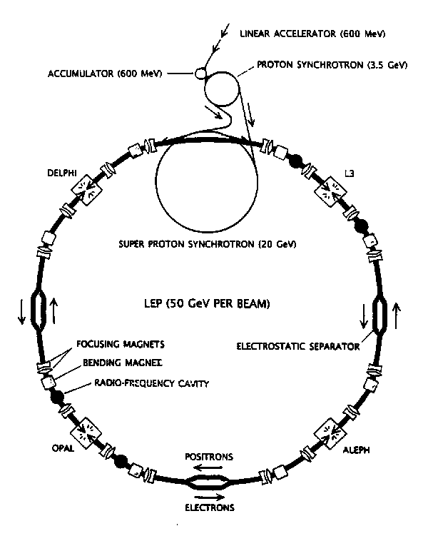
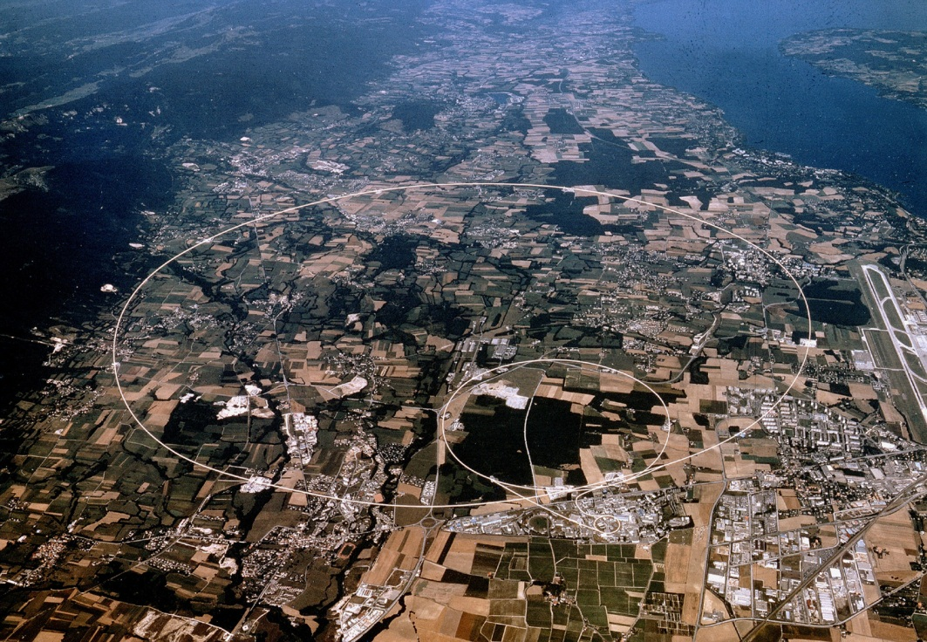
LEP (at CERN)
27km circumference
Electron-positron collider
4 experiments: ALEPH, DELPHI, L3, OPAL
CMS energy: 90GeV (LEP I) - 209GeV (LEP II)
Peak Luminosity: 10³²cm⁻²s⁻¹
Operation: 1989-2000
Highest particle speed in any accelerator

Slide 6
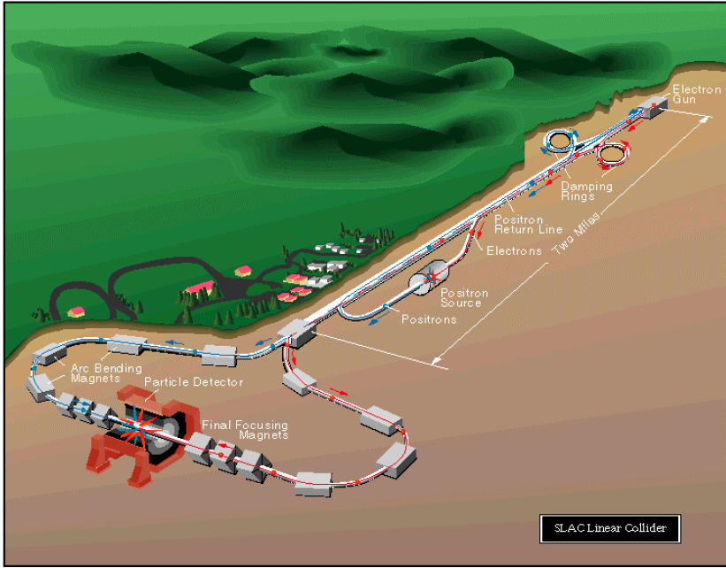
SLC (at SLAC)
Electron-positron linear collider
2 experiments: first MARK II, then SLD
CMS energy: 92GeV
Peak Luminosity: 2x10³⁰cm⁻²s⁻¹
Operation: 1989-1998
The only linear collider sofar

Slide 7
The LHC (at CERN)
27km circumference (well, the LEP tunnel)
4 main experiments
Nominal CMS energy: 14TeV
Peak Luminosity: 10³⁴cm⁻²s⁻¹
Operation: 2009-today
Highest particle energy in any accelerator

Slide 8
The LHC Experiments

Slide 9
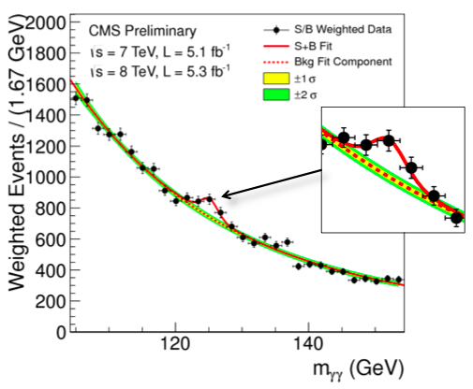
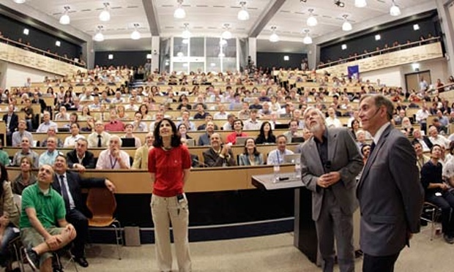
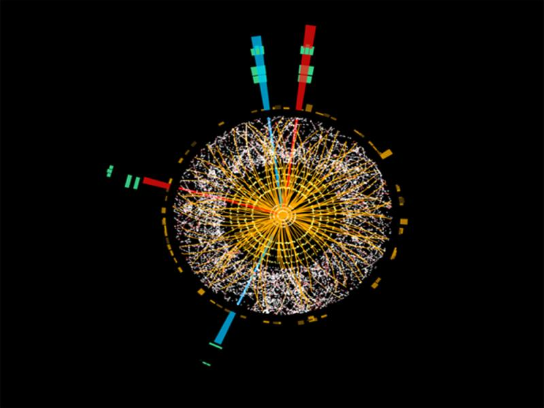
Higgs Discovery
Higgs candidate in CMS
July 4, 2012
A higgs-like particel has been found in ATLAS and CMS
Nobelprize in 2013 to François Englert and Peter W. Higgs
Higgs candidate in ATLAS

Slide 10
LHC schedule beyond LS1
LS2 starting in 2018 (July) => 18 months + 3 months BC
LS3 LHC: starting in 2023 => 30 months + 3 months BC
Injectors: in 2024 => 13 months + 3 months BC
Physics
Shutdown
Beam commissioning
Technical stop
30 fb⁻¹
YETS
EYETS
YETS
LS 2
YETS
Run 2
Run 3
Run 2
LS 2
Run 3
YETS
LS 3
Run 4
YETS
LS 3
Run 4
300 fb⁻¹
LS 4
Run 5
LS 5
LS 4
Run 5
LS 5
(Extended) Year End Technical Stop: (E)YETS
F. Bordry
3’000 fb⁻¹
LHC schedule approved by CERN management and LHC experiments spokespersons and technical coordinators (December 2013)

Slide 11
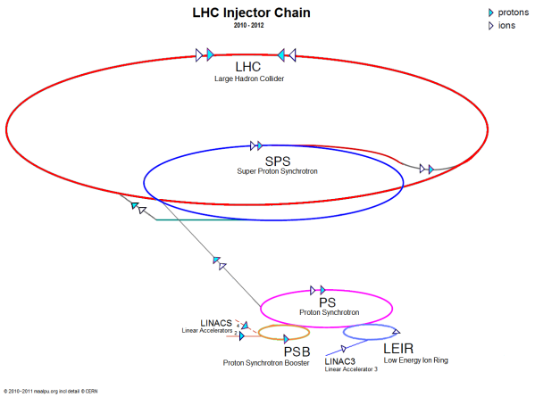
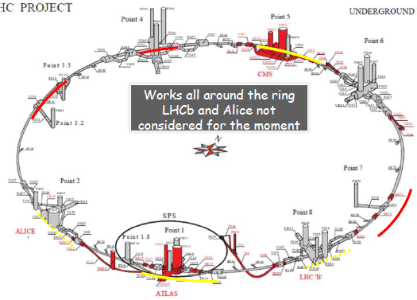
The HL-LHC Project
Goal is to obtain about 3 - 4 fb⁻¹/day (250 to 300 fb⁻¹/year)
Many improvements on the injector chain
Linac 4 - PS booster
PS
SPS
Many improvements on the LHC ring
New IR-quads Nb₃Sn (inner triplets)
  New 11 T Nb₃Sn (short) dipoles
  Collimation upgrade
  Cryogenics upgrade
  Crab Cavities
  Cold powering
  Machine protection
  …

Slide 12

Example of International Collaboration
F. Bordry
Baseline layout of HL-LHC IR region
D2
Q4
with national laboratories but also involving industrial firms

Slide 13
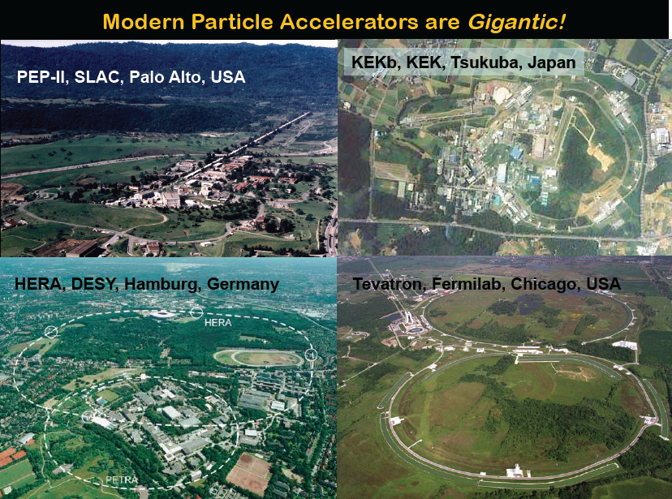
Other Colliders
B. Barrish

Slide 14
Lepton Collider Physics

Slide 15
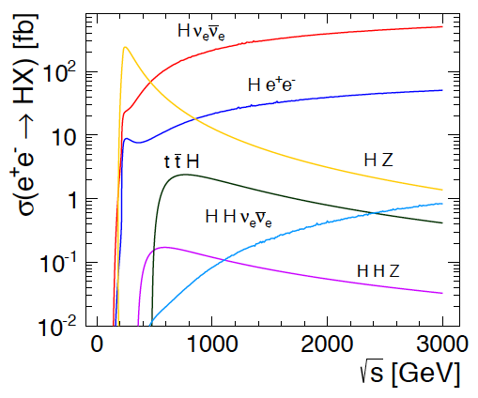
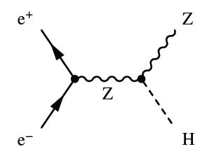
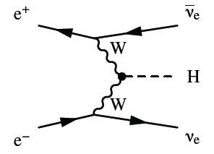
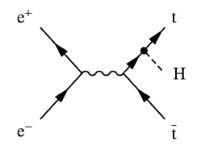
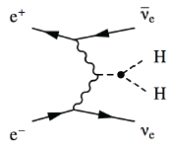

Higgs Physics in e+e- Collisions
Precision Higgs measurements
Model-independent
  Higgs couplings
  Higgs mass
Large energy span of linear colliders allows to collect a maximum of information:
  ILC: 500 GeV (1 TeV)
  CLIC: ~350 GeV – 3 TeV

Slide 16
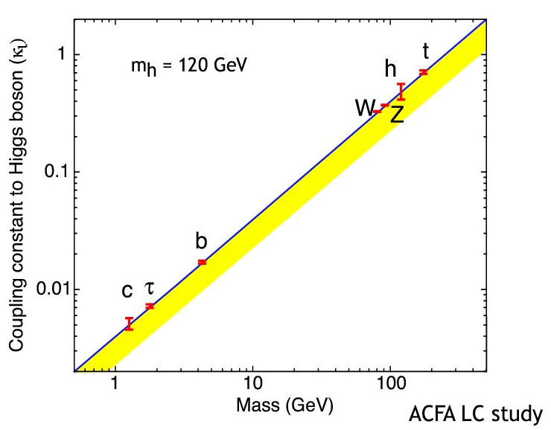
Higgs Branching Ratios
An important verification of the higgs model
Predict that higgs decay rates depend on particle masses
Maximum cross section around 250GeV
Measure decay products of the higgs

Slide 17
Invisible Higgs Decays
Can we check that the Higgs does not decay into something invisible, e.g. neutrinos?
Yes, missing mass (or recoil mass) analysis:
1) Measure the Z, e.g. from produced jets
2) Subtract Z momentum from initial state
(E_{cm},0,0,0)-(E_{Z}, P_{Z,x}, P_{Z,y}, P_{Z,z})=(E_{H}, P_{H,x}, P_{H,y}, P_{H,z})
3) Result is mass and momentum of other particle
Even if we do not see it
So we know the missing particle

Slide 18
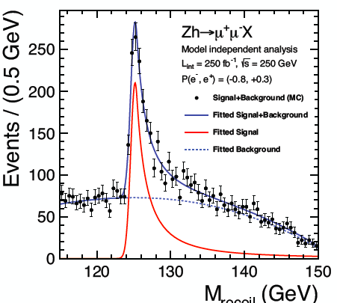

Example Result
Not everything that has the mass of a higgs is a higgs
Actual higgses
Other things that look like higgses
Predicted signal
Accurate mass measurement
best near 250 GeV
Δm_{H} ≈ 30 MeV

Slide 19
Higgs Branching Ratios
Quick calculation:
Higgs mass 125GeV
W mass 80GeV
A higgs cannot not decay into two W?
Well it can if one of the W has a too low mass (is virtual)
But nature does not allow that too often
Higgs will not decay very often into WW or tt pairs
The coupling measurement is not very good

Slide 20
Higgs Coupling to W and Top
Precision Higgs measurements
Model-independent
  Higgs couplings
  Higgs mass
Large energy span of linear colliders allows to collect a maximum of information:
  ILC: 500 GeV (1 TeV)
  CLIC: ~350 GeV – 3 TeV

Slide 21
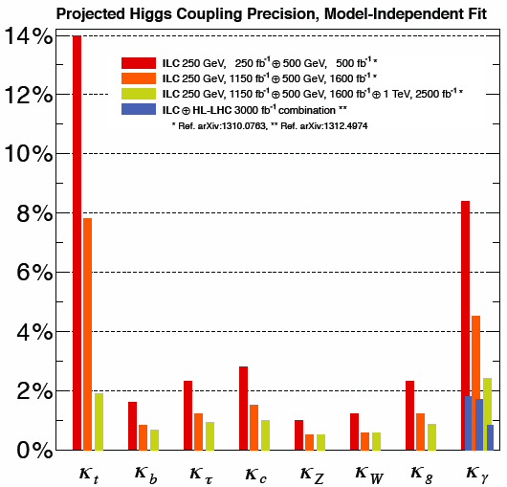
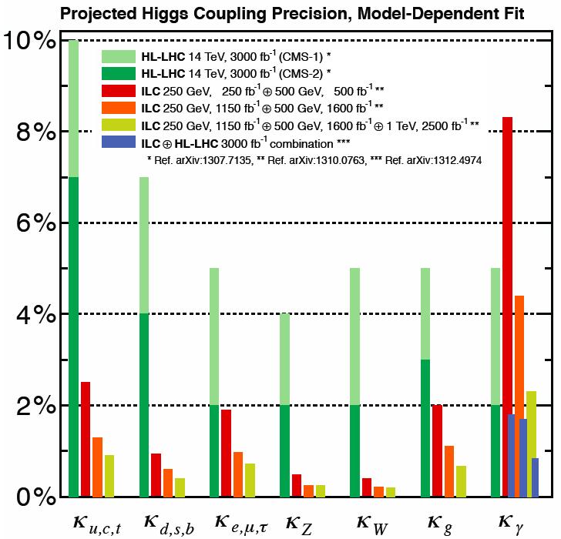
Combined Higgs results (ILC)
Fully model-independent
LHC-like fits, assuming SM decay modes only
Kerstin Tackmann in ICFA seminar 2014 (Higgs – decays and properties)

Slide 22
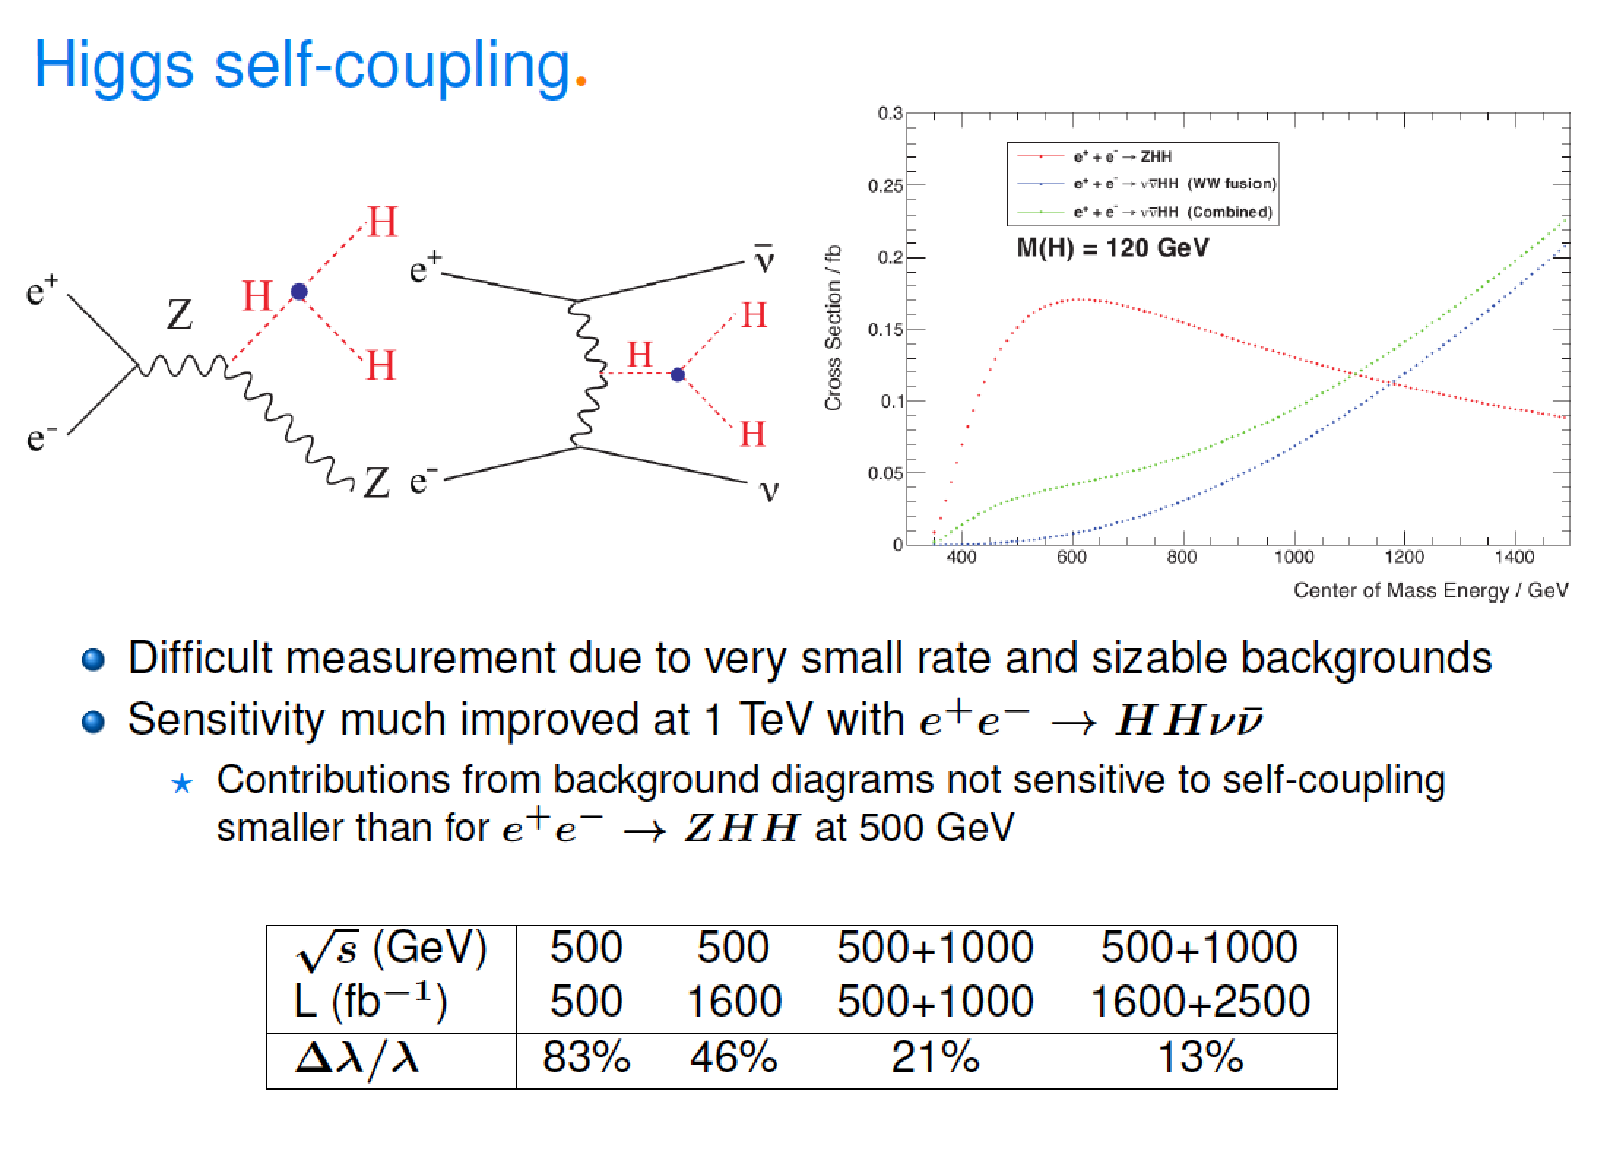
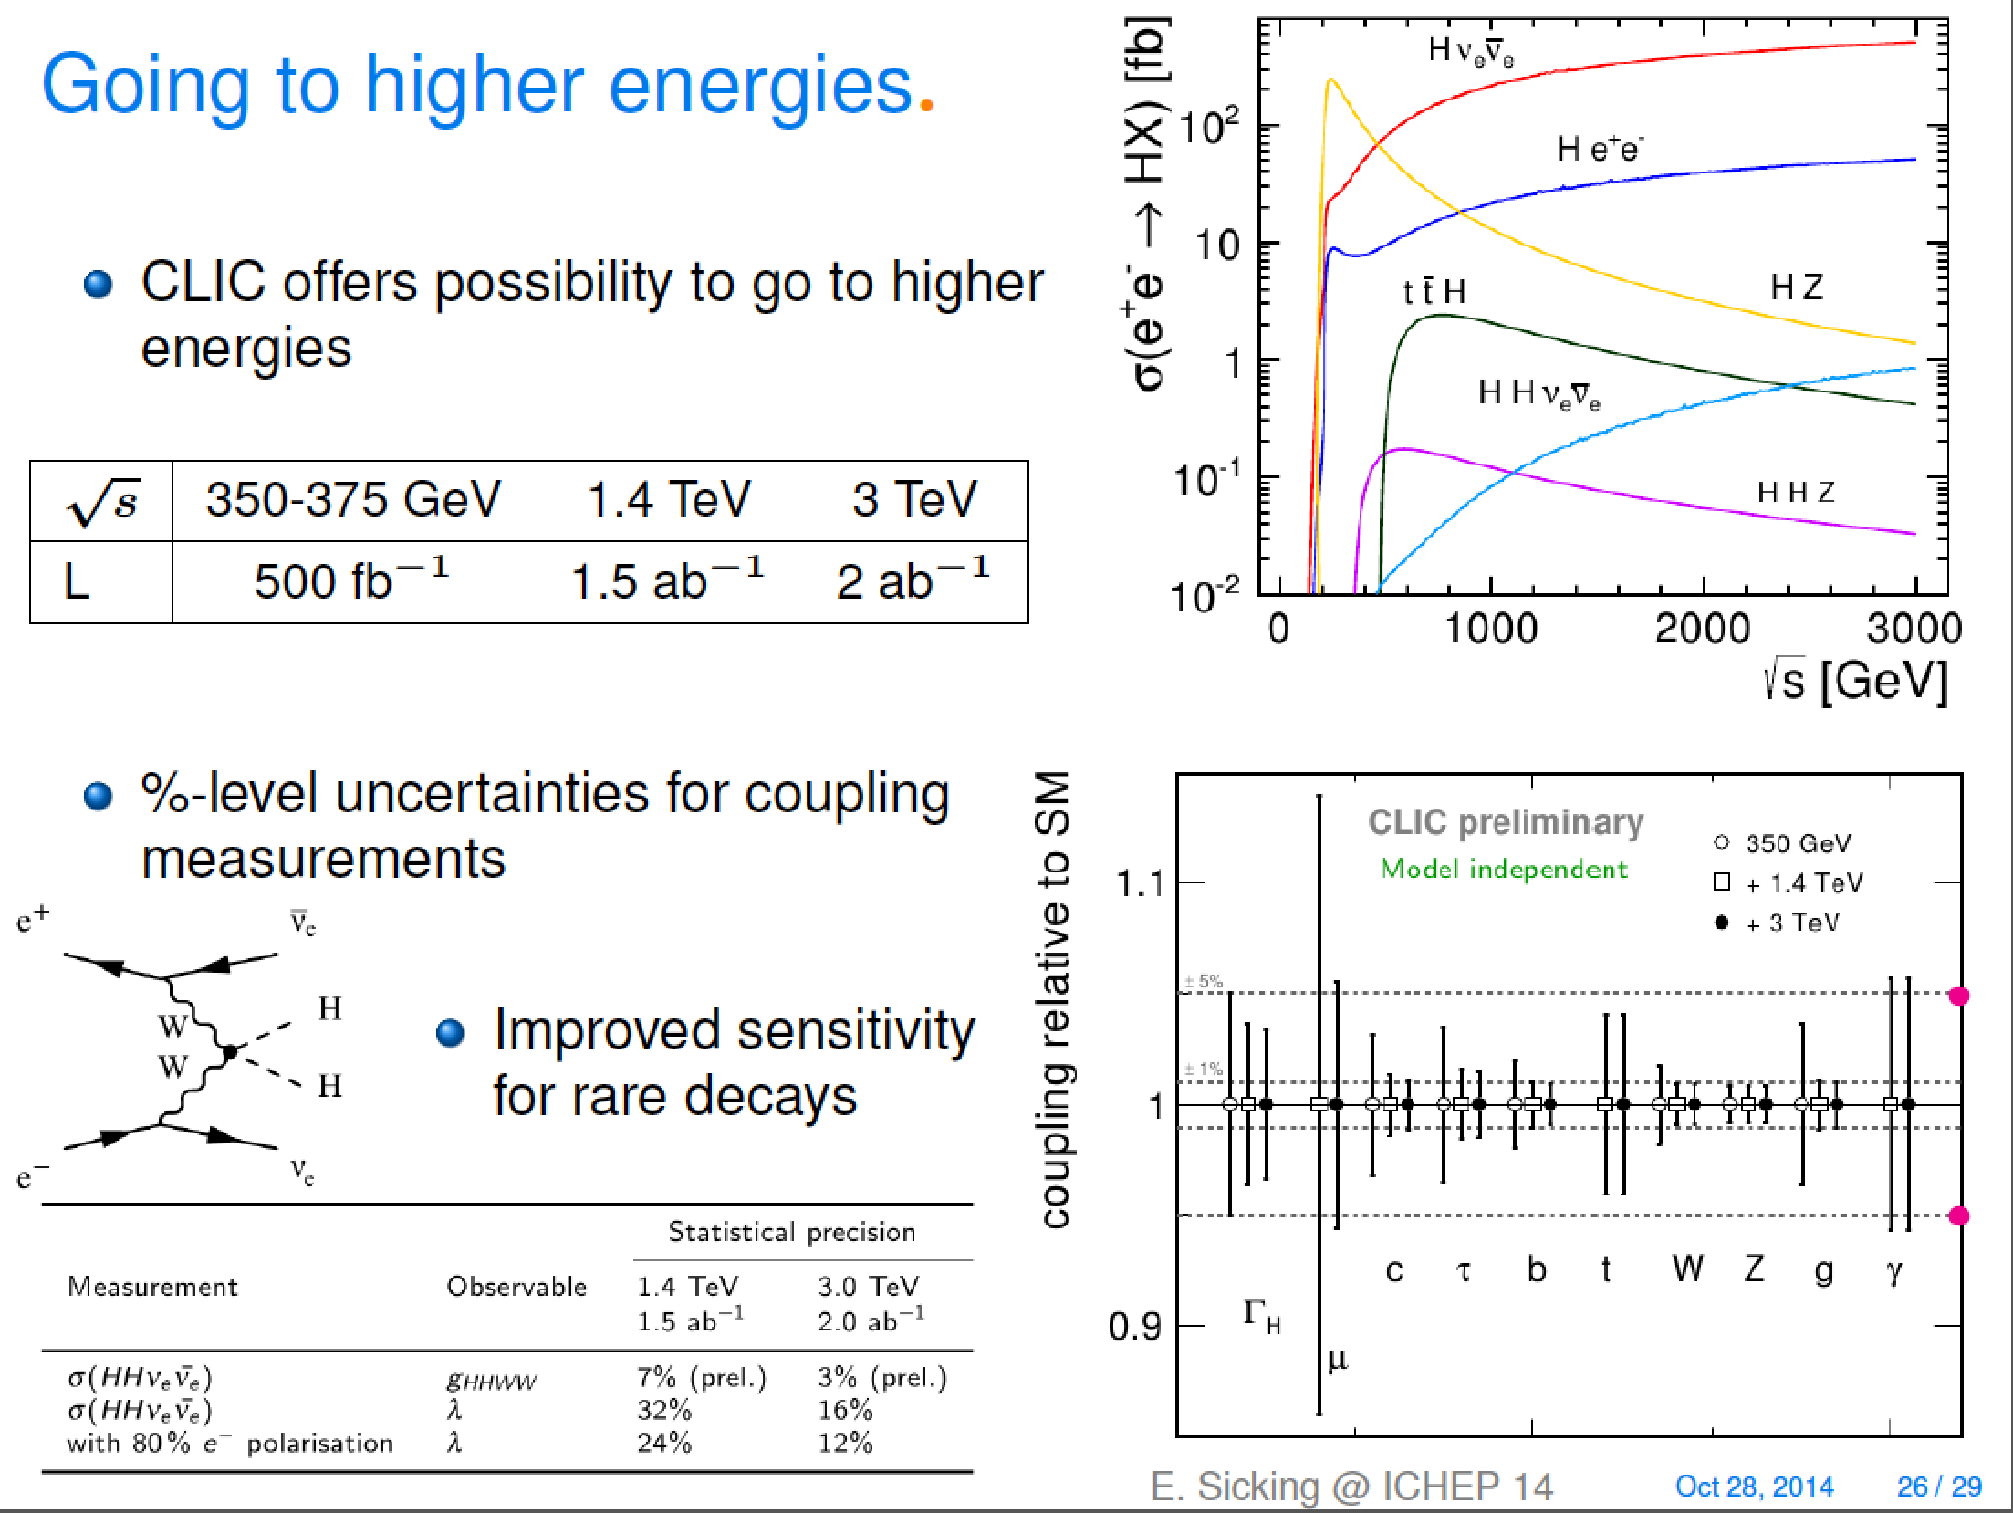
Double Higgs – and CLIC Higgs summary
From talk of Kerstin Tackmann (Higgs – decays and properties) in ICFA seminar 2014

Slide 23
Top Production at Threshold
K. Seidel et al. arXiv:1303.3758
Top production at threshold is strongly affected by beam energy spread and beamstrahlung

Slide 24
Top Production at Threshold
Experimental precision makes the theorists sweat
Very precise measurements

Slide 25
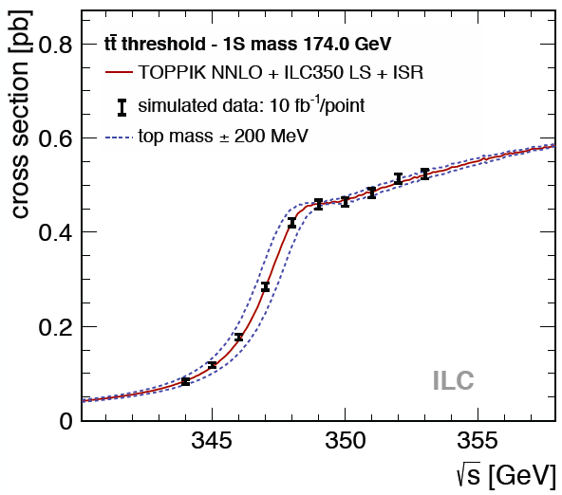
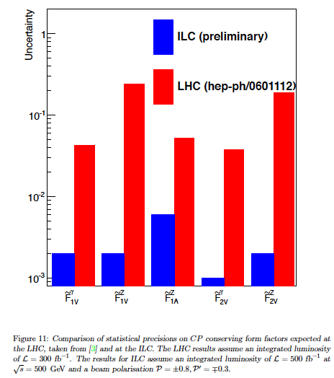
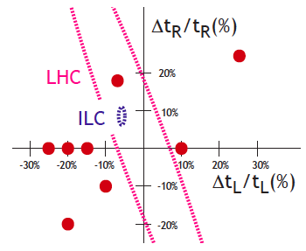
Top Physics
Top quark in the SM, heaviest elementary particle:
Many high-precision measurements possible in e⁺e- (like for s, c quarks) – some examples
Accurate coupling measurement from:
tt cross section
Helicity
Forward-backward asymmetry F_{AB}
ILC study at 500 GeV and 500 fb⁻¹
Provides good sensitivity to BSM physics
Sensitivity to BMS increases with energy
Threshold scan with well-defined 1S mass
Stat. accuracy Δm_{t}=20-30 MeV (ILC-CLIC)
Theor. accuracy currently Δm_{t} = 100 MeV
Note: LHC comparisons not recent (Snowmass 2005)
arXiv:1307.8102
Accuracy of left-handed and right-handed top couplings, together with deviations from various BSM models (arXiv:1403.2893)

Slide 26
Physics Beyond the Standard Model
Hard to know what to expect
But we know that the standard model is not the hole truth
Will not go all the different options

Slide 27
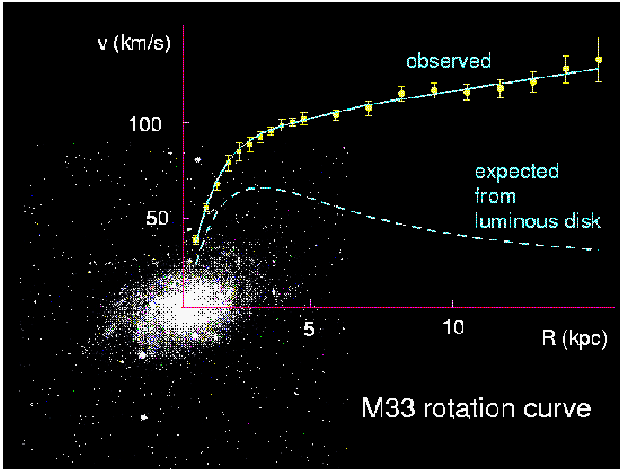
Example: Dark Matter
The outer region of galaxies rotate faster than expected from visible matter
Corbelli & Salucci (2000); Bergstrom (2000)
Dark matter would explain this
Other observations exist
But all through gravity
What is it?
One explanation is supersymmetry

Slide 28
Supersymmetry
Supersymmetric
Partner
~
~
~
~
~
u
c
t
γ
H
u
c
t
γ
H
~
~
~
~
~
d
s
b
g
H
d
s
b
g
H
~
~
~
~
ν_{e}
ν_{μ}
ν_{τ}
W
ν_{e}
ν_{μ}
ν_{τ}
W
~
~
~
~
e
μ
τ
Z
e
μ
τ
Z
Spin
1/2
Spin
1
Spin
0
Spin
0
Spin
1/2
Spin
1/2

Slide 29
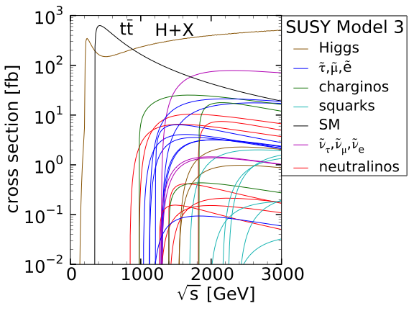
Example of Potential SUSY Scenario
350GeV
Consistent with current LHC results

Slide 30
Conclusion on Physics Case
Lepton colliders offer additional paths to the Higgs
  Model independent
  Invisible decays
Most of the Higgs measurements require at least ~350 GeV
Higher energies to add
  Htt (500 GeV or slightly above)
  Higgs-self coupling (even higher energy best)
  higher energies generally improves the results for rare decays
Lepton collider offer a unique path to the top at threshold
Requires around 350GeV (ttbar threshold at)
Symmetry measurements suggests 400-500 GeV
New physics at LHC – who knows ? Most likely the higher energy the better.

Slide 31
Lepton Collider Options
Three main approaches
Big LEP-type collider ring
  FCC-ee, CepC
  Later a proton collider in the same tunnel
Linear collider
  ILC, CLIC
  The focus of this school
Muon collider

Slide 32
Ring Collider Energy Limitation
Beam can be used many times
Lepton beam energy is below LHC
-> magnets are not a problem
accelerating cavities
N
N
But synchrotron radiation is:
At LEP2 lost 2.75GeV/turn for E=105GeV
Pay for installed voltage (ΔE) and size (R),
so scale as:
S
S
-> use heavier particles, e.g. muons
-> or linear collider
(-> or try to push a bit harder on cost)

Slide 33
Linear Collider Energy Limitation
source
main linac
Hardly any synchrotron radiation
Beam can only be used only once
-> strong beam-beam effects
Acceleration gradient is an important issue

Slide 34
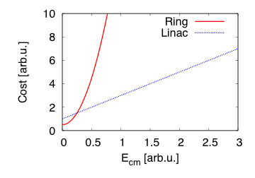
Simplified Cost Scaling Comparison
Linac:
Ring:
Power consumption behaves similar to cost for constant luminosity
There will always be an energy where linear colliders are better

Slide 35
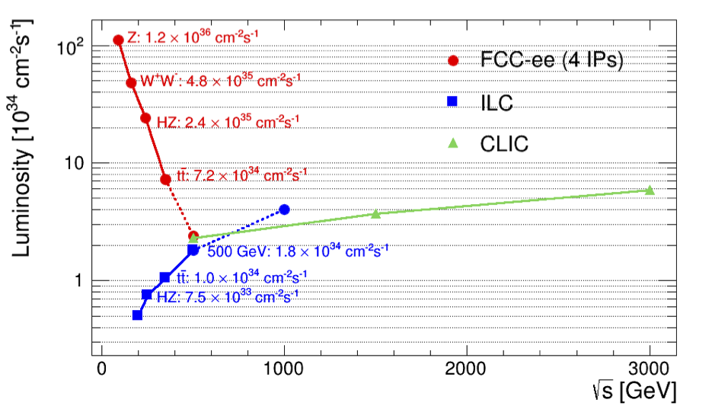
Circular vs. Linear Colliders
F. Gianotti
Circular,
adding four experiments
Modified from original version:
http://arxiv.org/pdf/1308.6176v3.pdf
CepC (2 IPs)
China prepares a project similar to FCC-ee
Linear

Slide 36
CEPC, SppC, FCC

Slide 37
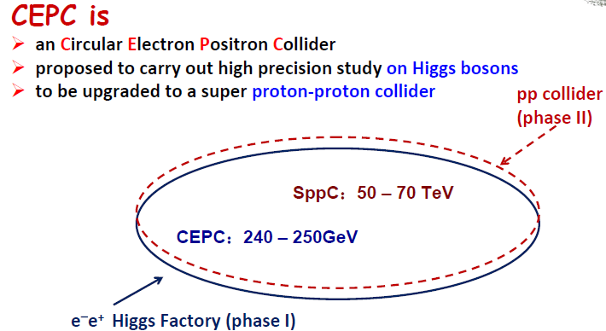
Note: CEPC/SppC
D. Wang & H. Geng
6th TLEP Workshop
50-70 km
(centre-of mass !)
Study of project in China under leadership of IHEP
Emphasis is on lepton collider
CEPC is similar to FCC-ee, SppC similar to FCC-hh
Will not go into any detail

Slide 38
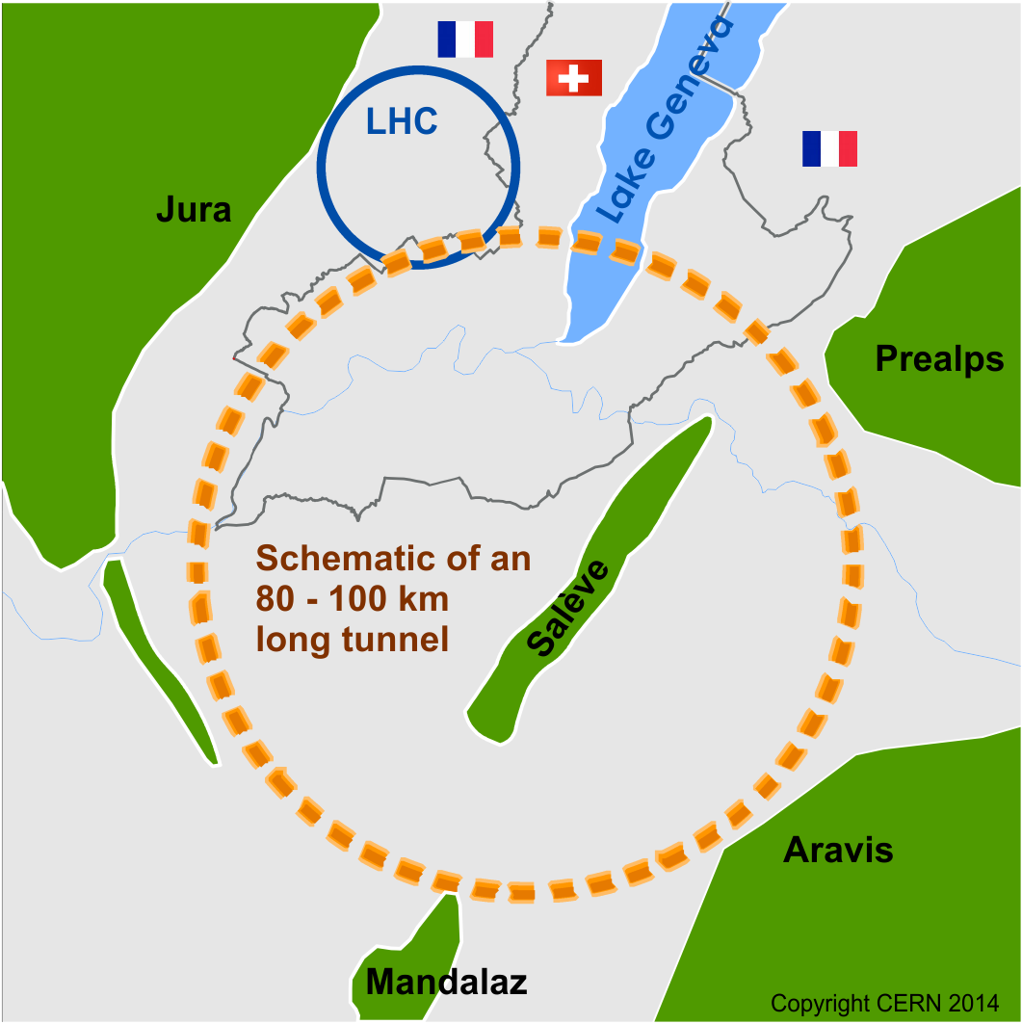
FCC
FCC-hh:
100TeV pp cms energy
Can use ions
Defining infrastructure requirements
100km circumference
FCC-ee:
e⁺e⁻ collider, 90-350 GeV cms
Potential intermediate step
FCC-he:
Hadron-electron option

Slide 39
The Key Challenges
Energy
  Limited by the machine size and the strength of the bending dipole
  Have to maximise the magnet strength
Luminosity
  Need to maximise the use of the beam for luminosity production
Beam power handling
  Small losses lead to background in detectors and machine
  Accidental losses
  Need a concept to deal with the beam power
Cost
  Push to the limits to reduce cost
Site
  Do we have a fitting site (next to CERN)?

Slide 40
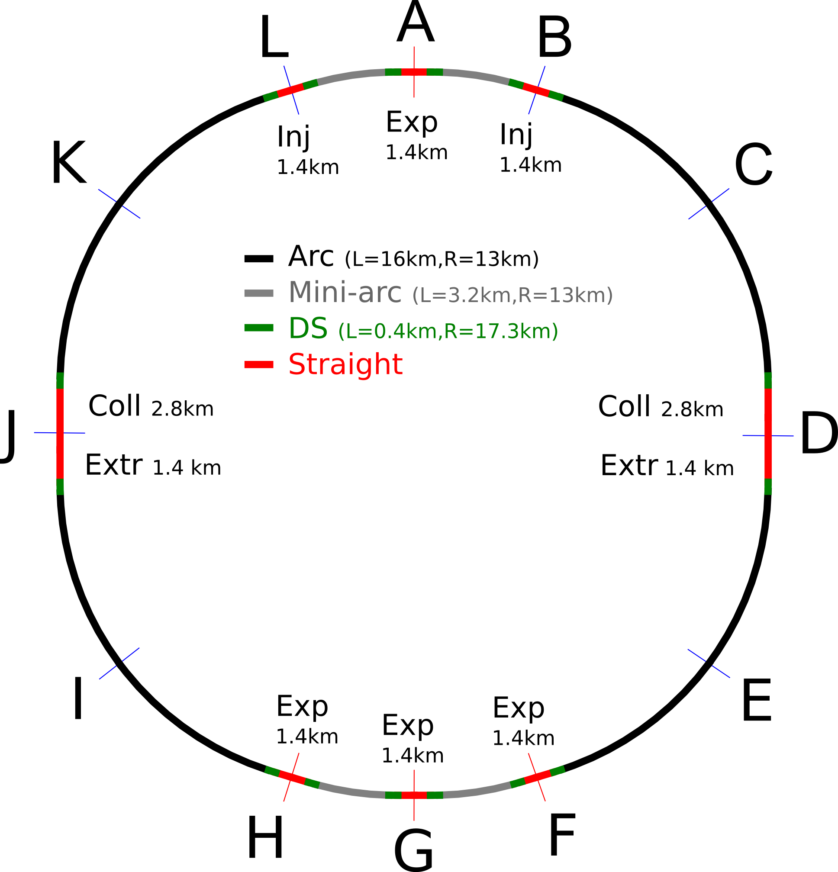
Baseline Layout
Circumference 100km
Two high-luminosity experiments (A and G)
Two other experiments (F and H)
Two collimation/extraction insertions
Two injection insertions, should include RF
Length for arcs 83km

Slide 41
Main FCC-hh Parameters
 | LHC | HL-LHC | FCC-hh
Cms energy [TeV] | 14 | 14 | 100 | 100
Luminosity [10³⁴cm⁻²s⁻¹] | 1 | 5 | 5 | 20
Bunch distance [ns] | 25 | 25 | 25 | 25/5
Background events/bx | 27 | 135 | 170 | 680 (136)
Bunch length [cm] | 7.5 | 7.5 | 8 | 8
Two main experiments
Two reserve experimental areas used in baseline
80% of circumference filled with bunches
Baseline: 250fb⁻¹ per year (including shutdowns)
focus on 25ns spacing
Ultimate: 1000fb⁻¹ per year
more emphasis on 5ns

Slide 42
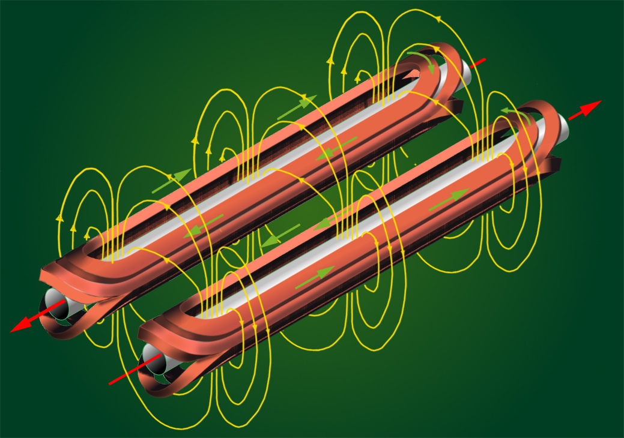
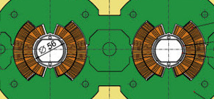
Dipole Basic Concept (“Cosine Theta”)
B
I(φ)
φ
I(φ)

Slide 43

Limits for the Field
The cable can quench (superconductivity breaks down)
if the current is too high
If the magnetic field is too high
This limits the achievable field
  In theory
  Even lower limit in practice
Can use different materials
  Nb-Ti is used for LHC
  Nb₃Sn is used for high luminosity upgrade

Slide 44
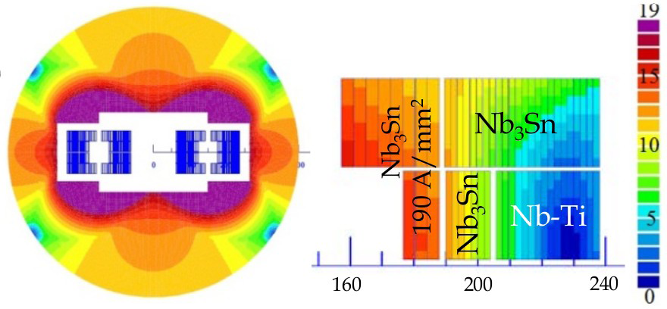
Cost Effective Magnet Design
Nb₃Sn is more costly than Nb-Ti
Use both materials
Coil sketch of a 15 T magnet with grading, E. Todesco

Slide 45
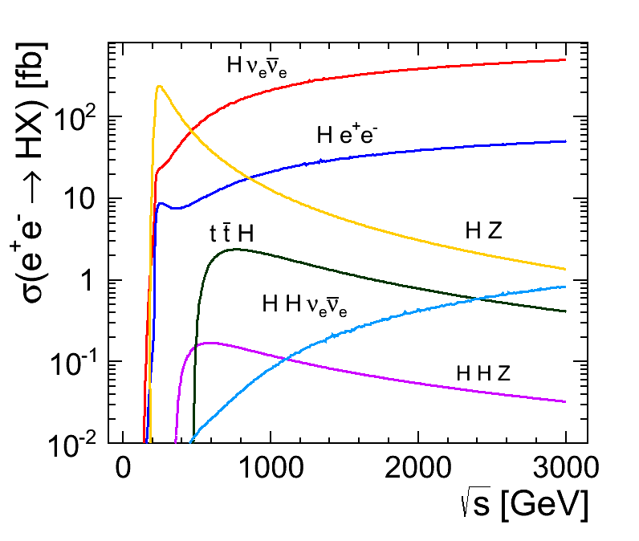
FCC-ee Rational
Use FCC-hh tunnel
Operate at
  90 GeV (“Tera-Z”)
  160GeV (W pairs)
  240GeV (Higgs via Zh)
  350GeV (top threshold, higgs productions via Zh and WW)
Limited energy reach
But proton collider takes care of high energies
Consistent with current LHC results

Slide 46
FCC-ee Parameters
Parameter | Z | W | H | t | LEP2
E (GeV) | 45 | 80 | 120 | 175 | 104
I (mA) | 1400 | 152 | 30 | 7 | 4
No. bunches | 16’700 | 4’490 | 1’330 | 98 | 4
β*_{x/y} (mm) | 500 / 1 | 500 / 1 | 500 / 1 | 1000 / 1 | 1500 / 50
ε_{x} (nm)/ε_{y} (pm) | 29/60 | 3.3/7 | 1/2 | 2/2 | 30-50/~250
σ_{x}(μm)/σ_{y}(nm) | 120/250 | 40/84 | 22/45 | 45/45 | 250/3500
ξ_{y} | 0.03 | 0.06 | 0.09 | 0.09 | 0.07
L (10³⁴ cm⁻²s⁻¹) | 28 | 12 | 6.0 | 1.8 | 0.012
Using flat beams
Significant luminosity increase compared to LEP:
Smaller emittances, beta-functions, larger power consumption
Now even higher luminosities are being discussed

Slide 47
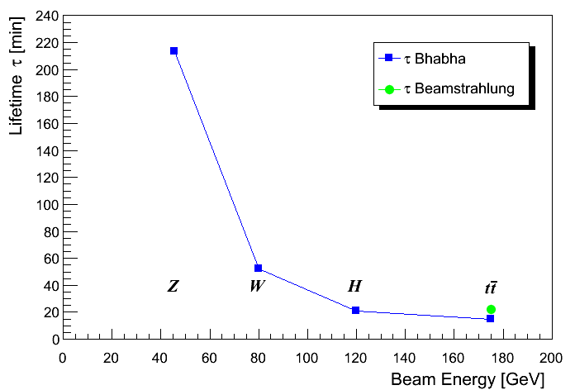
Luminosity Lifetime
Luminosity lifetime is dominated by radiative Bhabha scattering
(total cross-section σ_{ee} ≈ 0.21b )
=> Lifetimes down to ~15 minutes at 350GeV
=> Continuous top-up injection
n_{ip} = 4

Slide 48
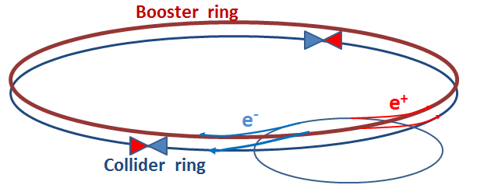
Top-up Injection
Boost energy in booster ring to collision energy
Inject into collider ring on top of circulating beam
Requires third ring
Can keep collider current almost constant, even with short lifetimes
Tested in B-factories
Injection into booster at 20GeV
Injection into collider ring very 10s or so

Slide 49
Linear Colliders

Slide 50

Generic Linear Collider

Slide 51
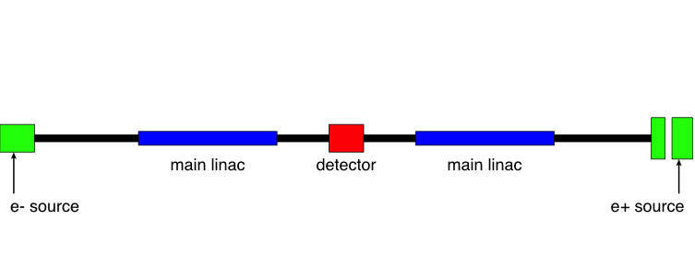
Generic Linear Collider
The main linac provides the energy of the beam
Issue 1: the gradient

Slide 52
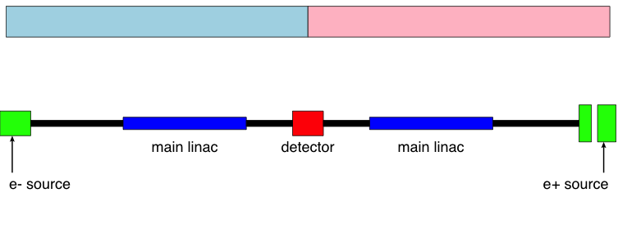
Generic Linear Collider
But little luminosity, since beams collider only once
Need very small σ_{x} and σ_{y}

Slide 53
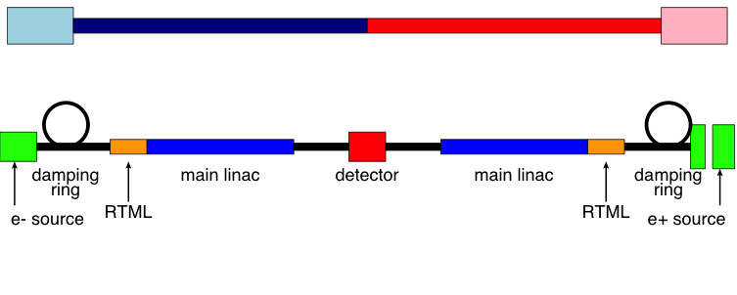
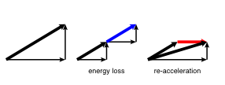
Generic Linear Collider
The damping rings reduce the phase space (emittance ε_{x,y}) of the beam
The RTML (ring-to-main linac transport) reduces the bunch length

Slide 54
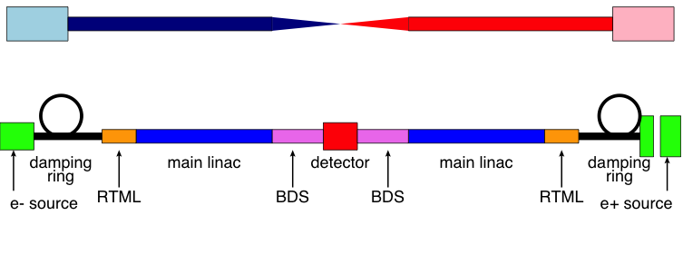
Generic Linear Collider
The beam delivery system (BDS) squeezes the beam as much as possible, i.e. reduces β_{x,y}

Slide 55
ILC Layout

Slide 56
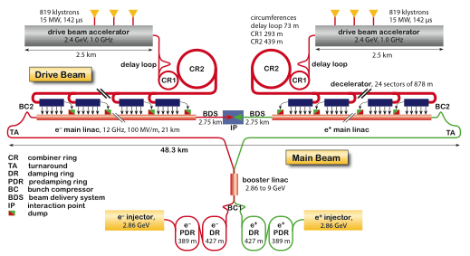
CLIC Layout at 3 TeV
Drive Beam Generation Complex
Main Beam Generation Complex

Slide 57
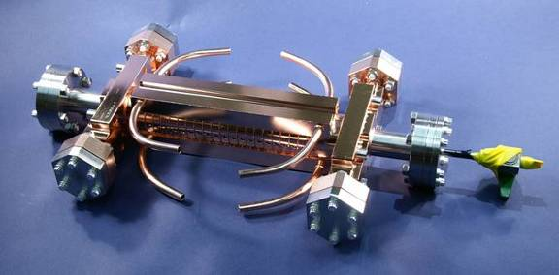
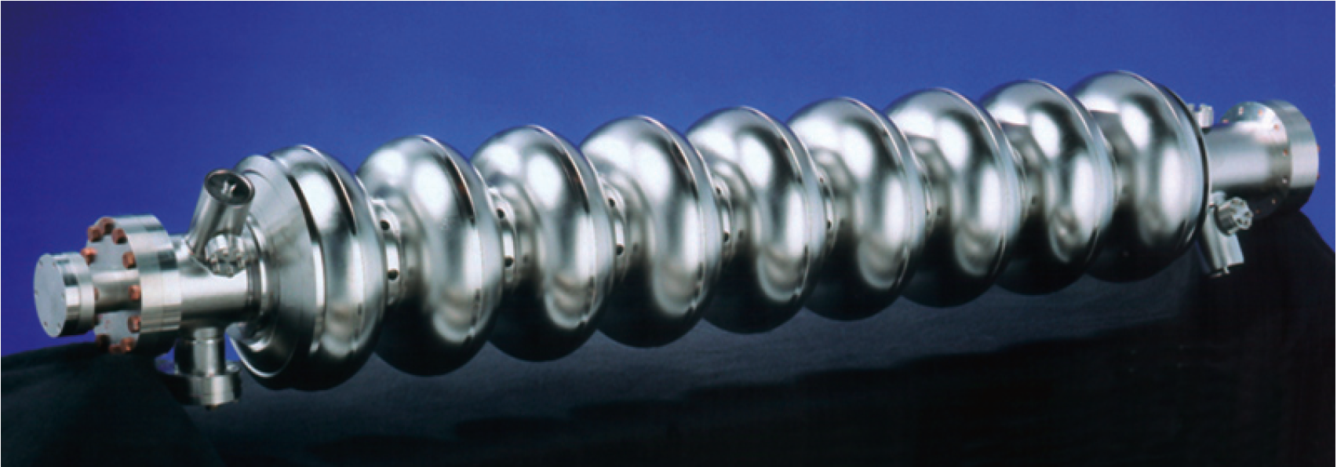
Cavity/Accelerating Structure
ILC cavity
1.3 GHz, superconducting
Target effective operational 31.5MV/m
Target gradient 35MV/m
Q₀≈10¹⁰
CLIC accelerating structure
12 GHz, normal conducting
Target loaded gradient 100MV/m
Target unloaded gradient 120MV/m
Q₀≈6 10³

Slide 58
ILC TDR
http://www.linearcollider.org/ILC/Publications/Technical-Design-Report

Slide 59
The CLIC CDR documents
In addition a shorter overview document was submitted as input to the European Strategy update, available at:
http://arxiv.org/pdf/1208.1402v1
An input document to Snowmass 2013 has also been submitted:
http://arxiv.org/abs/1305.5766

Slide 60
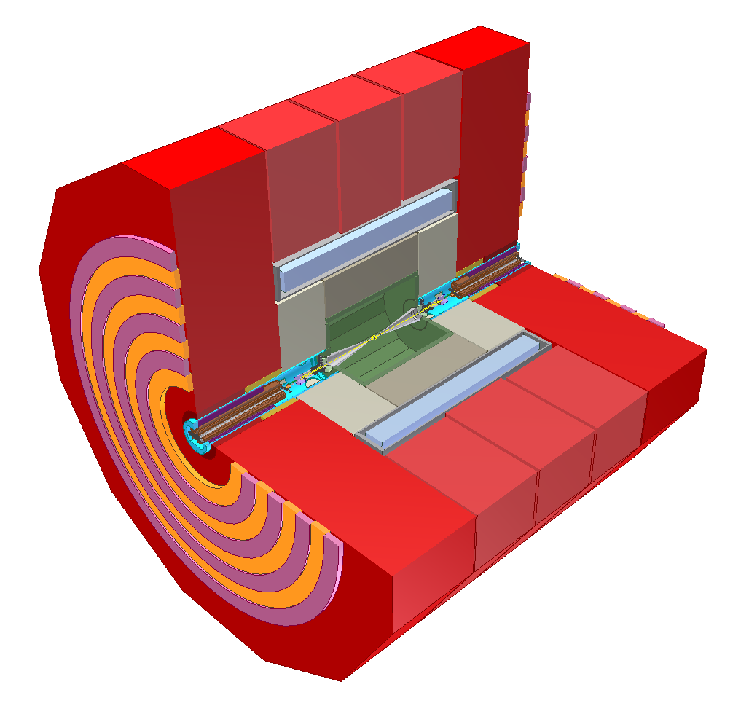
Linear Collider Experiment
10⁹ readout cells
Field return and muon particle identification
Final steering
of nm-size beams
B-field for momentum and charge measurement
Energy measurement of (charged and) neutral particles
6 m
Measure momentum
and charge of charged particles
Measure vertex and
Short-lived particles
L. Linssen

Slide 61
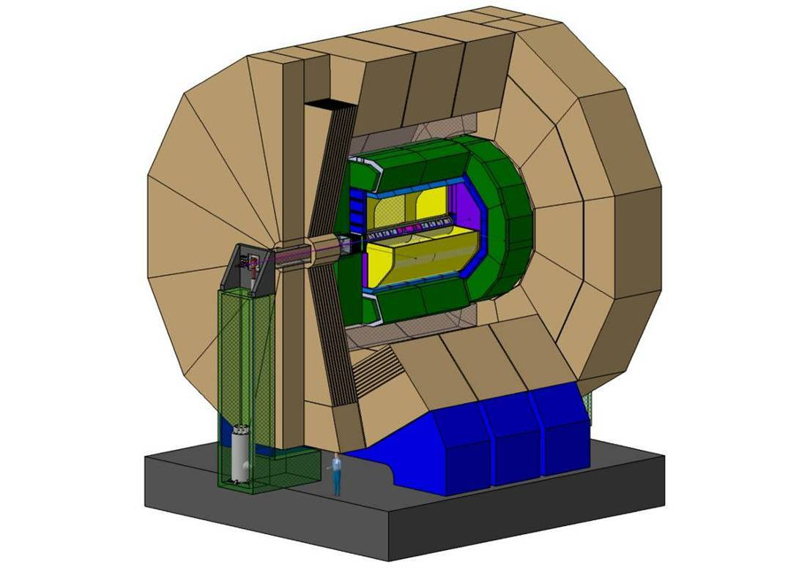
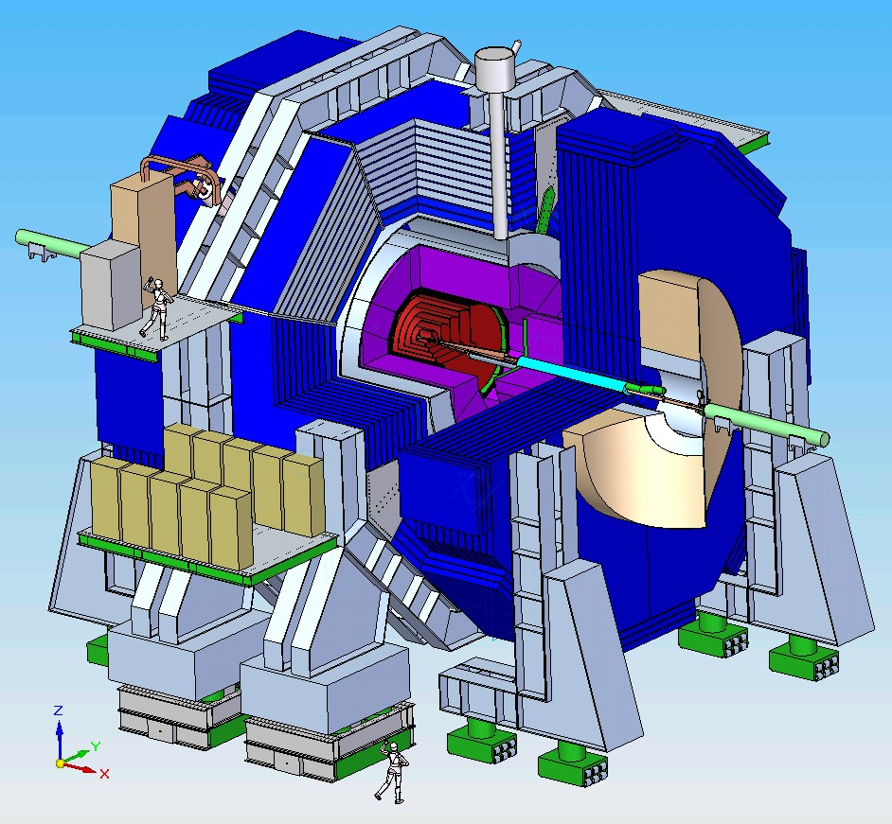
ILC Detector Concepts
ILD
SiD
CLIC detector concepts are based on SiD and ILD.
Modified to meet CLIC requirements

Slide 62
ILC and CLIC Main Parameters
Parameter | Symbol [unit] | SLC | ILC | CLIC
Centre of mass energy | E_{cm} [GeV] | 92 | 500 | 3000
luminosity | L [10³⁴cm⁻²s⁻¹] | 0.0003 | 1.8 | 6
Luminosity in peak | L_{0.01} [10³⁴cm⁻²s⁻¹] | 0.0003 | 1 | 2
Gradient | G [MV/m] | 20 | 31.5 | 100
Particles per bunch | N [10⁹] | 37 | 20 | 3.72
Bunch length | σ_{z} [μm] | 1000 | 300 | 44
Collision beam size | σ_{x,y} [nm/nm] | 1700/600 | 474/5.9 | 40/1
Vertical emittance | ε_{x,y} [nm] | 3000 | 35 | 20
Bunches per pulse | n_{b} | 1 | 1312 | 312
Distance between bunches | Δz [mm] | - | 554 | 0.5
Repetition rate | f_{r} [Hz] | 120 | 5 | 50
ILC has parameter sets from 250GeV to 1TeV
CLIC has parameter sets from 250GeV to 3TeV

Slide 63
Luminosity and Parameter Drivers
Can re-write normal luminosity formula
Beam power
Luminosity
spectrum
Beam Quality
(+bunch length)
Need to ensure that we can achieve each parameter

Slide 64
Luminosity and Parameter Drivers
Can re-write normal luminosity formula
See main linac lecture
(and ILC and CLIC lecture)
Beam power
Luminosity
spectrum
Beam Quality
(+bunch length)
Need to ensure that we can achieve each parameter

Slide 65
Beam-beam Effect
Bunches are squeezed strongly to maximise luminosity
Electron magnetic fields are very strong
Beam particles travel on curved trajectories
They emit photons (O(1)) (beamstrahlung)
They collide with less than nominal energy

Slide 66
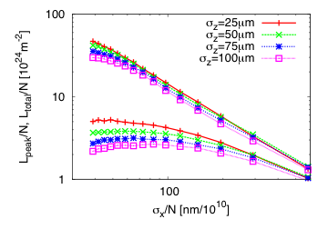
Beamstrahlung Optimisation
For low energies (classical regime) number of emitted photons
For CLIC at 3TeV (quantum regime)
Hence use
Total luminosity grows for smaller beams
CLIC parameter choice
But luminosity in peak starts to decrease again

Slide 67
Ultra Low Beam Emittances/Sizes
Natural to produce flat beams in the damping rings
  You make the beam go round in the horizontal
  It is excited by noise in the synchrotron radiation
Important challenge to maintain a small vertical emittance from the damping ring to the IP
Address the issue by
  Clever system design
  Clever tuning algorithms
  Technical development of components
  Experiments
See the next lectures

Slide 68


Link to FELs
LCLS in operation at SLAC
using the old SLC linac (S-band)
European X-FEL under construction at DESY
Based on TESLA-technology (same as for ILC)
Other S-band based FELs exist as well:
e.g. Trieste, Shanghai, …
Based on C-band developed for linear colliders:
SACLA operating at SPRING-8
Swiss FEL under construction at PSI
Design studies planned for FELs using
X-band linac technology:
Ankara, Trieste, Melbourne

Slide 69
Muon Collider

Slide 70


Muon Collider Concept
Muon are heavy so they emit little synchrotron radiation
But they do not live very long
Produce them, cool them quickly and let them collide in a small ring

Slide 71

Final Transverse Cooling System

Slide 72

MICE
Tracking Spectrometer
Focus
Coils
RF
Cavities
Liquid
Hydrogen
Absorbers
Fiber Tracker
Under construction
Will test 10% 4D emittance reduction (0.1% accuracy)
Single particle experiment
Linda Coney, UCR
http://www.mice.iit.edu/

Slide 73
Muon Collider Parameters
M. Palmer

Slide 74
Gamma-gamma Collider

Slide 75
Gamma-gamma Collider Concept
Based on e⁻e⁻ collider
But collide electron beam with laser beam just before the IP (at small angle α)
Hard backscattered photons move almost in direction of initial electron (angle ~1/γ)
Photons collide, electrons as well
α
ϑ
Backscattered photons form a spectrum with maximum energy given by
Practical maximum is 83% of electron energy
-> Typical laser wavelength O(μm), some J per pulse
Many photons are softer than maximum energy
-> Typical luminosity O(10%) of geometric e⁻e⁻ luminosity

Slide 76
Plasma Acceleration

Slide 77

Principle Electron Driven Plasma
Plasma can be generated by electron beam, proton beam or laser beam

Slide 78


Achieved Accelerations
Using SLC beam L=0.85m, G=O(50GV/m)
=> 42GeV
Using laser beam to generate the plasma at Berkeley
=> 1GeV
E167 collaboration SLAC, UCLA, USC
I. Blumenfeld et al, Nature 445, p. 741 (2007)

Slide 79
Laser-driven Plasma Accelerator (LPA)
Parameters from

Slide 80
Beam-driven Plasma Accelerator (PWFA)

Slide 81

FACET at SLAC
Drive bunch: charge O(10¹⁰) particles, 23 GeV
  Can use electrons and positrons
Test of beam loading
  60%-90% efficiency of energy transfer
Test of positron acceleration
Test of plasma lenses
  Self-focusing of the beam
http://facet.slac.stanford.edu/
Image credit: SLAC

Slide 82
Plasma Accelerator R&D
Use of old SLAC linac to produce electron beam for plasma generation (FACET, FACETII)
Further development of laser-plasma acceleration in ELI (extreme light infrastructure)
  http://extreme-light-infrastructure.eu
Use of proton beam to generate plasma
  AWAKE at CERN
A long-term development that will take quite a while to become useful for colliders
  Many open questions remain, e.g. beam quality, staging, …

Slide 83
Conclusion
Lepton colliders have a physics case
  Higgs studies
  Top studies
  Precision studies
  The unknown
  Expect results from the LHC
Linear collider can deliver high centre-of-mass energy lepton collisions
  Technically quite mature
  Circular electron-positron colliders have a limited energy reach (but high luminosity at low energy)
  Alternatives (muon collider, use of plasma) require long development

Slide 84
Reserve

Slide 85

Lepton Pair Production
Colliding Photons can produce electron-positron pairs (incoherent pair production)
O(10⁵) per bunch crossing
Beamstrahlung photons can turn into pair in strong field
(coherent pair production)
O(1-10⁸) per bunch crossing
Trident cascade

Slide 86

Spent Beam Content
Spent beam particles
Beamstrahlung
Coherent pairs
Trident cascade pairs
Incoherent pairs
Hadrons
…
J. Esberg

Slide 87

Spent Beam Divergence
Beam particles are focused by oncoming beam
Photons are radiated into direction of beam particles
Coherent pair particles can be focused or defocused by the beams but deflection limited due to their high energy
-> Extraction hole angle should be significantly larger than 6mradian
We chose 10mradian for CLIC
-> 20mradian crossing angle
ILC requires 14mradian crossing angle
CLIC

Slide 88
CLIC Inner Detector Layout
The last focusing magnet of the machine is inside of the detector
A. Seiler

Slide 89
Inner Detector Layout
10mradian
For the beam
10mradian
To fit the quadrupole
A. Seiler

Slide 90

Incoherent Pairs
ϑ₀
r B_{z}
Not to scale

Slide 91

Vertex Detector Design
Have to avoid backscattering
Full simulation shows 1.5hits/mm⁻²
A. Seiler, D. Dannheim

Slide 92


Hadronic Background
Only events used with
Most energy is in forward/backward direction
- E_{vis}≈ 450GeV per hadronic event
- E_{vis}≈23GeV for θ>0.1
- E_{vis}≈12GeV for θ>0.2
20% from e⁺e⁻ (cannot be reduced)
Adds about 20% charged hits in the inner layer of the vertex detector
Can be used to monitor luminosity

Slide 93

PandoraNewPFAs
M. Thomson. J. Marshall
1 TeV Z=>qqbar
1.4 TeV of background !
with 60 BX background

Slide 94

LooseSelectedPandoraNewPFAs
0.3 TeV of background

Slide 95

SelectedPandoraNewPFAs
0.2 TeV of background

Slide 96

TightSelectedPandoraNewPFAs
0.1 TeV of background

Slide 97


Impact of timing cuts on jets
Impact of the PFOSelector timing cuts on the jet energy resolution
ILD

Slide 98
Beam-Induced Background Summary
Beamstrahlung
  Disappear in the beam pipe
Coherent pairs
  Largely disappear in beam pipe
Incoherent pairs
  Suppressed by strong solenoid-field
Hadronic events
  Impact reduced by time stamping
Muon background from upstream linac
  Not discussed here

Slide 99

CLIC_ILD and CLIC_SiD
These images are derived from the simulation models for the CDR

Slide 100



Higgs physics 250 – 500 GeV, and above
Large energy span available at Linear Colliders => access to Higgsstrahlung + WW-fusion as needed to obtain g_{HZZ}, g_{HWW}, Γ_{H} and a wide range of other couplings
Accurate mass measurement
best near 250 GeV
Δm_{H} ≈ 30 MeV
ttH threshold near 500 GeV, significant gain in going to higher energy (ultimately below 2%)

Slide 101



Physics beyond standard model
See talk of Monica D’Onofrio in the ICFA seminar 2014 (Searches for SUSY)
Example of ILC study:
Light higgsinos with small mass splitting, tagged via soft ISR photon
ILC
ILC
Example of CLIC studies:
SUSY particles with high mass
Using end-point spectrum (left)
Reconstruction of complex multi-jet final state (right)
smuon
CLICdp
3 TeV
result: Δm/m ≤ 1%
result: Δm/m = 0.3%

