Slide 1
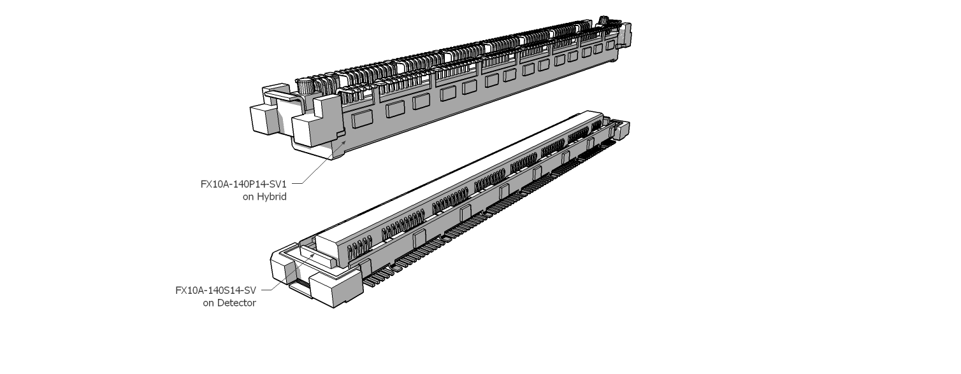
New MPGD Connector
Hans Muller CERN

Slide 2
Motivation for new connector
Pansonic 130 pin connectors not produced any more
Panasonic 130 pin only available in large Qty
Pansonic 130 pin has only 2 GND pins
HRS 140 pin very similar, in production
HRS 140 pin available in single Qty
HRS 140 pin has GND pins every 10 position
HRS 140 pin allows for new functionality: 12 spare pins

Slide 3
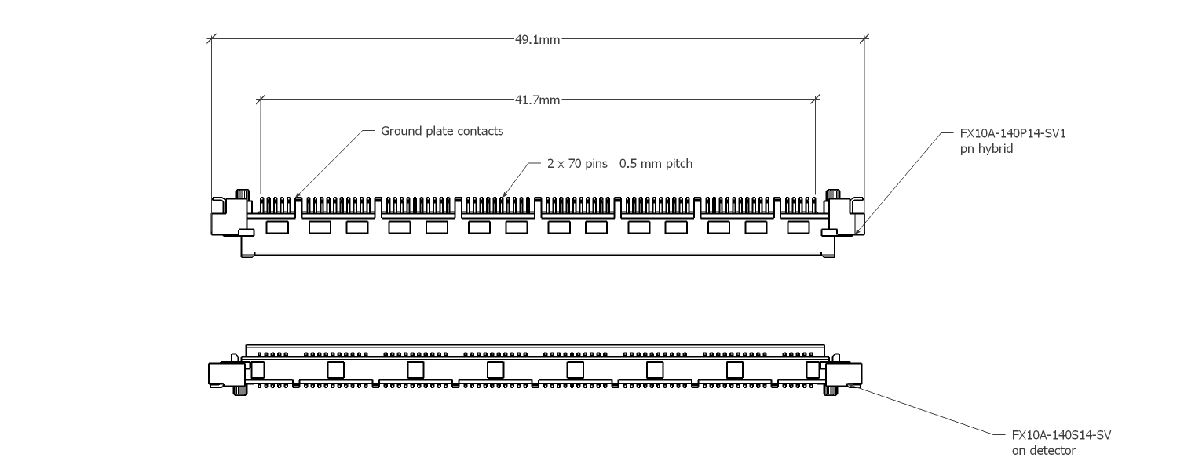
Lateral dimensions FX10A-140S
Fits on 50 mm wide hybrids

Slide 4
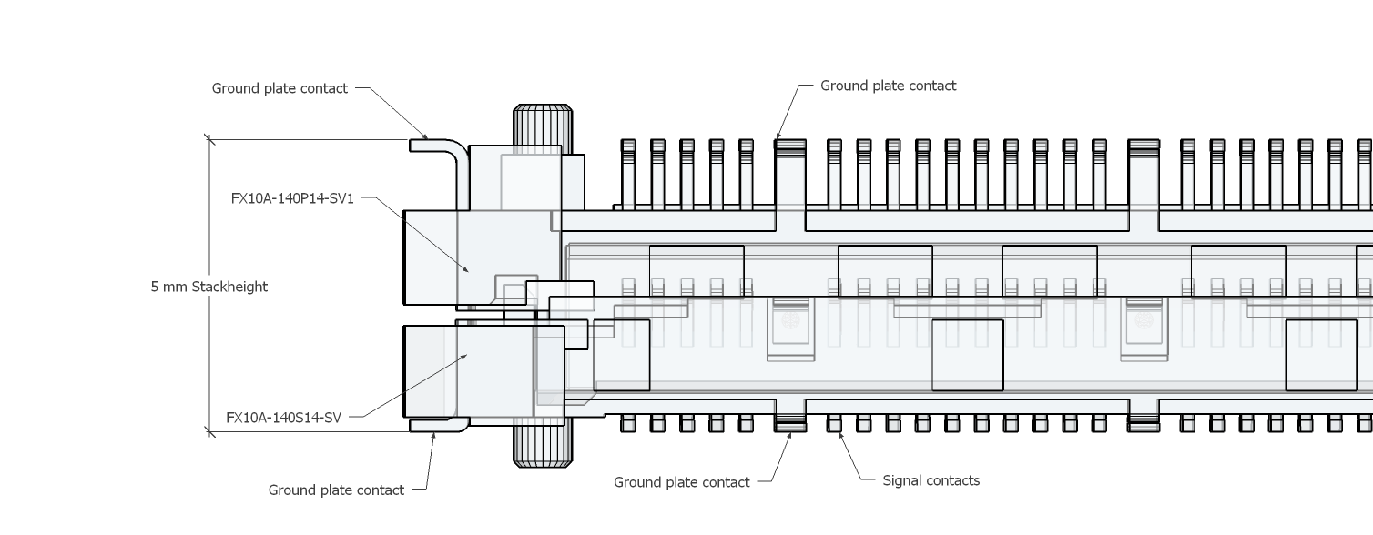
Height dimensions

Slide 5
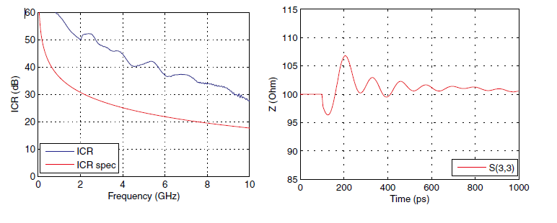
HRS Manufacturer Specs http://www.hirose-connectors.com
FX10 series 0.5mm pitch
ICR Insertion Loss Ratio meets IEEE 802.3ap for 15+ Gbps

Slide 6
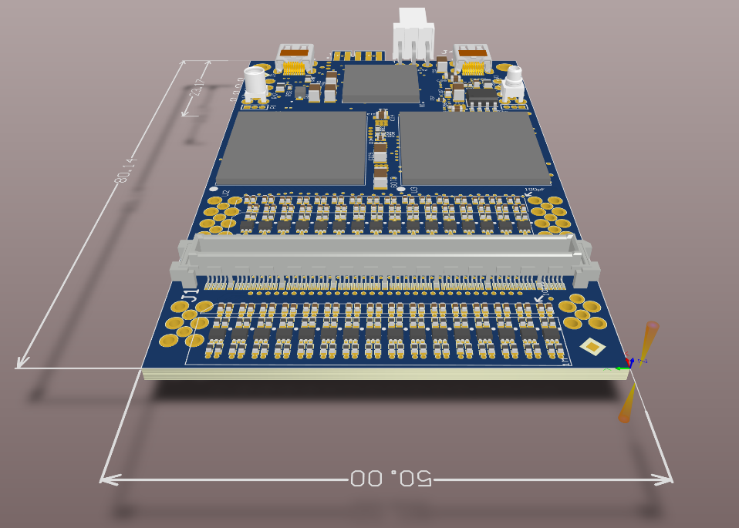
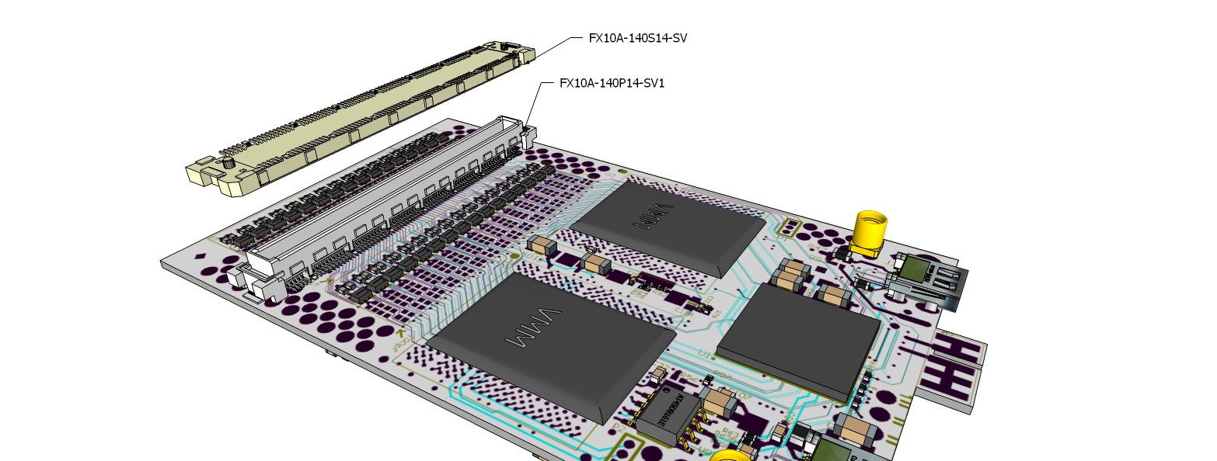
New Hirose connector as from VMM-128 v3
Altium design A.Rusu
Rui will start new connector on MPGD’s when adapters for transition period become available

Slide 7
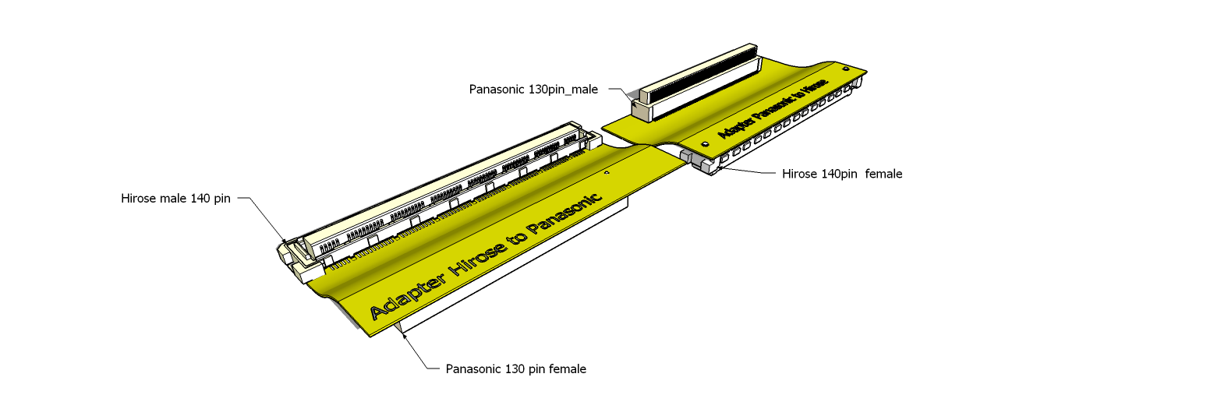
Adapters for transition time
Flex PCBs to be designed ( A.Rusu) for both versions

Slide 8
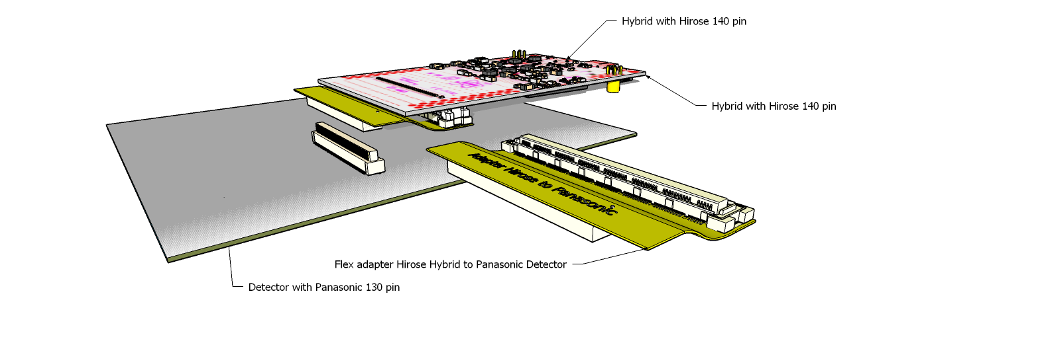
New Hybrid with HRS plugged on detector with old Panasonic connector

Slide 9
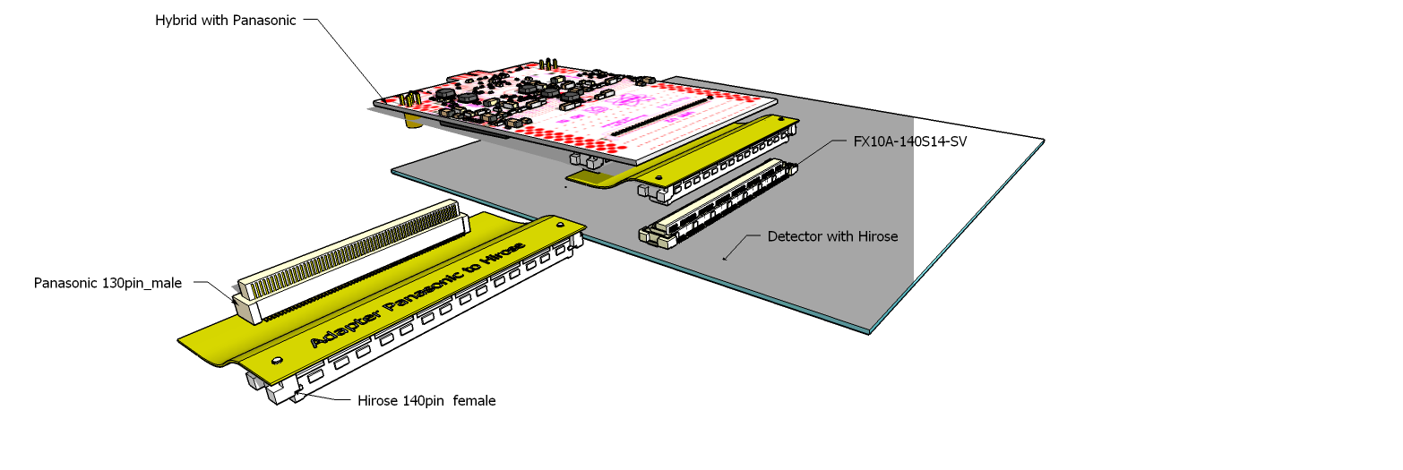
Old Hybrid with Panasonic plugged on detector with new Hirose connector

Slide 10
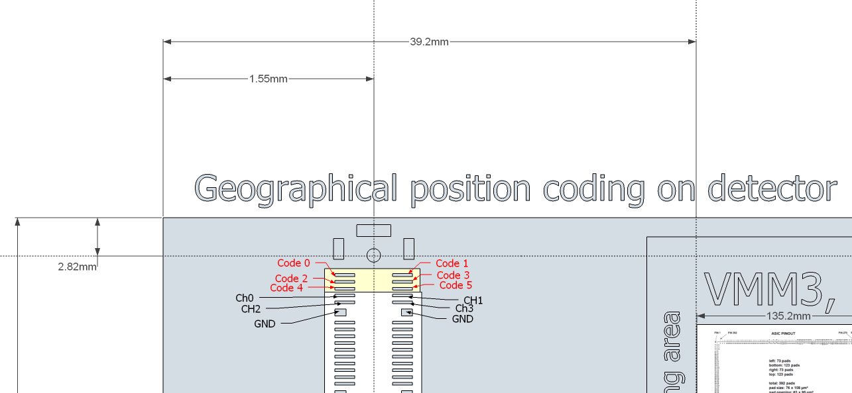
New functionalities a.) geographic address position
Will allow to read the geographical
position of a hybrid along a detector frame
Readout via
slow controls SRS
Detector side
TOP
VMM hybrid
+2V5
FPGA
6 code pins on right side viewed from top
10k pullups
6
Position coding by GND / No GND
Detector Frame
Example Position = 10 0001

Slide 11
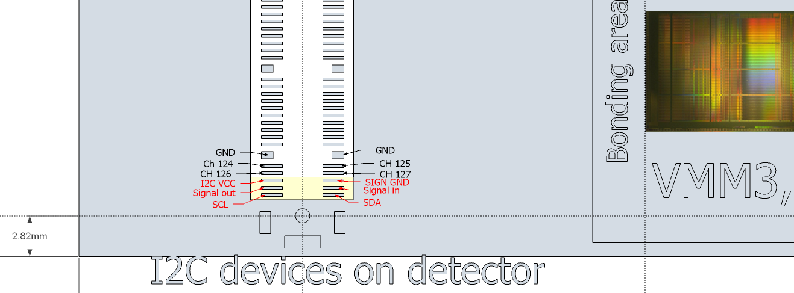
New functionalities b.) optional I2C devices on detector
Will allow to place and
use intelligent sensors on the detector
I2C device control and readout
via
slow controls SRS
TOP
Detector side
VMM hybrid
+2V5
FPGA
6 x I2C support pins on left side, viewed from top
6pin connector plugin
Vcc
I2C device
gnd
sda
scl
S-out
S-in
Detector Frame

Slide 12
Examples I2C chips for potential use on detectors
ROHM color sensor BH1745NUC
Sensirion SHT25 Humidity and Temperature sensor
Analog Devices ADT7301ARTZ-500RL7 temperature sensor
Vishay Proximity and ambient light detector VCNL4010
Texas Instruments LED driver (up to 11 in series) with ambient sensing LM3530
MAX ambient light sensor 0.025 Lux to 104,448 Lux MAX44007

