Slide 1
Resistive materials and their patterning methods
Atsuhiko Ochi
Kobe University
RD51 mini-week@CERN 09/12/2015

Slide 2
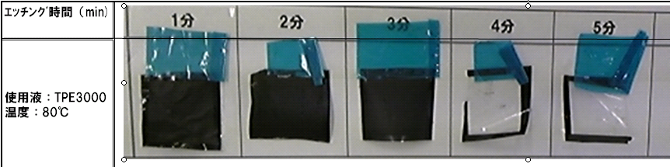
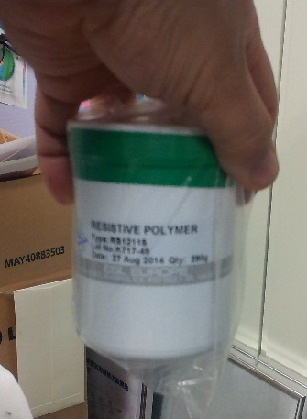
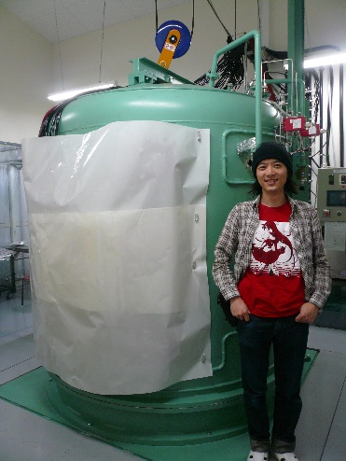
Our experiences of resistive materials
Resistive Polyimide sheet
  Dupont Kapton XC series
  Commercially available (not in Japan, Rui’s help was needed)
  Typically, 2MΩ/sq. , 25μm thickness
Resistive polyimide paste
  Produced in Toray
  It is not commercially available
  A few MΩ/sq. , 10-20μm thickness
Resistive epoxy paste
  ESL RS12500 series
  Commercially available
  Typically, 1MΩ/sq. , 10μm thickness
Carbon sputtering
  Carbon deposition by dry sputtering
  100kΩ/sq. – 100MΩ/sq. , 0.1μm thickness

Slide 3
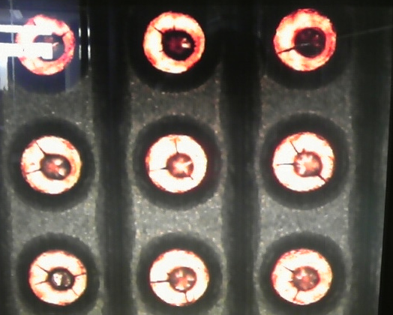
Resistive polyimide sheet + μ-PIC
Dupont XC seriese
Our first trial for resistive MPGDs (2010, Kobe Univ.)
Etching is available by Raytech Inc.
First prototype of μ-PIC have been developed
Max gain > 10000, however not stable
  No reduction of the spark
Problems:
  it was difficult to avoid the etching for substrate polyimide
  Cracks are seen inside the polyimde
Drift plane
-HV
~1cm
Detection area
: filled by gas
Resistive sheet
Cathode
25μm
+HV
R
R
100μm
A.Ochi et.al., JINST 7 C5005 (2012)
R
Anode
400μm

Slide 4
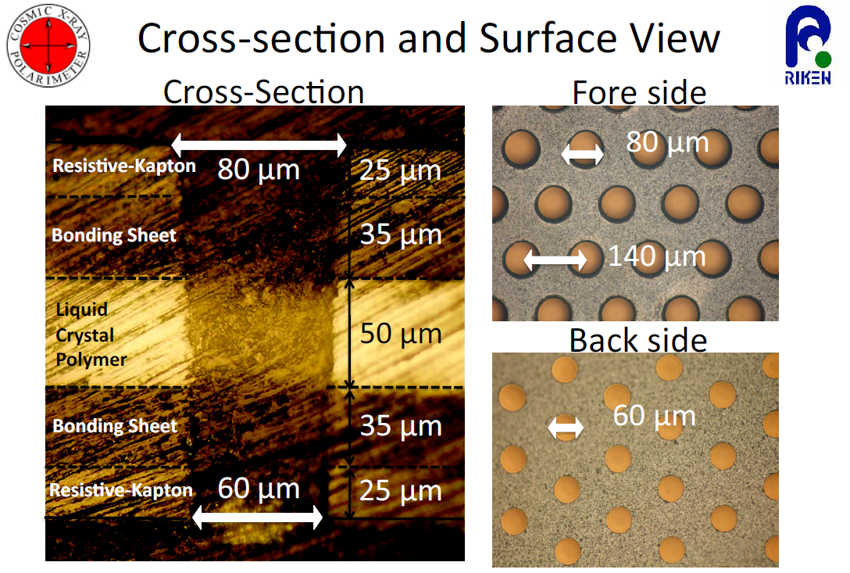
Resistive polyimide sheet + GEM
Prototype of resistive GEM was developed in RIKEN group
LCP is sandwiched by resistive polyimide, and holes are drilled by laser
They success to get signals, but it was not clear whether sparks was reduced or not.
A. Yoshikawa et.al., JINST 7 C6006 (2012)

Slide 5
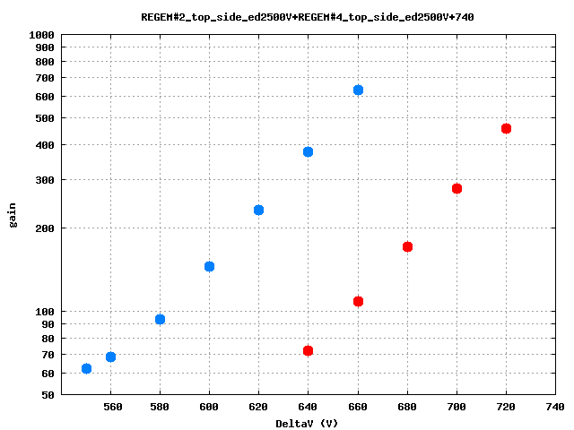
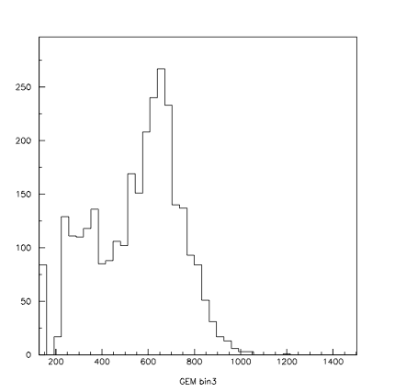
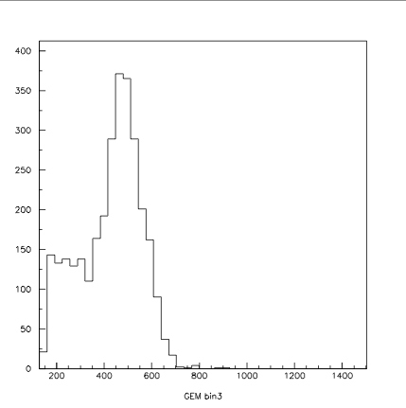
3-2. Result①: Gain vs ΔV of RE-GEM
10³
Typical ADC Spectrum
80μm
d=50μm
2nd RE-GEM
Gain 〜380
60μm
FWHM 49%
Effective Gain
2nd RE-GEM
1st RE-GEM
80μm
Gain 〜280
10²
1st RE-GEM
FWHM 48%
d=120μm
60μm
50
Ed =2.5kV/cm, Ei = 〜 7kV/cm
540
580
620
660
700
740
200
600
1000
1400
Δ V_{GEM}
[ch]
The slope of the gain curve is almost the same.
The gain of 2nd RE-GEM is larger than that of 1st.
A. Yoshikawa, MPGD2011 slide
Notes:
(1’:45”)
From here, Experiment Results
I show you the 1st and 2nd RE-GEM gain curve.
This Figure show the gain curve, the effective gain as a function of applied voltage.
Blue lines is gain of 2ndRE-GEM,
we got enough pulse height to obtain effective gain at 580V
and plot the gain curve up to 660V,
where we got the maximum gain about 600.
The upper right hand figure shows a typical ADC spectrum
obtained at 640V.
Red lines is gain of 1st RE-GEM,
we got enough pulse height to obtain effective gain at 640V
and plot the gain curve up to 720V,
where we got the maximum gain about 500.
The lower right hand figure shows a typical ADC spectrum
obtained at 700V.
Both Energy resolutions of 1st and 2nd are about 50%.
So we can say, we successfully produced and operated the world’s first RE-GEM.
The slope of the gain curve is almost the same
and
the gain of 2nd RE-GEM is larger than that of 1st.
These implies that the almost the same electrostatic field is formed inside the holes both of case 1st and 2nd RE-GEM.
and
the gain difference at same voltage due to the electrode distance.

Slide 6
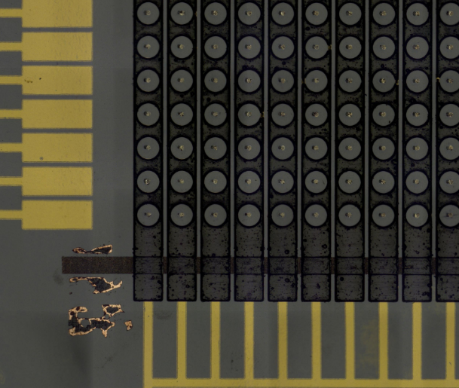
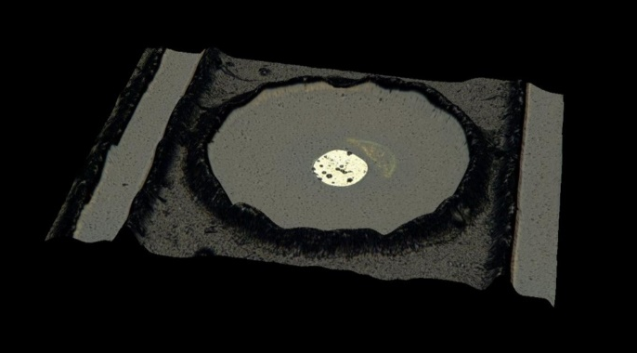
Resistive polyimide paste + μ-PIC
Drift plane
Resistive polyimide paste is processed by liftoff
Qualities of the electrodes are better.
Sparks are strongly reduced (next slide)
However, there are difficulties for stable operation.
  Anode pin alignment
  Short problem in pickup electrodes
Resistive cathode (-HV)
400 μm
Anode
Thin
substrate
Pickup electrode
Thick substrate
50 μm
A.Ochi et.al., JINST 9 C01039 (2014)

Slide 7
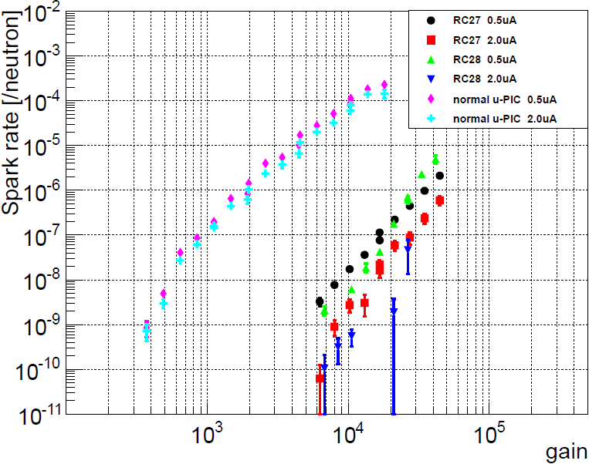
Spark probability for fast neutron (~2MeV)
Conditions
  Gas: Ar+C₂H₆ (7:3)
  Drift field: 3.3kV/cm
  Definition of the sparks:
    Current monitor of HV module shows more than 2μA or 0.5μA.
  Spark probability = [Spark counts] / neutron
  The spark rates on normal μ-PIC are are also plotted as comparison (cyan, magenta plots).
Results
  Reduction of sparks are obviously found. The rate was 10³⁻⁵ times less than normal μ-PIC case at same gas gain.
Spark reduction

Slide 8
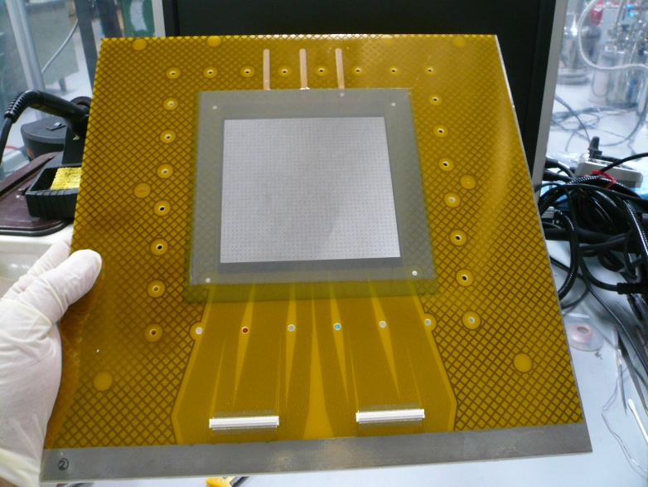
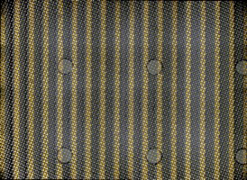
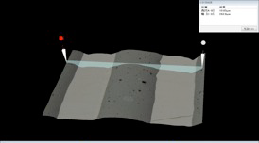
Resistive paste + MM
Resistive strips are formed by screen printing
First trial was done in 2012 using resistive polyimide paste.
Now, we are using resistive epoxy paste for ATLAS NSW production

Slide 9
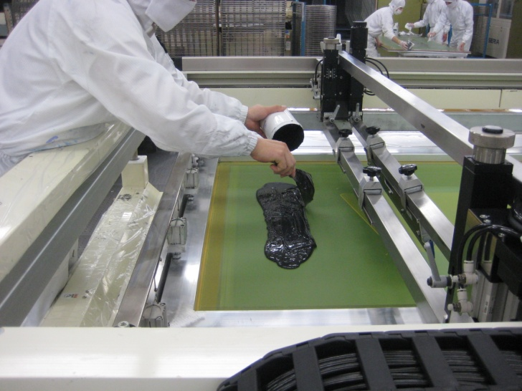
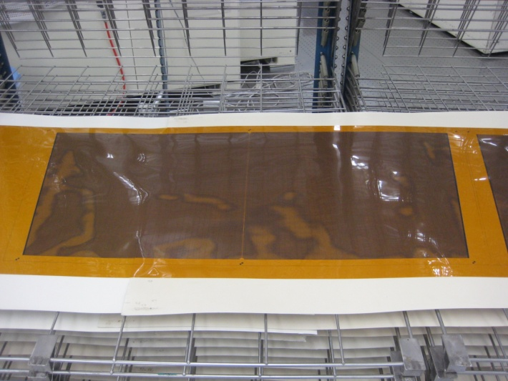
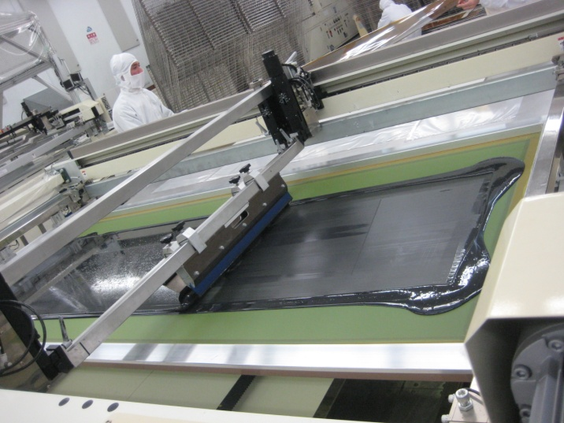
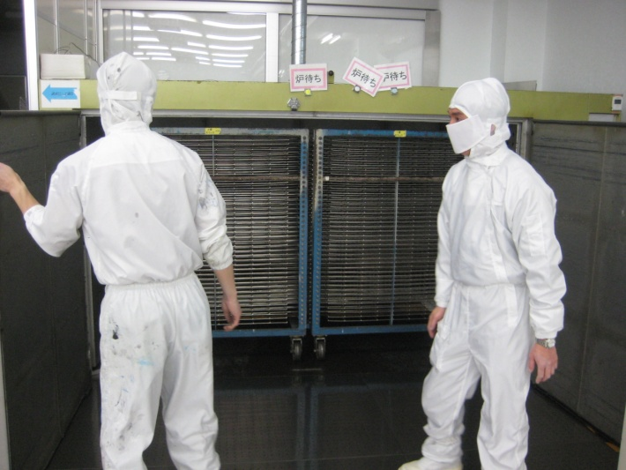
Printing procedure (Matsuda Screen)
Resistive paste is put on
Printing is done
Squeegee is controlled automatically
Drying with 170 degree, 2H.

Slide 10
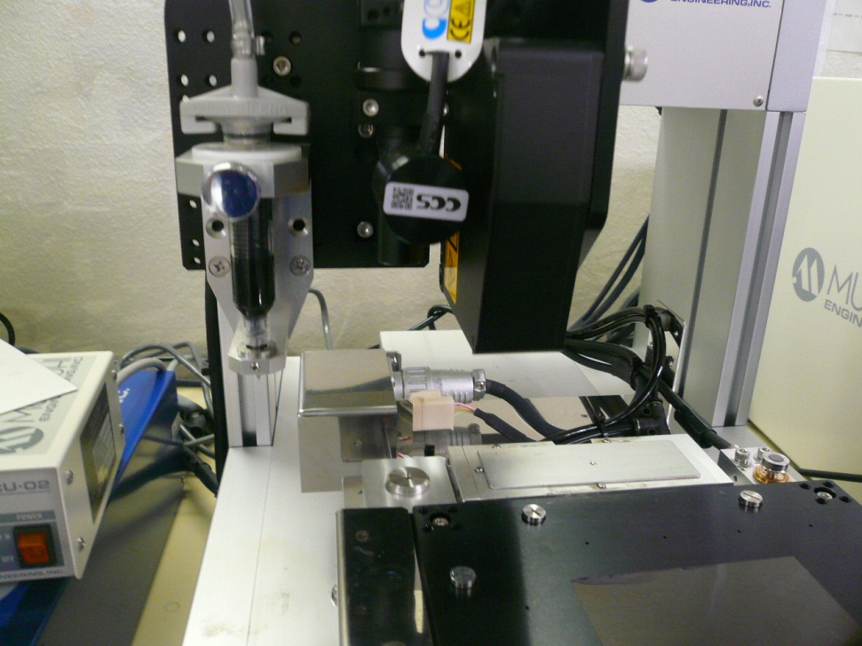
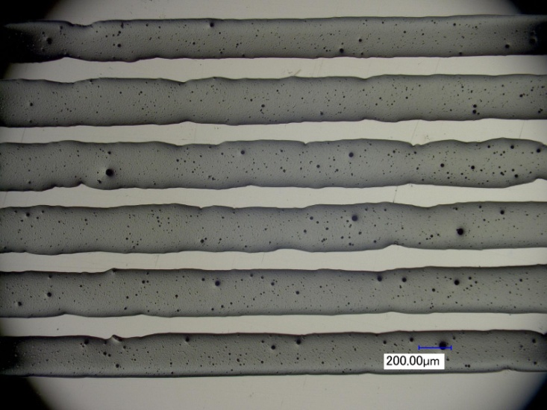
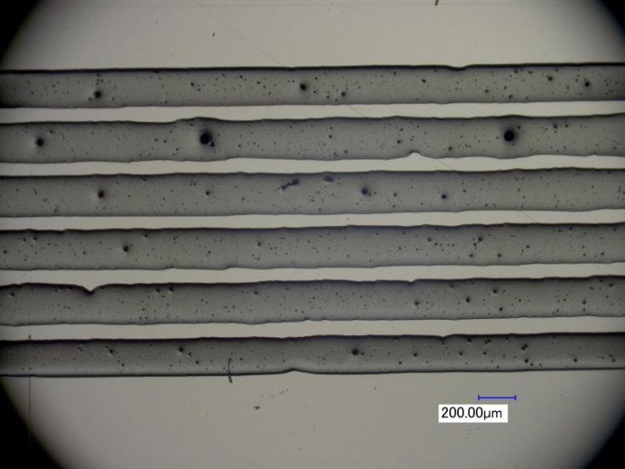
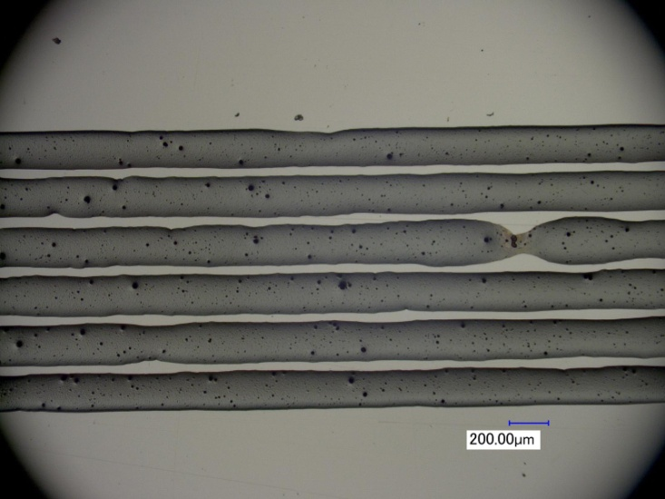
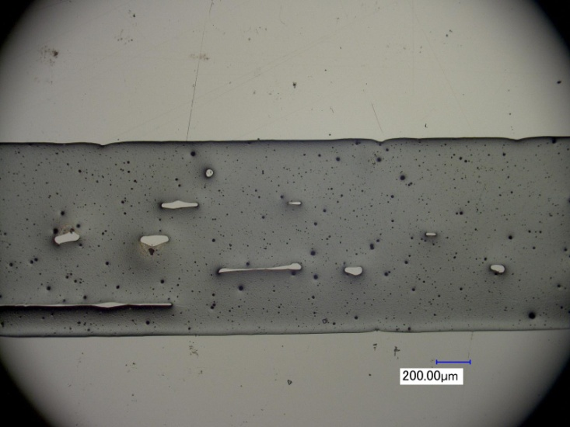
Another approach for MM strip processing using resistive paste
Strip patterns are written directly by dispenser
Fine patterns are available
However, too much time needed for large area
400μm pitch
300μm pitch
250μm pitch
200μm pitch
10

Slide 11
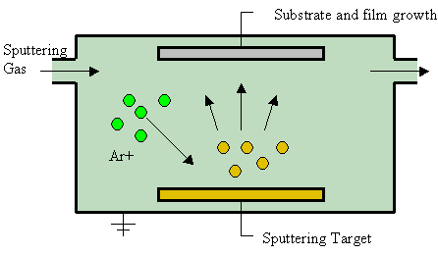
Sputtered carbon
Photo resist
(reverse pattern of
surface strips)
Sputtered carbon
  Diamond like, and amorphous structure
  It means, carbon particles of molecular size!
Fine structure with proper resistivity is available
  with liftoff method
Substrate (polyimide)
Carbon spattering
Substrate (polyimide)
Developing the resists
Substrate (polyimide)
A.Ochi et.al., PoS (TIPP2014) 351

Slide 12
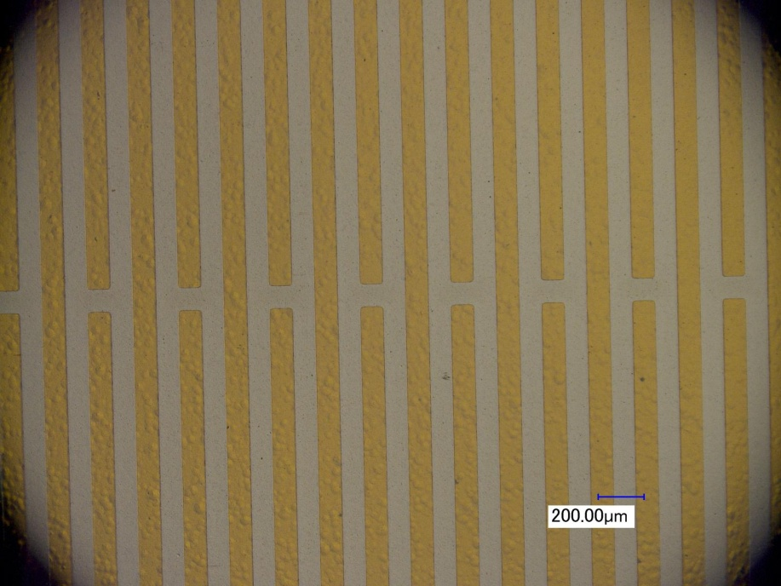
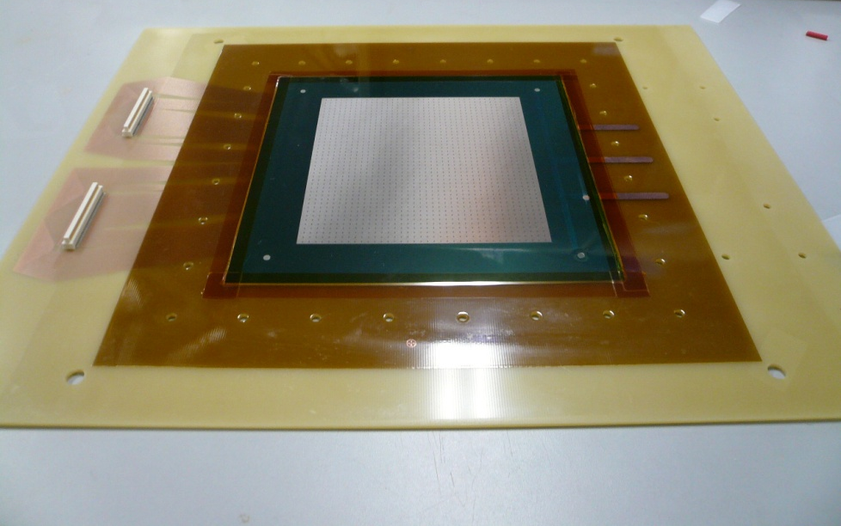
Sputtered carbon + MM
First attempt to make MPGDs using carbon sputtering (from June 2013)
  This R&D is aimed for ATLAS NSW MM.
  Fine strip pitch of 200 μm or 400 μm is formed on 50μm polyimide foil.
Carbon (300-600Å)
Substrate (polyimide)
Mesh
Resistive strips (sputtered)
Pillar
25μm
Flexible foil (polyimide)
35μm
Bonding film
Readout strips
Rigid PCB (epoxy)

Slide 13
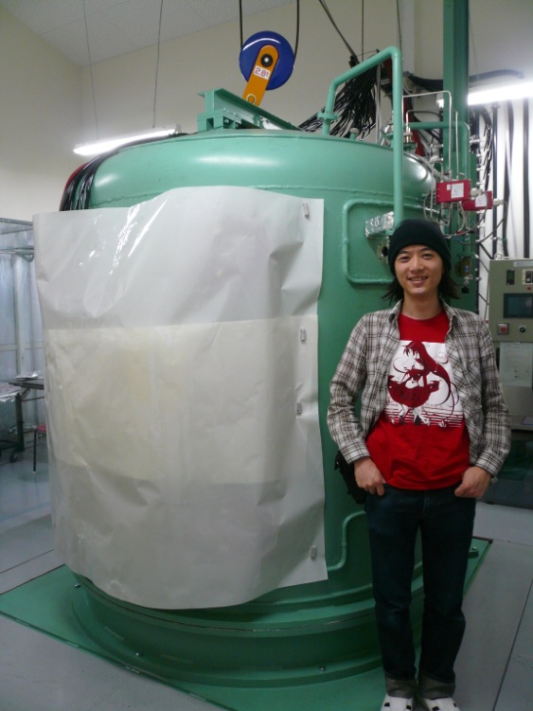
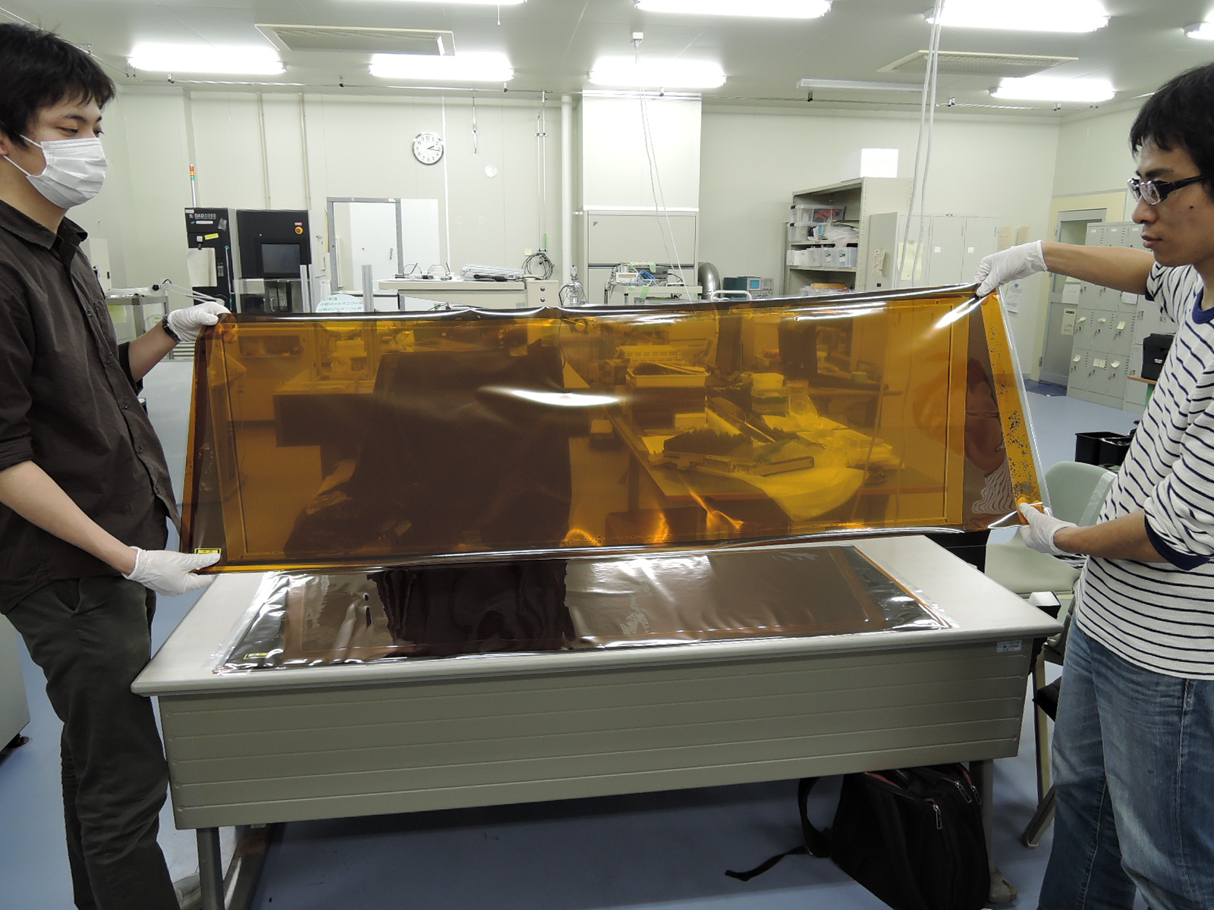
Sputtered carbon + Large MM
Large size (maximum 4.5m x 1m) is available with industrial equipment.
Resistive strips of ATLAS MM for MMSW and module-0 are made from carbon sputtering
Be-Sputter Co. Ltd.
(Kyoto Japan)

Slide 14
Sputtered carbon + μ-PIC
Cathode structure should be fine
Sputtering with liftoff is very good method for those structures.
Two dimensional signals are observed
  Gas gain ~ 10000
More studies needed for stable operation

Slide 15
Sputtered carbon + GEM
Re-GEM was formed by Laser drilling on double sided carbon sputtered foil
Gas gain is less than 20 (very low)
de-smear

Slide 16
Summary
Various resistive materials were tested for μ-PIC, MM and GEM prototypes.
For fine structure, photo lithographic method is suitable.
  Most fine structure will be formed by carbon sputtering
  Also huge size (>1m) production is available
Screen print of resistive paste is very low cost
  Less fine, but it is enough to ATLAS NSW MM resistive strip
Materials | Resistive sheet | Paste (polyimide) | Paste (epoxy) | Sputter
Resistivity | 2M | 1M~2M | 0.5M~2M | 50k~100M
Fineness | ~50μm | ~100μm | ~100μm | ~10μm
Process | Etching Laser drilling | Liftoff Screen print | Screen print | Liftoff Laser drilling
Detector | μ-PIC GEM (RIKEN) | μ-PIC MicroMEGAS | MicroMEGAS | μ-PIC MicroMEGAS GEM

Slide 17
Kapton type (EN/HN)
Kapton HN is commonly used as MPGD substrate (particular in CERN)
HN type is provided as standard type Kapton by Dupont.
In Japan, similar series of Kapton foil is provided by Toray-Dupont.
Standard type (in Japan) is “H” type
  I think, it is almost same as “HN” type
Dimensional stability of “EN” is better than “H”
Item | Unit | 200EN | 200H
Ultimate tensile strength | MPa | 350 | 315
Tensile modulus | Gpa | 5.8 | 3.4
Thermal Coefficient of Linear Expansion (50~200ºC) | ppm/ºC | 16 | 27
Shrinkage (@200ºC) | % | 0.01 | 0.20

