Slide 1
Cluster size and position resolution for carbon-loaded kapton and diamond-like carbon
P. Colas, CEA/Irfu Saclay

Slide 2
The charge density function for a point charge in Cartesian coordinates is:
Therefore: the charge seen by a given pad at a given time, Qpad(t) is:
x_{high}, x_{low}, y_{high}, y_{low} define the pad boundaries &

Slide 3
Convoluting by the shaping function:

Slide 4
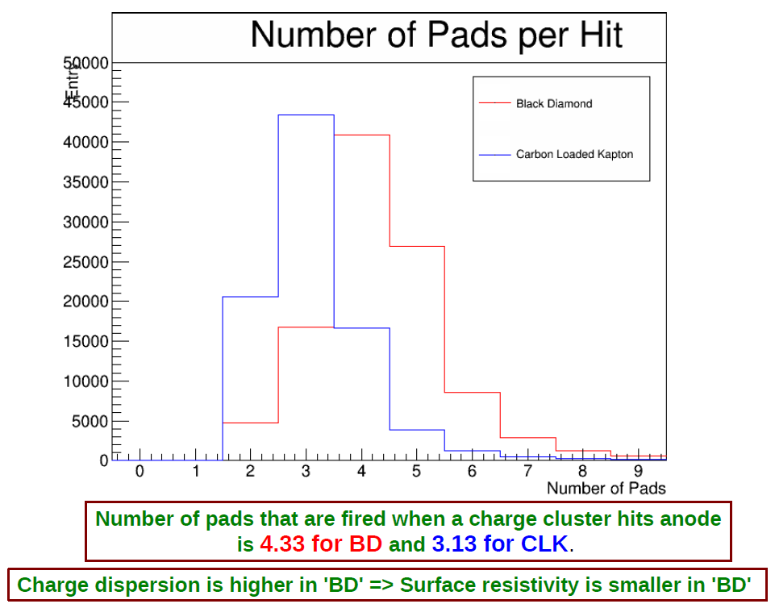
Pad multiplicity
Npad / hit

Slide 5
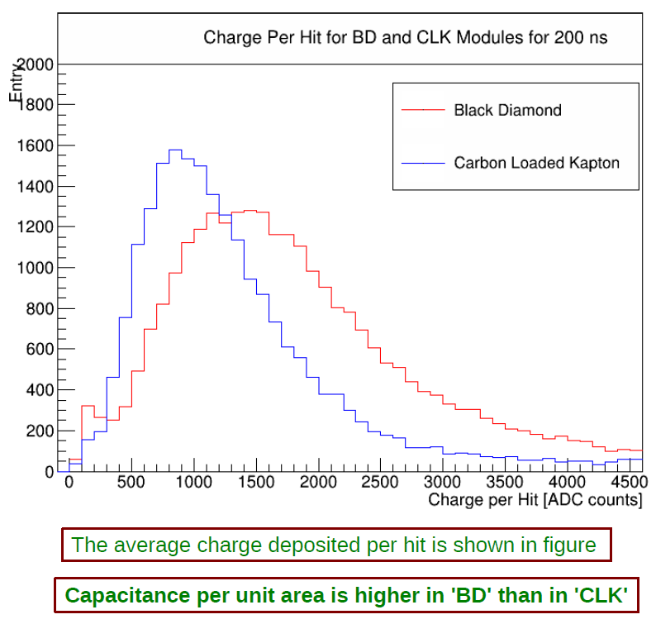
Charge deposition
Black Diamond (DLC) modules give more charge than Carbon loaded Kapton (CLK)
Npad / hit

Slide 6
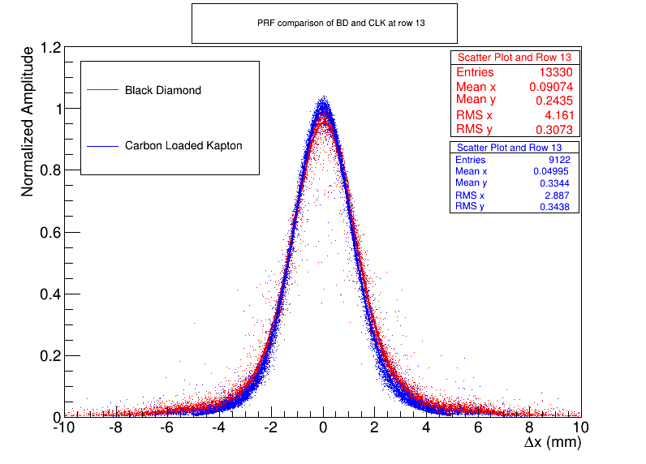
The Pad Response Function is wider for Black Diamond than for Carbon-loaded Kapton.
r.m.s.
CLK : 2.55 mm
BD : 2.85 mm

Slide 7
