Slide 1

SHIP Test Beam Oct-Nov 2015
G.Bencivenni
LNF-INFN, Italy
LABORATORI NAZIONALI DI FRASCATI
www.lnf.infn.it

Slide 2
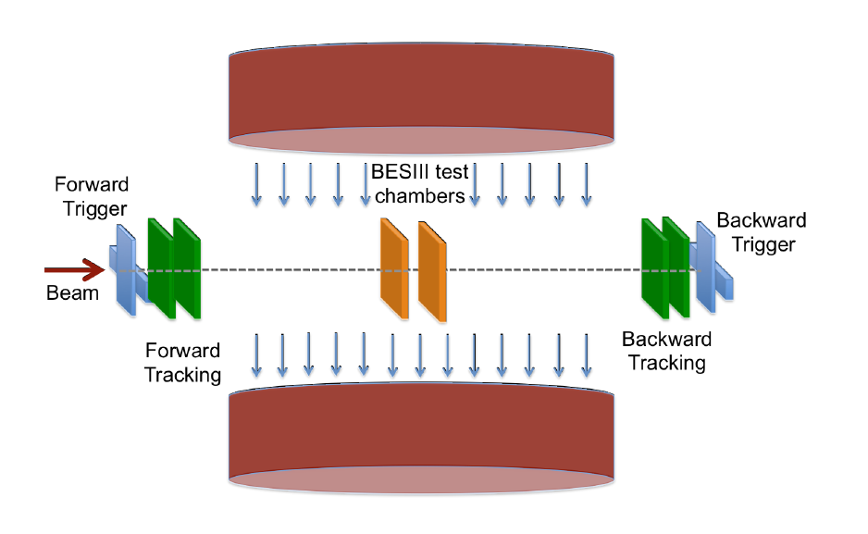
Beam Test Setup
GEM detector
µ-RWELL detector
No-bending plane
Emulsion
bending plane
GOAL: study of the matching between emulsion and electronic tracker
trigger scintillators and GEM trackers outside Goliath
setup was foreseen two kind of electronic detectors, both independently coupled with emulsion set-up:
a large drift gap XY GEM
two 1-D µ-RWELL coupled at 90° to supply XY info
beam set-up displaced wrt the beam axis of ∼10 cm in order to reduce the irradiation of the emulsion units
tracking with linear fit
track residual w/COG
analysis code by INFN - Ferrara
not delivered

Slide 3

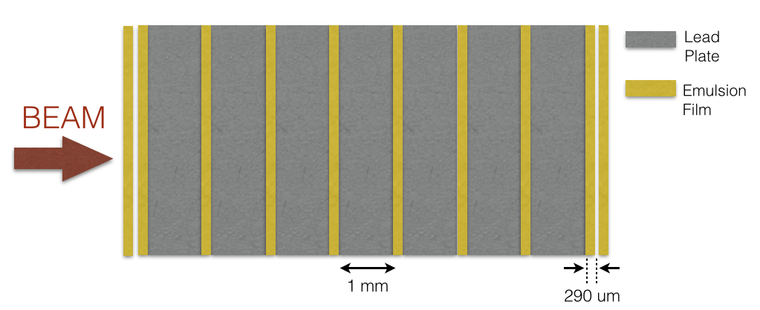


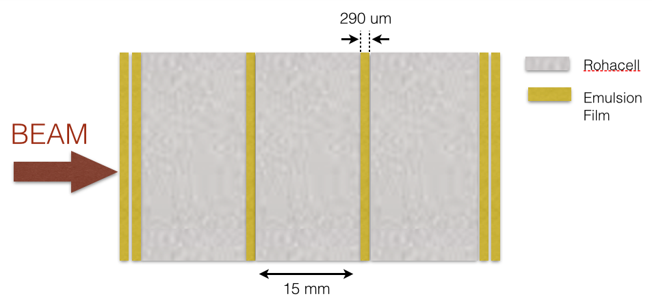
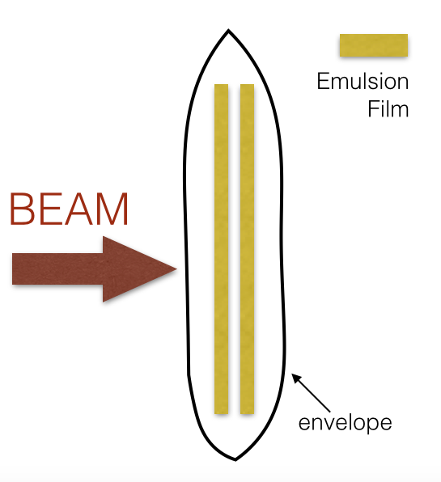
Emulsion Target Units
The Emulsion Cloud Chamber (ECC)
The Emulsion Doublet (CS – Changeable Sheet)
The Compact Emulsion Spectrometer (CES)

Slide 4

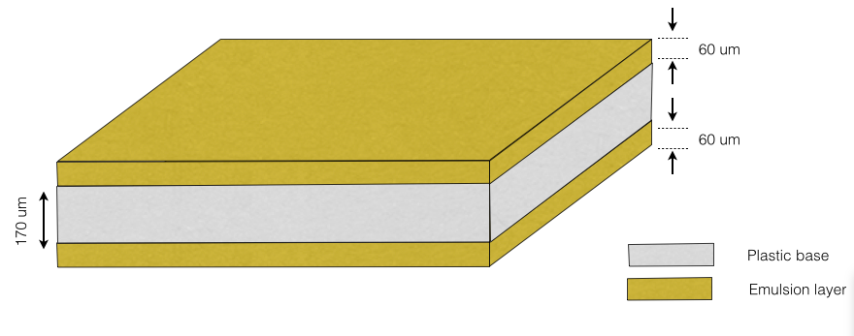
Emulsion Films
Emulsion films produced in Nagoya University
60 μm
Film dimensions
      Surface: 125 mm x 100 mm
      Total thickness: 290 μm
60 μm
170 μm
New emulsion gel developed in Nagoya University
      Grain density: 50 grains/100 μm (higher than OPERA films)
Emulsion production
    Emulsion poured in middle August 2015 and cut by hand
    Shipped to CERN by plane
    Total amount of emulsion films produced: 120
    Emulsion films used in the Emu+GEM test beam: 30

Slide 5

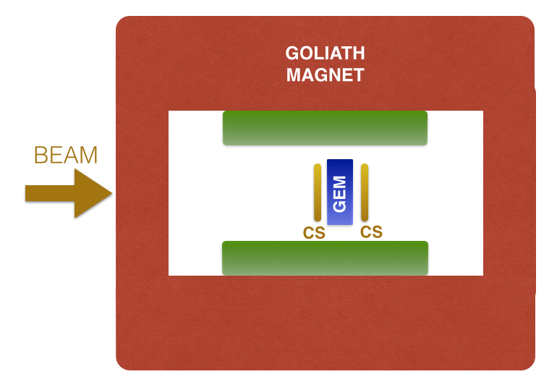



CS exposure
Aim: study of the GEM space resolution with external track point (coming from the two CS) reconstructed with precision at level of few µm
Experimental setup: #2 CS attached on GEM upstream and downstream surfaces
      Low density: 50 tracks/cm²/angle
      5 exposure angles
Target: 2 x CS
Magnetic Field: + 1T
Target: 2 x CS
Magnetic Field: - 1T
Exposure 1
Exposure 2
.
x
B=1T
0°
7.5°
B=1T
0°
7.5°
15°
30°
45°
15°
30°
45°
θ
θ

Slide 6

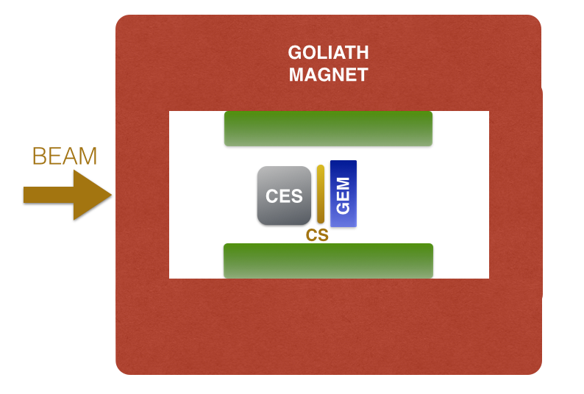

CES exposure
Aim: track matching between GEM and CES (Emulsions interleaved with Rohacell)
Target: 1 CES + 1 CS (Emulsion doublet)
      Low density: 100 tracks/cm²/angle
      6 exposure angles
      No magnetic field
-30°
0°
7.5°
15°
30°
45°
θ

Slide 7

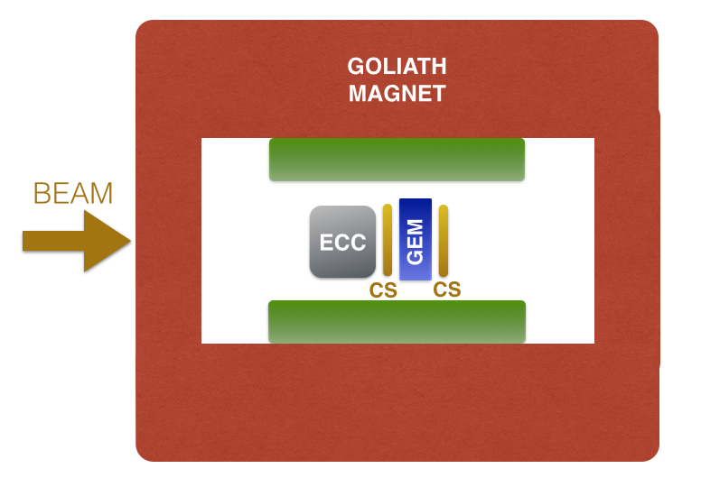
ECC exposure
Aim: track matching between GEM and ECC (Emulsions interleaved with Lead)
Target: 1 ECC + 2 CS (Emulsion doublet)
      Low density: 100 tracks/cm²/angle
      6 exposure angles
      No magnetic field
-30°
0°
7.5°
15°
30°
45°
θ

Slide 8
Electronic tracker & Emulsion matching
The electronic tracker should provide the time stamp to the event reconstructed by the emulsion unit
COG method:
XY(elect) position from electronic detector is compared/matched with the XY(emu) by the emulsion unit.
It works only with small angle & low B field.
Micro-TPC mode:
direct comparison/matching between the track_segment (elect) reconstructed by the electronic detector and the track_segment (emu) finely reconstructed by the emulsion unit.
It works well also at large angle & high B field
t1
t2
t3

Slide 9
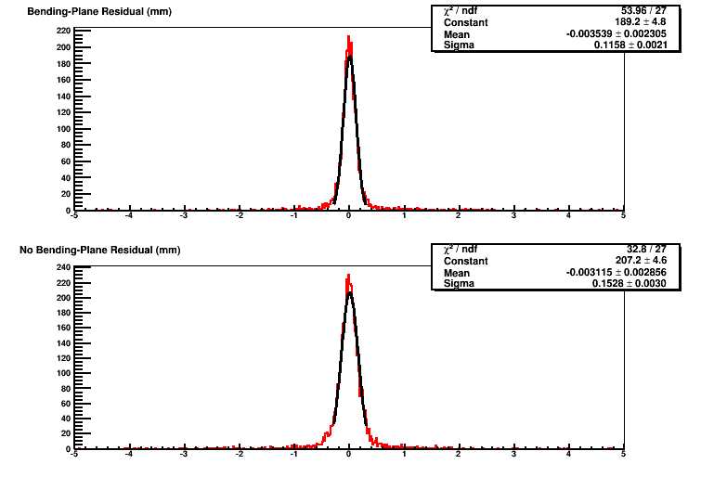
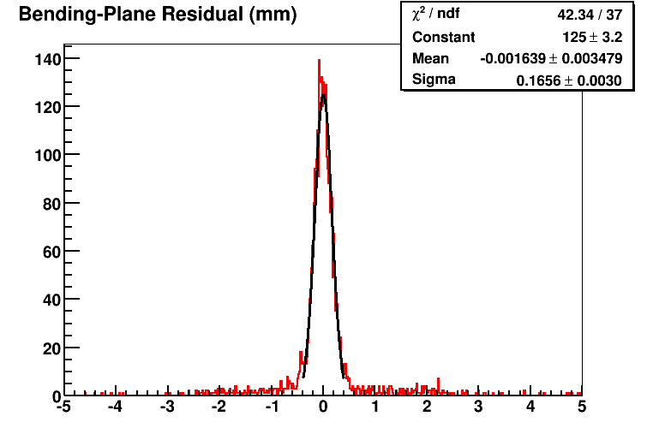
Electronic Detectors layout
Triple-GEM detector:
6/2/2/2 gap geometry
µ-RWELL detector:
4 mm drift gap & resistivity ∼1MΩ/
USE ONLY AS SW-TRIGGER TO CLEAN THE EVENT SAMPLE
6
2
4
2
2
1 D r/o (400 µm strip pitch)
X-Y r/o (650 µm strip pitch)
GEM operated in Ar/CO2=70/30
µ-RWELL operated in Ar/ISO=90/10
Center of Gravity (COG)
method
Bending-plane
Bending-plane
σ =115 µm
σ =165 µm
No-Bending-plane
σ =152 µm

Slide 10
RUN conditions
Calibration RUN (upstream – downstream trigger):
Scan in drift field with orthogonal tracks & B=0 T (7 runs)
Scan in HV with orthogonal tracks & B=0, -1 T (18 runs)
Scan in angle (0,7.5,15,30,45) & B= 0, ± 1 T & 2 GEM Gain (30 runs)
Run with emulsion setup (trigger w/forward scintillators + SW trigger based on forward trackers + µ-RWELL):
Scan with CS emulsion: angle (0,7.5,15,30,45) & B= 0, ± 1T
(10 runs)
Scan with CES & ECC emulsion: tilt angle (0,7.5,15,30,45) & B= 0 T (10 runs)
We present preliminary results based on (COG) method for the Calibration runs
NO micro-TPC MODE ANALYSIS (the code is under development by INFN-FE)
NO COMBINED RESULTS BETWEEN GEM & EMULSIONS SETUP

Slide 11
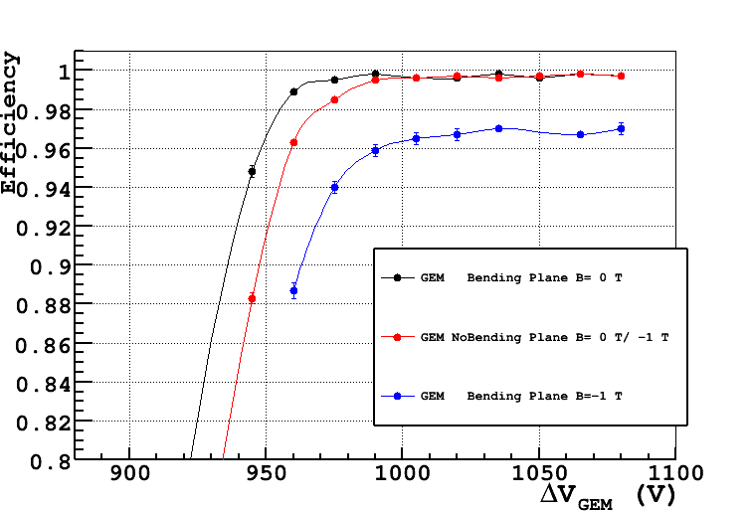
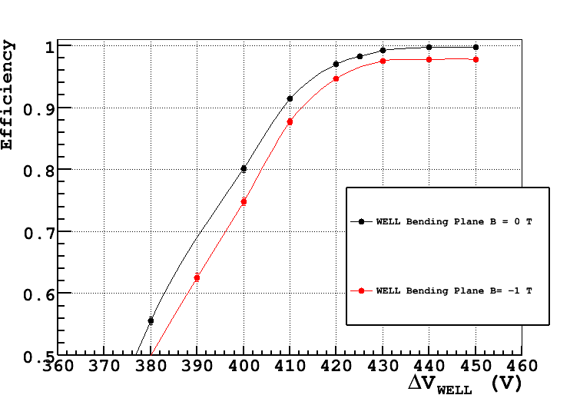

Efficiency vs HV
with orthogonal tracks
GEM detector
µ-RWELL detector
Gain∼ 2000
Gain∼ 7000
The efficiency decrease with B

Slide 12
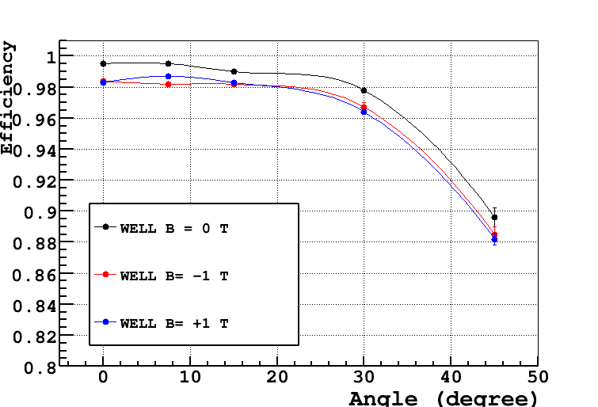
Efficiency vs tilt angle
w & w/out magnetic field
GEM detector - Gain∼ 4000
µ-RWELL detector - Gain∼ 8000
Larger the incidence angle
Larger the spread of the charge over the readout strips
Smaller the charge collected by the strips
Smaller the efficiency
The effect is larger w/B

Slide 13
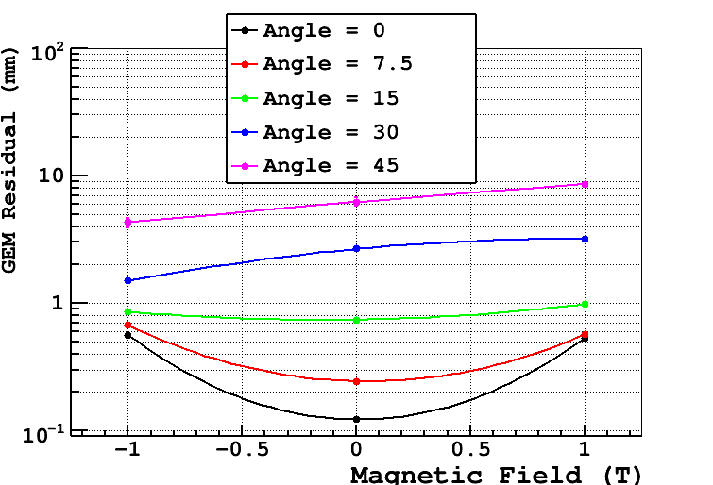
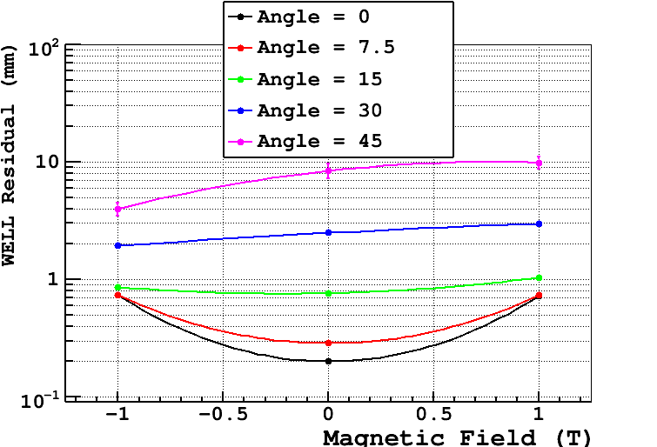
Track residual vs magnetic field
for different tilt angle
The track reconstruction based on COG methode make sense only at small incidence angle and low B field.
E
α_{L}
B
x
electron drift
beam
F_{E}
GEM detector
F_{B}
µRWELL detector

Slide 14
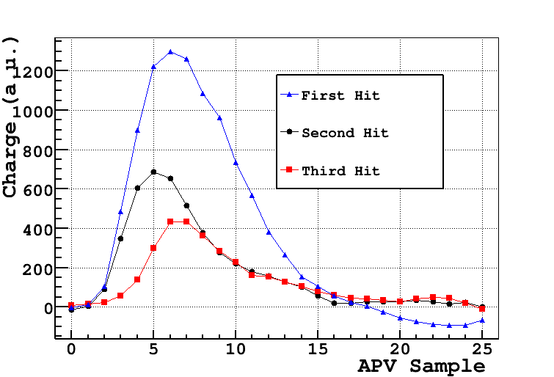
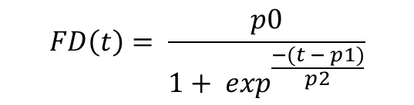
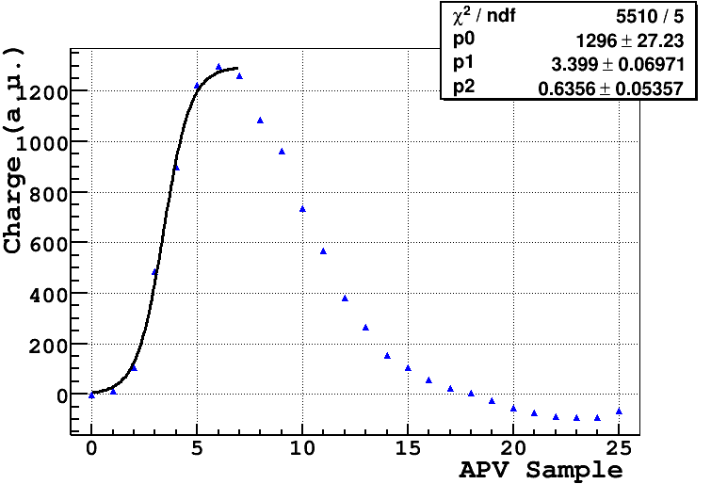
μ-TCP mode (I)
orthogonal tracks & B = 1T
work in progress
Event with 3 hits
Charge distribution fitted with a Fermi-Dirac:
p1 is the time at half-maximum of the charge distribution

Slide 15
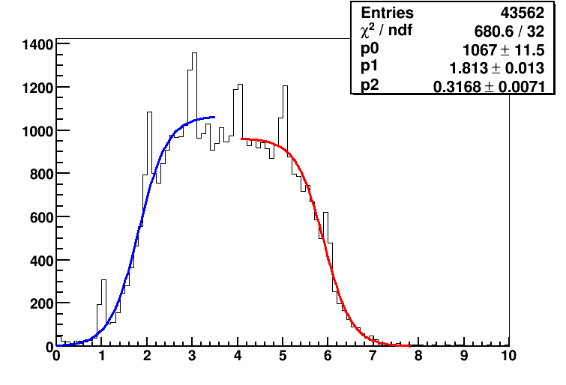
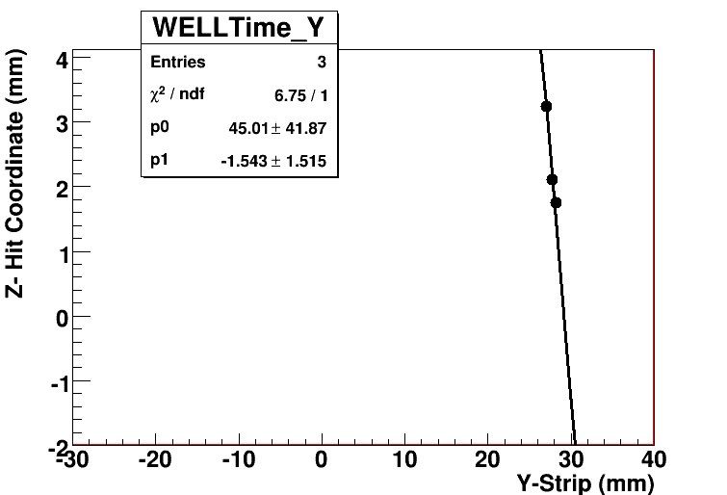
μ-TCP mode (II)
orthogonal tracks & B = 1T
work in progress
The Fermi-Dirac’s parameter p1 for all events
T0 = 1.81 APV Sample →
( 45.323 +- 0.003) ns
Tmax = 5.91 APV Sample → (147.657 +- 0.004) ns
ΔT = 102.3 +- 0.1 ns
Drift Gap = 4 mm
Drift Velocity = (3.9 +- 0.1) cm/μs
Drift Velocity (Garfield) = (3.5+-0.1) cm/ μs
Double Fermi-Dirac Fit

Slide 16
Summary
The analysis of the SHIP TB data is still at an early stage:
the study of the GEM space resolution vs angle and B requires for more sophisticated analysis than usual COG (at least for α > 15°)
the code for micro-TPC mode (by Ferrara group) is under development
combined analysis between GEM and emulsion target units (CS, CES, ECC) still to be started (delay on the emulsion chemical development)
At the moment it’s difficult to foresee for other TB with emulsions in 2016

Slide 17
2016 Beam Time request
In the framework of µ-RWELL R&D we are collaborating with the CMS – phase2 upgrade group for the design & construction of a first prototype of large area µ-RWELL with the so called LR resistive scheme (see Morello presentation of today).
The goal is to have a dedicated TB of such a proto by the end of the 2016 (last H4 TB time slot).
In parallel we also aim to test some small (10x10 cm²) µ-RWELL protos with other features (such as HR resistive scheme and thicker WELL amplification stage – 125µm )

Slide 18
SPARES

Slide 19
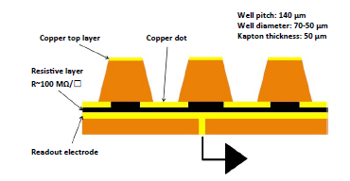
The µ-RWELL architecture
The µ-RWELL^{(*)} PCB is realized by coupling:
a “suitable patterned GEM foil” for the “amplification stage”
a “resistive stage” for the discharge suppression & current evacuation
  “Low particle rate” (LR) << 100kHz/cm²: single resistive layer → surface resistivity (∼100 MΩ/)
  “High particle rate” (HR**) >> 100kHz/cm²: more sophisticated resistive scheme must be implemented (performed by MPDG_NEXT- LNF financed by GR5-INFN)
a simple readout PCB board → OK
1
2
3
The simplest scheme of µ-RWELL detector
Copper top layer
Resistive layers
(by DLC)
Vias (conductive )
Vias (conductive)
Readout electrode
^{(**)} the final goal being O(1 MHz/cm²)
^{(*)} the first prototype of such a type of detector (at that time called Blind-GEM detector) has been proposed in the 2009 by the author.

Slide 20
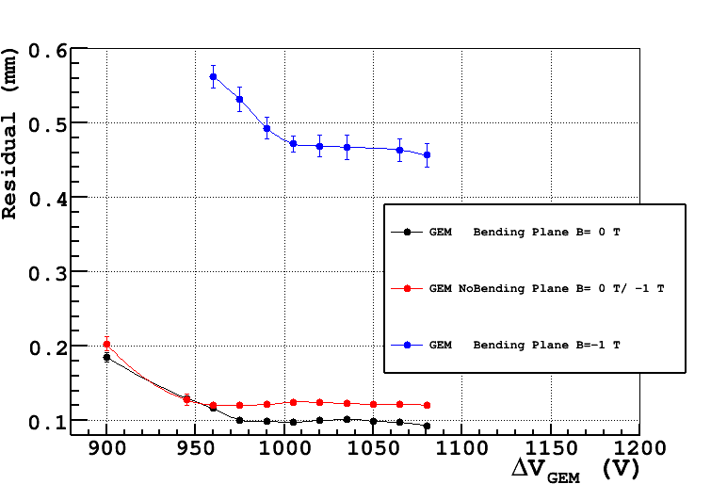
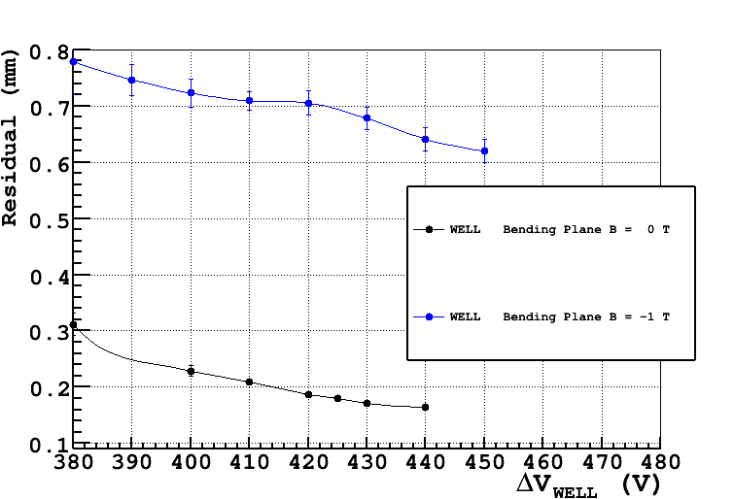
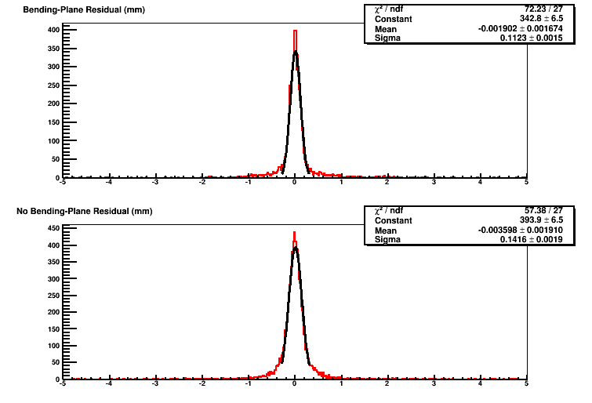
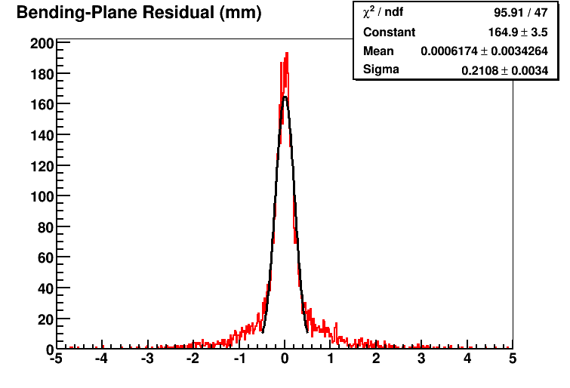
Track residual vs HV
with orthogonal tracks
GEM detector
WELL detector
Bending-plane
No Bending-plane

Slide 21
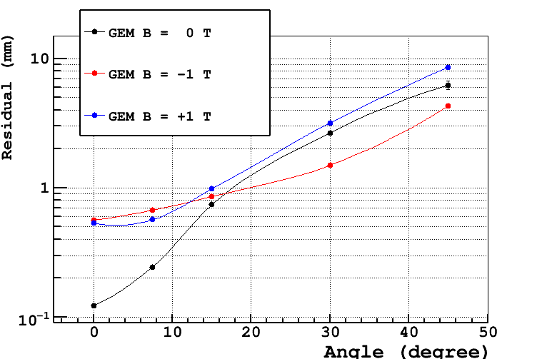
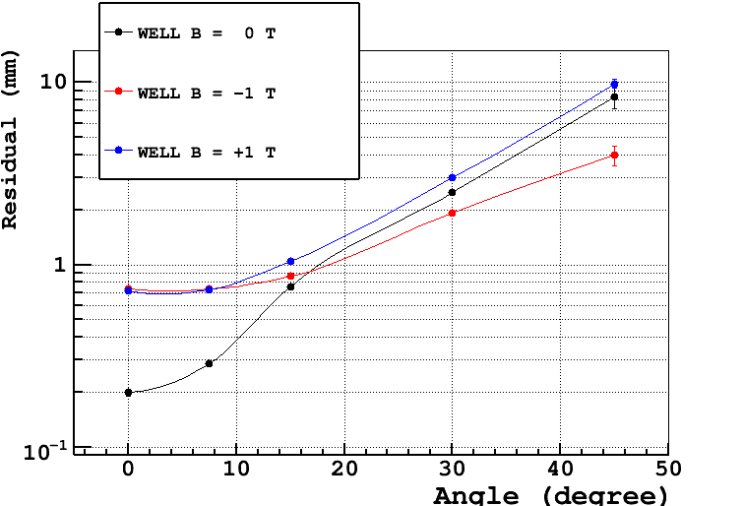
Track residual vs tilt angle
w & w/out magnetic field
E
α_{L}
B
x
electron drift
beam
F_{E}
F_{B}
GEM detector
µ-RWELL detector

