Slide 1



ATLAS Forward Calorimeter Analysis
University
Mohammed I
Physics Laboratory of Matter and Radiation
Faculty of Sciences
Oujda
KTH/ FSO meeting
28/ 10/ 2015
Malika TOUIL – Yahya TAYALATI

Slide 2

Electrons Analysis
Reconstruction of energy in Fcal considering only the energy deposited in FC1.
Cut of Eta between 3.4 & 4.4 .
Cluster energy with a radius of 8cm fitted by double gaussian .
Energy resolution.
Position resolution.
2

Slide 3
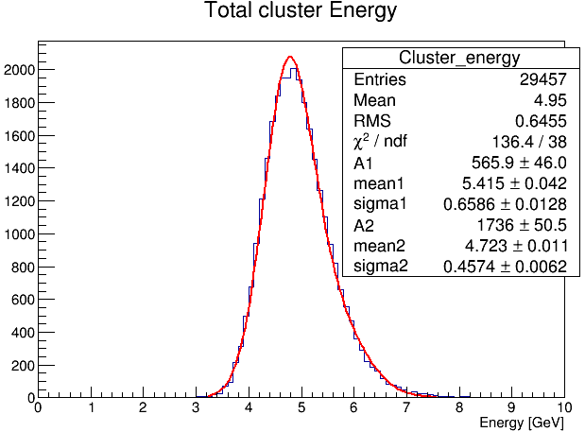
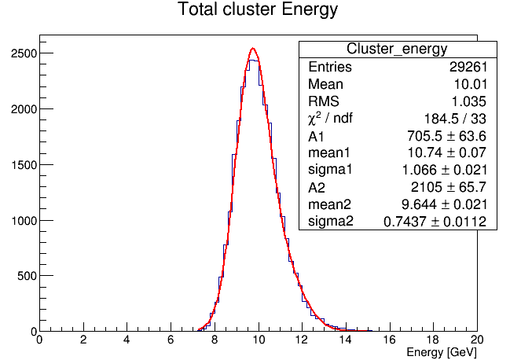


Electrons – Energy Reconstruction
Total cluster energy in FCal with a radius of 8cm .
Fit with Double gaussian.
5 GeV
10 GeV
3

Slide 4
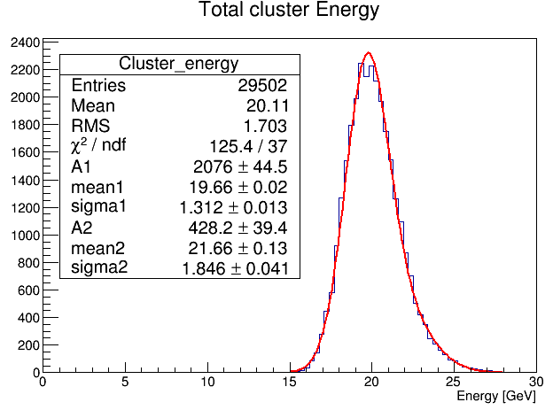
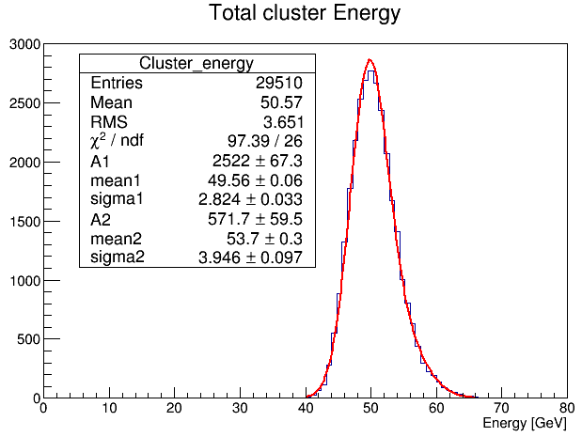


Electrons – Reconstruction of energy
Total cluster energy in FCal with a radius of 8cm .
Fit with Double gaussian.
20 GeV
50 GeV
4

Slide 5
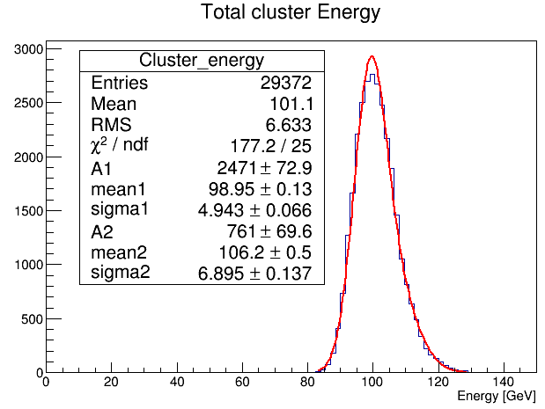
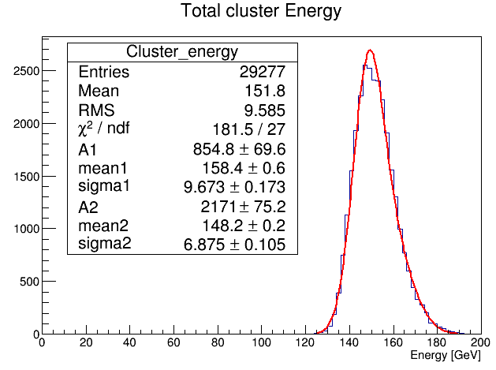


Electrons – Reconstruction of energy
Total cluster energy in FCal with a radius of 8cm .
Fit with Double gaussian.
100 GeV
150 GeV
5

Slide 6
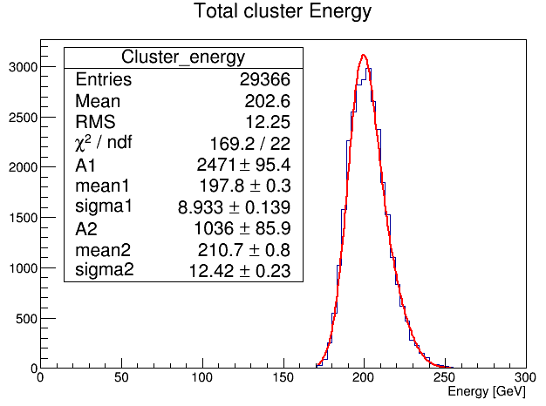
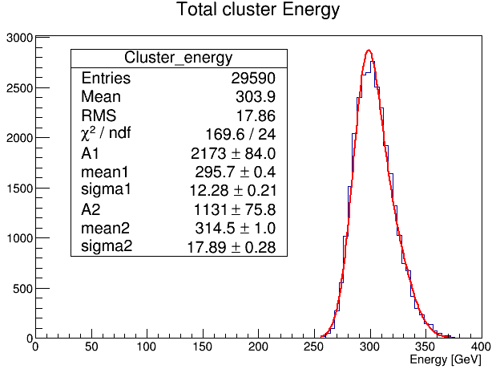


Electrons – Reconstruction of energy
Total cluster energy in FCal with a radius of 8cm .
Fit with Double gaussian.
200 GeV
300 GeV
6

Slide 7
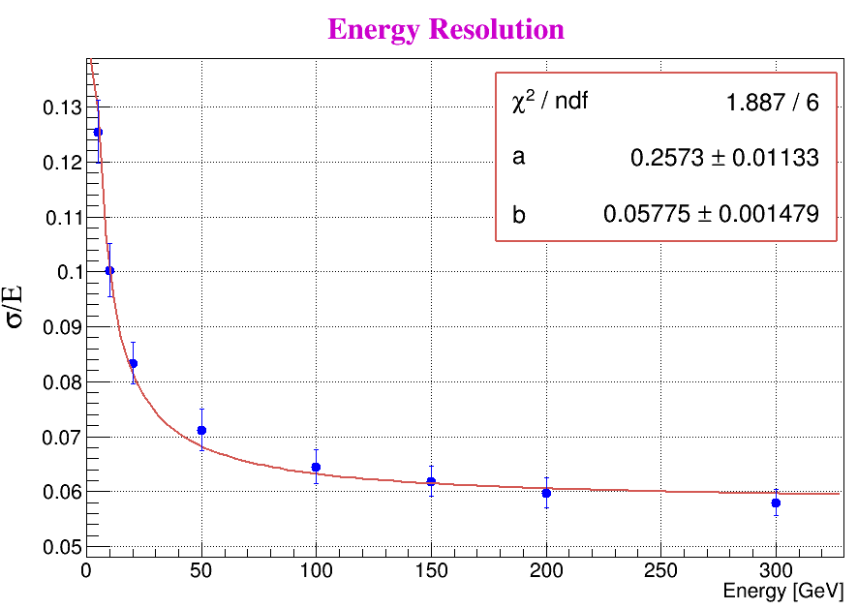

Electrons – Resolution of energy
a= (25.73 ± 0.01) %$√GeV$
b= (5.7 ± 0.001) %
7

Slide 8
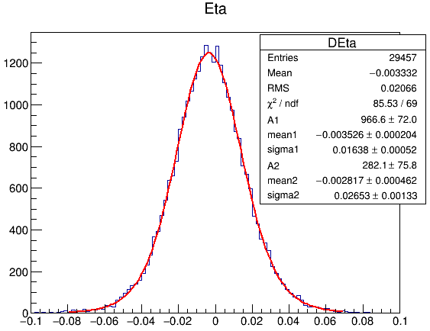
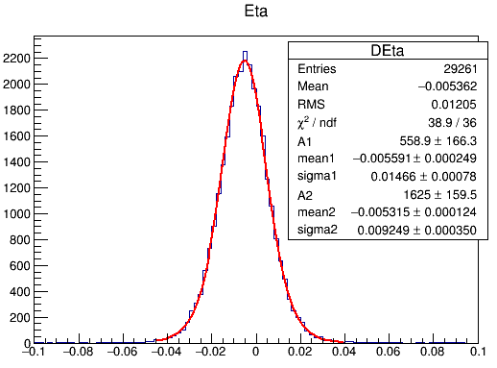
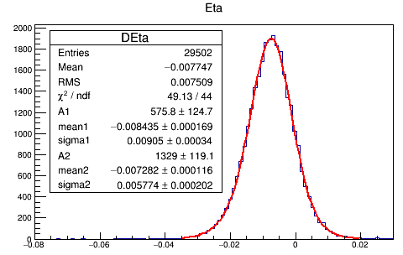
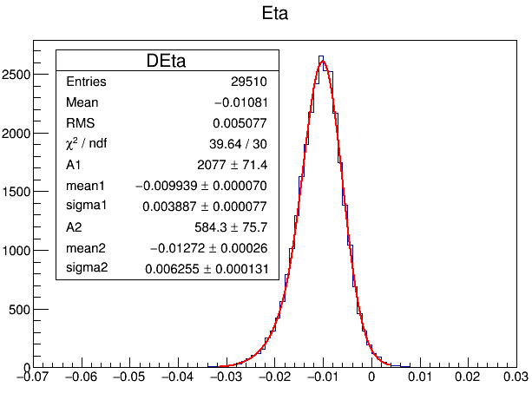
Electrons – η Position – fit with double gaussian
5 GeV
10 GeV
20 GeV
50 GeV
8

Slide 9
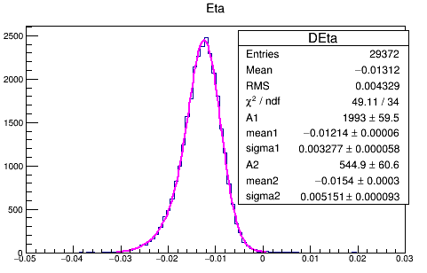
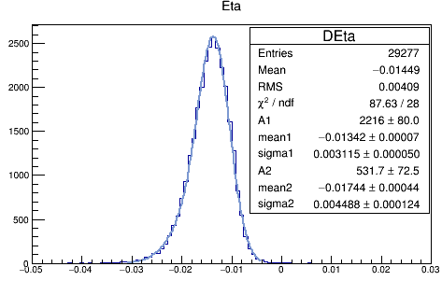
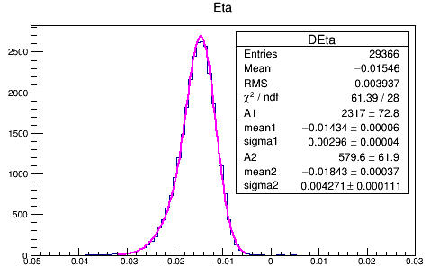
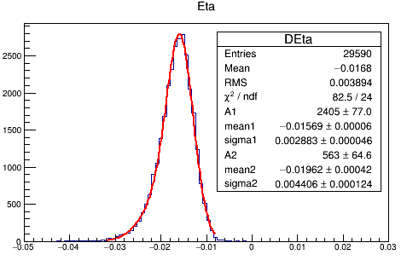
Electrons – η Position – fit with double gaussian
100 GeV
150 GeV
200 GeV
300 GeV
9

Slide 10
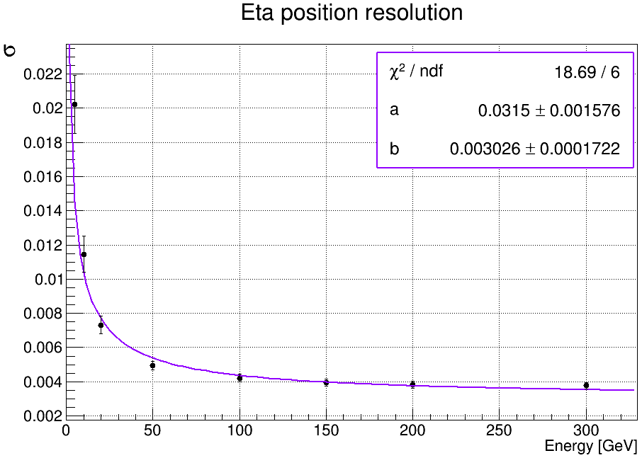

Electrons – η Position Resolution
a= (3.15 ± 0.001) %$√GeV$
b= (0.3 ± 0.0001) %
10

Slide 11
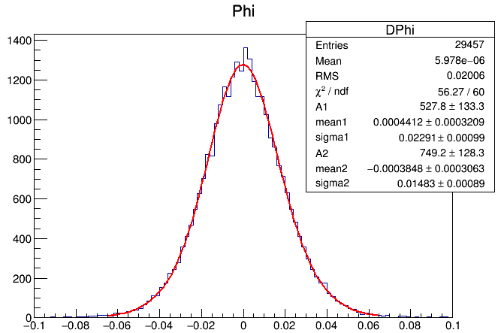
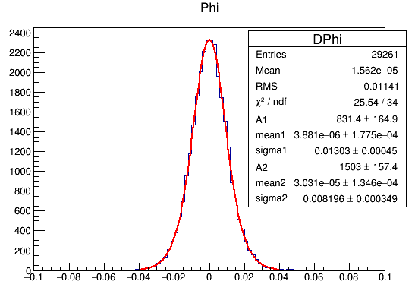
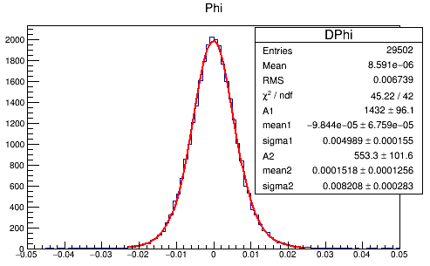
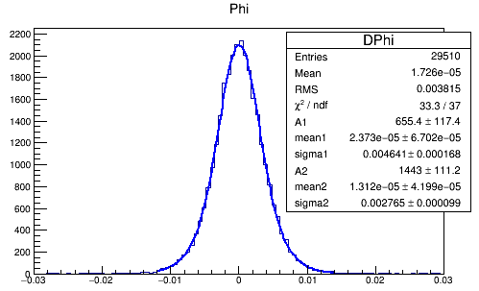
Electrons – φ Position – fit with double gaussian
5 GeV
10 GeV
20 GeV
50 GeV
11

Slide 12
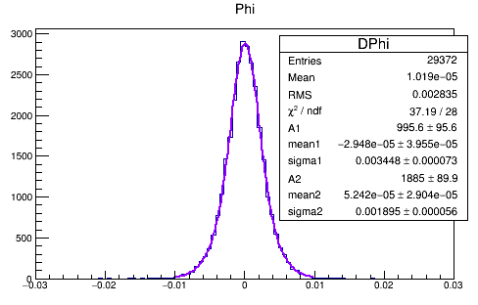
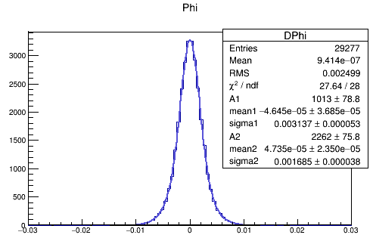
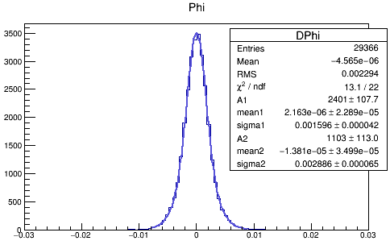
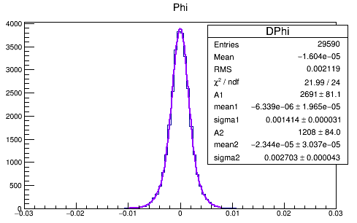
Electrons – φ Position – fit with double gaussian
100 GeV
150 GeV
200 GeV
300 GeV
12

Slide 13
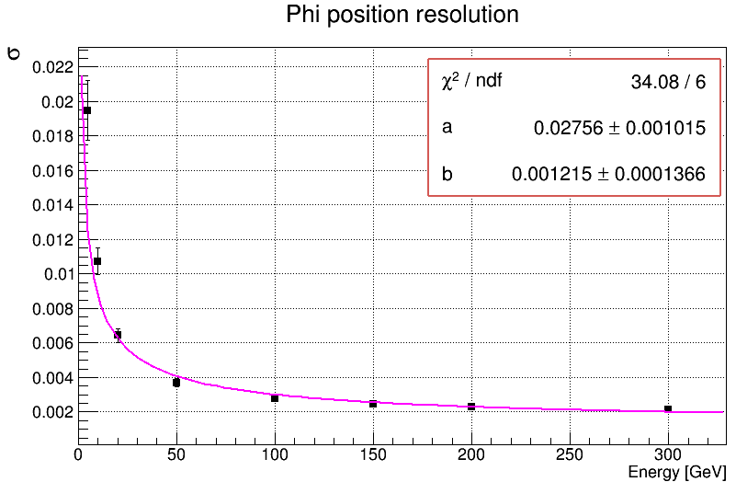
Electrons – φ Position Resolution
a= (2.75 ± 0.001) %
b= (0.12 ± 0.0001) %
13

Slide 14
Pions Analysis
Reconstruction of energy in Fcal .
Cut of Eta between 3.5 & 4.1 .
Cluster energy with a radius of 16cm fitted by double gaussian .
Energy resolution.
Position resolution.
14

Slide 15
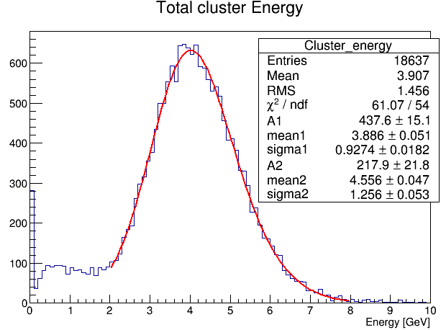
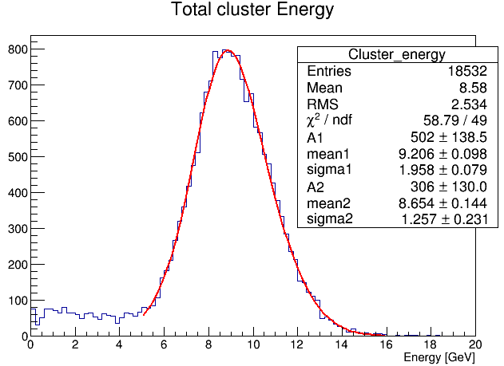
Pions – Reconstruction of energy
Total cluster energy in FCal with a radius of 16cm .
Fit with Double gaussian.
5 GeV
10 GeV
15

Slide 16
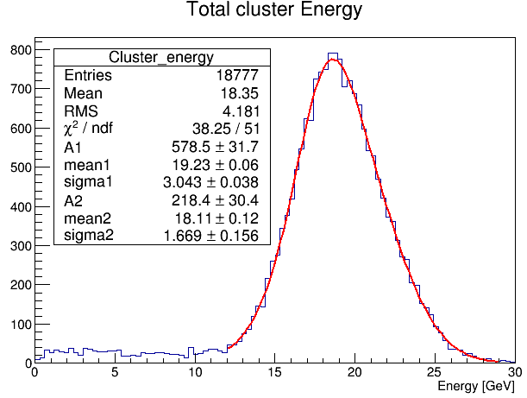
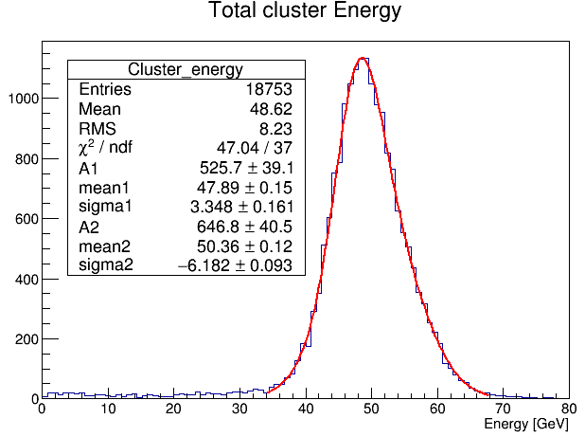
Pions – Reconstruction of energy
Total cluster energy in FCal with a radius of 16cm .
Fit with Double gaussian.
20 GeV
50 GeV
16

Slide 17
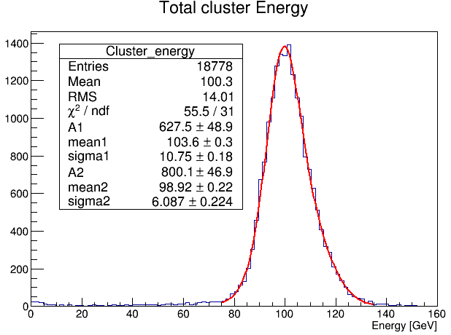
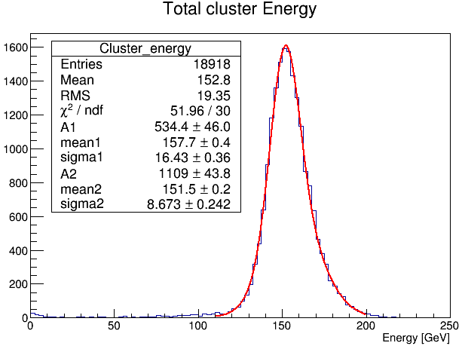
Pions – Reconstruction of energy
Total cluster energy in FCal with a radius of 16cm .
Fit with Double gaussian.
100 GeV
150 GeV
17

Slide 18
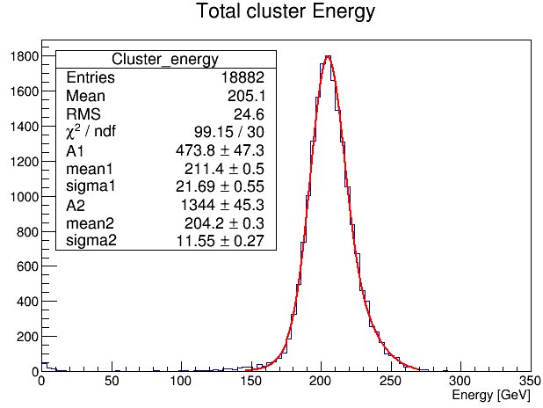
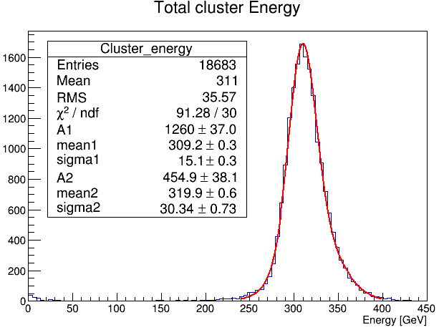
Pions – Reconstruction of energy
Total cluster energy in FCal with a radius of 16cm .
Fit with Double gaussian.
200 GeV
300 GeV
18

Slide 19
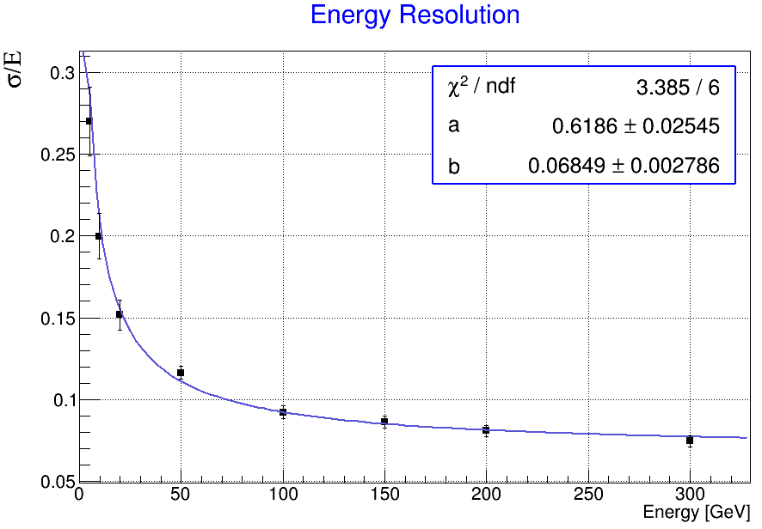

Pions – Resolution of energy
a= (61.86 ± 0.02) %$√GeV$
b= (6.8 ± 0.002) %
19

Slide 20
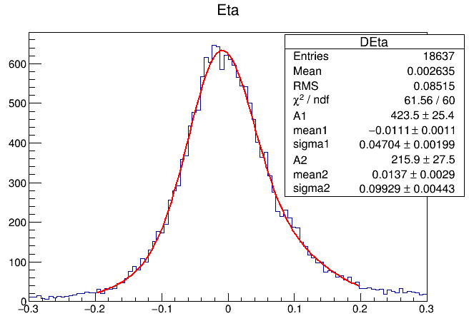
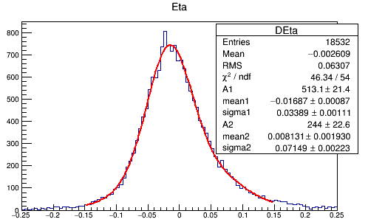
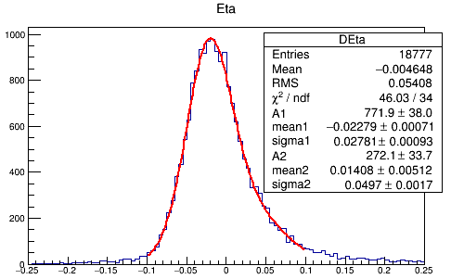
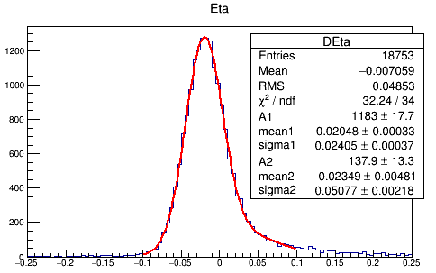
Pions – η Position – fit with double gaussian
5 GeV
10 GeV
20 GeV
50 GeV
20

Slide 21
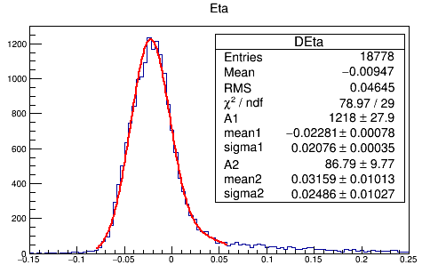
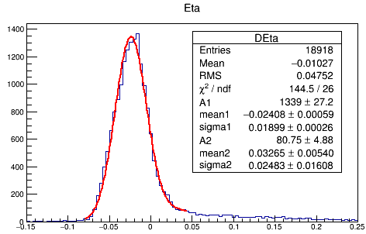
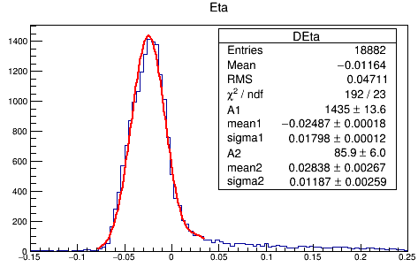
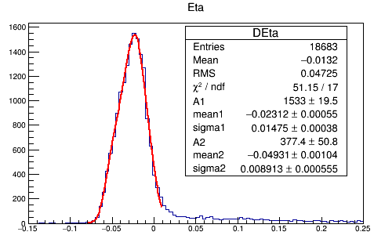
Pions – η Position – fit with double gaussian
100 Gev
150 Gev
200 Gev
300 Gev
21

Slide 22
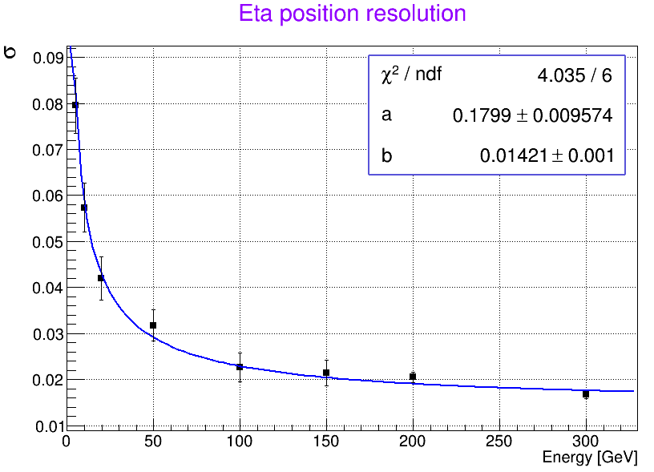

Pions – η Position Resolution
a= (18 ± 0.009) %$√GeV$
b= (1.4 ± 0.001) %
22

Slide 23
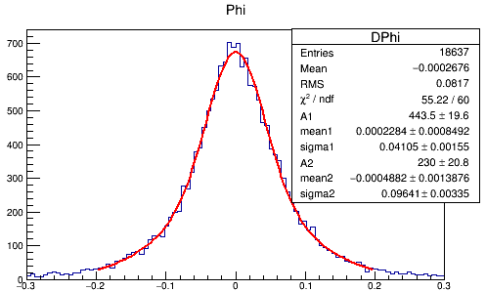
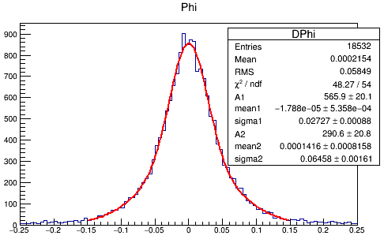
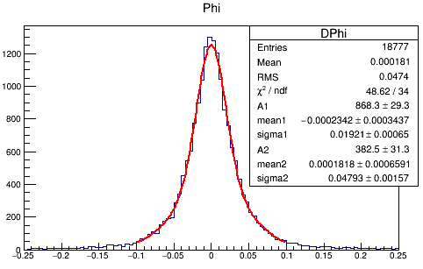
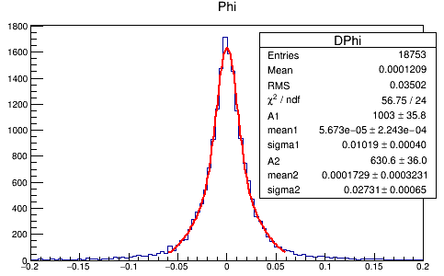
Pions – φ Position – fit with double gaussian
5 GeV
10 GeV
20 GeV
50 GeV
23

Slide 24
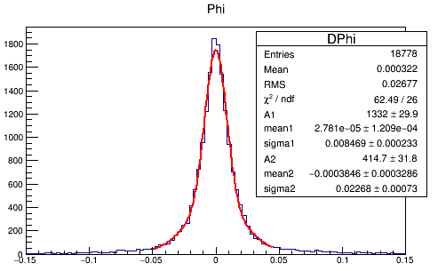



Pions – φ Position – fit with double gaussian
100 GeV
150 GeV
200 GeV
300 GeV
24

Slide 25

Pions – φ Position Resolution
a= (16.17 ± 0.004) %
b= (0.3 ± 0.001) %
25

Slide 26

Calcul of resolution error
$$d \left(\frac{σ}{μ}\right)= \frac{dσ}{2σμ}+\frac{dμ }{σμ}$$
26

Slide 27




27

Slide 28








28

Slide 29










Example of 200 GeV electron
$A_{1}=$ 1000
$A_{2}=$ 2000
$µ_{1}=$ 200
$µ_{2}=$ 200
d$σ=$ 11.4
&
d$μ=$ 0.47
$$σ_{1}=12$$
$$σ_{2}=8$$
Value of resolution error
29

