Slide 1
PACMAN Workshop, June 2016
Error sources in dimensional metrology
Ben Hughes , NPL, UK
Welcome to the National Physical Laboratory

Slide 2
Outline
Dimensional metrology
The Metrology Loop
Error sources and mitigation

Slide 3
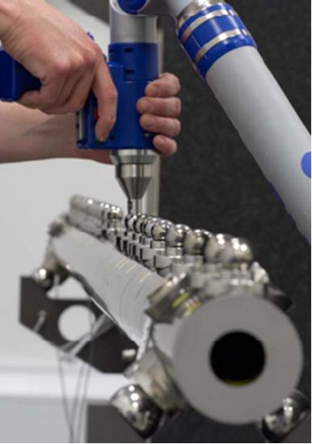
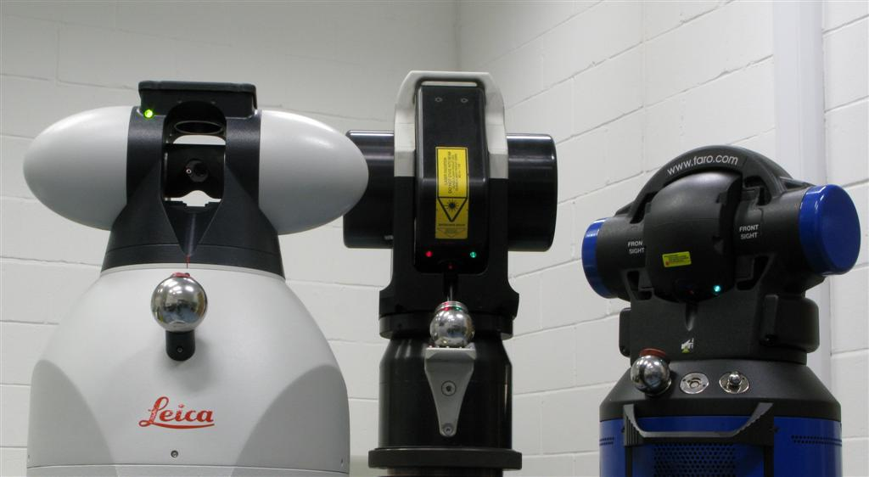
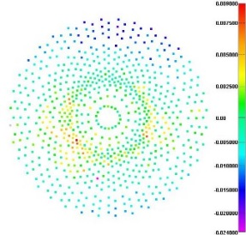
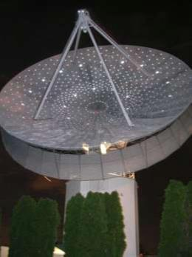
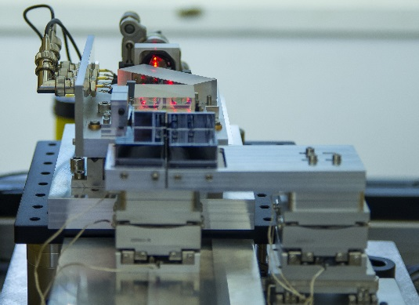
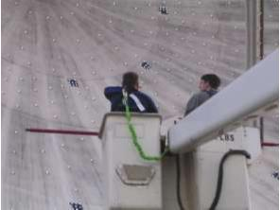

Dimensional Metrology
1D, 2D and 3D
Contact or Non-contact
Range based, angle based or a combination of both
Scales from pm to …

Slide 4
The Metrology Loop
A metrology loop is the closed path containing all elements between the sensor and the part that affect the measurement.
Often the metrology loop has elements in common with the structural or force loop.
Changes in the metrology loop due to, for example, temperature change, vibration or structural forces, are indistinguishable from changes in the dimension being measured.

Slide 5
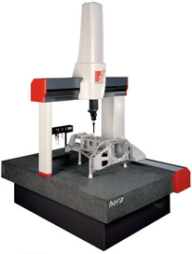

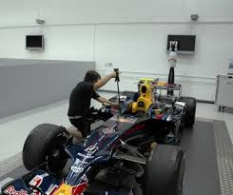
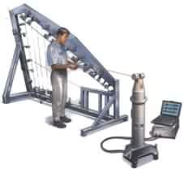
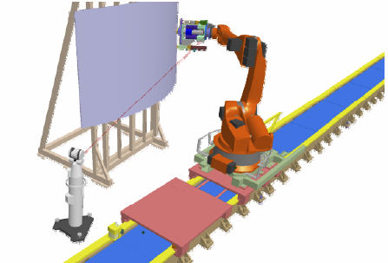
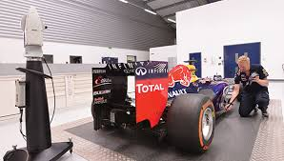
The Metrology Loop

Slide 6
Error Sources and Mitigation
Thermal
Refraction & Refractive index gradient
Mechanical errors
Geometric errors

Slide 7
Error Sources and Mitigation
Thermal effects
  One of the biggest potential sources of error in dimensional metrology!
  ISO 1: “The standard reference temperature for geometrical product specification is fixed at 20 °C”
  Dimensions measured at T ≠ 20 °C must be corrected
    L₂₀ = L_{T}[1 - α(T-20)]
        α is coefficient of thermal expansion
        e.g. α_{steel} = 12×10⁻⁶ K⁻¹, α_{aluminium} = 23×10⁻⁶ K⁻¹
  Thermal expansion affects the instrument too
    Distorts the metrology loop

Slide 8
Error Sources and Mitigation
Thermal effects continued
  Mitigation
    Use low CTE materials for critical parts of the metrology loop e.g. Invar or Zerodur
    Minimise uncertainty in thermal expansion correction by controlling temperature close to 20 °C
      Active environmental control
      Local insulation
      Avoid handling parts
      Allow time for thermal stabilisation

Slide 9
Error Sources and Mitigation
Refractive index
  Affects optical length measurements e.g. interferometers
  Refractive index, n, determines speed of light in a medium, c’. So distances measured in terms of the speed of light must be corrected.
    c’ = c₀/n c₀ = speed of light in vacuum
  n at standard temperature and pressure ~ 1.00027
  dn/dT ~ -1×10⁻⁶ K⁻¹
  dn/dP ~ 2.7×10⁻⁷ hPa⁻¹
  Can calculate n from air temperature and pressure readings using e.g. Edlen’s formula

Slide 10
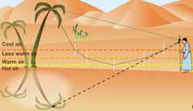
Error Sources and Mitigation
Refractive index gradient
  Gradient normal to direction of propagation of a beam bends the beam
  This is how a mirage is formed!
  Affects optical angle measurements e.g. laser tracker

Slide 11
Error Sources and Mitigation
Mechanical - Stiffness of metrology loop
  Instrument e.g. CMM structure
  Instrument support e.g. laser tracker tripod
  Part support/clamping
  Isolate force loop from metrology loop

Slide 12
Error Sources and Mitigation
Mechanical - Vibration induced the metrology loop
    Eliminate/isolate source
    Isolate metrology loop
    Stiffen structure – high resonant frequency
    Also air movement in optical metrology systems

Slide 13
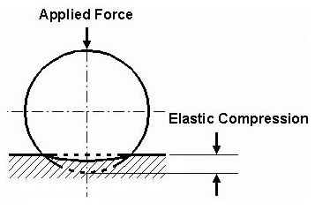
Error Sources and Mitigation
Mechanical – elastic compression
  Occurs whenever mechanical probing takes place
  Depends on contact force
  Geometry of component (e.g. flat, sphere, cylinder)
  Component and probe materials
  Type of contact (e.g. point, line)
  http://emtoolbox.nist.gov/Main/Main.asp
Compression corrections for tungsten carbide spheres between flat steel anvils for various forces
NPL GPG 80

Slide 14
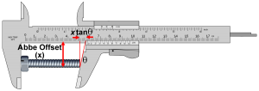
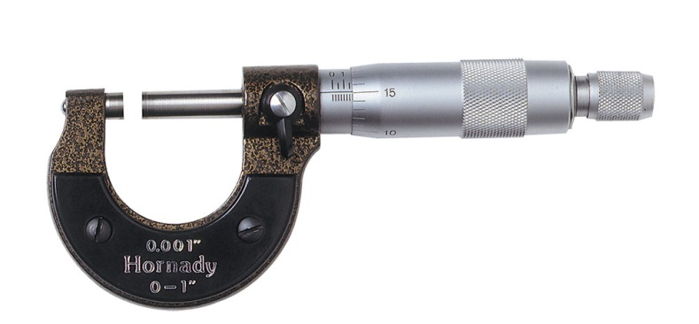
Error Sources and Mitigation
Alignment - Abbe error
  Measurement scale is not in line with the object being measured – Abbe offset, x.
  Straightness of axis or sloppy fit of calliper causes angle between jaws, θ.
  Eliminate by aligning scale coaxially with part, or compensate my measuring x and θ.
Images from www.muelaner.com

Slide 15
Error Sources and Mitigation
Alignment - Cosine error
  Angular misalignment, θ, between scale, or axis, and part.
  Length error, ΔL = L(1 - cosθ ).
  Minimise by minimising θ.

Slide 16
Error Sources and Mitigation
Alignment – Sine error
  Occurs in angle-based coordinate metrology due to angle measurement error, δφ.
  Error proportional to range, r.
  Reduce coordinate error by reducing δφ and/or r.
  Eliminate by measuring coordinates in terms of range only.

Slide 17
Conclusion
There are many sources of error in dimensional metrology
Careful control of the metrology loop can help minimise or eliminate many sources of error

Slide 18
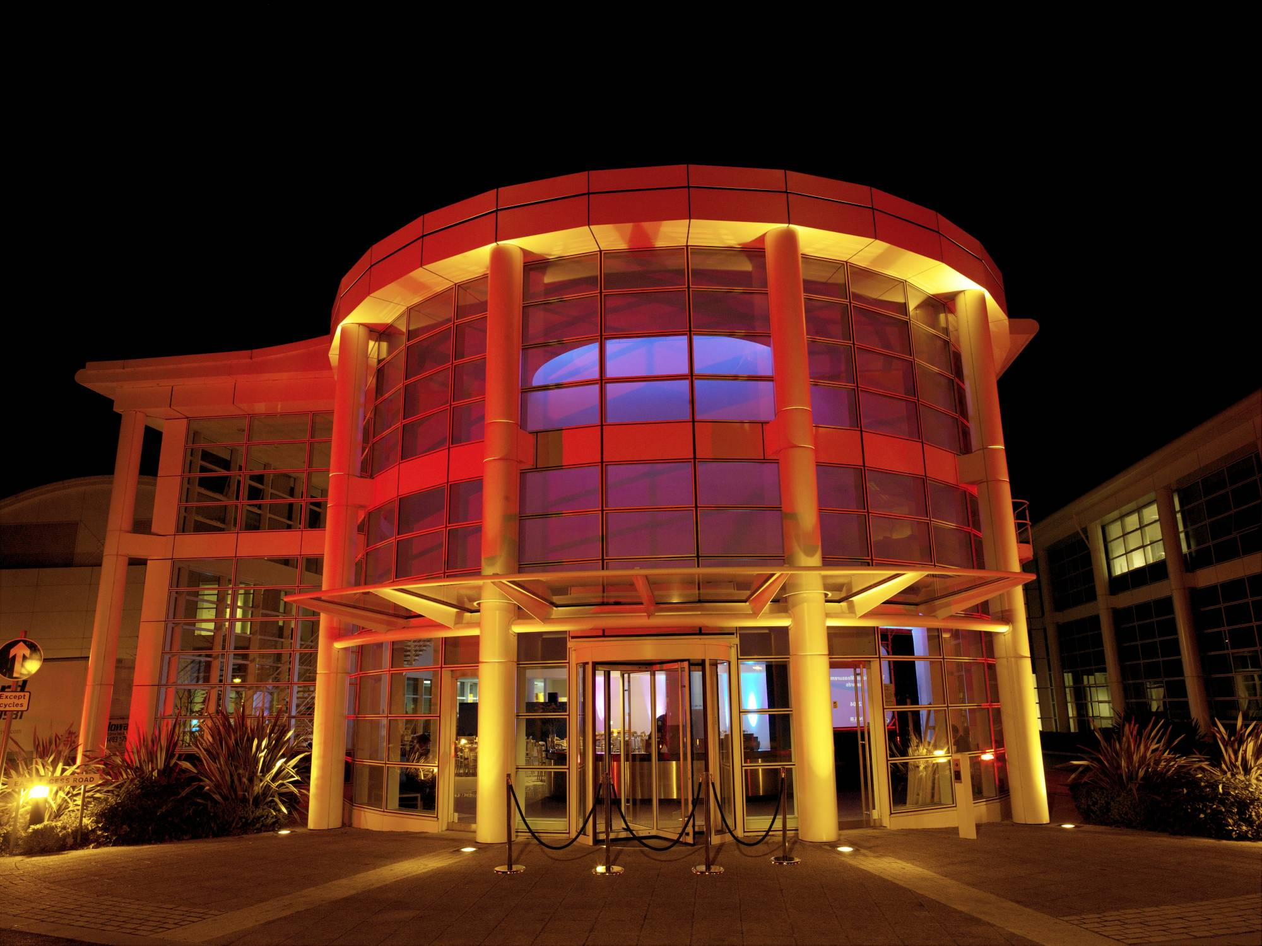

THANK YOU
                Ben Hughes
                Principal Research Scientist
                ben.hughes@npl.co.uk
                020 8943 6124

