Slide 1
ELENA Installation follow-up
02/04/2015
Worksite follow-up

Slide 2
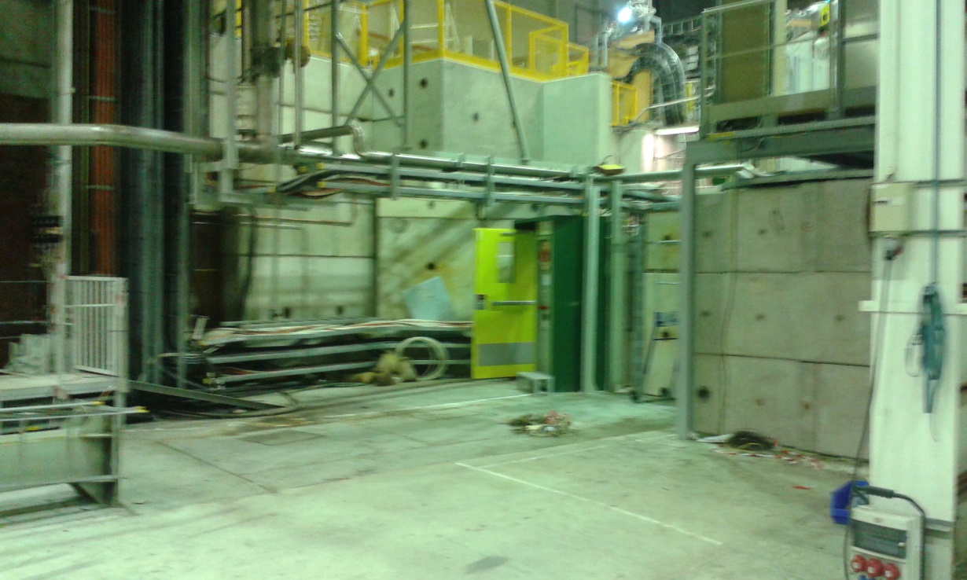
Worksite follow-up
CV Works :
  Installation of cooling pipes from b.393 finished
  Installation of the support for the cable tray finished
GS Works :
  Dismantling of the kickers platform complete
  Dismantling of the false floor complete

Slide 3
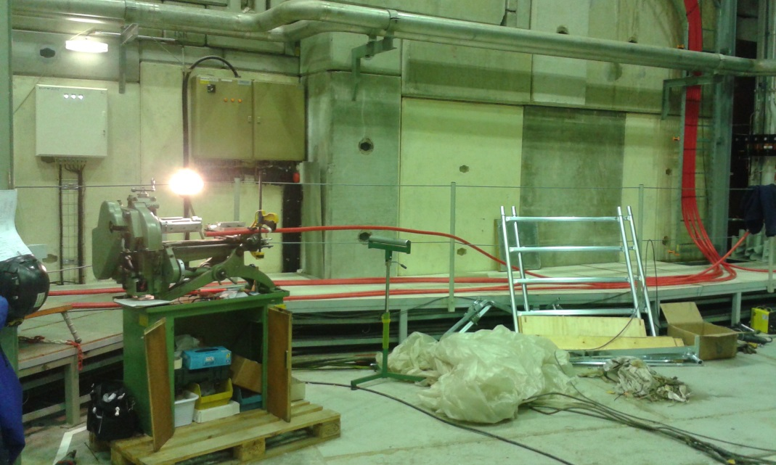
Worksite follow-up
TE-ABT works (b.193):
  Cable pulling on-going (warning on the routing of the cables)

Slide 4
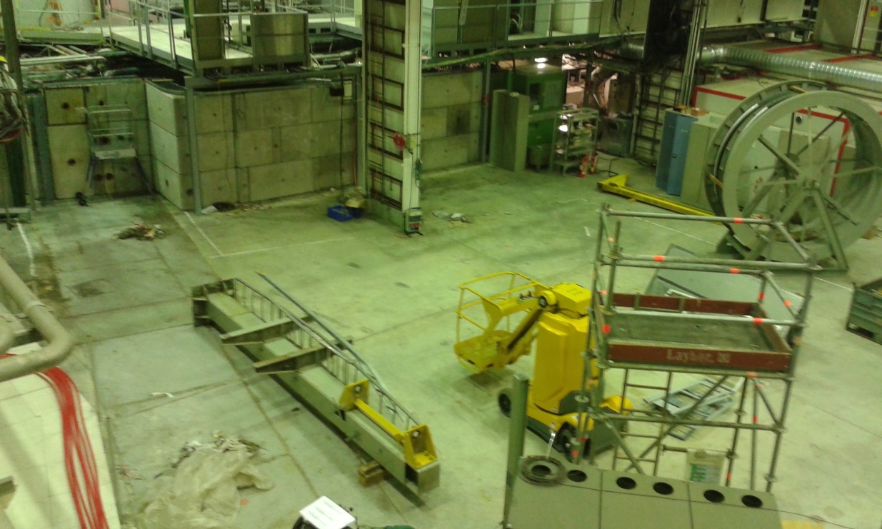
Worksite follow-up
General cleaning of the area :

Slide 5
Worksite follow-up
Updated planning for the week 14:
  Completion of CV works on Friday (F. Moro)
  Dismantling of kicker platform and false floor from Monday to Wednesday (D. Parchet)
  Cleaning of the area finished on Wednesday (E. Harrouch)
  Start of the survey work on Thursday (T. Dobers)

Slide 6
Worksite follow-up
Updated planning for the week 15:
  Installation of the lateral false floor (D. Parchet)
  Survey marking of the 6 dipoles and the centre to be done before Wednesday 8/04 (T. Dobers)
  Installation of the hexagonal false floor (D. Parchet)
  CV works for the source reception (F. Moro/B. Lefort)

Slide 7
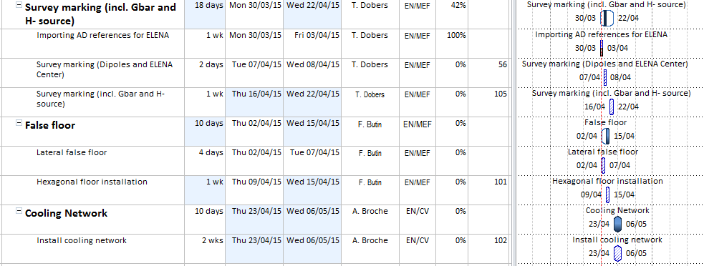
Planning proposal for the coming weeks

