Slide 1
FCC-ee IR magnet design: first steps
M. Koratzinos
Other FCC Magnets meeting 09,
11/11/2015

Slide 2
Purpose
I will try to state the problem
Indicate steps already made
Discuss future steps
Many thanks to:
Glyn Kirby and Jeroen Van Nugteren of TE-MSC for fruitful discussions and the use of tools (Field 2015)
Shlomo Caspi for an introduction to CCT magnets

Slide 3
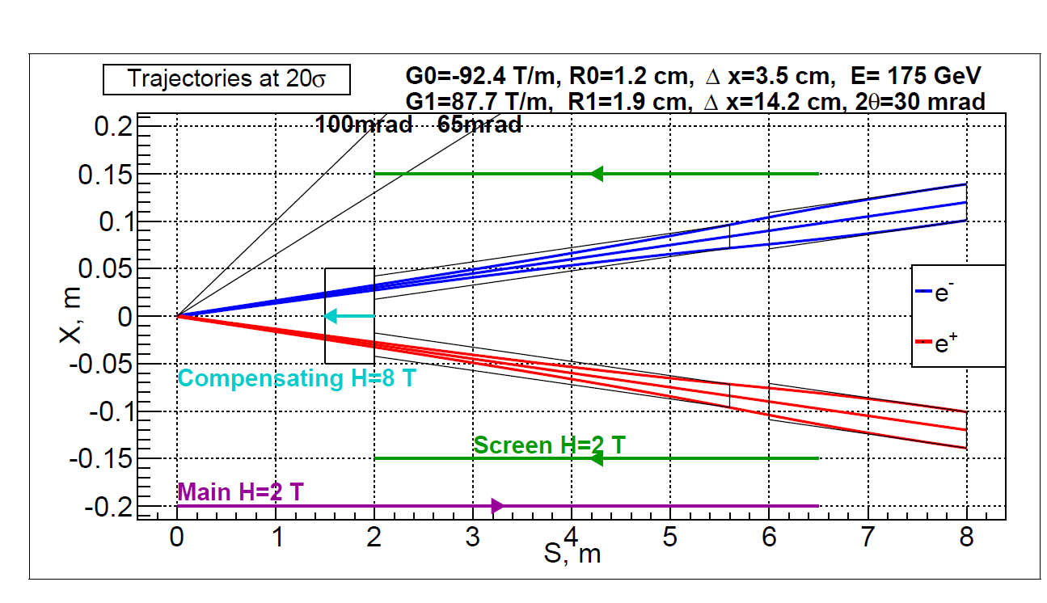
The IR region of a typical FCC-ee experiment
Final quads
Main detector solenoid
Quad screening solenoid
Compensating solenoid
An artist’s impression of the forward region around the IP

Slide 4
Objectives
Objective no. 1: the vertical emittance blow up should be as small as possible
Objective no.2: the crosstalk between final focus quads should be minimised
Constraints: stick to the 100mrad cone
(for all that follows, I am using the Field2015 program – thanks, Jeroen. Calculations are done in Excel)

Slide 5
Emittance blow up
The beams arrive at an angle (+- 15mrad)
The detector solenoid is strong and rather long
We need to shield the beams as much as possible from the solenoid field of the detector.
What we cannot shield we need to ‘undo’ by ensuring that the field integral seen by the beam is zero
There is a resulting vertical emittance blow up due to this; the value should be small compared to our emittance budget
Vertical emittance budget: ~1pm

Slide 6
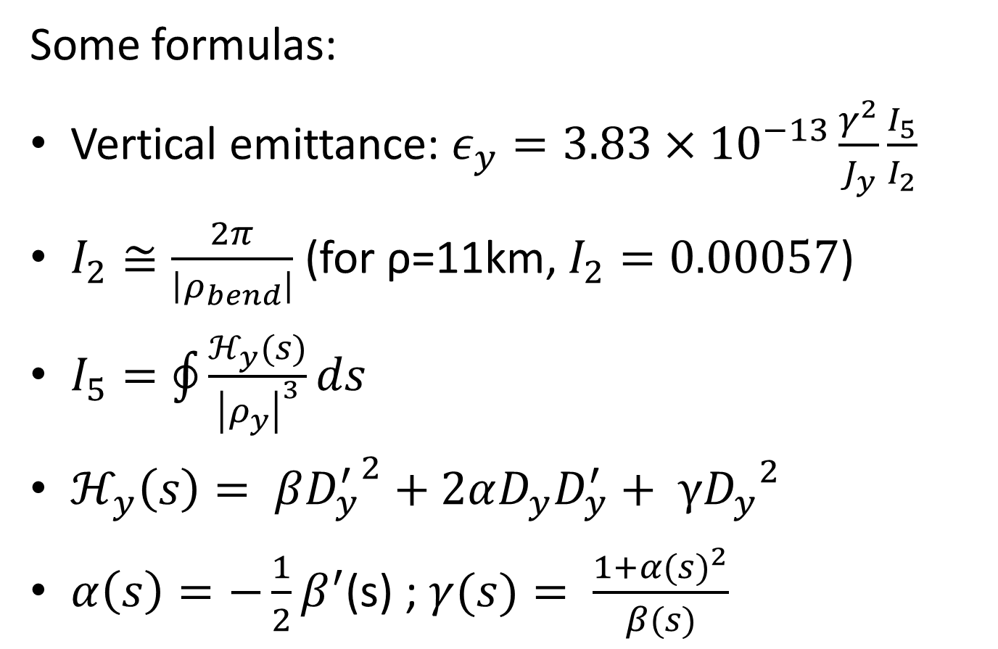
Emittance blow up
More important at low energies!
Some formulas:
Vertical emittance: $ε_{y}=3.83×{10}^{−13}\frac{γ^{2}}{J_{y}}\frac{I_{5}}{I_{2}}$
$I_{2}≅\frac{2π}{\left|ρ_{bend}\right|}$ (for ρ=11km, $I_{2}=0.00057$)
$I_{5}=\oint{\frac{ℋ_{y}(s)}{{\left|ρ_{y}\right|}^{3}}ds}$
$ℋ_{y}\left(s\right)= β{D_{y}^{′}}^{2}+2αD_{y}D_{y}^{′}+ γ{D_{y}}^{2}$
$α\left(s\right)=−\frac{1}{2}β^{′}$(s) ; $γ(s)= \frac{1+{α(s)}^{2}}{β(s)}$

Slide 7
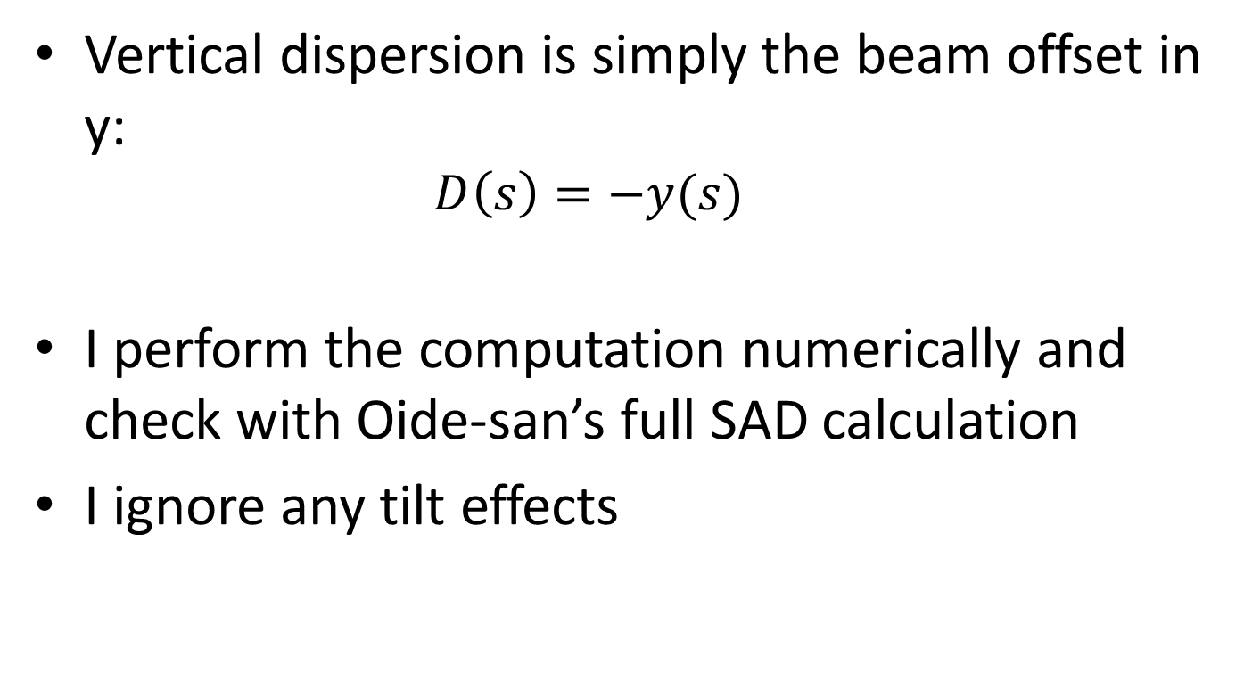
Calculation of dispersion
Vertical dispersion is simply the beam offset in y:
  $$D\left(s\right)=−y(s)$$
I perform the computation numerically and check with Oide-san’s full SAD calculation
I ignore any tilt effects

Slide 8
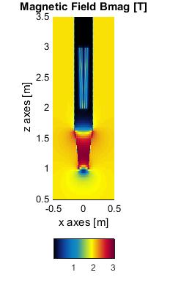
Shielding solenoids
Two screening solenoids are used: a long -2T solenoid, ensuring zero field where the quads are, and a -4T tapered but short (65cm) solenoid, ensuring that the overall field seen by electrons is zero
Other schemes were used, but the one on the left gave the best results: emittance blow up due to two such IPs in the ring of 0.11pm
The tapered solenoid improves the emittance blow up by a factor ~2

Slide 9
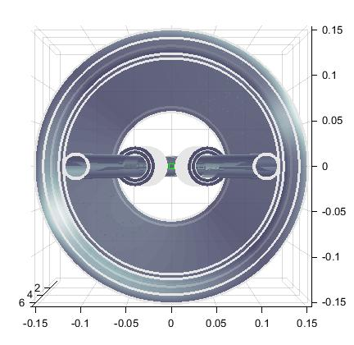
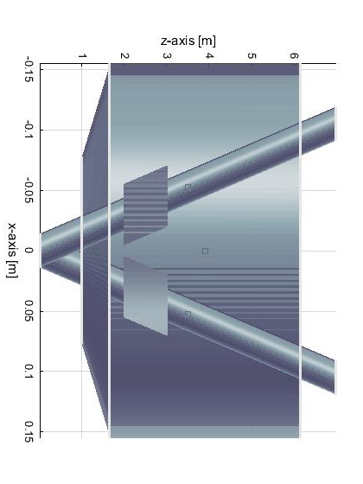
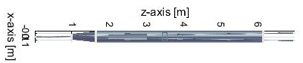
The layout
True proportions view

Slide 10
Note on the layout
Ensuring a minimal emittance blow up is not an easy task: one needs to minimize the edge effects, so the bigger the solenoid, the better. But one needs to respect the 100mrad cone.
Further optimization is possible.
The existence of a stand alone tool (Field2015 + calculations in excel) allowed for fast progress compared to MAD

Slide 11
Bx and Bz components
Emittance is increased by two components of the field:
Bz*sin(theta) and
Bx (due to edge effects)
Out of the two contributions, the second one is more important
e⁻

Slide 12
Magnetic field
Z and X components of the overall field long the path of the electrons
Field components perpendicular to direction of motion of electrons (giving y kick)

Slide 13
α,β,γ, D, D’ close to the IP

Slide 14

Curly H
$$ℋ_{y}\left(s\right)= β{D_{y}^{′}}^{2}+2αD_{y}D_{y}^{′}+ γ{D_{y}}^{2}$$
At ~1m, H is small, maximum at ~1.6m

Slide 15
Components of I5
Edge at ~1m dominates

Slide 16
Emittance blow up
The result is for two IPs. It has been verified by K. Oide and his code who gets a total value of 0.11pm

Slide 17
First estimation of forces&twists
Name | x [m] | y [m] | z [m] | Fmag [N] | Tmag [N/m]
anti_solenoid | 0 | 0 | 3.9 | 2.0E+05 | 1.7E+04
beampipe | 0.0525 | 0 | 3.5 | 0.0E+00 | 0.0E+00
anti_sol_4T | 0 | 0 | 1.325 | 2.0E+05 | 5.3E+02
beampipe_2 | -0.0525 | 0 | 3.5 | 0.0E+00 | 0.0E+00
nested coil - 1_left | -0.0375 | 0 | 2.5 | 1.6E+03 | 5.8E+02
nested coil - 2_left | -0.0375 | 0 | 2.5 | 3.3E+03 | 1.2E+03
nested coil - 1_right | 0.0375 | 0 | 2.5 | 1.6E+03 | 5.8E+02
nested coil - 2_right | 0.0375 | 0 | 2.5 | 3.3E+03 | 1.2E+03
Left quad
Right quad

Slide 18
Estimation of inductances
 | Anti solenoid | beampipe | Anti solenoid 4T | beampipe_2 | nested coil - 1_left | nested coil - 2_left | nested coil - 1_right | nested coil - 2_right
Anti solenoid | 2.13E+01 | 0.00E+00 | 1.23E+00 | 0.00E+00 | -1.79E-01 | 3.27E-01 | -1.90E-01 | 3.42E-01
beampipe | 0.00E+00 | 0.00E+00 | 0.00E+00 | 0.00E+00 | 0.00E+00 | 0.00E+00 | 0.00E+00 | 0.00E+00
Anti solenoid 4T | 1.23E+00 | 0.00E+00 | 6.73E+01 | 0.00E+00 | -4.78E-03 | 8.73E-03 | -5.07E-03 | 9.12E-03
Beampipe 2 | 0.00E+00 | 0.00E+00 | 0.00E+00 | 0.00E+00 | 0.00E+00 | 0.00E+00 | 0.00E+00 | 0.00E+00
nested coil - 1_left | -1.79E-01 | 0.00E+00 | -4.78E-03 | 0.00E+00 | 4.85E-01 | -2.19E-01 | 2.25E-03 | 3.40E-03
nested coil - 2_left | 3.27E-01 | 0.00E+00 | 8.73E-03 | 0.00E+00 | -2.19E-01 | 9.06E-01 | 3.45E-03 | 6.16E-03
nested coil - 1_right | -1.90E-01 | 0.00E+00 | -5.07E-03 | 0.00E+00 | 2.25E-03 | 3.45E-03 | 5.03E-01 | -2.31E-01
nested coil - 2_right | 3.42E-01 | 0.00E+00 | 9.12E-03 | 0.00E+00 | 3.40E-03 | 6.16E-03 | -2.31E-01 | 9.31E-01
Inductance Given in | mH
Stored Energy | 0.82991 MJ
Total Inductance | 93.5888 [mH]

Slide 19
Final focus quads
We need fields of 100T/m
Beam pipe is at a radius of 1.3cm (corresponding to 20 sigma horizontal)
Total quad length: 2 × 1.6m
(the inner quad can have an inner bore slightly smaller and the outer slightly bigger, but this is not a question for this moment)
For this application, a CCT approach might be appropriate

Slide 20
Advantages of CCT quads
The novel technique of helical coils (CCTs) has a number of important advantages for this application:
Good field quality
Absence of iron
Easy to manufacture
Easy to incorporate additional rings with corrector elements
Possible to design out any cross talk by changing pitch and angle of groove
Good synergies with the design of corrector magnets of FCC-ee
Fast prototyping/not labour intensive
(It is a new technique, becoming more fashionable now)

Slide 21
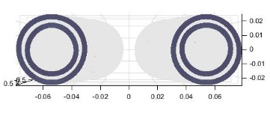
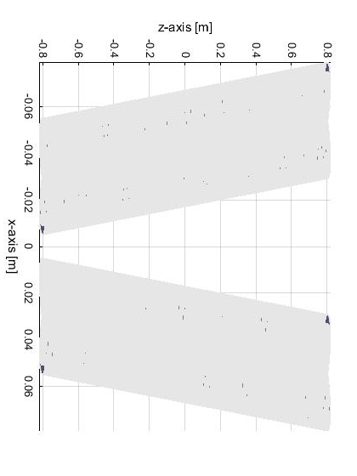
layout
1.6m long, 1.5cm inner bore

Slide 22
Field quality @2/3 aperture (1cm)
With no errors, field quality is excellent – the two edges have anti-symmetric fields. Largest component is B1 and A4
Highest component after integration is A1 with a value of 0.1 units

Slide 23
Harmonics integrals – one quad
B1 [T] | B2 [T] | B3 [T] | B4 [T] | B5 [T] | B6 [T] | B7 [T] | B8 [T] | B9 [T] | B10 [T]
2.19E-08 | -1.54E+00 | -2.31E-09 | -2.86E-07 | -4.00E-09 | -1.24E-06 | 4.22E-09 | 1.09E-08 | 1.70E-09 | 1.83E-06
A1 [T] | A2 [T] | A3 [T] | A4 [T] | A5 [T] | A6 [T] | A7 [T] | A8 [T] | A9 [T] | A10 [T]
1.27E-05 | 2.44E-08 | -1.13E-08 | 9.70E-08 | -8.80E-09 | -7.12E-08 | -5.14E-09 | -7.26E-08 | 3.49E-09 | -1.64E-08
Highest component is, curiously, A1 with 0.13 units of 10⁻⁴

Slide 24
Harmonics integrals – two quads
B1 [T] | B2 [T] | B3 [T] | B4 [T] | B5 [T] | B6 [T] | B7 [T] | B8 [T] | B9 [T] | B10 [T]
1.22E-03 | 1.56E+00 | -8.22E-05 | -1.30E-03 | 5.15E-06 | 5.79E-05 | -3.40E-07 | -1.97E-06 | 2.69E-09 | -1.80E-06
A1 [T] | A2 [T] | A3 [T] | A4 [T] | A5 [T] | A6 [T] | A7 [T] | A8 [T] | A9 [T] | A10 [T]
-5.11E-02 | 3.39E-04 | 5.59E-03 | -2.01E-05 | -2.79E-04 | 1.37E-06 | 1.11E-05 | -1.47E-07 | -3.71E-07 | 2.95E-08
Highest components are B4, A3 with ~10 -50 units of 10⁻⁴
Crosstalk should be designed out!

Slide 25
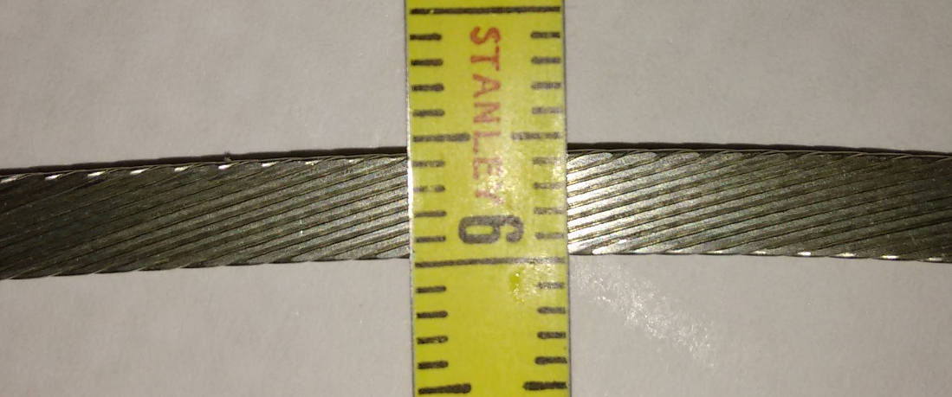
Cable/strand chosen
I arbitrarily had chosen a cable of 4 by 1 mm. a very similar cable apparently exists (Niobium-Titanium corrector magnet cable – Glyn promised to send me a full spec sheet

Slide 26
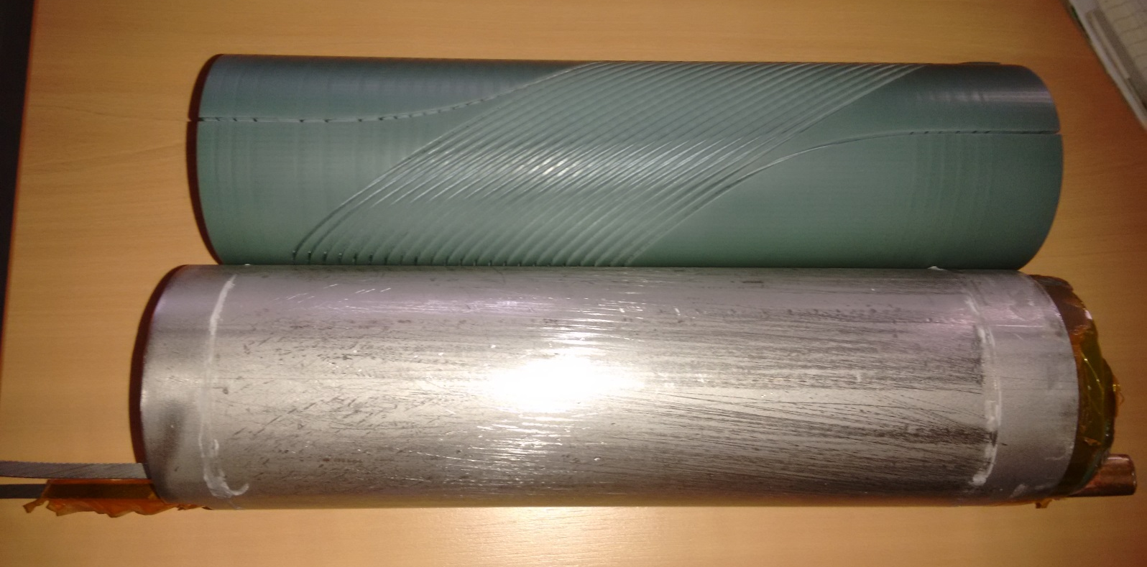
Fast prototyping
… in Glyn’s office – 3D printing and preparation ‘by hand’

Slide 27
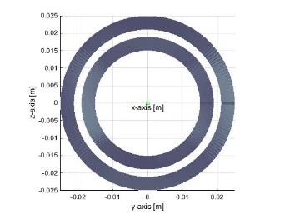
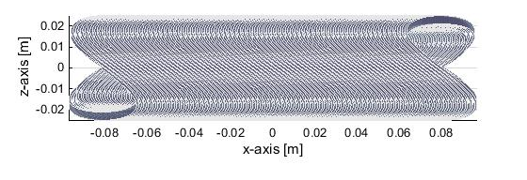
A possible prototype
Shown in blue is position of cables.
In red size of magnet. Inner bore has diameter of 2.6cm

Slide 28
Work plan
Finish work on emittance blow-up: verify, optimise, look into tapered solenoids
Start working on the CCT quadrupoles
  Understand the design
  Export to Opera / verify calculations
  Design crosstalk elimination
  If advisable, build a prototype (resources could be minimal)

