Slide 1
Field Cage Design
- Rahul Sharma

Slide 2
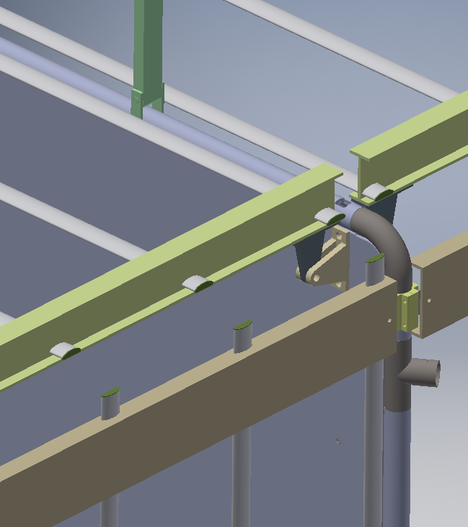
Field Cage Design CPA Side
Top I beams
CPA Hinge
Al Profiles
Side C-Channels

Slide 3
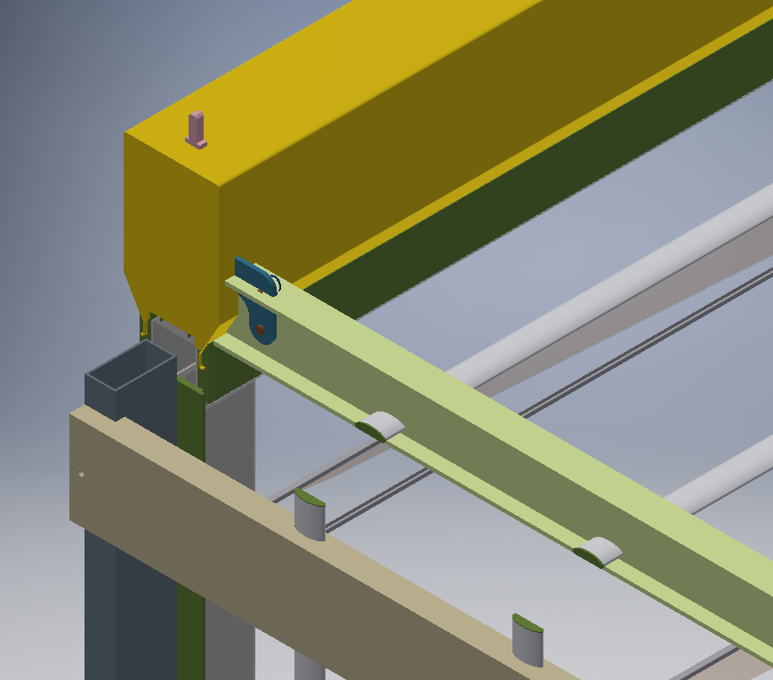
Field Cage Design APA Side
APA Bracket
APA Side Tube

Slide 4
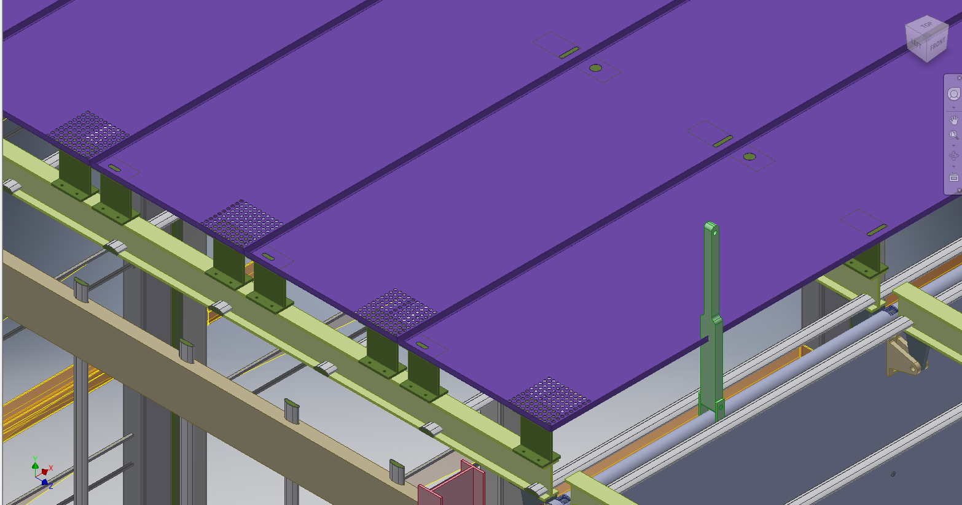
Ground Plane Integration
Ground Planes
GP Standoffs

Slide 5
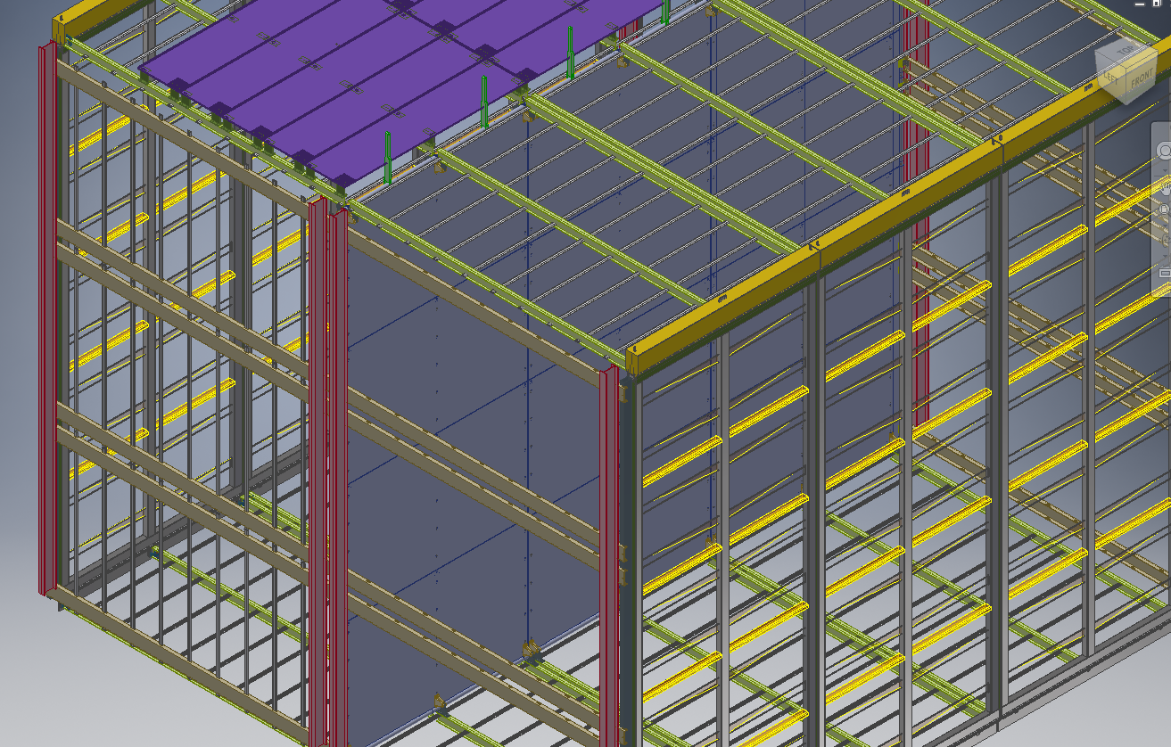
TPC & Field Cage
End Wall
Hanger
I Beams

Slide 6
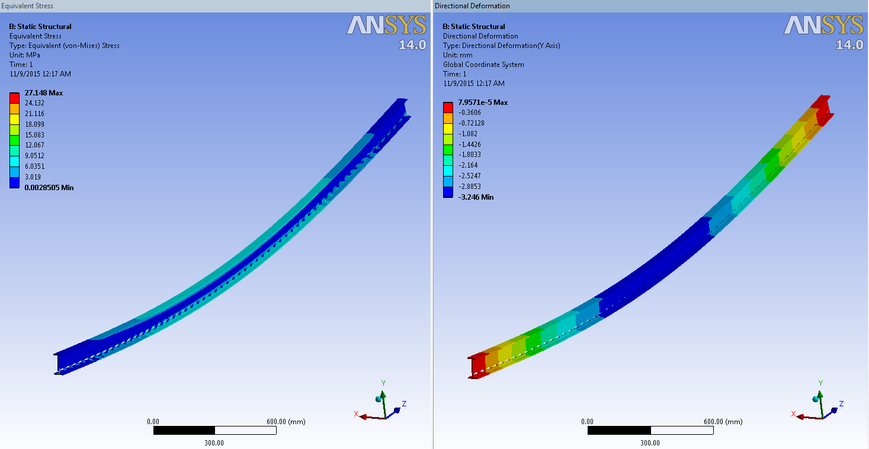
I Beam Analysis

Slide 7
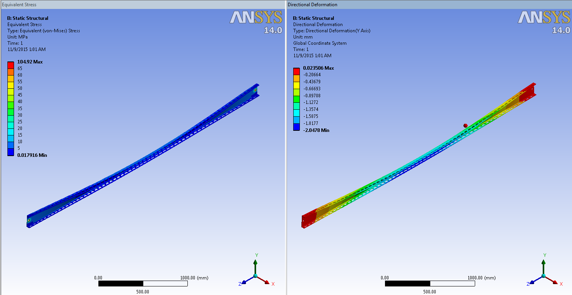
C-Channel Analysis

