Slide 1
TPC Cold Electronics and Photon Detectors Interfaces
Bo Yu
Nov. 11, 2015

Slide 2
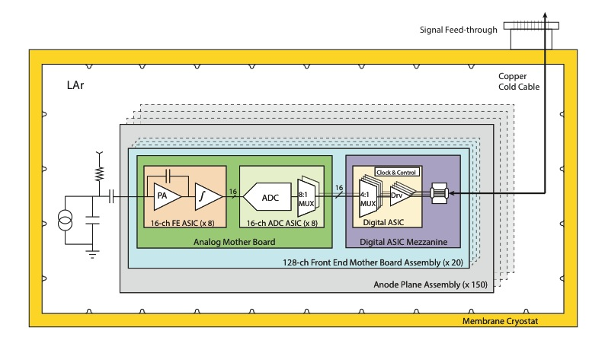
TPC Readout Electronics
1 Gb/s data link x 4

Slide 3
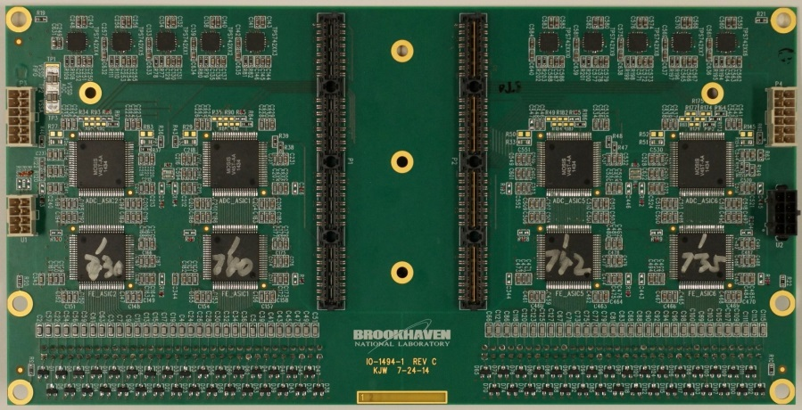
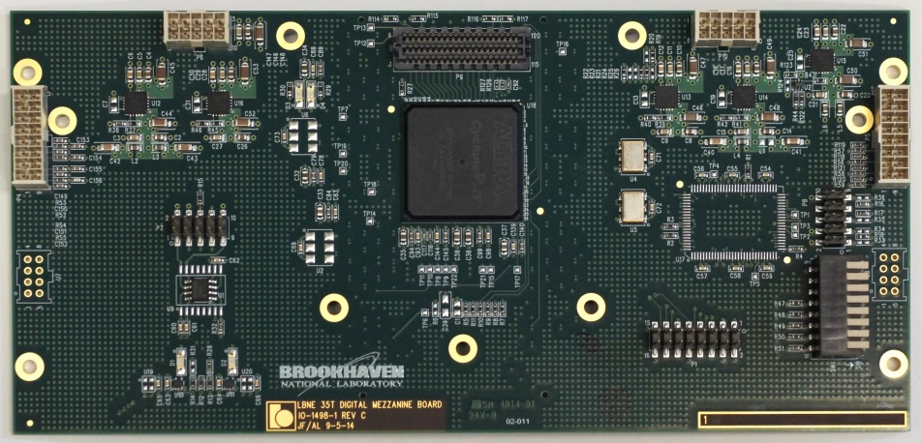
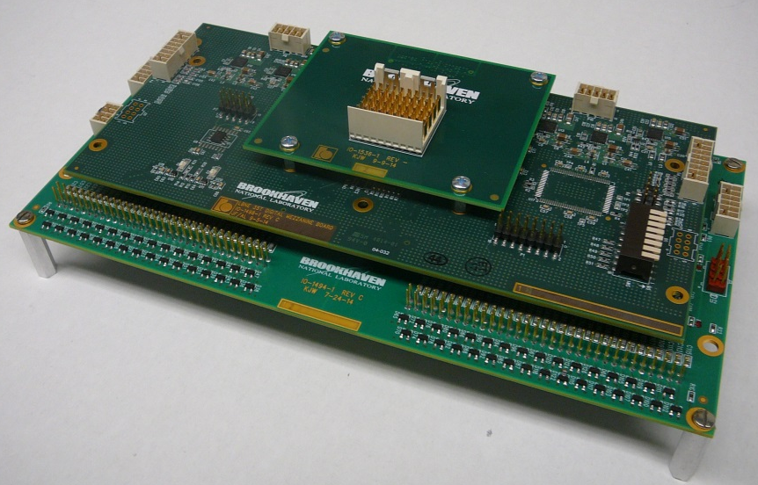
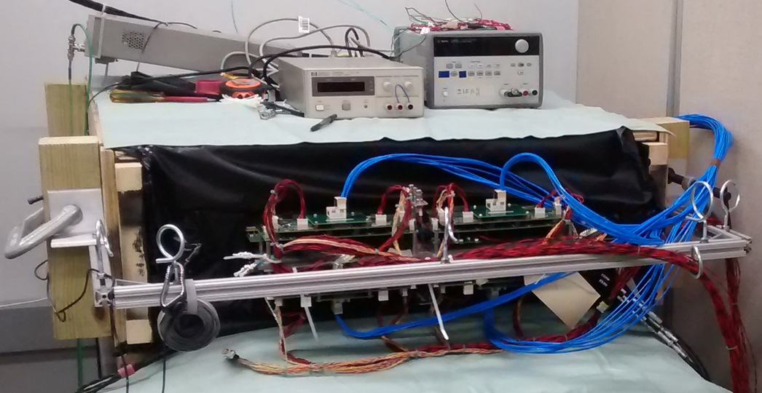
DUNE 35 Ton Cold Electronics – Basis of SBND FEMB Design
Analog Mother Board
FPGA Mezzanine
Front End Mother Board Assembly
FEMB test with APA
Details of DUNE 35t FEMB can be found in the backup slides

Slide 4
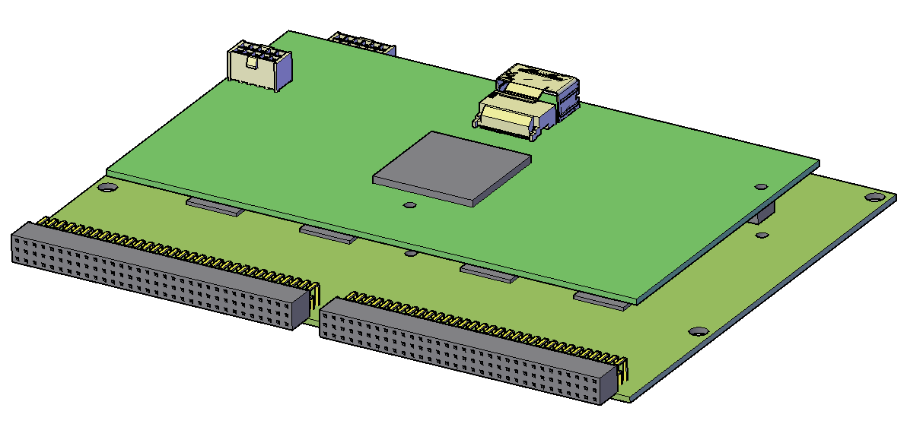
SBND Cold Electronics Boards
Width of the board: 180mm. Current DUNE APA has a 230mm board pitch.

Slide 5
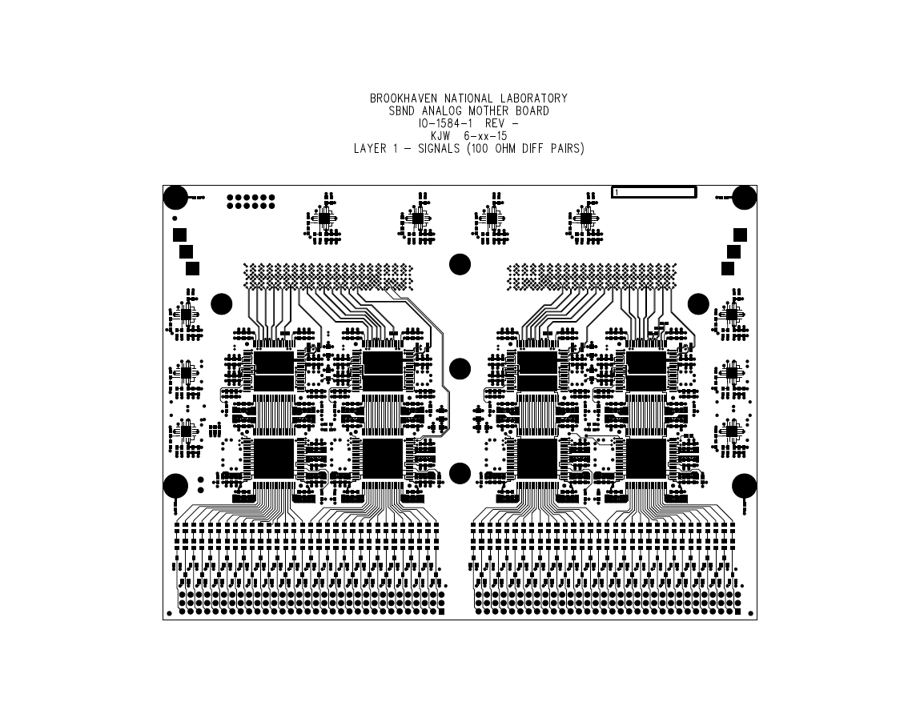
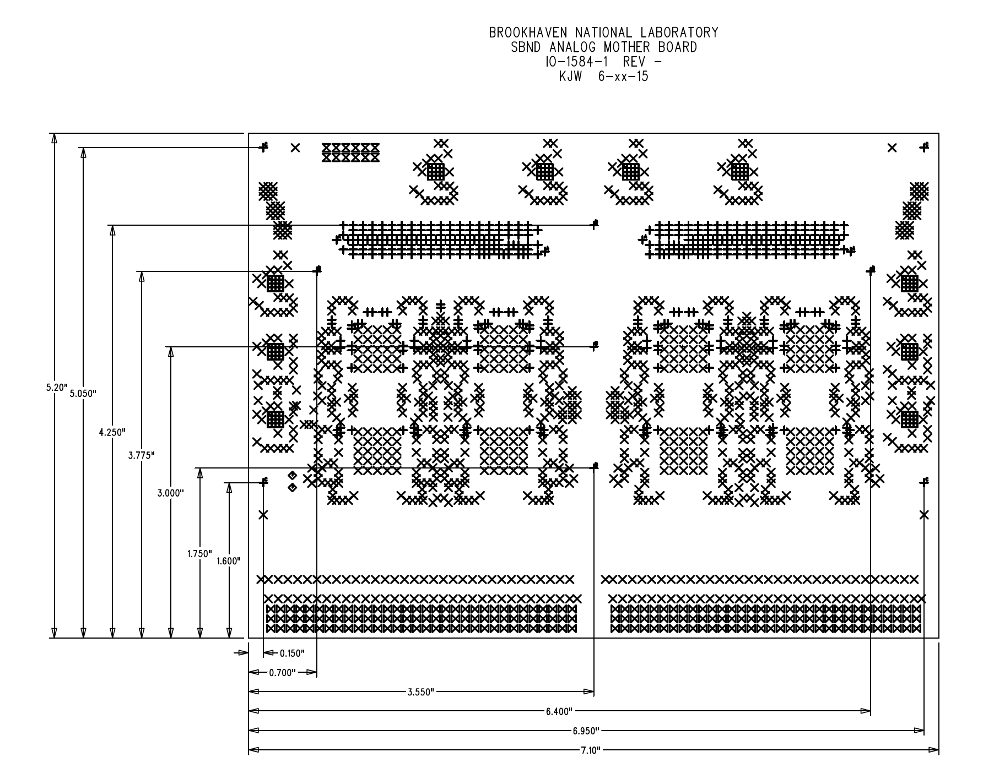
SBND FEMB Design – Analog Mother Board
Preliminary layout design of top analog mother board has been finished, to check the mechanical integrity
Board size has been defined: 7.1” x 5.2” or 180.34mm x 132.08mm

Slide 6
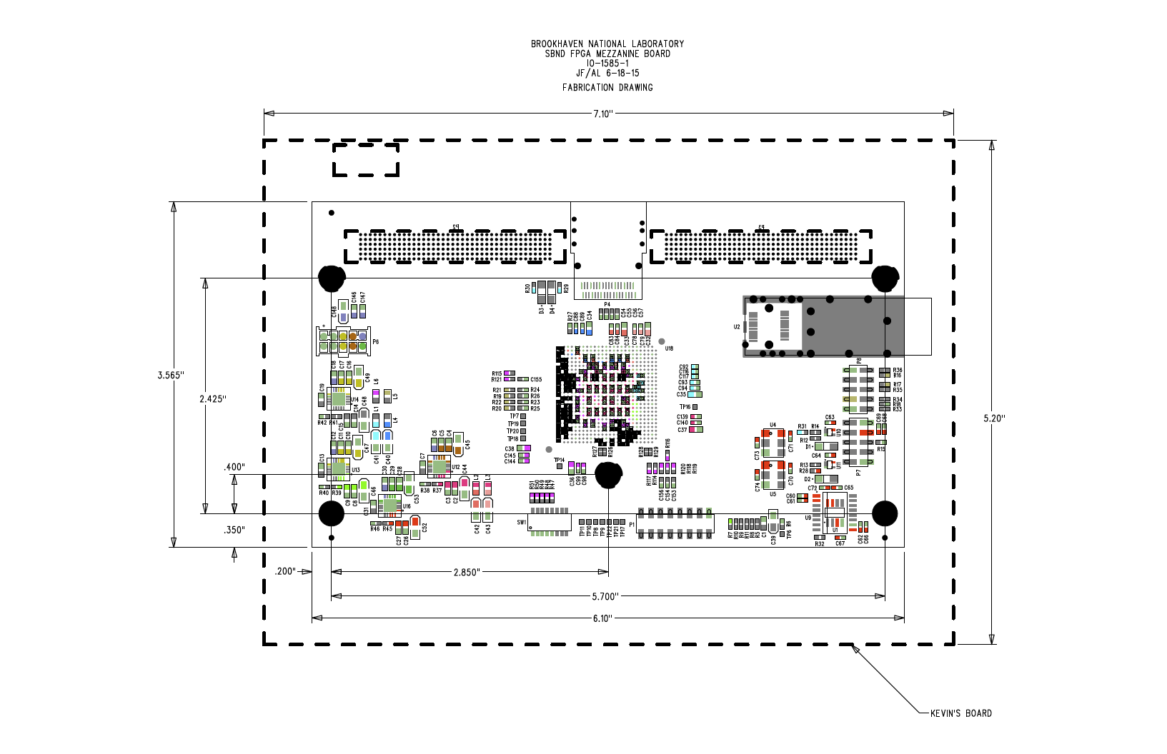
SBND FEMB Design – FPGA Mezzanine
Preliminary layout design of FPGA mezzanine has started, to check the mechanical integrity
Board size has been defined: 6.1” x 3.565” or 154.94mm x 90.55mm

Slide 7
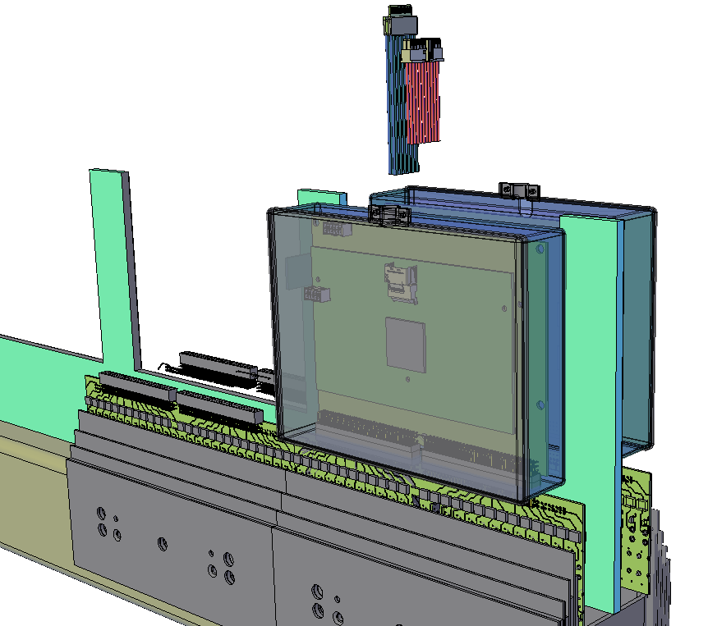
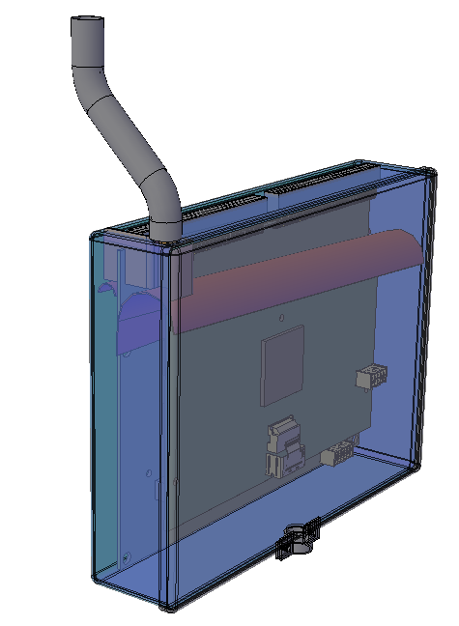
Modular Electronics Enclosure Concept
These enclosures could make bubble collection in the lower APAs more manageable.

Slide 8
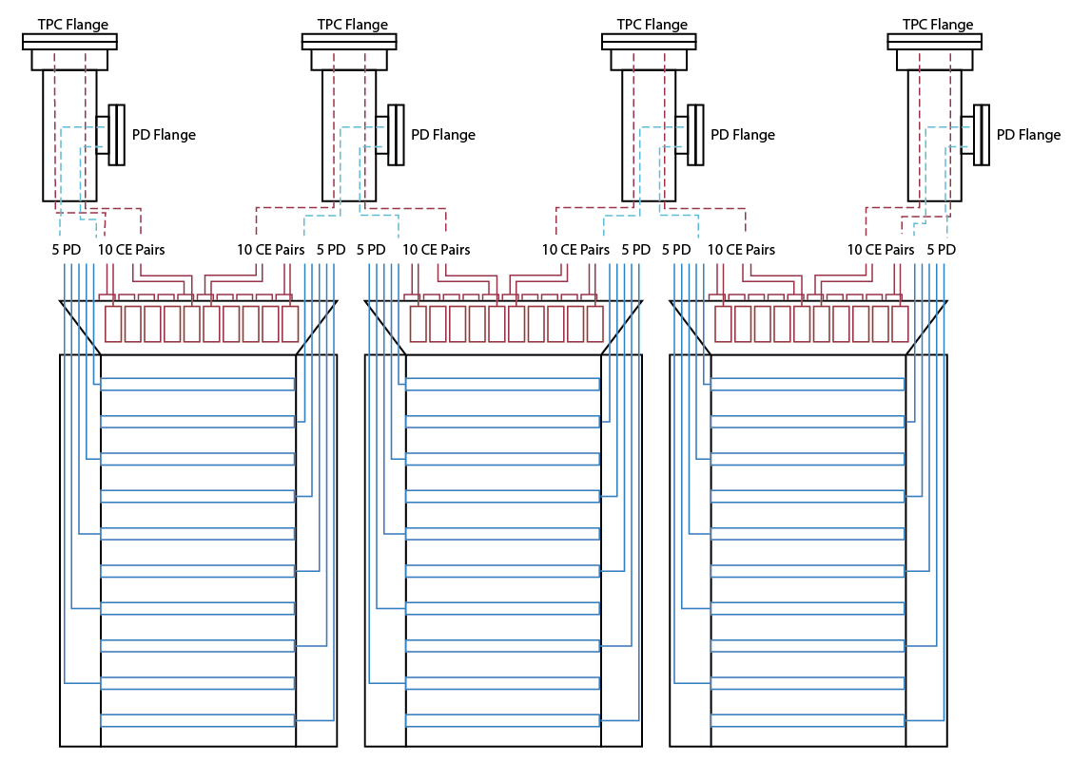
ProtoDUNE APA Cable Routing Concept
25%
occupancy
50% occupancy
25%
occupancy

Slide 9
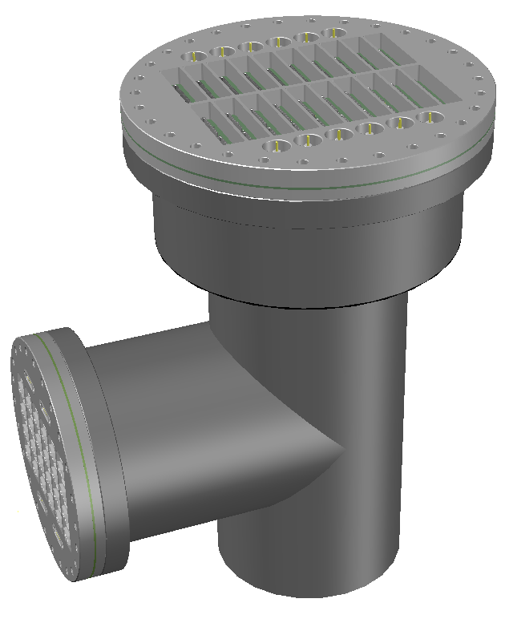
A Combined TPC + PD Nozzle
14” CF flange for the cold electronics and bias cables from TWO APAs
10” CF flange for the PD cables from TWO APAs plus 4 DB15 connectors
8” pipe for the cryostat nozzle
Lifting the field cage panels through these ports remains possibility.

Slide 10
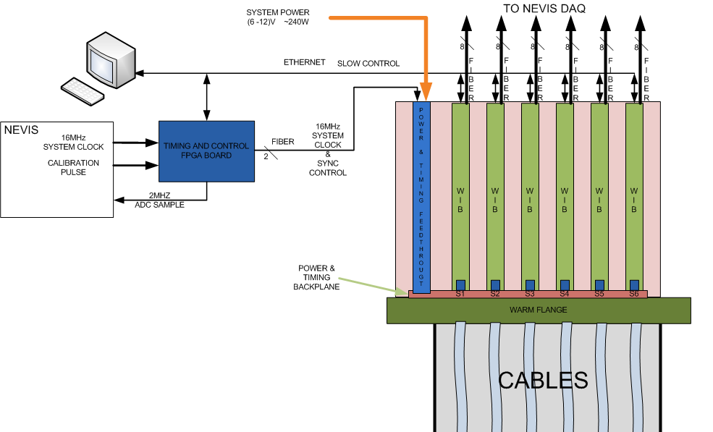
SBND Warm Interface Electronics
MBB (Magic Blue Box)
Warm interface electronics will be installed on top of the warm flange board
  Receive data from cold electronics through cold cables
  Send data to Nevis electronics over fiber optical links
  Manage power, timing, control and monitoring to cold electronics
Each FT has 6 Warm Interface Board (WIB)
  Each WIB will control 4 128-ch FEMBs
  Total 3072 channels per FT flange

Slide 11
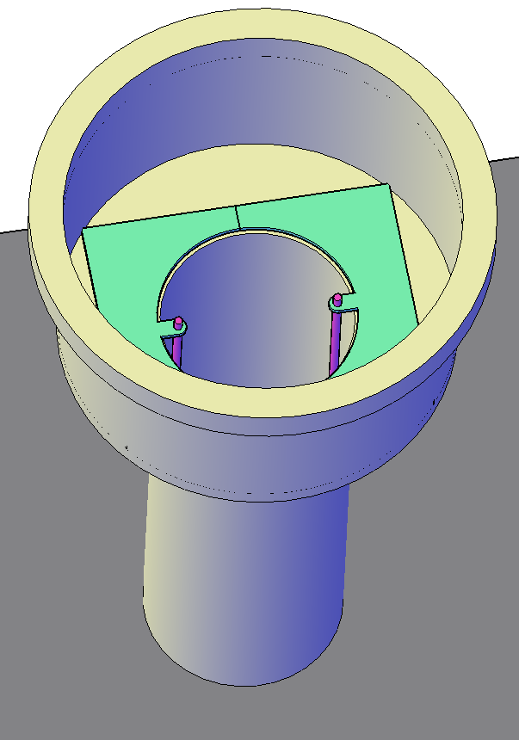
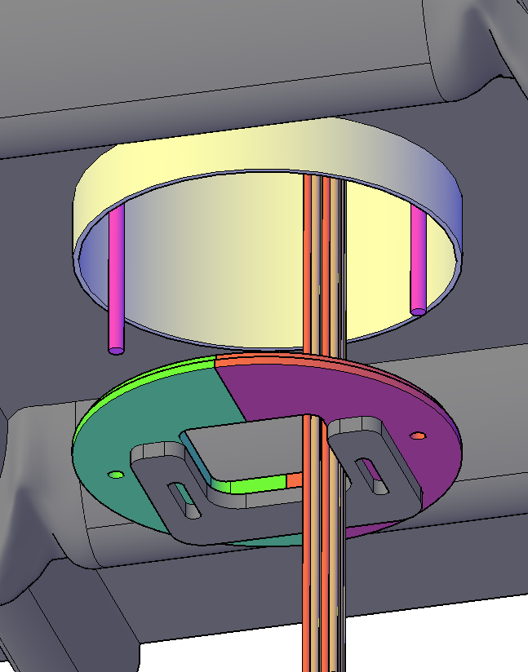
Integrated Cable Strain Relief and Baffle
Once fully engaged, the nozzle has only very small gaps between cables, and the baffle. With a moderate purging from the warm space above, a high upward flow rate can be maintained to prevent impurities from back diffusion down through the cracks.

Slide 12
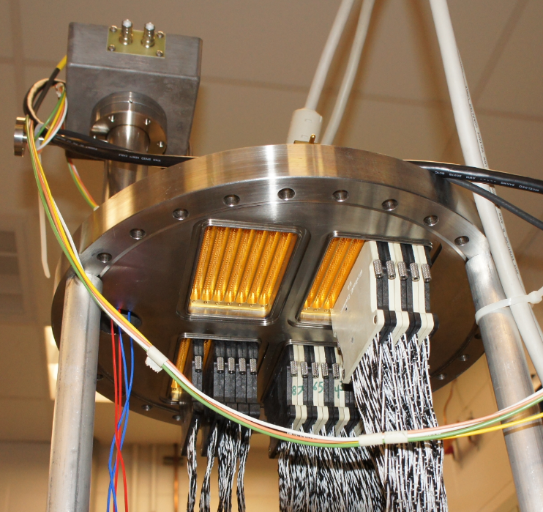
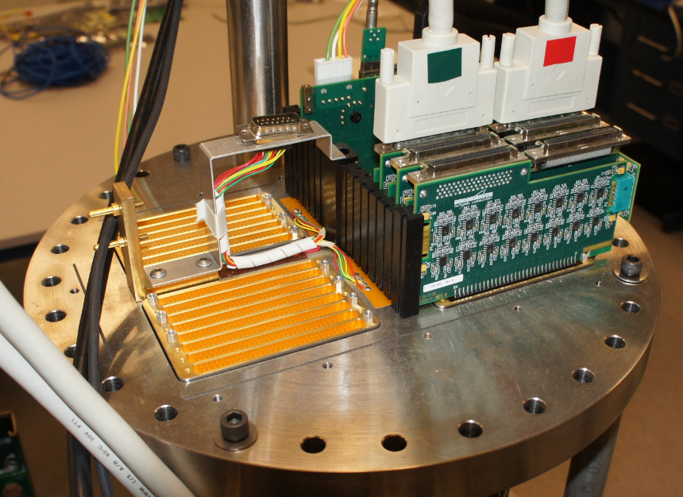
Signal Feed-through
Baseline design is to use ATLAS pin carrier for a single warm signal feed-through flange
  MicroBooNE uses a warm flange with ATLAS pin carriers, total 1,920 pins on 14” CF flange
    ATLAS LAr Calorimeter with ~230 signal feed-through flanges, ~450,000 penetrations in total, has been operated for ~10 years without leaking
    Methodology of lifetime study of feed-through to be developed

Slide 13
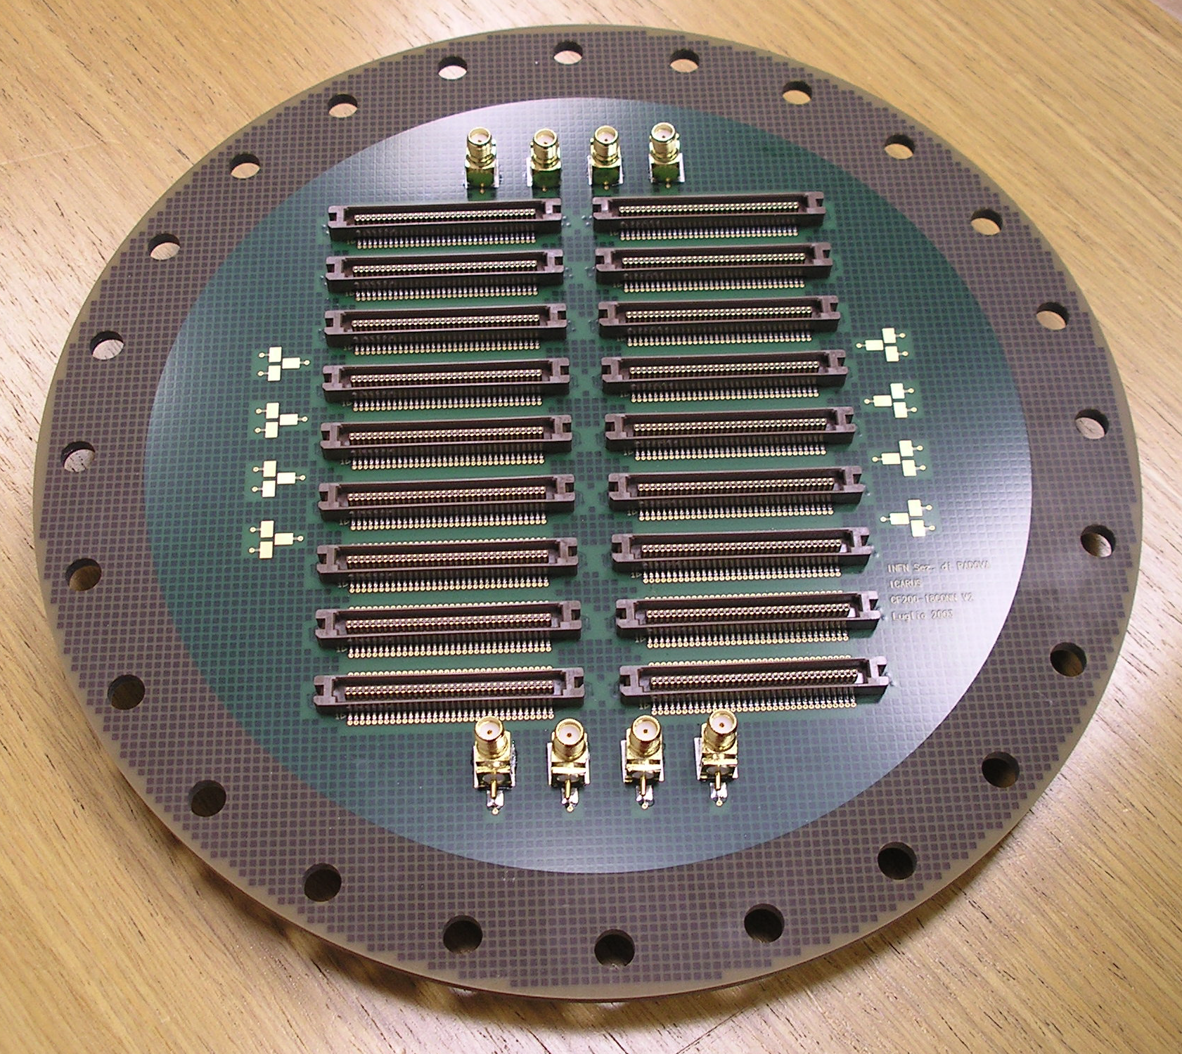
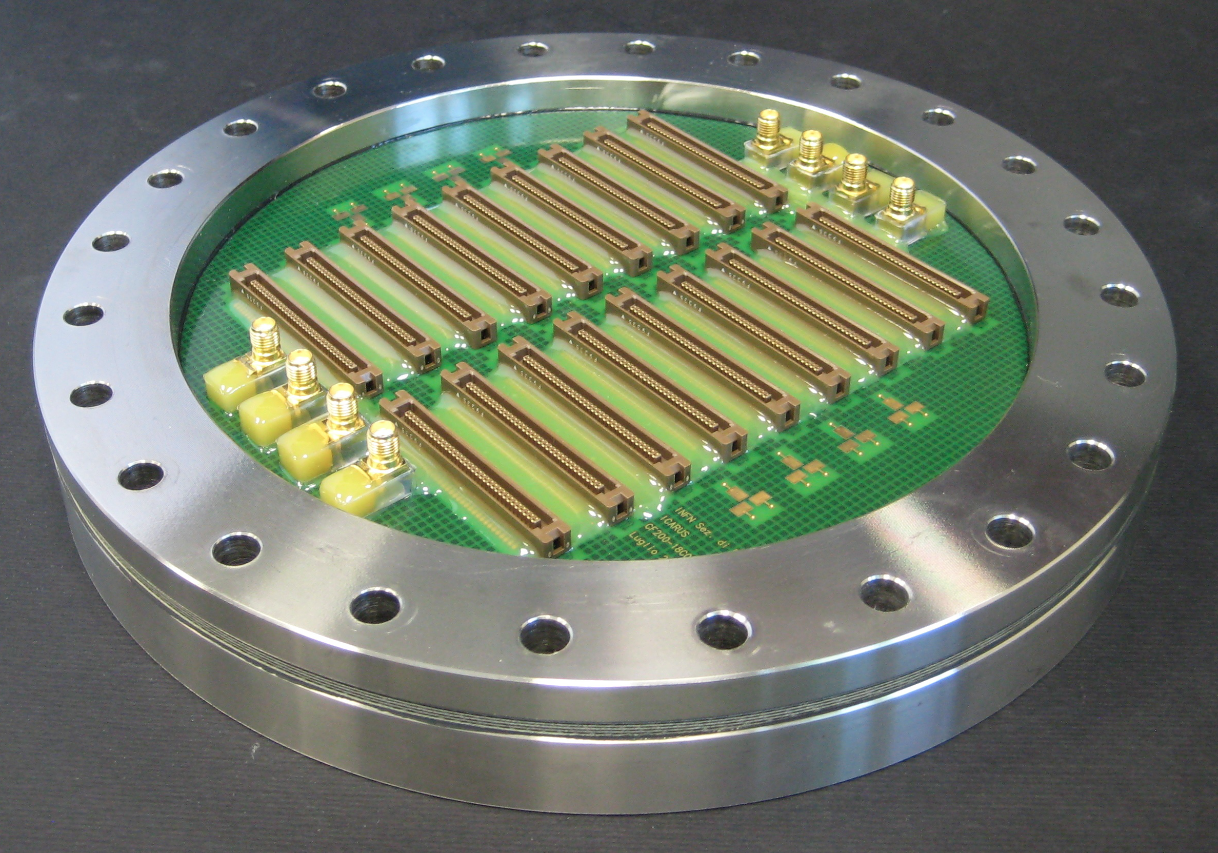
PCB Based Signal Feed-through
Cost of a signal feed-through with ATLAS pin carrier is > $10k per flange
A PCB based solution is being considered to reduce the M&S cost
  ICARUS style feed-through, PCB is glued between SS rings
  Working on collaboration with INFN Padova

Slide 14
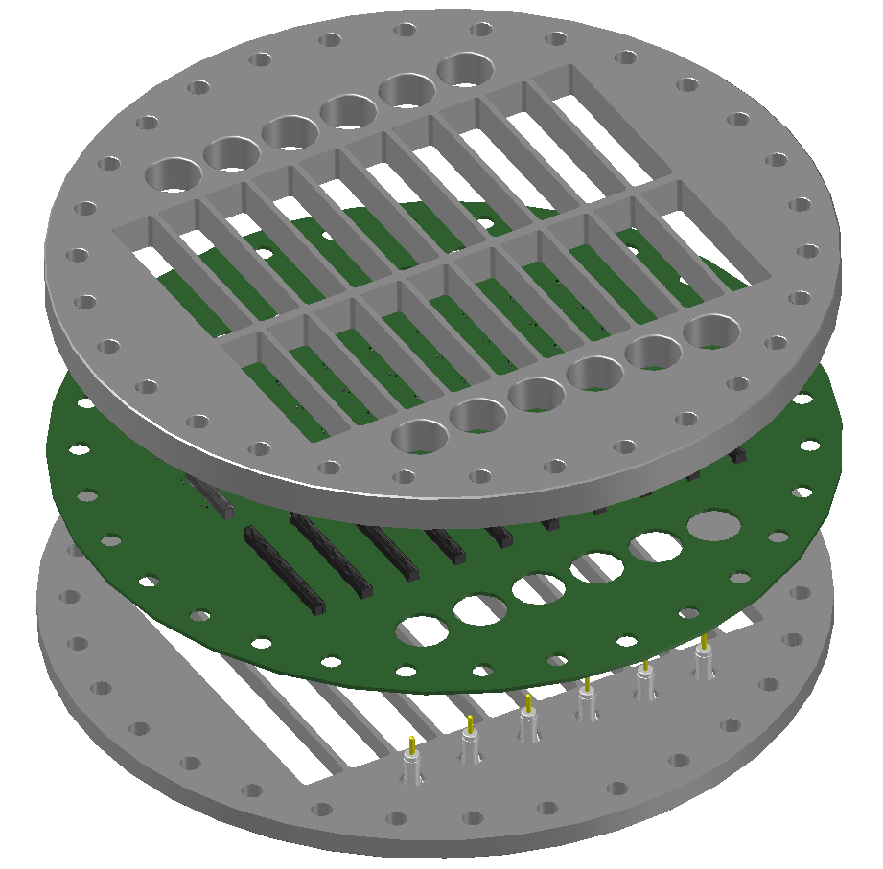
CE Signal Flange Construction
The flange is constructed from a standard 14” CF flange, sliced into two halves, with a PCB glued in between.
The PCB has 40 power connectors and 40 data connectors on the cold side. On the warm side, 20 edge connectors supply the power, and 10 connectors link the data lines.
12 SHV ceramic feedthroughs are welded on the flange. They provide the bias voltages for the wire planes and the electron diverters.
The ribs on the flange keep the deformation of the PCB due to cryostat pressure minimal.

Slide 15
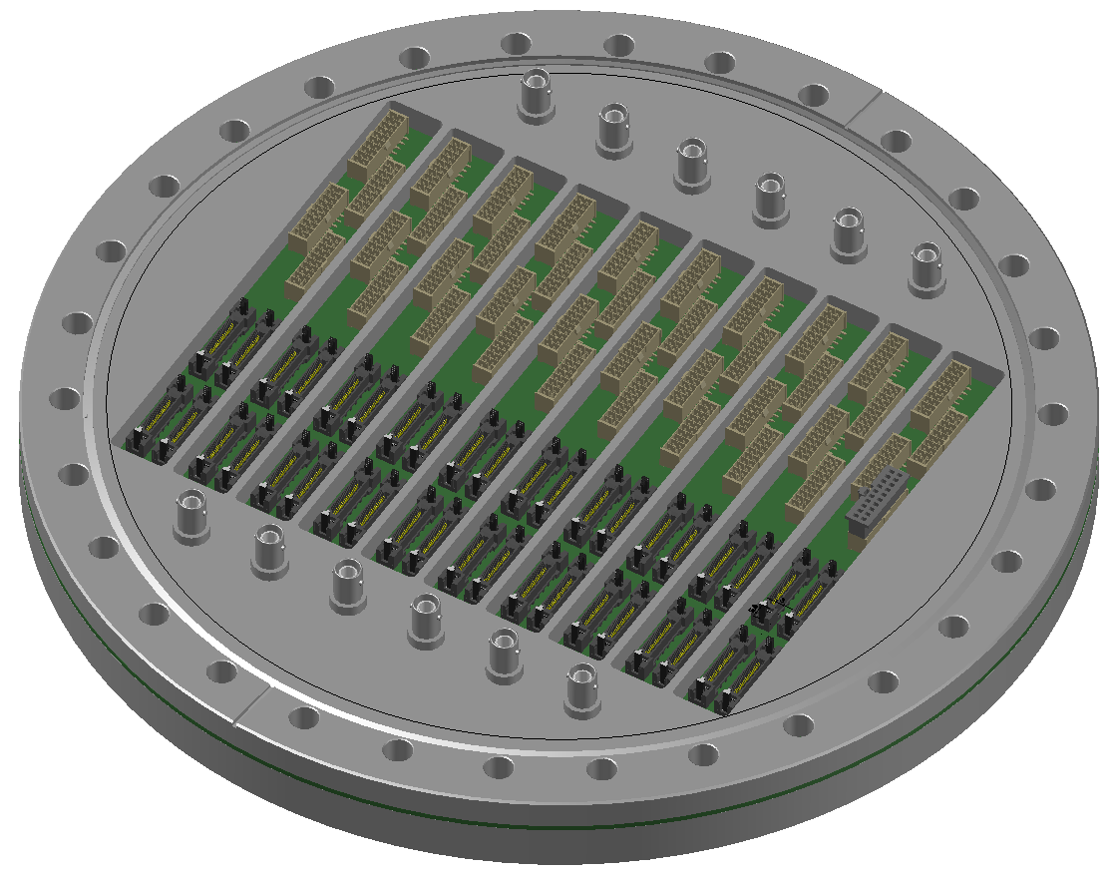
CE Flange: Cold Side
40 IPL1-9 connectors for power
40 HSEC8-120 connectors for data

Slide 16
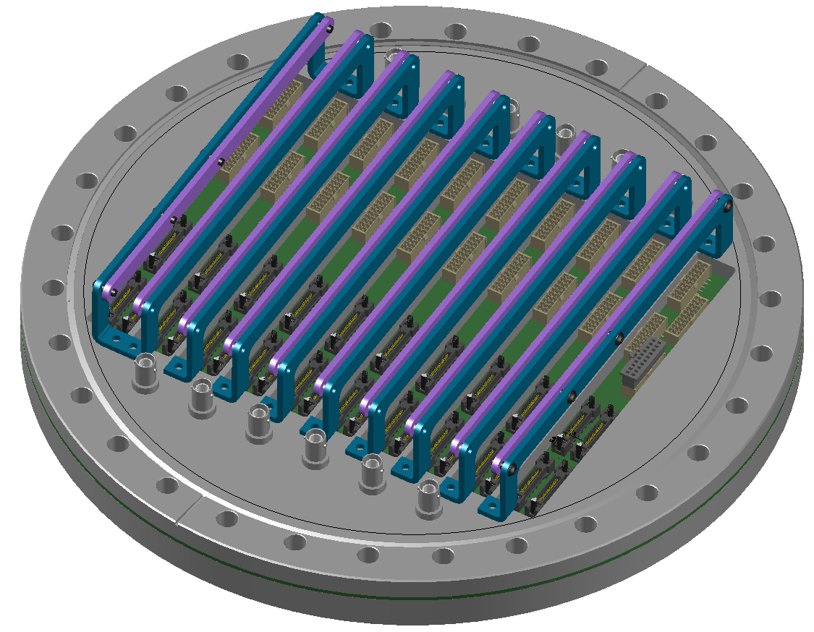
CE Flange: Cold Side, with Cable Strain Relieves

Slide 17
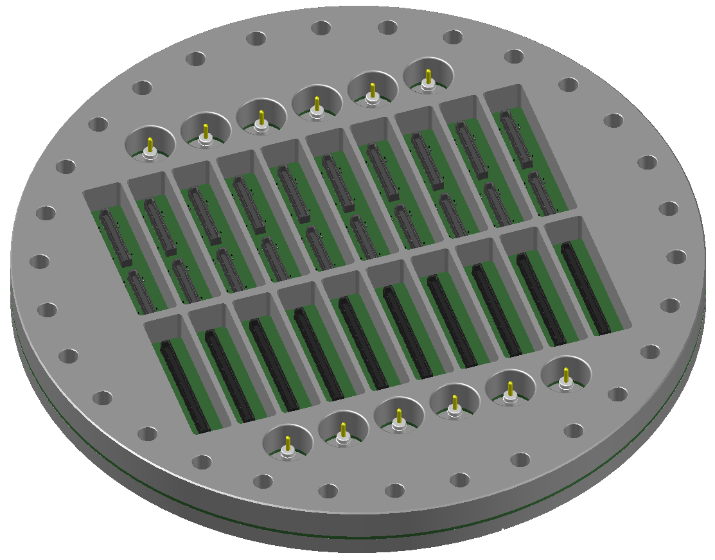
CE Flange: Warm Side
Warm Interface Boards are expected to be plugged in directly into the connectors
20 ERF8-40 for power
10 ERF8-75 for data

Slide 18
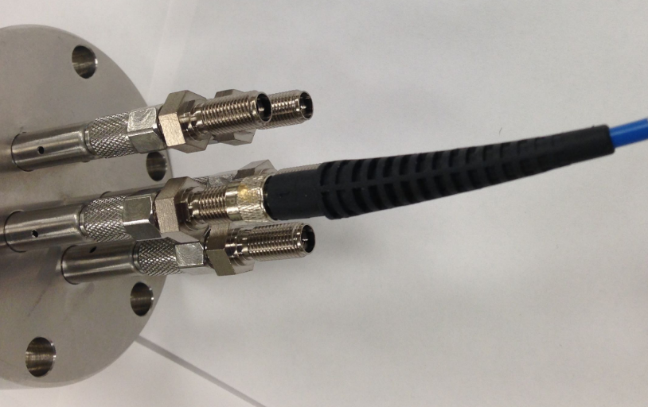
Photon Detection System Cables
For entire ProtoDUNE (from Norm Buchanan):
  60 CAT6A cables which have a diameter of 0.32”. The minimum bend radius is 1.2”.
  10 fibers coupled to SMA905 Multimode Connector, Ø770 µm Bore, SS Ferrule connectors (http://www.thorlabs.com/thorproduct.cfm?partnumber=10770A).
Dave Warner suggests one 4-5/8” CF flange (3” OD pipe) with 12 fibers.
35ton fiber feedthrough flange

Slide 19
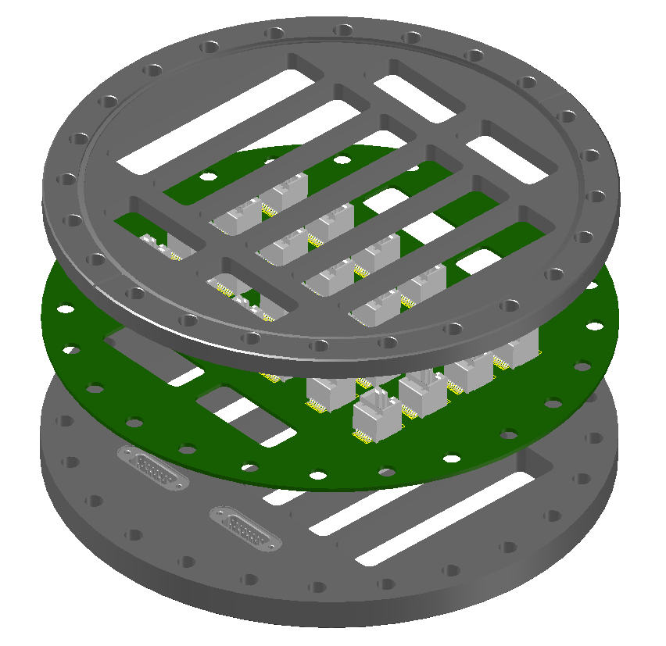
PD Cable Flange
The flange is constructed from a standard 10” CF flange, sliced into two halves. The cold side (top in this view) has the knife edge to seal against a standard copper gasket.
A PCB has 24 RJ45 SMT jacks (4 spares) mounted on both sides. The ribs on the flange keep the deformation of the PCB due to cryostat pressure to a few microns.
4 additional DB15 feedthroughs are welded on one of the flanges for other miscellaneous signal connections.

Slide 20
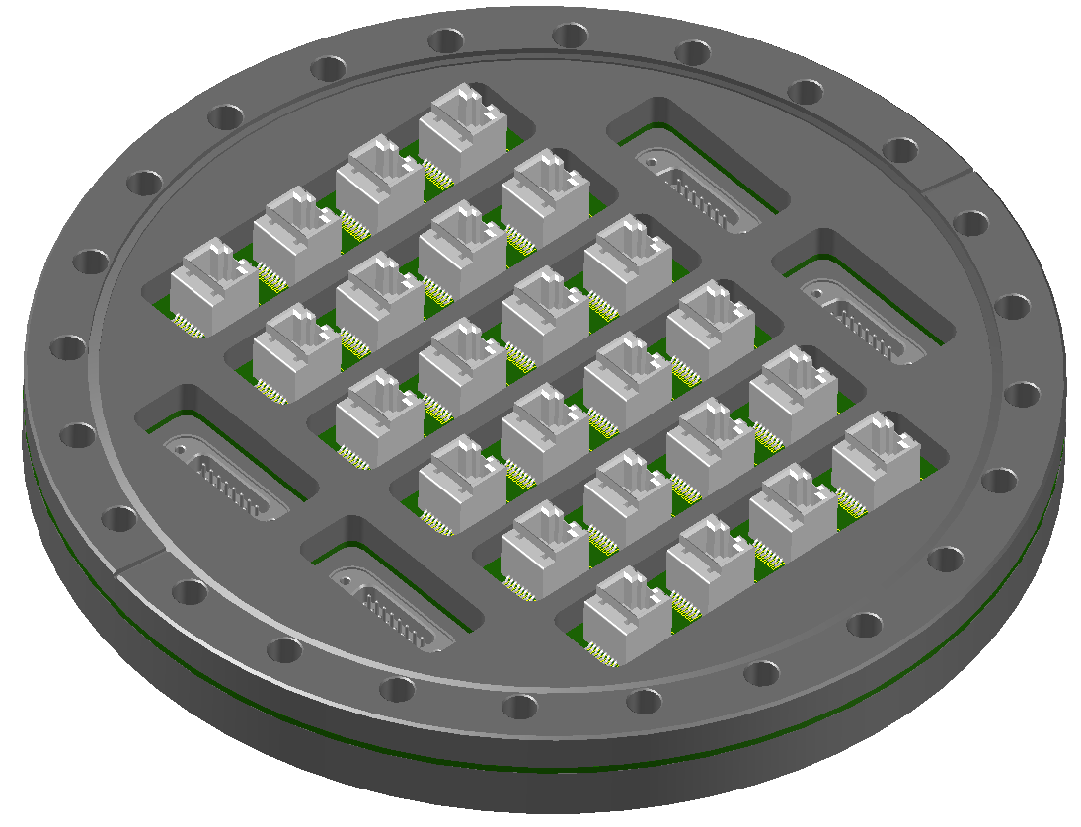
Cold Side
24 RJ45 jacks are shown (20 needed for 2 APAs). 4 DB15 feedthroughs are also included for additional signal connections (e.g. 4x 35ton cameras)

Slide 21
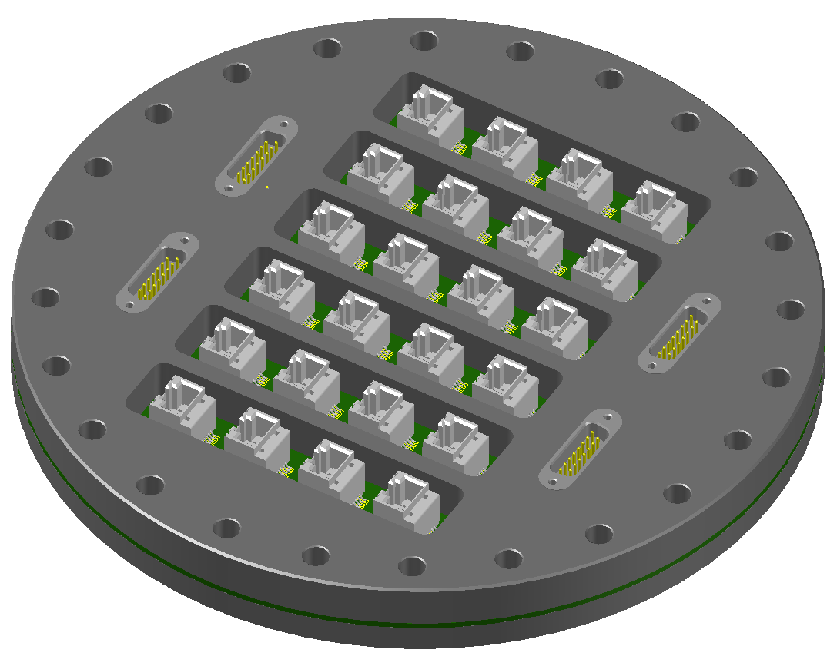
Warm Side
Direct plugin PD readout electronics cards can also be installed on this side with appropriate connectors

Slide 22
TPC +PD Cable Cross Section
Signal Cable (twinax) | Length [mm] | 3.45
 | Width [mm] | 1.73
 | Area [mm^2] | 5.97
 | # of Cable per FEMB | 12.00
 | # of FEMB per APA | 20.00
 | Xsec per APA [cm^2] | 14.32
Power Cable | Outer Diameter [mm] | 1.32
 | Area (square) [mm^2] | 1.37
 | # of Cable per FEMB (incl. ext. cal.) | 18.00
 | # of FEMB per APA | 20.00
 | Xsec per APA [cm^2] | 6.27
Wire Bias Cable | Outer Diameter [mm] | 2.5
 | Area (square) [mm^2] | 6.25
 | # of Cable per APA | 6
 | Xsec per APA [cm^2] | 0.38
PD Cable | Outer Diameter [mm] | 8.13
 | Area (square) [mm^2] | 66.1
 | # of Cable per APA | 10
 | Xsec per APA [cm^2] | 6.6
 | Total Xsec per APA [cm^2] | 28

Slide 23
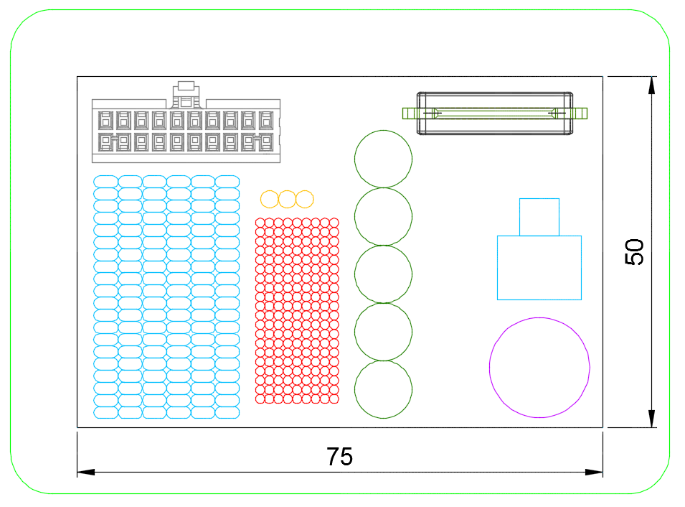
Cable Size vs APA Opening:
Can we route lower APA cables through the frame?
APA frame tube (inside)
This graph shows the size of cable bundles of HALF of all cables for an APA compared with a few key dimensions.
Also included are the cross sections of the connectors used. They do not have to pass through the opening all at once.
APA opening at the non-readout end
Data connector
Power connector
Bias cables
PD cables
Twinax cables
RJ45
Power cables
SHV
The upper opening where the electronics plate meet the frame tube also needs careful consideration to allow all cables to pass through.

Slide 24
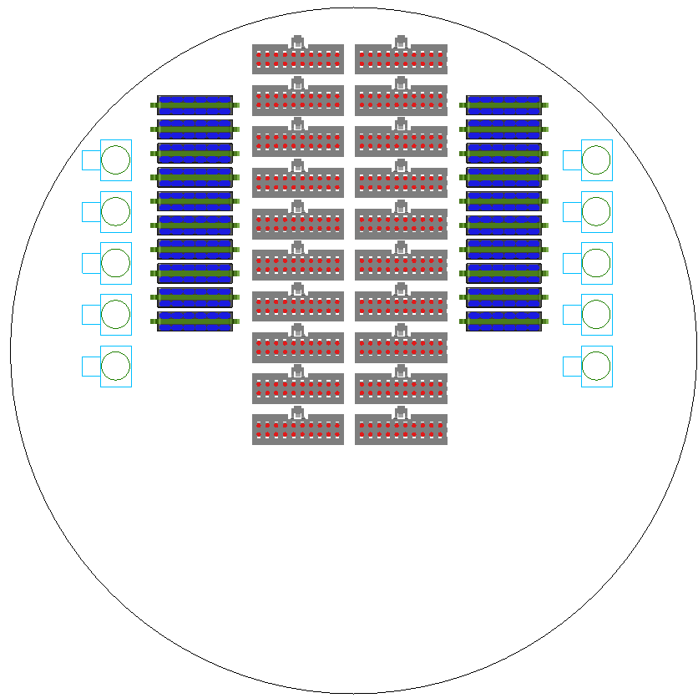
TPC Cables Through Roof Nozzle
This graph shows the size of TPC data, power and PD cables with connectors from one APA compared to a 20cm ID pipe.
Once the cable and connectors are staggered, there is plenty of room for two APAs if needed (FD?)

Slide 25
Power, Rack Requirements (ProtoDUNE)
Cold Electronics
  4W per FEMB x 120 = 480W
  25W per WIB x 30 = 750W
  => 4 MPV8016 modules (<1 MPOD chassis)
Wire bias
  6 per APA (1 MPOD module, 8ch) x 6, no current draw, <2kV
PD Readout
  1U SSP module per APA, 1A @ 220V

