Slide 1
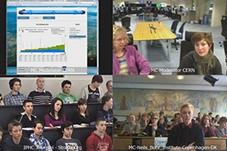
World Particle Day (or another name)
Idea: 24 hours of students reporting in results of masterclass-like particle measurements
Moderator Shifts: CERN, Fermilab, and...
Measurements: one or more particles; not necessarily in IMC, e.g. CMS J/Ψ, OPAL Z, ...
Needed: Plan that ends in WPD in Oct or Nov 2016; people
Next: more discussion, work in MC2NC
Why?
Reach southern hemisphere more
Create excitement
Prep for IMC
…

Slide 2
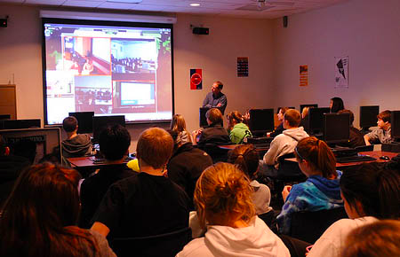
World Particle Day discussion points
Can and should we do this in 2016?
Who can help?
What should we consider for
  Measurements?
  Moderators?
Target WPD participants?
How big/small should we start?
How do we get groups on board?
Technology issues!
…

Slide 3
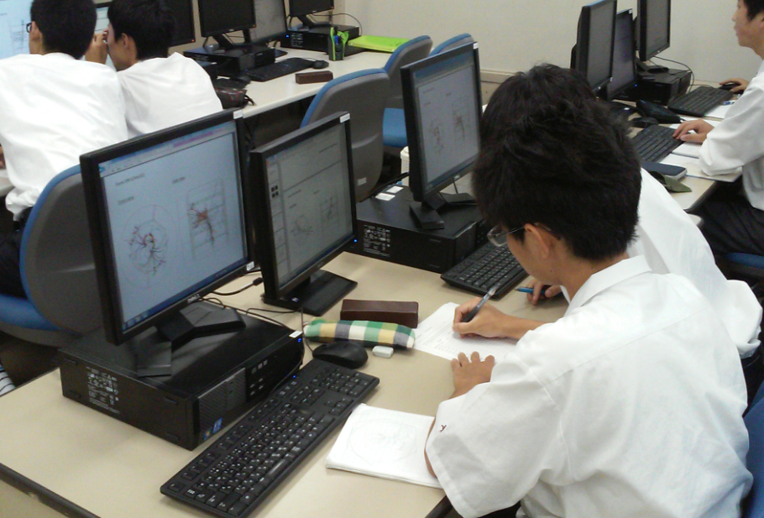
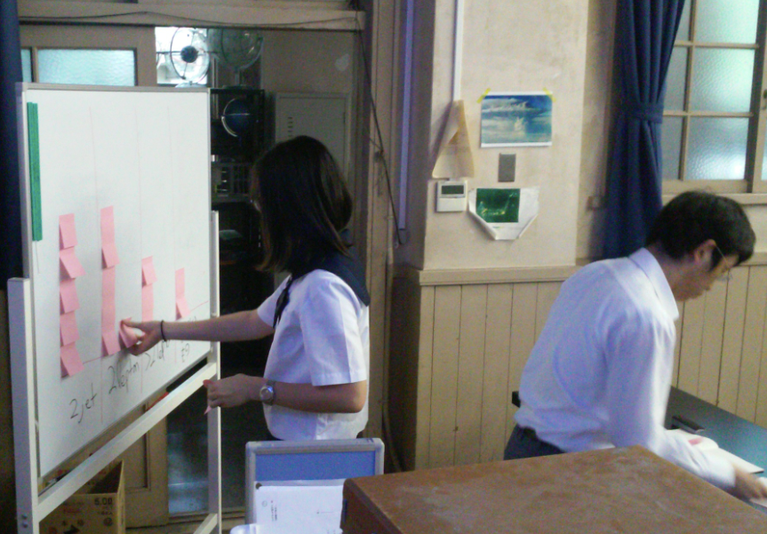
ILC Mini-Masterclasses
Mostly in Japan
Monte carlo (well, yeah…)
e+e- → Z → Zh (higgs-strahlung)
  Subtract Z
  Characterize Higgs decays
Micro version: Z→νν (easier)
Teacher workshop Tokyo
Students Tokyo, Shizuoka, Sendai
Preview of what ILC physicists will do

Slide 4
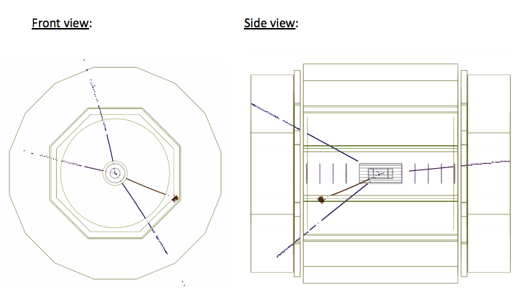
ILC Mini-Masterclass: try a bite

Slide 5
International Baccalaureate (IB)
International high-standards diploma program
Started for international schools but has spread
IB Physics now has particle physics in CORE
QuarkNet has IB Physics teachers – formed a group
Visited Graeme Anderson at IBO, The Hague:
  Open to informal collaboration
  Teacher feedback: questions, seek more support
  Interest in Masterclasses → investigations with data
Ask me about IB exams, Group 4 Project, Internal Assessment…

