Slide 1
Longitudinal Bunch-by-Bunch Feedback at DLS
Guenther Rehm
Diamond Light Source
TWIICE2, 9 Feb 2016

Slide 2
Outline
Motivation
System overview
Kicker cavity
Hardware
Firmware / Software
First results
Conclusions

Slide 3






Purpose of BbB Feedback
A BbB feedback will add negative feedback at betatron or synchrotron oscillation frequency of each individual bunch.
By doing so, it supresses oscillations of each individual bunch and as a consequence also of any mode of oscillation of many or all bunches
It is used to supress transverse or longitudinal multi-bunch instabilities, which can be caused by wakefields or ion trapping
Transverse
Multibunch Instability
Mode 3 2 1
Longitudinal
Multibunch Instability
Mode 3 2 1

Slide 4
Need for Longitudinal Feedback
Currently two SC cavities installed (Cornell type)
Will add two NC cavities (HOM damped design) in Summer 2017
BESSY 2, MLS, DELTA have these HOM damped NC cavities, still need longitudinal FB
Diamond needs longitudinal FB ready to operate before NC cavity installation to ensure operation at 300mA

Slide 5
Digital Longitudinal BbB Feedback
Control
System
RF clock
History buffer
I/Q
AD
converter
I/Q
RF
Frontend
D
igital Signal
D
A
Modulator
Processing
Converter
FPGA based Feedback Processor
Power
Amplifier
Button
Pickup
Kicker
Cavity
A/D and D/A run synchronous to bunches, every bunch measured
RF frontend can be shared with transverse feedback
Different feedback parameters/actions for individual bunches possible

Slide 6
Top Level Requirements
Each bunch needs acting upon, typically only 2ns between bunches
Each oscillation mode is associated with a frequency, these span 0-250 MHz bandwidth
All modes need to receive negative feedback:
  Phase response of the whole loop over the whole bandwidth needs to be flat to a few 10 degree, otherwise driving some modes instead of damping
  Amplitude response should be flat to within 3dB, otherwise very little damping for some modes

Slide 7
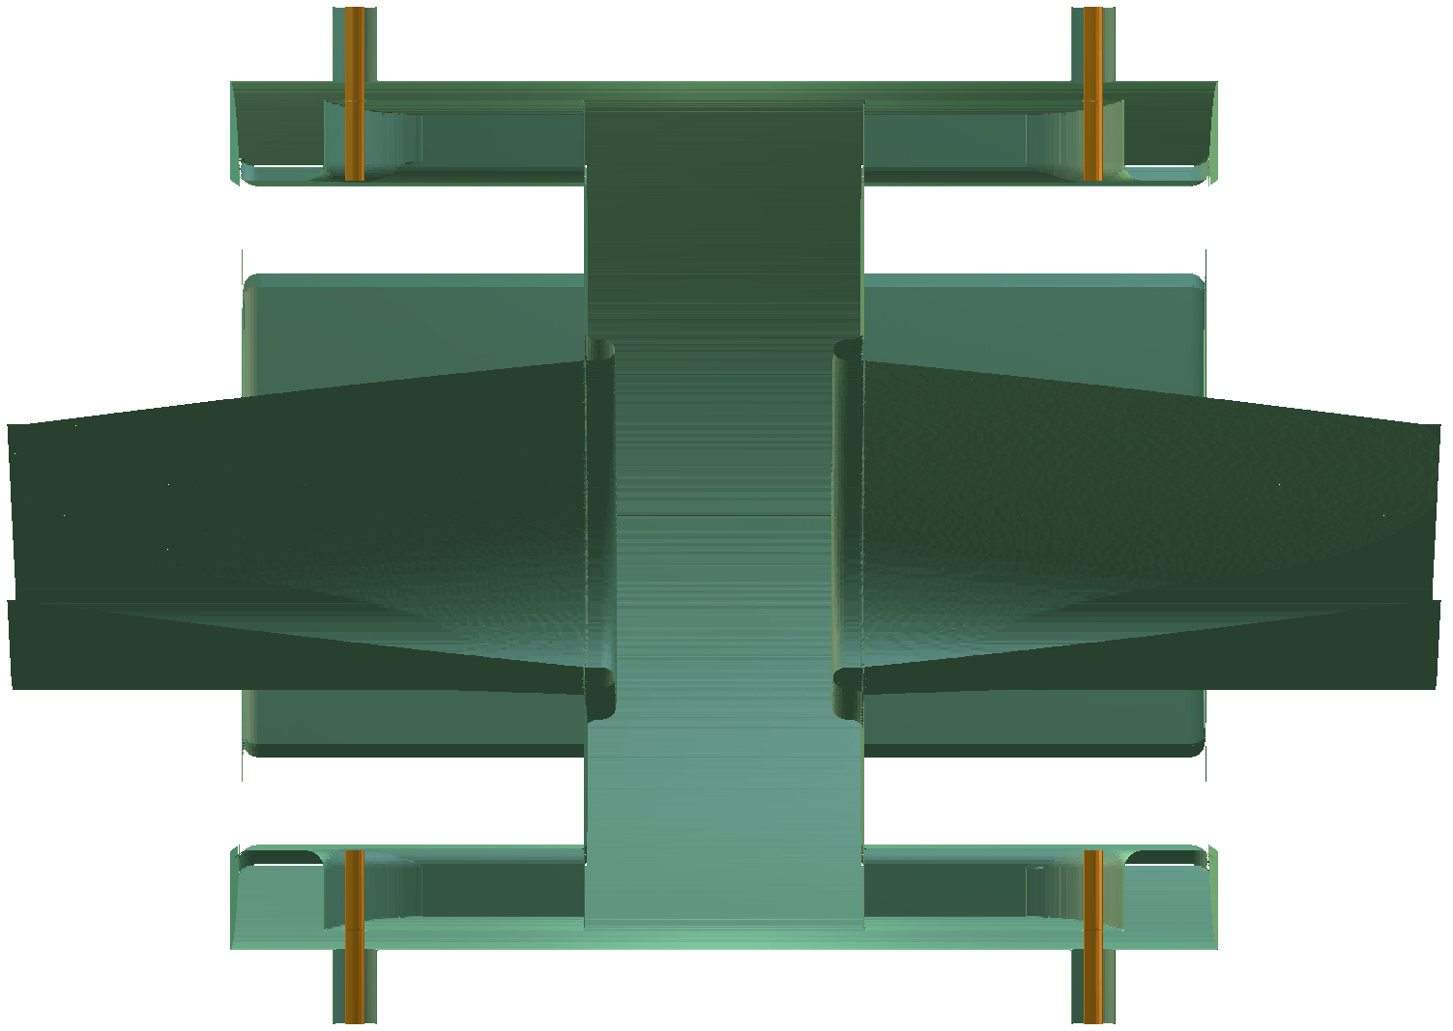
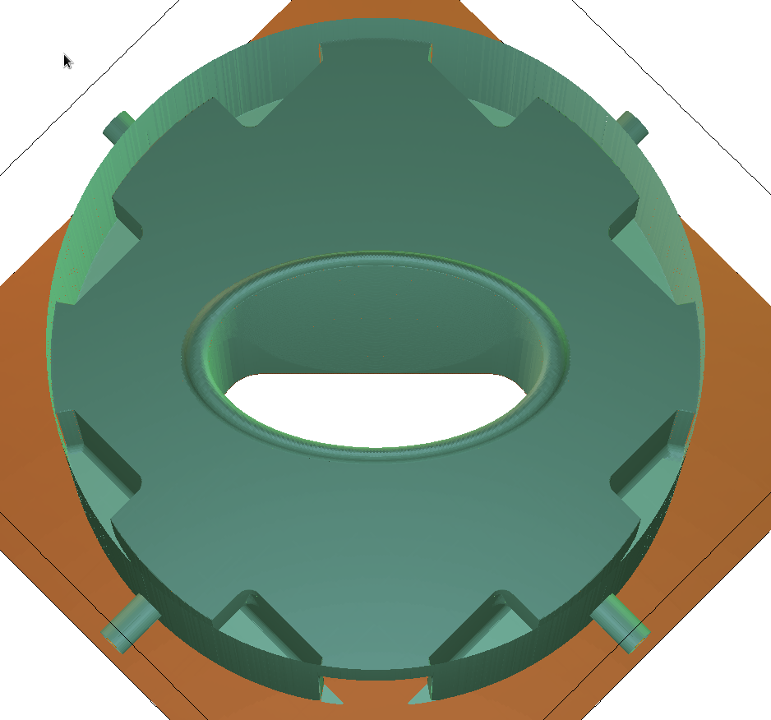
Cavity Geometry
Pillbox cavity with 8 ridged waveguide couplers following DAPHNE, SLS/Elletra, BESSY, LNLS tradition
Need to taper to race track cross section of adjacent vessels
Cut A along beam axis
Cut B halfway through cavity
A
B
A. Morgan, Proc. of IBIC15, MOPB064

Slide 8
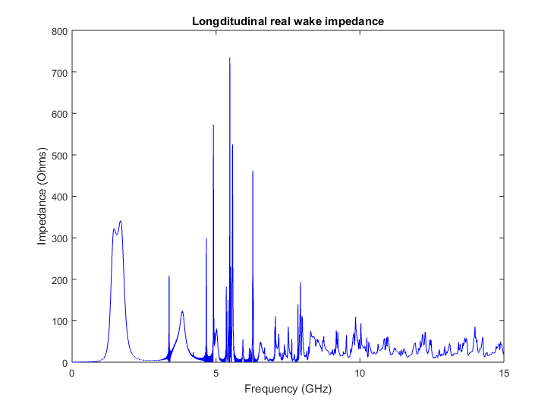
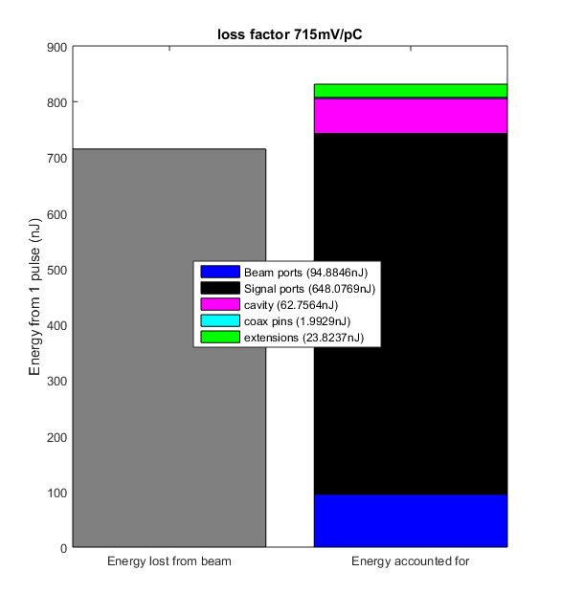
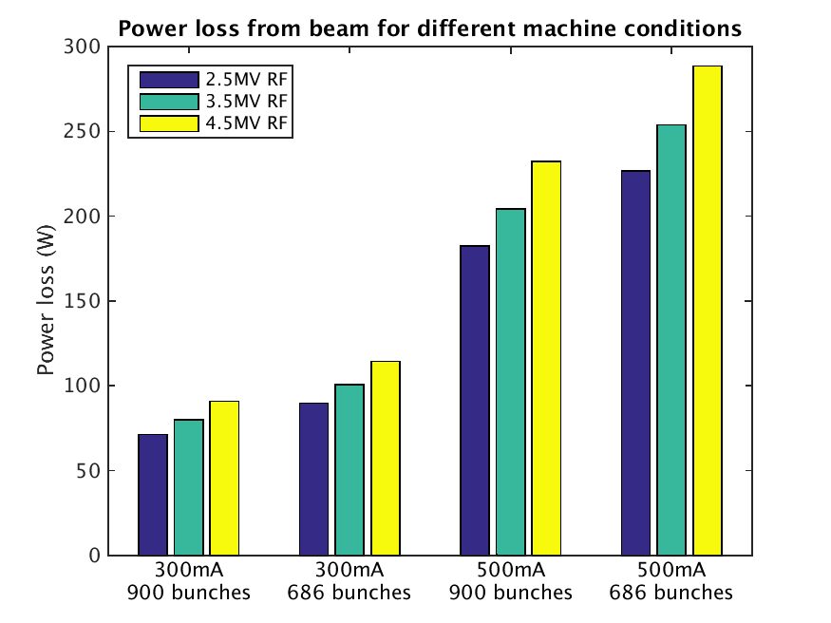
GdfidL Results (WIP)
A. Morgan, Proc. of IBIC15, MOPB065

Slide 9
RF Frontend
Hybrids for ABCD to XY processing:
  ABCD digitisation as in EBPMs would just be a burden
  Scaling of X/Y with bunch charge is not an issue, in fact it provides automatically more gain at higher stored current
  Handling of large ABCD to look at the differences is not good for S/N
Keep RF frontend:
  250 MHz bandwidth requires this as undersampling would deteriorate S/N too much
Use I/Q mixing rather than synchronous mixer
  Process I/Q all the way through digital processor to I/Q modulator

Slide 10


Embedded or Modular Processor
Embedded | Modular
Extremely compact (1/2 size 1U) | Compact 2U
Fixed ADC/DAC | Choice of ADC/DAC through FMC
Fixed FPGA size | Choice of FPGA through carrier
Fixed CPU | Choice of CPU through crate / module
Standalone | Crate could house several channels
One specific use | Adaptable use
All built for one purpose with system performance in mind | Combination of modules with reliance on standardised interfaces
Significant development cost/time | Available ‘off the shelf’

Slide 11
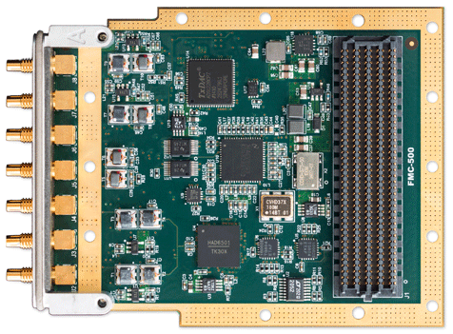
ADC/DAC on FMC module
Innovative Integration FMC-500
Two A/D, 500MS/s,
14 bit, DC coupled
Two D/A, 1230MS/s, 16 bit, DC coupled
External sample clock
Timing chip for sample alignment
Image courtesy of Innovative Integration

Slide 12
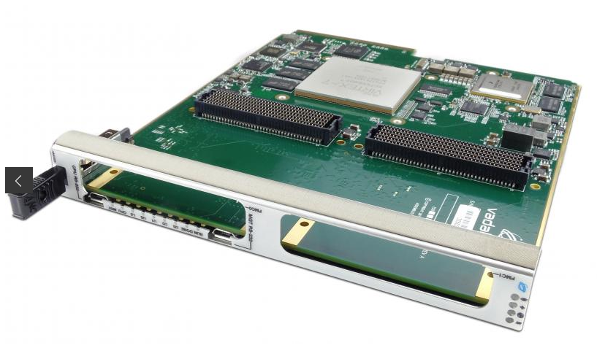
AMC FPGA Carrier for Dual FMC
Vadatech AMC 525
Xilinx Virtex-7 690T
3600 DSP blocks
Quad-core 1.2GHz CPU
2GB DDR3 RAM
Dual High Pin Count
FMC sites
Image courtesy of Vadatech

Slide 13
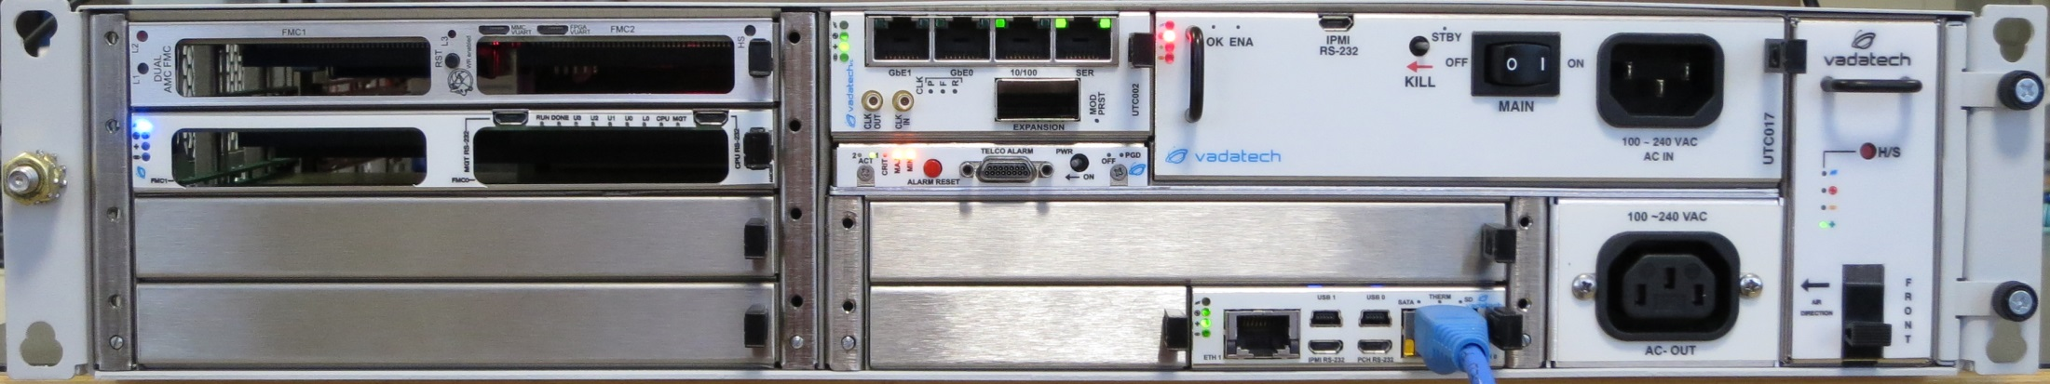
MTCA crate
Vadatech VT814
Redundant power supplies, fans
PCIe and GBE on backplane
Room for 5 FPGA carriers
CPU card AMC720
4 core Xeon 2 GHz, 32GB RAM

Slide 14
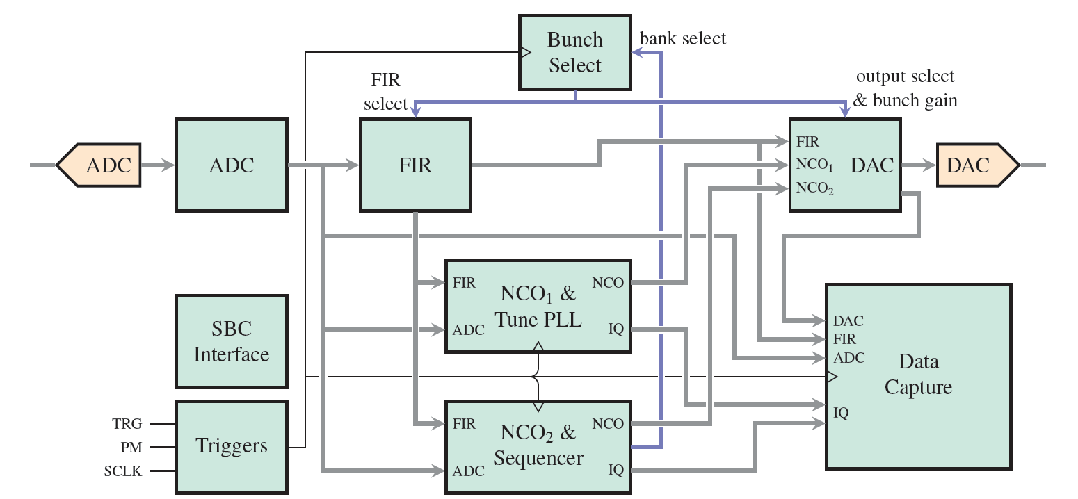
Firmware
In-house developed firmware in VHDL will be ported from TMBF to new hardware
M. Abbott, Proc. of ICALEPCS15, MOPGF097

Slide 15
More than Feedback
Besides the fundamental task of B-b-B feedback the power for the FPGA offers lots of other opportunities:
  BbB observation to assess motion in any mode (250 MHz instantaneous bandwidth spectrum analyser)
  BbB manipulation:
    Exciting bunch with small oscillation for measurement of tunes
    Exciting bunches with large oscillation for bunch clearing
    Different feedbacks / actions for different bunches at different times
  Mode by Mode manipulation:
    Excite individual modes and observe natural and forced damping
    Different feedback for different modes (idea for future!)
All this requires FPGA/memory/network resources

Slide 16
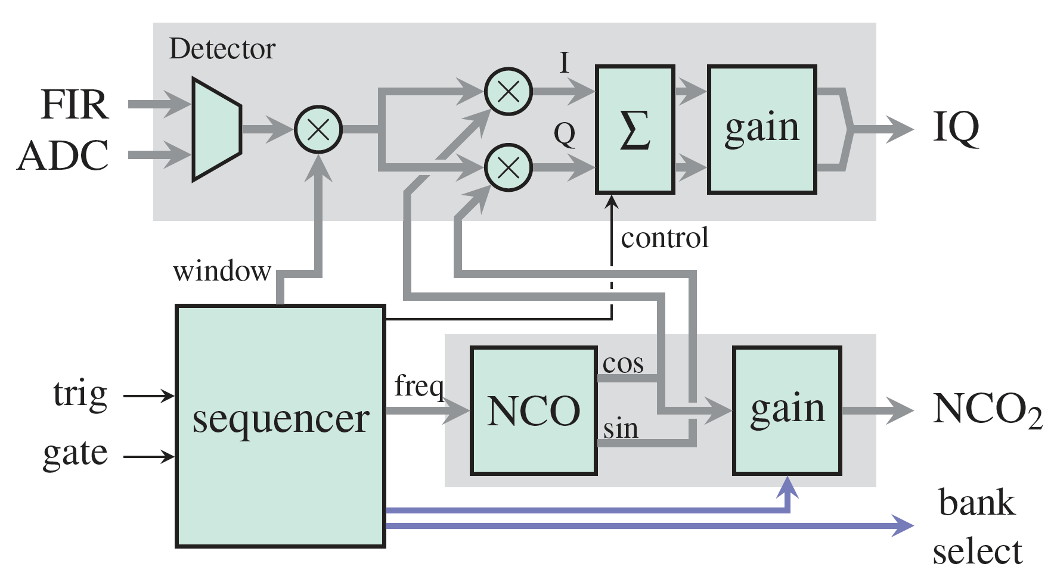
Detector and Sequencer
Numerical oscillator is controlled by sequencer that can produce sweeps, drive/grow/damp, mode-by-mode
Bunch data is analysed by Detector to reduce a configurable number of turns into mode amplitudes
This allows measuring drive/grow/damp on all modes within seconds
M. Abbott, Proc. of ICALEPCS15, MOPGF097

Slide 17
Stripline as Longitudinal Kicker
Transverse kicks at baseband (0-250MHz) in differential mode
Longitudinal kicks upconverted to 3*RF in common mode
Diplexers combine signals to allow concurrent use as vertical and longitudinal kicker
Vertical Processor
180
0
Longitudinal Processor
RF
x3

Slide 18
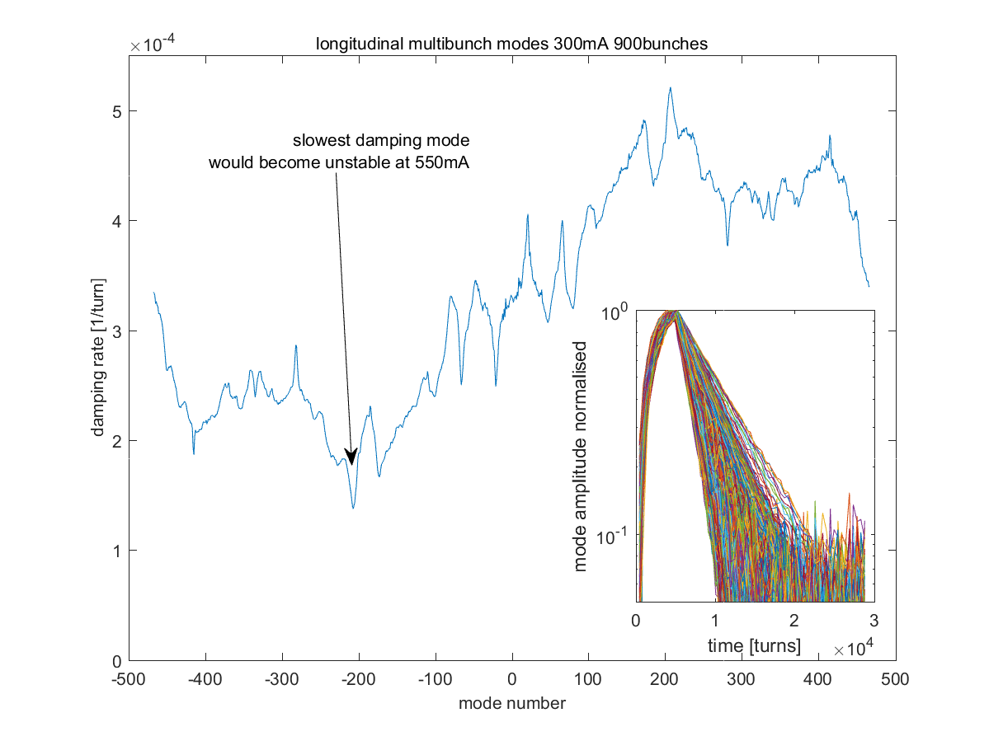
Longitudinal Damping Rates

Slide 19
Conclusions
Diamond will install a longitudinal BbB feedback by early 2017 to ensure continued operation at 300mA with NC cavities
System will be based on MTCA technology with firmware/software ported from existing TMBF
Preliminary investigations using vertical stripline as longitudinal kicker show clear impact of longitudinal impedance
Mode-by-mode drive/damp experiments are key to characterising stability margin of all modes

Slide 20
Acknowledgements
DLS: Alun Morgan, Michael Abbott, Isa Uzun
Micha Dehler (SLS)
Eric Plouviez (ESRF)
Dmitry Teytelman (Dimtel)

