Slide 1


Measurement and analysis
of the impact of transverse incoherent wake fields
in a light source storage ring
P. Brunelle, R. Nagaoka and R. Sreedharan

Slide 2
I. INTRODUCTION
Extensive experimental studies have been made to characterize the incoherent tune shifts.
Comparison with the existing theoretical models.
The measurement and the analysis of the data were carried out using specific tools and methods :
    Orbit response matrix analysis for optics tuning
      identification of the location and the strength of wake fields
    Bunch-by-bunch transverse feedback (TFB) system
      weak intensity bunches as a function of the distance from an intense bunch
    Exposure of the beam to a betatron resonance
      measuring the incoherent tunes of a single high intensity bunch

Slide 3
    Orbit response matrix analysis for optics tuning
      identification of the location and the strength of wake fields
The results were presented at TWIICE 2014
Impact of Incoherent Transverse Wakefield on Storage Ring Optics
http://indico.cern.ch/event/277919/session/12/contribution/29/attachments/506916/699838/2013-12-04_TWIICE_2014_Brunelle_indico.pdf
All the results presented today are summarized in a paper submitted to PRST-AB and in the process of being refereed :
Measurement and analysis of the impact of transverse incoherent wake fields in a light source storage ring

Slide 4
y
Non-circular resistive-wall chamber
a transverse wake is created even if the driving beam stays on axis.
Non-oscillating wake fields add up to build an extremely long range field.
Its leading field component is “quadrupolar” type. Trailing particles are focused (defocused) "incoherently".
Focusing strength depends linearly on the beam current and on the cross section geometry.
x
For SOLEIL with vertically low gap chambers in most of the ring, the incoherent wake was evaluated to be non-negligible for both single and multibunch modes (R. Nagaoka, EPAC 2004)
Pioneering studies :
- K. Yokoya, Part. Acc., 41(1993) 221
- A. Burov, V. Lebedev “Transverse Resistive Wall Impedance for Multi-Layer Flat Chambers”, EPAC 2002
- A. Chao, S. Heifets, B. Zotter, Phys. Rev. ST-AB 5, 111001 (2002)

Slide 5
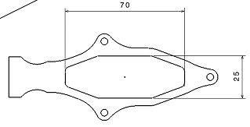
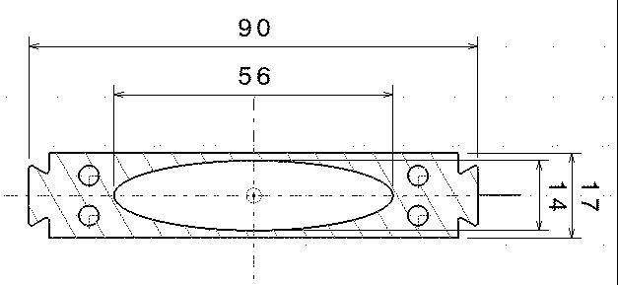
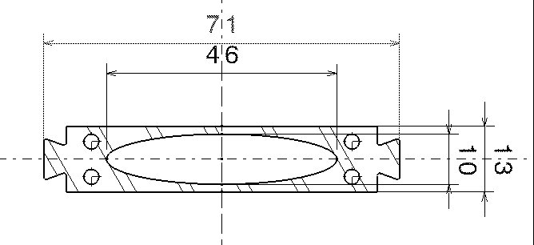
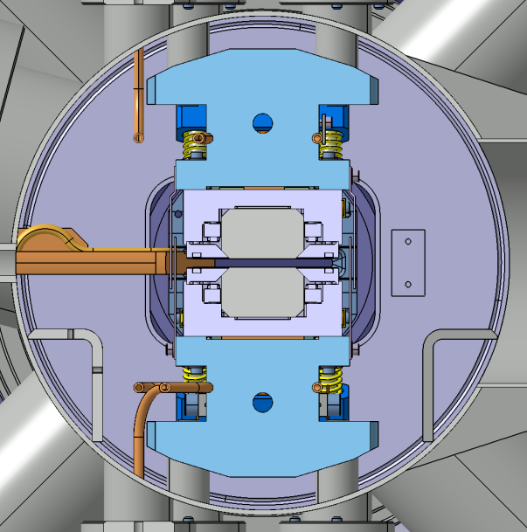
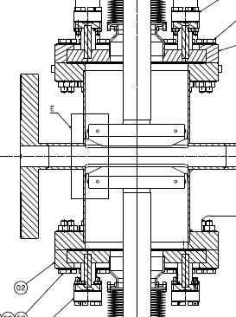
Standard chambers
X = 2 x 35 mm
Z = 2 x 12.5 mm
Long SS chambers
X = 2 x 28 mm
Z = 2 x 7 mm
Medium SS chambers
X = 2 x 23 mm
Z = 2 x 5 mm
Length = 10.6 m
Length = 5.6 m
Short SS In vacuum U20 undulators
X = 2 x 52.5 mm Z = 2 x 2.75 mm
Long SS Vertical Scraper
X = 2 x 35 mm Z = 2 x 4.1 mm
e-
Length = 1.8 m
Length = 0.082 m

Slide 6
II. THEORY AND NUMERICAL EVALUATION OF INCOHERENT TUNE SHIFTS
• The early studies focused on the incoherent focusing strength felt by a “witness” particle trailing a “source” particle at a distance z behind
for a flat chamber
• However, with the z^{-1/2} dependence that comes from assuming an infinitely thick RW, the summation of fields accumulated over previous turns “diverges” → Infinite tune shifts!
• Two groups studied ways to avoid this divergence by considering a RW of finite thickness and describing the field penetration across the chamber wall:
- A. Chao, S. Heifets and B. Zotter, Phys. Rev. ST Accel. Beams 5, 111001 (2002)
- Y. Shobuda and K. Yokoya, Phys. Rev. E 66, 056501 (2002)

Slide 7
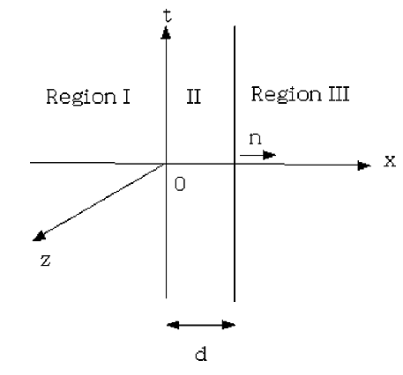
• Model of Chao, Heifets and Zotter:
- Made use of the exponential decay known for a circular cross section chamber by assuming that the time-dependence should not be much different for flat chambers.
- Assumed the initial z^{-1/2}-dependent decay prior to exponential regime makes negligible contribution
→ Resultant tune shifts do not depend on the resistivity ρ_{R} nor wall thickness d
• Model of Shobuda and Yokoya:
- Solved EM fields in a one-dimensional system assuming application to flat chambers
- As expected, a faster decay than z^{-1/2} is derived
Beam in this region
→ Resultant tune shifts do not depend on the resistivity, but depends linearly on the wall thickness d

Slide 8
Numerical calculations
• With a program we developed at SOLEIL, the overall incoherent focusing felt by a particle circulating in the ring is calculated by evaluating the effective wake field of vacuum chambers piecewise.
• The database is composed of :
- A realistic chamber configuration around the ring with specific information on ∂W_{x} / ∂x_{w}
- Wall resistivity and thickness
- Local integrated beta functions at the chamber location
• In particular, the different time dependence of the field decay of the two models was well taken into account.

Slide 9
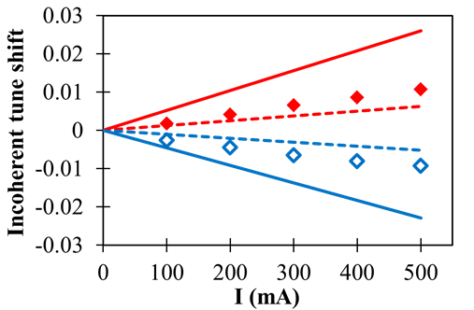
III. ANALYSIS OF MEASURED TUNE SHIFTS AND ORBIT RESPONSE MATRIX IN 4/4 MULTIBUNCH FILLING
Incoherent horizontal and vertical tune shifts versus total beam current in the 4/4 multibunch filling.
Model Chao et al.
Measured
Model Shobuda et al.
(The precision on tune measured values is 1 10⁻⁴)

Slide 10
Comparison of incoherent tune shifts calculated for the SOLEIL ring in the 4/4 uniform filling with a 500 mA beam current.
Model | Horizontal incoherent tune shift | Vertical incoherent tune shift
Analytical formula Model Chao et al. | +0.0100 | -0.0177
Analytical formula Model Shobuda et al. | +0.0080 | -0.0081
Piecewise integration Model Chao et al. | +0.0260 | -0.0229
Piecewise integration Model Shobuda et al. | +0.0080 | -0.0067

Slide 11
IV. IMPACT OF INCOHERENT FOCUSING ON NEIGHBORING BUNCHES
To investigate the time dependence of the wakes excited by the main bunch, the tunes of low current bunches (parasitic bunches) were measured as a function of their distance from the main bunch.
Experimental setup
It is anticipated that the incoherent wake excited by the main bunch damps rapidly after its passage leaving the long-range tail that scales like t^{-1/2} → Only four parasitic bunches (15 µA )were therefore stored close to the main bunch, both upstream and downstream.
The measurement was carried out for several main bunch currents (12, 16 and 20 mA).
TFB was employed to excite each of the 8 parasitic bunches independently to measure their tunes.
A large improvement in the tune signal detection resulted from replacing the BPM by a shorted stripline in order to minimize the cross-talk.

Slide 12
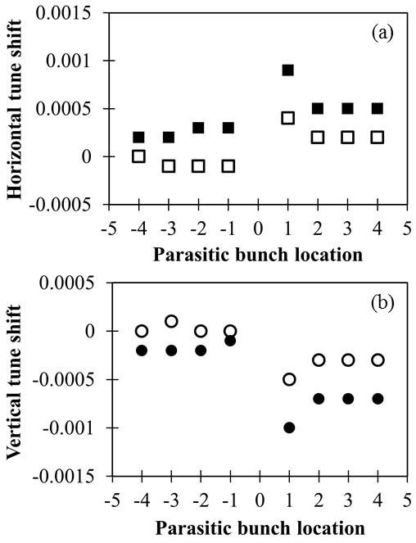
Measurements
The tune shifts are defined as the difference between the incoherent tunes measured on parasitic bunches and the zero-current machine tunes measured at a very low beam current prior to the experiment.
Main bunch current = 20 mA
Main bunch current = 12 mA
The average over ten measurements allowed a precision of 2 10-4 for the tune values.

Slide 13
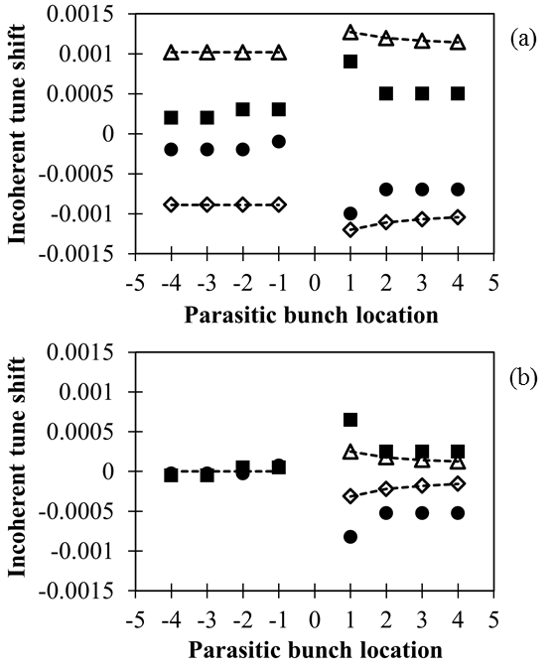
Comparison with the Chao model calculation
20 mA for the main bunch current
Raw data
Horizontal / Calculated
Horizontal / Measured
Vertical / Measured
Vertical / Calculated
When subtracting the offsets, the calculations considerably underestimate the relative tune shifts
The calculation well reproduces qualitatively the relative tune shifts of the parasitic bunches.
Mean long-range
tune shifts
of the upstream bunches
are subtracted.

Slide 14
V. SHORT-RANGE INTRABUNCH CHARACTERISTICS
The betatron tune shifts of a high current bunch consist of two contributions:
a coherent shift induced by the dipolar wakes
an incoherent part arising from the monopolar resistive-wall wakes.
The standard beam shaking used to measure betatron tunes generally cannot distinguish between the two contributions.

Slide 15
Measurement of the incoherent part
The idea is to make use of the betatron coupling resonance ν_{x} – ν_{y} = 8, which is sufficiently close to the ring working point of (18.155, 10.229).
Advantage of detecting the resonance condition with high precision by following the maximum vertical beam size with an X-ray pinhole camera without incurring beam losses.
Disadvantage is that we are not able to deduce the tune shift in each transverse plane separately.
Assume that the two tune shifts are approximately equal in magnitude with opposite signs under the specific linear optics employed in the SOLEIL ring

Slide 16
Test of the experimental setup with a low bunch current beam
nuz
nux-nuz = 18-10 = 8
.
10.229
nux
18.155

Slide 17
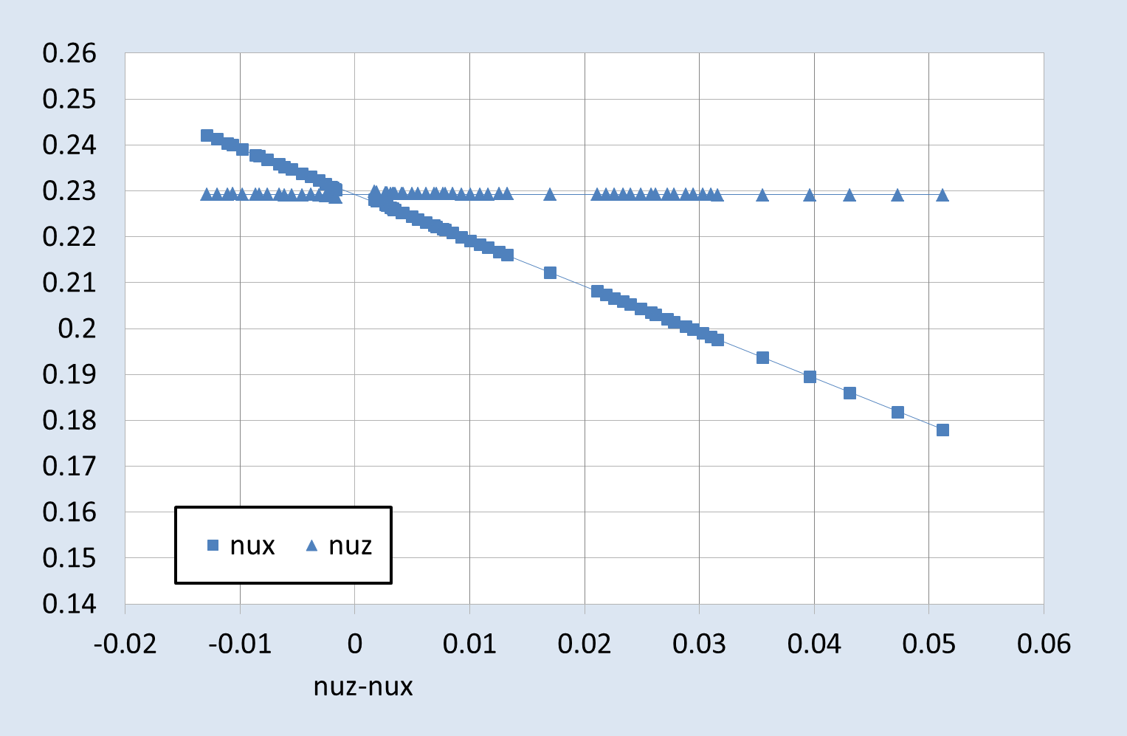
Test of the experimental setup with a low bunch current beam
nuz
nux-nuz = 18-10 = 8
.
10.229
1.7 10⁻³
nux
18.155

Slide 18
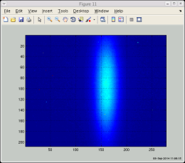
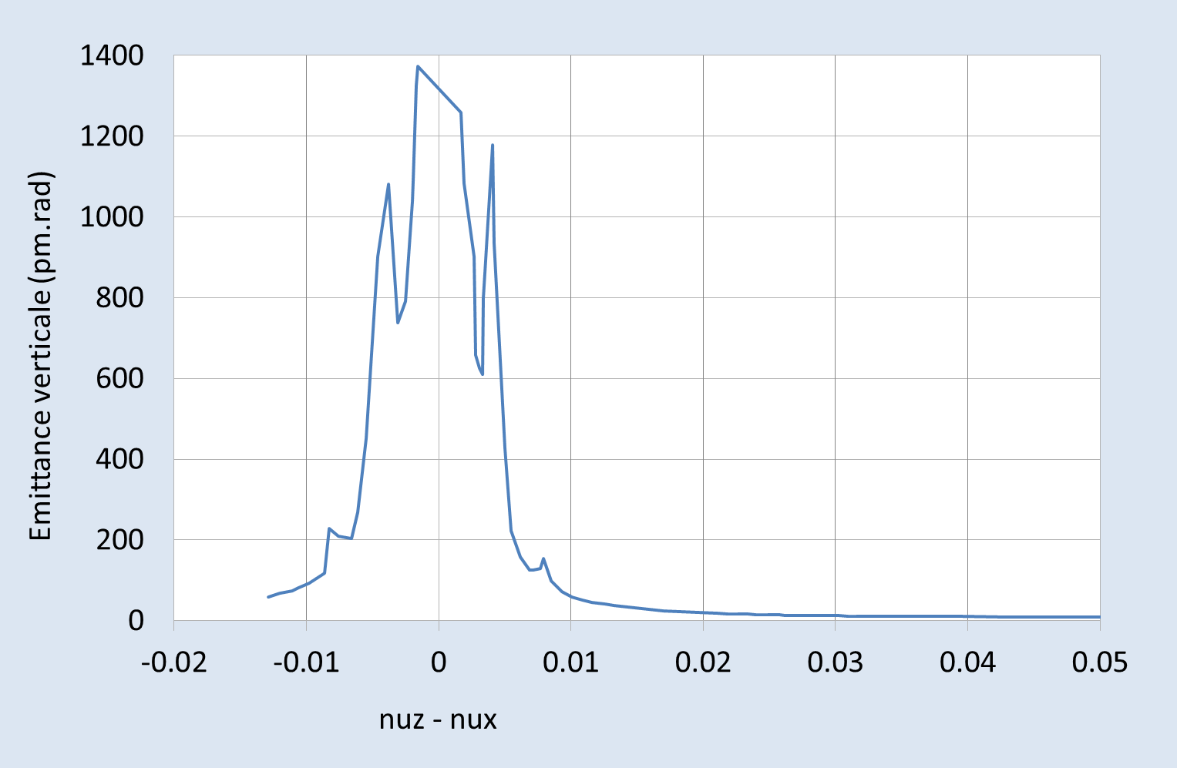
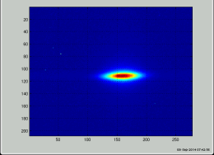
Test of the experimental setup with a low bunch current beam
nuz
nux-nuz = 18-10 = 8
.
10.229
nux
18.155

Slide 19
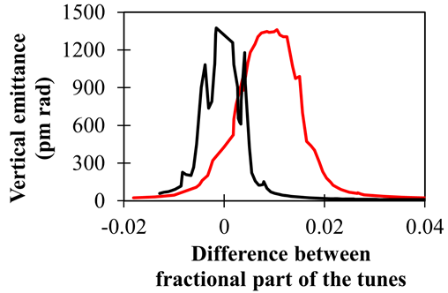
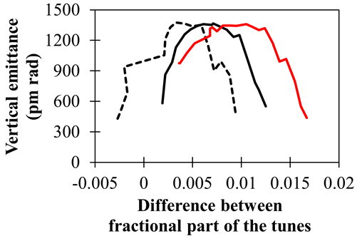
Application of the experimental setup to a high current bunch
Low current bunch
20 mA current bunch
Bunch current (mA) | Incoherent tune shift Δν_{x} = - Δν_{y}
20 | 5.0 10⁻³
16 | 4.0 10⁻³
12 | 3.2 10⁻³
6 | 2.2 10⁻³
3 | 1.0 10⁻³
6 mA current bunch
12 mA current bunch
20 mA current bunch

Slide 20
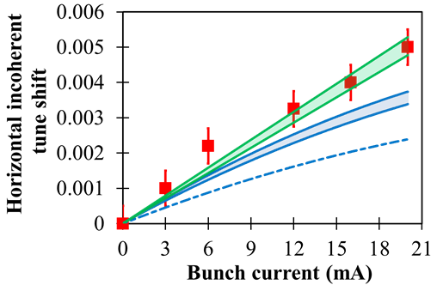
Comparison with theory
Measurements
Calculation:
- NEG coating (0.5 µm and 1.0 µm thickness)
- Bunch lengthening with current not taken into account
Calculation:
- NEG coating (0.5 µm and 1.0 µm thickness)
- Bunch lengthening with current taken into account
Calculation:
- NEG coating not taken into account
- Bunch lengthening with current taken into account

Slide 21
VI. CONCLUSION
• We studied the incoherent wake fields arising from the passage of a high current beam in non-circular resistive-wall beam pipes experimentally and numerically for the SOLEIL storage ring.
• We explored the time dependence of the excited field in the following three distinct regimes :
  Extremely long range over many revolutions.
  Range involving adjacent bunches.
  Short-range felt by particles within a bunch.
• Three specific experimental methods were applied respectively :
  Orbit response analysis with LOCO in deducing effective focusing strengths.
  Bunch-by-bunch tune measurement using a specific setup of transverse feedback.
  Intrabunch tune measurement using a betatron coupling resonance.
  • It was experimentally confirmed that a particle is focused nearly 20 times in a intense bunch of 20 mA than in a high multibunch beam of 500 mA
  ⇒ This can explain the different working points required for high current per bunch modes of operations as well as their much higher sensitivity to tunes.
• The experimental results were compared with calculations.
- In multibunch, the analytical treatment of the field penetration across the chamber wall appears to be one of the causes for the deviations from the measured tunes
- In single bunch where the field diffusion is not important, the theory tends to underestimate the measurement. Inclusion of the effect of NEG non-negligibly improves the agreement.

