Slide 1

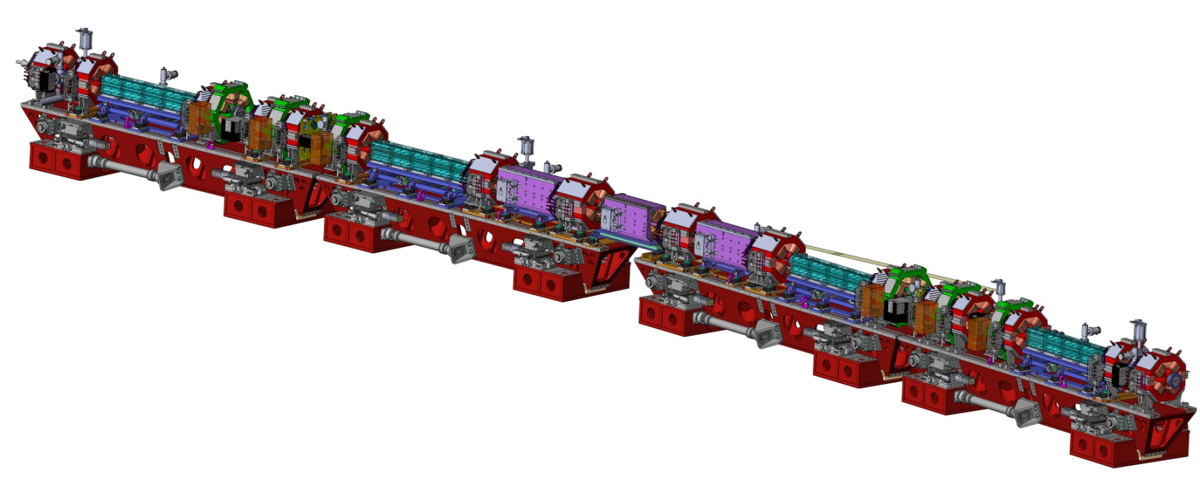
TWIICE 2 workshop
Abingdon, 8 February 2016
Collective effects in the ESRF upgrade machine
S. White
On behalf of the ASD group

Slide 2
Outline
Project overview
Performance goals, lattice,
vacuum chambers
comparison with present machine
Resistive wall
tune shift
coupled bunch modes
Geometric impedance
RF cavities, RF fingers, flanges,
BPMs, preliminary model
Summary and outlook

Slide 3
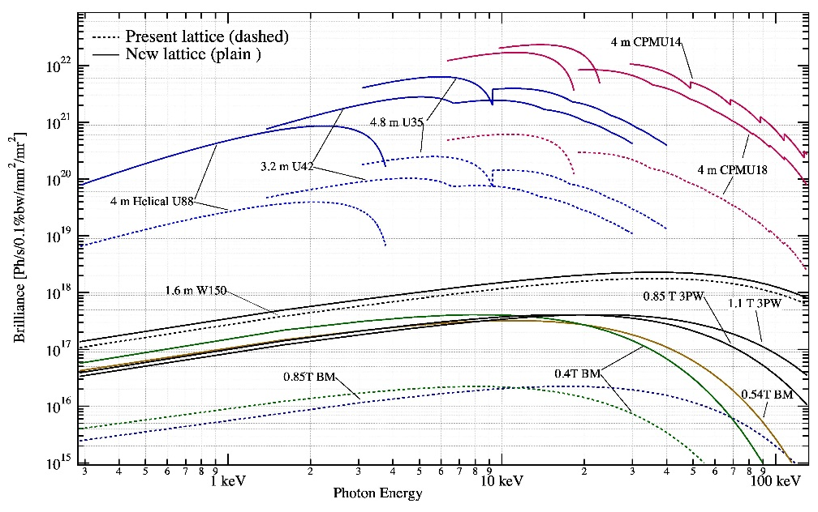
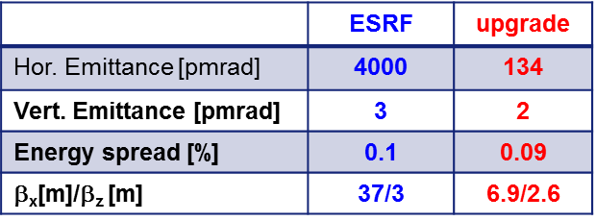
Design GOALS
The ESRF-EBS program (Extremely Brilliant Source) :
  Reduction of the horizontal equilibrium emittance
  Increase of coherence and brilliance
Constraints related to the present machine and users:
  Beam lines currently operating in dipoles and straight sections unchanged
  Same temporal structure of the bunches and a total current of 200mA
  Re-use as much as possible the current injectors and infrastructures
  Installation and commissioning should not exceed a duration of 19.5 months

Slide 4
MACHINE PARAMETERS AND FILLING MODES
 | Upgrade | ESRF
Energy [GeV] | 6.00 | 6.04
Circumference [m] | 843.98 | 844.39
Max. beam/bunch current [mA] | 200/10 | 200/10
Natural emittance [pm] | 135 | 4000
Tunes | 75.21, 26.34 | 36.44, 13.39
Multi-bunch Chromaticity | 6, 4 (10,10) | 4, 7 (8,12)
Energy spread [%] | 0.095 | 0.106
Momentum compaction | 8.72e-5 | 17.8e-5
Synchrotron tune | 3.52e-3 | 5.92e-3
Average β (X/Y) [m] | 4.0/7.6 | 16.6/24.8
Lifetime multi-bunch [h] | ~20 | ~80
Uniform:
992 bunches
200mA total
7/8+1:
868+1 bunches
200mA total
8mA single
16 bunches:
90mA total
~6mA per bunch
4 bunches:
40mA total
10mA per bunch
Stability conditions required for a large variety of configurations
Reduced lifetime mitigated by top-up operation

Slide 5
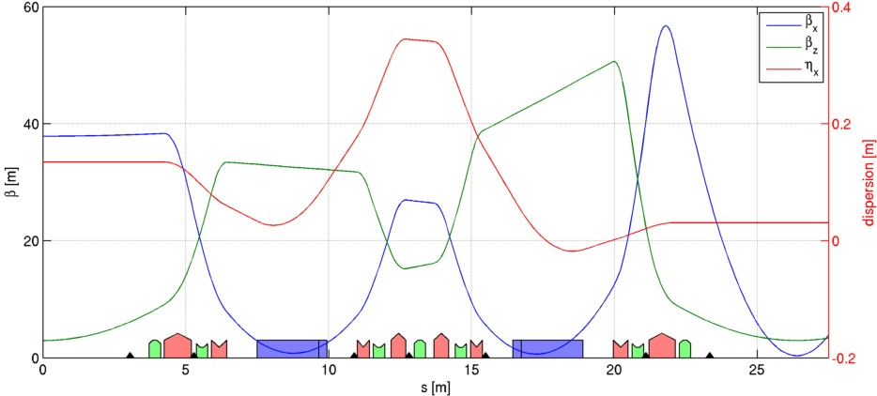
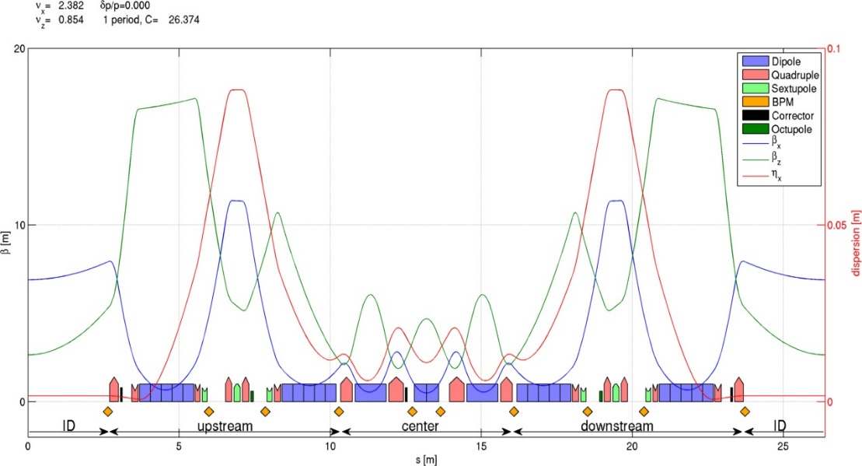
Linear optics
Present lattice:
  16 super-periods (32 cells in total)
  2 dipoles per cell
  Emittance ε_{x}~4nm
New lattice:
  32 super-periods
  7 dipoles per cell
  Emittance ε_{x}~135pm
Present lattice
Main characteristics:
  2 high dispersion zones to allow for chromatic corrections
  Δφ~π between chromatic sextupoles: partial sextupolar resonances compensation
  Longitudinal gradient in dipoles: emittance reduction
New lattice

Slide 6
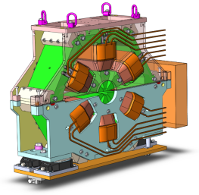
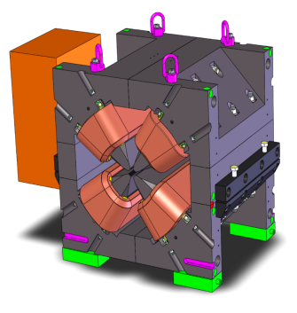
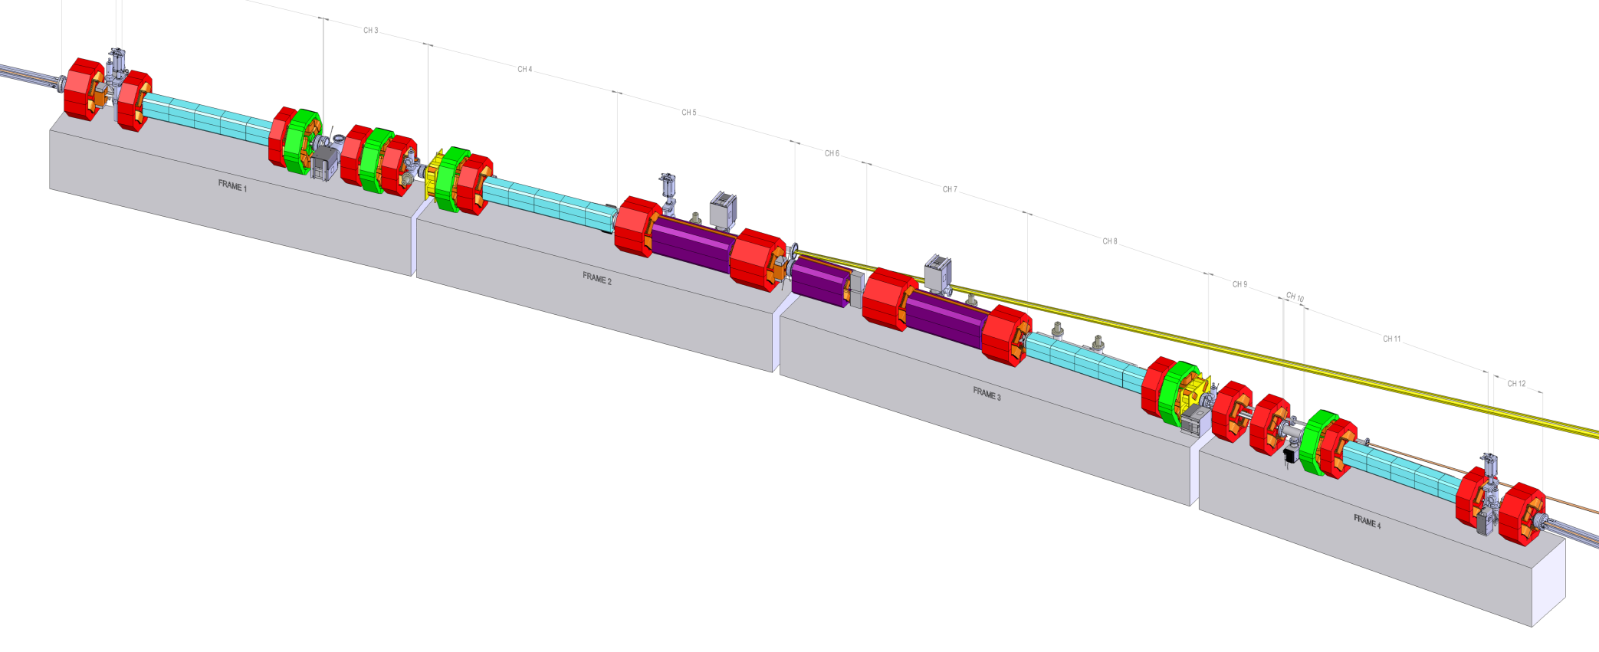
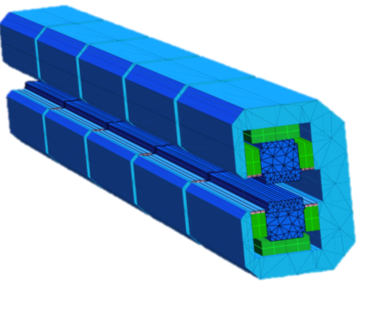
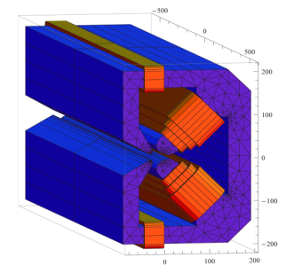
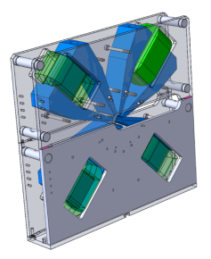
Magnets
192 Sextupoles
Length 200mm
900-2200 Tm⁻²
Also used as dipole and skew quad correctors
128 High gradient Quadrupoles
Gradient: 85 T/m
Bore radius: 12.5 mm
Length: 390/490 mm
Power: 1-2 kW
96 Correctors (H/V)
Length 120mm
0.08 T
384 Moderate gradient quadrupoles
Gradient: 51 T/m
Bore radius: 15.5 mm
Length: 160/300 mm
Power: 0.7-1 kW
All magnets individually powered
128 Permanent magnet dipoles
longitudinal gradient 0.16 − 0.65 T, magnetic gap 26 mm
1.8 meters long, 5 modules
Hybrid Sm2Co17 / Strontium Ferrite
96 Combined function
Dipole-Quadrupoles
0.54 T / 34 Tm⁻¹
& 0.43 T / 34 Tm⁻¹
64 Octupoles
51.2 10³ T/m⁻³
Courtesy of G. Le Bec

Slide 7
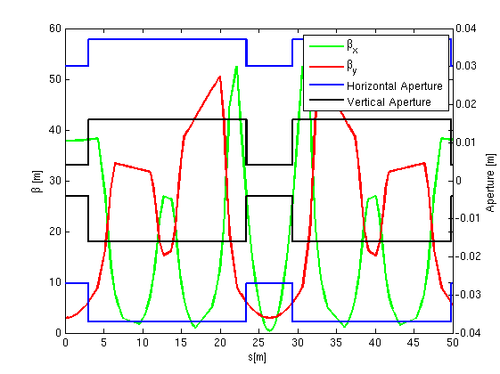
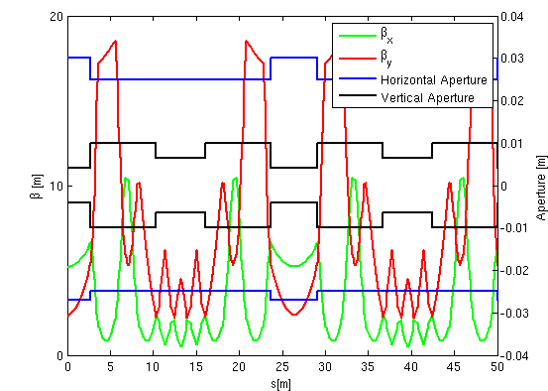
Beam pipes
Present machine:
2 apertures
Present machine:
Arc vertical aperture 32mm stainless steel
ID vertical aperture 8mm NEG coated aluminum
New machine:
Upstream/downstream vertical aperture 20mm stainless steel
Central vertical aperture 13mm stainless steel
ID vertical aperture 8mm NEG coated aluminum
Aluminum chambers in all dipoles
32mm
8mm
Upstream/downstream chamber
TM cut-off = 9.33 GHz
New machine:
3 apertures
Central (strong focusing) chamber
TM cut-off = 13.76 GHz
20mm
8mm
13mm
ID chamber

Slide 8
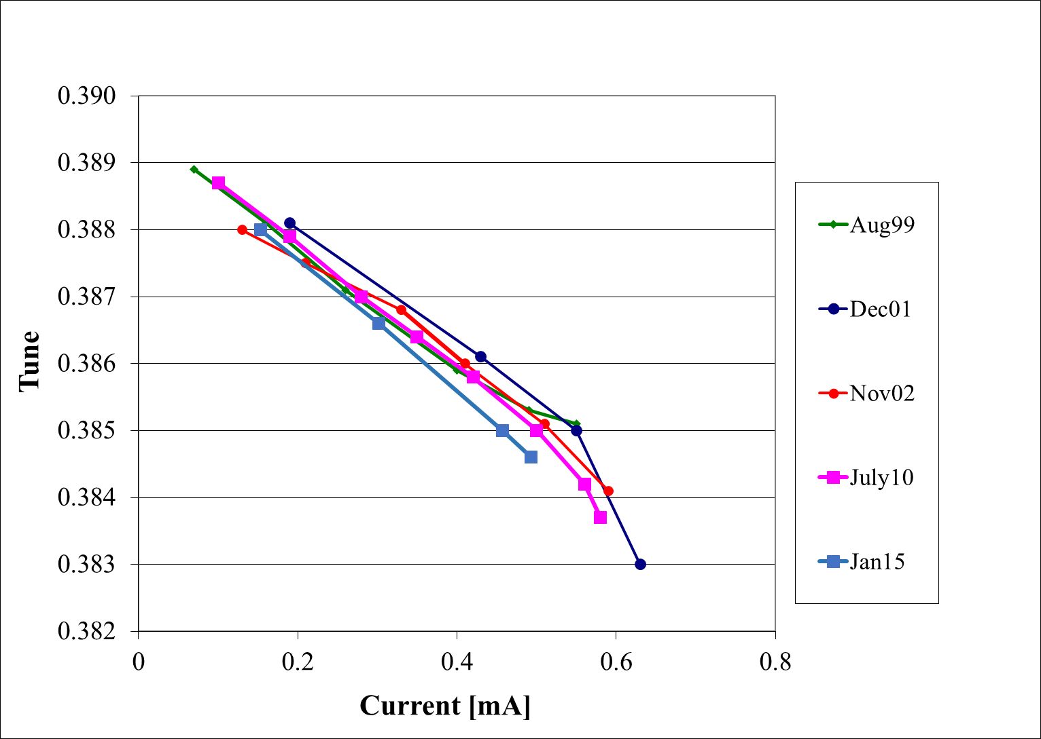
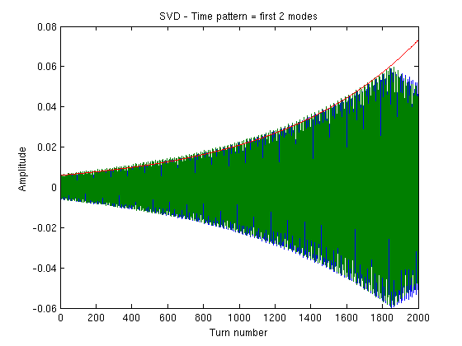
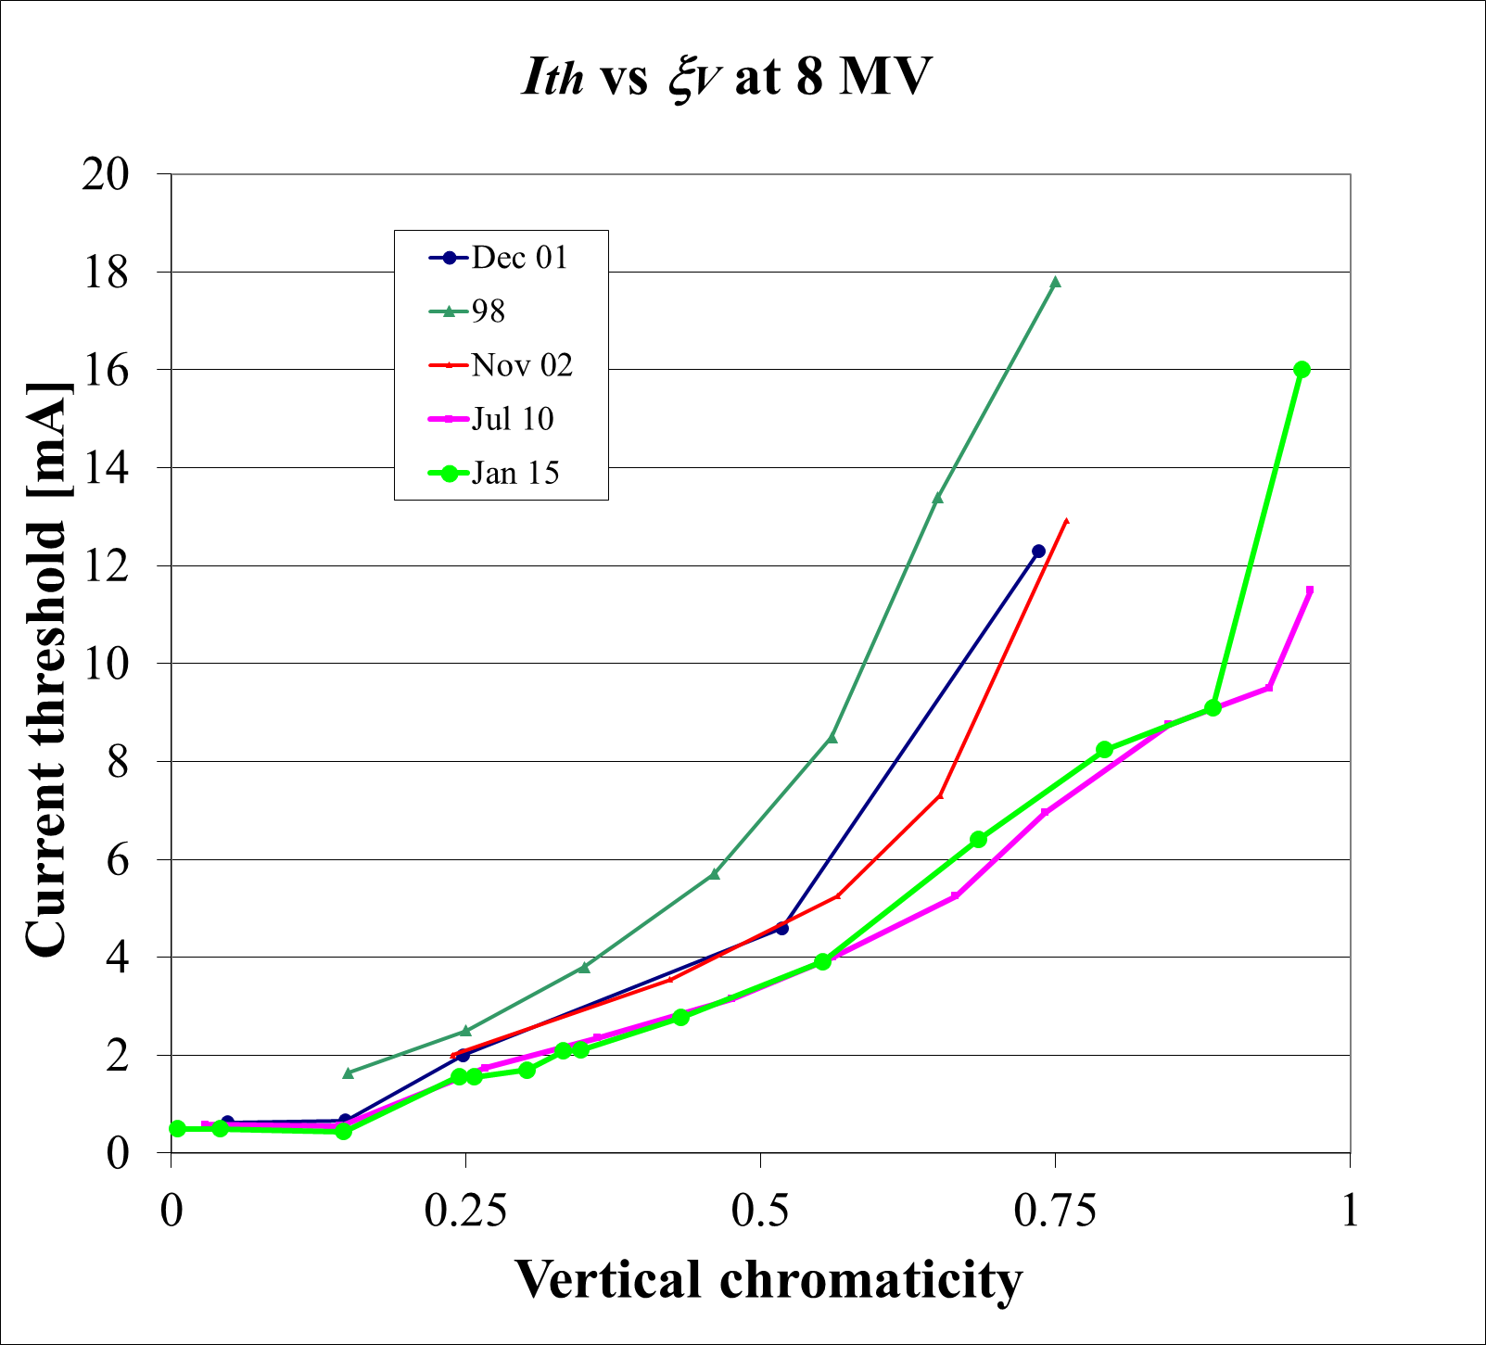
Present situation and Implication of new parameters
    Reduced beam pipe aperture- increased geometric and resistive wall wake fields:
      Stronger single bunch instabilities: TMCI, microwave
      Stronger resistive wall multi-bunch instabilities
    Beam / lattice parameters:
      Smaller Q_{s} / α_{p}: TMCI/microwave at lower currents?
      Lower β-functions: improved transverse impedance effects
    Present situation (See E. Plouviez’s talk for details):
      Feedbacks not required to stabilize standard operation modes
      Used to stabilize ion instabilities during vacuum conditioning
Microwave threshold ~4.5mA
Q’=0.0: threshold ~0.5mA
Q’=0.0
Tune shift and threshold: instability cured by chromaticity up to >10mA
Multi-bunch transverse instability:
cured by chromaticity up to 200mA

Slide 9
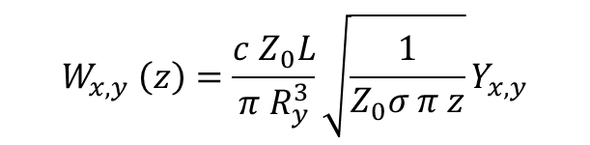
Resistive wall
 | L [m] | <β_{x}> [m] | <β_{y}> [m] | Rx [mm] | Ry [mm] | s [S/m]
Present Machine
Arc | 673.2 | 14.7 | 29.8 | 37.0 | 16.0 | 1.45e6 (SS)
ID | 171.2 | 23.5 | 4.1 | 28.5 | 4.0 | 3.5e7 (NEG,Al)
New Machine
Central | 96.9 | 1.83 | 2.73 | 25.0 | 6.5 | 1.45e6 (SS)
Up/down | 255.7 | 6.24 | 9.38 | 25.0 | 10.0 | 1.45e6 (SS)
Dipole | 91.4/228.9 | 1.24/1.16 | 11.3/3.75 | 25.0 | 6.5/10.0 | 3.5e7 (Al)
ID | 171.2 | 7.4 | 3.98 | 28.5 | 4.0 | 3.5e7 (NEG,Al)
$$W_{x,y} \left(z\right)=\frac{c Z_{0}L}{π R_{y}^{3}}\sqrt{\frac{1}{Z_{0}σ π z}}Y_{x,y}$$
Y is the Yokoya factor to account for elliptical shape: for a flat beam chamber: ~0.41/0.82
The total wake field is the sum of the components weighted by <β>
The wake is computed using IMPEDANCEWAKE2D (N. Mounet)
assumed 8mm NEG coated Aluminium beam pipe in all IDs: in-vacuum undulators are not taken into account

Slide 10
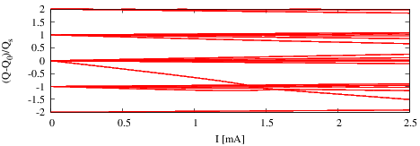
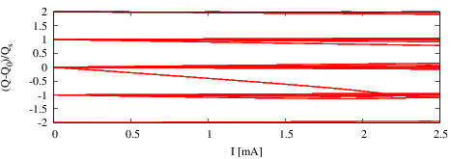
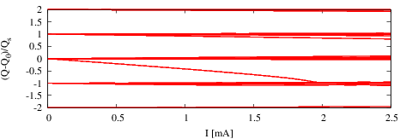
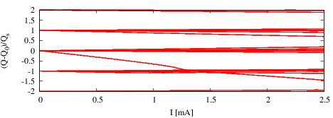
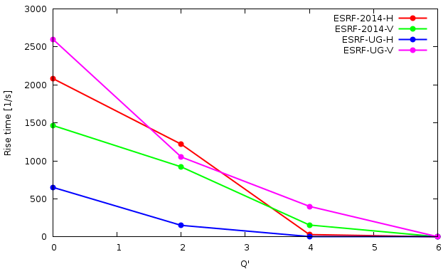
Transverse TUNE shift and Coupled bunch modes
Present machine
New machine
The vertical threshold is the most important
ΔQ/Qs degraded by approximately 50% in the vertical plane, better in the horizontal plane
Stability to be evaluated with the complete model
Feedbacks could become useful again
Ith~1.9mA
Ith~1.3mA
Simulations done with HEADTAIL including radiation damping:
7/8 filling pattern, 868 bunches, 200mA total current: well below TMCI threshold
The chromaticity thresholds for the present machine are consistent with operational data Q~4-6
Behaviour should be relatively similar for the upgrade machine + feedbacks available

Slide 11
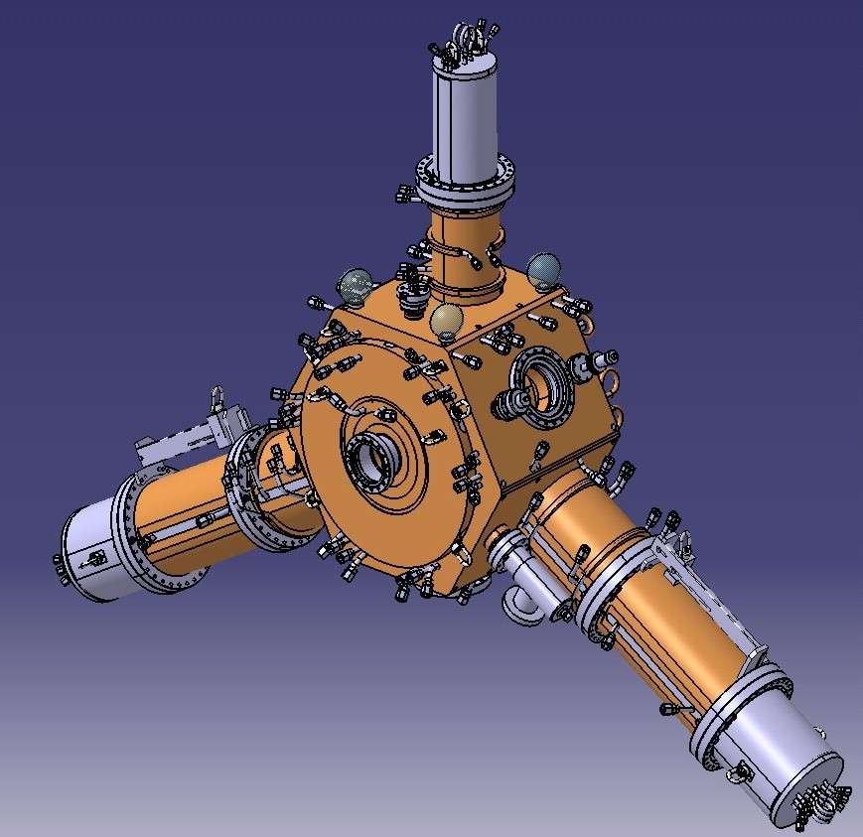
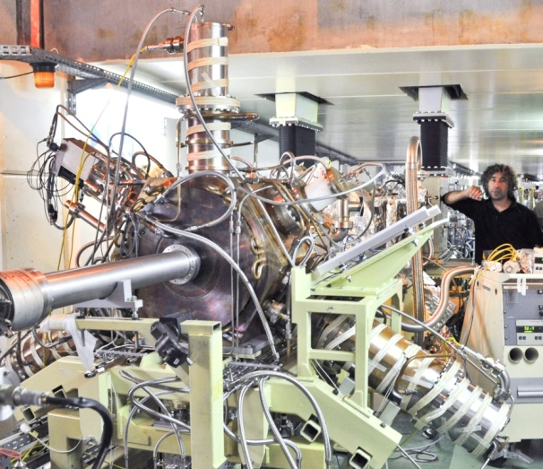
RF Cavities
Based on 500 MHz BESSY, MLS, ALBA design [E.Weihreter et al.]
ESRF 352.2 MHz design: several improvements
3 cavities installed and tested (passive and active) in the ESRF
HOM absorbers:
Ferrite loaded tapered ridges
352 MHz
HOM dampers = ridge waveguides
3 RF sections up to 15 modules
Courtesy of V. Serriere

Slide 12
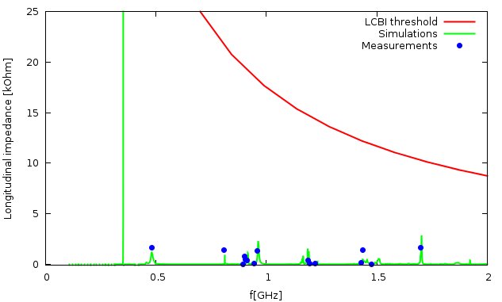
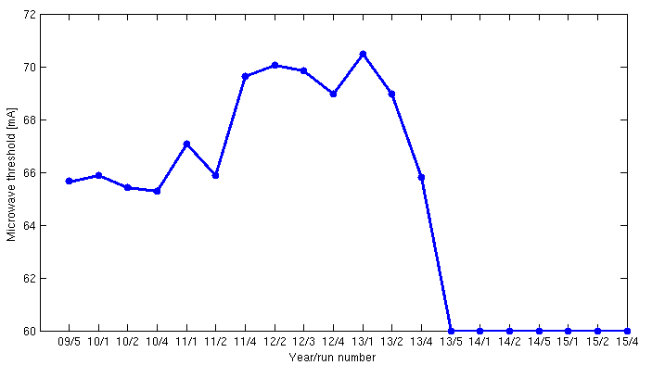
Simulations and measurements
Very exhaustive design study. See: ‘Cavity design report’ , V. Serriere et al.
Longitudinal coupled bunch instabilities should not be an issue
Design optimization
Simulation and bead-pull
measurements
The microwave threshold can be monitored during USM (User Service Mode) in 16 bunches operation by looking at the energy spread
The installation of prototype cavities seems to be correlated to a degradation: large contribution to the overall impedance budget
The same degradation was observed on bunch length measurements
Cavity
prototypes
Installation?

Slide 13
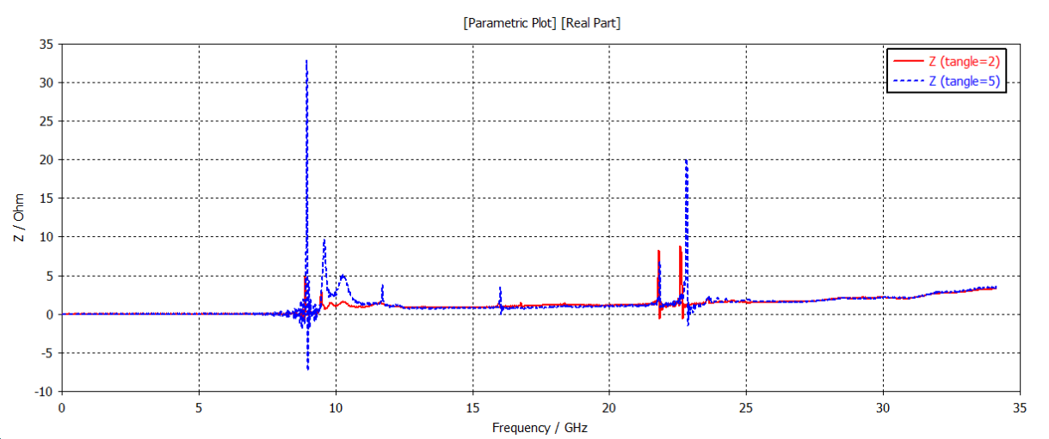
RF fingers
Being patented:
Schematic view
Non axisymmetric geometry:
Enforced constant profile at +/-25mm for all devices
Side view, X=0
50mm
front view
e⁻ beam
e⁻ beam
taper: θ=2º
0.3mm step
In-house design (T. Brochard):
-Mechanically very robust
-Impossible for a finger to ‘fall’ in
the vacuum chamber
Side blades added and distance between blades <1mm: impedance given by transitions from the chambers to the blades
Prototype installed: some heating observed but the data is polluted by a nearby absorber: further tests required
k_{loss}(5º) ≈ 2.0e-2 V/pC
k_{loss}(2º) ≈ 5.0e-3 V/pC

Slide 14
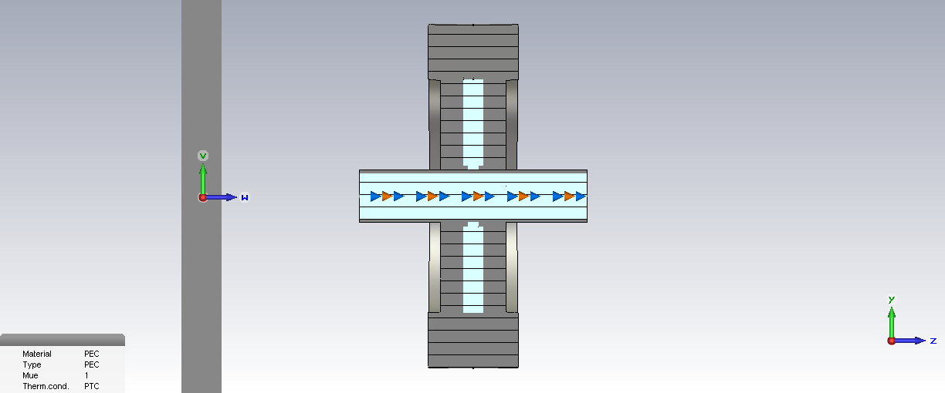
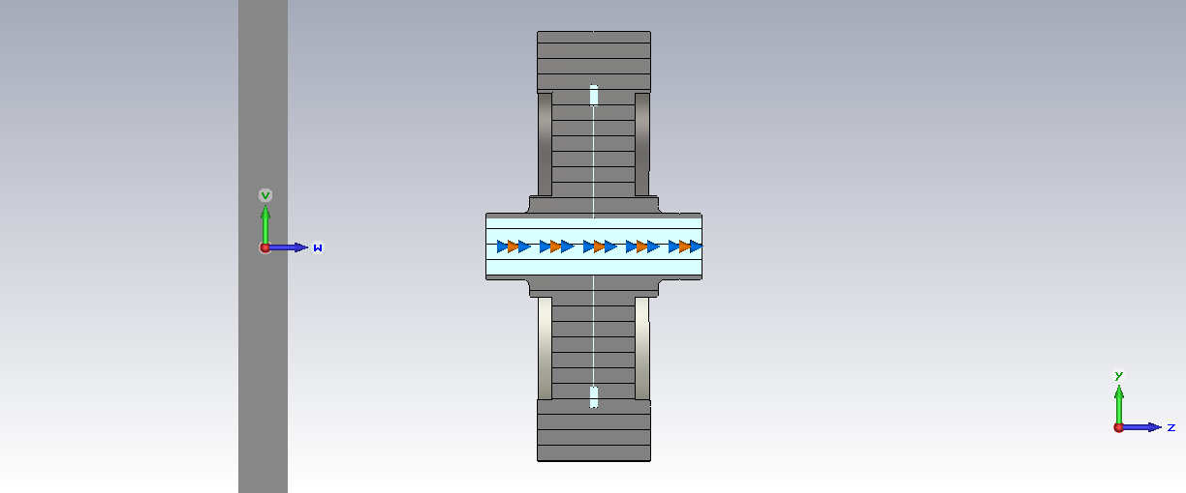
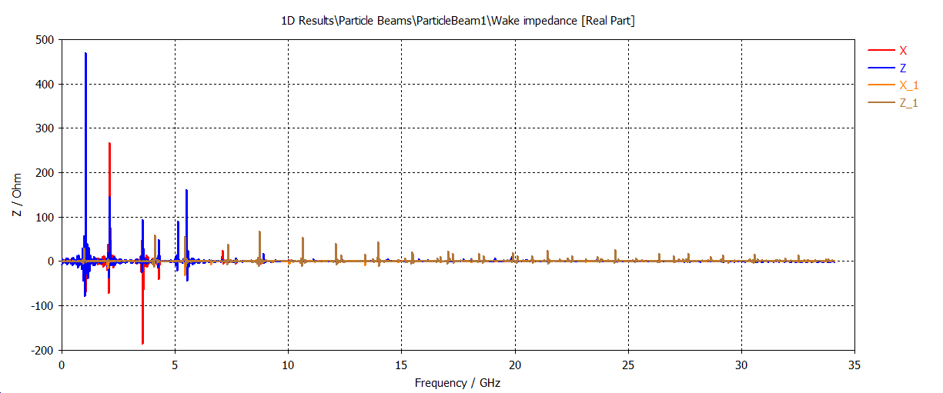
FLANGES
Design 1
Design 2
Two designs initially proposed by the drafting office
About 500 flanges in the new machine
2.8mm
3.0mm
strong modes
X1
Z1
X2
Z2
3.2mm
~beam pipe cut-off
Finally decided to add a conductor joint to design #2 to minimize impedance
Joint shape optimized to minimize discontinuities in the profile
significant constant wake

Slide 15
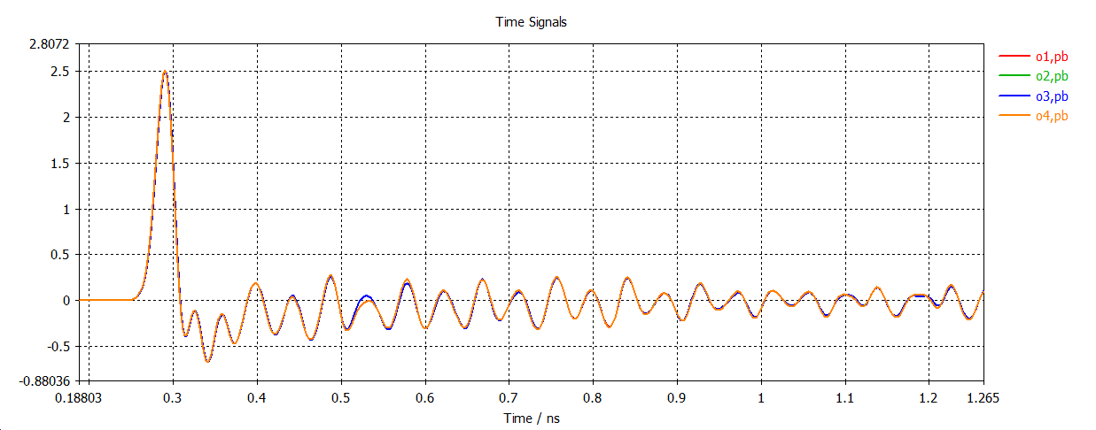
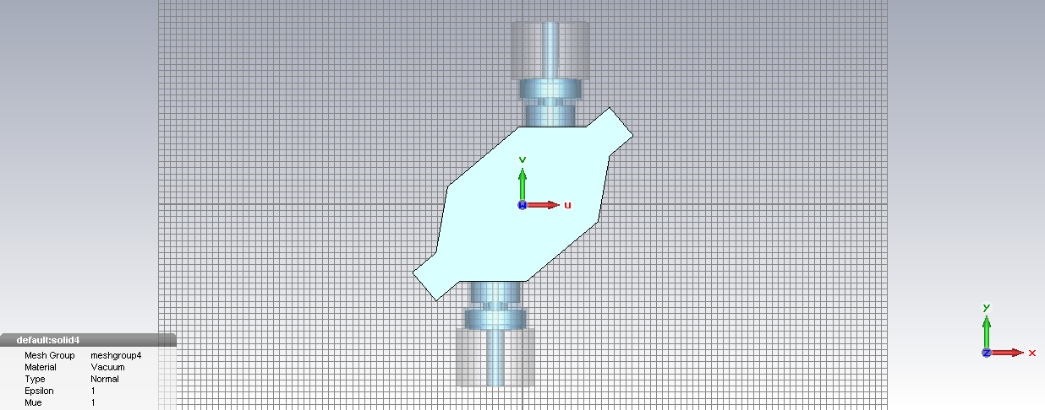
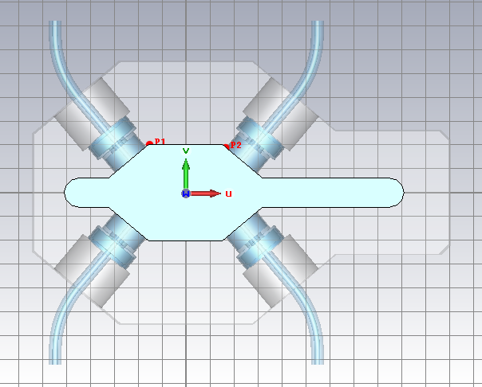
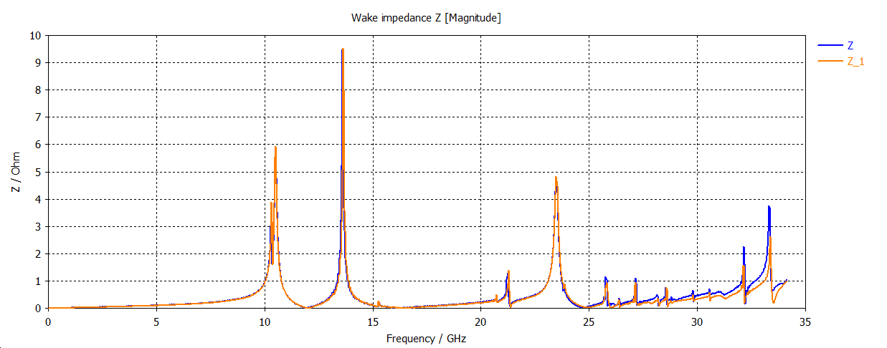
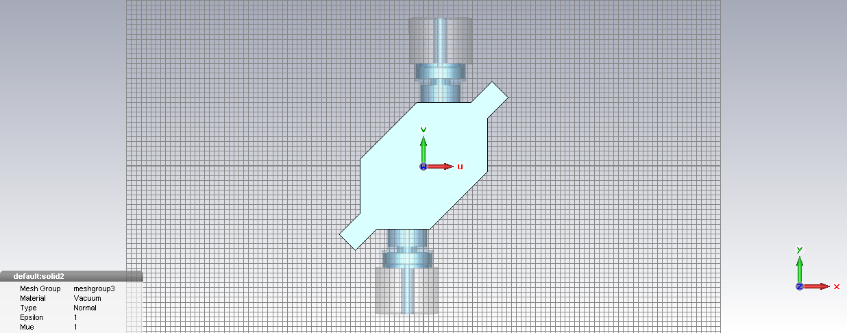
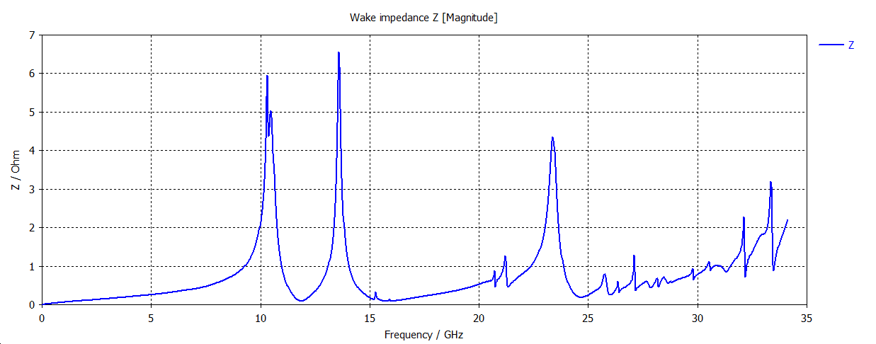
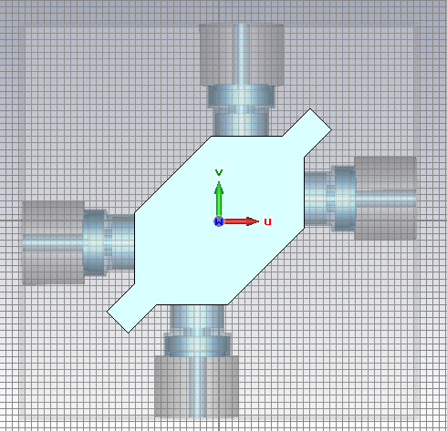
Beam position monitors
40º
Not converged even
With 4.0e6 mesh cells
Modified geometry:
No significant impact
40º
45º
Issues meshing the coaxial structure in CST:
Aligned BPMs with the XYZ reference system
Changed the angle between buttons to 45º
Full geometry:
k_{loss} ~ 7.5e-3
45º

Slide 16
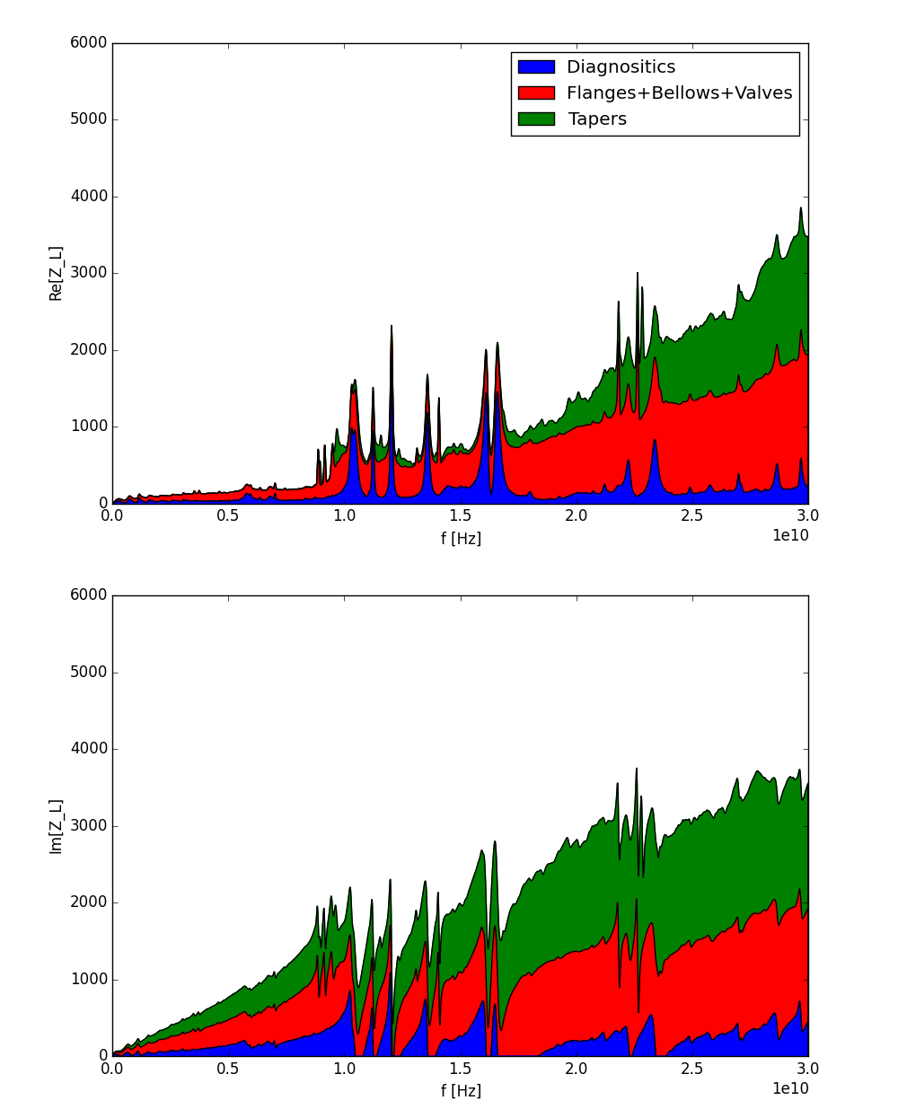
Preliminary longitudinal impedance MODEL
The present model includes (all calculated for both chamber profiles and σ_{s}=3mm):
  BPMs, CTs, striplines
  Flanges, bellows, vacuum valves
  Tapers to/from ID, small profile, large profile
  Cavities and cavities tapers
  Resistive wall with all IDs with 8mm aperture
For now we are still below the measured Z/n~0.85 (2015)
Still missing: scrapers, absorbers, undulators, ceramic chambers,…
 | K_{loss} [V⁄pC] | Z⁄n [Ω]
Diagnostics | 3.4 | 8.5 10⁻³
Flanges+bellows | 7.7 | 25 10⁻³
Tapers | 1.5 | 21 10⁻³
Cavities | 4.5 | 0.39
Resistive wall | 38.7 | 0.22
Total | 55.8 | 0.67

Slide 17
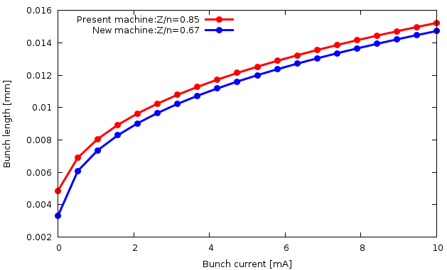

BUNCH LENGTHENING
Assuming a pure inductance we can estimate the bunch lengthening versus current using:
${\left(\frac{σ_{s}}{σ_{s0}}\right)}^{3}−\frac{σ_{s}}{σ_{s0}}= \frac{\sqrt{π} I Z_{n} }{{2 V_{rf}h\cos{φ_{s}} \left(\frac{ω_{0}}{ω_{s}} α σ_{δ0}\right)}^{3}}$
Although the impedance the impedance of the new machine is smaller (for now) the bunch length are almost equal in both cases
This also has an impact on lifetime (Touschek losses):
  Radiation protection
  Collimator design
Tracking simulations required to validate these results

Slide 18
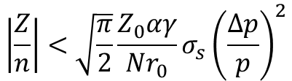
MICROWAVE THRESHOLD
The Keil-Schnell-Boussard criterion for bunched beams gives:
The analytical estimate for 0.7Ω give a threshold at 0.8mA which is well below the measured value:
  Poor approximation for ESRF parameters (short bunch length)
  We can however used this formula to scale the threshold
Using the new machine beam parameters and impedance estimates we get 0.25mA:
  Scaling the measured threshold we get 1.4mA
  This is fine for multi-bunch operation <1.0mA/bunch
  We can expect a strong degradation of single bunch operation
This is again to be confirmed with tracking once the full model is available
Studies are ongoing to evaluate de benefits of a 3rd harmonic cavity
$$\left|\frac{Z}{n}\right|<\sqrt{\frac{π}{2}}\frac{Z_{0}αγ}{Nr_{0}}σ_{s}{\left(\frac{∆p}{p}\right)}^{2}$$
2009 data:
-Measured threshold: ~4.5 mA
-Measured Z/n ~0.7Ω
To be noted: since then a degradation of ~20%
was observed without any complains for the beam lines

Slide 19
Summary and outlook
The reduction of beam pipe and modification of machine parameters has some impact on beam instabilities: the new machine will be more sensitive to impedance effects
Resistive wall:
      The negative impact of the reduction of aperture and synchrotron tune is partially compensated by changes of material and reduced β-functions
      Multi-bunch instabilities should not be an issue, ΔQ/Qs in the vertical plane is 50% larger
Geometric impedance:
      Mostly iterations with drafting office to reduce impedance until now, no detailed model
      New HOM cavities: longitudinal coupled bunch instabilities mitigated
      Tried to reduce as much as possible the impedance of the main contributors: flanges, bellows and tapers are improved w.r.t the present machine
Longitudinal model:
      Very preliminary, more refined model needed: for now lower than present impedance obtained
      Bunch length should be similar, microwave threshold strongly degraded
Outlook:
      Missing devices to be calculated and optimized
      Transverse impedance model calculation ongoing
      Short-range wake field for tracking simulation should become available over the coming year
      3rd harmonic cavity studies ongoing

Slide 20
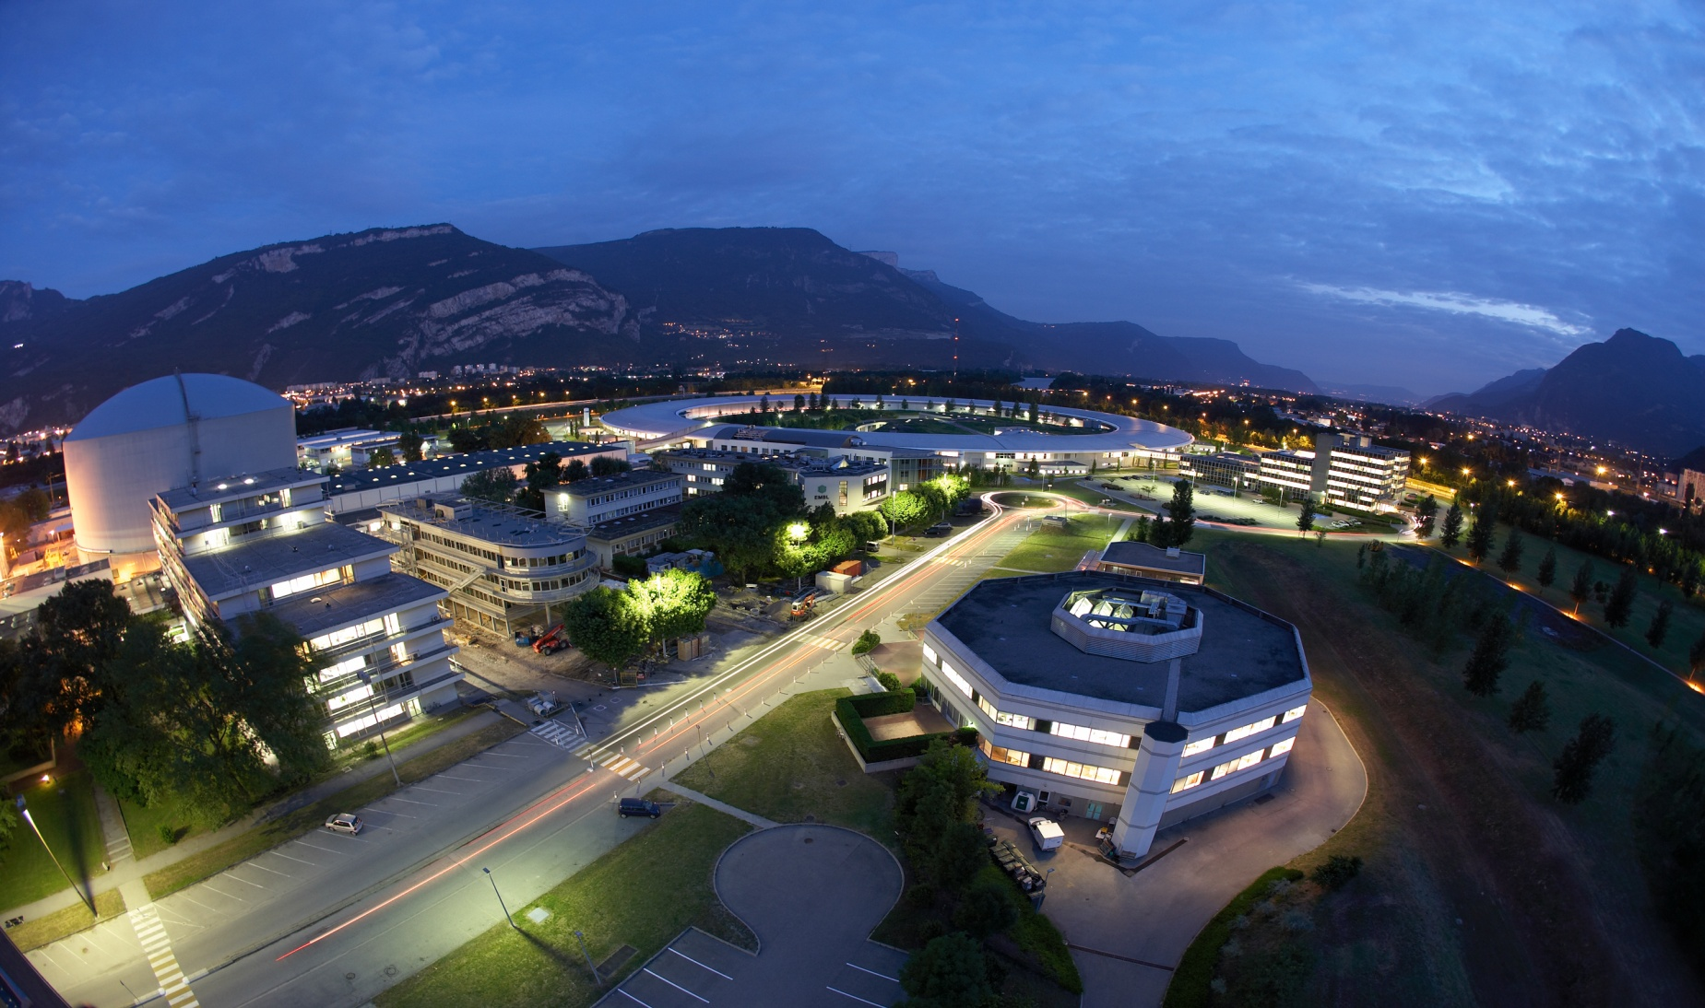
THANKS FOR YOUR ATTENTION

