Slide 1
Progress on macro-particle simulations of fast beam-ion instabilities in the framework of the PyHEADTAIL code
L. Mether, G. Rumolo
TWIICE 2 February 8th 2016

Slide 2
Outline
Fast beam-ion instability
Simulating the fast beam-ion instability
Simulation codes
  PyECLOUD
  PyHEADTAIL
  Ions in PyECLOUD and PyHEADTAIL
Outlook
Summary

Slide 3
Fast beam-ion instability
Gas molecules ionized by beam
Beam electrons accelerated by ions
Coupled electron-ion oscillations
Positive ions oscillate in beam field
Instability
In synchrotrons without clearing gap, ion density builds up over several turns
  Conventional ion instability
For bunch train followed by gap, ions build up only during one train passage
  Fast beam-ion instability (FBII)

Slide 4
Fast beam-ion instability
Ion density increases for every bunch passage – effect stronger at tail of train
Ions transfer information on offsets from bunch to bunch – head and tail of train coupled
Over time can lead to multi-bunch instability, tune shift, emittance growth

Slide 5

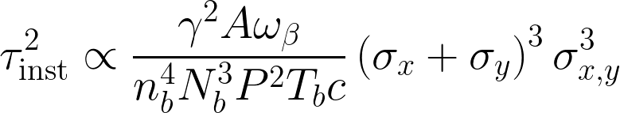
Analytical results
Treatment based on linear approximation of Bassetti-Erskine formula
  Velocity kick for ion with mass number A
    N_{b} = bunch intensity, σ_{x,y} = rms transverse beam sizes, r_{p} = classical proton radius
  Instability rise time
    T_{b} = bunch spacing, n_{b} = nr of bunches, P = pressure, ω_{β} = betatron frequency
  Long bunch train, high intensity, small beam → short rise time
Fast beam-ion instability. I. Linear theory and simulations
Raubenheimer et al. Phys. Rev. E 52, 5, 5487

Slide 6
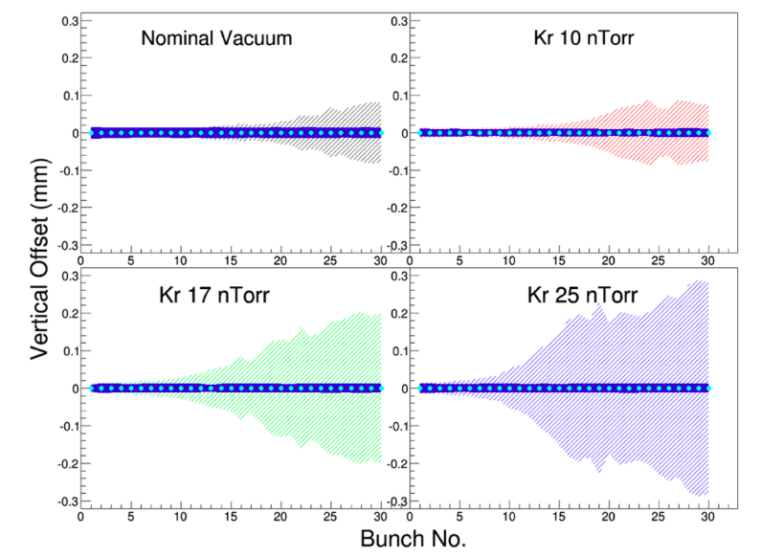
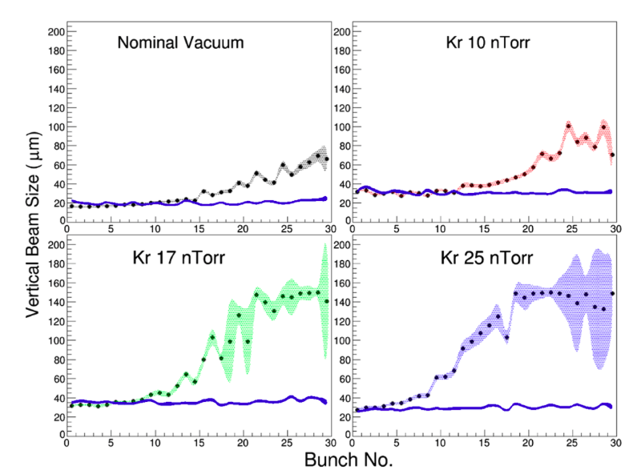
Observations
Observed in several machines under vacuum degradation
Measurements at CESR-TA (Dec. 2013, Apr 2014)
  Varying ion species, pressure, bunch charge, train structure, feedback etc.
Feedback on
Feedback on
A. Chatterjee et al. Phys. Rev. ST Accel. Beams 18 (2015) 6, 064402

Slide 7


Simulation studies
Simulation with strong-strong 2D macro-particle multi-bunch tracking code
Aim to estimate the effect of parameters on instability rise-time
  Beam parameters: intensity, emittance, etc.
  Constraints for vacuum pressure and composition
Relevant for several possible future projects at CERN
  CLIC (Compact Linear Collider)
  FCC-ee, FCC-he (Future Circular Collider)
  LHeC (Large Hadron Electron Collider)

Slide 8
Simulation outline
The machine lattice is divided into a number of interaction points (IP)
  An electron bunch train is tracked through the lattice
  In every IP, the beam-ion interaction is simulated
IP

Slide 9
Simulation outline
In every interaction point, the beam is passed bunch by bunch
Calculate e-fields
Generate ions
Give velocity kick
Introduce bunch

Slide 10
Simulation outline
In every interaction point, the beam is passed bunch by bunch
Represent ions generated between two IP’s
Electric fields of ions and electrons calculated separately on same grid
Calculate e-fields
Generate ions
Give velocity kick
Ion densities given by partial pressures and ionization cross-sections
Calculate e-fields
Velocity kicks applied according to e-field of opposite particles
Ion distribution
σ_{ion} = σ_{beam}
Generate ions
Give velocity kick
Drift ions
Transport bunch
Introduce bunch
Transport bunch
Introduce bunch

Slide 11
Simulation outline
In every interaction point, the beam is passed bunch by bunch
Represent ions encountered between two IP’s
Electric fields of ions and electrons calculated separately on same grid
Calculate e-fields
Generate ions
Give velocity kick
Drift ions
Ion densities given by partial pressures and ionization cross-sections
Velocity kicks applied according to e-field of opposite particles
Ion distribution
σ_{ion} = σ_{beam}
Introduce bunch
Transport bunch

Slide 12
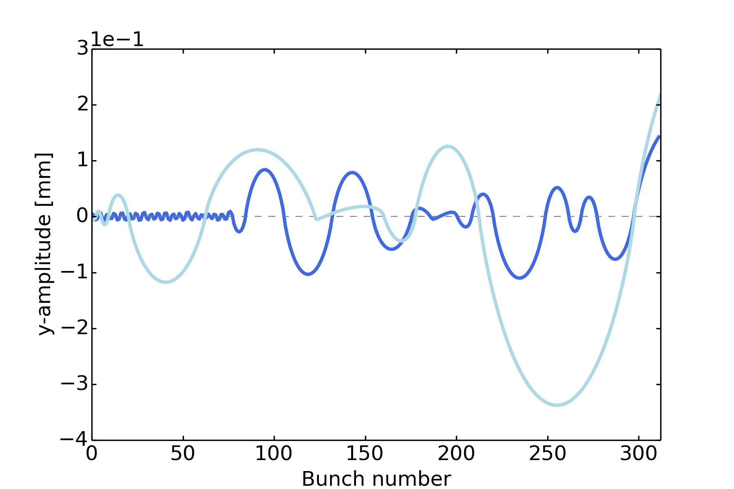
Simulation codes
FASTION
  Developed at CERN, by G. Rumolo
  Written in C
  Based on HEADTAIL for electron cloud
  Used e.g. for CLIC linear structures, CESR-TA
  Recent work to adapt to future synchrotrons
Several CERN beam dynamics codes re-designed in the past few years
  Aim to make codes more user friendly, maintainable and flexible
  Electron cloud build-up: ECLOUD → PyECLOUD
  Collective effects: HEADTAIL → PyHEADTAIL
Decision to incorporate fast beam-ion instability simulations into
framework of PyECLOUD and PyHEADTAIL codes
Sample ion trajectories, CLIC DR, H₂O
coupled

Slide 13
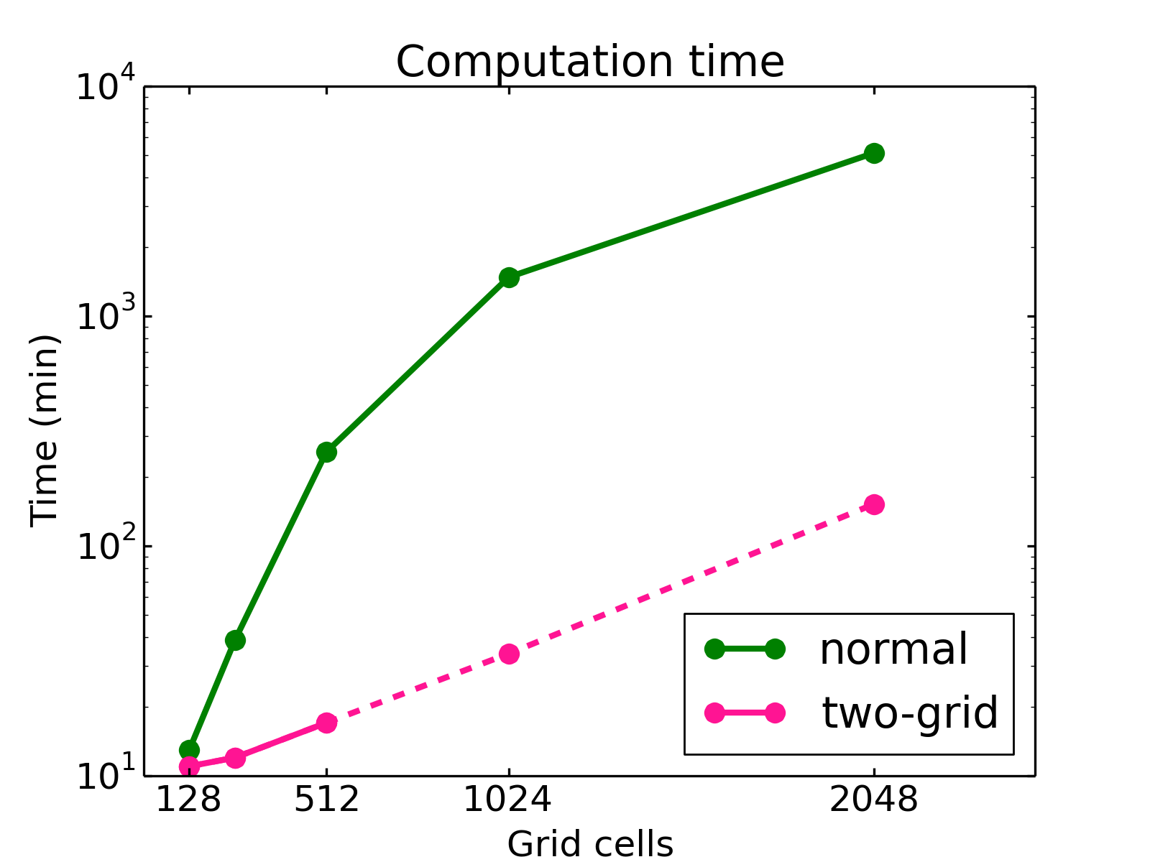
Recent work on FASTION
Run-time optimization
  For CLIC damping ring, simulate at least one damping time, τ_{d} ≈ 1400 turns
    Initially: 1 turn, 27 min → 26 days for 1400 turns
    After optimization: 1 turn, 16 min → 15 days for 1400 turns
Resolution problems
  Due to rescaling of grid to adapt to expanding ion distribution
    Good resolution → impossibly long run-time
Solution: two-grid method
  Keep grid around beam fixed
  Use second grid to track outer ions
    1 turn, 15 min → 14 days for 1400 turns
    With improved resolution
Next step: parallelization

Slide 14
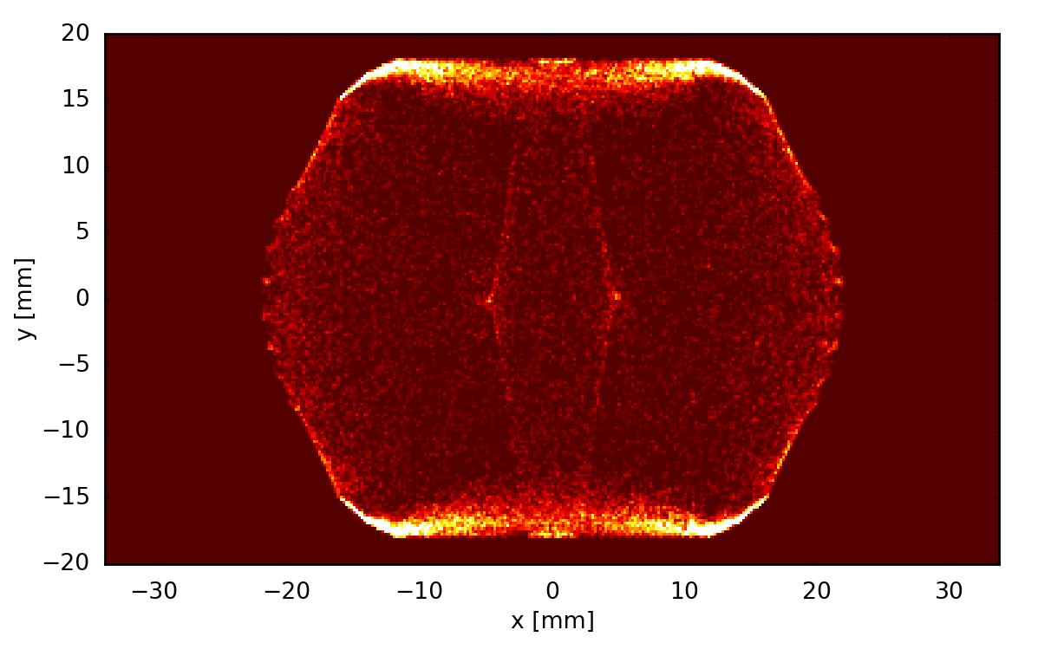
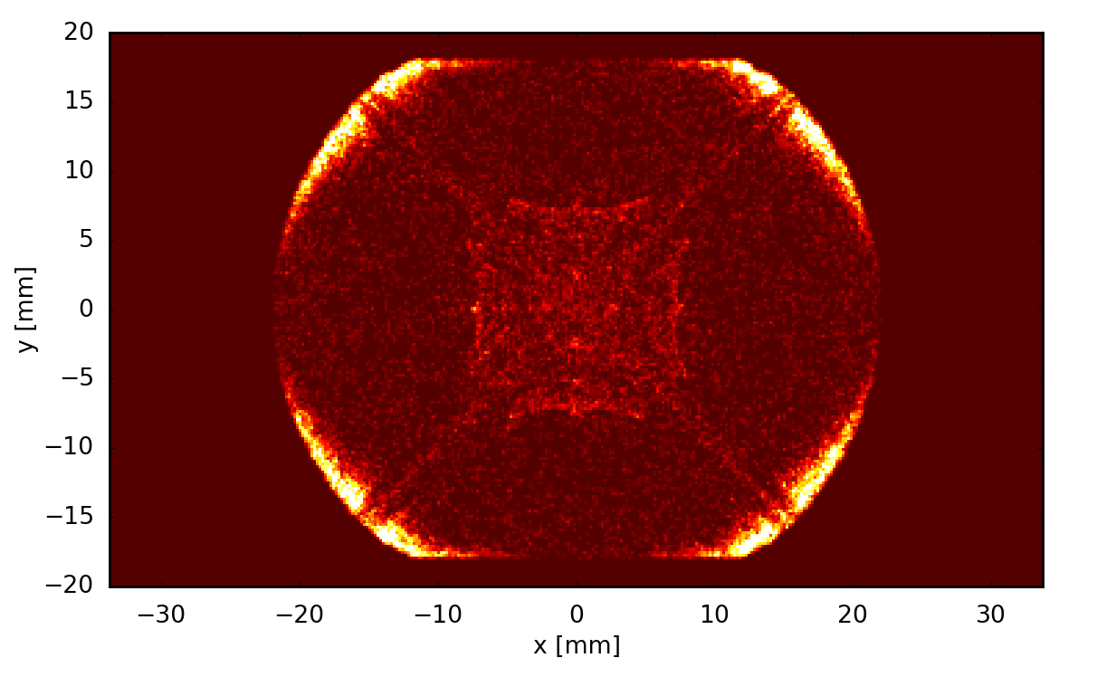
PyECLOUD
Simulation code for electron cloud formation
  Developed and maintained at CERN since 2011 by G. Iadarola
  Following the legacy of the ECLOUD code (F. Zimmermann et al., 1997…)
  2D macro-particle code
  Written in Python with Fortran (f2py) and C (CYTHON) extensions
Features
  Gas ionization
  Boris algorithm for moving particles in magnetic fields
  PIC module with multiple solver methods for arbitrarily shaped chambers
E-cloud pinch: Dipole
E-cloud pinch: Quadrupole
G. Iadarola

Slide 15
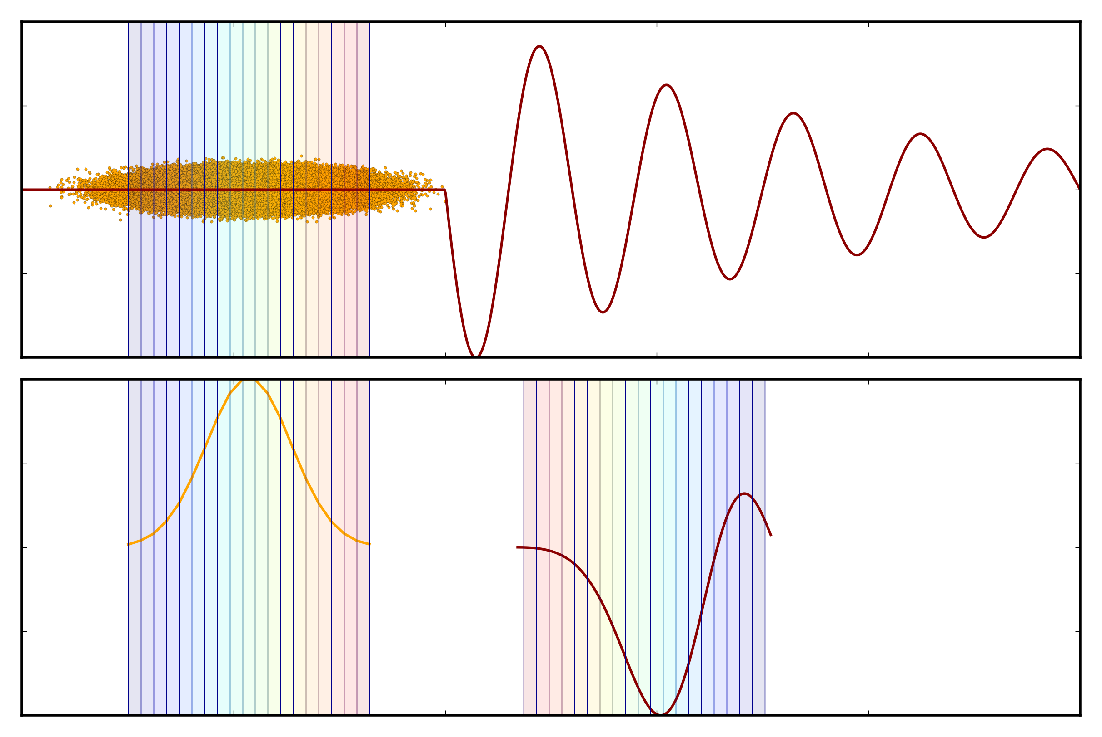
PyHEADTAIL
Simulation code for collective effects: impedance, e-cloud instability, etc.
  Developed and maintained at CERN since 2014 by H. Bartosik, K. Li et al.
  Based on the HEADTAIL code (G. Rumolo et al., 2000)
  2-3D macro-particle code
  Written in Python with C (CYTHON) extensions
Features
  RF systems and synchrotron motion
  Chromaticity
  Transverse feedback
github.com/PyCOMPLETE
  PyHEADTAIL
  PyECLOUD
  PyPIC
Wakefield
Wake kick
Kevin Li

Slide 16
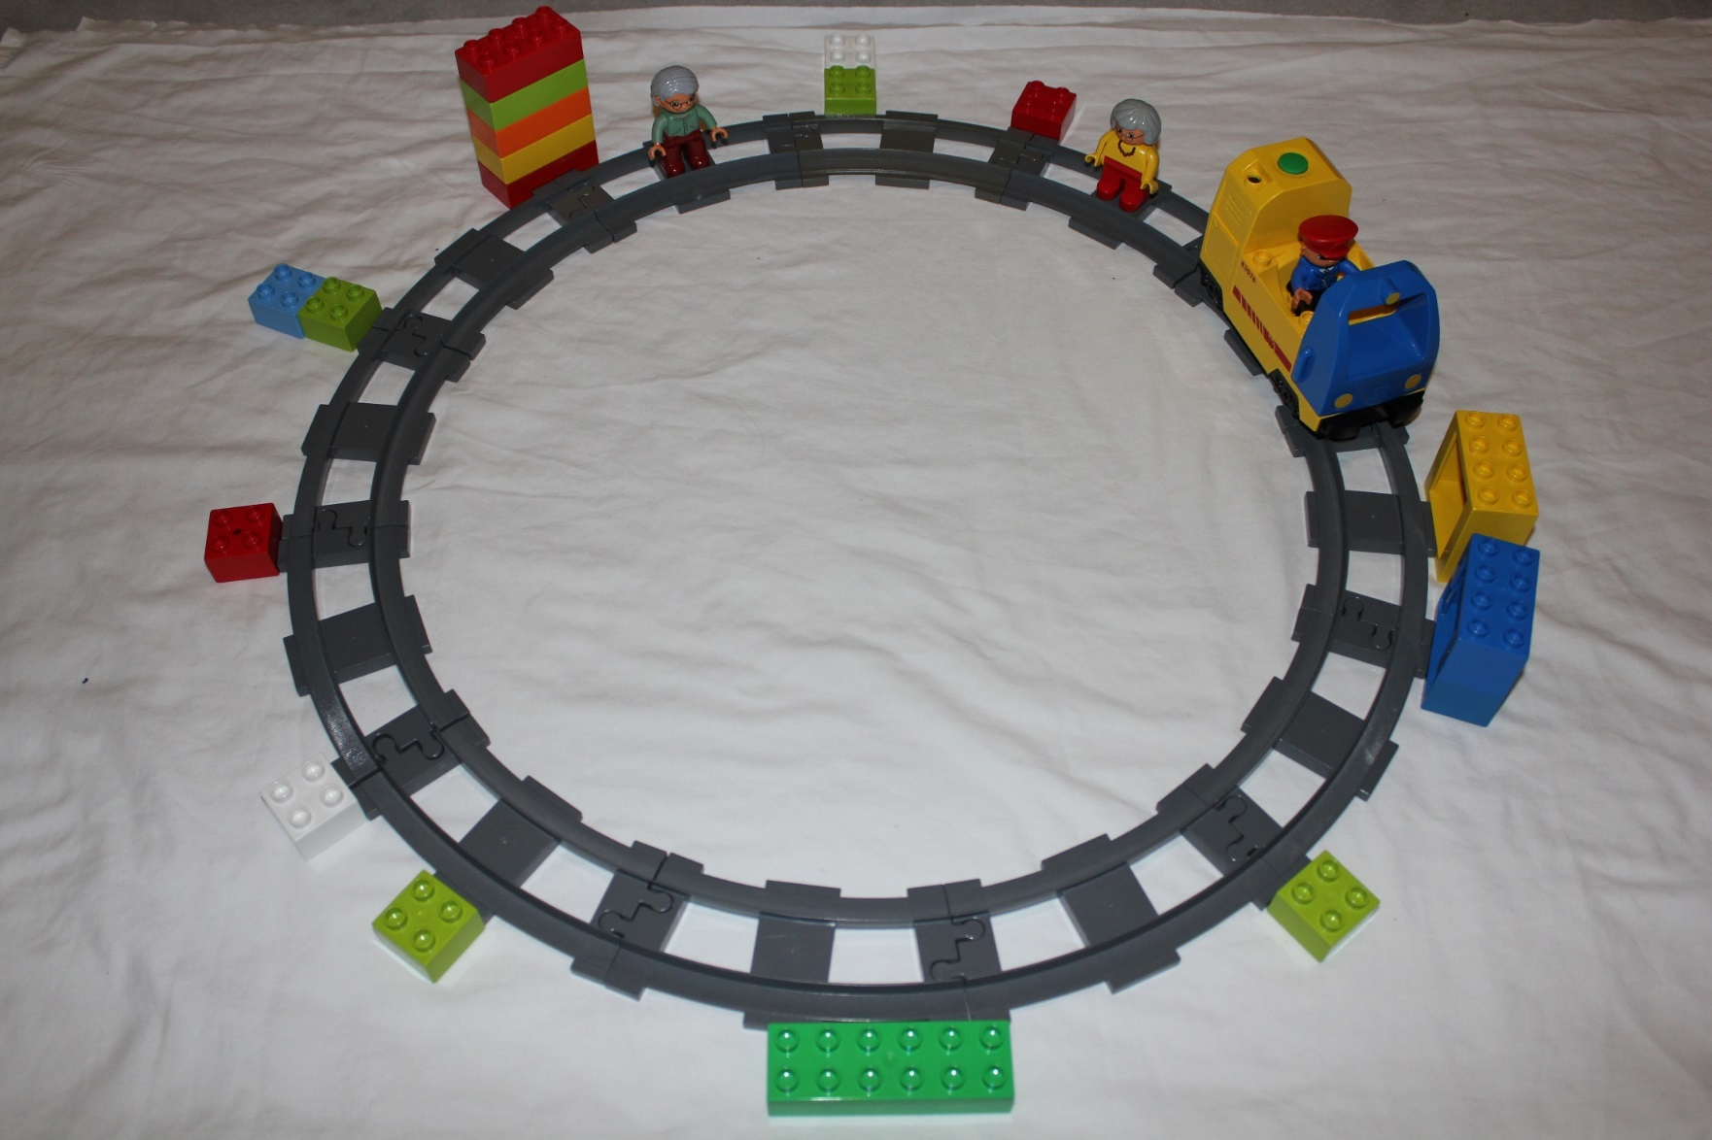
PyHEADTAIL coupled to PyECLOUD
PyECLOUD
(dipole)
Beam
RF system(s)
PyHEADTAIL
PyECLOUD
(quadrupole)
Impedances
PyECLOUD
(drift)
Tracking along the machine
(with Q‘, octupoles etc.)
Transverse feedback
Space charge
Kevin Li

Slide 17
Ion simulations with PyECLOUD and PyHEADTAIL
Interface for PyECLOUD as PyHEADTAIL module for beam dynamics simulations
PyECLOUD
Calculate e-fields
Generate ions
Give velocity kick
Drift ions
PyHEADTAIL
PyHEADTAIL
Introduce bunch
Transport bunch

Slide 18
Progress
Generalization to arbitrary charge and mass in PyECLOUD/PyHEADTAIL
Implementation of multi-bunch in PyHEADTAIL
Extension of PyECLOUD gas ionization routines
  Multiple species, field ionization
Implementation of grid methods
  Rectangular (non-square) grid cells
    Necessary for very flat beams (e.g. CLIC)
  Two-grid method
Testing
Parallelization
In progress
In progress

Slide 19
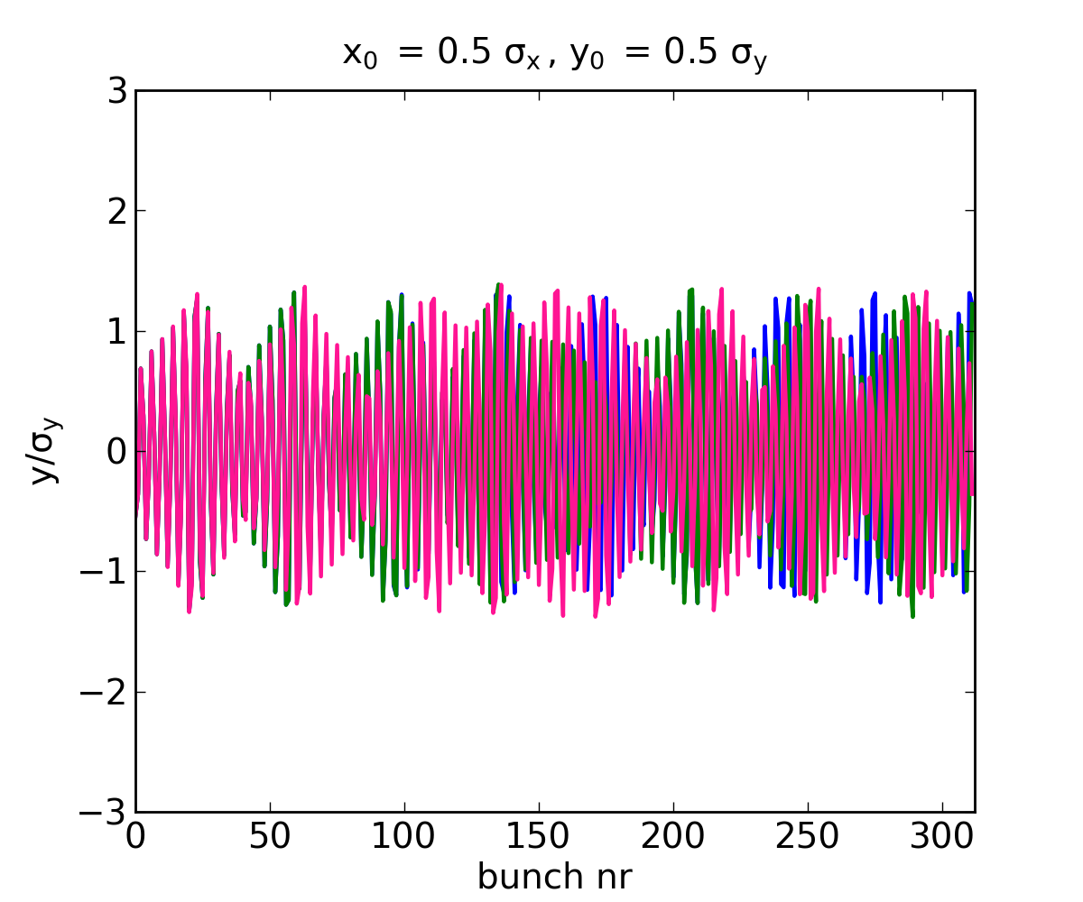
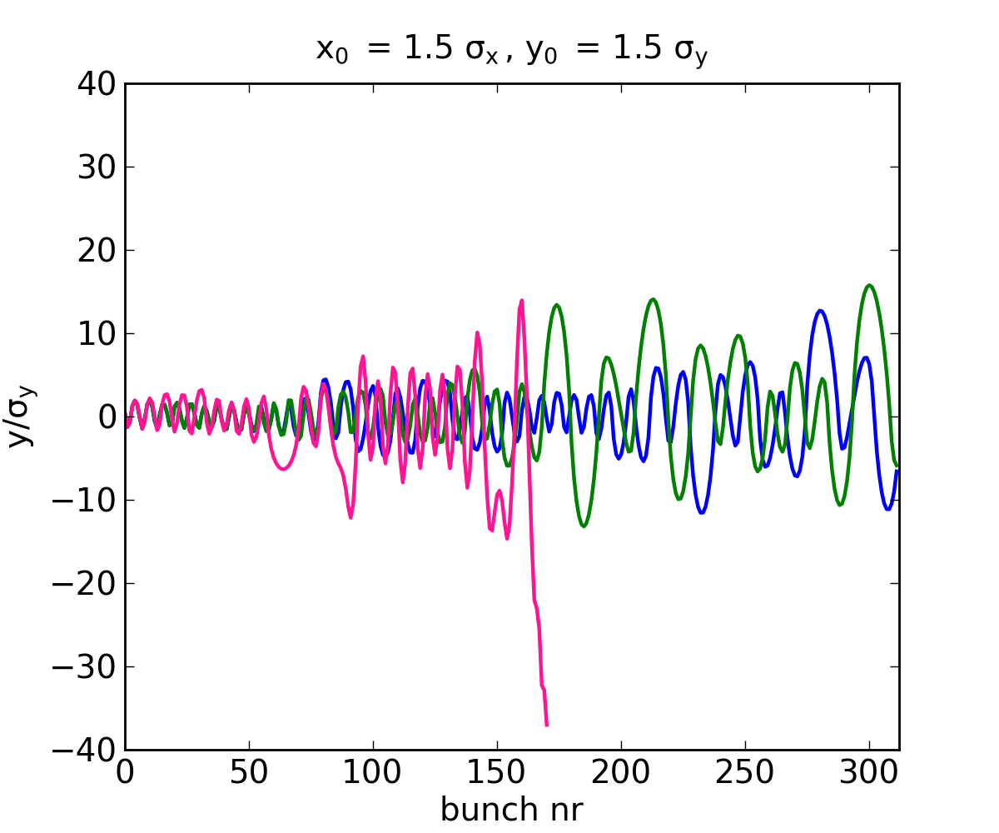
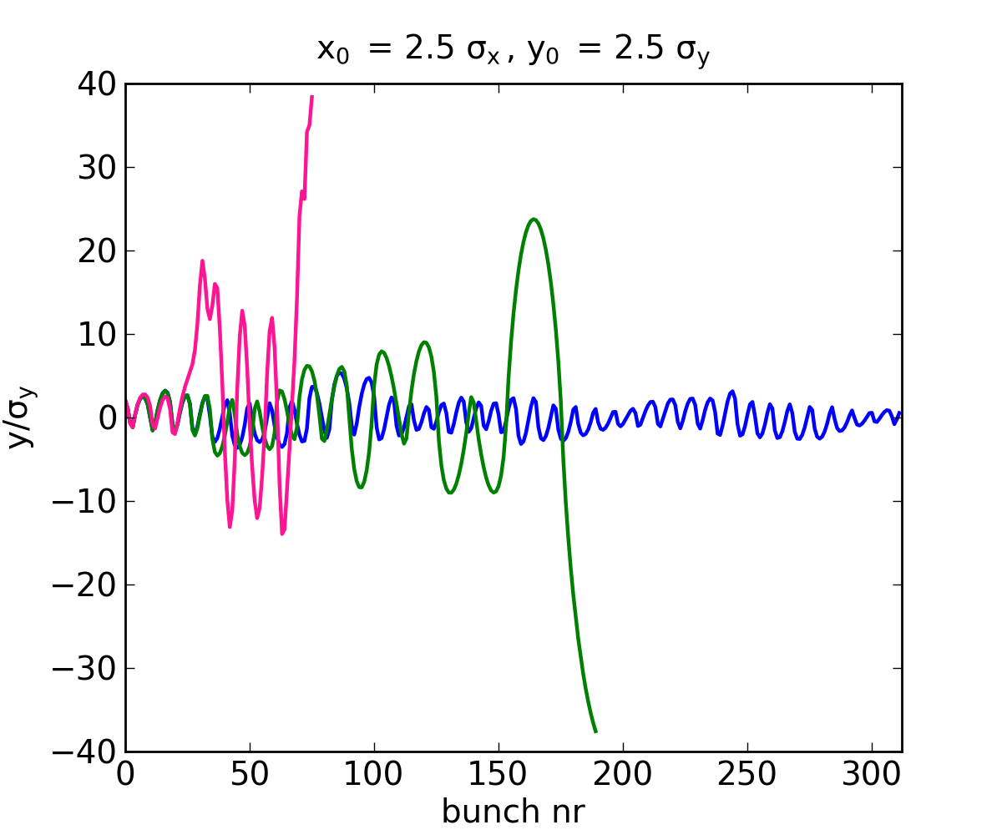
Benefits
Facilitate continued maintenance
Share workload of common developments, e.g. parallelization
Benefit from features already implemented in PyECLOUD/PyHEADTAIL
  Separate ion build-up and instability simulations for multi-turn ion trapping
  Ion self space charge
  E-field boundary
  Magnetic fields
  Bunch slices
  Synchrotron motion
  Transverse feedback
Trajectories for H₂O ion during passage of CLIC-like bunch train, with B-fields
B-field off
Dipole
Quadrupole

Slide 20
Summary
The FBII can affect electron machines with clearing gaps
  Usually not a problem in current machines with nominal vacuum
  Expected to be relevant for future CERN projects: CLIC, FCC-ee, LHeC
  Also new and upgraded low emittance light sources
Simulation studies
  2D macro-particle, multi-bunch tracking simulations
  Estimate the effect of beam and vacuum parameters on instability
FASTION → PyECLOUD + PyHEADTAIL
  Work in progress
  Add maintainability and flexibility
  Share workload of common development
  Introduce many new features and possibilities

Slide 21
Thank you!

