Slide 1
LHC online modeling
Mark IV
Piotr Skowroński
Tobias Persson
Agnieszka Szczotka
Jaime Coello de Portugal
Lukas Malina
Mattias Fjellstrom
Jonne Moeskops

Slide 2
The goal
Provide a set of software applications aiding in the LHC setup and studies using best knowledge model
The applications:
  Prediction tool
    What happens if some setting is changed
  Aperture meter
    Calculate aperture at a given moment taking into account current optics, orbit and collimator openings
  Chroma vs Octupoles strength
  Tune Footprint
  …
Best knowledge model
  model that can account for the actual machine settings and the measured beam parameters → accuracy

Slide 3
The best knowledge model
Model that can account for the actual machine settings and the measured beam parameters
  Orbit
  Beta beating
  Knobs settings
  Power converter settings
  Misalignments
  Magnet errors
  Hysteresis
  …

Slide 4
Any Online Application Schema
Data extraction and model builder
A MADX
script
execution
Model
builder
INPUTS
(Control System,
LSA, Logging, DB’s, …)
MADX model
Plots &
numbers
Common to any application

Slide 5
Data extractor and model builder
Implemented a dedicated Java library for extraction of all the data needed for the online model and model building
Based on this library, command line application that can be used for batch processing or by any data analysis tool via system call
  It produces directly MADX script that includes the requested inputs
Examples
  Extract optics LSA to create a Madx script for beam 1
lhc-model-extractor.sh -e –time "2012-07-16 03:40:00” -beam B1
  Extract also the beam orbit from timber
lhc-model-extractor.sh -oe -e –time "2012-07-16 03:40:00” -beam B1
  Include MQT and steerers in the model
lhc-model-extractor.sh –e –time "2012-07-16 03:40:00" –beam B1 –ItoK “MQT,CORR”
  Extract measured beta beating
lhc-model-extractor.sh -e –time "2012-07-16 03:40:00" –beam B1 –opticerr
  Knobs
  Device ( f.g. collimator) settings
  See the documentation on our web page for more examples
Tobias Persson
Jonne Moeskops
Agnieszka Szczotka

Slide 6
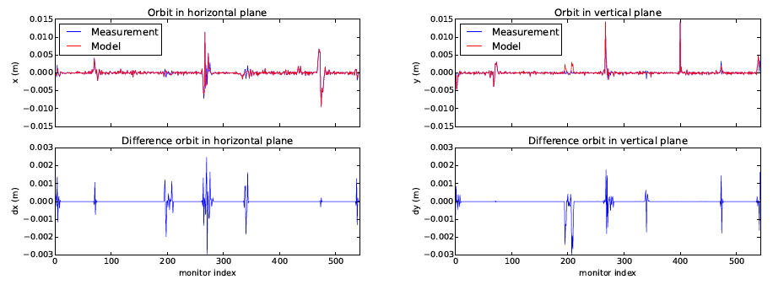
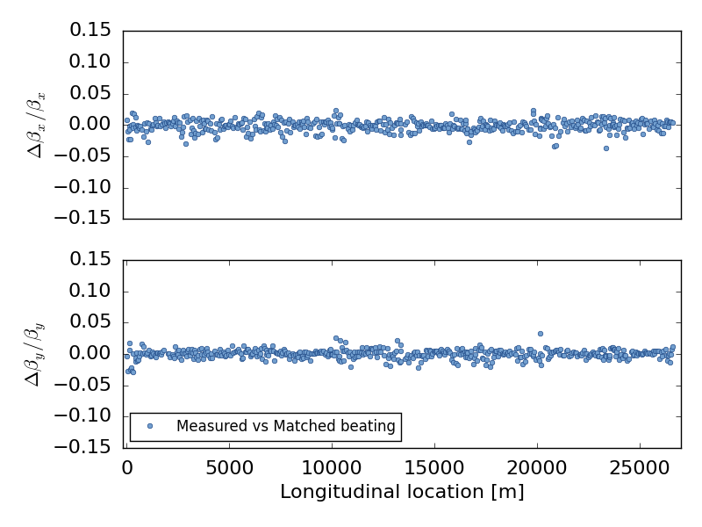
Orbit and Beta Beat modeling
For many applications it is necessary to model
  Orbit ( f.g. feed-down effects)
  Beta beating (f.g. amplitude detuning, tune footprints)
Implemented tools that automatically incorporate the two
  Install virtual correctors around quadrupoles
  MADX orbit correction is run to find the virtual steerers settings
  Beta-beating optics correction for virtual quads
Mattias Fjellstrom
Lukas Malina
Difference between measured and modeled betas

Slide 7
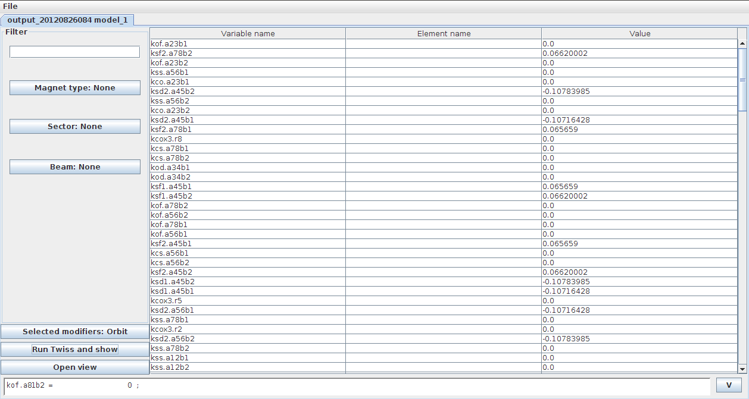
Online Model GUI / Predictor tool
Jaime Coello de Portugal
GUI to build models
Offers possibility to change arbitrary parameters to study the models: the prediction tool

Slide 8
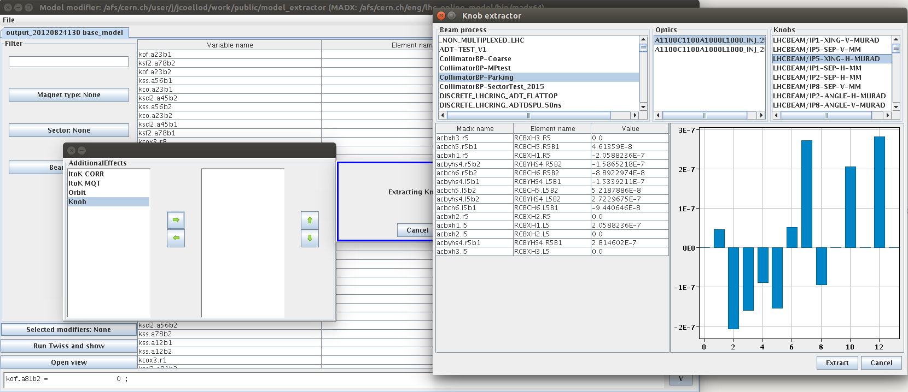
GUI / Predictor tool
Jaime Coello de Portugal
Example functionality:
finding and applying knobs from LSA

Slide 9
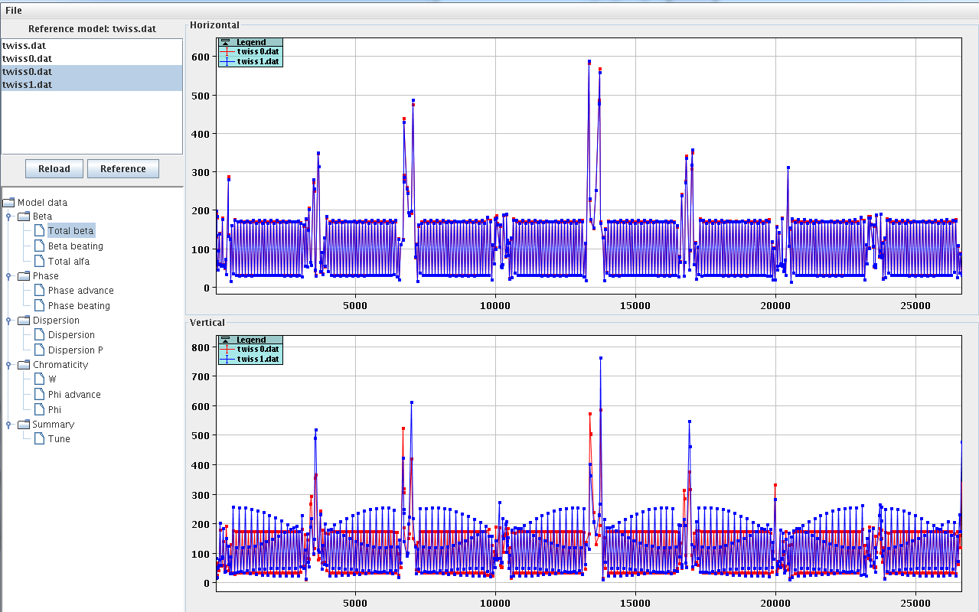
GUI / Predictor tool
Jaime Coello de Portugal
Plotting and comparing selected models

Slide 10
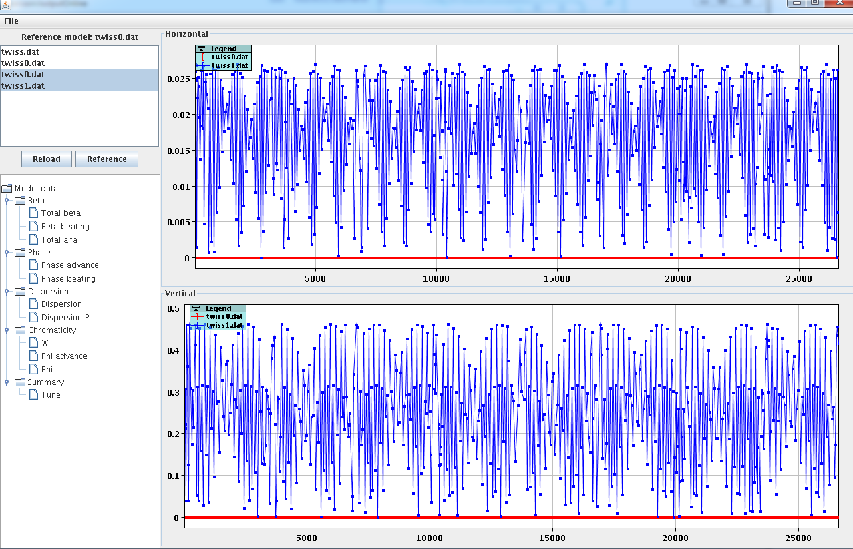
GUI / Predictor tool
Jaime Coello de Portugal
Plotting and comparing selected models

Slide 11
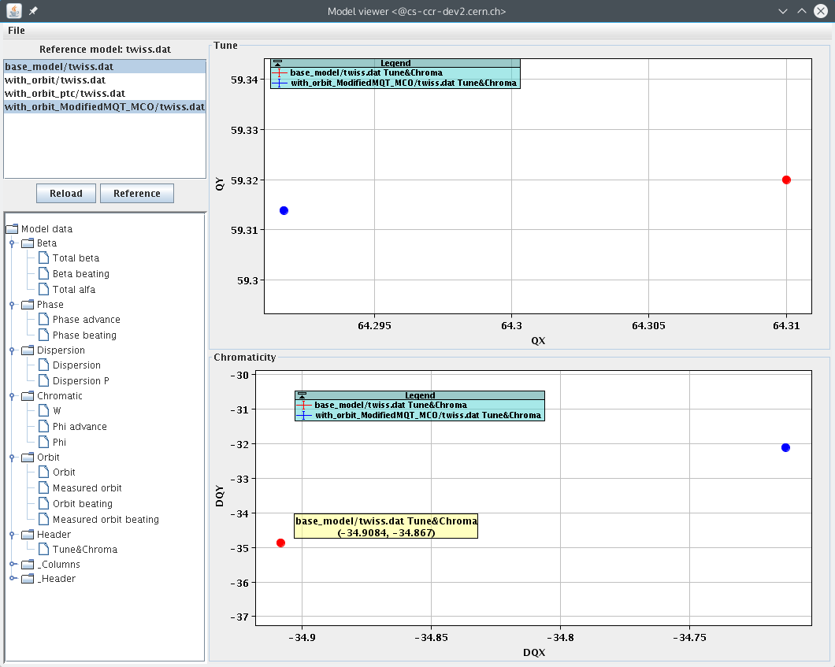
GUI / Predictor tool
Jaime Coello de Portugal
Plotting and comparing selected models

Slide 12
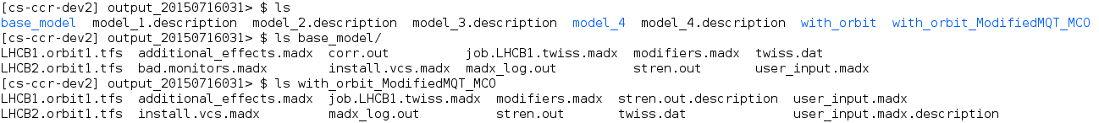
GUI / Predictor tool
The models and output files are left in the directory and can be further modified and analyzed manually
The GUI application can be used to
quickly bootstrap a model to further continue
with custom analyses

Slide 13
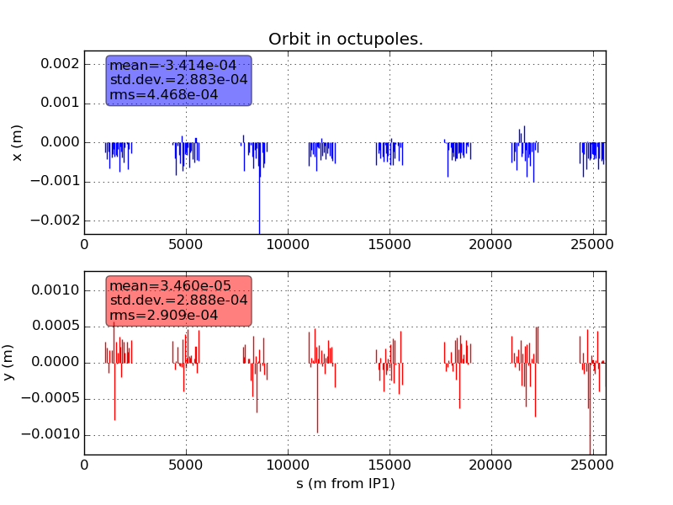
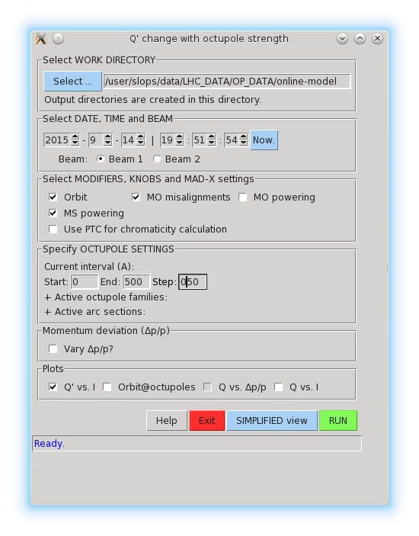
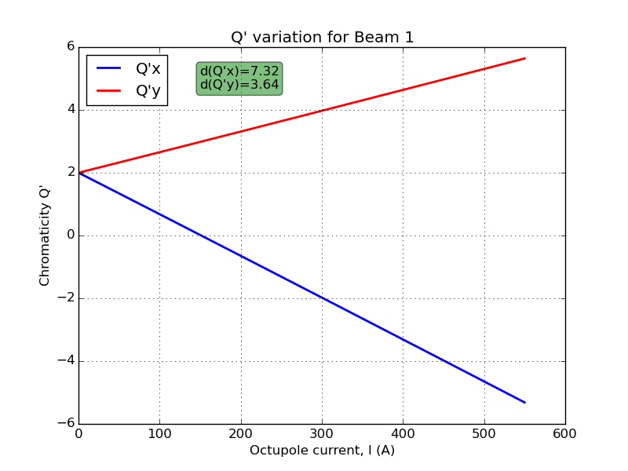
Chroma GUI
Mattias Fjellstrom
A dedicated application to study chromaticity
in function of octupole current

Slide 14
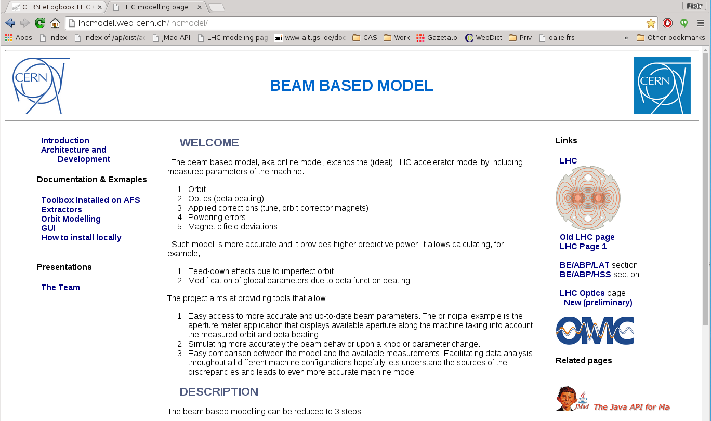
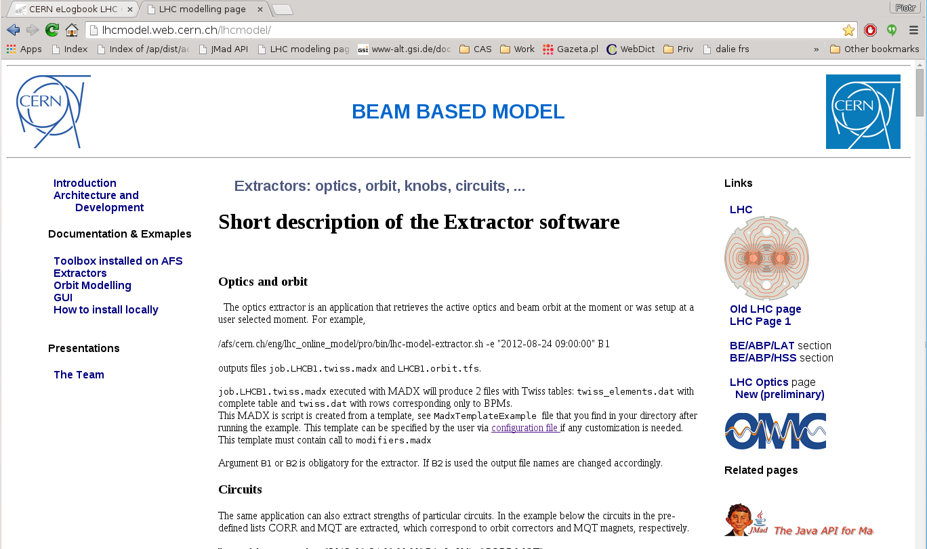
Web page http://lhcmodel.web.cern.ch

Slide 15
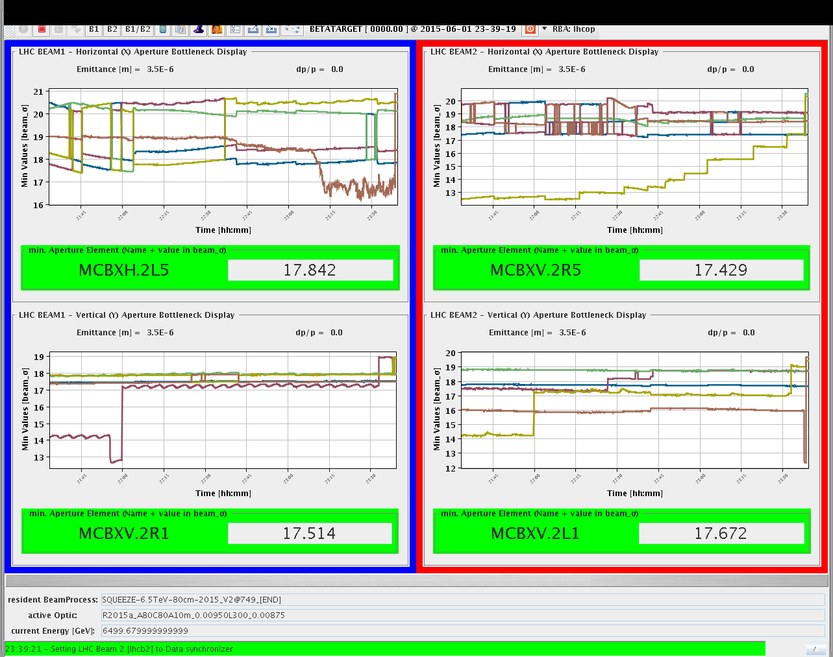
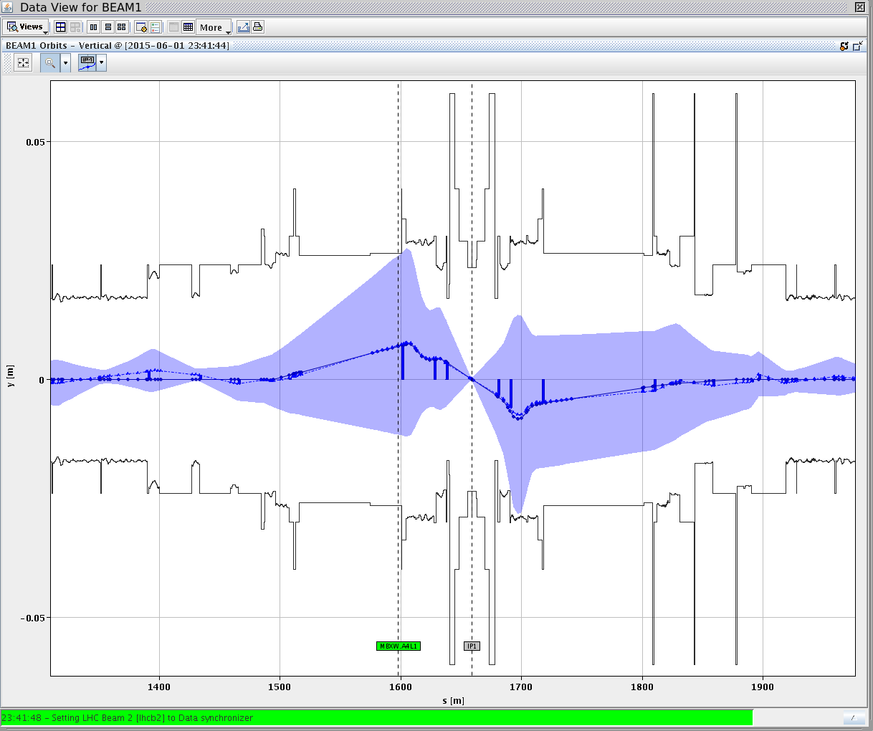
Maintenance for Run 1 applications
The applications and underlying libraries developed during Run 1 were updated to follow the control system LS1 upgrades
  Aperture Meter
  Tune Footprint

Slide 16
Application available on AFS
All the codes are installed on
/afs/cern.ch/eng/lhc_online_model/pro
Wrapper scripts in the the bin subdirectory assure
simple single command execution
Multiple examples and use cases provided

Slide 17
Currently working on
WISE implementation in Java
  Provides interface to databases with measurements of magnets
    Magnetic errors
    Misalignments
  Until now it is implemented in Excel sheet (Visual Basic)
GUI
  Nonlinear parameters from PTC
  deltap scans for evaluation of nonlinear parameters with MADX
Beam process player
  Verification of the settings defined in LSA

Slide 18
Validation studies
Model’s predictive power needs to be proven
Cases when various knobs were trimmed will be studied, to evaluate how accurately the model
predicts the observed changes in the beams
  For example, change of orbit, tune or chroma on
  sextupole or octupole powering
At the same time we will look for systematic effects
across different optics and settings

Slide 19
The end

Slide 20
The scope
Provide more detailed machine model that accounts for
all dynamical information available in the control system
  For example orbit or implemented corrections
  For a given moment in past as well as “on-line”
Applications
  To check effects of settings changes
    What happens if – prediction tool
  To provide data for model-based measurements
    For example beta beating or aperture measurements
  Verify the accuracy of the model against measurements
Study the available data to validate the beam based model
and look for systematic effects

Slide 21
Online Model is quite a fuzzy term
→ different people mean different things:
  Optics uploader to LSA and its verifications
  Use of the model for beam measurements and setup
  Online monitoring of the measured machine parameters and
  online comparison with the model to spot and study the differences → aiming at improving the model
  Combinations of the above

Slide 22
Result of our survey
The first priorities
The Predictor Tool: an application that allows checking effects
of arbitrary setting changes (what happens if we change …)
  GUI letting easily changing arbitrary machine parameters/knobs and displaying of the expected optics changes
  It requires:
    Extraction of optics, orbit and optics measurements (dispersion, beta beat)
    Orbit and optics modelling (the effective model)
      adapting the model to reproduce the measured orbit and optical parameters
    Extraction of power converter settings
    Knobs extraction and simulation so they can be tested
    before setting in the machine
    Later include more subtle data like misalignments, magnetic errors, etc.
Revival of Aperture Meter

Slide 23
The picture
Machine settings
Tools for
predictions
model dependent measurements
MD studies
Converter(s)
the model
Strength files
Nominal Optics
MADX scripts
Twiss files
Orbit modelling
Optics modelling
Beam orbit
Misalignments
Tools for
Improving
the model
Magnetic Errors
Optics Measurements

Slide 24
Needed Tooling
The aperture meter revival and its maintenance
Inputs for model creation:
  Nominal optics from LSA (directly strength files)
  Orbit
  Knobs
  Circuits Settings
  Circuit Currents to strength converter(s)
  Misalignments
  Magnet errors
  Beta-Beat Measurements from LSA
  Other relevant measurements
Orbit and optics modelling
GUI(s) for optics visualization and analysis flow control
Tool to check effects of setting/knob changes
Model improvements and studies

Slide 25
Strategy: modular approach
In order to gain maximum flexibility and to provide possibility for batch analyses each component is implemented as a command line tool
Data exchanged via TFS tables (files)
Can use the components stand-alone, for example
  The optics extractor lets finding very quickly the exact state
  of the machine during an MD
    Bootstrapping the model for analyses (f.g. MDs data)
Fast to integrate with other applications, for exmple
  JMad
  Aperture Meter
Integration done through libraries (Java packages).

Slide 26
Orbit modeling
Mattias Fjellstrom
lhcmodel/virtualcorrectors
Orbit modeling performed by MADX SVD orbit correction tool
  Provides a script to install virtual correctors at each quadrupole magnet
  Orbit correction finds their setting to reproduce the extracted orbit
  Saves the setting to a file

