Slide 1

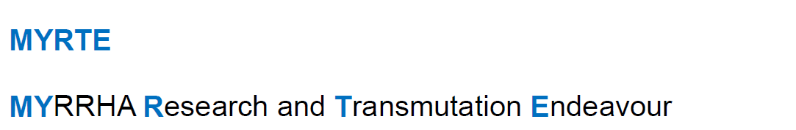



MYRTE WP2
“Accelerator R&D for
ADS/MYRRHA”
Jean-Luc BIARROTTE
CNRS-IN2P3 / IPN Orsay, France

Slide 2
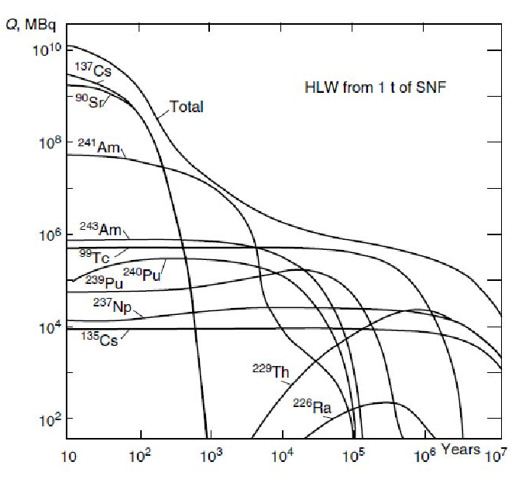

Nuclear wastes
About 2500 tons of Spent Nuclear Fuel are produced every year by the 145 reactors of EU
High Level Wastes represent 0.2% in volume & 95% in radiotoxicity and are long-term dominated by Minor Actinides (MA, especially ²⁴¹Am)
Reference solution for HLW management = long-term geological disposals
Initial Uranium ore
The Yucca Mountain Nuclear Waste Repository (USA)
project de-funded in 2011
Activity of High Level Waste remaining after processing of 1 ton of Spent Nuclear Fuel in dependence of time

Slide 3
Motivation for Partitioning & Transmutation
Partitioning & Transmutation (P&T) strategy: reduce radiotoxicity, volume and heat loads of long-lived nuclear wastes (MA) before geological storage
H. Aït Abderrahim (SCK•CEN)

Slide 4
Present options for MA transmutation
Transmutation of MA into fission products is efficient only if:
  Fission to capture cross section ratio is high enough
  Enough neutrons are available to feed the transmutation process
  => Need for a fast neutron spectrum
In which type of fast reactor could we transmute ?
  In the next generation GEN-IV nuclear power plants (critical Fast Reactors)
    homogeneous mode with low AM content in fuel (< 3%) for safety reasons
    heterogeneous mode (MA blankets)
  In a few dedicated MA burners (subcritical Accelerator Driven Systems), highly loaded with MA
  => sensitive compromise btwn safety / economics / proliferation / politics...

Slide 5
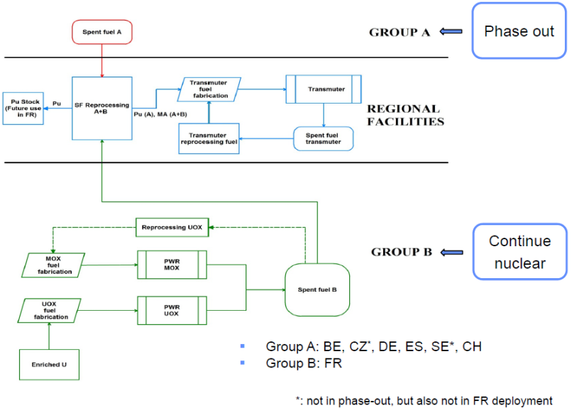

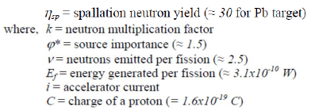
ADS (Accelerator Driven System)
ADS sub-critical systems = present reference solution for dedicated “transmuter” facilities
Suited for various strategies on nuclear energy
One “small” 400 MWth industrial ADS could burn about 100kg of MA / year (→ 10 to 20 units for EU)
G. Van den Eynde (SCK•CEN)
ADS reactor specificities
Neutron multiplication factor keff<1 (typically between 0.93 & 0.97)
Driven by external neutron source
(proton beam + spallation target)
No control rods, no safety rods
Some very fast neutrons (> 20 MeV) in the core

Slide 6
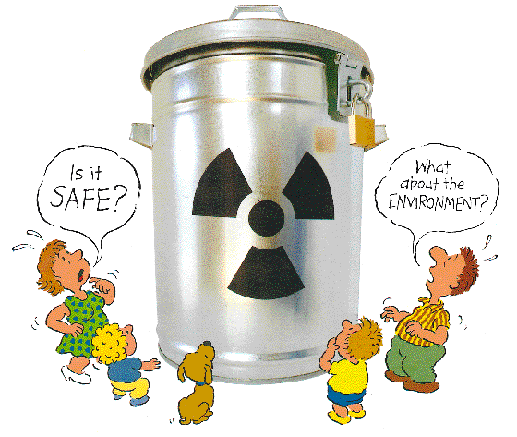
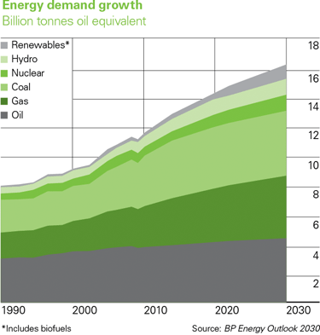

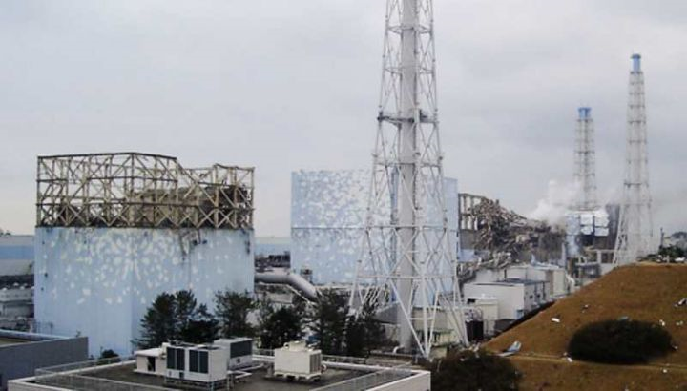

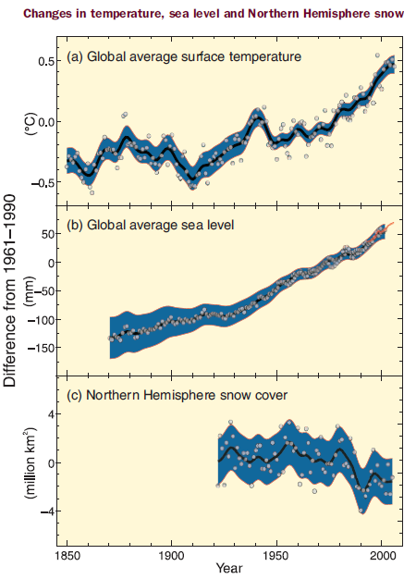

P&T = small part of a complex equation…
+
+
+
+
=

Slide 7
The MYRRHA linac concept
Main MAX achievements
MYRTE WP2 objectives & organisation

Slide 8
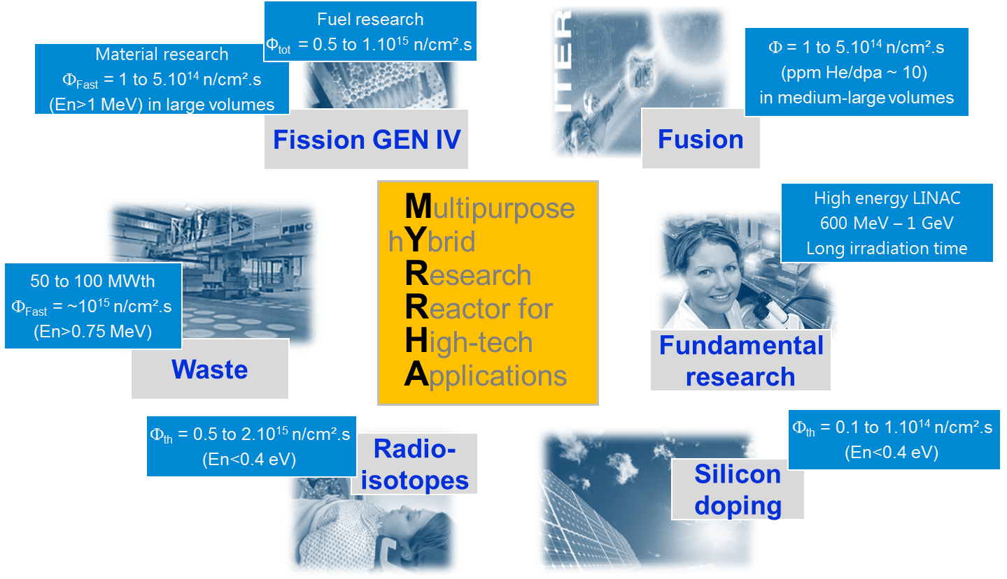

The MYRRHA project

Slide 9
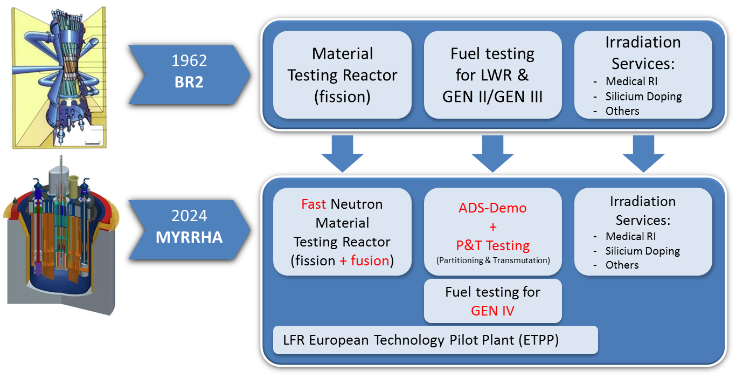
The MYRRHA project
MYRRHA: a multipurpose irradiation facility at

Slide 10
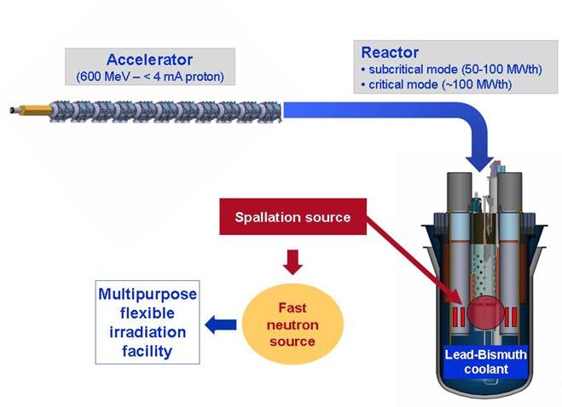
MYRRHA as an ADS demonstrator
Demonstrate the physics and technology of an Accelerator Driven System (ADS) for transmuting long-lived radioactive waste
Demonstrate the ADS concept
(coupling accelerator + spallation source + power reactor)
Demonstrate the transmutation
(experimental assemblies)
Main features of the ADS demo
50-100 MWth power
Highly-enriched MOX fuel
Pb-Bi Eutectic coolant & target
k_{eff} around 0.95 in subcritical mode
600 MeV, 2.5 - 4 mA proton beam

Slide 11
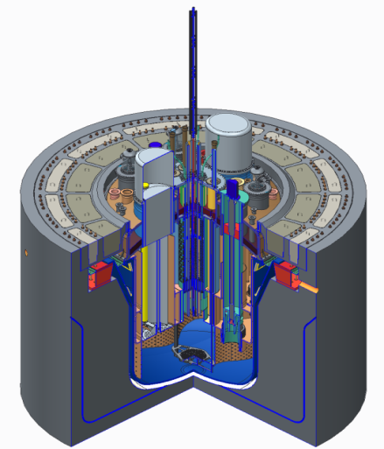
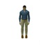
MYRRHA reactor layout (V1.6)
Beam tube
Heat exchangers (×4)
Reactor cover
Primary pumps (×2)
Fuel manipulators (×2)
Core
You :)
Diaphragm
Main vessel

Slide 12
MYRRHA proton beam requirements
High power proton beam (up to 2.4 MW)
Proton energy | 600 MeV
Peak beam current | 0.1 to 4.0 mA
Repetition rate | 1 to 250 Hz
Beam duty cycle | 10⁻⁴ to 1
Beam power stability | < ± 2% on a time scale of 100ms
Beam footprint on reactor window | Circular ∅85mm
Beam footprint stability | < ± 10% on a time scale of 1s
# of allowed beam trips on reactor longer than 3 sec | 10 maximum per 3-month operation period
# of allowed beam trips on reactor longer than 0.1 sec | 100 maximum per day
# of allowed beam trips on reactor shorter than 0.1 sec | unlimited
Extreme reliability level

Slide 13
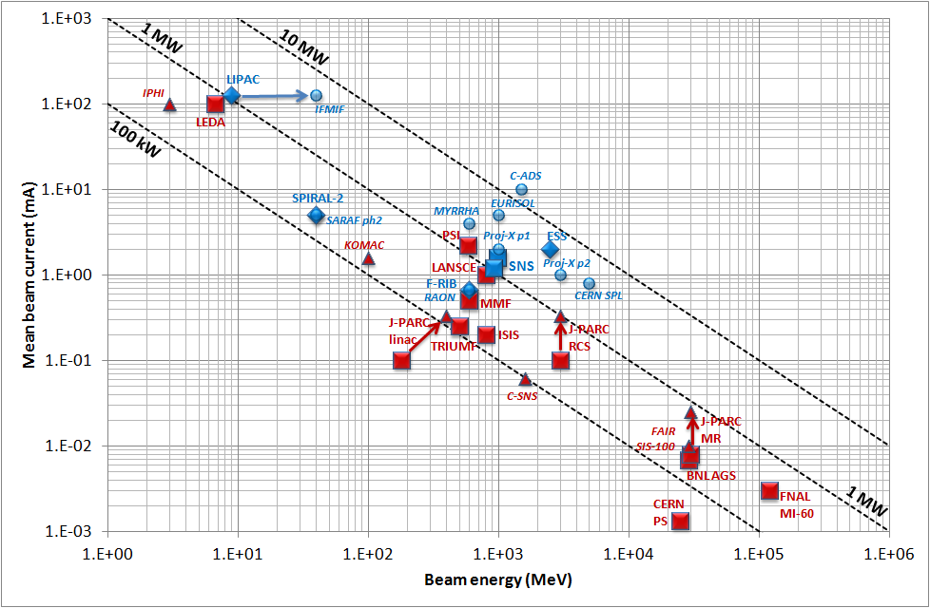
Panorama of high-power hadron accelerators
Existing NC machines
Under construction NC machines
Existing SC machines
Under construction SC machines
Planned SC machines
Only 2 accelerators are presently above the MW level: PSI & SNS
J-L. Biarrotte, Proc. SRF 2013

Slide 14
The ADS reliability requirement
Beam trips longer than 3 sec must be very rare:
To limit thermal stress & fatigue on the target window, reactor structures & fuel assemblies
To ensure a 80% availability – given the foreseen reactor start-up procedures
Present MYRRHA specifications: <10 beam trips per 3-month operation period (i.e. MTBF > 250h) – derived from the PHENIX reactor operation analysis
Far above present HPPA accelerator performance – MTBF is a few hours at PSI or SNS
Far above present ADS specifications in US or Japan – based on simulations
In any case, reliability guidelines are needed for the ADS accelerator design:
Strong design i.e. robust optics, simplicity, low thermal stress, operation margins…
Redundancy (serial where possible, or parallel) to be able to tolerate failures
Repairability (on-line where possible) and efficient maintenance schemes

Slide 15
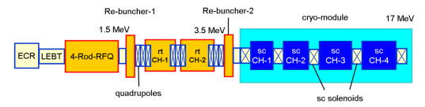
Strategy for a fault in the injector = parallel redundancy
❶ Initial configuration
❸ The failure is localized in injector
Operational injector 1: RF + PS + beam ON
The switching magnet polarity is changed (~1s)
+
-
Warm stand-by injector 2: RF+ PS ON, beam OFF (on FC)
Need for an efficient fault diagnostic system !
❷ A failure is detected anywhere
❹ Beam is resumed
Beam is stopped in injector 1 by the Machine Protection System @t₀
Failed injector 1, to be repaired on-line if possible
+
-
Injector 2 operational (@t₁ < t₀ +3sec)

Slide 16
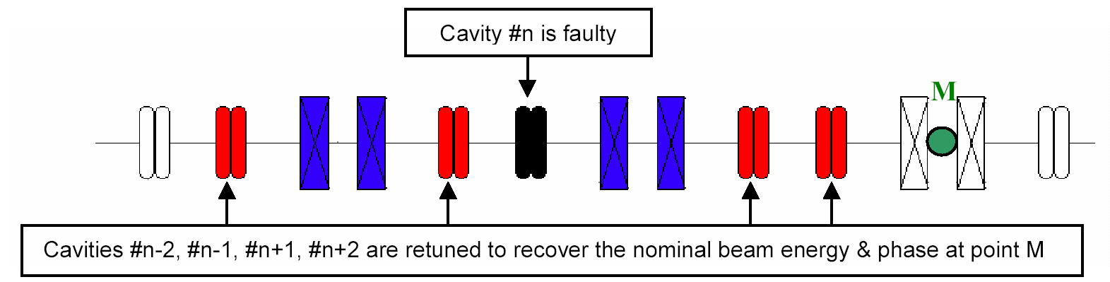
Strategy for a fault in the main linac = serial redundancy
❶ A failure is detected anywhere
→ Beam is stopped by the MPS in injector at t₀
❷ The fault is localized in a SC cavity RF loop
→ Need for an efficient fault diagnostic system
❸ New V/φ set-points are updated in cavities adjacent to the failed one
→ Set-points determined via virtual accelerator application and/or at the commissioning phase
❹ The failed cavity is detuned (to avoid the beam loading effect)
→ Using the Cold Tuning System
❺ Once steady state is reached,
beam is resumed at t₁ < t₀ + 3sec
→ Failed RF cavity system to be repaired on-line if possible

Slide 17
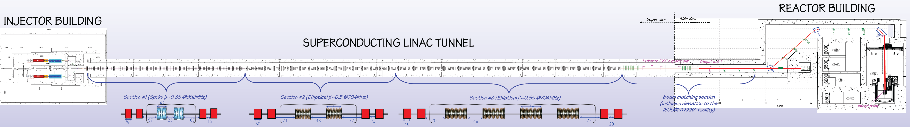
Layout of the MYRRHA linac

Slide 18
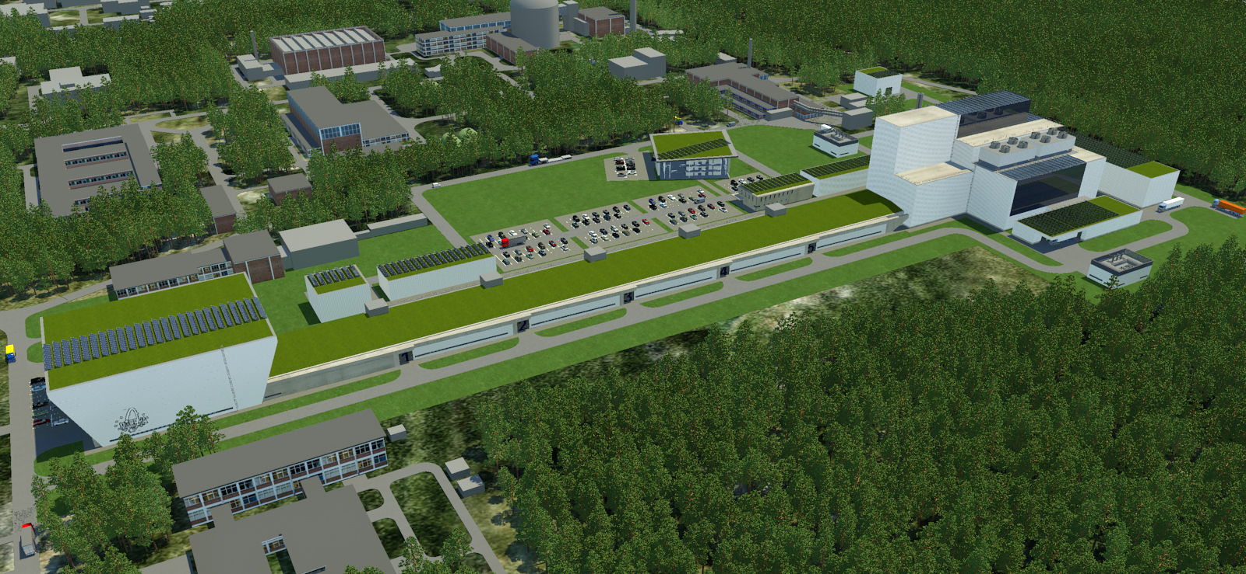
Layout of the MYRRHA linac

Slide 19
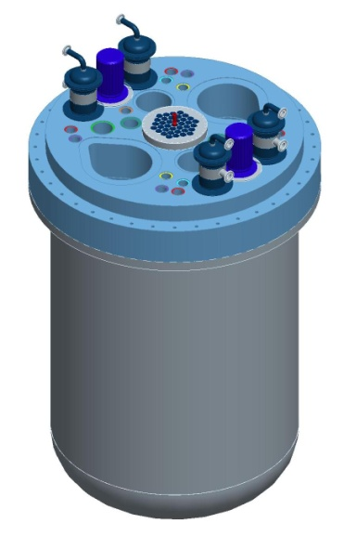

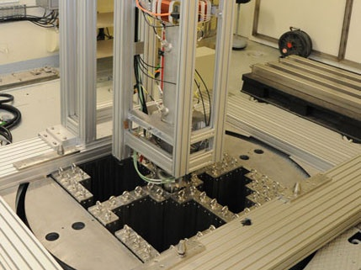
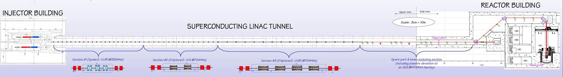
MYRRHA within EURATOM FP7
CDT
Reactor design
SCK●CEN
(2009-2012)
MARISA
Consortium organisation & licensing
SCK●CEN
(2013-2016)
FREYA
GUINEVERE exp.
SCK●CEN
(2011-2016)
MAX
Accelerator design
CNRS
(2011-2014)
MAXSIMA
Safety assesment
SCK●CEN
(2012-2018)
ARCAS
Transmutation economics
SCK●CEN
(2010-2013)

Slide 20
The MYRRHA linac concept
Main MAX achievements
MYRTE WP2 objectives & organisation

Slide 21
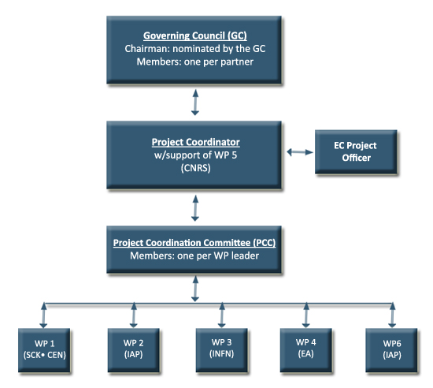











The MAX project (2011-2014)
Goal: deliver a consolidated reference layout of the MYRRHA linac
with sufficient detail and adequate level of confidence in order to initiate
in 2015 its engineering design and subsequent construction phase
WP1: Global accelerator design
WP2: Injector developments
WP3: Main linac developments
WP4: System optimisation
http://ipnweb.in2p3.fr/MAX/
11 partners
~ 5 M€ total cost
~ 10 people FTE

Slide 22
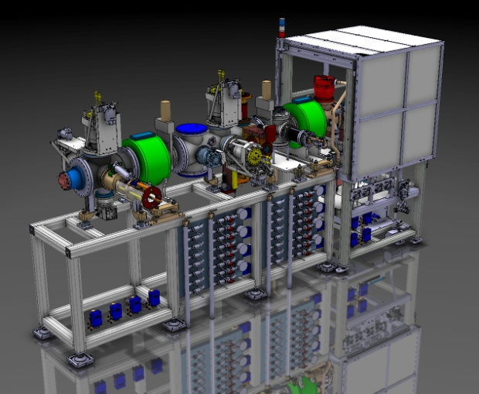
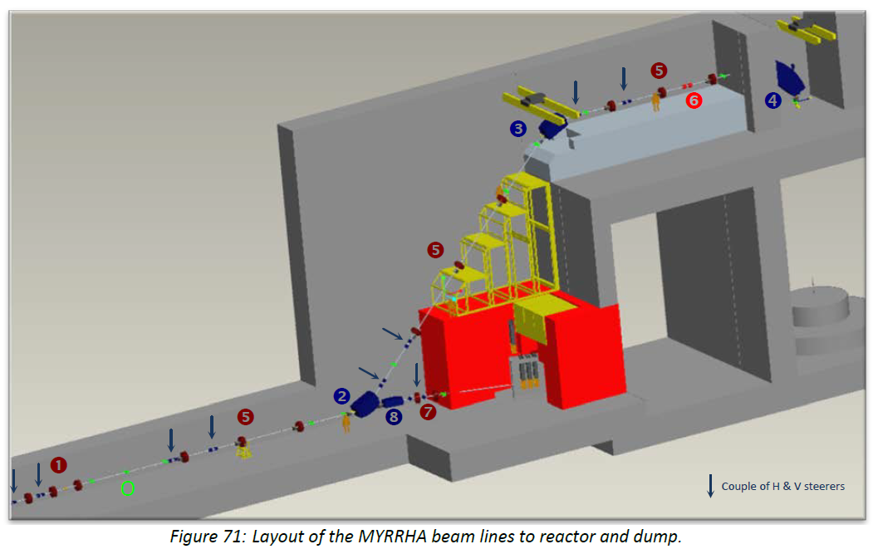
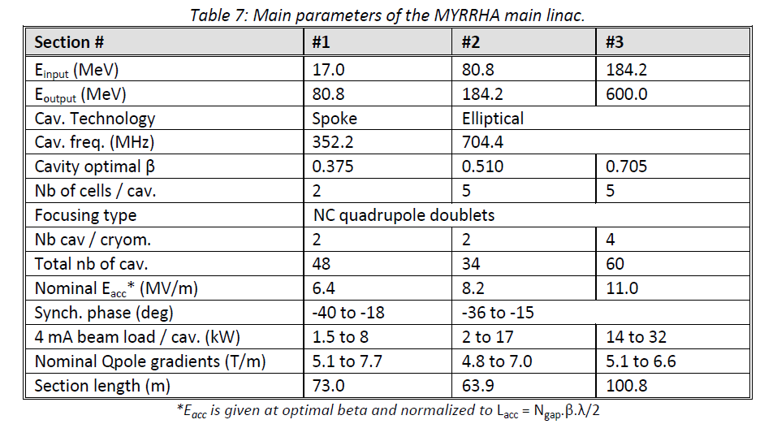
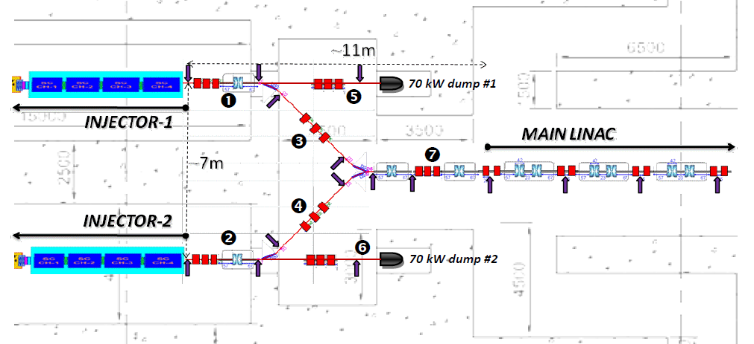
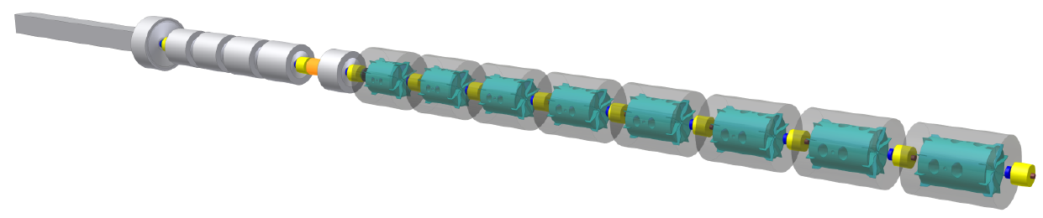
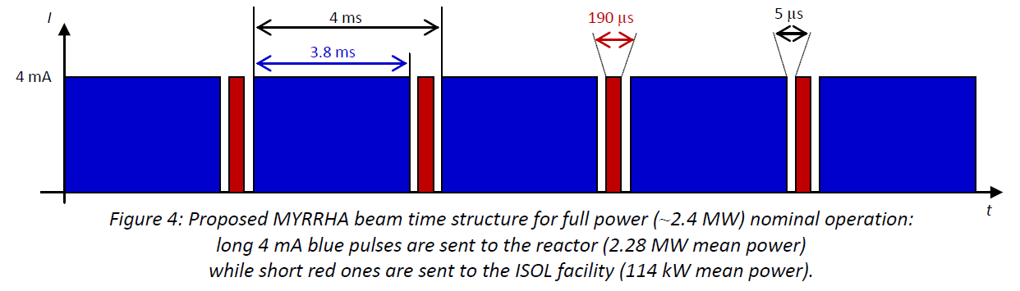

WP1 – Global accelerator design
Production of a reference design for the whole MYRRHA accelerator
  LEBT, together w/ MARISA
  (presently under construction by SCK+LPSC)
  RFQ + CH booster
  (incl. several improved versions)
  MEBT
  (conceptual design)
  Main SRF linac
  (incl. fault-tolerance capabilities)
  HEBT, from CDT inputs
  (ISOL deviation + reactor interface)
  Definition of beam time structure & power control strategy

Slide 23
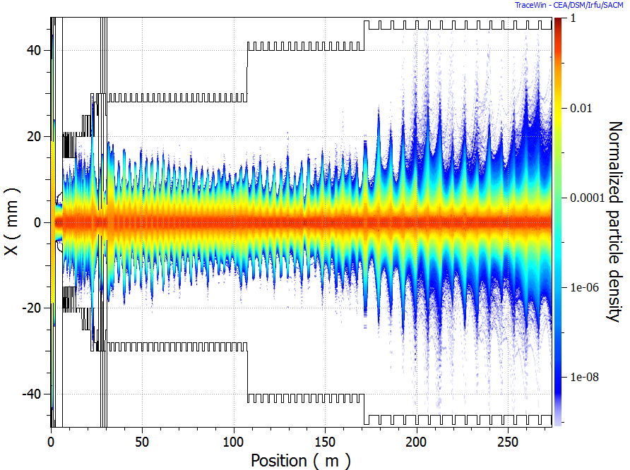
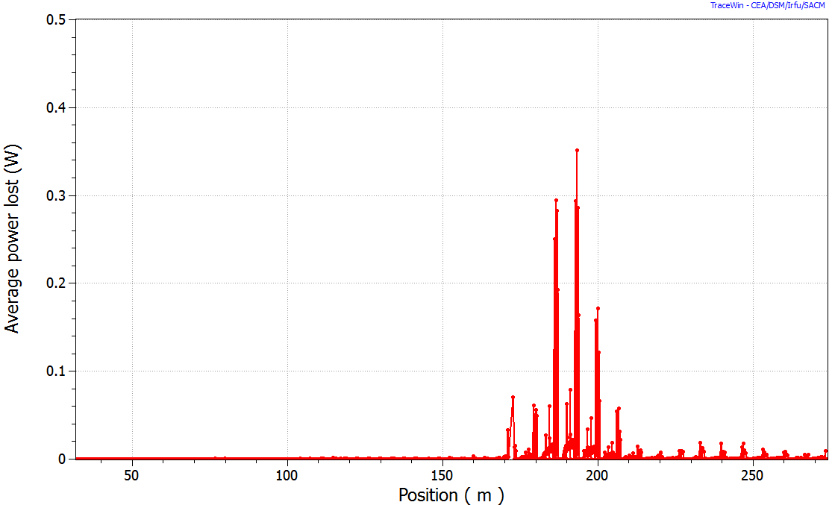
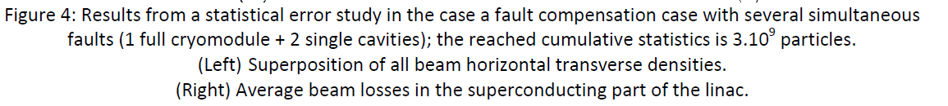
WP1 – Global accelerator design
MYRRHA linac international design review (Brussels, Nov. 2012)
  Very encouraging feedback, list of very valuable recommendations
Consolidation of the reference design
  Beam dynamics benchmarking activities
  Beam simulations from source to target
  Monte Carlo error studies (incl. fault compensation cases)
    Longitudinal acceptance is the key point for beam loss control
    Compensation schemes should be slightly less aggressive (i.e. involving more cavities)
Assessments of the MYRRHA buildings layout

Slide 24
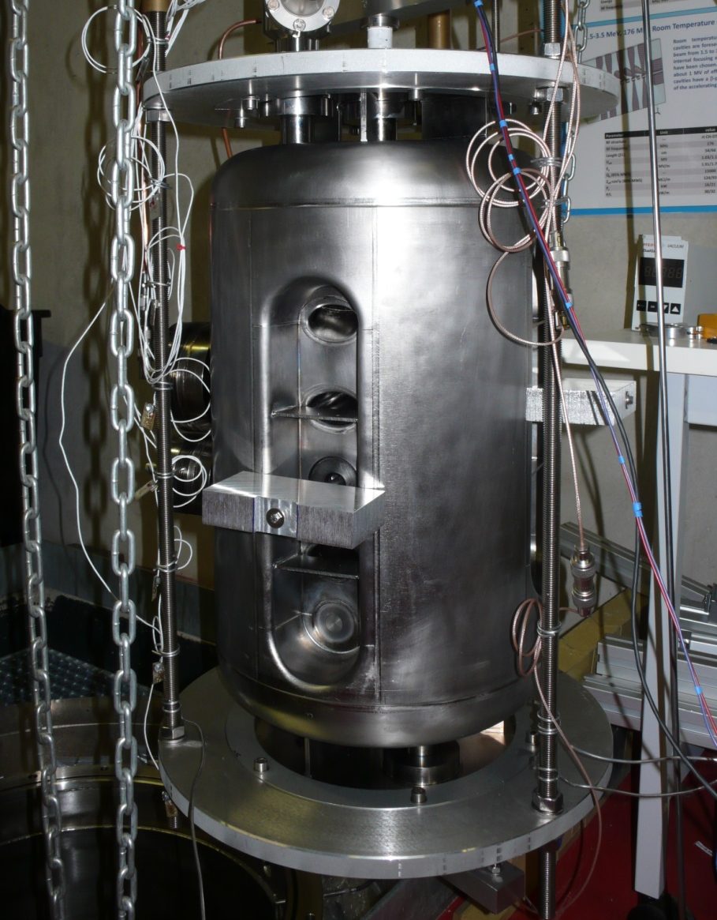
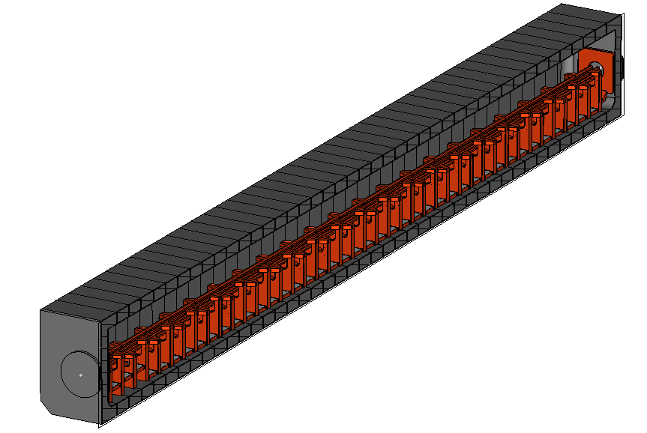
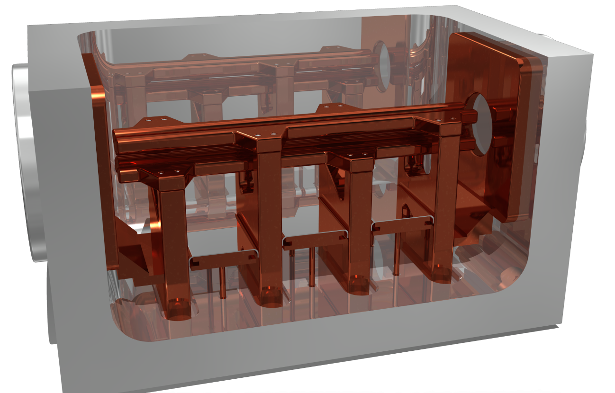
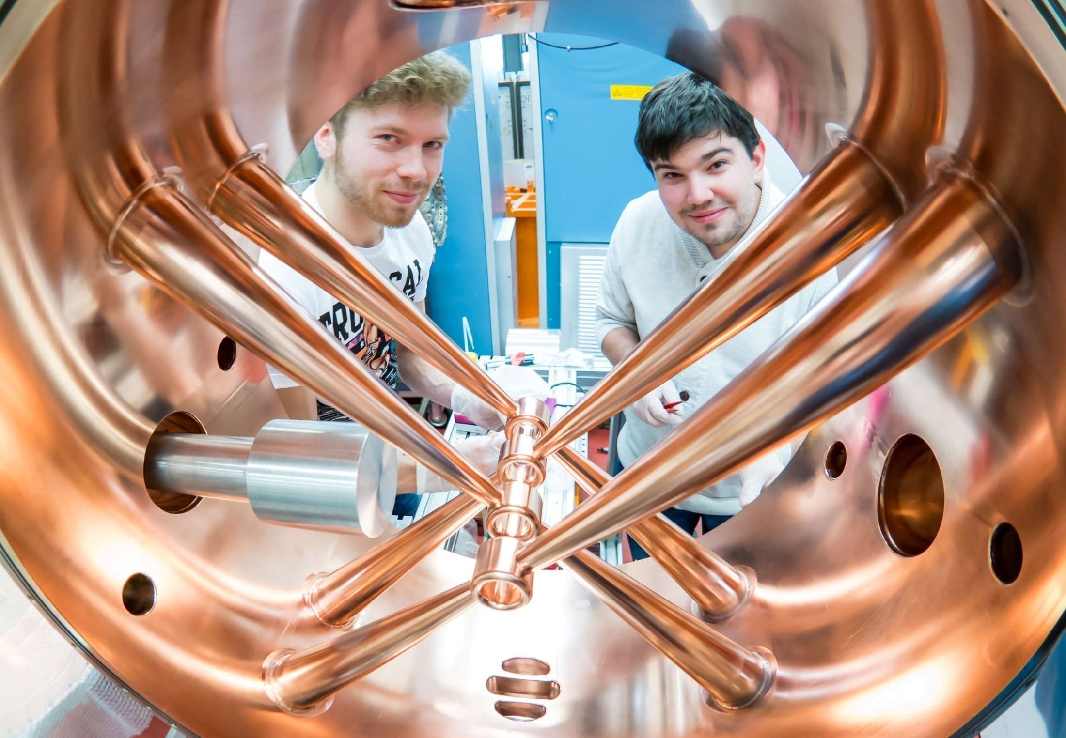
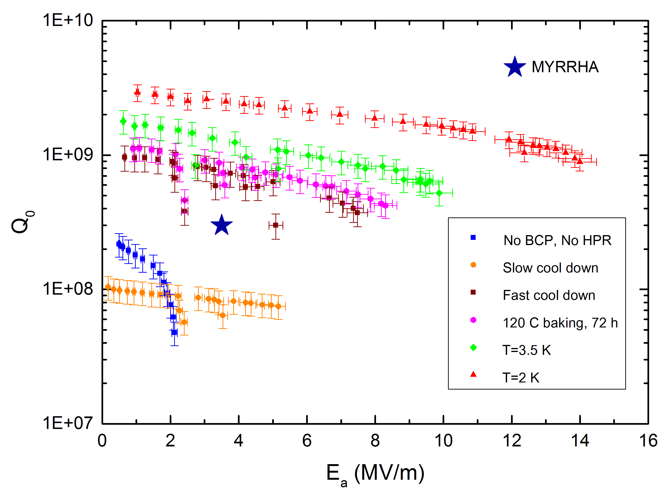
WP2 – Injector developments
R&D on the MYRRHA 176 MHz RFQ
  4-rod w/ technology choices optimized for reliable CW operation
  Fabrication and successful high-power RF test of a short
  prototype → 116 kW/m
  Design of the 4m-long MYRRHA RFQ
R&D on the MYRRHA CH cavities
  NC and SC CH cavity design incl. ancillaries
  Fabrication of a NC 5-gap CH-prototype
  Fabrication and successful tests of a SC 7-gap
  CH-prototype → 14 MV/m

Slide 25
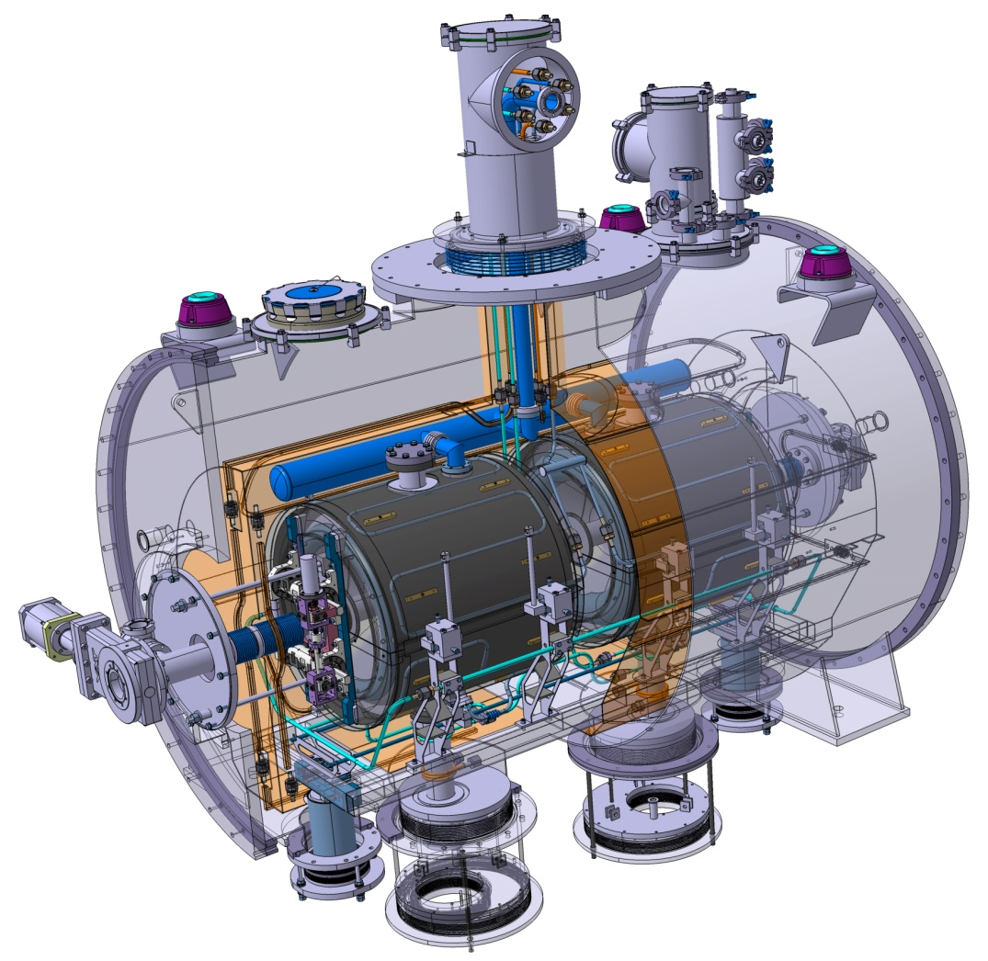
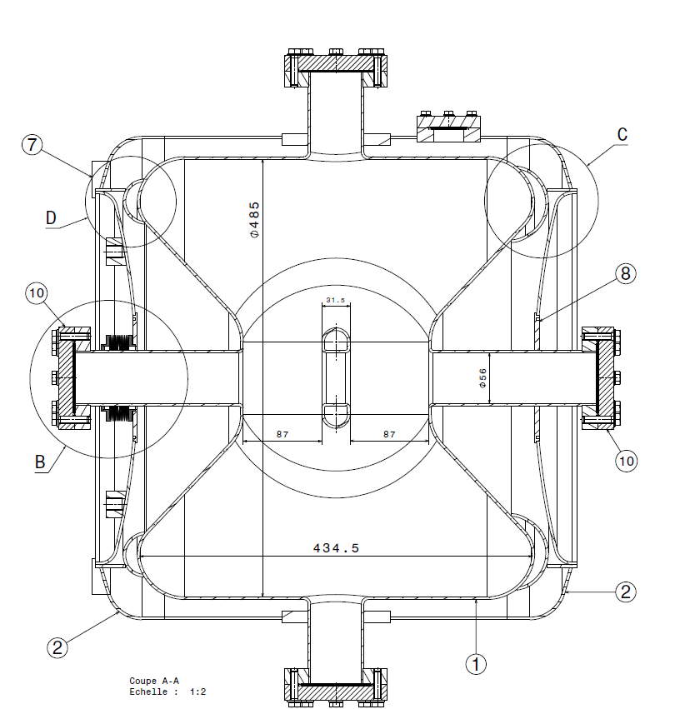
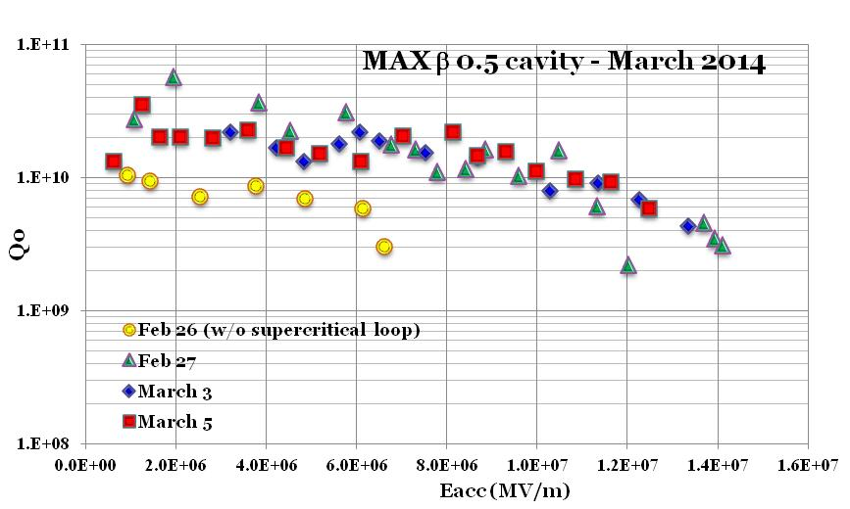
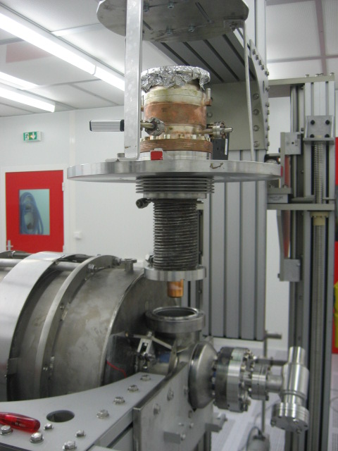
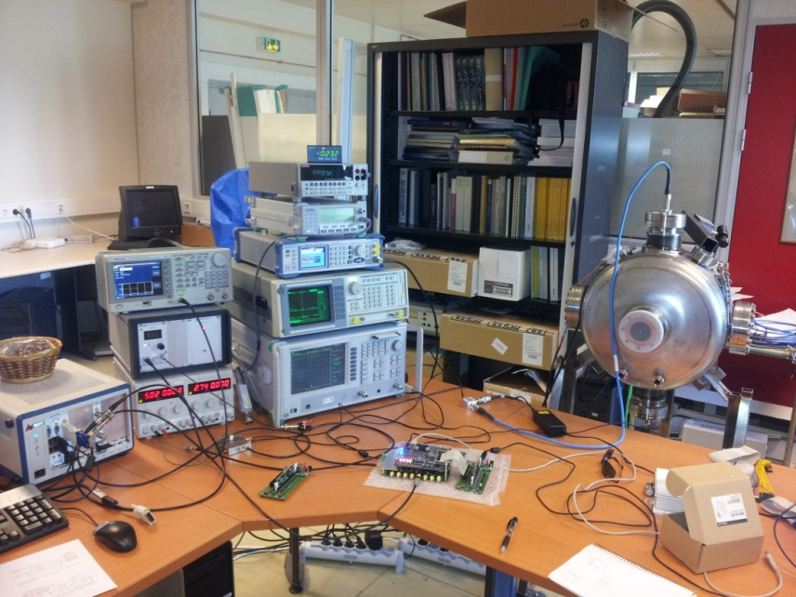
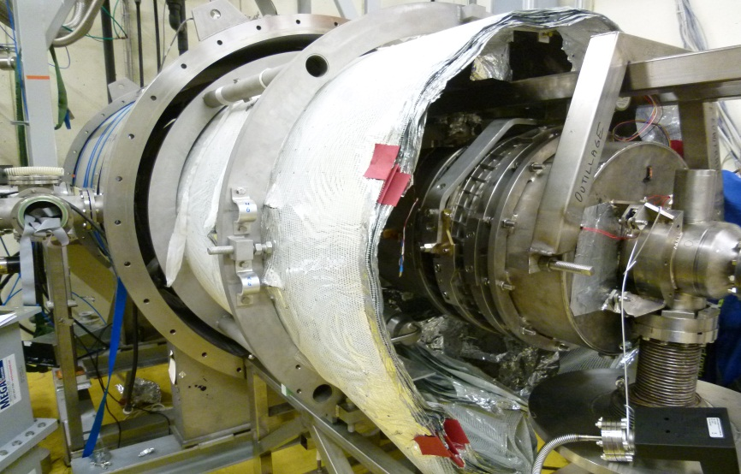
WP3 – Main linac developments
R&D on the MYRRHA 352 MHz Spoke cryomodule
  Design of the MYRRHA spoke 2-gap cavity
  incl. call for tender for 2 prototypes (presently in fabrication)
  Detailed design of the MYRRHA spoke cryomodule
  incl. engineering drawings
R&D on 704 MHz elliptical cavities
  High-power commissioning of the test cryomodule
  w/ β=0.5 5-cell cavity, 80kW IOT, @2K
  Development and test of an innovative control system
    Main sequences of the fault recovery scenario tested, incl. LLRF + pizo-based CTS + ADEX smart control
    Low-beta elliptical cavities are too soft mechanically -> might be replaced by ESS-type spoke cavities
  Assessments on multipacting

Slide 26
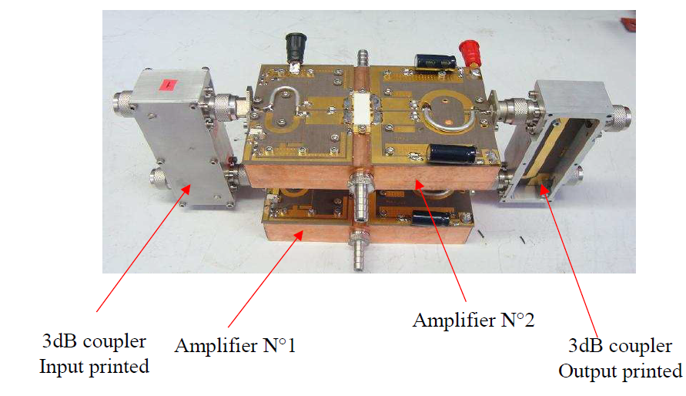
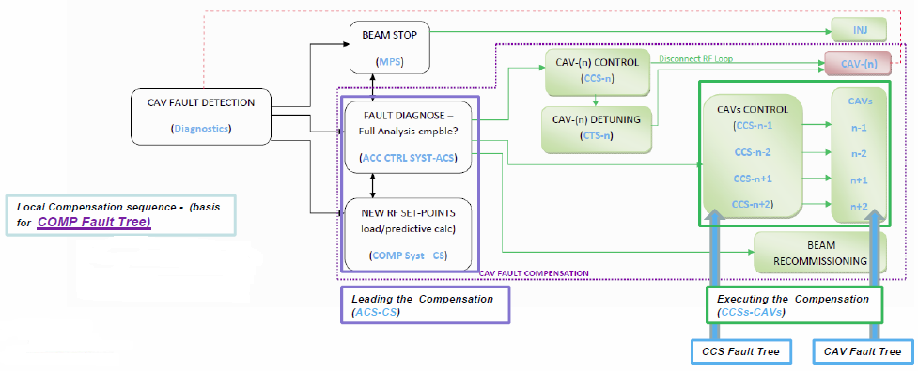
WP4 – System optimisation
Reliability analysis
  Development of a reliability model of the SNS accelerator
  & benchmark w/ SNS logbook data
  Development of the MYRRHA linac reliability model
    Diagnostics and C&C must be designed with increased reliability
    We expect 13 compensation events per 3-month cycle -> the 30% margin on RF power could be lowered
R&D on 700 MHz solid-state amplifiers
  Design of a 32kW SSPA for MYRRHA
  Development & test of a 800W elementary module
Conceptual design of the MYRRHA cryogenic plant & choice of 2K operation
Main lessons learned from the GUINEVERE ADS operation analysis

Slide 27
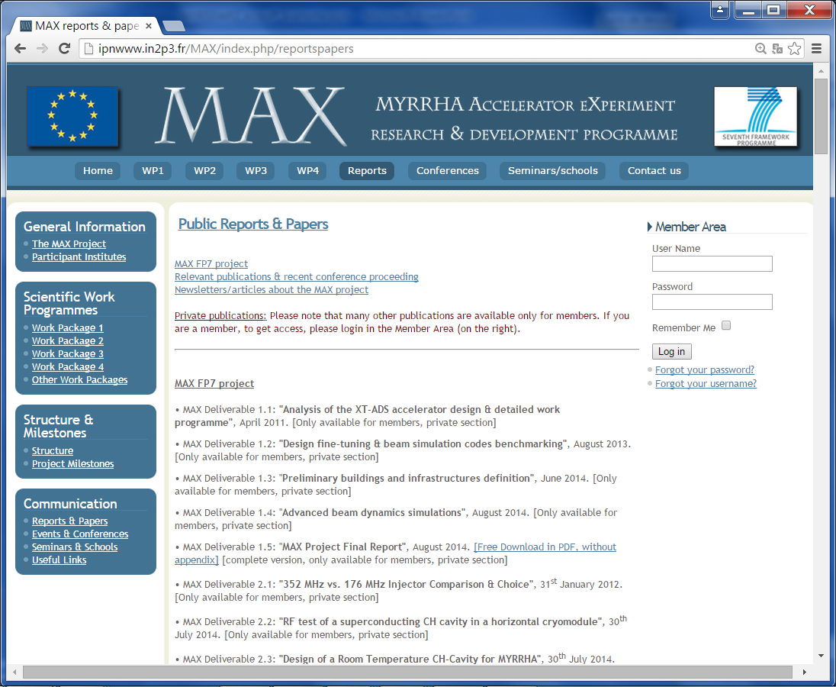
MAX final report is available on http://ipnwww.in2p3.fr/MAX

Slide 28
The MYRRHA linac concept
Main MAX achievements
MYRTE WP2 objectives & organisation

Slide 29
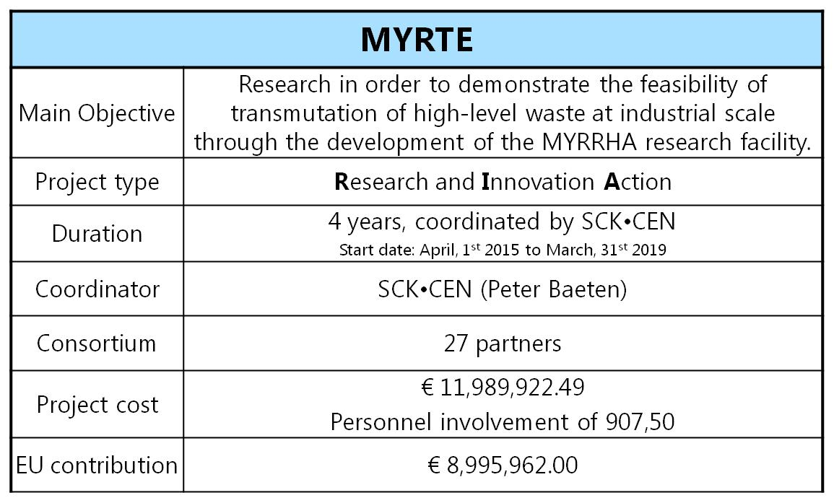
The MYRTE project

Slide 30
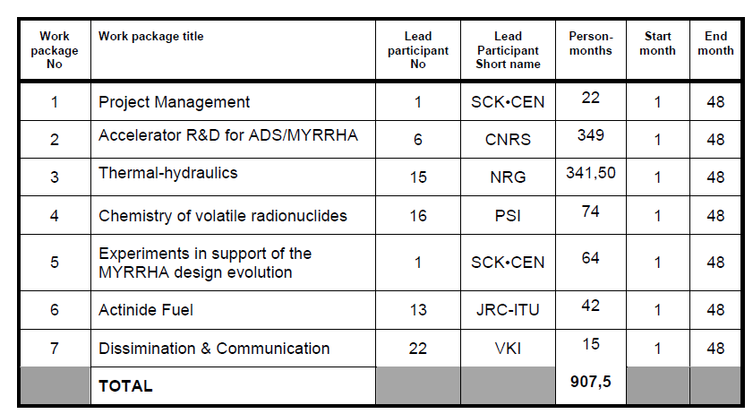
MYRTE overview

Slide 31
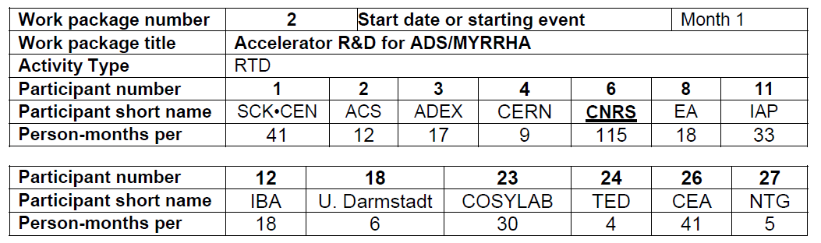






MYRTE WP2 overview
13 partners
  4 research institutes (CNRS, SCK*CEN, CERN, CEA) for a total of 206 pm
  2 universities (IAP, U. Darmstadt) for a total of 39 pm
  7 SME & industries (ACS, ADEX, EA, IBA, COSYLAB, TED, NTG) for a total of 104 pm
Overall budget: 5.3 M€
  349 pm over 4 years (about 8 FTE)
  1760 k€ for consumables and travels
EC contribution: 4.0 M€

Slide 32
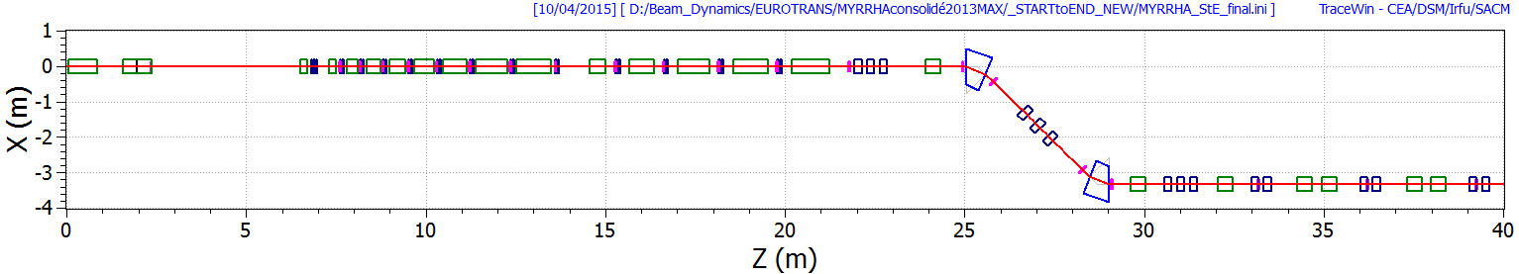
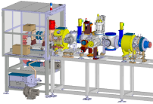



WP2 objectives
Pursue the research, design and development of the MYRRHA accelerator
W/ special focus on the first section of the INJECTOR part (building from previous work)
MYRRHA injector #1
MEBT
Main LINAC
Source
RFQ
NC CH cavities
SC CH cavities
SC Spoke cavities
Existing Source + LEBT
installed at CNRS/LPSC Grenoble
MAX RFQ short prototype
MYRRHA RFQ design

Slide 33

WP2 objectives – Injector demonstration
  Realisation of a full-size MYRRHA-type RFQ demonstrator (Task 2.1)
    IAP, NTG, U. Darmstadt, SCK•CEN, CEA, CNRS
    April 2015 → Oct. 2017
  Construction of a prototype Solid State RF power amplifier (Task 2.2)
    IBA, SCK•CEN, CNRS, Cosylab, IAP
    April 2015 → Oct. 2017
  Digital Low Level RF development (Task 2.3)
    CNRS, SCK•CEN, Cosylab
    April 2015 → Oct. 2017
  Injector commissioning (Task 2.7)
    SCK•CEN, CNRS, ADEX, CEA, Cosylab, IAP
    April 2017 → April 2019

Slide 34

WP2 objectives – Beam characterization & control
  Space-charge experiments (Task 2.8)
    CNRS, CEA, IAP, SCK•CEN
    April 2015 → Oct. 2017
  Beam diagnostics development (Task 2.4)
    CEA, CNRS, SCK•CEN, Cosylab
    April 2015 → April 2019
  Control system in a highly reliable accelerator context (Task 2.5)
    Cosylab, SCK•CEN, ADEX, ACS, CEA, CNRS, IAP
    April 2015 → April 2019
  Beam simulation code development, global coherence (Task 2.6)
    CEA, CNRS, SCK•CEN
    April 2015 → April 2019

Slide 35
WP2 objectives – Others
  LINAC4 reliability analysis (Task 2.9)
    CERN, EA, SCK•CEN, TED
    April 2015 → April 2019
  MYRRHA SRF spoke R&D (Task 2.10)
    CNRS, ACS
    April 2015 → Oct. 2017
  SRF CH demonstration with beam (Task 2.11)
    IAP
    April 2015 → Oct. 2017
  MYRRHA linac cost estimation (Task 2.12)
    SCK•CEN, ACS, TED, CNRS, IAP
    April 2015 → Oct. 2016

Slide 36
WP2 structure, timing & organisation
12 Tasks
WP2 (CNRS)
Task 2.1 (IAP)
Task 2.2 (IBA)
Task 2.3 (CNRS)
Task 2.4 (CEA)
Task 2.5 (Cosylab)
Task 2.6 (CEA)
Task 2.7 (SCK*CEN)
Task 2.8 (CNRS)
Task 2.9 (CERN)
Task 2.10 (CNRS)
Task 2.11 (IAP)
Task 2.12 (SCK*CEN)
4 Milestones
  MS1 @month +6
  MS2 @month +18
  MS3 @month +30
  MS4 @month +48
WP2 meetings
  WP2 kick-off meeting in Paris, June 15-16, 2015
  Then 1 WP2 general meeting every 6 month
  In parallel, as many technical task meetings as necessary
12 Deliverables (1 per Task)
  1 due @MS2
  6 due @MS3
  5 due @MS4
Progress review & quality assurance
  Technical design reviews when needed
  Progress monitoring by « Performance indicators »

Slide 37


WP2 performance indicators
TB filled and agreed asap!

Slide 38

MYRTE management structure
GOV
1 representative for each institution
MMT
MYRRHA project management team
EC officer
Roger GARBIL
Roger.GARBIL@ec.europa.eu
REPORTING
PCO
Peter BAETEN (SCK*CEN)
pbaeten@SCKCEN.BE
w/ management assistant:
Margot DEGREVE
mdegreve@SCKCEN.BE
TEC
WP leaders + PCO
WP2 leader
J-Luc BIARROTTE (CNRS)
biarrott@ipno.in2p3.fr
w/ management assistant:
Virginie LAURENCIER
laurenci@ipno.in2p3.fr
Your main contacts for ALL scientific aspects, communication,
WP2 organisation, general information…
Your main contacts (if you are the representative of your institute) for financial, administrative & legal aspects (cf. periodic reporting)

Slide 39


Periodic Reporting Overview
Electronic-only Submission/Signature
MYRTE (48 months)
Start Date 01/04/15
P1 (18) 30/09/16
P2 (18) 31/03/18
PF (12) 31/03/19
Deadline
Period Ends
Deadline
END
COO Submission to EC
60 Days Max.
EU Approval
90 Days Max.
P1 28/02/17
P2 31/08/18
PF 31/08/19
P1 30/11/16
P2 31/05/18
PF 31/05/19
E-Mail From EC to COOrdinator
EU checks DELx, PAR,
PMR, PFR and costs
Beneficiaries fill in their ‘detailed’ Forms C,
Beneficiaries’ FSIGN finalise them
EU checks ‘detailed’
Electronic FormCs
COO fills in his ‘detailed’ FormC
Project Review
(if applicable)
EU executes Payment
on the basis of Electronic
documentation available
COO validates Beneficiaries’ FormCs
NO
YES
E-Mail From EC
to COOrdinator
COOrdinator FSIGN finalises FormCs
COO submits final DELx, periodic reports PAR, PMR, PFR
EU closes period Px
and/or project
NO
EU validates final DELx, PAR, PMR, PFR
YES
COO: Coordinator, PAR: Project Activity Report, PMR: Project Management Report, PFR: Project Final Report, DELx: Due Deliverables

Slide 40

EC Research Participant Portal
http://ec.europa.eu/research/participants/portal/

Slide 41

Communication & Dissemination
All MYRTE WP2 future reports (Deliverables 2.1 to 2.12) have a CONFIDENTIAL dissemination level
  Don’t spread them away!
  We can ask for exceptions if needed…
The MYRTE web-site is under development at SCK*CEN for information exchange
  In the mean time, FP6/FP7 reports can still be found on the MAX web-site http://ipnwww.in2p3.fr/MAX/
  Please ask for a login if you need one! ;)
Publications & communications to conferences, workshops... are highly welcome
but need to:
  display the EU emblem
  include the following text:
  “This work has received funding from the Euratom research and training programme 2014-2018 under grant agreement N° 662186 (MYRTE project)”

Slide 42


Communication & Dissemination
1 Accelerator school
(October 2016? TBD)
At least 1 international workshop
(End of project)

Slide 43

Thank You for your attention…
…& long live Paris!

