Slide 1


LINAC4
Description of the linac and the commissioning with the purpose of triggering discussion on reliability issues.

Slide 2
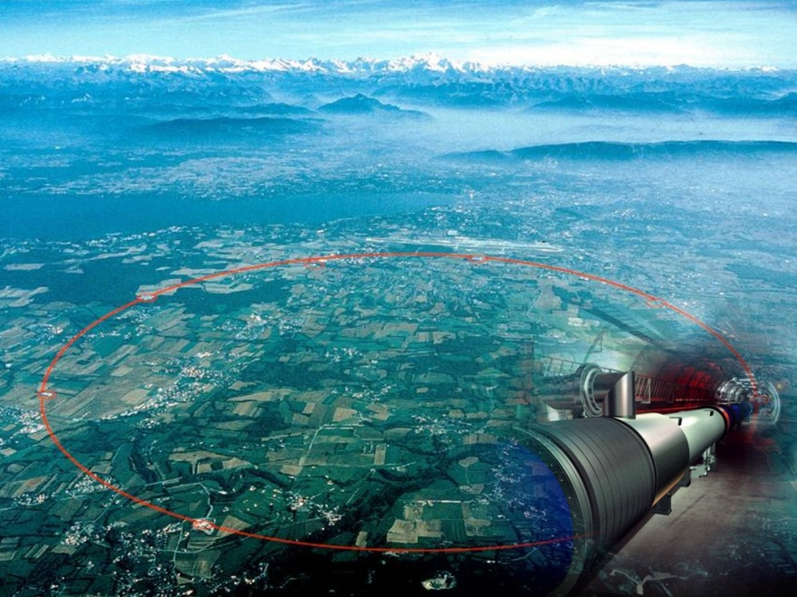
LHC Luminosity
From optics at Interaction point
Brightness from Injectors : defined at low energy
From machine design and limitations (e cloud)
  N_{b} number of particles per bunch
  n_{b} number of bunches
  f_{r} revolution frequency
  ε_{n} normalised emittance
  β* beta value at Ip
  F reduction factor due to crossing angle
  N_{b} , ε_{n} defined by the injector chain
  β* LHC insertion
  F beam separation schemes
  n_{b} electron cloud effect

Slide 3


Upgrading LHC Luminosity
 | Luminosity (cm⁻²s⁻¹) | Beam intensity @ injection (*)
Present (2012) | ~2 x10³³
Nominal () | 1 x 10³⁴ | 1.1 x10¹¹
Upgraded () | ~5 x10³⁴ | ~2.4 x10¹¹
(*) protons per bunch, in 3 μm emittance
planned
requires upgrade of both LHC and injectors, to be completed in the 3rd long LHC Shut-down (~2021/22)
At the moment, the injectors can provide only the intensity required for the nominal luminosity
Need of an upgrade program of the injectors for higher brightness and intensity.
Notes:
Important parameter is the peak luminosity – most important term on lumi formula is brightness (n. of protons in the given emittance – density of the beam) – density is created in the injector, where we have to fight against space charge (couplomb repulsion).

Slide 4
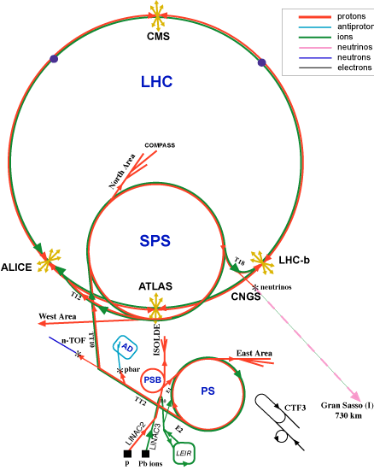
LHC INJECTOR CHAIN
Linac2 (50 MeV)
160mA , 100 µsec , 1 Hz
↓
PS Booster (1.4 GeV) 1972 – radius 25 m
4 rings stacked
Output energy already upgraded twice
↓
PS (25 GeV) 1959 – radius 100 m
↓
SPS (450 GeV) - 1976 radius 1100 m
↓
LHC
Max Space charge Tune Shift reached
Max Space charge Tune Shift reached

Slide 5
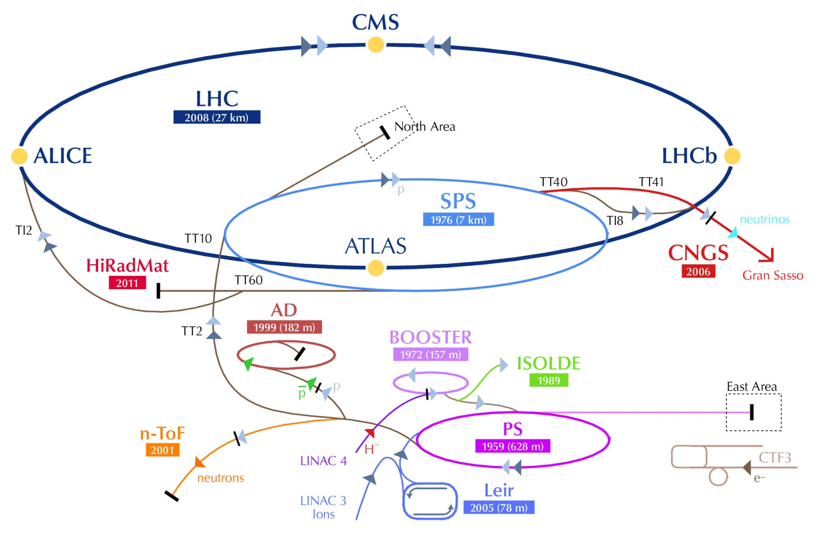

Slide 6
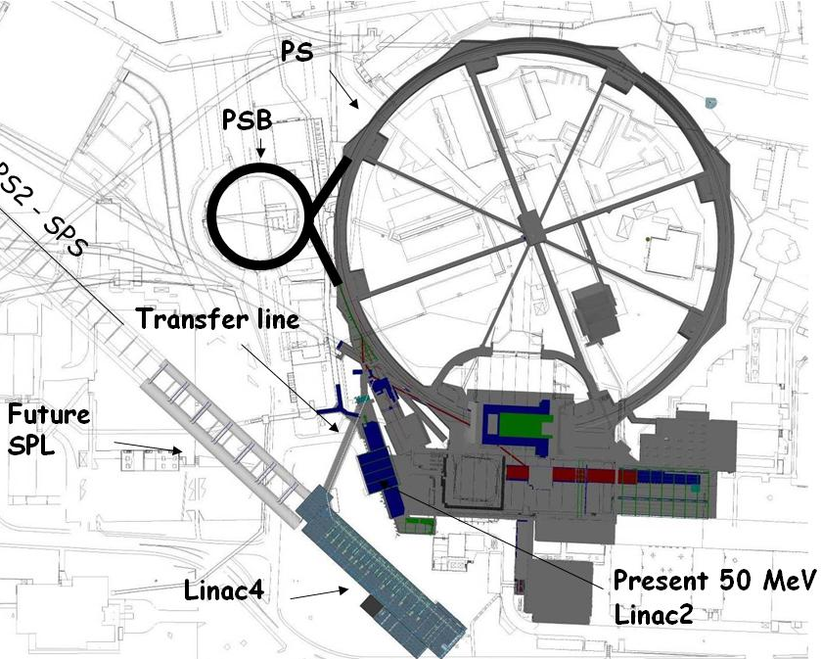
LIMITATIONS TO INTENSITY
In its June 2007 session the CERN Council has approved the White Paper "Scientific Activities and Budget Estimates for 2007 and Provisional Projections for the Years 2008-2010 and Perspectives for Long-Term", which includes construction of a 160 MeV H- linear accelerator called LINAC4, and the study of a 5GeV, high beam power, superconducting proton Linac (SPL).
Low injection energy into the PSB is the first and most important limitation →
increase PSB injection energy from 50 to 160 MeV (factor 2 in βγ² and brightness) and go from proton to H¯ injection.
Factor 2 in PSB beam intensity for LHC beams and for other PSB users + modern injector
Three bottlenecks for higher intensity from the LHC injectors:
Space charge tune shift at PSB injection (50 MeV).
Space charge tune shift at PS injection (1.4 GeV).
Electron cloud and instabilities in SPS.
Notes:
No space for energy upgrade – parallel to the present Linac2

Slide 7
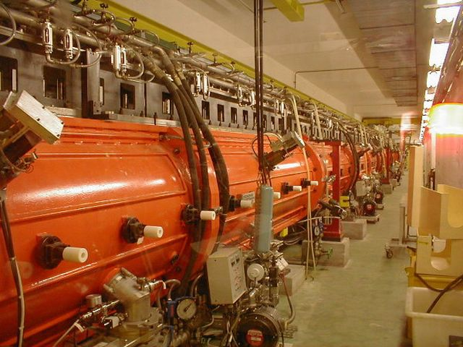
Linac2 (1978 , upgraded 1993)
A Duoplasmatron ion source giving up to 300 mA of beam current, 200mA protons.
Until 1993 the pre-injector was a 750 kV Cockcroft-Walton replaced by a 4-vane RFQ (RFQ2) with an injection energy of 90 kV and an output energy of 750 keV.
A three tank , 202.56 MHz drift tube linac with quadrupole focusing brings the beam energy to 50 MeV.
An 80 meter beam transport carries the linac beam to the 1.4 GeV PSB .

Slide 8
LINAC4-Motivation
Linac 2 has a low energy that limits the intensity in the PSB (and the LHC luminosity);
Linac2 experiences persistent vacuum problems (leaks) rising concerns for its future;
Linac2 is one of the 2 last injectors in the world still using protons: all modern machines went to H- ions (easier injection, less expensive linac, lower beam loss)

Slide 9
Present and expectation
LINAC2 |  | LINAC4
protons | Charge exchange injection (reduce emittance) | H-
160mA | Lower current means better beam quality | 40mA
100 µsec 1Hz | Longer injection in the PSB (100turns) | 400 µsec 1Hz
50 MeV | Space charge tune shift at PSB injection is half | 160 MeV
200 MHz | RF frequency that is not widespread anymore. No components “off the shelf”. | 352 MHz
Since 1978 | Tanks, vacuum, mechanics are aging. | All new component
No longitudinal matching at injection | 30-50% of the beam lost at injection | Fast chopping Energy painting
98% | Availability | ???????

Slide 10
LINAC4 PARAMETERS
Ion species H⁻
Output Energy 160 MeV
Bunch Frequency 352.2 MHz
Max. Rep. Frequency 2 Hz
Max. Beam Pulse Length 0.4 ms
Max. Beam Duty Cycle 0.08 %
Chopper Beam-on Factor 65 %
Chopping scheme: 222 transmitted /133 empty buckets
Source current 80 mA
RFQ output current 70 mA
Linac pulse current 40 mA
Tr. emittance (source) 0.25 π mm mrad
Tr. emittance (linac exit) 0.4 π mm mrad
Max. repetition frequency for accelerating structures 50 Hz
1.1 Hz maximum required for injection in the PSB
Chopping at low energy to reduce beam loss at PSB.
- Structures and klystrons dimensioned for 50 Hz.
- Power supplies, electronics, cooling and electricity) dimensioned for 2 Hz.

Slide 11
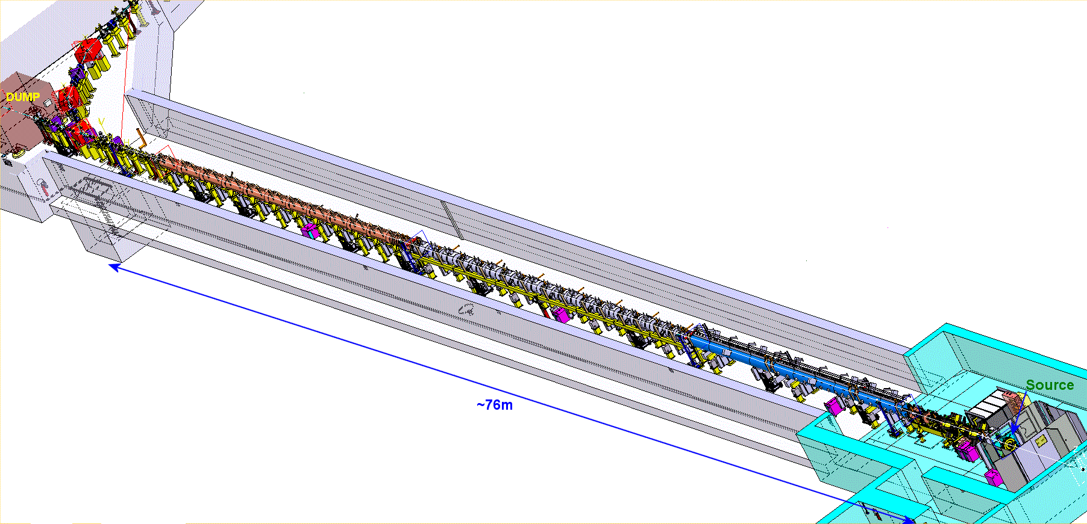

LINAC4 machine layout- 352MHz
Π-mode | CCDTL | DTL | Pre-injector
160 MeV | 100 MeV | 50 MeV | 3MeV
23 m 12 Modules 8 Klystrons: 12MW 12 EMQ 12 steerer 3/12 installed | 25 m 7 Modules 7 Klystrons : 7 MW 7 EMQ + 14 PMQ 7 steerers 4/7 installed | 19 m 3 Tanks 3 Klystrons : 5 MW 1 EMQ 114 PMQ 2 steerers | 9 m Source(s) 2 solenoids RFQ 11 EMQ 3 Cavities 2 Chopper units In-line dump
beam
Commissioning stages
160 MeV | 105 MeV | 50 MeV | 12 MeV | 3 MeV | 45 keV
August 2016 | March 2016 | October 2015 | Completed (10mA- Aug 14) | Chopping demonstrated | Not the final source

Slide 12
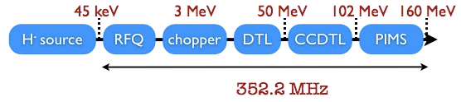
Linac4 architecture
No superconductivity (not economically justified in this range of beta’s and for duty cycle up to 50 Hz)
Single RF frequency of 352 MHz (no sections at 704 MHz, standardised RF allows for considerable cost savings)
H- for injection in the PS Booster, chopping to minimize capture loss.
High efficiency, high reliability, flexible operation → three types of accelerating structures.

Slide 13
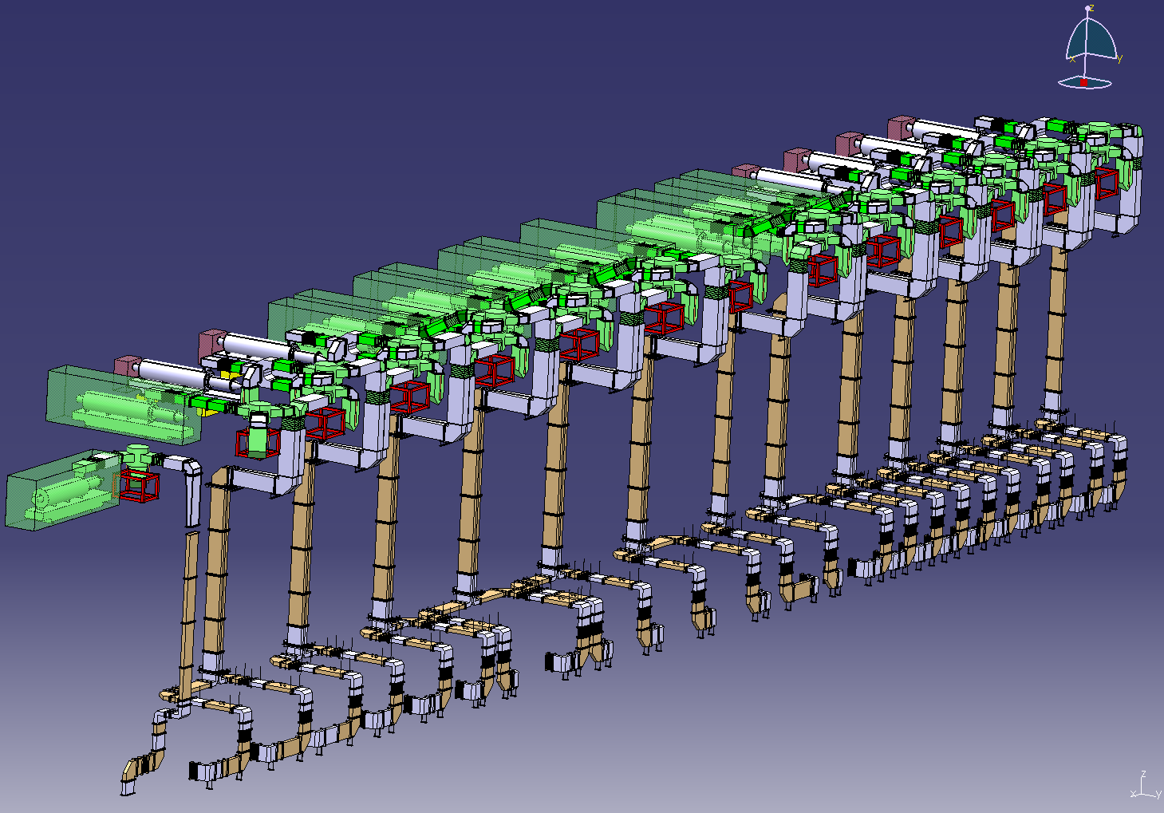
The RF System – overall view
Initial installation: 13 LEP klystrons (1.3 MW) + 6 new klystrons (2.8 MW) → 2 cavities/klystron only in the PIMS section;
Progressively, pairs of LEP klystrons replaced by new klystrons, extending the section with 2 cavities/klystron.
Final installation: 14 new klystrons

Slide 14
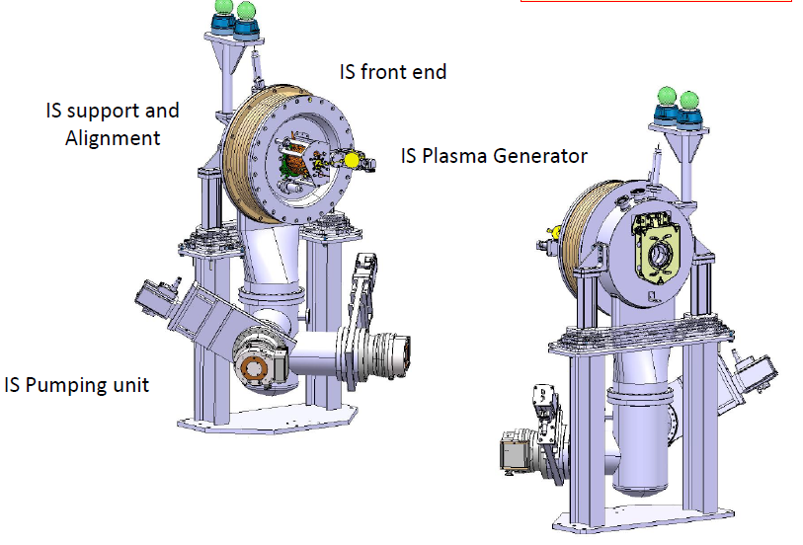
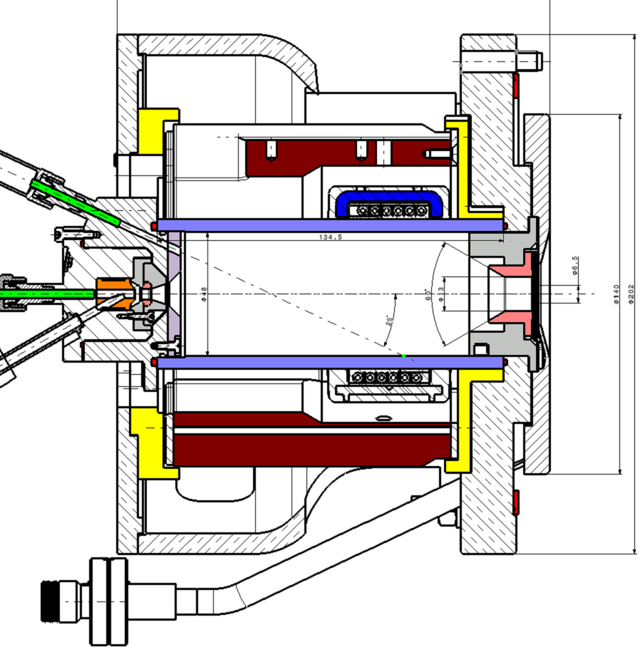
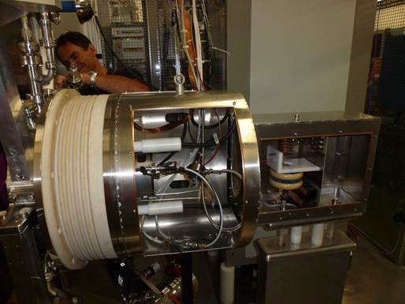
The ion source
Hydrogen bottle – atoms (proton+electron) are injected in the plasma chamber – an externally applied electric field heats the atoms and separates protons and electrons – creation of a plasma, confined by magnetic fields – the RF field applied excites a resonance of the atoms, that can attract an electron and create an H- ion – the H- is then extracted via the high voltage electrodes of the source.

Slide 15
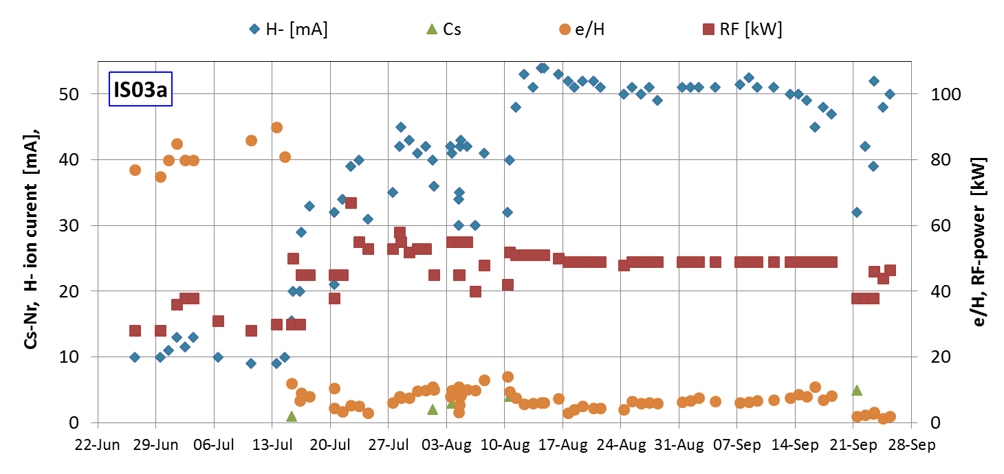
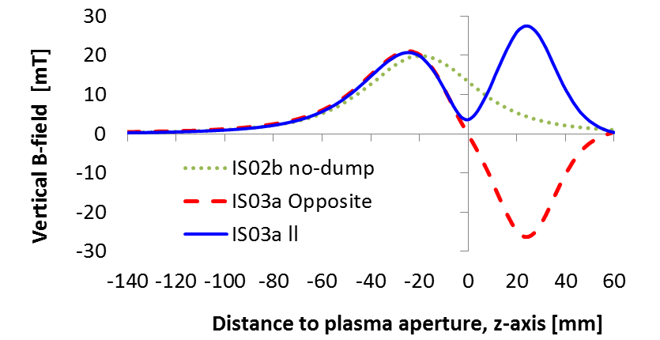
Cs: 21.5 mg
No Cond. effect
9-weeks
2015
Filter & dump B-Field
Plasma chamber Extraction / e-dump
Achieved :
Stable plasma generator
Opposite
Parallel

Slide 16
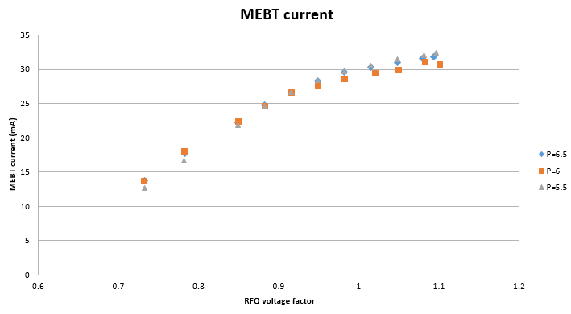
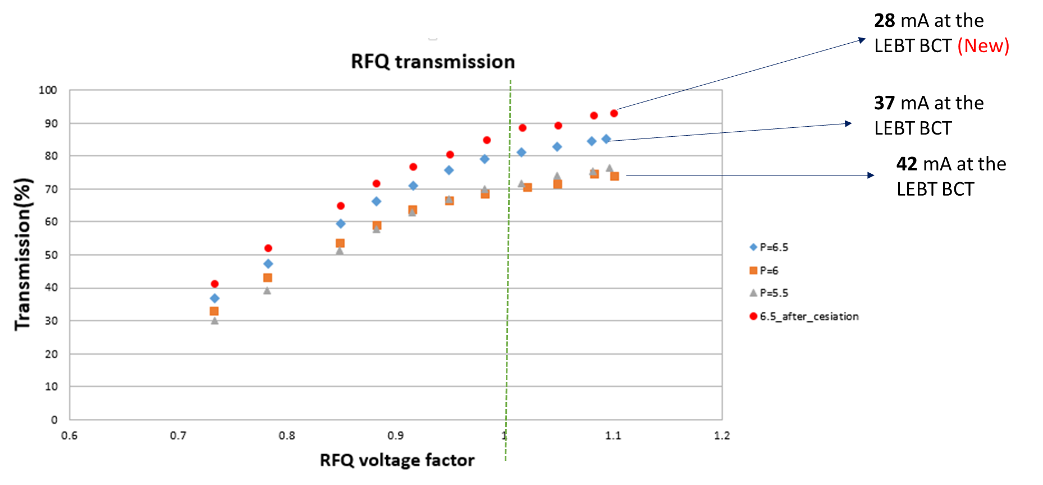
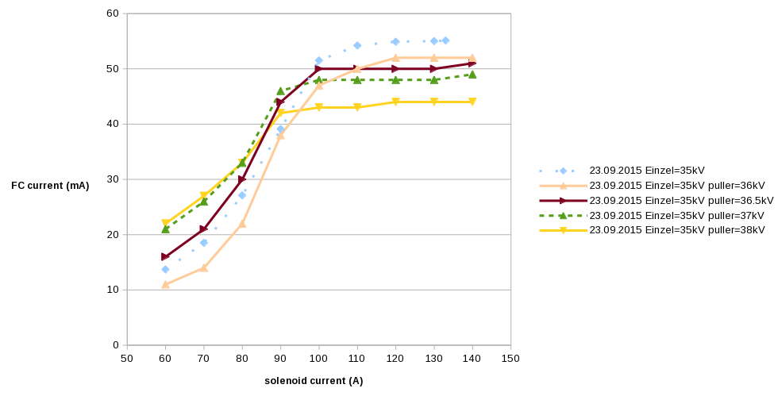
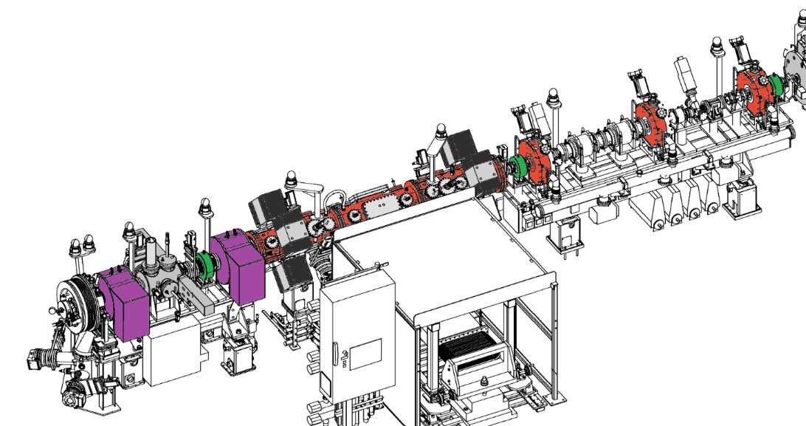
1) 30 mA at 3MeV | 2) The emit from the source exceeds the RFQ acceptance
3) Due to mismatch between the source and the LEBT we lose some beam already in the first solenoid
3MeV BCT2
45 keV
BCT1

Slide 17
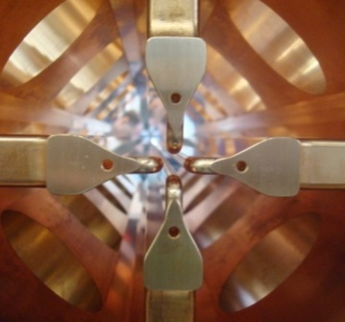
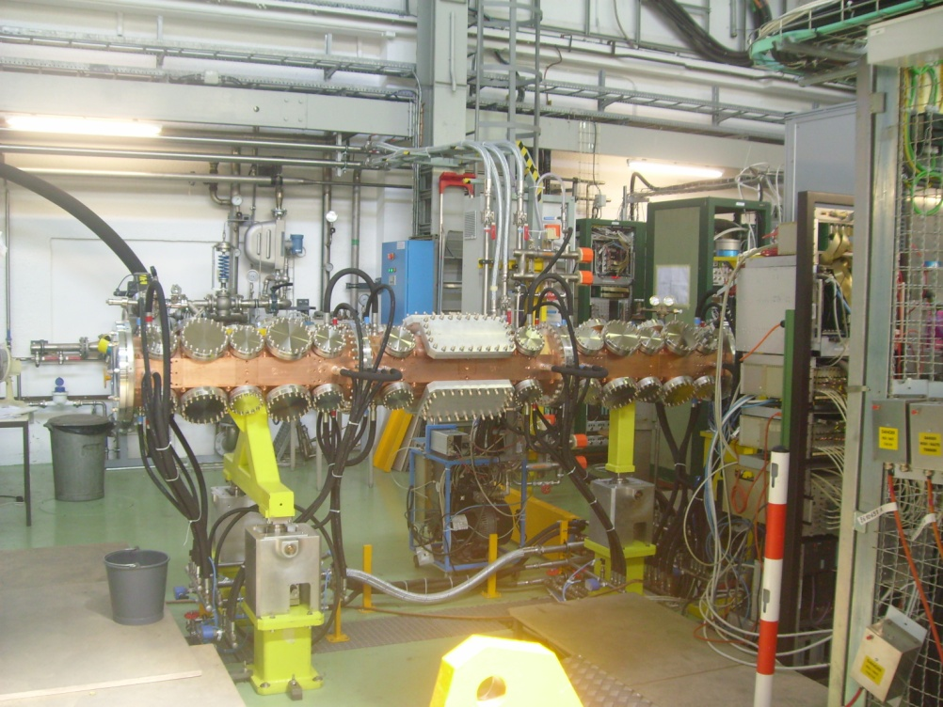
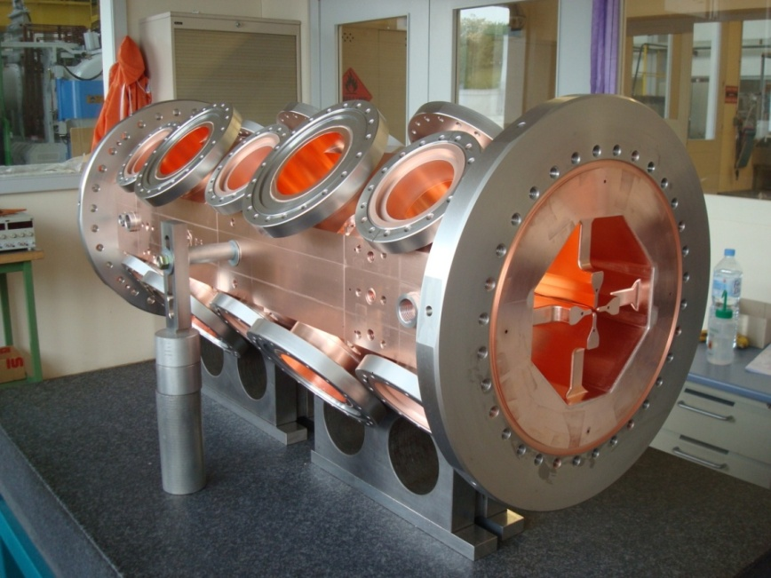
The RFQ
RFQ = Focusing channel + bunching + acceleration
The Radio Frequency Quadrupole (RFQ) is the first accelerator in Linac4 (3m, up to 3 MeV). It focuses bunches and accelerates the beam in a quadrupole channel inside an RF resonator.
3 MeV because below the activation threshold

Slide 18
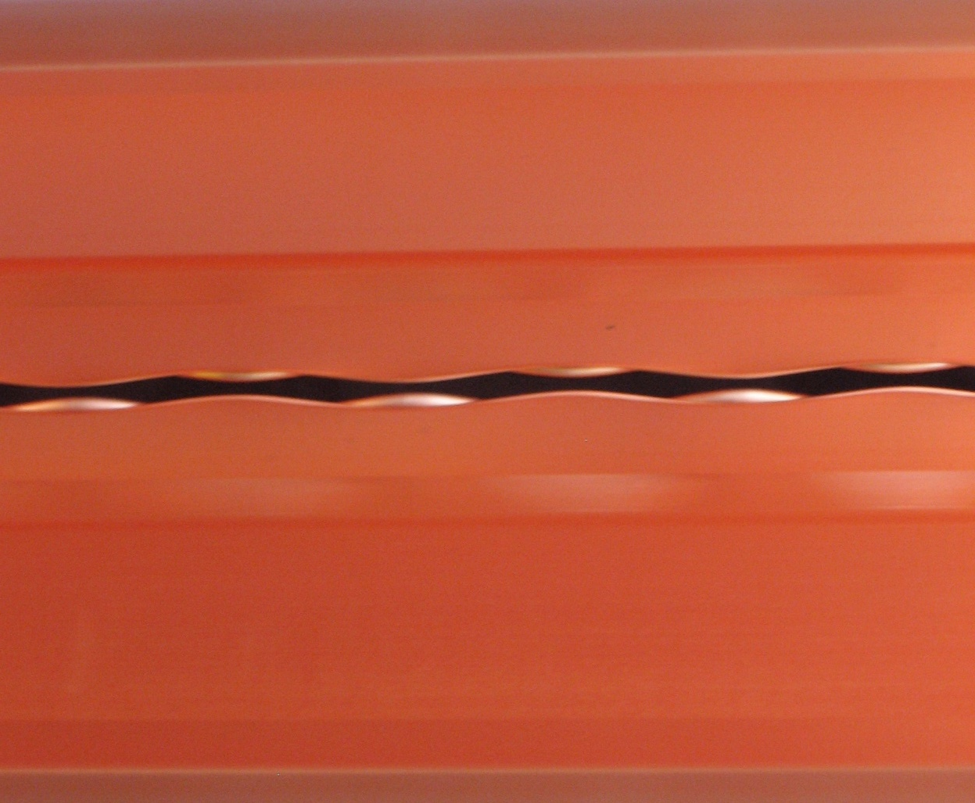
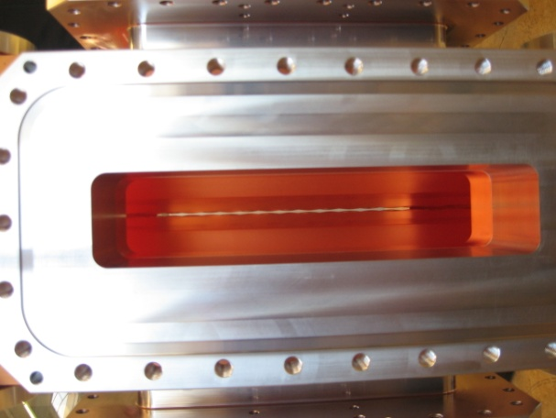
looking into an RFQ…
Looking from the RF port into the new CERN RFQ (Linac4, 2011)

Slide 19




transverse field in an RFQ
-
-
alternating gradient focussing structure with period length βλ
(in half RF period the particles have travelled a length βλ/2 )
+
+
+
+
-
-

Slide 20
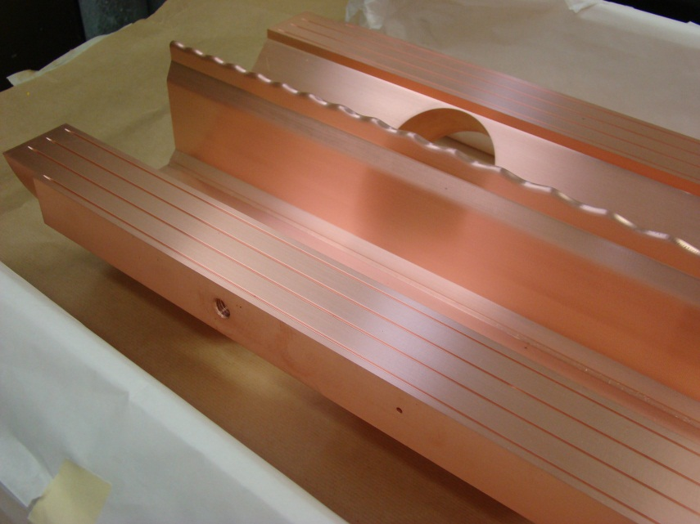
acceleration in RFQ
longitudinal modulation on the electrodes creates a longitudinal component in the TE mode

Slide 21
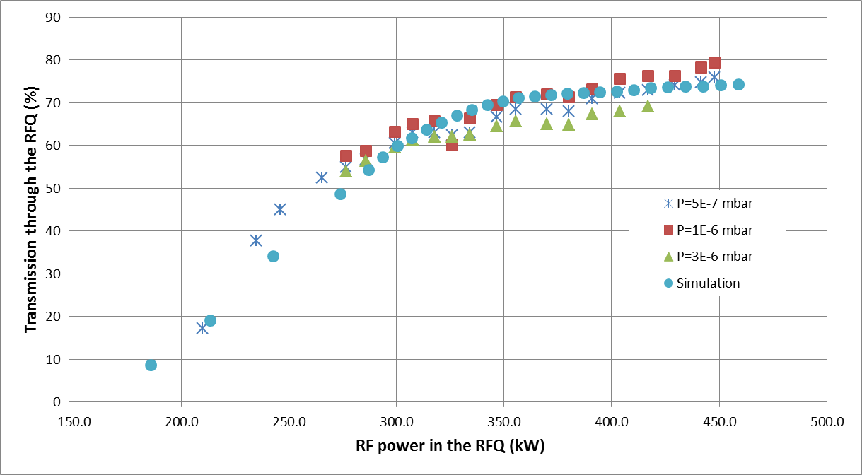
rfq works to specs
RFQ Transmission vs. RF power for different pressure in the LEBT (neutralisation). The nominal RFQ power is 400 kW.

Slide 22
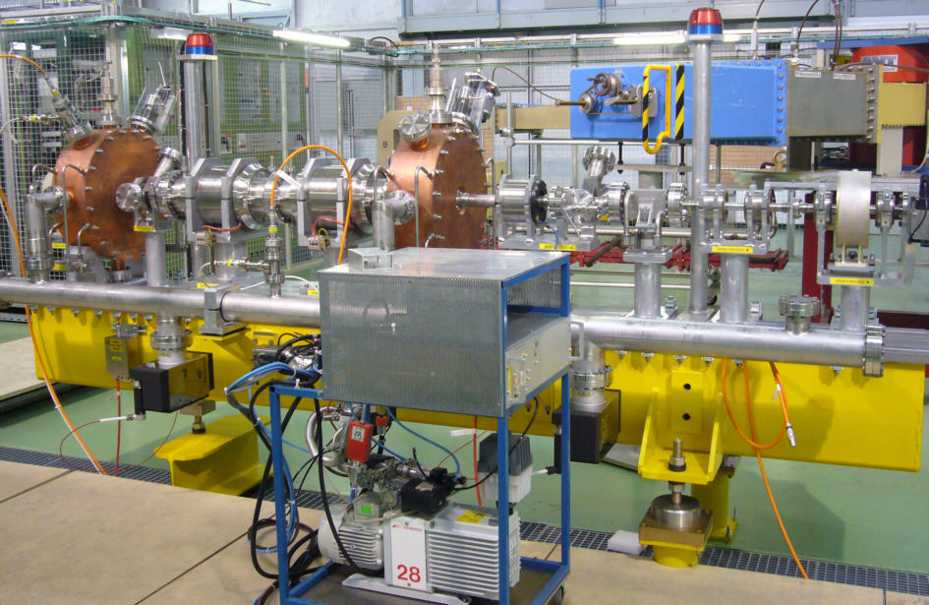
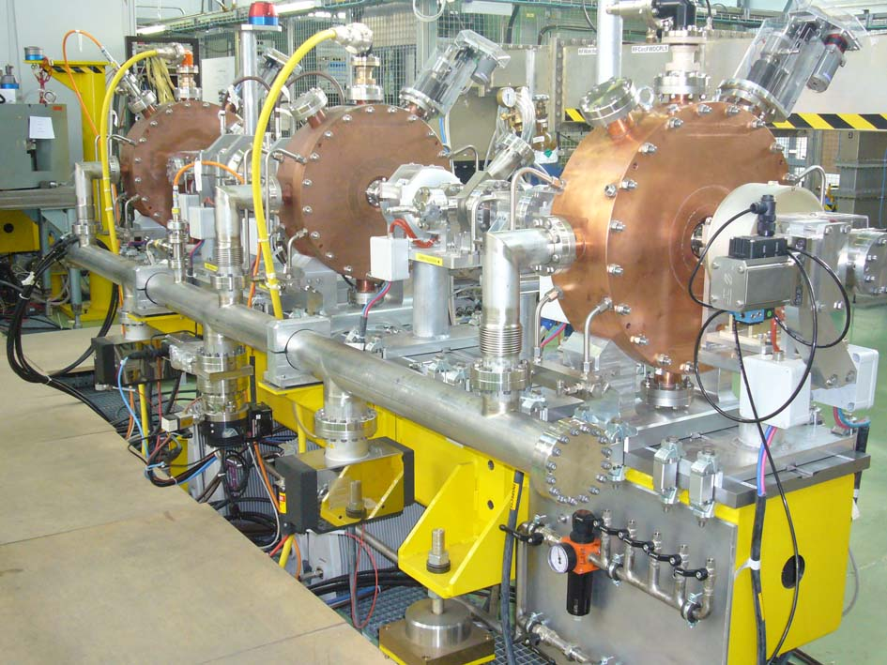
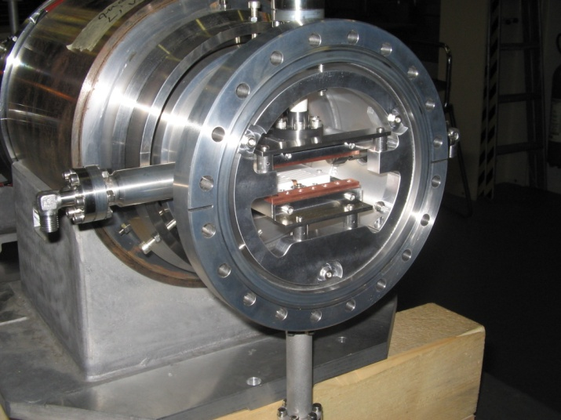
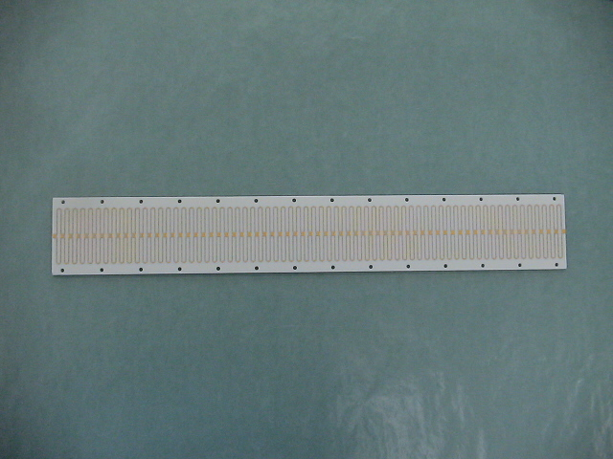
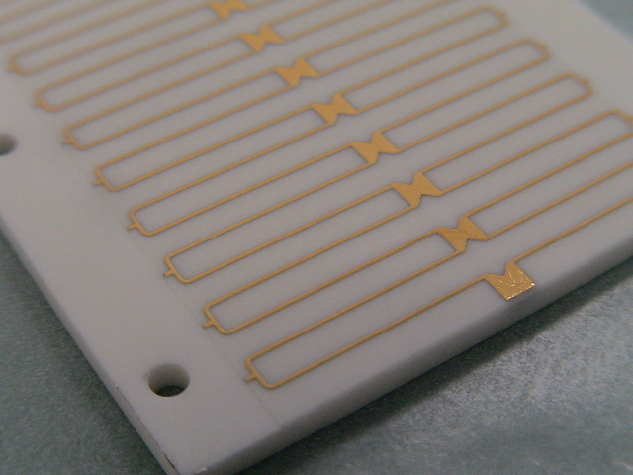
Chopper line

Slide 23
chopping
“longitudinal matching” from a linac to a ring with the purpose of controlling the losses
  rise time of the injection kickers/length of the machine.
  Shave the linac beam to match the RF bucket of the ring
Perform the chopping at low enough energy but when the beam has already imprinted the RF structure, i.e. after the first stage of acceleration.

Slide 24
Chopping-example
LOSSES
2.84 ns
Beam from a 352 MHz linac injected in a 40 MHz ring
2.84 ns
Injected in the stable area of the bucket : no losses

Slide 25
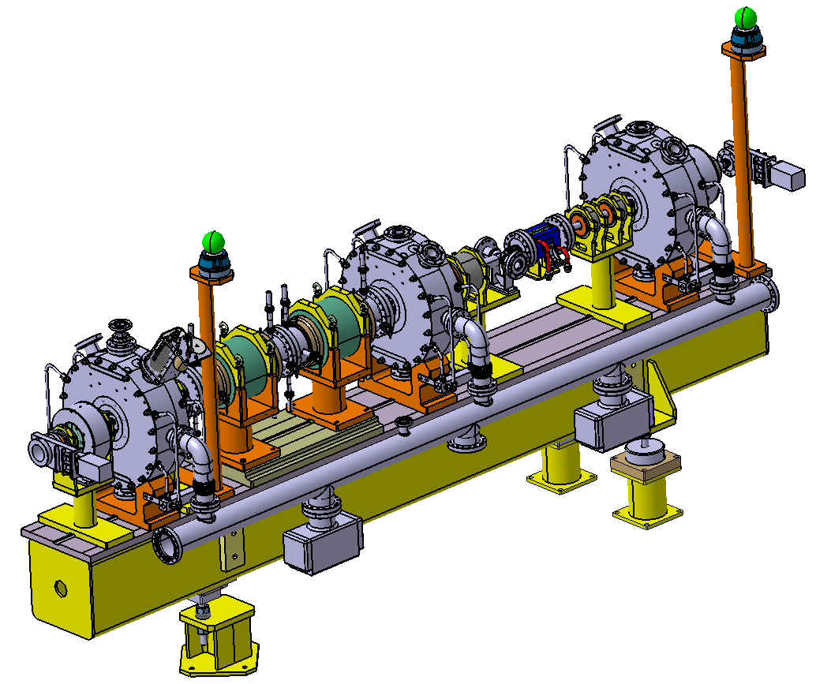
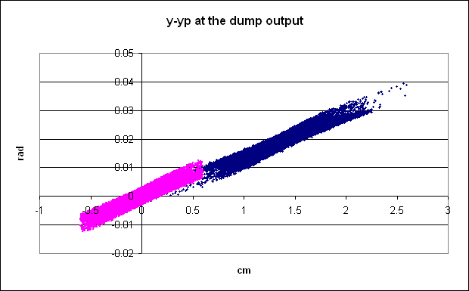
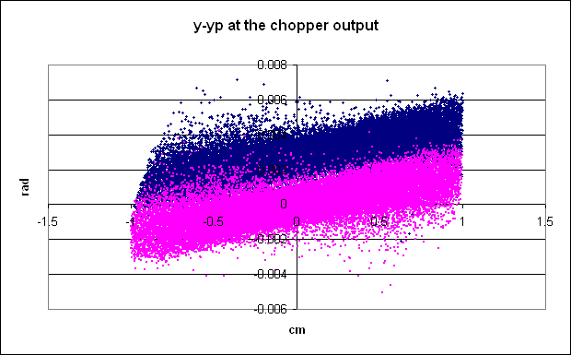
Special feature 1: “chopping” removing microbunches (150/352) to adapt the 352MHz linac bunches to the 1 MHz booster frequency
Match to the DTL
Match from the RFQ
Chop
Emittance increase 20-30%

Slide 26
Chopper line layout
Matching section
Chopping section
Matching section
10⁴ ions
1.15×10⁹ ions
2.84 ns
for PSB : suppress 150/352 microbunches (1MHz)
for SPL and Nufact : suppress 3/8 microbunches (40 MHz CERN nufact)

Slide 27
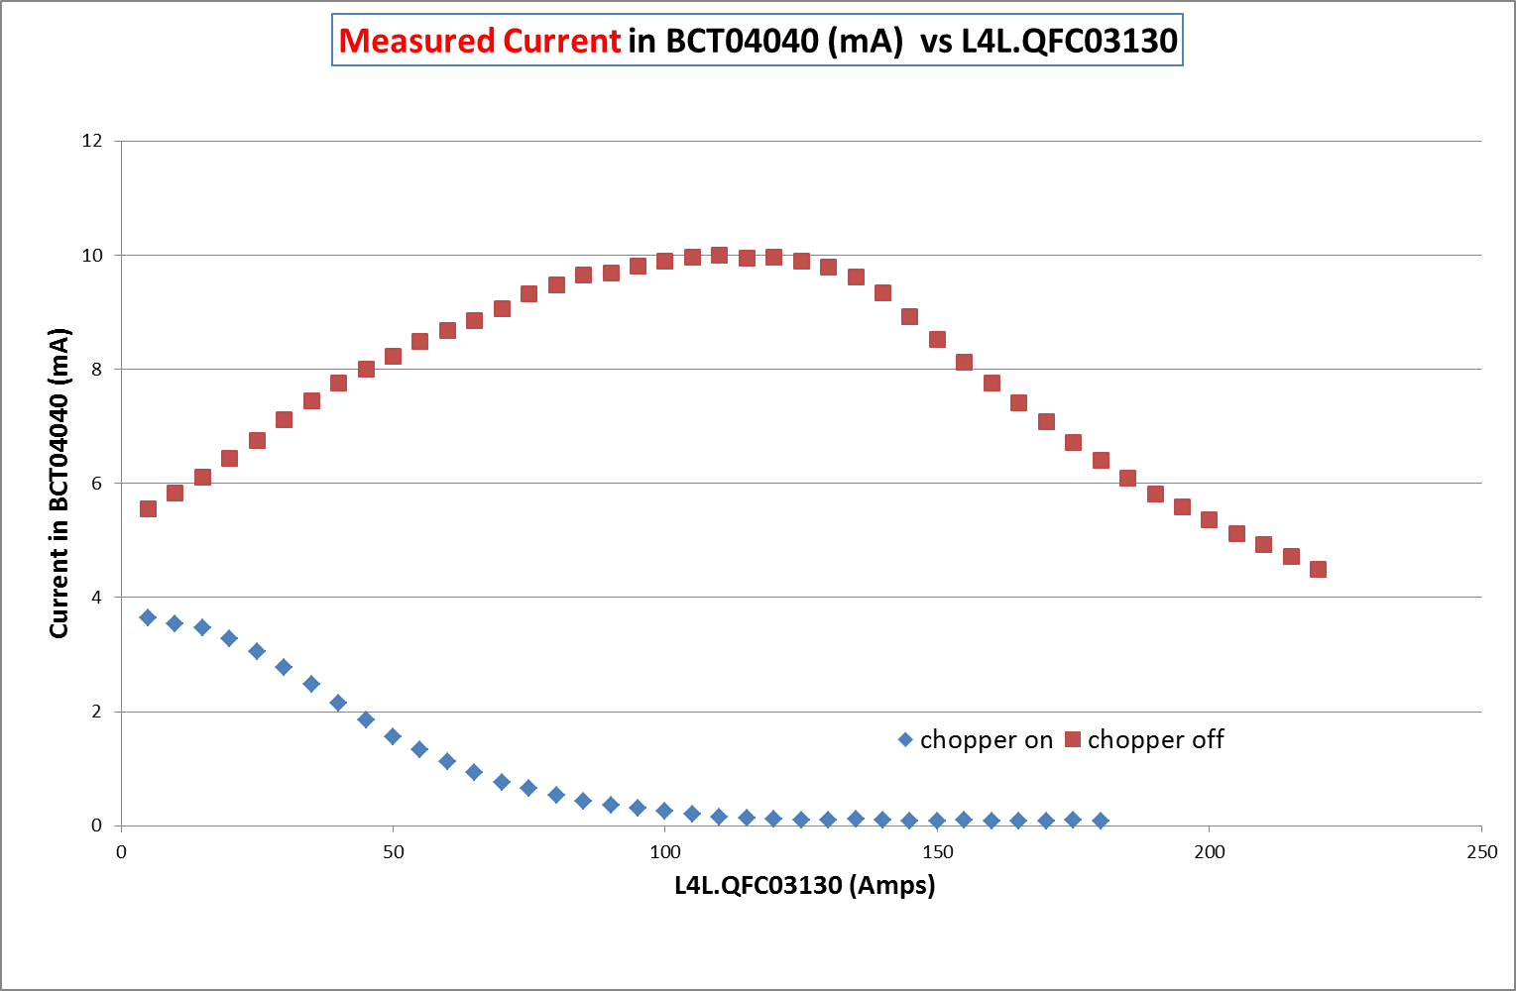
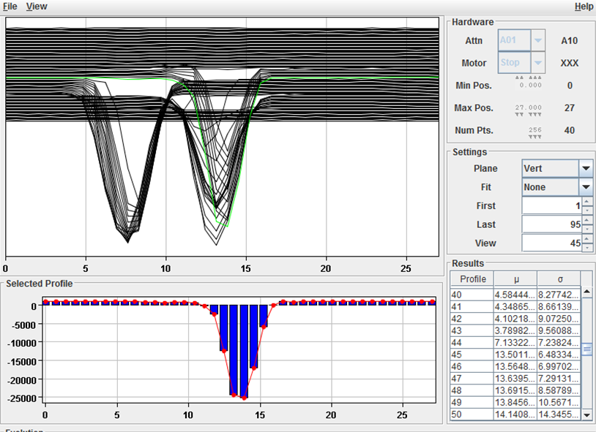
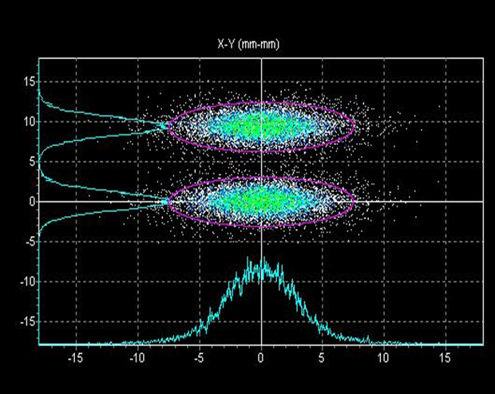
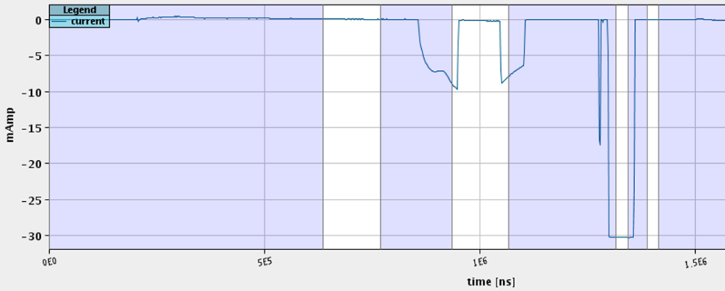
Chopper works
At the BCT after the inline dump | At the wire scanner before the dump
Meas 2014
Simu
2008

Slide 29
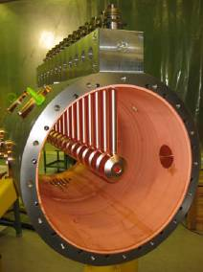
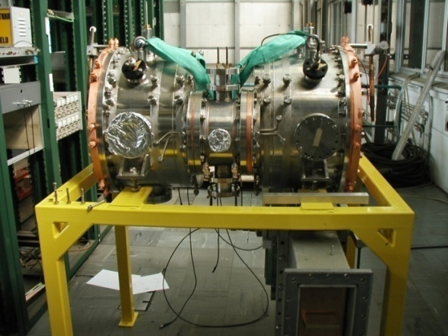
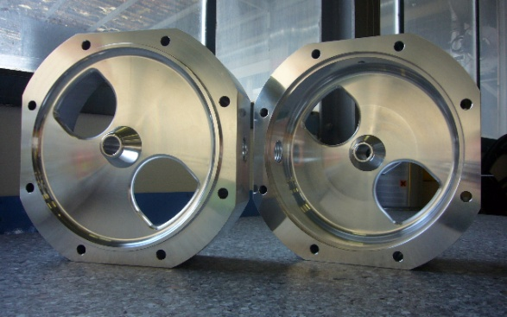
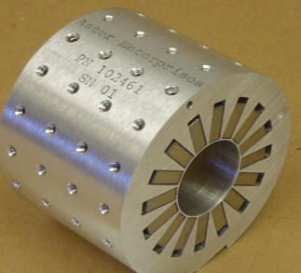
FROM 3 to 160 mev
DTL, 3 – 50 MeV
CCDTL, 50 – 100 MeV
PIMS, 100 – 160 MeV
7-cell cavities in p-mode (12 cavities)
  DTL equipped with permanent magnet quadrupole

Slide 30
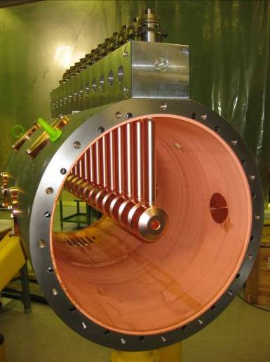
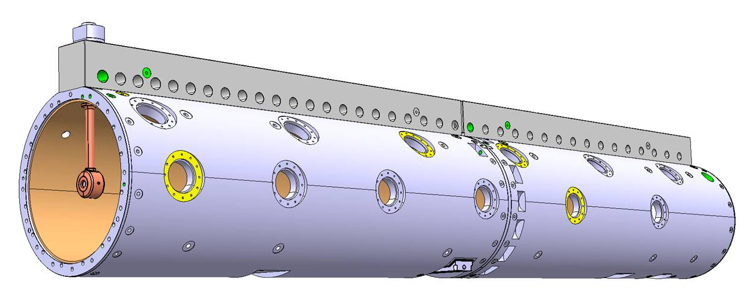
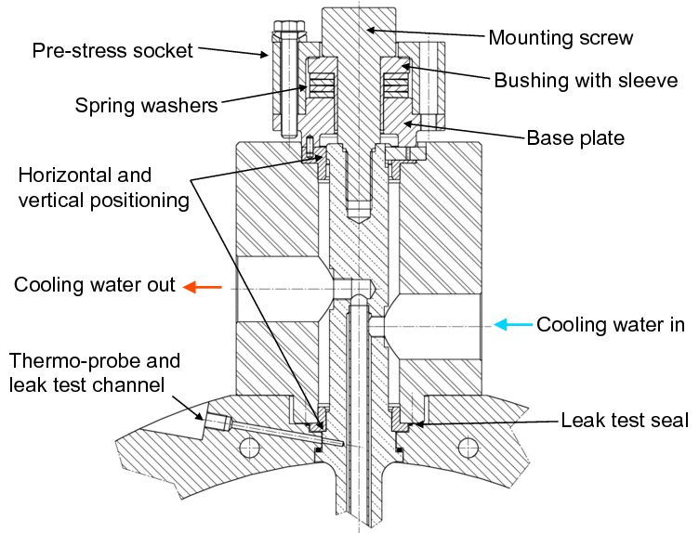
Linac4 – Drift Tube Linac
3-50 MeV, 3 tanks.
New CERN design, tested on a prototype (1m, 12 drift tubes) at full RF power (10% duty cycle).
Main features: drift tubes rigidly mounted on a girder, with special mounting mechanism, only metallic joints and no adjustment. Tank in Cu-plated stainless steel. Permanent Magnet Quadrupoles in vacuum.

Slide 31
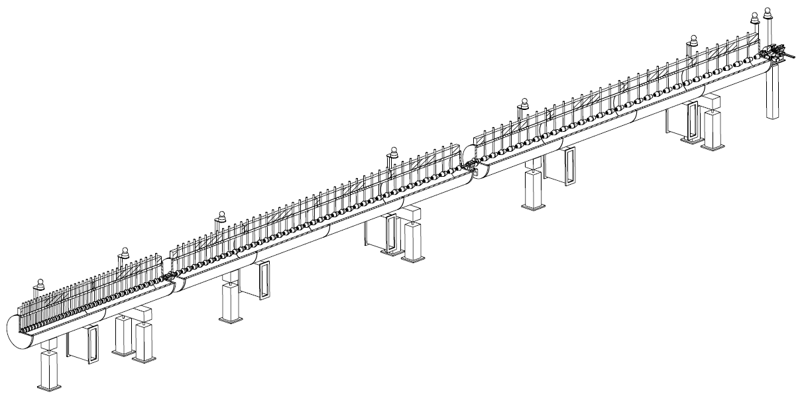
the Linac4 DTL
352 MHz frequency
Tank diameter 500mm
3 resonators (tanks)
Length 19 m
120 Drift Tubes
Energy 3 MeV to 50 MeV
Beta 0.08 to 0.31 → cell length (βλ) 68mm to 264mm
→ factor 3.9 increase in cell length
beam

Slide 32
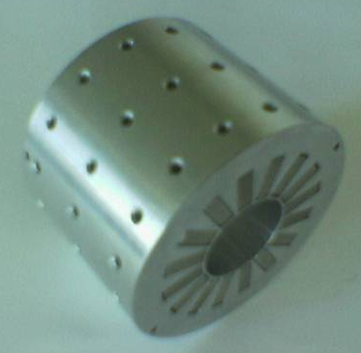
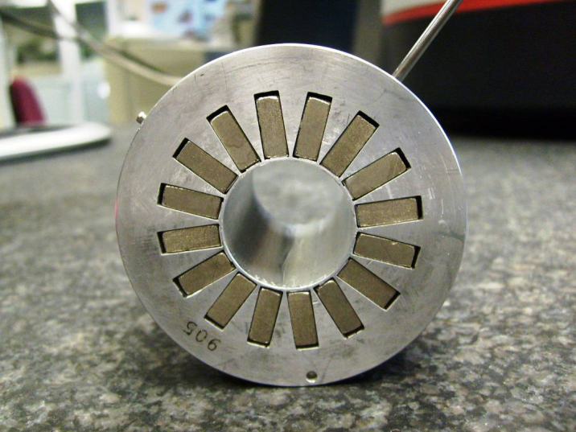
PMQs for the DTL
48 screws
One PMQ installed in each Drift Tube
  FFDD system
  Max/Min integrated gradient= 2.4/1.2 T
  Tolerance : ±0.5% on the field, 1mrad on the roll, harmonics <0.01 at 75%radius,
Magnet Material - Samarium Cobalt (Sm₂Co₁₇)
  PM material selected to minimize field strength loss due to neutron fluence.
Housing Material - Stainless Steel (316LN)
  For use in vacuum (low degassing)
  Stable against corrosion (galvanic couple with copper)
  Thermal expansion coefficient similar to copper
  Low conductivity protects against accidental heating during the welding process
Installation in Drift tube
  Each PMQ will be positioned in the centre of the drift tube, oriented with a dowel pin and clamped in position by a spring washer
  The drift tube will not have a full bore tube and the end-caps, located on the PMQ, will be welded to the body of the drift tube after positioning of the PMQ.
Hole and Pin to position in drift tube
16 pole pieces

Slide 33
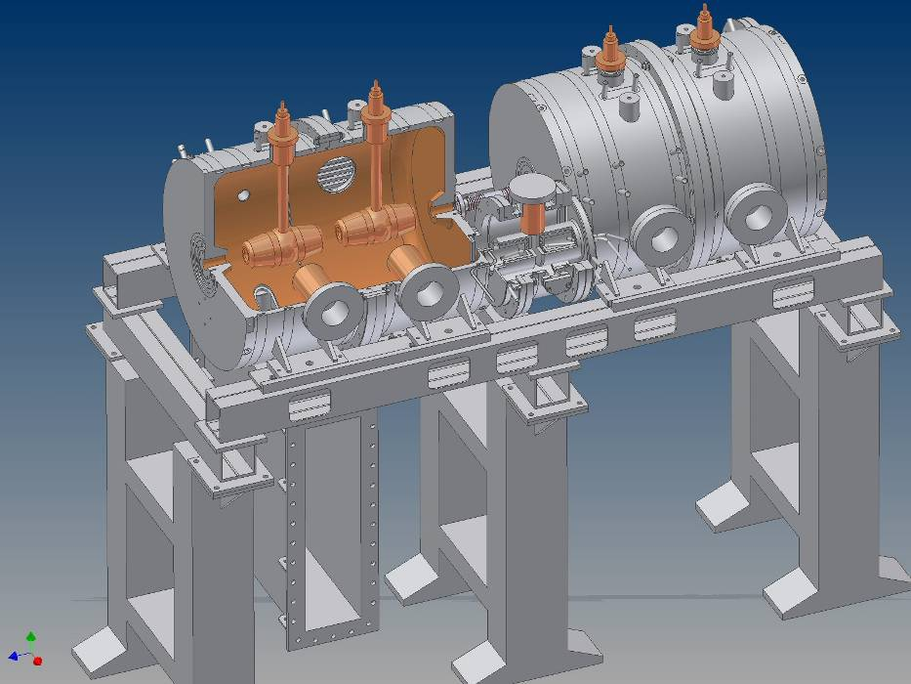
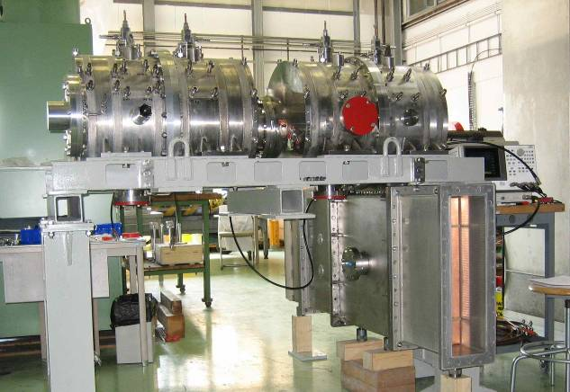
The Cell-Coupled Drift Tube Linac
Series of DTL-like tanks (0-mode), coupled by coupling cells (π/2 mode)
352 MHz, will be used for the CERN Linac4 in the range 40-100 MeV.
Quadrupoles between tanks → easier alignment, lower cost than standard DTL
DTL-like tank (2 drift tubes)
Coupling cell
DTL-like tank (2 drift tubes)
Waveguide input coupler

Slide 34
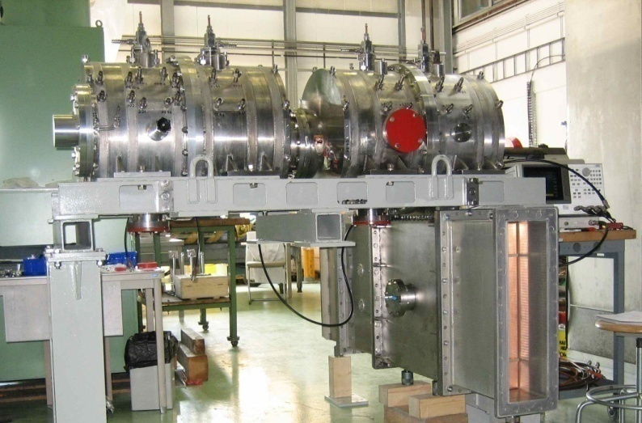
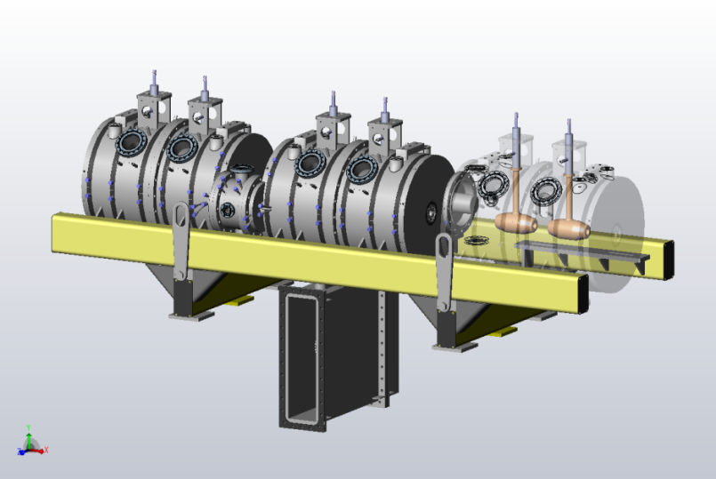

Linac4 – Cell-coupled DTL
50-100 MeV, 7 modules of 3 tanks each.
New design, tested on a prototype (2 tanks, 4 drift tubes) at full RF power (10% duty cycle).
Main features: Focusing by PMQs (2/3) and EMQs (1/3) external to drift tubes. Short tanks with 2 drift tubes connected by coupling cells.
Construction started at VNIITF (Snezinsk) and BINP (Novosibirsk) in January 2010.
Structure used for the first time in a particle accelerator !

Slide 35





Linac4 – Pi-Mode Structure
100-160 MeV, 12 tanks of 7 cells each.
Tank #1 (pre-series) completed and RF conditioned to 1.25 times the design voltage.
Main features: Focusing by external EMQs, tanks of 7 cells in pi-mode. Full-Cu elements, EB-welded.
Construction started (2011) in collaboration with Soltan Institute (Warsaw) and FZ Julich.
Structure used for the first time in a proton accelerator !

Slide 36

“energy painting” linear energy variation over 10 + 10 µsec (20 turns) to better fit the 100 µsec pulse to the booster bucket ,
The field in the last two tanks of the PIMS is linearly increased /decreased from 2.6 to 3.28 MV/m over 20 µsec to vary the beam energy by
± 1MeV /160 MeV……
EoT (n=11,12)=3.28 MV/m
→ΔE=+1MeV
EoT (n=11,12)=2.93 MV/m
→ nominal E=159.4 MeV
EoT (n=11,12)=2.6 MV/m
→ΔE=-1MeV
….as a results the booster bucket is uniformly filled (up+down) over 20 injection turns.

Slide 37
Beam dynamics
The emittance (and current) are determined in the first 10 meters!

Slide 38
Focusing field
“Locally” irregular due to extra space for intertank and diagnostic
Can match current from 30 to 80 mA, nominal is 70mA

Slide 39
Accelerating field and phase

Slide 40
Phase advance
Phase advance is smooth
Ratio long/transv is such as to avoid resonances
Limit to the max current comes from the longitudinal phase advance

Slide 41







collaborations
RFQ RF design, RF amplifiers, modulator construction (French Special Contribution), completed.
Prototype modulator, waveguide couplers, alignment jacks from India,
45 keV 3 MeV 50 MeV 100 MeV 160 MeV
Movable tuners from Italy,
Beam dynamics studies and
commissioning
H
-
LEBT
RFQ
chopper line
DTL
CCDTL
PIMS
transfer line to PSB
source
80 m
Chopper line built in a EU Joint Research Activity
Participation of ESS-Bilbao in DTL construction,
Construction of CCDTL in Russia, via an ISTC Project
Collaboration agreement with Soltan Institute (Poland) for PIMS construction.

Slide 42

Medium-term schedule (2015-16)
Planning by J. Coupard

Slide 43
Longer-term schedule (2017/20)
start connection activities
Install Debuncher at the position of the HST, leave temporary dump in, send beam in first 3 bendings and in debuncher
8-month window for interventions and repairs after reliability run (eg. DTL2)
6-month long reliability run (beam sent on the main dump)
3-month beam testing after the repairs and interventions
After installation of new LBE and dump at PSB entrance, transport and measure the beam in LBE (PS closed)

Slide 44
Hardware Reliability issues
Source stability : RF plasma generator , 45 kV extraction
RF power sources : 19 klystron and 4 solid state amplifiers
Chopper : 4 chopper drivers
Quads, steerers and other foc elements (about 50 circuits)

Slide 45
software Reliability issues
Controls in general
BIS/SIS

