Slide 1
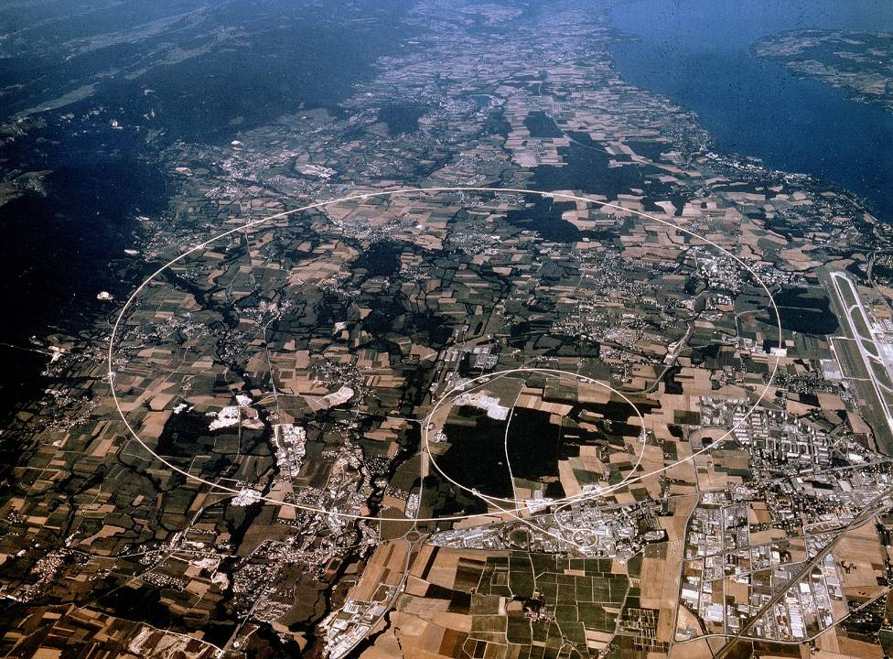
Overview of Dependability Studies at CERN
Apollonio, 17/11/2015
andrea.apollonio@cern.ch
Acknowledgements: J. Gutleber, M. Jonker, A. Niemi, R. Schmidt, P. Sollander, B. Todd, J. Uythoven, D. Wollmann, M. Zerlauth, students IMA Stuttgart

Slide 2

CERN Resources for Availability Studies
Presently at CERN:
2 PhD students
3 technical students
1 Fellow (Post-Doc)
1 Project associate
10-20 % of about 5 staff members

Slide 3
Projects, upgrades and new accelerators
2015
2018
2025
>2040
Upgrades for LHC run2
L4 REL RUN
Upgrades of injector chain
HL-LHC
CLIC??
FCC?
CERN
ESS
MYRRHA
EU

Slide 4
Projects, upgrades and new accelerators
2015
2018
2025
>2040
Upgrades for LHC run2
L4 REL RUN
Upgrades of injector chain
HL-LHC
CLIC??
FCC?
CERN
ESS
MYRRHA
EU

Slide 5
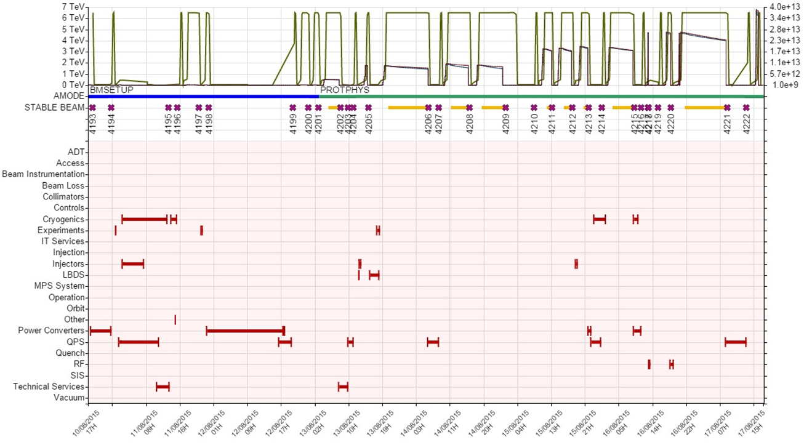
Accelerator Fault Tracker
Need for tools for efficient fault tracking
Availability Working Group in charge of weekly fault review

Slide 6
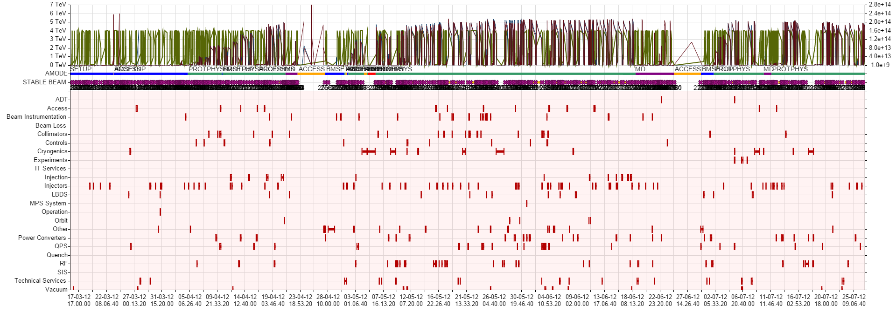
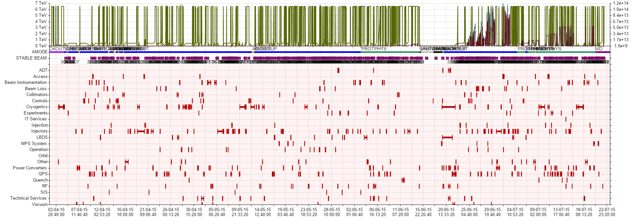
First Experience
2012 → 370 faults
2015 → 544 faults

Slide 7
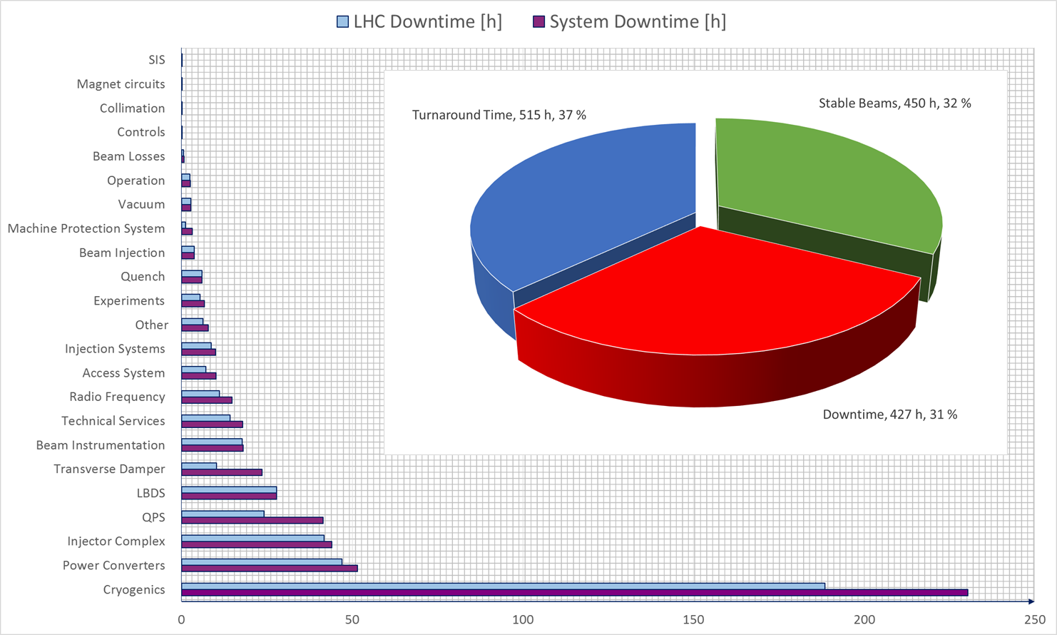
2015 Downtime by System (25 ns run)

Slide 8
Collaboration with IMA Stuttgart
Started in 2012/2013
5 technical students at CERN (studienarbeit + master thesis)
Different topics, mostly related to reliability of Machine Protection Systems
Plans for more studies in 2016 under discussion
Future reliability trainings at CERN

Slide 9
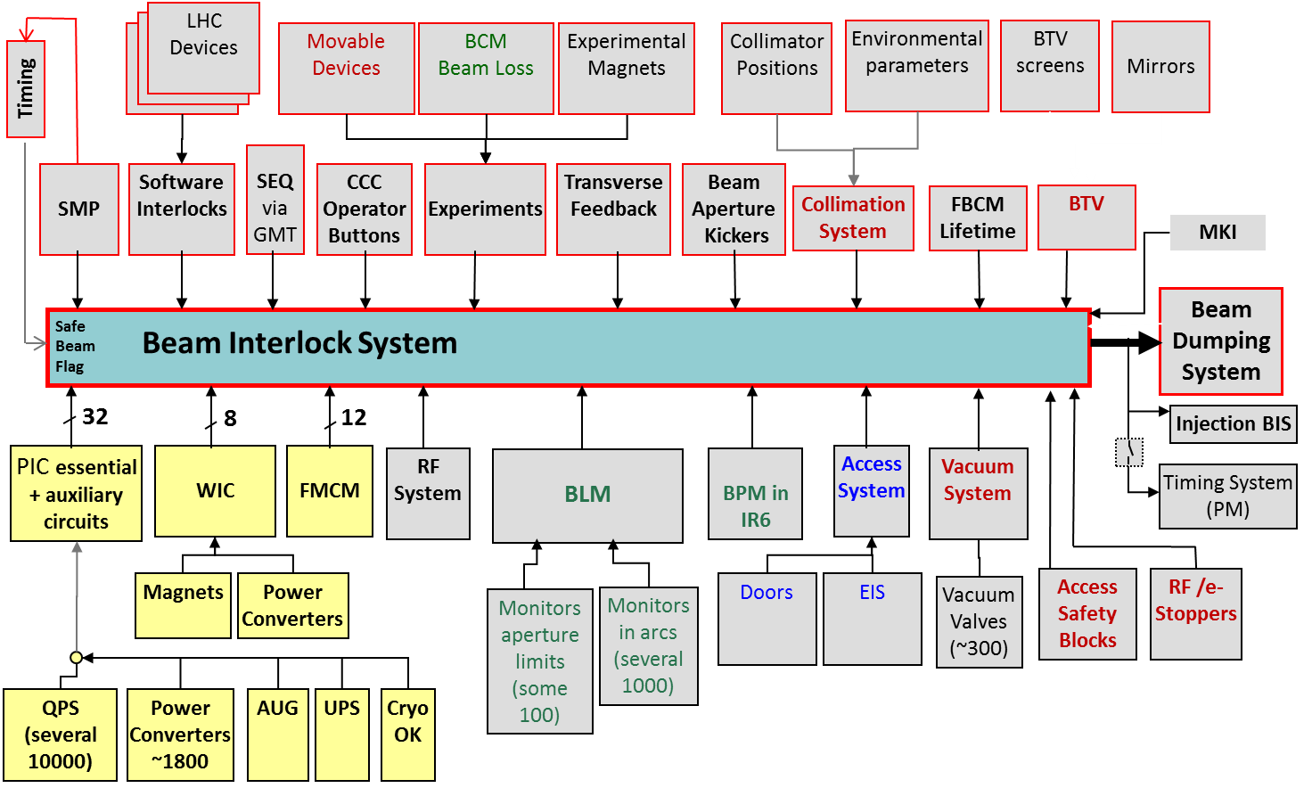
LHC MPS Overview

Slide 10
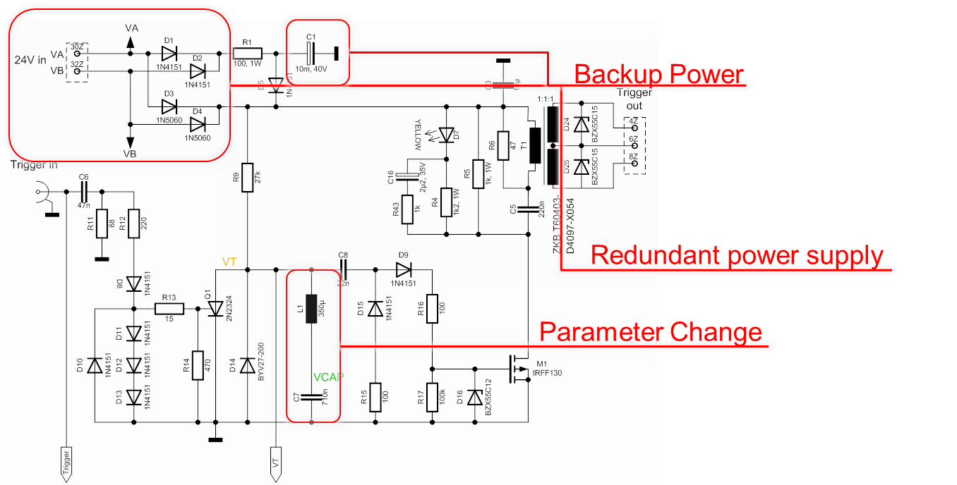
LHC Beam Dumping System: Retriggering
V. Vatansever, IMA Stuttgart
FMECA + failure rate with MIL-HDBK-217 (ISOGRAPH)

Slide 11
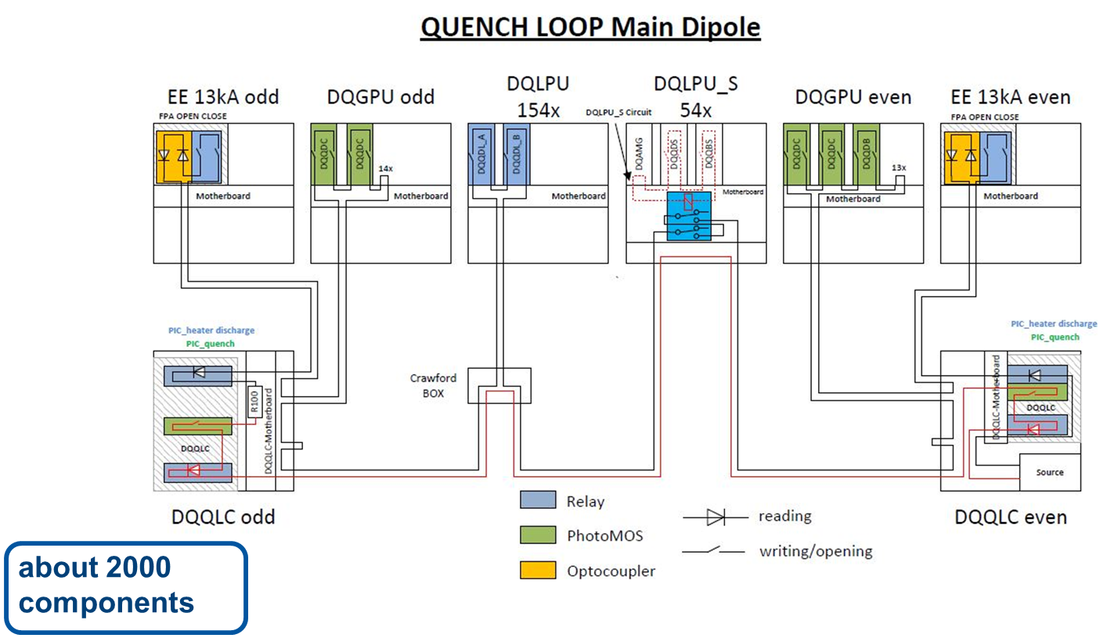
Quench Loop: Reliability Analysis
S. Guenter, IMA Stuttgart
FMECA + failure rate with MIL-HDBK-217 (ISOGRAPH)

Slide 12
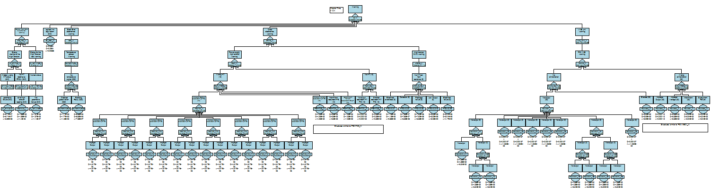
MPS Reliability Models
T. Griesemer, IMA Stuttgart
Example: Beam Loss monitors
Warning probability: 8.82·e-2 / mission
→ 35 warnings per year
Coherent modelling of MPS (ISOGRAPH)

Slide 13
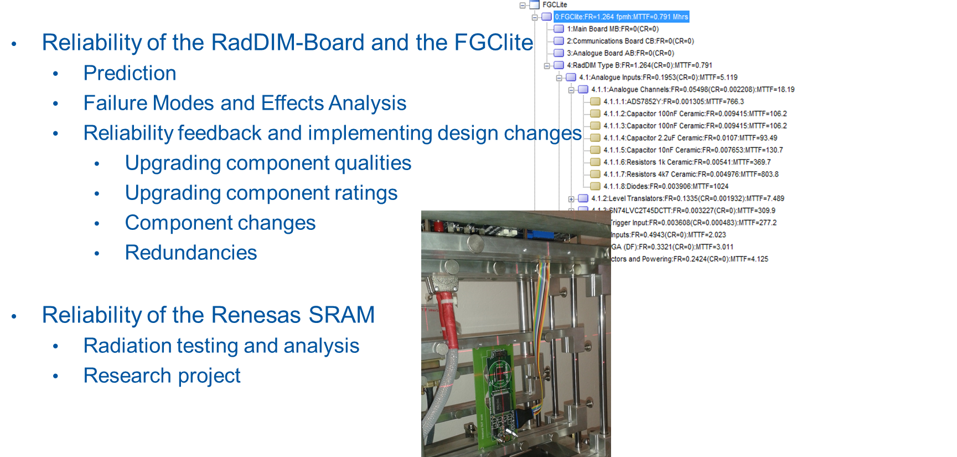
PC Controls Upgrade: Reliability Models
V. Schramm, IMA Stuttgart

Slide 14
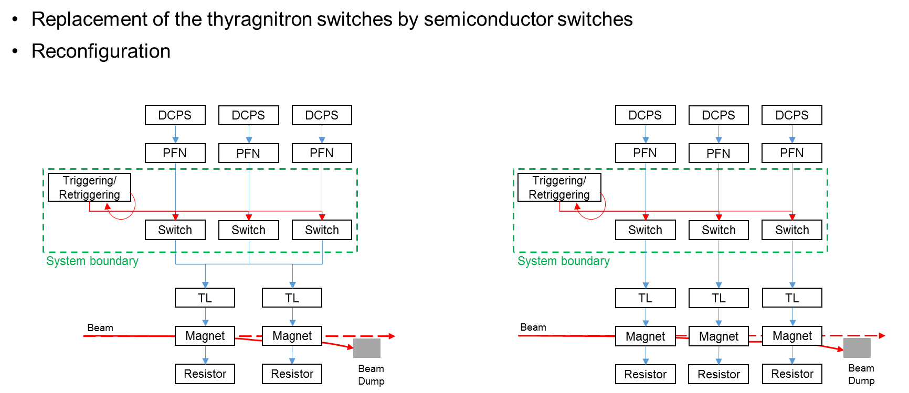
SPS Beam Dumping System
M. Blumenschein , IMA Stuttgart

Slide 15
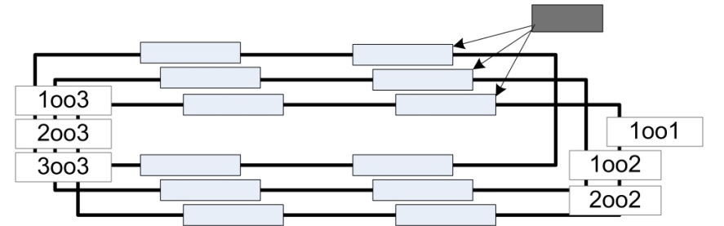
Study of future MPS architectures
Switch not ready to open upon demand, failed closed
1
0
blind
λ_{B}
0
0
ready
1
1
0
1
Switch closed, ready to open upon demand
λ_{F}
false
Switch open due to switch-internal failure covered by fail-safe measure
0
silent
Nominal condition
x
Observation over time period tf
Emergency condition detected, demanding system shutdown
1
demanding

Slide 16
Projects, upgrades and new accelerators
2015
2018
2025
>2040
Upgrades for LHC run2
L4 REL RUN
Upgrades of injector chain
HL-LHC
CLIC??
FCC?
CERN
ESS
MYRRHA
EU

Slide 17
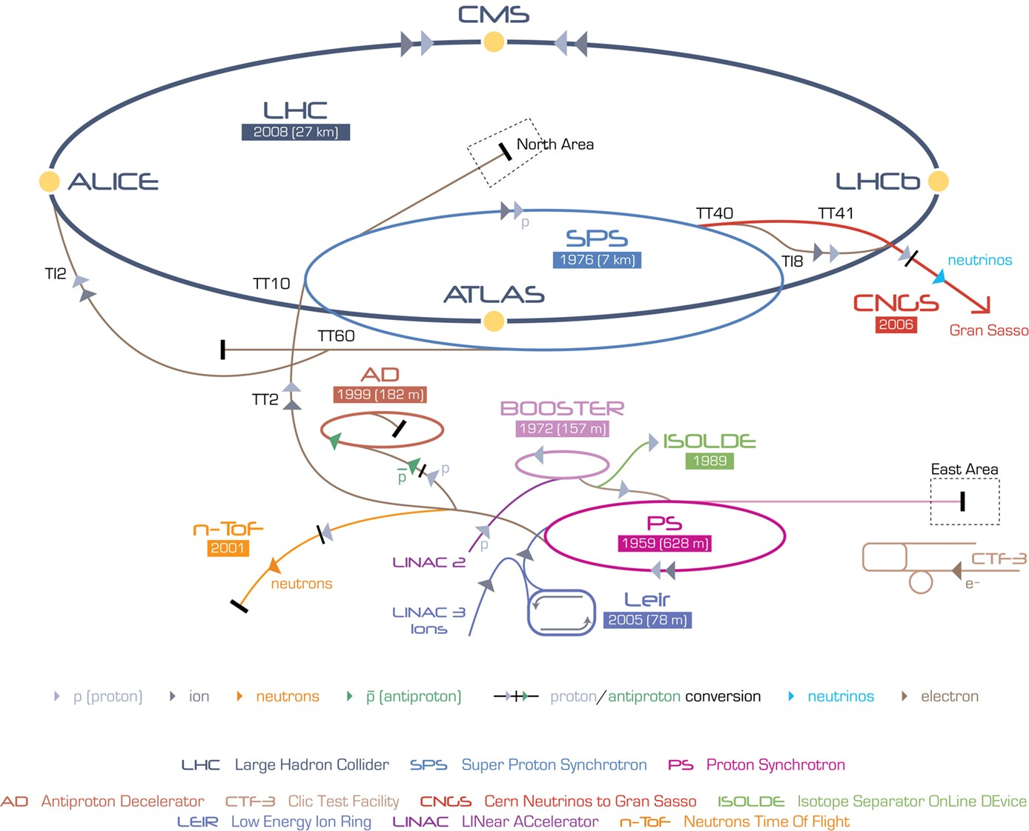
The LHC injector chain

Slide 18
Linac4 MPS and commissioning
STPA analysis of Linac4 Availability requirements
Study of Linac4 Beam Interlock System Architecture
Follow-up of Linac4 commissioning and reliability run (2017)
Linac4 availability model
Use of reliability data from Linac4 reliability run to develop an availability model of MYRRHA (Empresarios Agrupados, Spain)

Slide 19
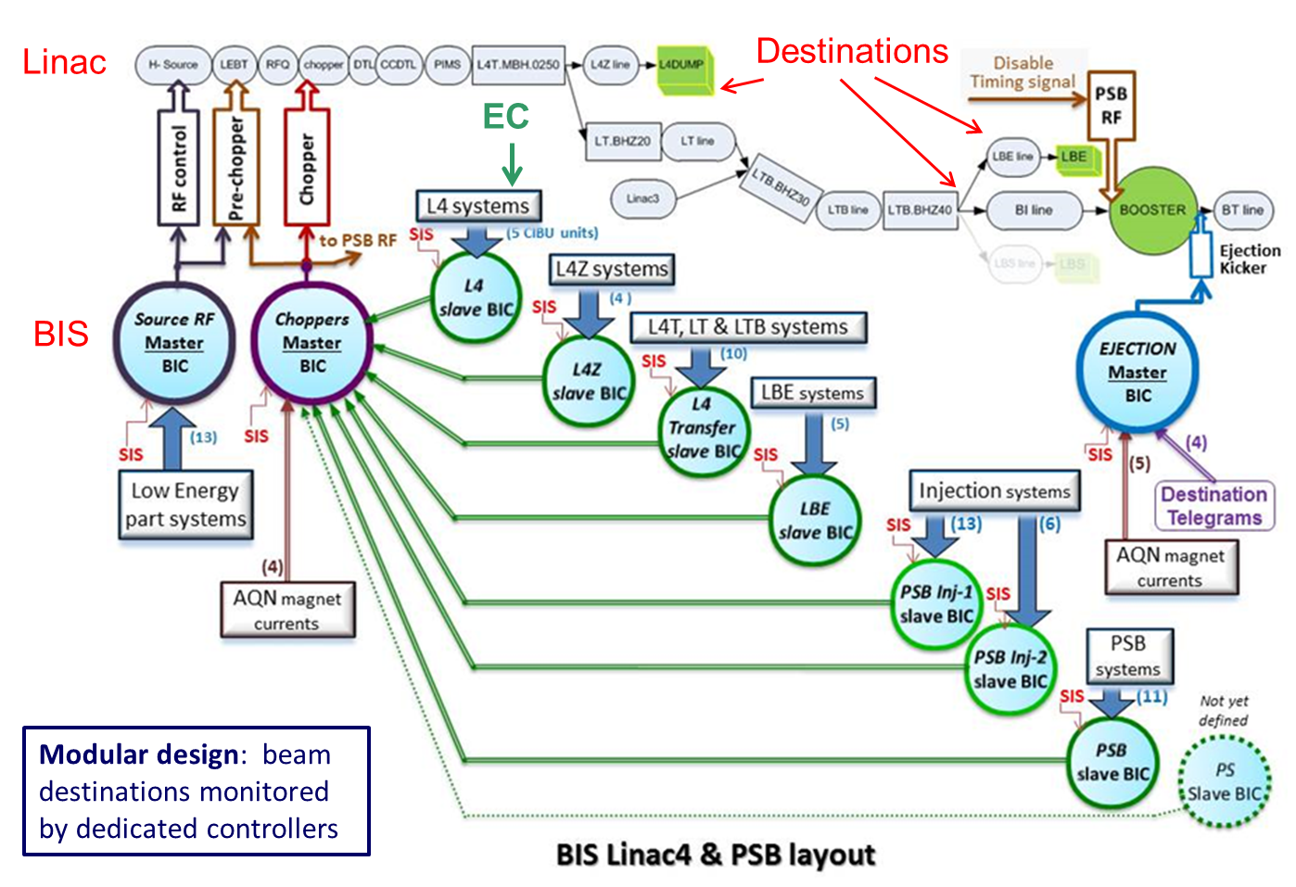
Linac4 Machine Protection

Slide 20
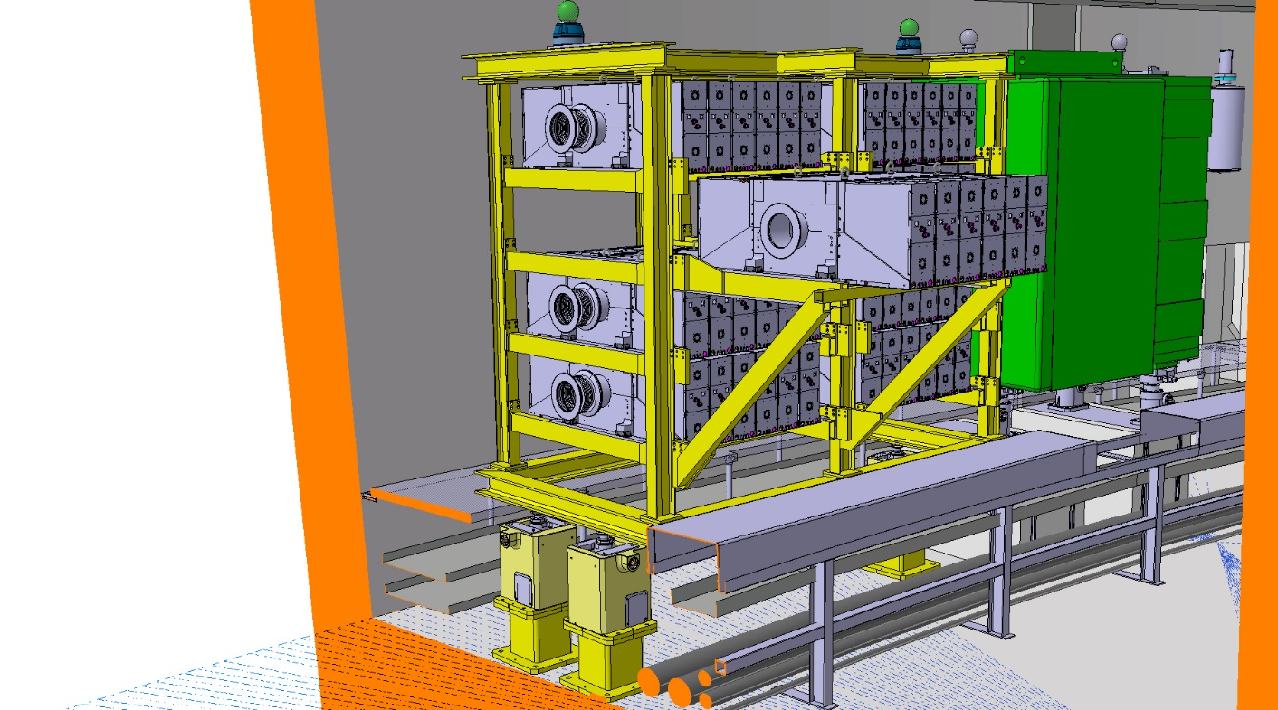
PSB RF Upgrade
An upgrade of the PSB RF system is foreseen in the framework of the CERN LIU project
Finemet cavities will be used
It is crucial to ensure that this system will have at least the same reliability of the present one
FMECA + detailed reliability analysis:
  MOSFET drivers
  RF amplifiers
Courtesy M. Paoluzzi

Slide 21
Projects, upgrades and new accelerators
2015
2018
2025
>2040
Upgrades for LHC run2
L4 REL RUN
Upgrades of injector chain
HL-LHC
CLIC??
FCC?
CERN
ESS
MYRRHA
EU

Slide 22
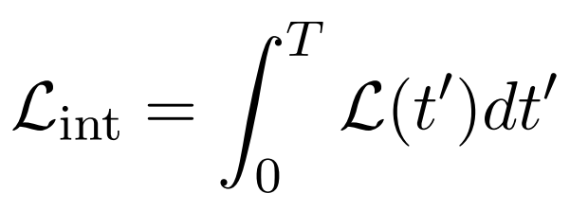
High-Luminosity LHC
Major LHC upgrade
Aims at ~ 10x more luminosity than current LHC (300 fb-1 per year)
New technologies and systems (Nb3Sn triplets, new cryo-plants, new collimators, SC links, …)
Peak luminosity limited by event pile-up
Availability is a crucial parameter to achieve the project goals
Beam Performance
Availability!

Slide 23
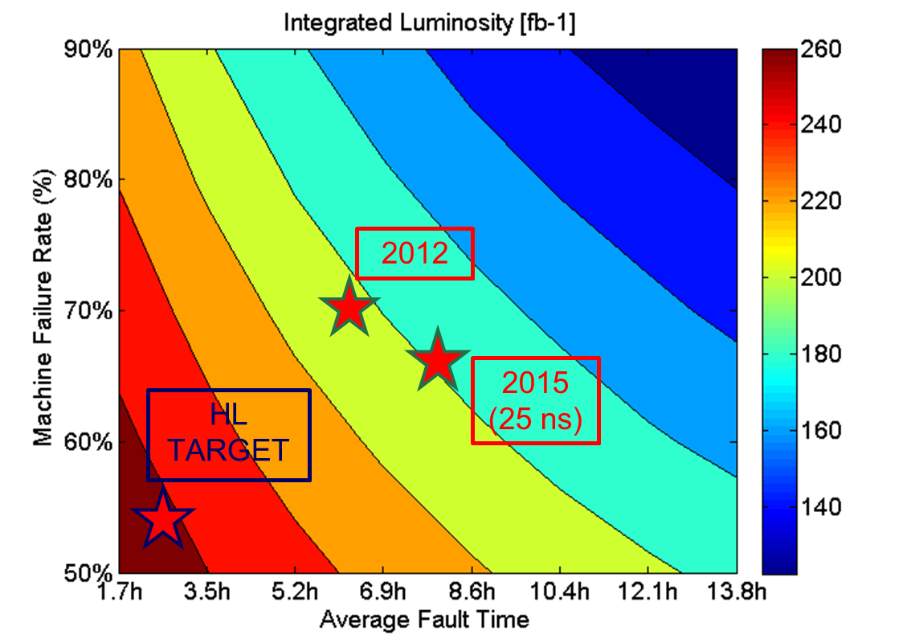
Sensitivity Analysis: HL-LHC
Reliability
Fault time:
Diagnostics
Logistics
Repair
Maintainability
Accelerator Upgrades

Slide 24
Projects, upgrades and new accelerators
2015
2018
2025
>2040
Upgrades for LHC run2
L4 REL RUN
Upgrades of injector chain
HL-LHC
CLIC??
FCC?
CERN
ESS
MYRRHA
EU

Slide 25
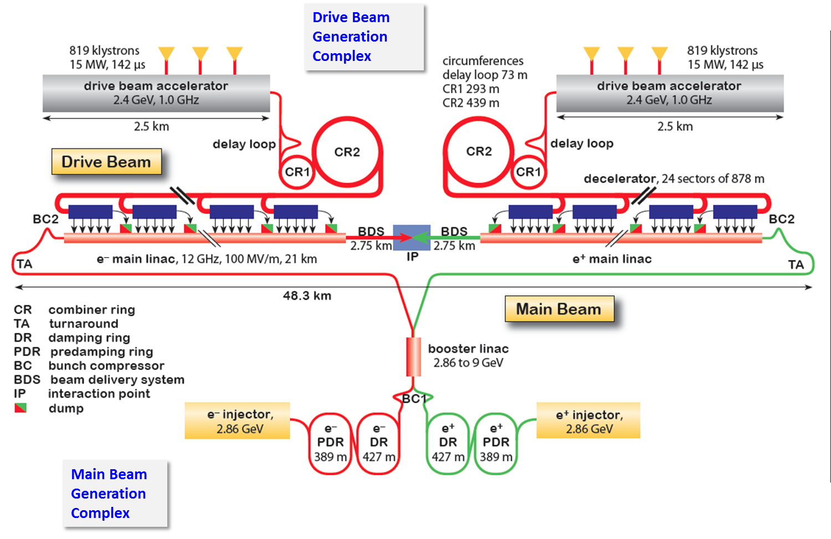
CLIC Layout
PhD started in November 2015 (O. Rey Orozco, previously at ESS)

Slide 26
Projects, upgrades and new accelerators
2015
2018
2025
>2040
Upgrades for LHC run2
L4 REL RUN
Upgrades of injector chain
HL-LHC
CLIC??
FCC?
CERN
ESS
MYRRHA
EU

Slide 27

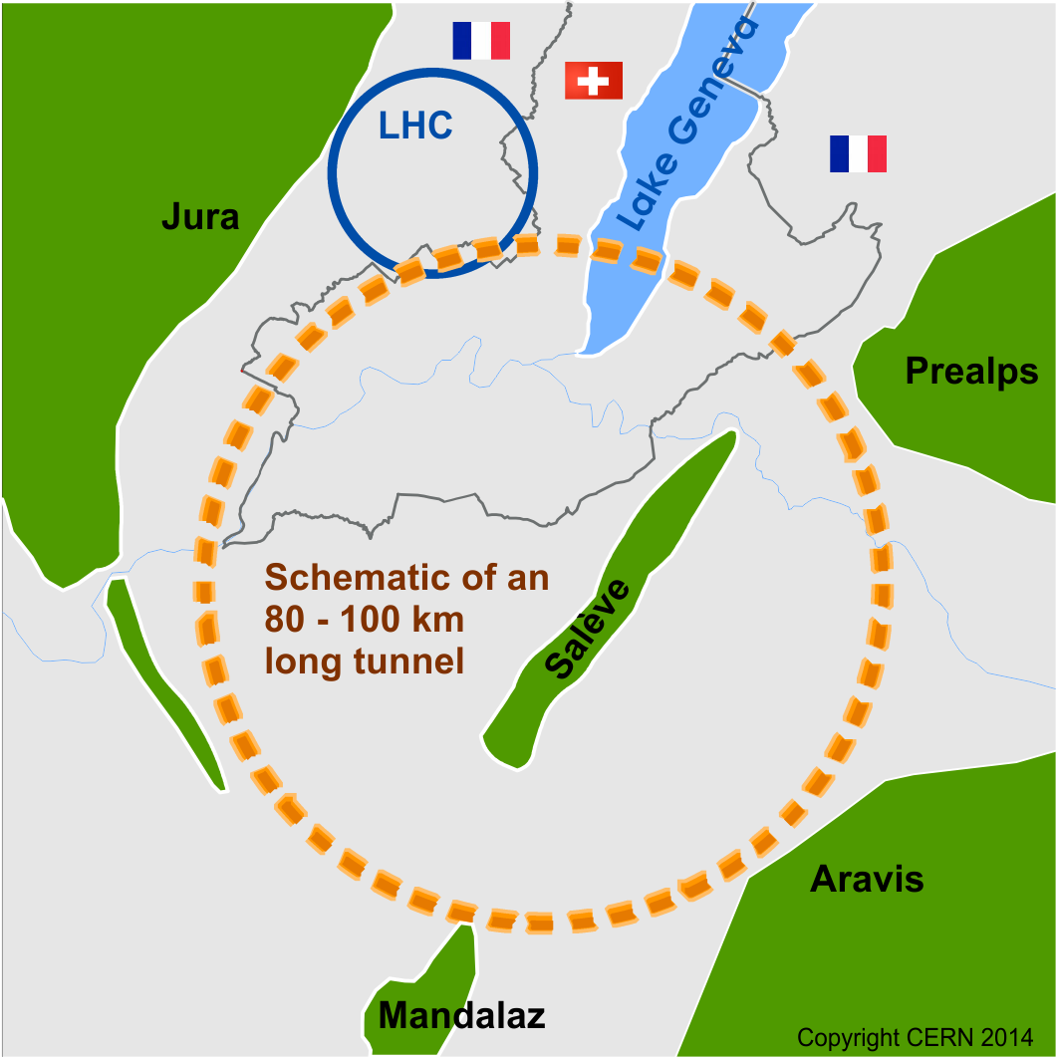
FCC Study
Conceptual Design Report (CDR) and cost review for the next European Strategy Update in 2018:
pp-collider (FCC-hh)
  ~16 T-> 100 TeV c.m. pp in 100 km
  ~20 T-> 100 TeV c.m. pp in 80 km
e⁺e⁻ collider (FCC-ee) as potential intermediate step
p-e collider (FCC-he) option
Requires a 80-100 km infrastructure in Geneva area
R. Schmidt. DPG Tagung Wuppertal 2015

Slide 28
Collaboration with TUT
Tampere University of Technology (TUT), Finland
Started in 2015
1 PhD student at CERN (A. Niemi) + 2 PhD students in Tampere + involvement of Prof. Seppo Virtanen
PhD student from TU Delft working on reliability analysis of the cryogenic system
Goal: development of availability model of a circular collider and its injectors
Software: ELMAS by RAMENTOR

Slide 29
Availability Modelling: Approach
Monte Carlo model for integrated luminosity and cost estimates (ELMAS)
LS
RUN
LS
RUN
LS
Years
TAT: Turnaround
SB: Stable Beams
FAULT: Machine fault
HWC
BC
MD
TS
PHY
ION
Weeks
Collaboration with TUT, Tampere, Finland, Prof. Seppo Virtanen
SUP
SB
FAULT
Days

Slide 30
Accelerator Fault-Tree
SUP
SB
FAULT
Functional Decomposition
(phase dependent)
FCN X
FCN Y
FCN Z
SYS 1
SYS 2
SYS 3
SYS 4
System Decomposition
Sub-system Decomposition
(level of detail defined by data availability/expert’s judgement)
COMP 1
COMP 2

Slide 31
Projects, upgrades and new accelerators
2015
2018
2025
>2040
Upgrades for LHC run2
L4 REL RUN
Upgrades of injector chain
HL-LHC
CLIC??
FCC?
CERN
ESS
MYRRHA
EU

Slide 32
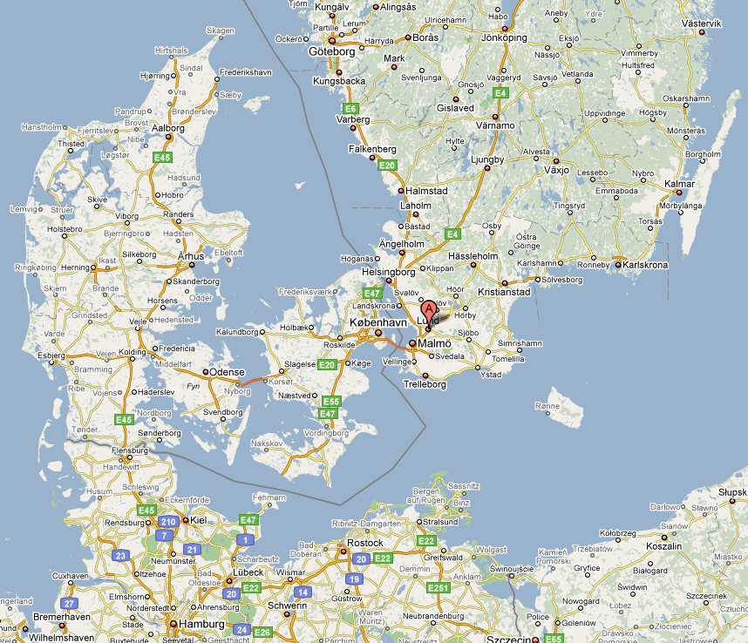
ESS Overview
The European Spallation Source (ESS) will house the most powerful proton linac ever built.
  The average beam power will be 5 MW which is five times greater than SNS.
  The peak beam power will be 125 MW which is over seven times greater than SNS
ESS is located in southern Sweden adjacent to MAX-IV (A 4th generation light source)
To provide a world-class material research center for Europe
Lund (Sweden)
[1]

Slide 33
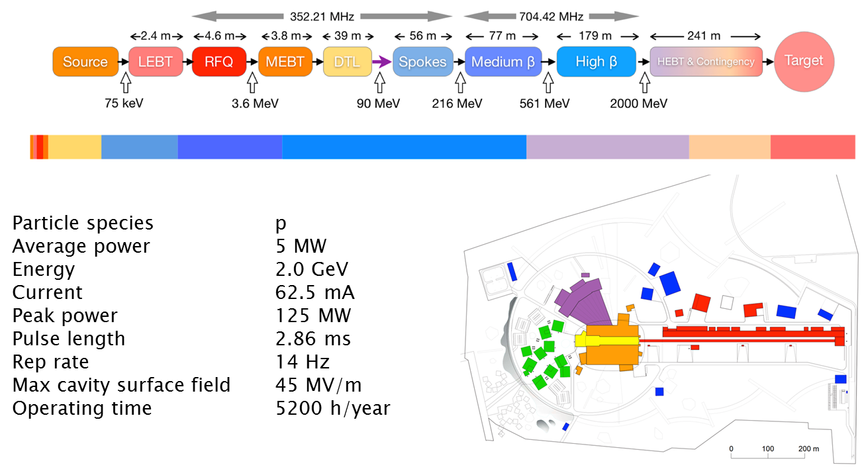
The ESS Linac
E. Bargallo
Accelerator Operation

Slide 34
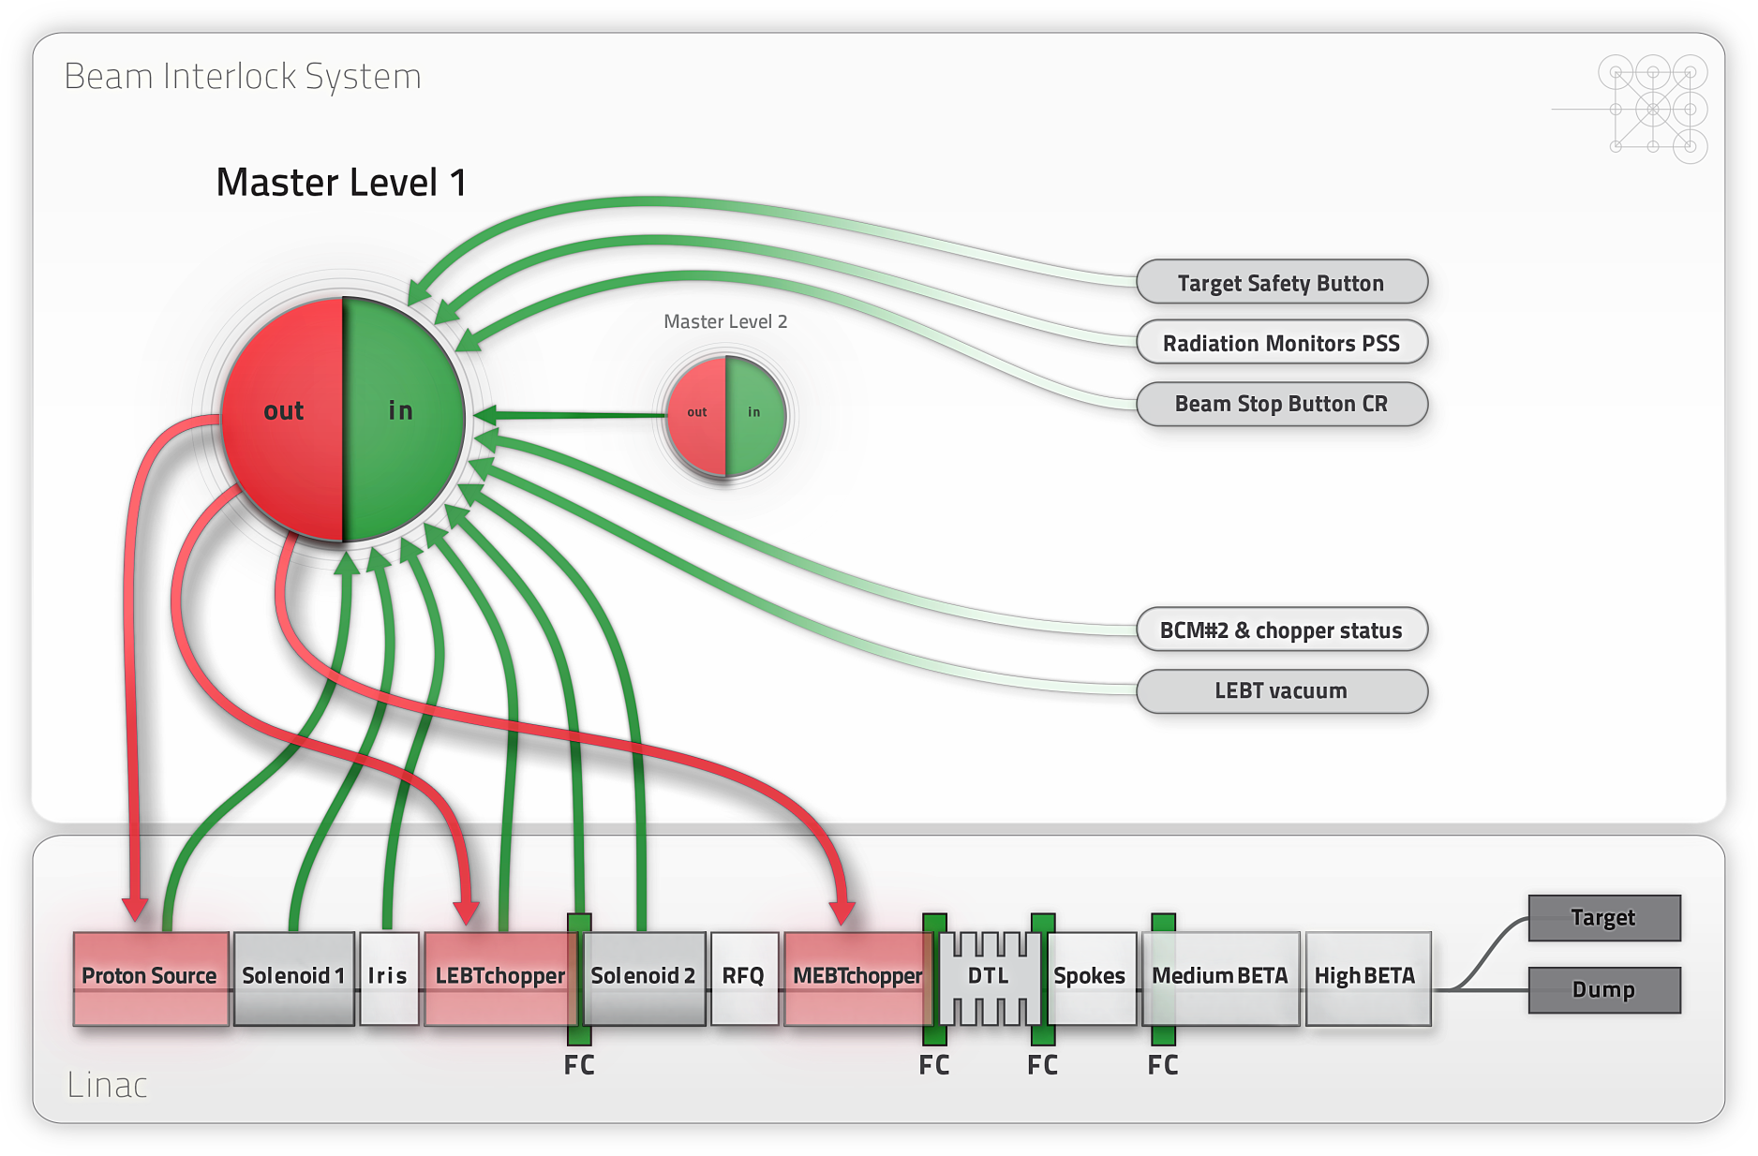
ESS BIS: Architecture
Courtesy A. Nordt

Slide 35
EuCARD-3 Proposal
Proposal under development
Develop a coordinated approach towards coherent RAMS standards in the accelerator community
IMA Stuttgart involved as a beneficiary
Trainings for students, staff, associated member of personnel on the essential practices of RAMS
Under discussion: first ‘test training’ at CERN in February 2016

Slide 36
THANKS A LOT FOR YOUR ATTENTION!

