Slide 1
Machine Protection and Interlocks
for Linac4

Slide 2
Beam Interlock System :
Backbone of the LHC Machine Protection
BLM
Collimation
FBCM
Injection
Kicker
BIS
LBDS
WIC
FMCM
PIC
Machine Interlock Systems:
BIS : Beam Interlock System
FMCM : Fast Magnet Current change Monitors
PIC : Powering Interlocks Controllers
WIC: Warm magnet Interlocks Controllers
Other elements:
BLM : Beam Loss Monitors
Collimation system
FBCM: Fast Beam change Monitors
LBDS: LHC Beam Dumping System

Slide 3
BIS for LHC rings : the connected systems
LHC
Devices
LHC
Devices
Environmental
parameters
LHC
Devices
Movable Devices
BCM
Beam Loss
Experimental Magnets
Collimator
Positions
BTV screens
Mirrors
Timing
SMP
Software
Interlocks
SEQ via
GMT
CCC
Operator Buttons
Experiments
Transverse Feedback
Beam
Aperture
Kickers
Collimation
System
FBCM
Lifetime
BTV
MKI
Beam
Dumping System
Beam Interlock System
Safe
Beam
Flag
Injection BIS
PIC essential
+ auxiliary
circuits
WIC
FMCM
RF
System
BLM
BPM in IR6
Access
System
Vacuum
System
Timing System
(PM)
Magnets
Power Converters
Monitors
aperture limits
(some 100)
Monitors in arcs
(several 1000)
Doors
EIS
Vacuum
valves
Access
Safety
Blocks
RF Stoppers
QPS
(several 1000)
Power
Converters
~1500
AUG
UPS
Cryo
OK
Based on a R.Schmidt’s drawing

Slide 4
BIS for Linac4 : the connected systems
Linac4
Devices
L4
Devices
L4
Devices
Beam
Destinations
( via Timing system )
External
Conditions
( via Timing system )
Software
Interlocks
CCC
Operator Buttons
Linac4
Dump
Beam
Stoppers
L4
Source
Beam Interlock System
Pre-chopper System
Choppers System
WIC
RF
System
BLM
BCT
(“Watch Dog”)
Vacuum
System
Magnets
Power Converters

Slide 5
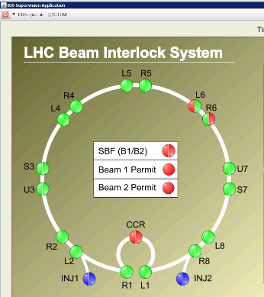
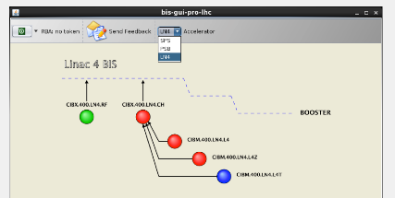
BIS : (# of LHC channels) Vs. (# of Linac4 channels)
Ring architecture
Tree architecture
17 Controllers for Beam-1
4 Controllers for Linac4 only*
+
17 Controllers for Beam-2
(*) Transfer line to Booster not included
~220 Interlocks connections from LHC systems
(beam-1, beam-2, both beams)
~30 Interlocks connections from Linac4 systems

Slide 6
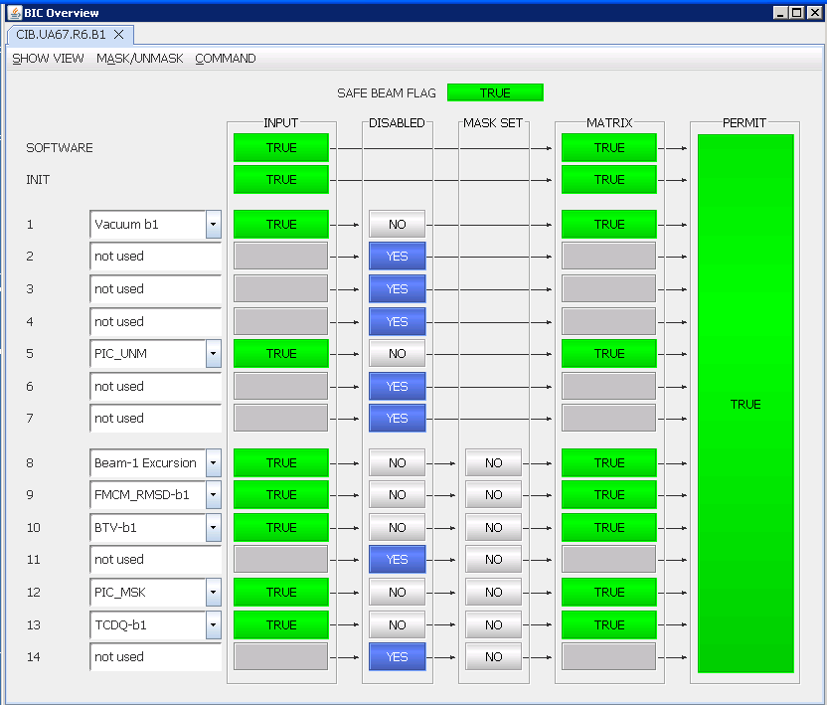
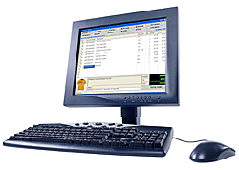
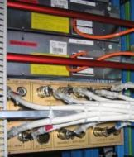
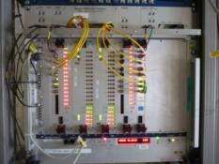
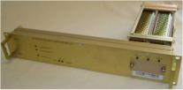
Beam Interlock System : simplified layout
Remote User Interfaces safely transmit Permit signals from connected systems to Controller
Controller acts as a concentrator,
  collecting User Systems Permits (14 HW + 1SW)
  generating local Beam Permit
Controllers linked either in Tree or in Ring architecture
Configuration DB
JAVA
Application
User_Permits
Software
Interlock
input
Technical
Network
#1
(local )
Beam Permit
User System #1
FESA class
Cupper links
User System #2
#2
copper cables
Optical
outputs
or
fiber optics links
rear
front
User System #14
#14
Beam Interlock Controller
(VME chassis)
User Interfaces
(installed in User’s rack)

Slide 7
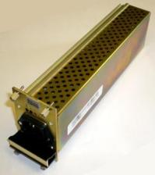
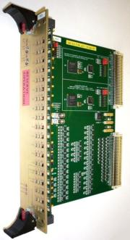
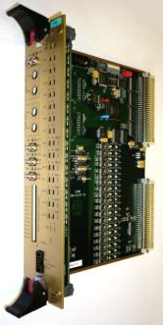
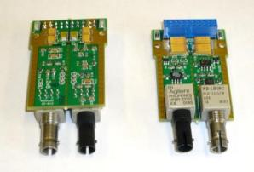
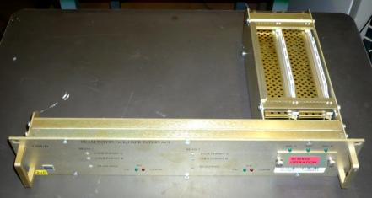
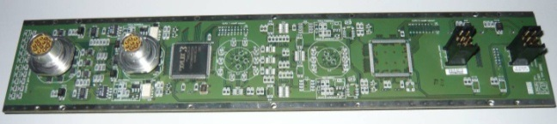
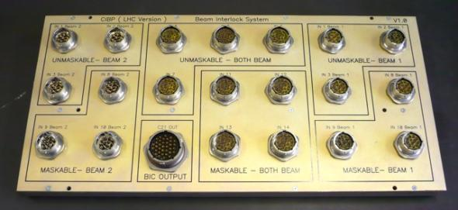
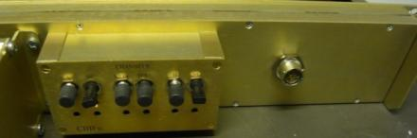
Beam Interlock System : the main Hardware boards
User Interface
Optical daughter cards
Redundant
P.S.
Manager
Test & Monitoring
F.O. variant of
the User Interface
Back Panel
User system’s side
Controller’s side

Slide 8

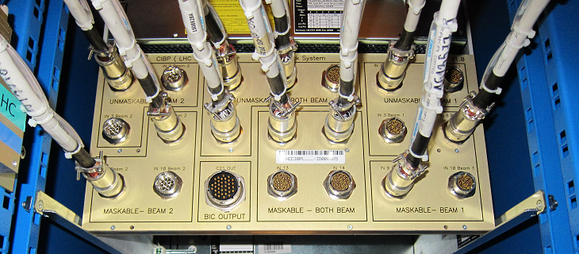
Beam Interlock Crate
Rear view
Front view

Slide 9
Quick overview of Beam Interlock System
The main features

Slide 10
the BIS principle
User Permit
inputs
User
Systems#n
AND
Beam Permit
output
User
Systems#3
User
Systems#2
“Actuator“
User
Systems#1
( Injection Kicker
or Extraction Kicker
or Dump Kicker,
or H- source, etc…)
Σ (User Permit = “TRUE“ ) → Beam Permit = “TRUE“

Slide 11
Full redundancy
User Permit
Inputs_A & _B
Matrix_A
Matrix_B
User
Systems#n
AND
2
AND
Beam Permit
Output_A
User
Systems#3
User
Systems#2
“Actuator“
User
Systems#1
Output_B
( Injection Kicker
or Extraction Kicker
or Dump Kicker,
or H- source, etc…)
2
Σ (User Permit_A = “TRUE“ ) → Beam Permit_A = “TRUE“
Σ (User Permit_B = “TRUE“ ) → Beam Permit_B = “TRUE“

Slide 12

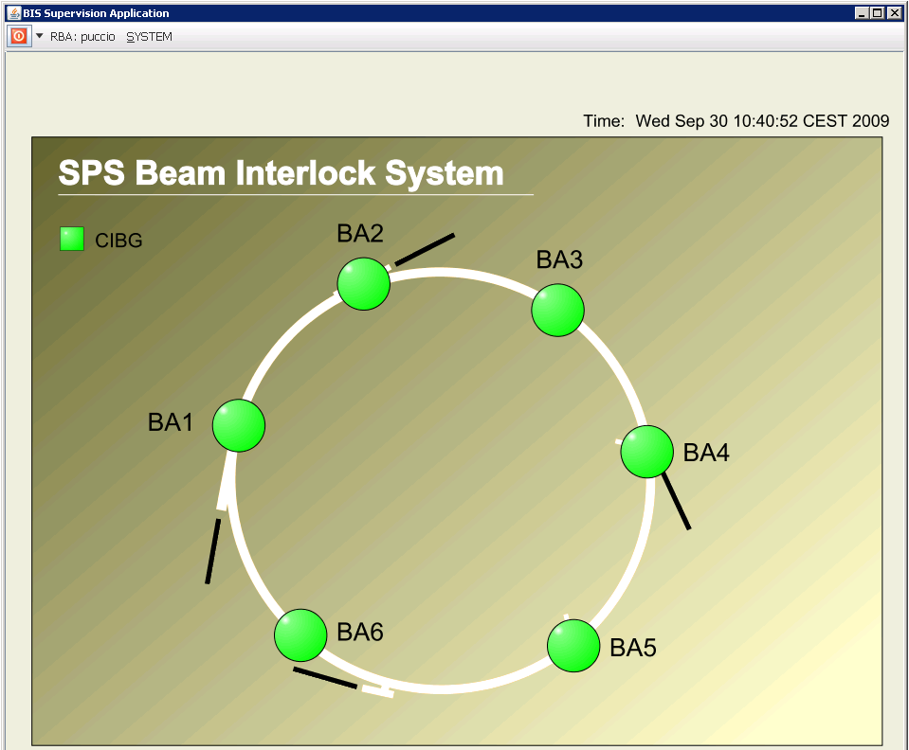
Scalability & Ring Architecture
Input#1
Input#14
BIC
x 17
x 6
Screen shot of the Supervision application
Screen shot of the Supervision application

Slide 13
Scalability & Tree Architecture
  Slave BICs: AND operation of 14 +1 inputs
  Master BIC: AND and OR operations possible
    Inputs: either outputs from Slave BICs or additional USER_PERMIT inputs
SW
1
“Slave” BIC
User Systems
14
1
“Master” BIC
«Actuator system »
14
SW
1
“Slave” BIC
14
Tree architecture is used in Linac4 and for the SPS to LHC Transfer lines

Slide 14
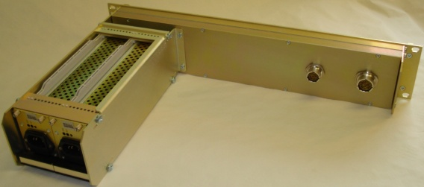
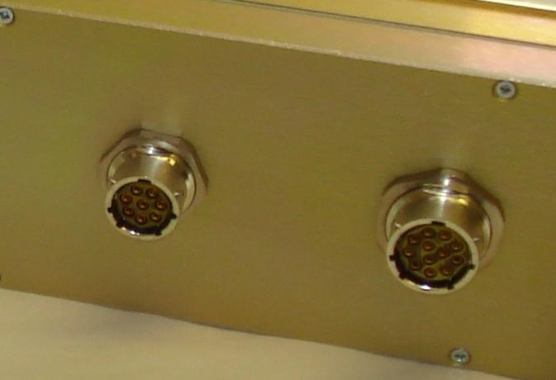
Unique Interface with the connected systems
Front view
Standard HW solution for connecting any User System via a copper cable [ F.O. variant available for long link (>1.2km) ]
rear view
User System
User_Permit state transmitted in RS485 format
Could be PLC based, or VME based, or any type of electronics…
to Controller
User
_
Permit
_
A+
User
_
Permit
_
A-
User_Permit = “FALSE” if Input current < ~10mA

Slide 15
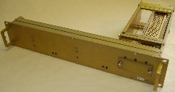
All LHC systems connected to the BIS in using the same Hardware interface
LHC
Devices
LHC
Devices
LHC
Devices
Movable Devices
BCM
Beam Loss
Experimental Magnets
Collimator
Positions
Environmental
parameters
BTV screens
Mirrors
Timing
Safe
Mach.
Param.
Software
Interlocks
LSA
CCC
Operator Buttons
Experiments
Transverse Feedback
Beam
Aperture
Kickers
Collimation
System
FBCM
Lifetime
BTV
Beam
Dumping System
Beam Interlock System
Safe
Beam
Flag
CIBU
CIBU
Injection BIS
PIC essential
+ auxiliary
circuits
WIC
FMCM
RF
System
BLM
BPM in IR6
Access
System
Vacuum
System
Timing System
(Post Mortem)
Magnets
Power Converters
Monitors
aperture limits
(some 100)
Monitors in arcs
(several 1000)
Doors
EIS
Vacuum
valves
Access
Safety
Blocks
RF Stoppers
QPS
(several 1000)
Power
Converters
~1500
AUG
UPS
Cryo
OK

Slide 16
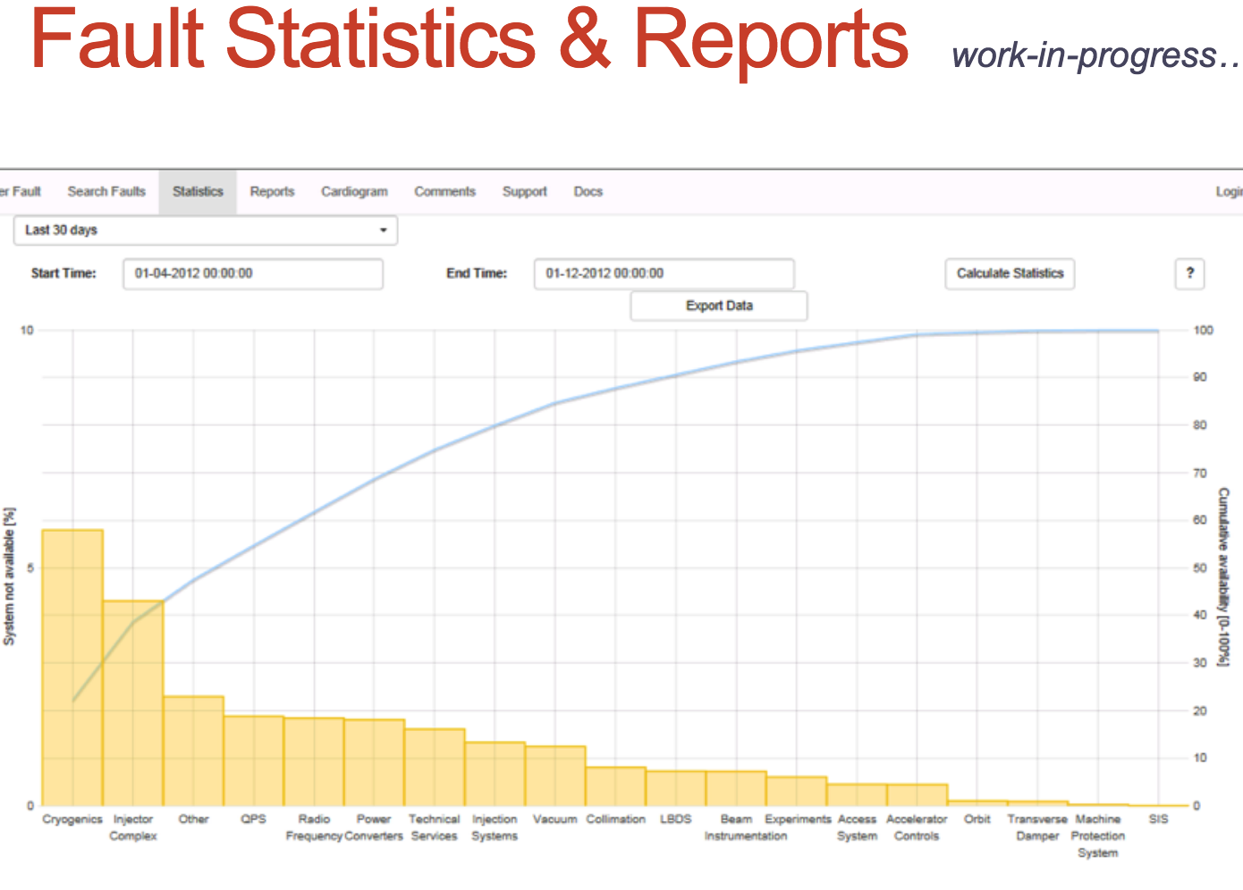
Very low contribution to overall LHC operation unavailability
Courtesy Chris RODERICK
Machine Protection system =
Beam Interlock System
+ Powering Interlocks
+ Warm magnets Interlocks

Slide 17
System Performance (I)
Dependable: By design (SIL3 was used as a guideline) the system must react with
a probability of unsafe failure of less than 10⁻⁷ per hour;
Beam abort less than 1% of missions due to internal failure (2 to 4 failures per year)
Simple: On purpose, its just a “Go / No Go” system together with an ‟ AND‟ function and no more ! For a protection system: the Simplest is always the Best
“Flexible”:
since half of User Permit signals could be remotely masked by an Operator
(the other half, i.e. the critical ones, can be never masked)
Condition = “Safe Beam Flag” state;
If FALSE => masks are no longer taken into account
For LHC, “Safe Beam Flag” is derived from beam intensity and energy

Slide 18
System Performance (II)
Safety process by Hardware:
Functionality into 2 redundant matrices with VHDL code written by different engineers following same specification
Critical versus Non-Critical:
At conception level, monitoring elements are separated from the 2 redundant safety channels
Fast: few μS from User Permit change to Local Beam Permit change

Slide 19
System Performance (III)
100% Online Test Coverage:
easily tested from end-to end in a safe manner
=> recovered “good as new”
“Monitorable”:
any Input/output changes are logged into
an History Buffer with precise time stamping (UTC time with 1μS accuracy)
Reliable:
whole design studied using Military and Failure Modes Handbooks
Results from LHC analysis are:
P (false beam dump) per hour = 9.1 x 10⁻⁴
P (missed beam dump) per hour = 3.3 x 10⁻⁹

Slide 20
Operational Tests
Pre-Operational Checks
Checks during Operation
Configuration verification and integrity checks
Fault Diagnostics and monitoring
Response Analysis
Post-Operational
Checks

Slide 21
Kernel of LHC Post-Mortem Analysis
Identification of the Beam Dump source
Reconstruction of the sequence of events that has led to the beam dump
the different History Buffers are gathered and analysed by the Post-Mortem system

Slide 22
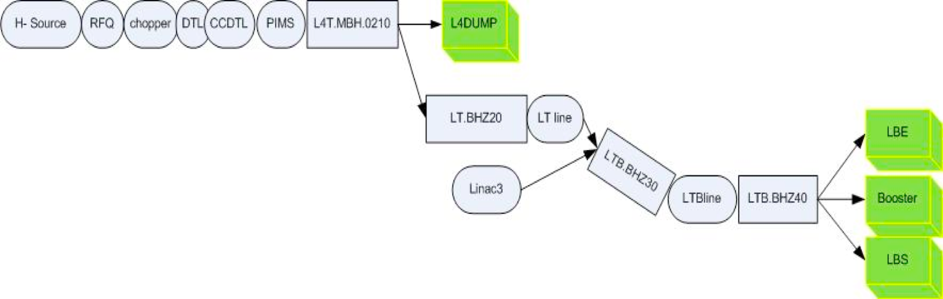
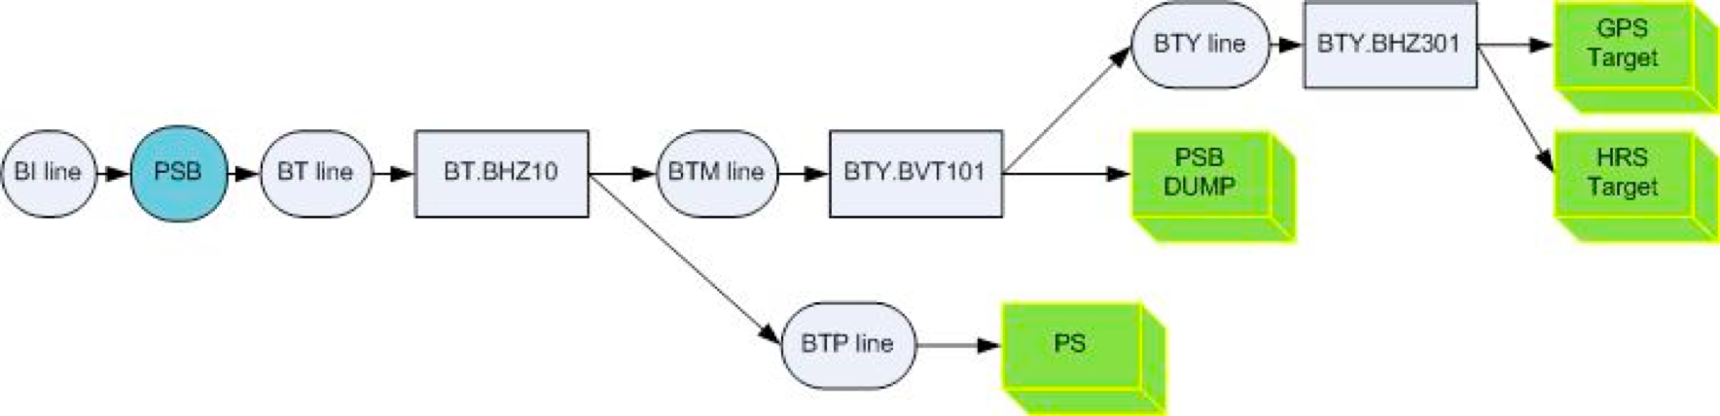
BIS for Linac4 and Booster : the Interlock zones
The Linac4 interlock zones :
The PS Booster interlock zones :

Slide 23
BIS for Linac4 and Booster : the design principle (I)
Main constraints:
  Multiple ‘interlock zones’ due to several destinations
    Destinations for Linac4: L4DUMP, LBE, PSB
    PSB destinations: BDUMP, ISOGPS, ISOHRS, PS
  PSB is the (timing) master of Linac4
    Maximise proton delivery via ‘External Conditions’;
    Beam stoppers and bending magnet rise-time too slow
PSB and Linac4 interlock systems have been considered together
Note: The Beam Interlock System is not involved in personnel safety !

Slide 24
BIS for Linac4 and Booster : the design principle (II)
Three main components:
  Hardware interlock system (BIS): reliable, fast
    For fast reaction times
    If considered useful to avoid machine activation
  Software interlock system (SIS): flexible
    For slow-changing parameters
    If some more complex logic needs to be adopted
  External conditions (EC): for proton optimization
    Consider user requests
    Method also useful for Booster ring-specific interlocks
    The “user” (+beam destination) is calculated for the current cycle depending on some necessary conditions;

Slide 25
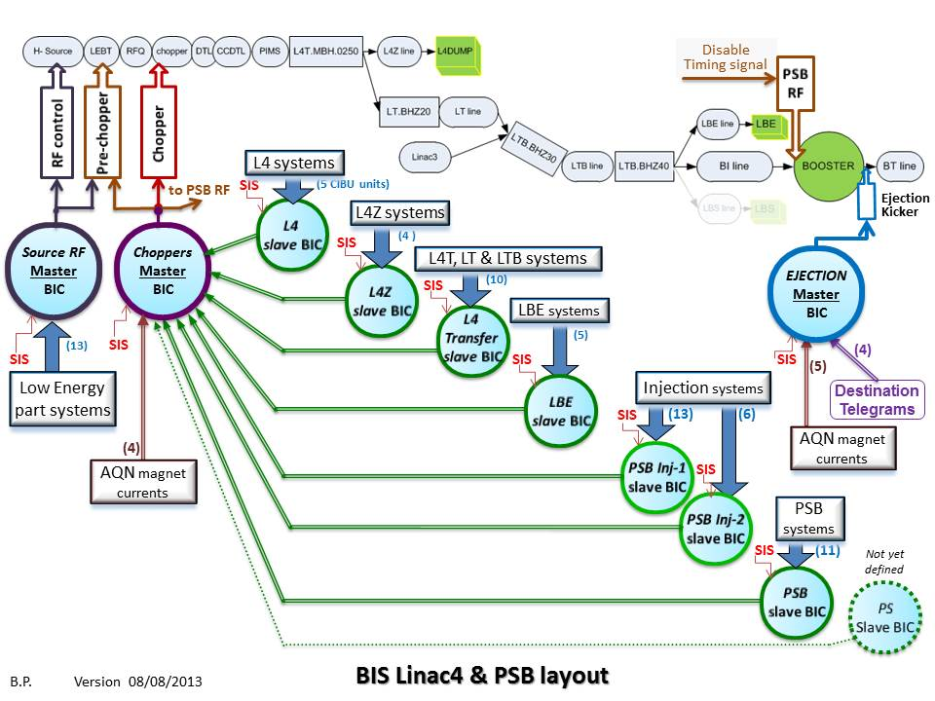
BIS for Linac4 and Booster : the global layout

Slide 26
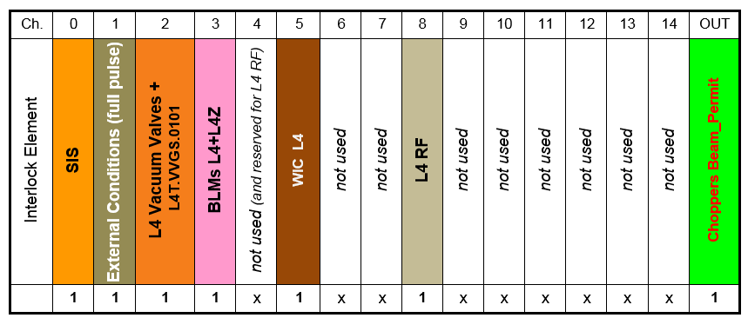
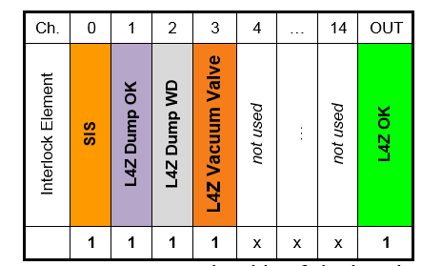
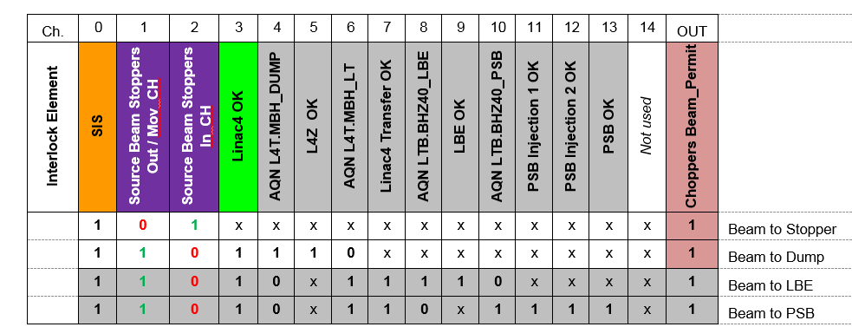
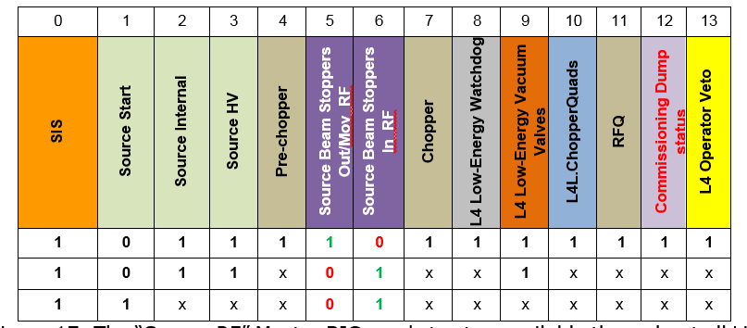
… the Linac4 layout only : Tree Architecture

Slide 27
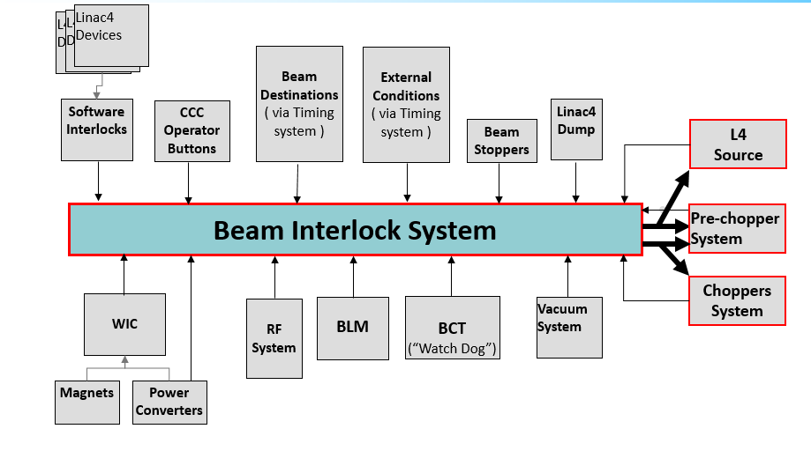
Magnet Interlock System for Linac4

Slide 28
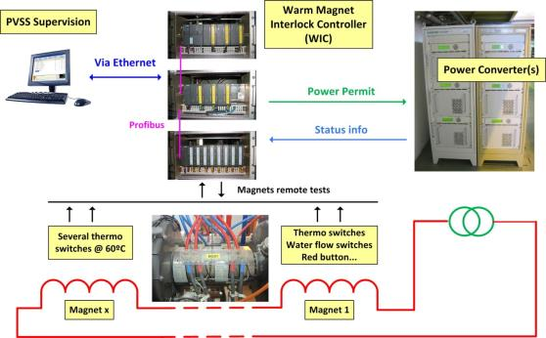


Warm Magnet Interlock Controllers : quick overview (I)
Standardized interlock system for normal conducting magnets based on Programmable Logic Controllers (PLC):
  Collects inputs from thermo-switches, flow switches and internal PC faults
  Provides Permits to the power converter and beam interlock system
Configuration DB
Beam Permit
Generic Solution => deployed from Linac4 up to LHC

Slide 29
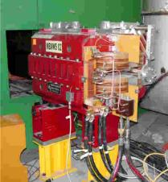
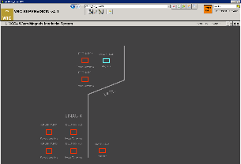

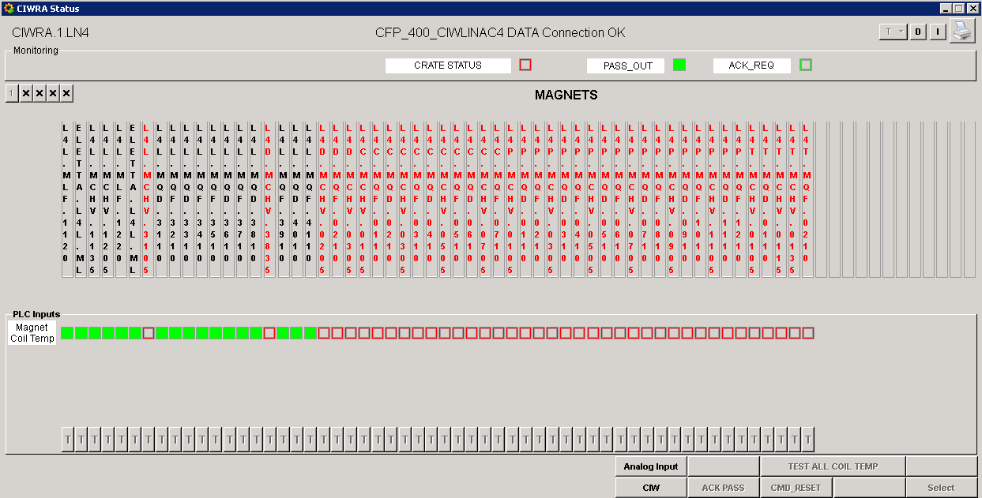
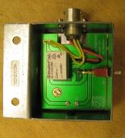
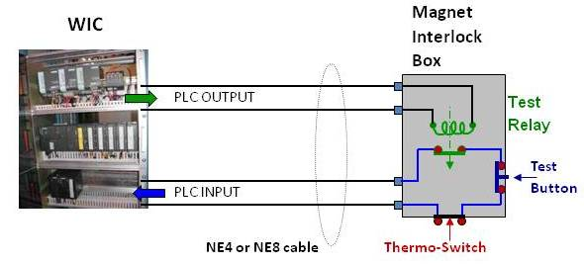
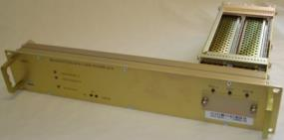
Warm Magnet Interlock Controllers : quick overview (II)
Thermoswitch –
ELMWOOD
Type 3106 – T117
Magnet Interlock Box
with (single) sensor
connectivity and remote
test relay
Magnet Interlock SCADA System
Remote test feature
Beam Permit towards BIS

Slide 30
That’s all !
Thanks for your attention

Slide 31
Additional slides

Slide 32
Linac4 BIS (1)
Master BIC ‘Source RF’
  Action: switch off the source RF voltage (~10 μs reaction time)
  Redundant action: pulse pre-chopper (use timing signals NX.STOP(START)-PCHOP); ~2 μs rise-time

Slide 33
Linac4 BIS (2)
Master BIC ‘Choppers’
  Action: pulse pre-chopper (use timing signals NX.STOP(START)-PCHOP); ~2 μs rise-time
  Redundant action: pulse chopper; a few ns rise-time
  Disable start timing of PSB RF if possible

Slide 34
Linac4 BIS (3)
Slave BIC ‘Linac4 and Linac4 Transfer OK’
  Input for Master BIC ‘Choppers’
    L4 Magnet Current Status: AQN of main bendings surveyed with FGCs depending on destination (OR of digital output signals if AQN outside window ~1 ms before beam pulse)
    EC only if all rings affected (e.g. user requests; see later)

Slide 35
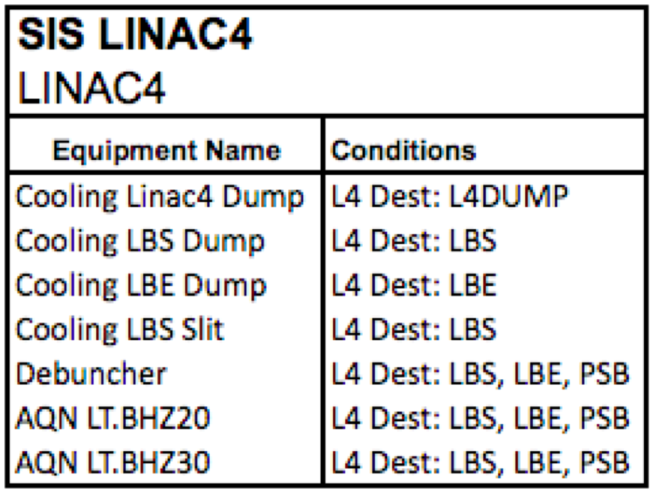
Linac4 Software Interlocks (SIS)
  Action depending on Master BIC affiliation
  List not exhaustive!

Slide 36
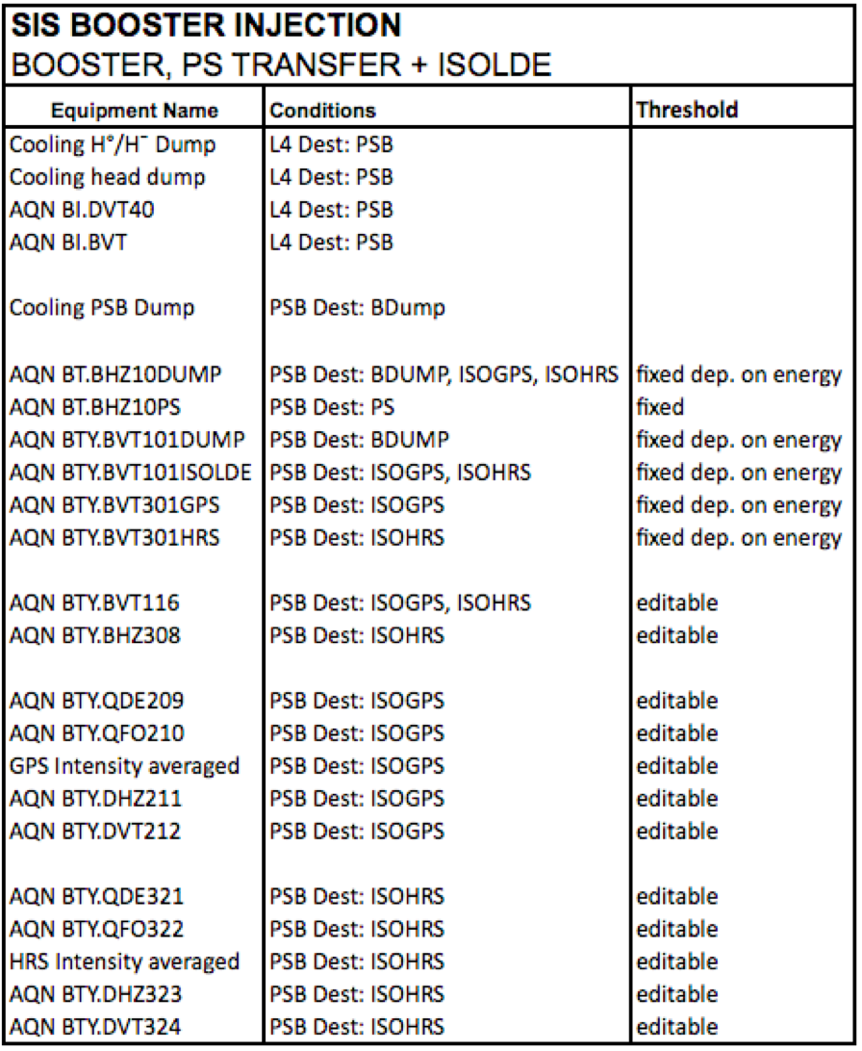
PSB Injection Software Interlocks (SIS)
Output connected to Slave BIC ‘PSB OK’
  Action defined by Master BIC ‘Choppers’ (pre-chopper, chopper and PSB RF)
  List not exhaustive!
  WIC information to be transmitted to SIS

Slide 37
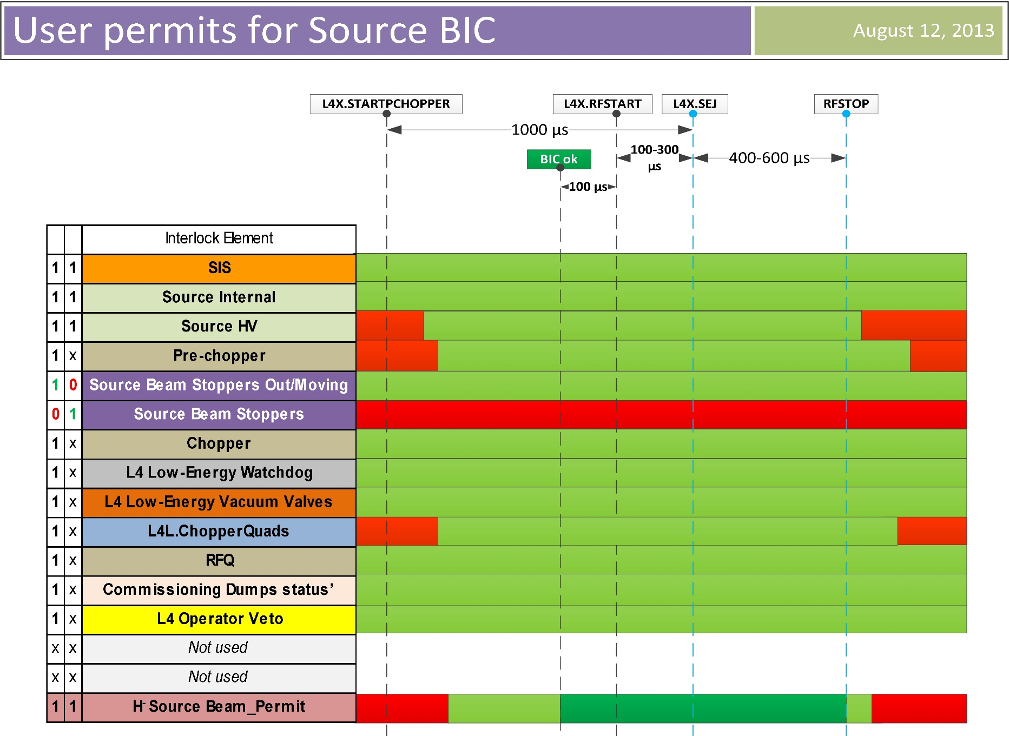
Application view of the USER_PERMIT signals for the ‘Source RF’ Master BIC used for the commissioning phases

Slide 38
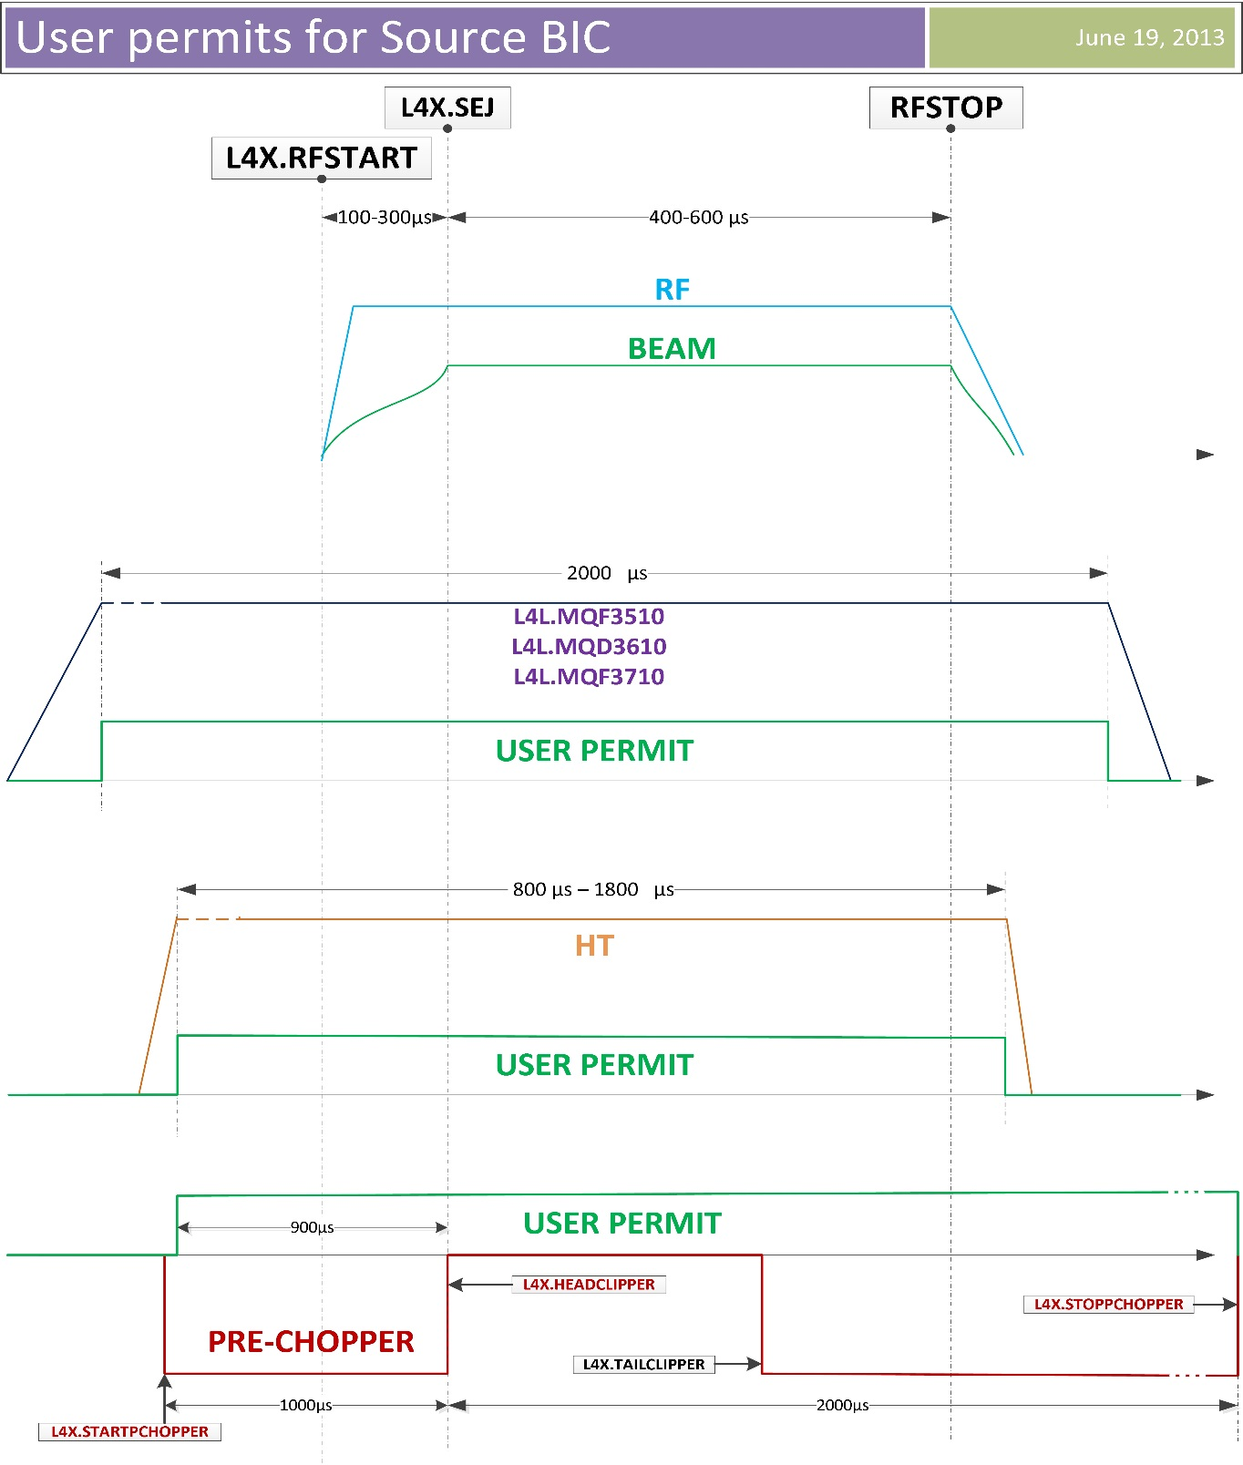
Timing diagram of the USER_PERMIT signals FOR the ‘Source RF’ Master BIC

Slide 39
BIS : standard solution from LHC down to Linac4
  Same Hardware:
    Fast, Safe, Reliable (initially designed for LHC)
    Standardised interface (CIBU)
    Proven solution
    Cost-effective
  Same Monitoring Software:
    Unique application in CCC
    100% Online test coverage
  Operational flexibility
    Software Interlock Inputs
    External Condition signals used as User_Permits
    Masking available on half of input channels

Slide 40
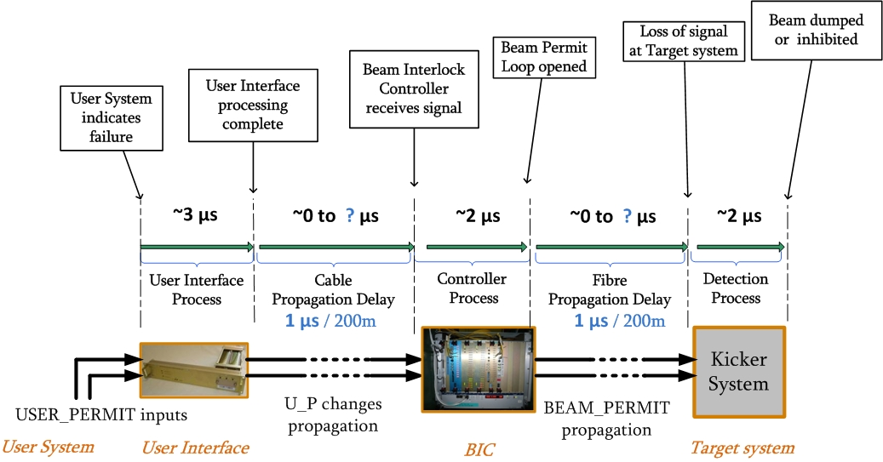
The reaction time
Actuator

Slide 41
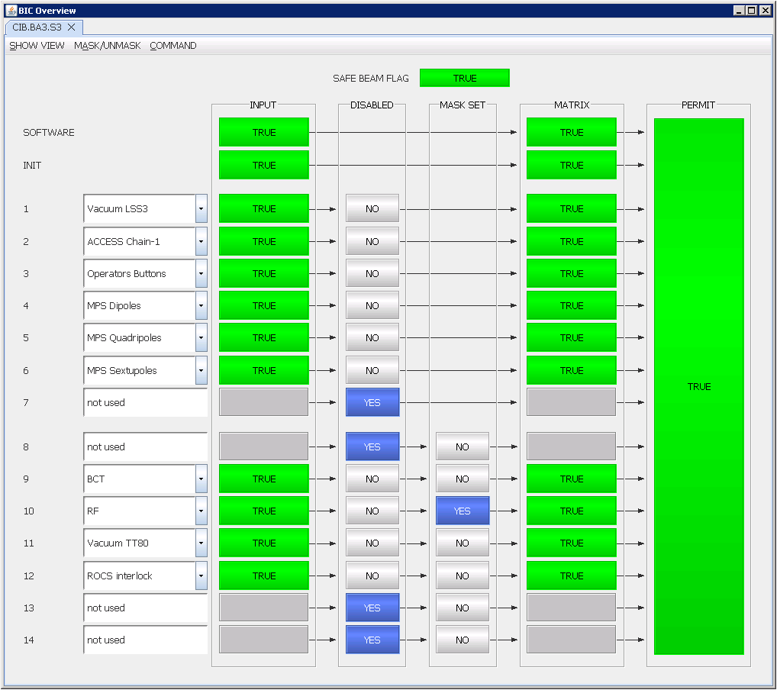
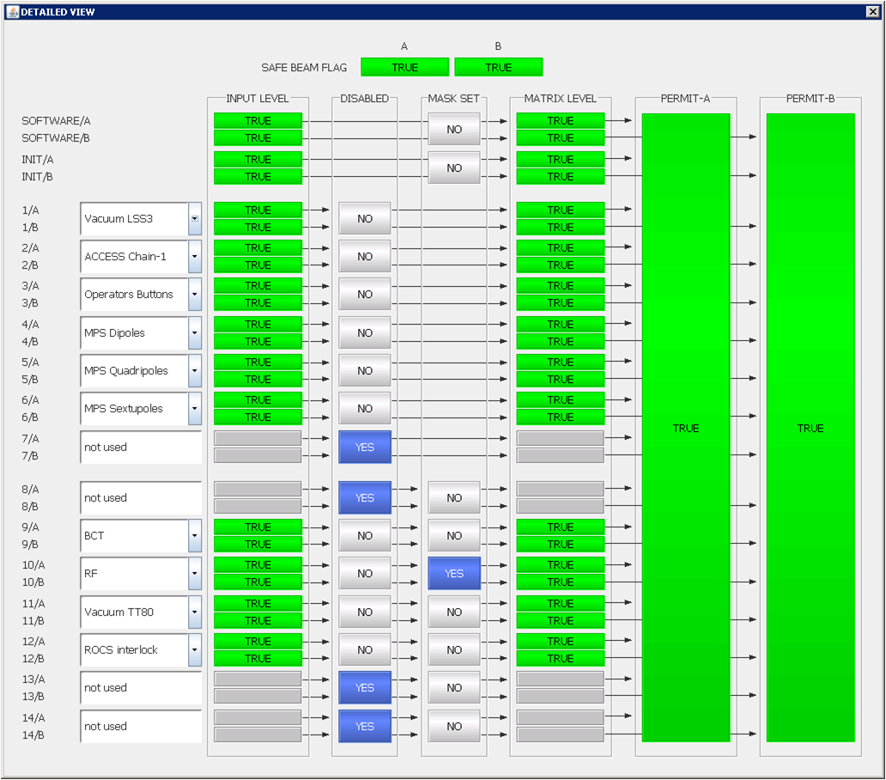
BIS Application : Monitoring of the Inputs/Outputs state

Slide 42
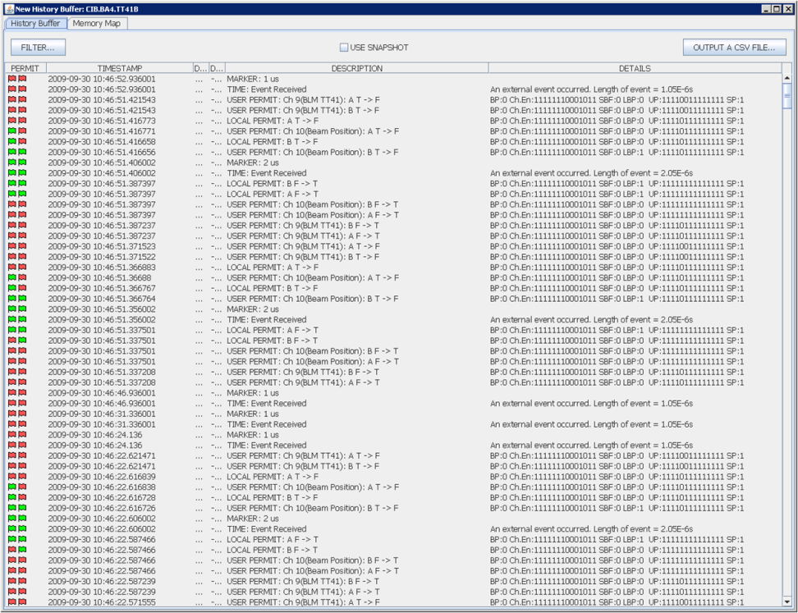
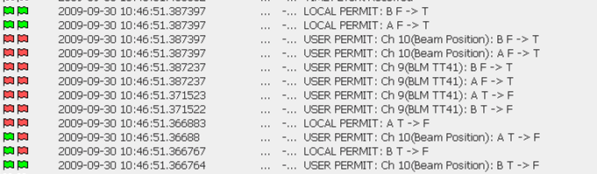
BIS Application: History Buffer

Slide 43
The “flexibility” : Masking of input(s)
Masking automatically removed when “Safe Beam Flag” = FALSE
Only 7 out of 14 inputs can be masked by the Operator

Slide 44
Safe Beam Flag
For LHC: the Safe Beam Flag (SBF) is produced by a dedicated system (Safe Machine Parameters Controller)
Based on Beam Energy and on Beam Intensity:
  if ( I · E < defined_Threshold ) then SBF = “TRUE” ; else SBF = “FALSE”
The SBF value is transmitted to the LHC Timing generator
=> information broadcasted over the GMT network.
Timing receiver installed in the BIC chassis gives the corresponding Hw signal value
Note: Safe Beam Flag for SPS only depends on beam intensity.

