Slide 1
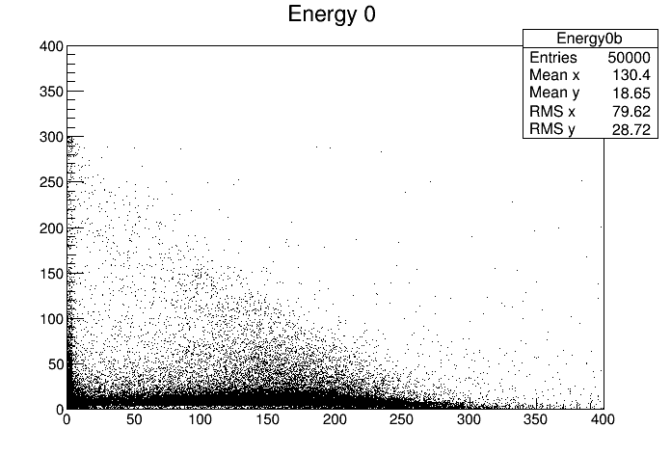
Out World Energy
Reconstructed Energy

Slide 2
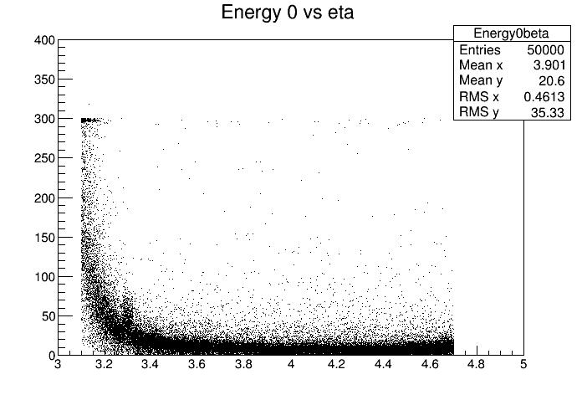
Out World Energy
MC Eta

