Slide 1

Future of the Offline
Predrag Buncic
CERN

Slide 2
Data Preparation Group

Slide 3

A
L
I
C
E
Timeline
Mandate to Offline and Physics
Coordinators to start DPG
Tracking Task Force
Management Board Retreat
Management Board Retreat
Start of HI Run
Reprocessing
2014
2015
Jan
Apr
Jul
Oct
Jan
Apr
Jul
Oct
2015
ALICE Week at GSI
Mandate to Offline to start
Tracking Task Force
TPC Tracking/Calibration/Aligment status report
3
Predrag Buncic
Offline Week, CERN, November 25, 2015

Slide 4

Offline
Board
O²
Calibration & Offline Weekly
Computing Board
Physics Borard
Physics
Board
PHYSICS
COORDINATION
OFFLINE
COORDINATION
O2
COORDINATION
PWG
PP
PWG
PP
PWG
PP
PRODUCTION
AND
DATABASES
GRID
FRAMEWORK
DEVELOPMENT
GRID RESURCE
COORDINATION
ALIROOT
FRAMEWORK
DEVELOPMENT
CALIBRATION
MONTE CARLO
EMBEDDING
MIXING
TRACKING
ALIGNMENT
PID
QA
4
GRID SITES AND
EXPERTS
DETECTOR SOFTWARE EXPERTS
PWGs
4
Predrag Buncic
Offline Week, CERN, November 25, 2015

Slide 5
A
L
I
C
E
Data Preparation Group: Charge
  Data Preparation Group
  With Physics Board define the quality that needs to be met by the reconstruction/simulation software in order to perform the required measurements
  With Run Coordination define the usable datasets that need to be reconstructed
  With PWGs define datasets that need to be simulated
  Coordinate and executes the calibration and QA activities that lead to reconstruction
  Coordinate, configure and test the corresponding MC productions
  Define and describe the datasets useful for analysis
  Issue tickets to Offline and detector experts for blocking software issues
  Provide the status reports to Physics Board get the input on priorities
  In cooperation with Offline and Physics Coordination Identifies areas and/or open tasks where the manpower is needed and defines service tasks to cover them
Barrel Tracking Team
Evolution of Tracking Task Force
Combined the effort and expertise from
  ITS, TPC, TRD, TOF
Delivers combined (global) tracks and PID
Responds to calibration and QA requests by DPG
Includes manpower from all participating detector projects + additional manpower from the collaboration
Barrel Tracking Group has a coordinator and a deputy
Operations
Development
5
Predrag Buncic
Offline Week, CERN, November 25, 2015

Slide 6
A
L
I
C
E
Data Preparation Group within Offline
OFFLINE
PHYSICS BOARD
Grid
Operations
Grid
Software
Data
Preparation
Group
Barrel Tracking
Team
Detector Software
Teams
PWG_PP
QA
Detector Software
Groups
Grid
Site Support
Core
Software
(Run 1&2 + O2)
Common
Software
Development
Operations
Development
6
Predrag Buncic
Offline Week, CERN, November 25, 2015

Slide 7
A
L
I
C
E
Data Preparation Group
Calibration
Coordinator
Calibration
Deputy
QA
Coordinator
QA
Deputy
MC
Coordinator
MC
Deputy
Operations team (not necessarily the experts and developers themselves)
  Facilitators, their job is to remove any impediments that obstruct a team’s pursuit of its sprint goals
  1 year mandate (6 months as deputy + 6 months coordinator) @ 50%
7
Predrag Buncic
Offline Week, CERN, November 25, 2015

Slide 8
A
L
I
C
E
Recent developments
Institute of Space Science, Bucharest (Catalin-Lucian Ristea) agreed to take the (institutional) responsibility for
  execution of the MC productions
  development, tuning and testing of the AOD filtering and QA train macros used in MC and RAW processing and AOD refiltering
  preparation and execution of the RAW data production cycle
Institute of Nuclear Physics, Cracow (Jacek Otwinowski) aiming to take the (institutional) responsibility for
  Supporting and developing common QA tools and procedures
  Common presentation layer for
    software QA
    detector (reconstruction) QA
    detector response (simulation) QA
8
Predrag Buncic
Offline Week, CERN, November 25, 2015

Slide 9
A
L
I
C
E
Data Preparation Group
Calibration
(PWG-PP)
QA Framework & Tools
(Cracow)
Detector QA
(PWG-PP-QA)
Simulation
Preparation
Sim & Reco
Execution
(ISS)
To first order, assigning the roles in DPG taking into account that we cannot disrupt the work that is currently being done in PWG-PP
The good news is that PWG-PP groups and Offline are already working together practically implementing this scheme
9
Predrag Buncic
Offline Week, CERN, November 25, 2015

Slide 10
A
L
I
C
E
Final stage: Data Preparation Project
DPP
  Once DPG is established and demonstrates its viability we will proceed with creation of an independent project charged with data preparation and detector software developments
Data
Preparation
Group
Barrel Tracking
Team
OFFLINE
PID
Grid
Operations
Grid
Software
Development
Detector Software
Teams
Grid
Site Support
Common
Software
Development
PHYSICS BOARD
Common
Software
Development
PWG_PP
QA
Offline Role:
  The Offline will focus on Computing aspects (Grid) and common software development (frameworks) as well as its contribution to O2 project
10
Predrag Buncic
Offline Week, CERN, November 25, 2015

Slide 11
A
L
I
C
E
One more step?
OFFLINE
COMPUTING
OFFLINE
SOFTWARE
DPP
Data
Preparation
Group
Grid
Operations
Grid
Software
Development
Core
Software
Development
Barrel Tracking
Team
PID
Grid
Site Support
O2
Software
Development
Detector Software
Teams
11
Predrag Buncic
Offline Week, CERN, November 25, 2015

Slide 12
Offline Project Organization

Slide 13
Computing Board
Fine print from the ALICE Constitution
A
L
I
C
E
Offline Project Organization
The Offline Board (OB) is responsible for the development of the Offline of the experiment and for the co-ordination among the offline software of the various sub-detectors, the Data Acquisition (DAQ), project and the global ALICE offline framework.
The OB is chaired by the Offline Coordinator (OC) and has the following membership:
up to two representatives from each Subproject;
one representative from the Physics Board;
one representative from the Technical Board;
authors of major software packages.
Ex-officio members of the OB are the Coordinators responsible for reconstruction, simulation, framework development and production environment. Representatives from the candidate Regional Centres are also members of the OB. The representatives of the Subprojects are nominated by the Subproject Leaders normally for three years. The OB holds both open and closed meetings.
13
Predrag Buncic
Offline Week, CERN, November 25, 2015

Slide 14
A
L
I
C
E
Who is doing what?
P. Buncic
OFFLINE
COORDINATOR
L. Betev
C. Zampolli
P. Hristov
ALIROOT
FRAMEWORK
DEVELOPMENT
CALIBRATION
GRID SOFTWARE
AND OPERATIONS
R. Shahoyan
Y. Schutz
A. Morsch
GRID RESOURCE
COORDINATION
RECONSTRUCTION
SIMULATION
GRID SITE AND FUNDING AGENCIES REPRESENTATIVES
DETECTOR GROUPS REPRESENTATIVES
14
Predrag Buncic
Offline Week, CERN, November 25, 2015

Slide 15
A
L
I
C
E
Offline Board Meetings
Weekly 1h meetings
Everyone is invited
Offline Board
2/17/2014
Offline Board
3/24/2014
Offline Board
4/28/2014
Offline Board
5/5/2014
Offline Board
5/12/2014
Offline Board
5/19/2014
Offline Board
Offline Board
5/26/2014
1/20/2014
.........
Offline Board
6/2/2014
11/23/2015
2014
2015
Jan
Apr
Jul
Oct
Jan
Apr
Jul
Oct
2015
15
Predrag Buncic
Offline Week, CERN, November 25, 2015

Slide 16
A
L
I
C
E
Offline Board Meetings
The weekly Offline Board (1h) Meetings were established 18 months ago
This seems to work well and covers most of the Offline operations
  Structured agenda with fixed format
  Presentations restricted to very short subjects requiring immediate attention or decision
  Longer discussions and proposals referred to the next Offline Week
Direct link to Offline
  Analysis community represented by the PB deputy and PWG conveners
  Everyone is invited
Possible changes in the future
  The core composition of the Offline Board will have to be re-aligned with DPG once it comes to life
  As we will have only two Offline Weeks in 2016 we will have to plan for longer OB meetings once per month to give room for longer presentations and proposals
  At least twice per year we will have to give more time to Computing Resources discussion
16
Predrag Buncic
Offline Week, CERN, November 25, 2015

Slide 17
Offline Weeks in 2016

Slide 18
A
L
I
C
E
Offline Weeks in 2016
18
Predrag Buncic
Offline Week, CERN, November 25, 2015

Slide 19
Planning

Slide 20
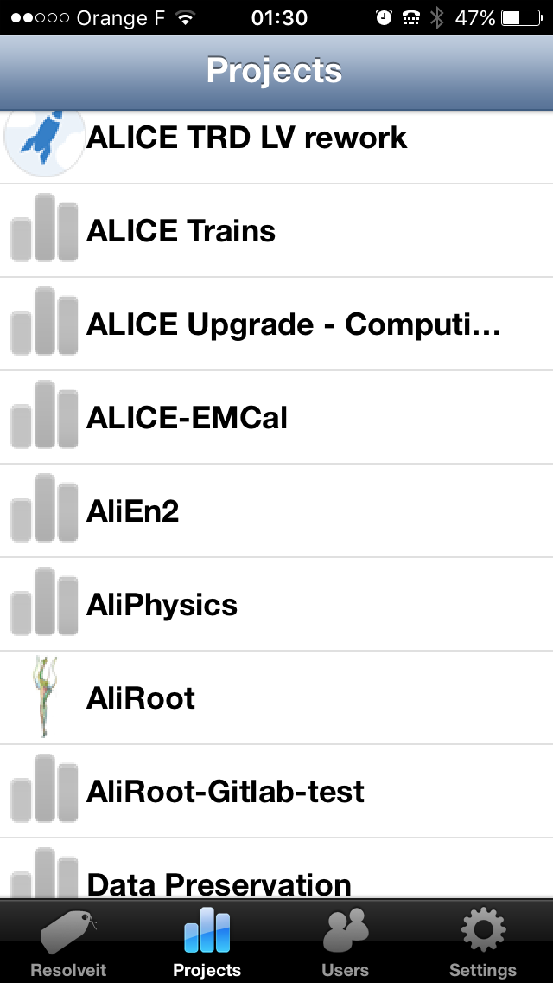
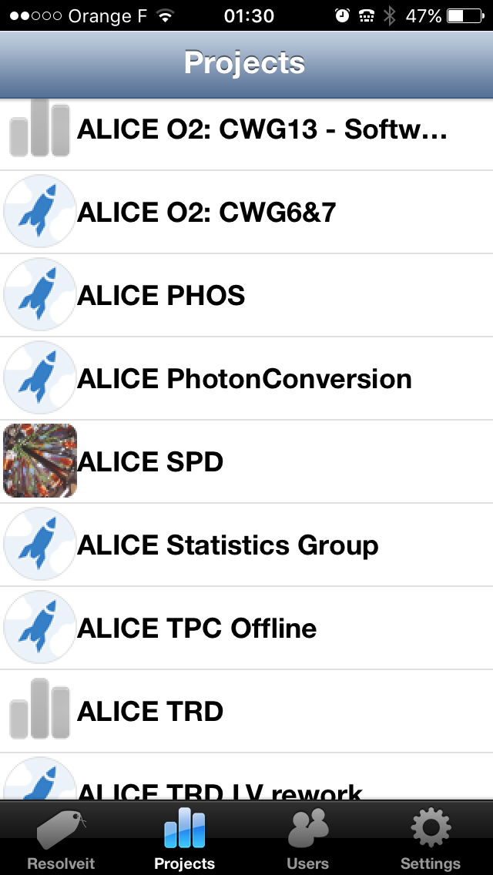
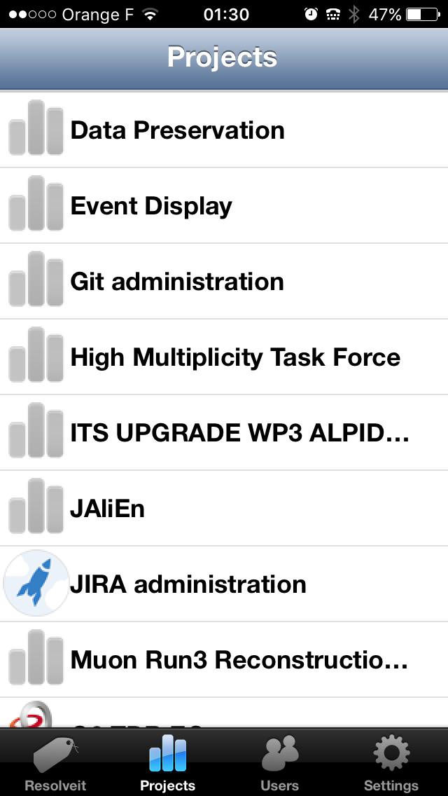
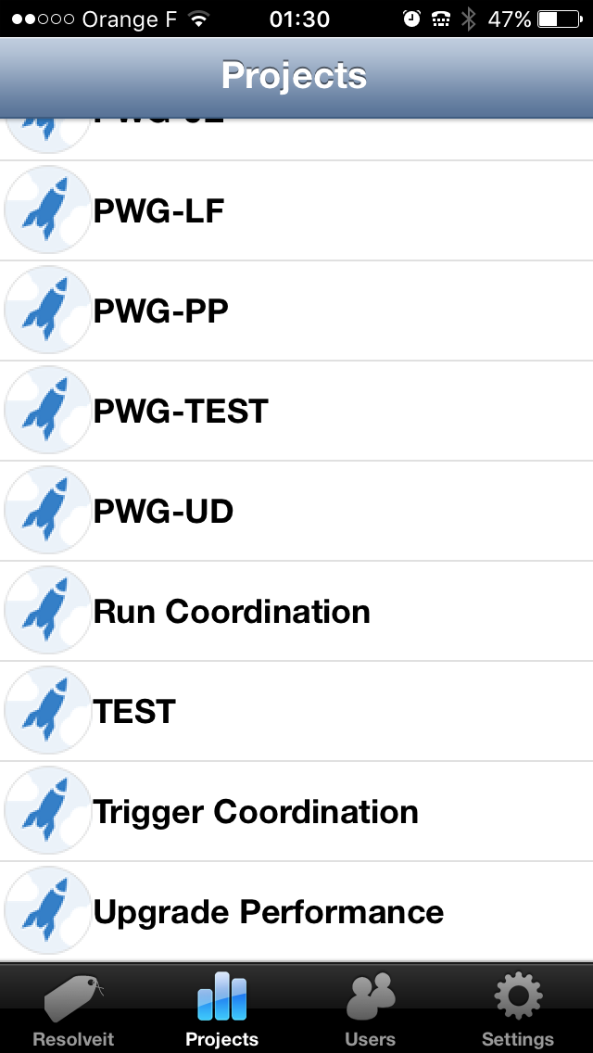
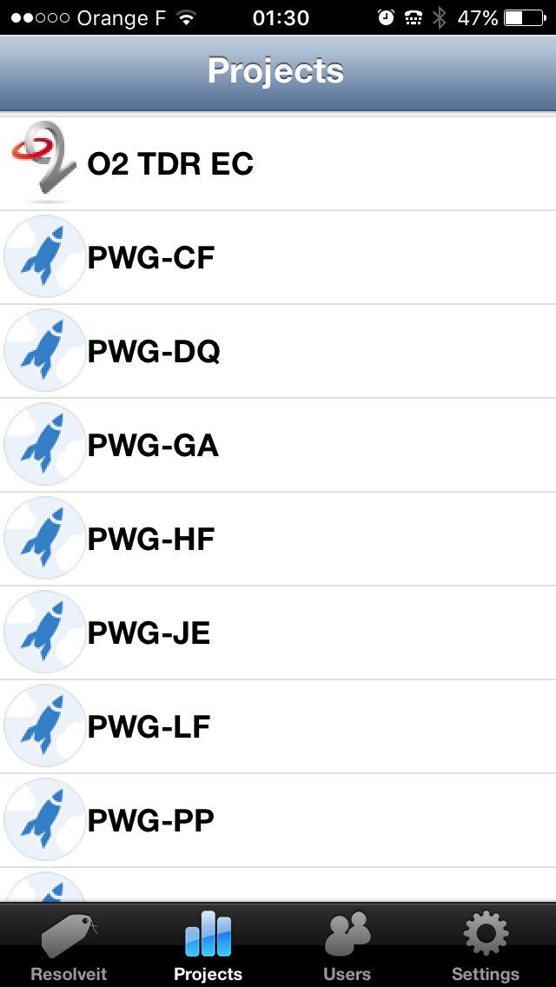
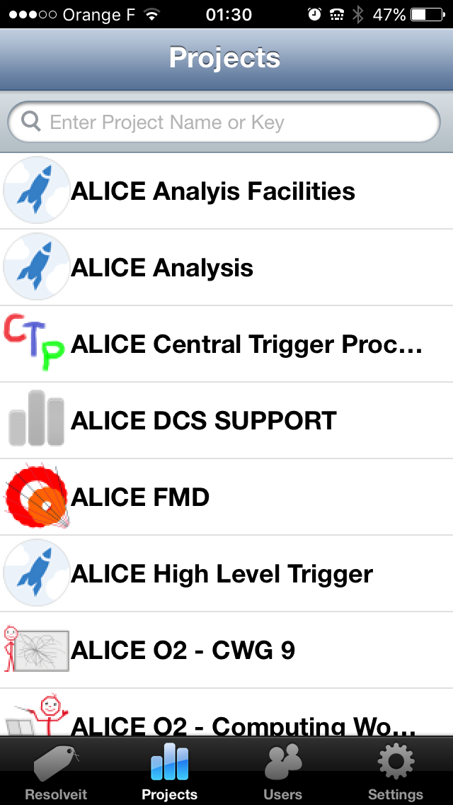
A
L
I
C
E
From JIRA to JIRAS
We will have to setup another meta-project to follow up high level milestones in Offline related projects
20
Predrag Buncic
Offline Week, CERN, November 25, 2015

