Slide 1
Beam Wire Scanner for PSB
Update
Dmitry Gudkov
BE-BI-ML
06-November-2015

Slide 2
Contents
Outcome of the Impedance meeting 2-Nov-2015
Outcome of the meeting with vacuum group 3-Nov-2015
Design News (N. Chritin, MME)
Motors (Status by 5-Nov-2015)
Conclusions and questions

Slide 3
Outcome of the Impedance meeting
(William Andreazza, Dmitry Gudkov, Paolo Magagnin, Raymond Veness, Benoit Salvant and Impedance colleagues)
The design of beam wire scanner for PSB was presented during the impedance team meeting on 2-Nov-2015 (presentation is available under https://indico.cern.ch/event/459020/ )
Some comments and questions following the meeting are shown below:
Question: What is resistance of the wire in the PSB (information required from BI-BL).
Comment: What works in one machine may well not work in another. Shorter bunch length could suggest smaller devices.
Comment: We could estimate the heating due to 'cavity modes' with input from heating using Mariusz’s heat balance (https://project-wire-scanner.web.cern.ch/project-wire-scanner/Notes/report_wire.pdf)
Comment: The wire is critical to understanding the situation (Benoit)
Comment: Putting it (wire) in a microwave is a good start (Fritz)
Comment: Not sure if the ‘coupler’-like cantilevered shaft is better or worse - will have to look (Fritz)
Comment: Shaft is electrically insulated from the body. This is not seen as a problem.
Input for design: Agreed to put a CF16 port on the axis of the shaft for a possible coupler.
Future tests: We said that we could imagine either to a dummy tank or make the tank early for test.
Comment: Beta is less than 1 in the Booster, so wire simulations are difficult (Fritz)
Comment: Impedance team has no strong objections for BWS PSB design (yes for LHC) (Benoit)

Slide 4
Outcome of the meeting with Vacuum group
(William Andreazza, Dmitry Gudkov, Jan Hansen, Paolo Magagnin, Friederike Salveter)
Some comments and questions following the meeting are shown below:
Additional pumping in for BWSs in PSB is required* (even in case of upgraded design).
CF DN 100 interface should be foreseen on the vacuum chamber of the beam wire scanner.
Additional budget for pumps should be foreseen (if not the case yet) – will be discussed with Bernd. ~12.5 kCHF/pump.
List of materials (previous outgassing tests) should be revised. The calculations for new design based on revised numbers (for example, no optical fibers inside the vacuum volume for new design).
Further calculations based on new inputs can be done in order to design pumping scheme.
All the materials used in the new design of BWS can be provided for outgassing tests ~early next year.
Complete BWS will be available for vacuum validation ~in 1 year.
Input from BE-OP is required to understand better vacuum parameters for PSB.
Pumping of 4xBWS can be organized either via vacuum manifold with 1..2 ION pumps or via individual ION pump on each BWS, or common vacuum tank for 4xBWS.
In case of use of manifold, the independent alignment of each BWS should be foreseen (possibly use bellows between manifold and BWS).
Possibility of using SAES minipumps (ION+NEG) is under question (not validated for PSB).
Simplified 3D model can be prepared for vacuum simulation.
* - data, simulation of SPS beam wire scanner prototype

Slide 5
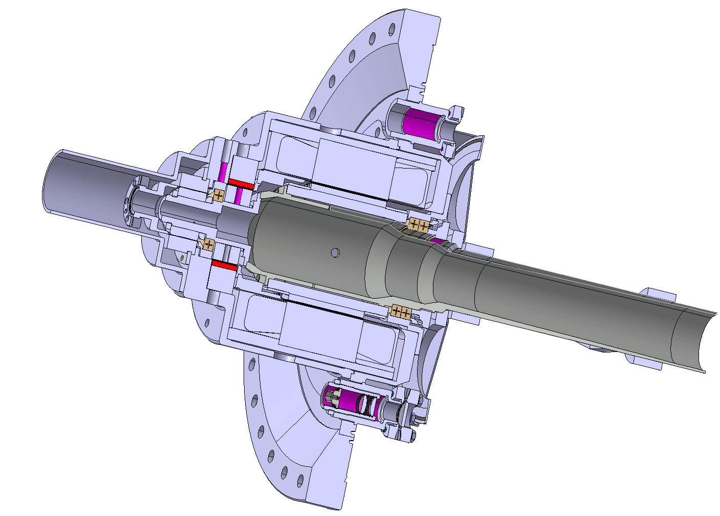
Design (Status 8-Oct-2015)
DN273
Thread M18 x 1
Magnetic brake
Resolver RO5032
Feedthrough protection
Optical disk protection
CF16 interface for feedthrough
Optical tube (2 lenses + fibre interface)
Viewport

Slide 6
Design (Status 5-Nov-2015)
Feedthrough
First Prototype in the PSB
PSB 4L1
CF100 for pump connection
Viewport
CF100
Vacuum chamber fixation features

Slide 7
Design (Status 5-Nov-2015)
Vacuum chamber
Optical disk ø192 mm
CF16 interface for N-type feedthrough (request from impedance team)
Hub
Optical sensors (x4)

Slide 8
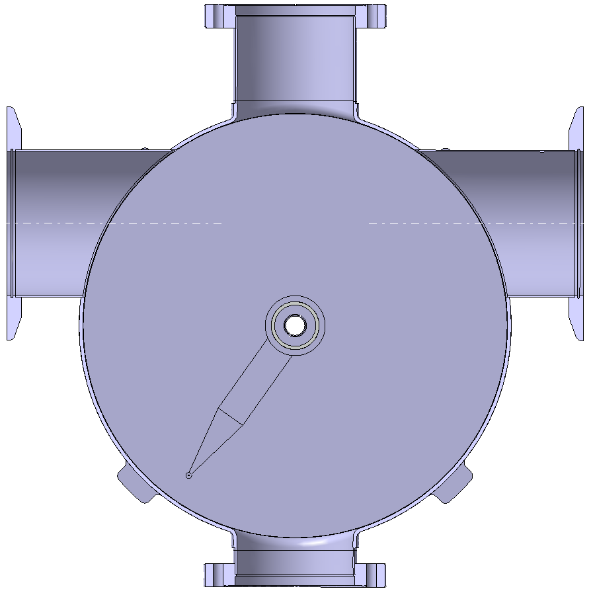

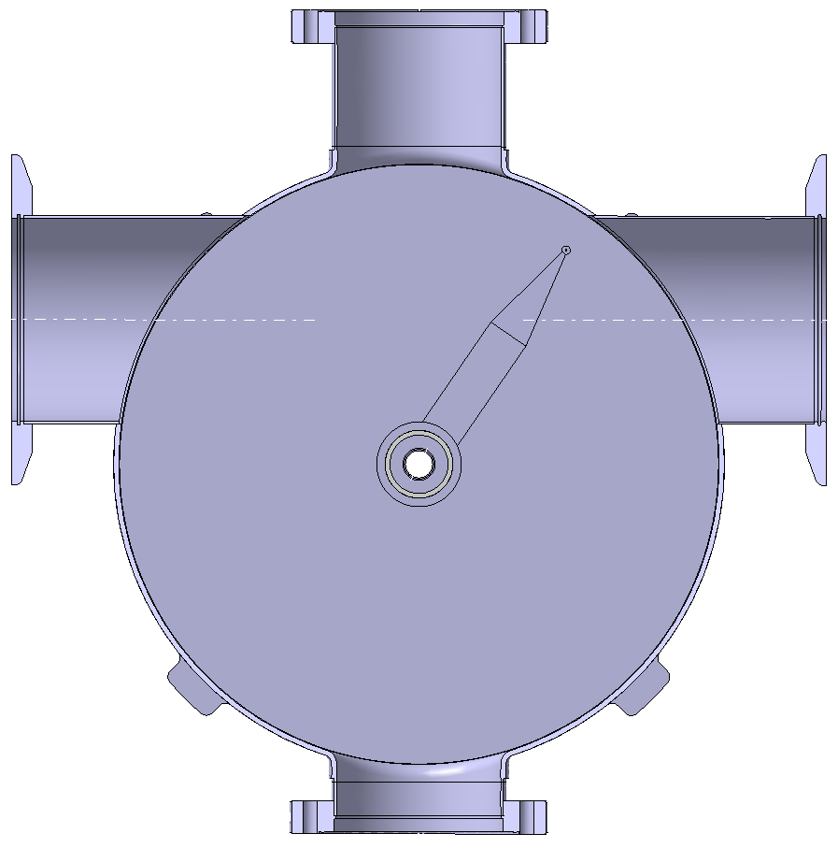
Definition of start and end fork positions
Start
Impact
End
beam
124°
(+180°)
34°
(+90°)
α
-56°
(+0°)
α
values to be approved

Slide 9
Design Status (6-Nov-2015)
Design is well advanced, readiness assessment of 3D model – 75 % (Nicolas).
The 3D model will be finalized (100 %) by end of CW46 (Nicolas).
Production details are being discussed with main workshop.
Some 2D drawings are under way.
Customised optical tube requested in THORLABS, 66 EUR/piece (5 pcs. order); 48 EUR/piece (10 pcs. order).
4 optical sensors (2 previously, confirm).
Requests from impedance and vacuum are taken into account in the 3D model.
Job request early January 2016; all parts produced – summer 2016.
Critical raw material (3d forged blanks and large CF flanges) – order soon, list is being prepared.
Fixation of 1 x BWS + 1 x SEM grid in PSB, design of the frame to be launched.
Alignment features will be designed together with holding frame.

Slide 10
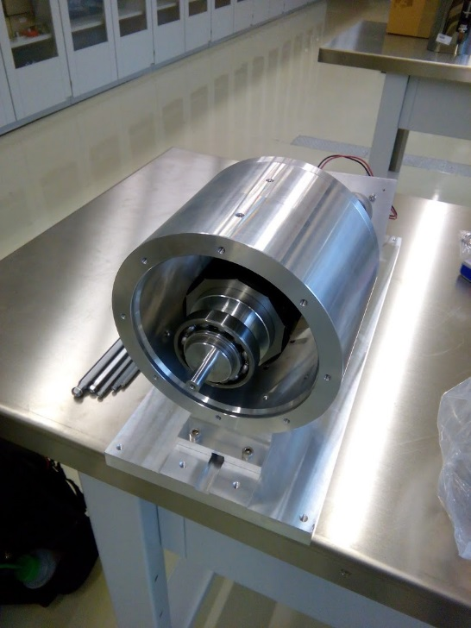
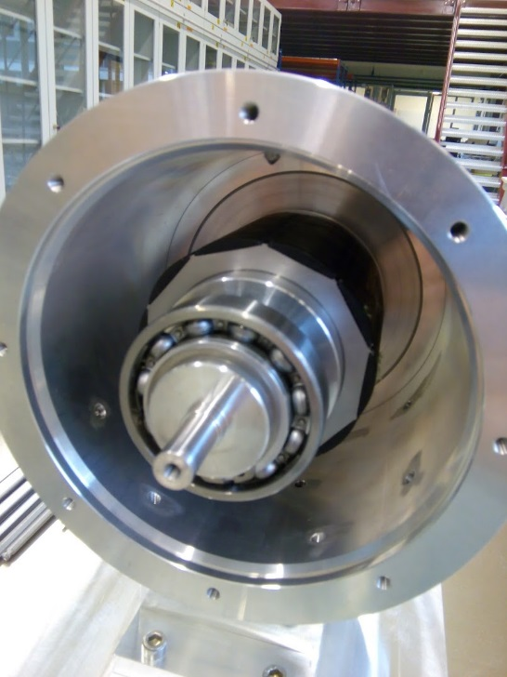
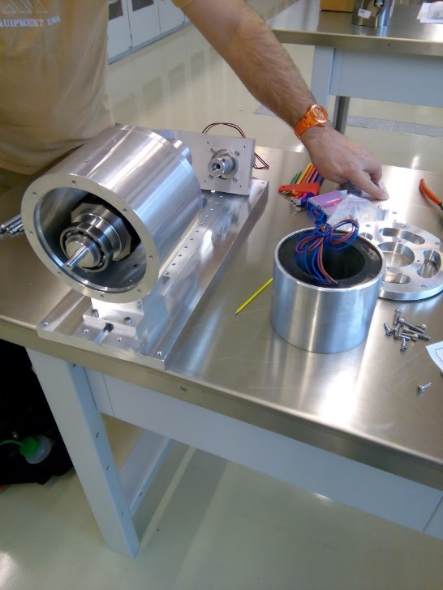
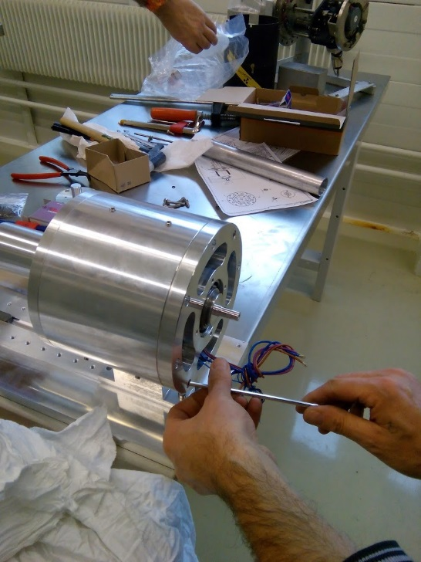
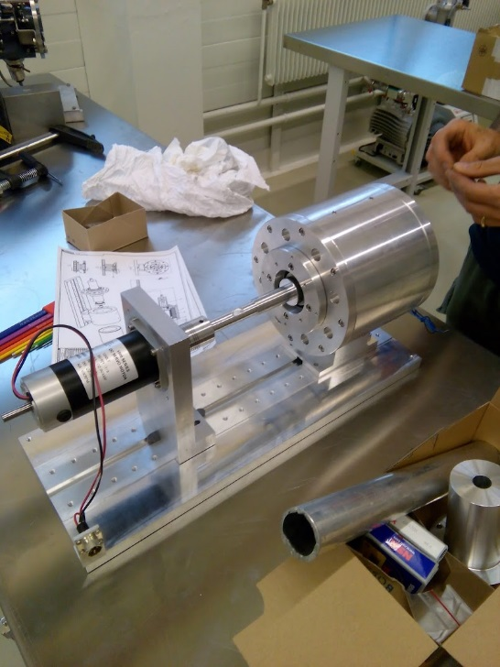
Orders of motors
Company | Model | P.O. sent | Delivery expected
Alxion | 145STK2M1C020S (standard) | 03.08.2015 | 06.11.2015
Alxion | 145STK2M - customised | 17.08.2015 | 27.11.2015
Kollmorgen | KBM-35H02-C00 (standard) | DELIVERED
Production of test benches for electromechanical tests: DELIVERED (for both Alxion and Kollmorgen)
Kollmorgen motor test bench is ready: pictures CW 44

Slide 11
Orders of motors (Alxion special)
Rotor parts ready (permanent magnets x 48, rotor body x 1, retaining rings x2)
We asked Alxion to send these parts to us for cleaning
Parts cleaned and should be sent back by 6-Nov-2015
Alxion will assemble the rotor and perform the metrological control of the external diameter
Based on the measured value the thin wall magnet holder will be produced
This holder will be sent to CERN for cleaning
CERN will clean the part and send it back to Alxion for final assembly of rotor

Slide 12
Thank you for your attention!
Questions?
…Discussion...

Slide 13
Extra slides

Slide 14
Beam Wire Scanner Prototype for PSB. Schedule

Slide 15
Optical system
Drawing of the metallic optical disk is ready.
Samples for Dundee university are prepared and will be sent soon:
4 samples of 304L (Vacuum) turned, with different roughness
4 samples of Anticorodal turned, with different roughness
3 hubs for fixation of glass optical disk have been ordered (P.O. sent, raw material 304L sent)

Slide 16
Electric Motor Requirements
* - The motor currently used is obsolete and will not be available for purchasing
Parameter | Value |  | Notes
Motor type | Frameless PMSM |  | Permanent Magnet Synchronous Motor
Rotor core material | Steel (should be approved by CERN)
Permanent magnets material | Samarium-Cobalt (Sm₂Co₁₇)
Wire linear speed, m/s | 20
Angular speed, rad/s | 110 (PS/SPS) | 133 (PSB)
Acceleration, rad/s² | 10672 (PS/SPS) | 15711 (PSB) | Sin-profile is used, spec. coefficient 1.85
Inertia of the load, kg x m² | 8.6E-04* (PS/SPS) | 7.29E-04* (PSB)
Radial air gap (stator ID – rotor ED), mm | 0.7
Ionizing radiation dose, kGy/year | 1
New motor will be the same in beam wire scanners for PS/SPS/PSB so should provide torque sufficient to accelerate the wire to linear speed 20 m/s in both configurations: 182.5 mm (PS/SPS) and 150 mm (PSB) mm forks;
The desired motor should be based on the standard market solution which will be available for many years;
The rotor will be located in vacuum and must be vacuum compatible; the use of any glue, other adhesives or insulating materials is not possible. Solid core rotor should be used.
The moment of inertia of the rotor should be minimized in order to reduce the required acceleration torque;
Features for mounting the rotor on the shaft (key-slots, holes, etc.) should be considered in the design;
*-values will be optimized during the next mechanical design phase

Slide 17
Potential suppliers and models
Supplier | Model | Rotor Inertia, kg x m² | Peak torque, N x m | Required torque PS/SPS, N x m | Required torque PSB, N x m | Dimensions, d_{ir}xD_{er}xD_{es}xL_{r}xL_{s}
ETEL | TMM140-030 | 9.98E-04 | 38.20 | 19.83 | 27.13 | 60x88x143x31
Allied Motion | HT05003 | 9.40E-04 | 31.29 | 19.21 | 26.22 | 64x78x122x62
Alxion | 145STK2M | 1.28E-03 | 55.00 | 20.07 | 27.48 | 56x77.7x145x86x119
Kollmorgen | KBM-35X02 | 2.50E-03 | 58.4 | 35.86 | 50.73 | 65x86.9x140x76x109
Parker | NK620 | 9.80E-04 | 26.60 | 18.63 | 25.57 | 26x71x111x60x106
Motion Control | B13-76 | 7E-04 | 26.50 | 16.65 | 22.45 | 58x??x127x76
Alxion | 145STK4M | 2.37E-03 | 110 | 34.5 | 48.7 | 56x77.7x145x140x173
Supplier | Model | Rotor Inertia, kg x m² | Peak torque, N x m | Required torque PS/SPS, N x m | Required torque PSB, N x m | Dimensions, d_{ir}xD_{er}xD_{es}xL_{r}
ETEL | TMM140-030 | 9.98E-04 | 38.20 | 19.83 | 27.13 | 60x88x143x31
Allied Motion | HT05003 | 9.40E-04 | 31.29 | 19.21 | 26.22 | 64x78x122x62
Alxion | 145STK2M | 1.28E-03 | 55.00 | 20.07 | 27.48 | 56x??x145x86
Kollmorgen | KBM-35X02 | 2.50E-03 | 58.4 | 35.86 | 50.73 | 65x??x140x76
Parker | NK620 | 9.80E-04 | 26.60 | 18.63 | 25.57 | 26x71x111x60
Motion Control | B13-76 | 7E-04 | 26.50 | 16.65 | 22.45 | 58x??x127x76
Not interested because of small quantity requested
Did no reply
Interested, quotation received
Interested, quotation received
Interested, quotation received but under consideration
Not interested (no experience with glue-less rotors)
3 companies are interested

Slide 18
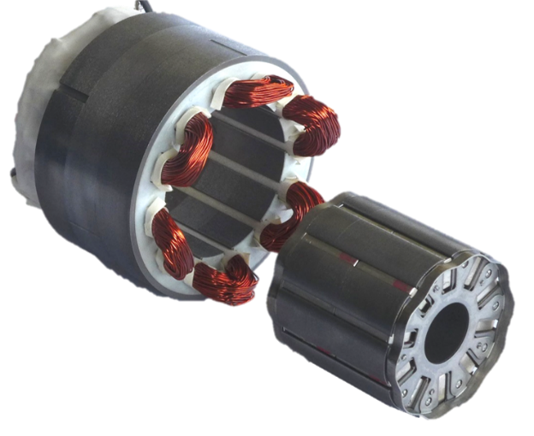
Potential suppliers and models. Prices
Supplier – Model | Price for prototype, EUR | Price for series, EUR | Additional cost | Delivery time, weeks | Total, prototype x1 | Total, prototype x2
Parker - NKD620EKxR1000 | 3154 |  | - | 10 | 3154 | 6308
Kollmorgen - KBM-35X02 | 5294 | 3566 | 3700 (NRE) | 16 | 8994 | 14288
Alxion - 145STK2M | 5250 | 1860 | 2700 | 14 | 7950 | 13200
Alxion - 145STK4M | 5710 | 2280 | 2900 | 14 | 8610 | 14320
See next slide for details
Supplier – Model | Price for 1, EUR | Price for 2, EUR
Parker - NKD620EKxR1000 | --- | ---
Kollmorgen - KBM-35X02 | 1078 | 2157
Alxion - 145STK2M | 2710 | 4060
Alxion - 145STK4M | 3150 | 4880
Rotor banding (done by Alxion)
Parker - NK620
Delivery time for standard models: Alxion – by 30.10; Kollmorgen – app. 7 weeks.
* - ALXION will be closed for vacation from August 3rd until August 21st included

Slide 19
Quotation from Parker
Still no official offer received
Torque margin for the proposed model is minimal (4%), the model with higher torque was requested in June
Offer sent for the model NKD620EKxR1000 (R1000?)
Waiting for reply from engineering department of Parker
Parker - NK620

Slide 20
Conclusions and questions
One or two prototypes? Do we buy from 1, 2 or 3 suppliers? Test data can be used later as a justification fro purchase of series.
More time needed to receive final quotation from Parker (however the delivery time is 10 weeks vs. 14/16 for other suppliers)
Price difference is minor for prototypes (Kollmorgen vs. Alxion) but becomes significant for series
Standard models can be purchased for first electromechanical tests (faster and cheaper)
New test bench should be designed and built for electromechanical tests of new motors

Slide 21
Kollmorgen - KBM-35H02-C00 (Standard model proposed)
Technical Details:
Kollmorgen proposes the use of a standard KBM-35H02-C00 modified to meet the environmental requirements specified above. The material changes shall be:
Convert all lead wires from Teflon insulation to Tefzel per UL 10086. These leads will be covered with Kynar tubing as the leads exit the stator encapsulation epoxy to reduce stress damage in handling.
Internal Stator winding connections shall be insulated with Kynar tubing for long term insulation stability in the radiation environment.
Rotor Core shall be constructed of solid 416 series stainless steel.
Rotor Magnets shall consist of Sm2Co17 magnet material. The magnets shall be secured with a low outgassing adhesive compliant with ASTM 595. This adhesive is used as an assembly aid to secure the magnets to the rotor during grinding and banding operations.
The magnets shall be retained by a 300 series stainless steel band on the rotor outside diameter and 300 series stainless steel end caps.
The Rotor Assembly shall be baked at 200°C for 2 hours to drive off volatiles.
Kollmorgen proposes the use of a full length key to secure the rotor to the CERN shaft.
Kollmorgen shall provide a materials list and appropriate drawings after order placement.
Mechanical and electrical interfaces will require further discussion and definition before being finalized.

Slide 22
Alxion - 145STK2(4)M
Technical details
Kit of frameless motor 145STK4M, 1500 rpm version with standard stator and special rotor.
The special rotor is constituted of a steel hub with grooves for magnets seats, covered by Sm2Co17 magnets and secured by a stainless steel sleeve on all the length:
the Sm2Co17 magnets have magnetic characteristics equivalent to our iron-neodymium magnets used in series; they have a special shape different from a tile and have to be manufactured specifically.
axial blocking rings are shrinked on each extremity
the airgap has been increased of 0.4 mm at radius for compensating the sleeve thickness and insuring a 0.7 mm airgap at the radius; consequently the torque for a given current decreases of 5 to 10%
the special rotor inertia is equal to 2.37. 10-3 Kg.m2
the rotor does not include any glue or varnish or polymer
the rotor alone can bear a bake-out temperature of 200°C; it is not the case of the stator that can bear 160°C maximum in windings, which is the threshold of temperature alarm through PTC resistor
we have no idea about the capability related to ionizing radiation dose but you mentioned that a standard stator and a rotor with a steel core and mechanical fixation of the magnets would create no problems
IMPORTANT NOTE: The key technological problem is to succeed to shrink the magnets with a stainlees steel sleeve with a good repeatability for making series. We have experimented a process that allowed to shrink a stainless steel sleeve on a rotor with our standard iron-neodymium magnets glued on the circular hub, without grooves. for magnets seats. We could not experiment the operation of shrinking a stainless steel sleeve on the special rotor with grooves in the hub for receiving Sm2Co17 magnets without glue as, at this preliminary stage, we could not experiment the assembly of those special magnets needing to be specially orderd and we did not make a special hub with grooves. According to our experience, the Sm2Co17 are brittle, more brittle than the iron-neodymium ones. It is also possible that some magnets break during sleeve shrinking. We have foreseen a certain rate of replacement of magnets but we cannot be 100% sure that no magnets particles or bit will not detach after assembly. Therefore, we shall be 100% sure about the feasibility of the rotor only once we have made the prototype.

Slide 23
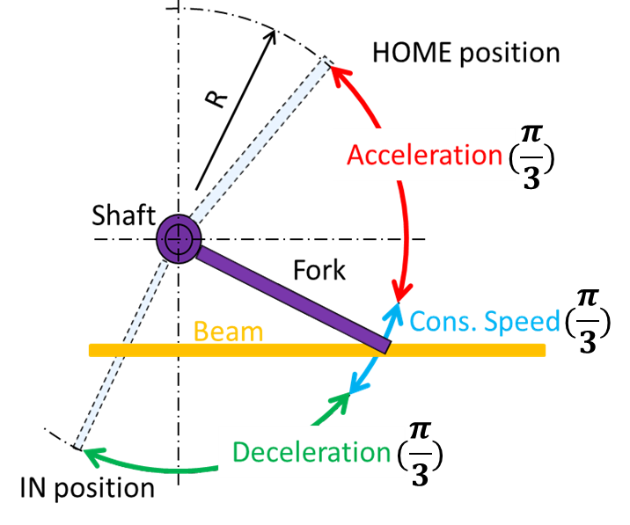
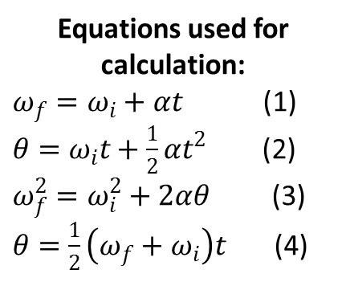
Torque required for acceleration of the wire scanner forks in order to achieve the velocity of 20 m/sec on the distance of 60⁰ $(\frac{π}{3})$
3 different lengths of the fork have been considered:
Option 1: R1 = 182.5 mm
Option 2: R2 = 150.0 mm
Option 3: R3 = 100.0 mm
Equations used for calculation:
$ω_{f}=ω_{i}+αt$(1)
$θ=ω_{i}t+\frac{1}{2}αt^{2}$ (2)
$ω_{f}^{2}=ω_{i}^{2}+2αθ$ (3)
$θ=\frac{1}{2}\left(ω_{f}+ω_{i}\right)t$ (4)
Angular speed and acceleration
 | Length of the fork, m | Linear speed of the wire, m/s | Angular speed of the wire, rad/s | Acceleration (constant), rad/s^2 | Peak acceleration (variable profile, k=1.85*), rad/s^2
Option 1 (R1) | 0.182 | 20 | 110 (1051) | 5790 | 10711.5
Option 2 (R2) | 0.150 | 20 | 133 (1270) | 8471 | 15671.4
Option 3 (R3) | 0.100 | 20 | 200 (1910) | 19108 | 35350.0
* - the coefficient used for calculations of the peak acceleration by C. Grosjean

Slide 24
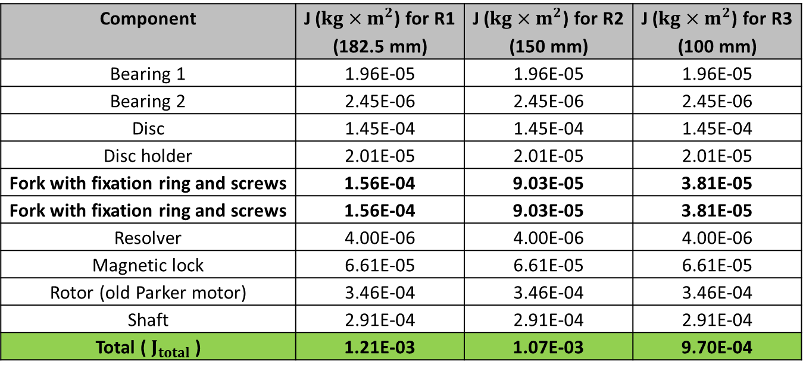
Moment of inertia of the shaft and components installed on it
(based on data from S. Samuelsson)
Component | J ($kg×m^{2}$) for R1 (182.5 mm) | J ($kg×m^{2}$) for R2 (150 mm) | J ($kg×m^{2}$) for R3 (100 mm)
Bearing 1 | 1.96E-05 | 1.96E-05 | 1.96E-05
Bearing 2 | 2.45E-06 | 2.45E-06 | 2.45E-06
Disc | 1.45E-04 | 1.45E-04 | 1.45E-04
Disc holder | 2.01E-05 | 2.01E-05 | 2.01E-05
Fork with fixation ring and screws | 1.56E-04 | 9.03E-05 | 3.81E-05
Fork with fixation ring and screws | 1.56E-04 | 9.03E-05 | 3.81E-05
Resolver | 4.00E-06 | 4.00E-06 | 4.00E-06
Magnetic lock | 6.61E-05 | 6.61E-05 | 6.61E-05
Rotor (old Parker motor) | 3.46E-04 | 3.46E-04 | 3.46E-04
Shaft | 2.91E-04 | 2.91E-04 | 2.91E-04
Total ( $J_{total}$ ) | 1.21E-03 | 1.07E-03 | 9.70E-04
Summary table of calculated data for torque and acceleration
 | Length of the fork, m | Required torque, Nm | Peak acceleration*, rad/s^2
Option 1 (R1) | 0.182 | 12.96 | 10711.5
Option 2 (R2) | 0.150 | 16.77 | 15671.4
Option 3 (R3) | 0.100 | 34.31 | 35350.0
* - calculated by multiplication of constant acceleration by k = 1.85

