Slide 1
30kA Energy Extraction Semi-Conductor Switch
PRR: 29-01-2016 SM18 -CLUSTER D
Quality Control, Test Program and Test results
Alexandr Erokhin
TE-MPE-EE

Slide 2
Quality control and tests
Quality assurance should include:
Before arriving to CERN - Factory Acceptance Tests on the manufacturer’s premises obligatory!
Input control of the components. Travellers, responsibilities
Input test of the delivered parts (quality test, electrical tests, pressure tests). Travellers, responsibilities
Approved test program
Complete test documentation, responsibilities

Slide 3
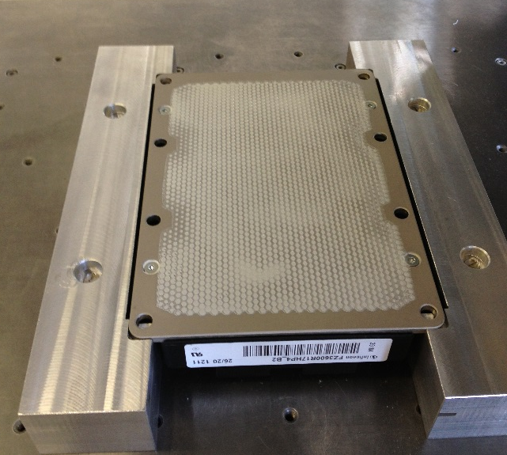
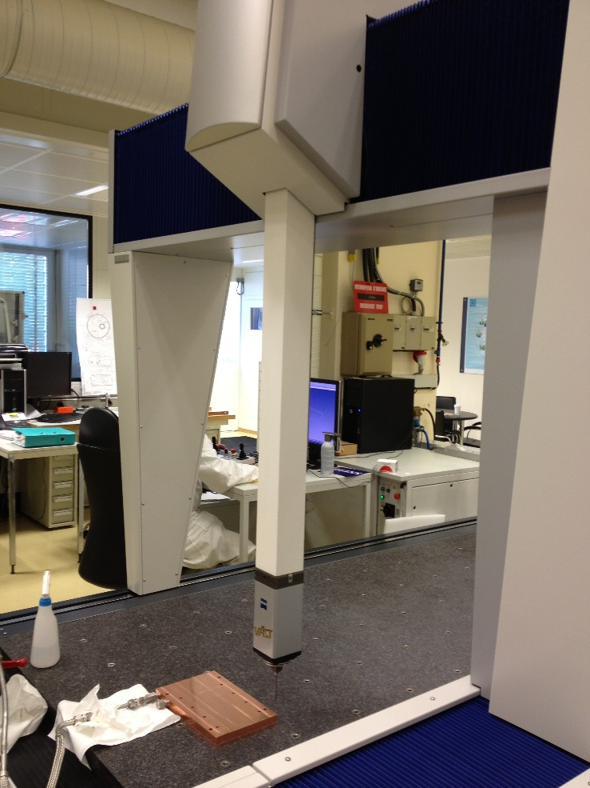
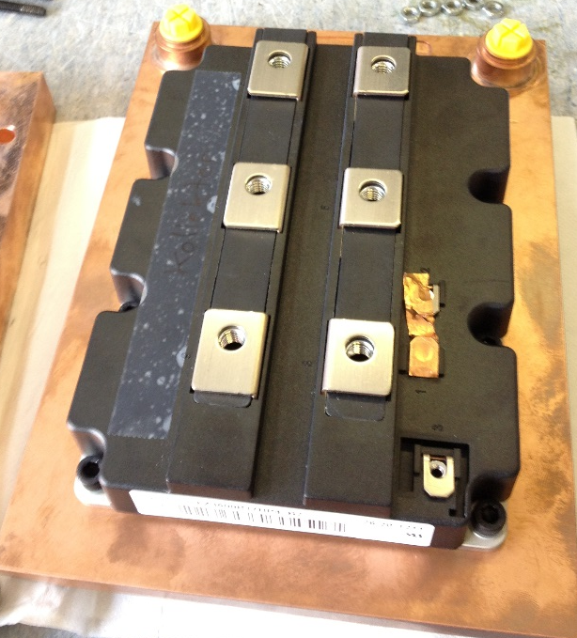
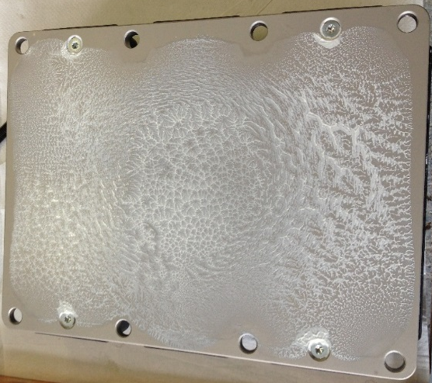
Parts input control
Correct printing of the grease
Heatsinks:
Surface test under 25 bars
Mounting
“pattern” after dismounting

Slide 4
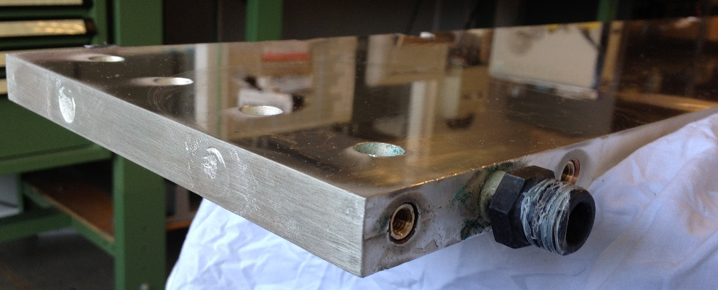
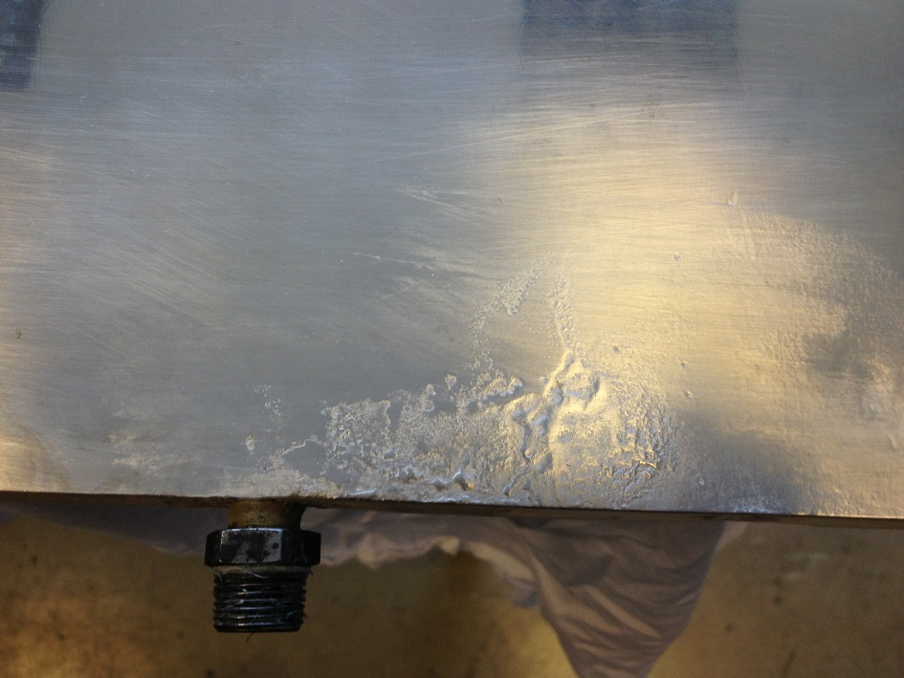
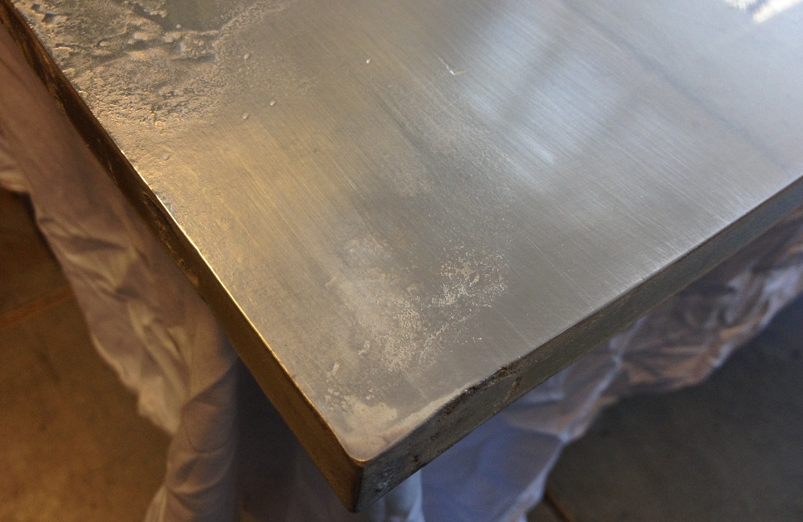
Parts input control
What should not be accepted
Deeply detailed written specification and on-site control must be!

Slide 5
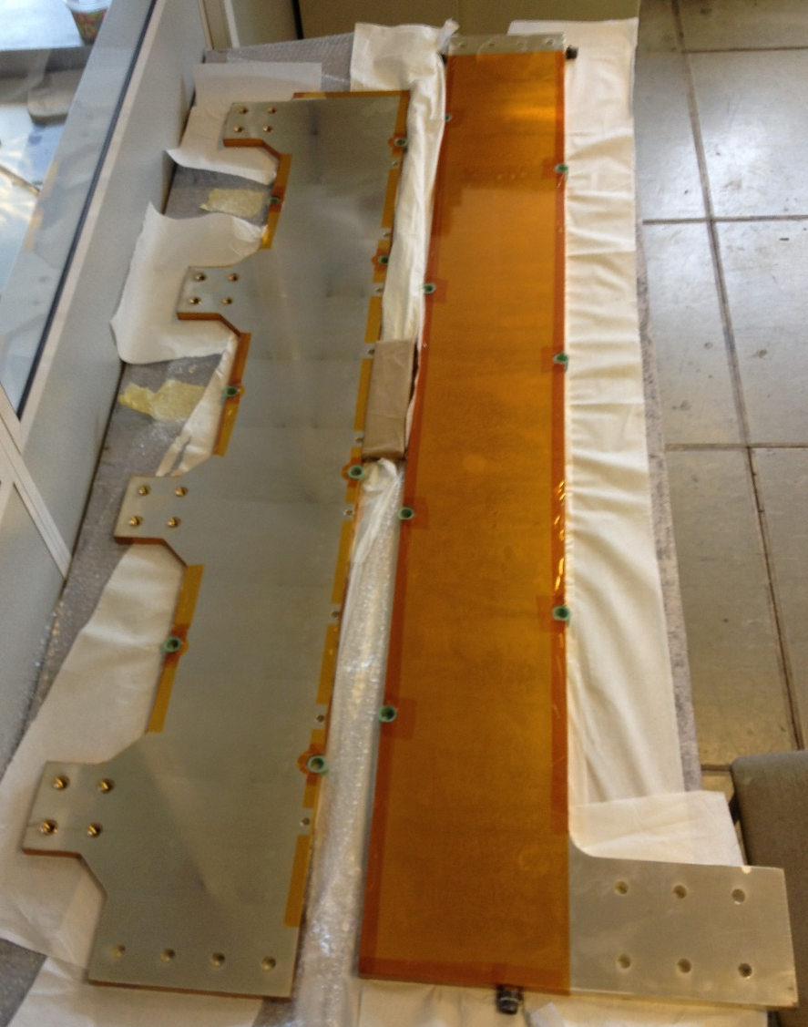
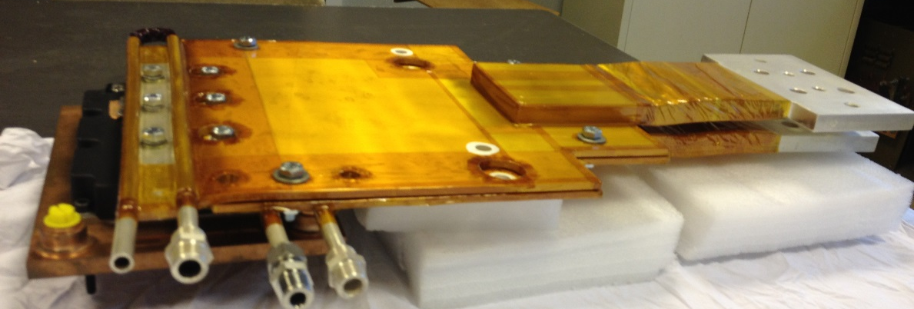
Parts input control
Bus-bars:
Surface check (especially for the connection flags)
Pressure tests with 25 bars
Correct lamination and hi-pot test

Slide 6
Test program
Visual control
Insulation test – 2.5kV. Dry conditions
Complete system pressure test – 25 bars
Insulation test – 2.5kV. With water running
Interlock tests
Functional tests without current
Functional tests for each IGBT separately
Functional test for groups of GBTs
Faults simulation – reaction control
Complete system functional tests
Heat run

Slide 7
Test program
Functional tests without current
Auxiliary voltages control
IGBTs commutation cycles ON – Off
Oscilloscope measurements for the gate side – all channels – delays?
Interlock tests
Analogue channels: noise, offsets, calibrations

Slide 8
Test programme
Functional tests with current
Each IGBT separately one by one.
Introducing IGBTs one by one. Master – Slave configuration
Tests of 1 IGBT: DC 0 – full current,
opening, transients, overvoltages…
3rd level snubber calculations and
implementation for all IGBTs

Slide 9
Test programme
Functional tests with current
Complete system:
Introducing delays for the switching Off for different IGBTs
reaction control:
oscillations
overcurrents
safe triggering
Switching Off in normal conditions: oscilloscope shots for the
transients
DC test: Current sharing, analogue measurements,
thermal scans

Slide 10
Test programme
Heat run
Complete system:
Ultimate current heat run for 1-2 hours
Ultimate current heat run for 8 hours
All temperatures should be monitored:
Input and output water
Heatsinks
Laminated busbars
Distribution busbars
Ambient temperature
Vce monitoring versus current and temperature
Thermal scans every 30 minutes.

Slide 11

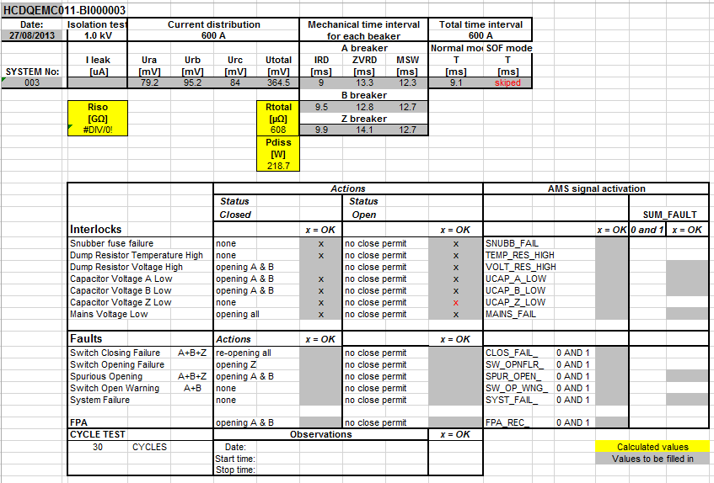
Test documentation
EDMS document – complete test program
All results to be saved in MTF

Slide 12
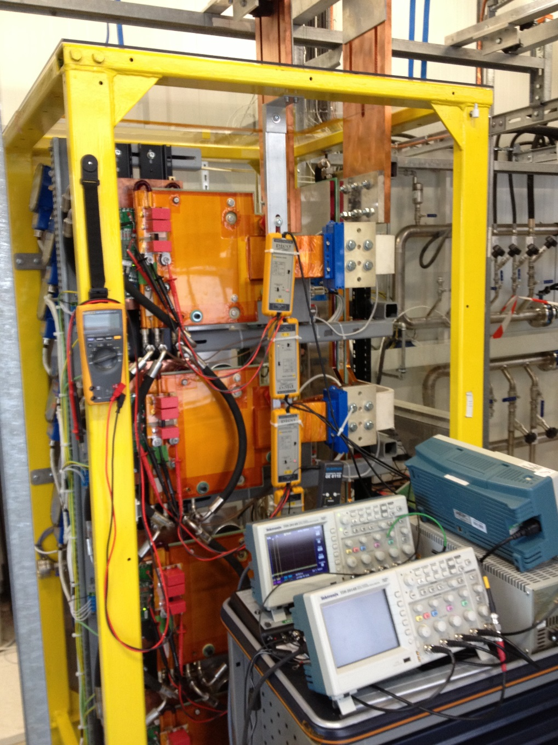
Test results
Test conditions
Beside the integrated measurement channel,
During test we use:
1. All Vge - 4 channels by one scope
2. All Vce - 4 channels by one scope
3. AC currents - 4 channels by one scope
4. Infrared camera during heat-run

Slide 13
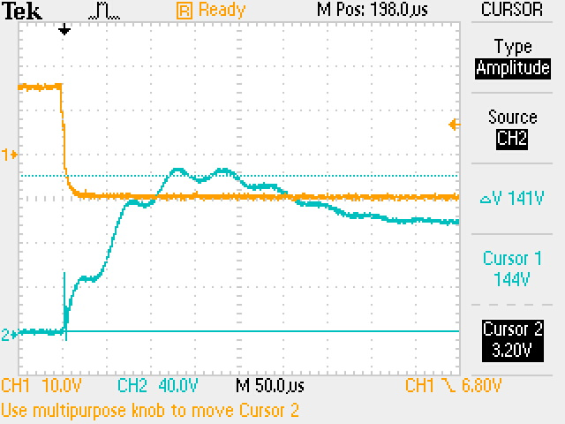
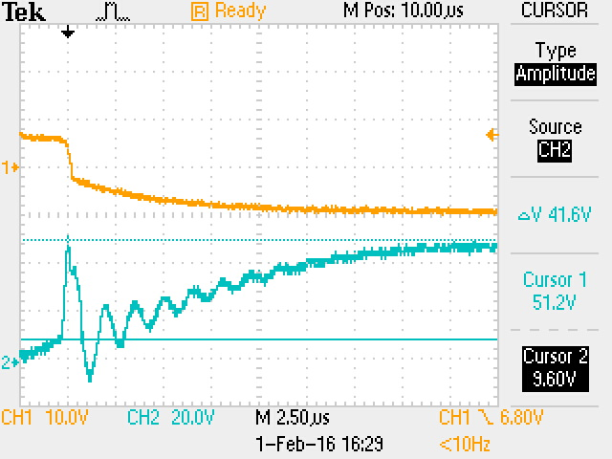
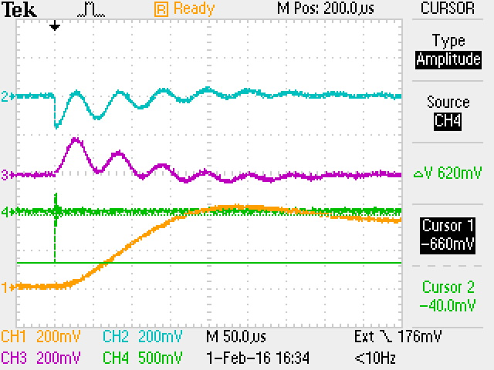
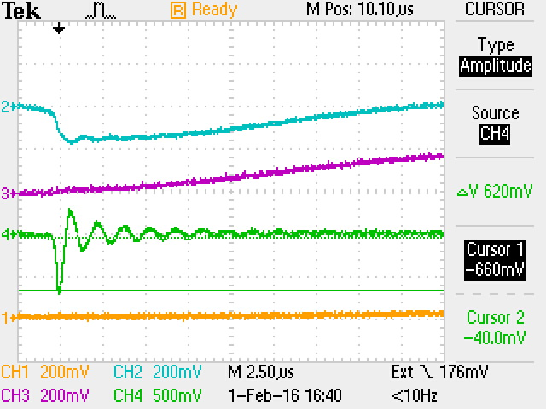
Test results
Functional tests with current
Each IGBT separately one by one.
Opening curves, voltages
Currents trough the snubber capacitors

Slide 14
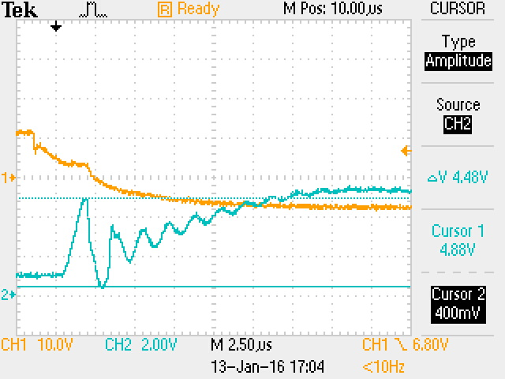
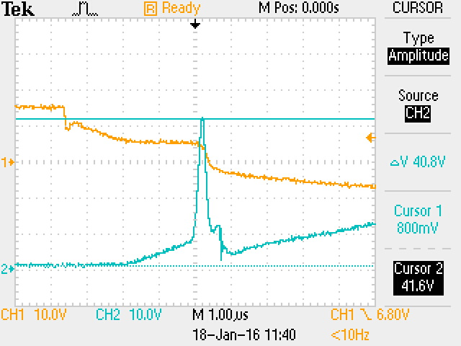
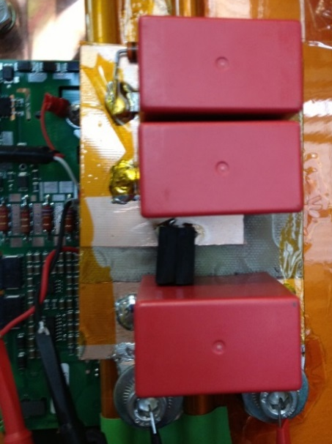
Test results
Functional tests with current
Snubbers design
C snubber ringing
Spike over RCD snubber
Since any kind of snubber will always has a small stray inductance (~5nH) it is not possible to have ΔU = 0. But the existing ΔU ~ 40V is not dangerous and fully acceptable

Slide 15
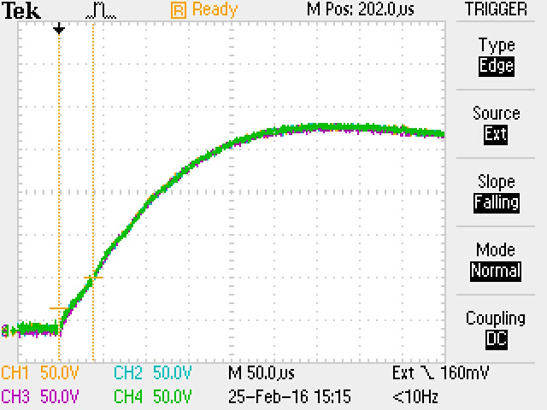
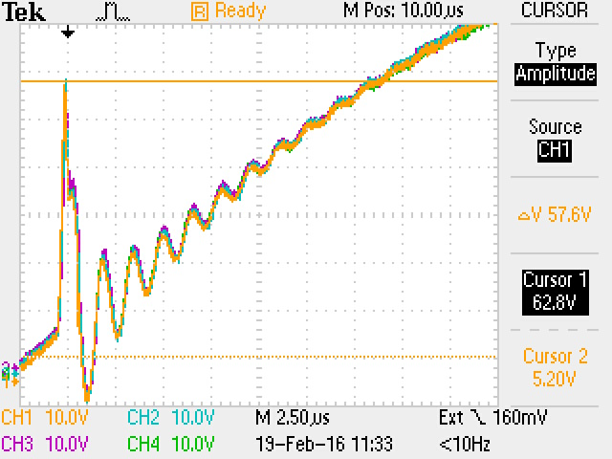
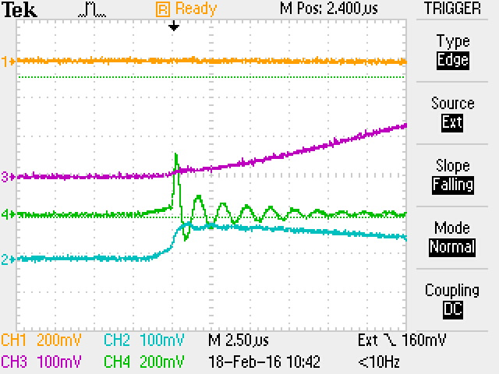
Test results
Functional tests with current
All four IGBT’s branches are connected, 7.5kA opening
Currents trough the snubber capacitors
Opening curves, voltages
RCDC snubber ringing
One can see that all 4 curves for the voltages are identical (curve to curve), meaning that 4 branches are symmetrical and have the identical impedances!
600kHz ringing at the beginning of the commutation has low amplitude and decays fast. But anyway we would like to damp it by increasing the IGBT opening time up to 10µs. In this case ringing will be damped by the IGBT resistance in linear mode.

Slide 16
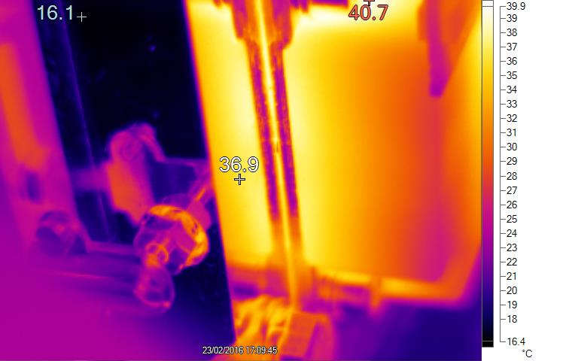
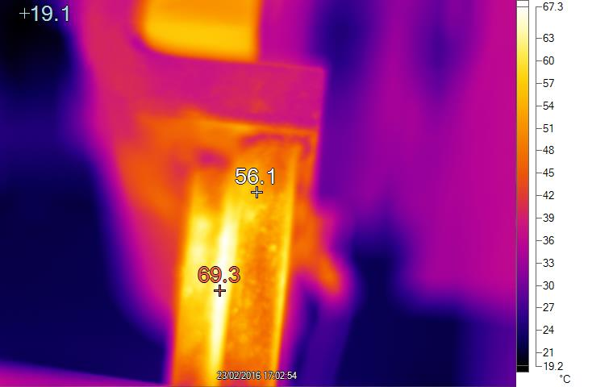
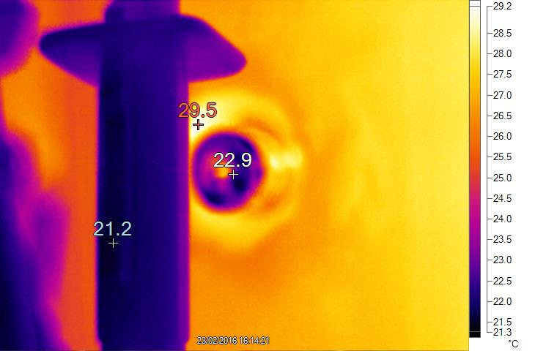
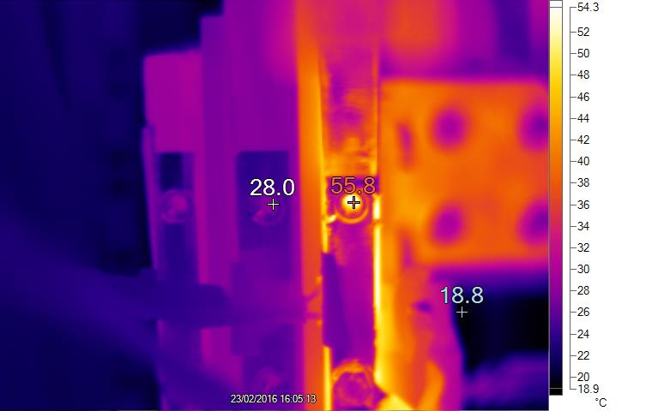
Test results
Heat run
Heatsink and IGBT housing
Shunt
Current shunts – average is ~70°C, but there are spots up to ~85°C
Laminated busbars and IGBT terminals
Distribution busbars
Air cooled distribution input busbar is stressed by the heat conducted from the input flag and from the 4 shunts.
Second air cooled bar is ~40°C
Water cooled bar is ~30°C

Slide 17
Test results
Heat run
Courtesy Pål Austnes
T probe

Slide 18
Test results
Heat run
Courtesy Pål Austnes

Slide 19
Test results
Heat run
Courtesy Pål Austnes
Out bus-bar at top is influenced by heatflow
via connection bar with many holes
(smaller cross section)
Notes:
Out bus-bar is water-cooled
Emmitter bus-bar is influenced by convectional heatflow by shunts
Out bus top is influenced by convectional heatflow by connection bar with many holes (smaller cross section)

Slide 20
Conclusions
Quality control: very strong attention should be paid for the technical specifications and factory and input quality control.
Preliminary tests to qualify the main components and parts of the prototype are done with nominal current. Results are good and precisely match the calculations and computer simulations!
Still a lot of tests should be performed: reliability tests, long heat runs, failure simulations, EMI.
Test folders should be organized

Slide 21
Thanks for your attention!

