Slide 1






21th CATIA FORUM Introduction

Slide 2

RULES
PLEASE TURN OFF YOUR PHONES

Slide 3

…and now the gifts promised during the last forum…

Slide 4

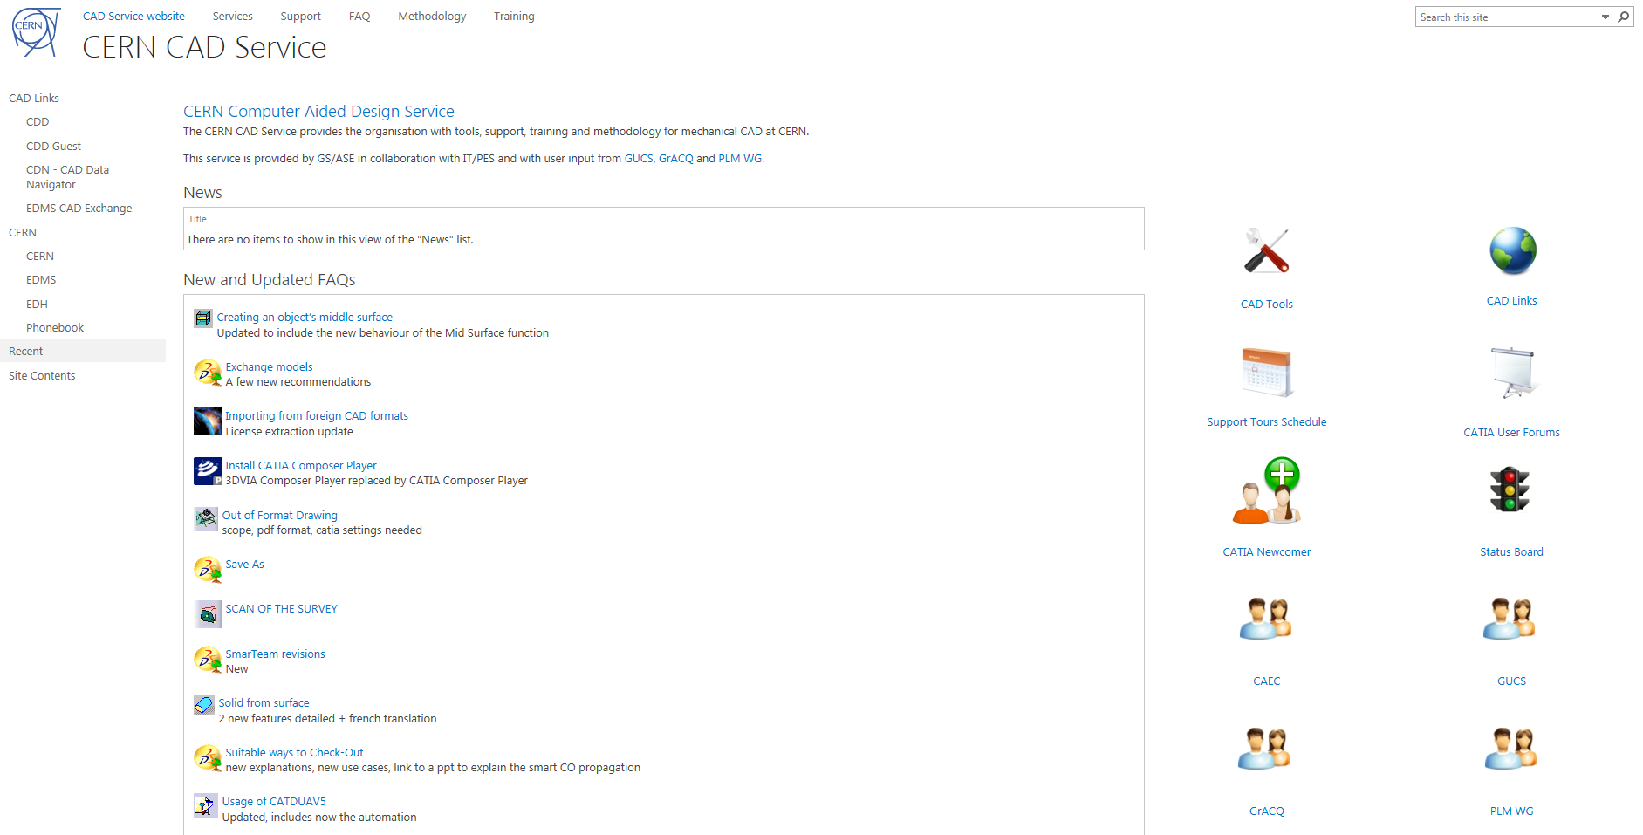
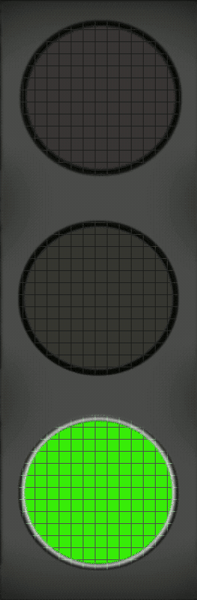
UPDATED CAD SERVICE WEB PAGE
Link : https://cad-support.web.cern.ch
IN PROD

Slide 5
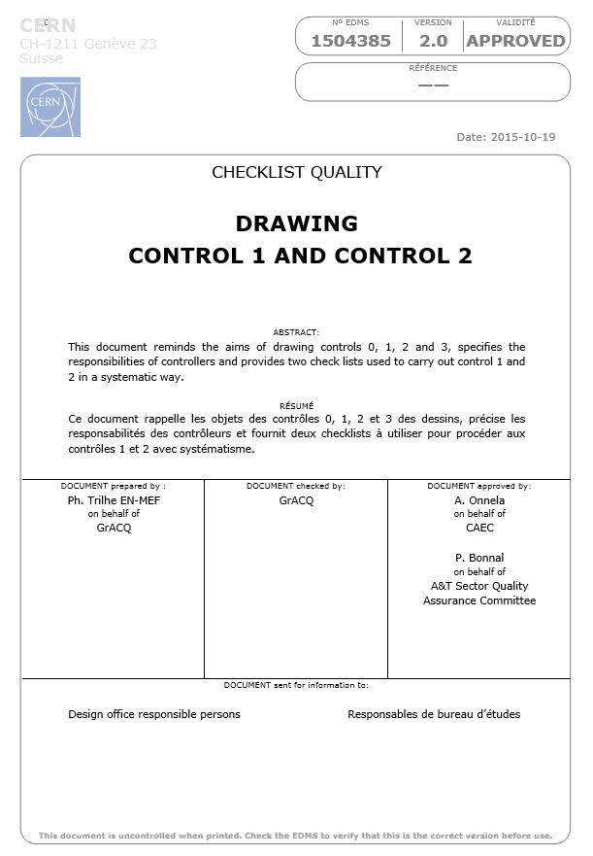
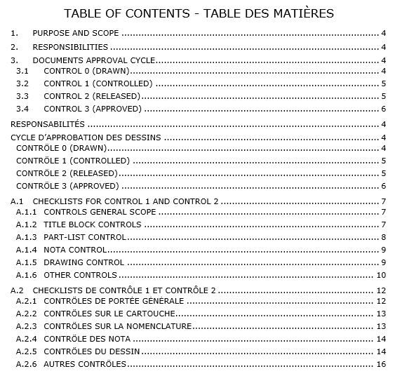

DRAWING CONTROL 1 AND CONTROL 2 (1/1)
Link to EDMS : https://edms.cern.ch/document/1504385/2.0
RELEASED BY
CAEC
PRACTICABLE STARTING
FROM NOW !!!

Slide 6
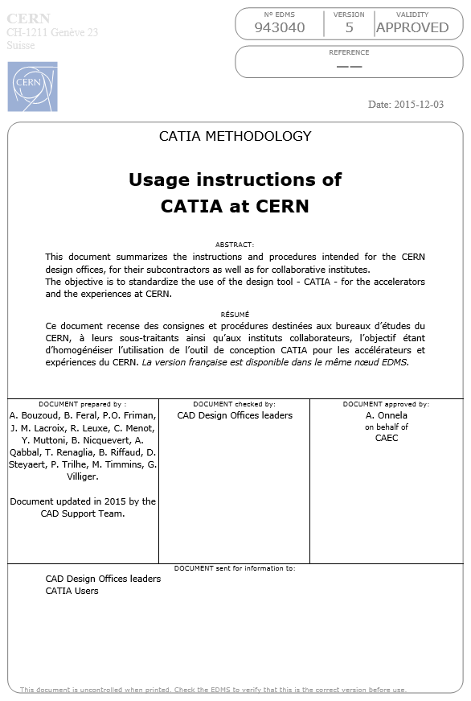

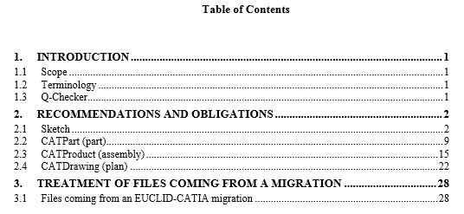
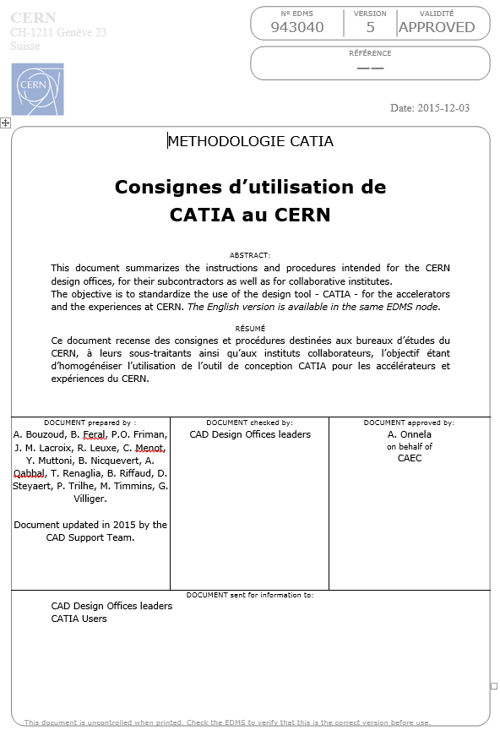
USAGE INSTRUCTIONS OF CATIA AT CERN (1/2)
Link to EDMS : https://edms.cern.ch/document/943040/5
CHECKED BY MORE THAN 50 OF YOUR DEPARTMENT/GROUP/SECTION LEADERS
RELEASED BY
CAEC
PRACTICABLE STARTING
FROM NOW !!!
FRENCH & ENGLISH VERSIONS

Slide 7
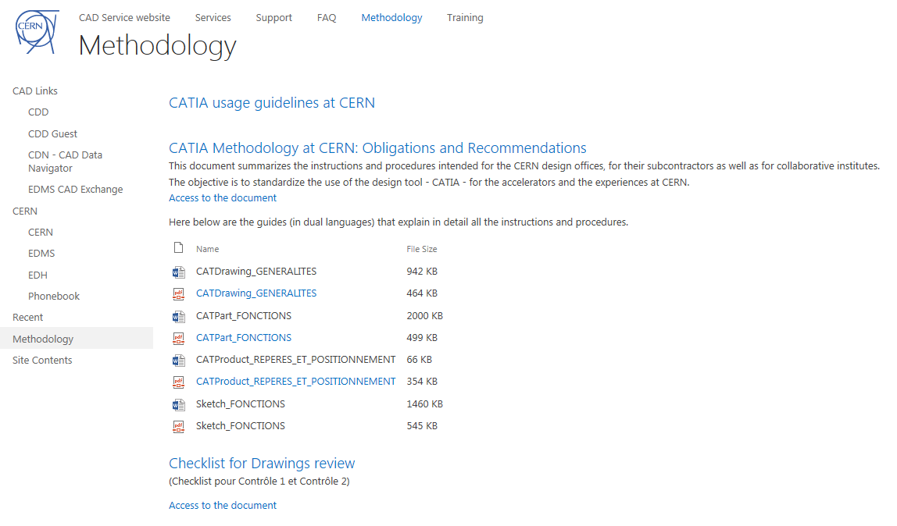

USAGE INSTRUCTIONS OF CATIA AT CERN (2/2)
Document
CAD Service Website
https://edms.cern.ch/document/943040/5
https://cad-support.web.cern.ch/methodology
Example

Slide 8

…and as usual, don’t forget to send your wish list to…

Slide 9
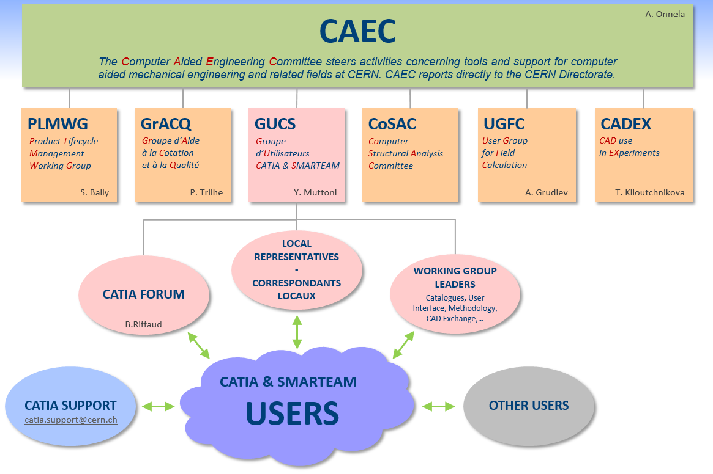
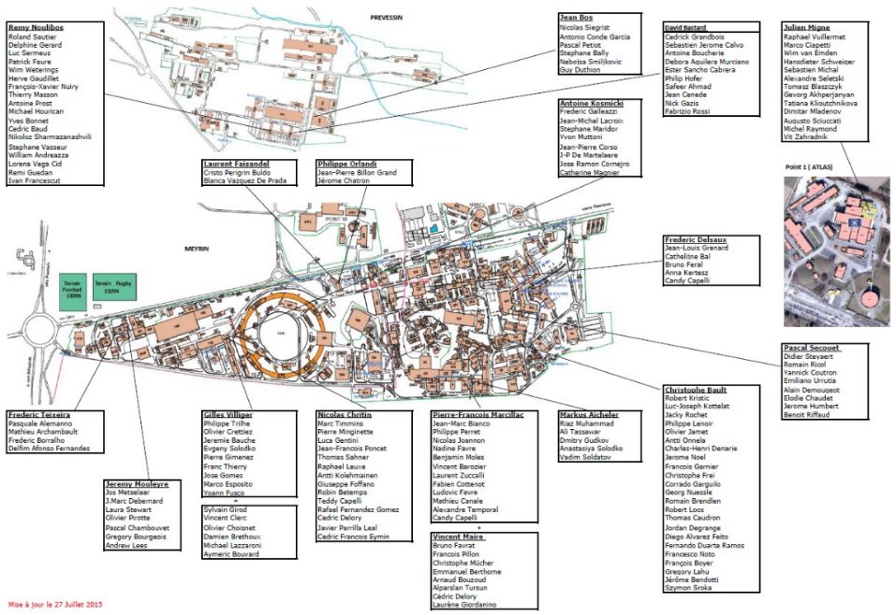
CONTACTS
LOCAL REPRESENTATIVES
WORKING GROUPS

Slide 10

…This forum is yours…
…We need your participation…
…Don’t hesitate to make a presentation…

