Slide 2
Welcome to CERN for the 3rd PLC/COTS based Interlock and Protection Workshop

Slide 3
3rd PLC/COTS based Interlock and Protection WS
Following the very successful first editions at ESS (Aug 2013) and ITER (Dec 2014), CERN is very happy to host 3rd edition
CERN is an extensive user of PLC/COTS technologies across many activities and organizational units (Electricity distribution, radiation protection, cryogenics, interlocks + equipment protection systems, personal safety, LHC equipment controls….)
Organization at CERN during the current technical stop will allow attendants to visit (large) operational PLC applications and have hands-on discussions with experts
Program interleaves 1¼ days of presentation and discussion with (up to) 3 site visits

Slide 4
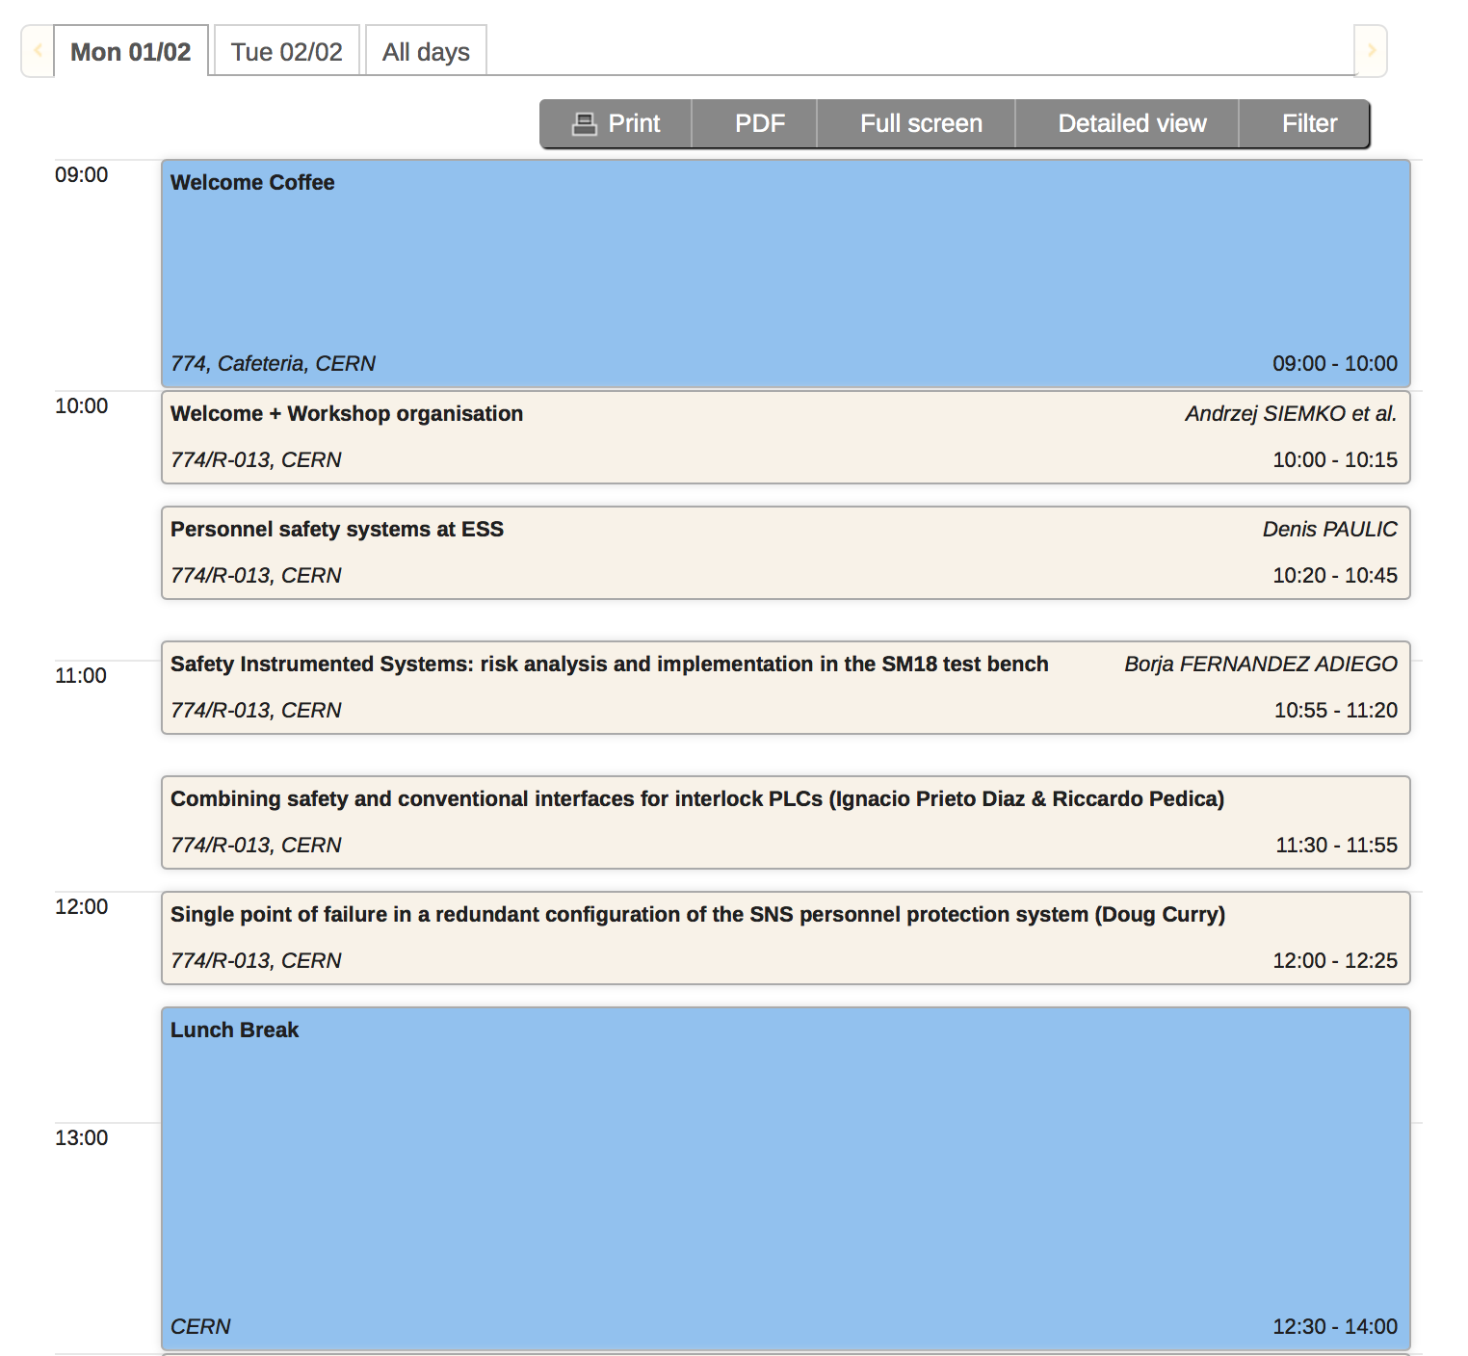
3rd PLC/COTS based Interlock and Protection WS
Session on PLC hardware and technologies
E.Blanco (chair), J.Ortola Vidal (scientific secretary)
Lunch break: Cafeteria 774 or Restaurant 3 (building 866)

Slide 5
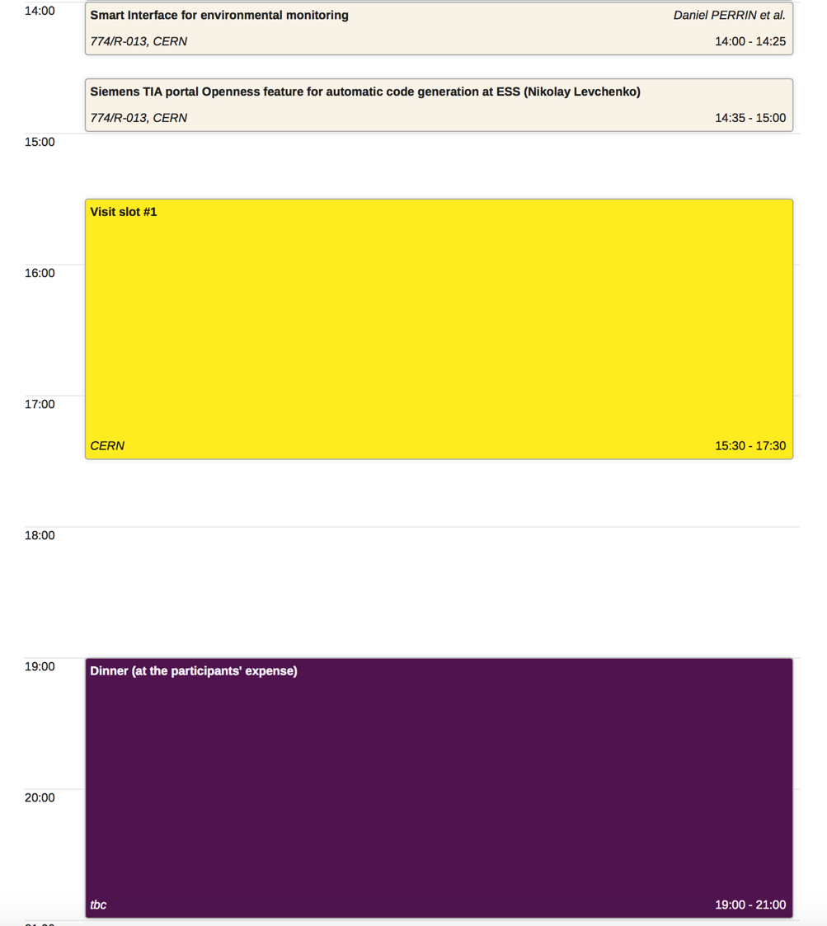
3rd PLC/COTS based Interlock and Protection WS
Session on PLC software and configuration
D.Piso (chair), N.Levchenko (scientific secretary)
Visit slot #1
17:30 Bus transport from B774 to Reception
19:00 Workshop Dinner @ Cafe d’Aviation

Slide 6
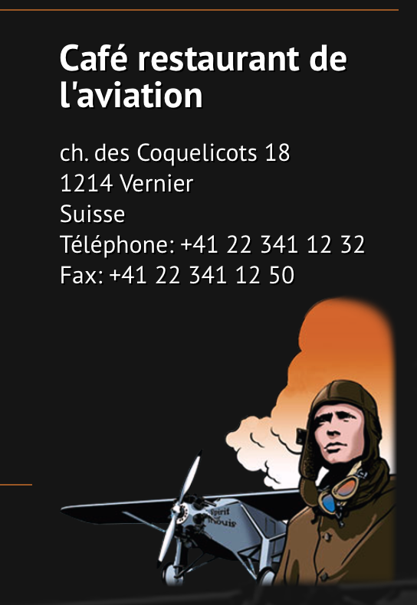
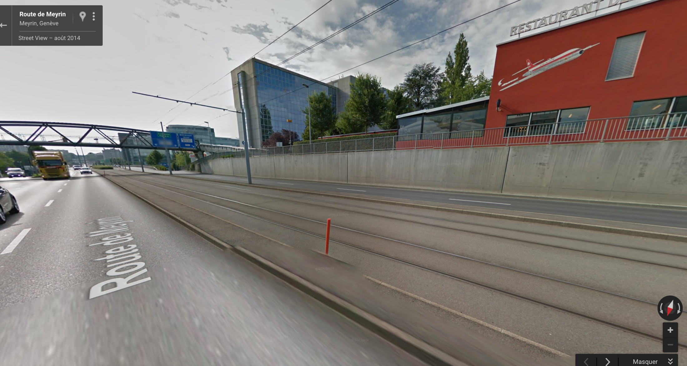
Workshop Dinner
On tram line 18 from CERN in direction Geneva – meet at 18:45 at CERN tramstop
Stop ‘Blandonnet’ (9min from CERN)
Restaurant
Tram Stop Blandonnet

Slide 7
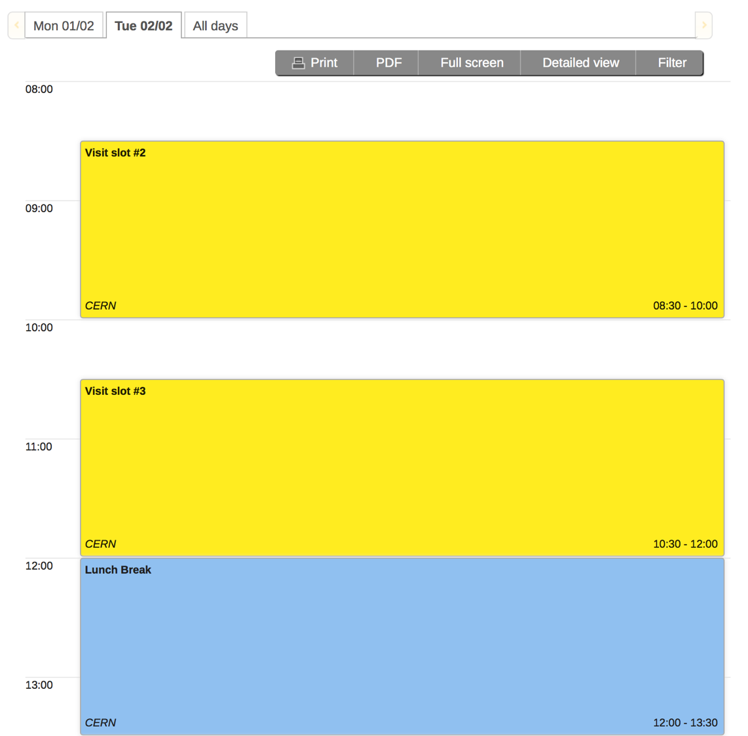
3rd PLC/COTS based Interlock and Protection WS
Meeting point 08:30 @ reception
Transport to visits
Visit slot #2
Visit slot #3
Lunch in R1 or R2 on Meyrin site
13:13 Bus transport from Reception
to B774

Slide 8
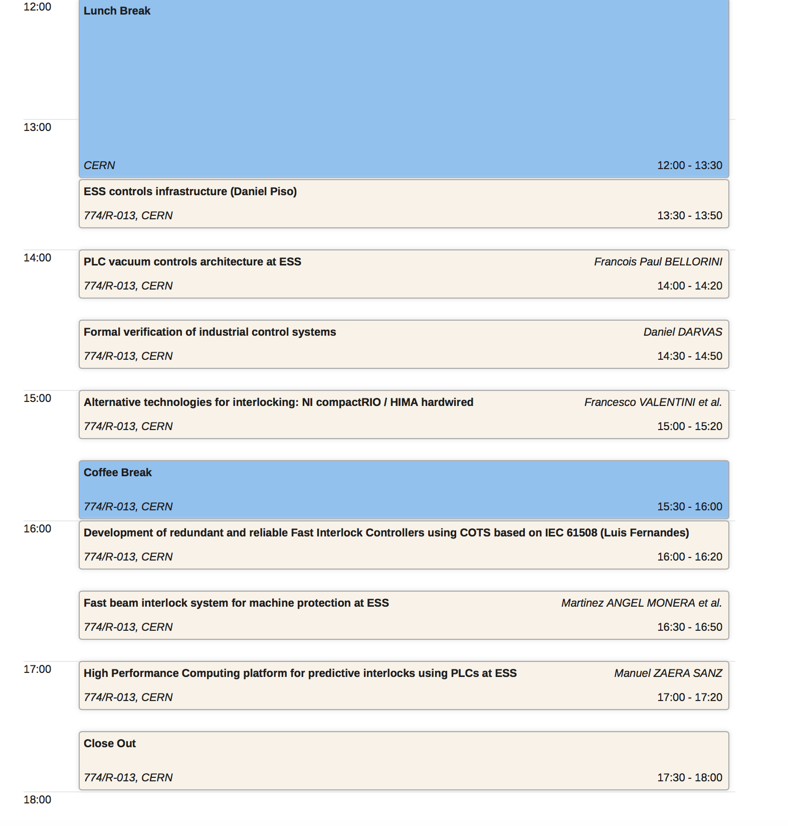
3rd PLC/COTS based Interlock and Protection WS
Session on PLC software and configuration
D.Piso (chair), N.Levchenko (scientific secretary)
Session on alternative dependable hardware for protection
L.Fernandez (chair), I.Prieto Diaz (scientific secretary)
18:00 Bus transport from B774 to Reception

Slide 9
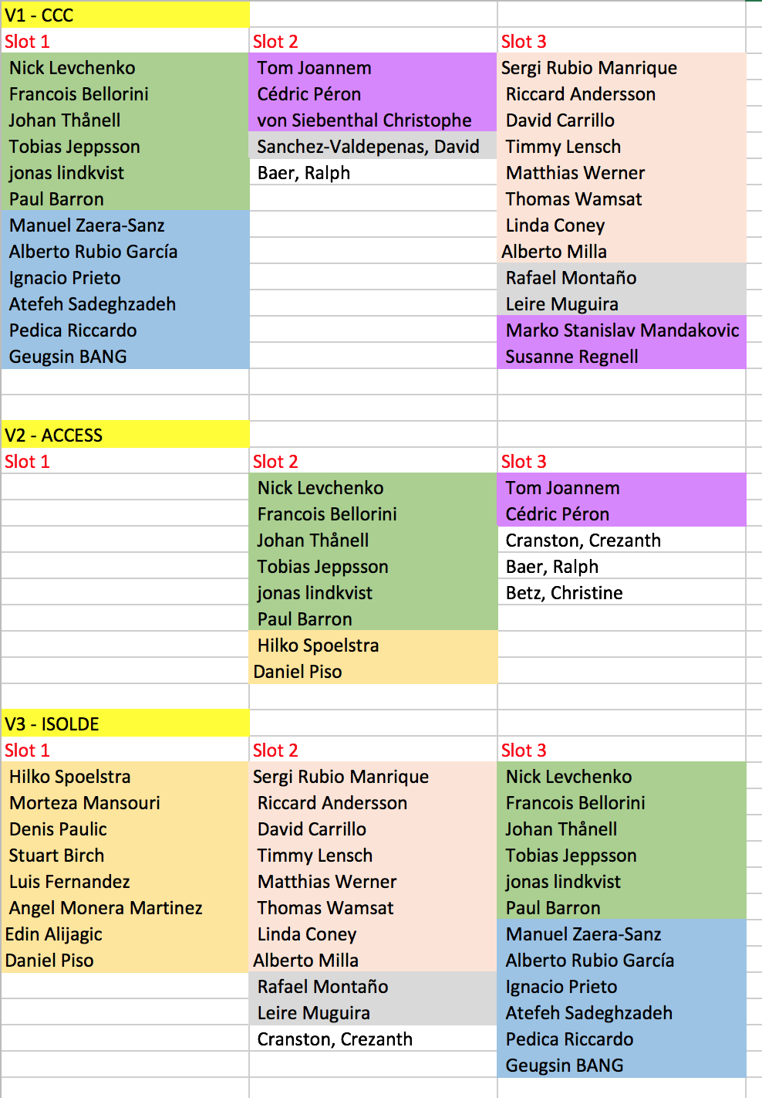
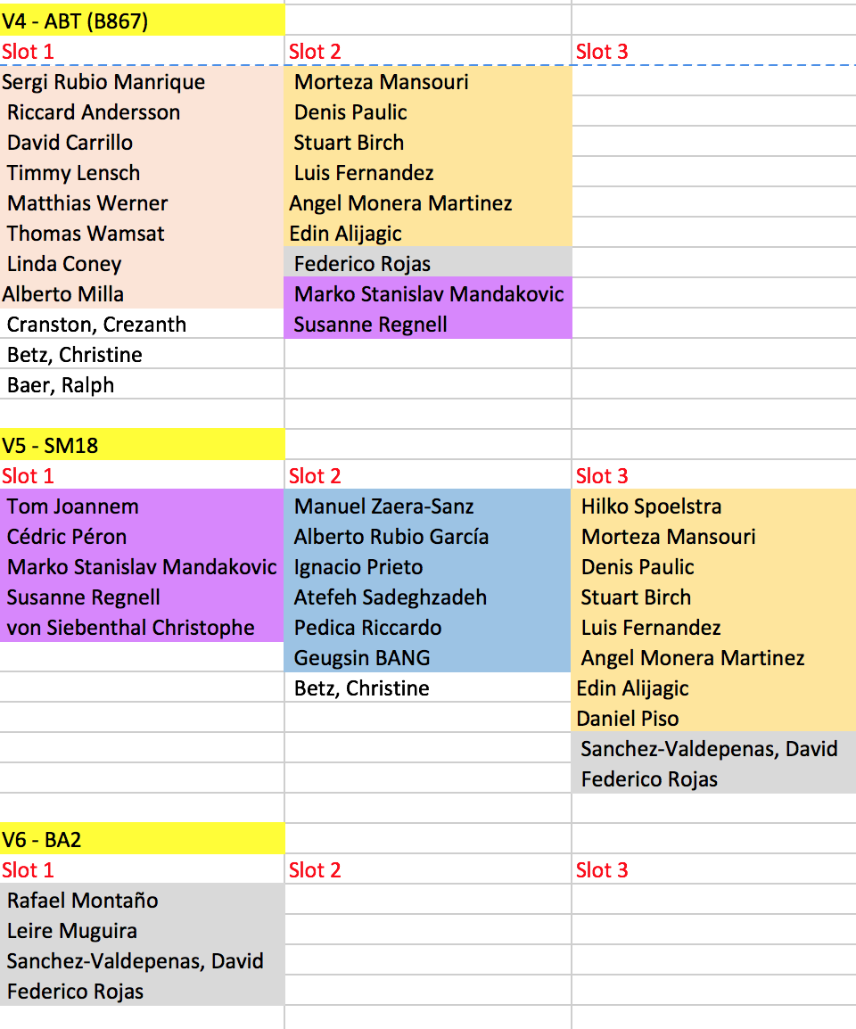
Visits

Slide 10
Practical Info
Workshop site: https://indico.cern.ch/event/461080/
Internet: Connect to CERN network, open browser, register as guest (Markus Zerlauth as warrant)
Videoconference: https://indico.cern.ch/event/461080/videoconference/
Emergency numbers:
  M.Zerlauth: +41 75 411 5012 (165012 from CERN phone)
  S.Sapountzi: +41 75 411 4690(164690 from CERN phone)

