Slide 1

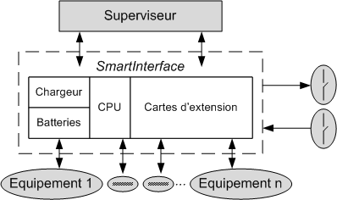
SMART INTERFACE
A Modular Monitoring Station

Slide 2


Background
2011: The need of a new Modular Monitoring Station was expressed
within the CERN HSE Unit
New
Modular
And
Reliable
Smart!
Station
Ok
Need

Slide 3

Background
2013: The SMART Interface was designed at CERN to have the
full control of the system
Reliable
Ethernet
Network
Measuring
Equipment
Online diagnostics
Modular
Checking communication
SCADA
SMART
Easy to install
5 days data backup

Slide 4
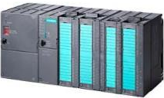

Objectives
SMART Interface
Supervision System
Measuring Equipment
Inputs Processing
Transmit Data
Data Storage
Restoring Data
Setting Parameters
Reading Parameters
Digital / Analog / Pulses Signals

Slide 5
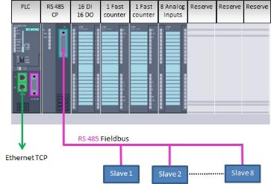

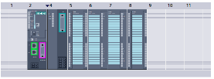
Hardware Design
SIEMENS S7-300 PLC
Electrical Cabinet
Goulotte
Goulotte
24VDC
Power Supply
Battery
Charger
Battery
Ready to use up to:
8 Digital Input channels
2 Fast Counting Input channels
8 Analog Input channels
8 RS485 channels
4 Digital Dynamics Outputs
Terminal Block for Detectors Connection

Slide 6
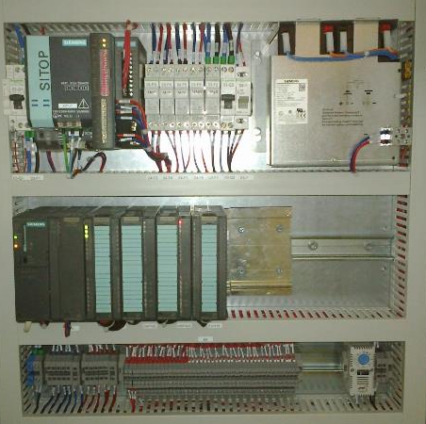
Hardware Design
Power Supply &
Battery Charger
Circuit Breakers
Battery
PLC RACK &
I/O Cards
Detectors Connections

Slide 7
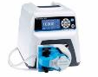
Software Design
Design of a Degraded mode to increase the Buffer time

Slide 8



Software Design
Refresh RT Data: 1 Sampling time / Channel
Data Storage: 2 Buffering times / Channel
(1 for Measurement mode & 1 for Degraded mode)
Adjustable Sampling & Buffering time range of 0.1 second to 24 days

Slide 9
Software Design
Digital Channels
Fast Counting Channels
Analog & RS485 Channels
Events

Slide 10
Dynamics Digital Outputs
DYNAMIC OUTPUT PARAMETERS
Name | Data Type | Comment
Flag_DI | ARRAY [1..8] of BOOL | 8 Digital Channels with 1 Alarm/Channel #1 Alarm taken into account in the equation
Flag_FC | ARRAY [1..2, 1..4] of BOOL | 2 Fast Counting Channels with 4 Alarms/Channel #1 Alarm taken into account in the equation
Flag_AI | ARRAY [1..8, 1..4] of BOOL | 8 Analog Channels with 4 Alarms/Channel #1 Alarm taken into account in the equation
Flag_RI | ARRAY [1..8, 1..4] of BOOL | 8 Remote Channels with 4 Alarms/Channel #1 Alarm taken into account in the equation
Logic_operator_1 | BOOL | #0 AND, #1 OR
Logic_operator_2 | BOOL | #0 AND, #1 OR
Timestamp | DATE_AND_TIME | Timestamp of the last configuration change
Output Equation:
(Flag_DI[1] AND DI_Channel[1].Alarm_status OR Flag_DI[2] AND DI_Channel[2].Alarm_status OR…OR Flag_DI[16] AND DI_Channel[16].Alarm_status)
[AND / OR] (Logic_operator_1)
(Flag_FC[1,1] AND FC_Channel[1].Alarm_status[1] OR Flag_ FC[1,2] AND FC _Channel[1].Alarm_status[2] OR…OR Flag_ FC[2,4] AND FC_Channel[2].Alarm_status[4]
[AND / OR] (Logic_operator_2)
Flag_AI[1,1] AND AI_Channel[1].Alarm_status[1] OR Flag_AI[1,2] AND AI_Channel[2].Alarm_status[2] OR...OR Flag_AI[8,4] AND AI_Channel[8].Alarm_status[4])

Slide 11
Dynamics Digital Outputs
2 Dimensions Arrays: Simple Code
// Code
FOR INDEX_1:= 1 TO 8 BY 1 DO
IF DI_ALARM[INDEX_1] AND FLAG_DI[INDEX_1] = TRUE THEN // Digital Channel Alarm Synthesis
SYNTHESE_DI_ALARM:= TRUE;
END_IF;
END_FOR;
FOR INDEX_1:= 1 TO 2 BY 1 DO
FOR INDEX_2:= 1 TO 4 BY 1 DO
IF FC_ALARM[INDEX_1, INDEX_2] AND FLAG_FC[INDEX_1, INDEX_2] = TRUE THEN // Fast Counting Channel Alarm Synthesis
SYNTHESE_FC_ALARM:= TRUE;
END_IF;
END_FOR;
END_FOR;
FOR INDEX_1:= 1 TO 16 BY 1 DO
FOR INDEX_2:= 1 TO 4 BY 1 DO
IF AI_ALARM[INDEX_1, INDEX_2] AND FLAG_AI[INDEX_1, INDEX_2] = TRUE THEN // Analog Channel Alarm Synthesis
SYNTHESE_AI_ALARM:= TRUE;
END_IF;
END_FOR;
END_FOR;
IF LOGIC_OPERATOR = FALSE THEN
IF OPERATOR_2 = FALSE THEN
OUT_DO_STATUS:= SYNTHESE_DI_ALARM AND (SYNTHESE_FC_ALARM AND SYNTHESE_AI_ALARM); //Output Calculation with 2 logic operators
ELSE DO_STATUS:= (SYNTHESE_DI_ALARM AND SYNTHESE_FC_ALARM OR SYNTHESE_AI_ALARM);
END_IF;
ELSIF OPERATOR_2 = FALSE THEN
DO_STATUS:= (SYNTHESE_DI_ALARM OR SYNTHESE_FC_ALARM AND SYNTHESE_AI_ALARM);
ELSE OUT_DO_STATUS:= SYNTHESE_DI_ALARM OR SYNTHESE_FC_ALARM OR SYNTHESE_AI_ALARM;
END_IF;

Slide 12
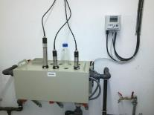

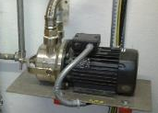
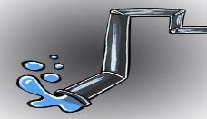

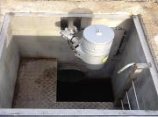
Application example
Conventional Measurement
Pumping System
Radiological sampling
Control Command
Specific Part
Hydrocarbon detector

Slide 13
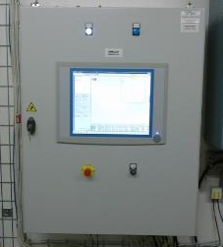
Application example
WATER MONITORING STATION
Hydrocarbon detector
Ethernet
Link
SMART INTERFACE
Conventional Measurement
Pumping System
Radiological sampling

Slide 14
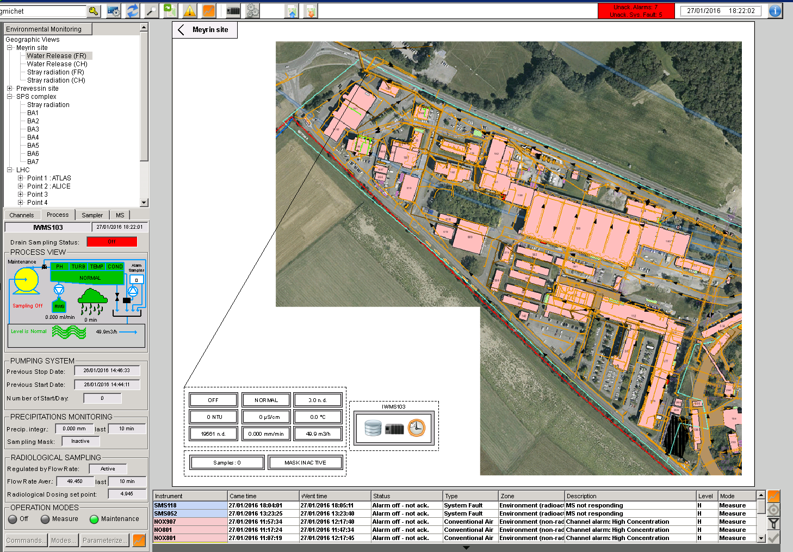
SCADA View

Slide 15
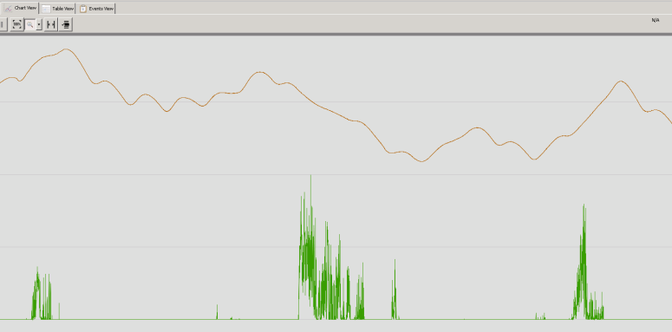
Data View
Water Temperature
Rain Gauge
0
30 days

Slide 16
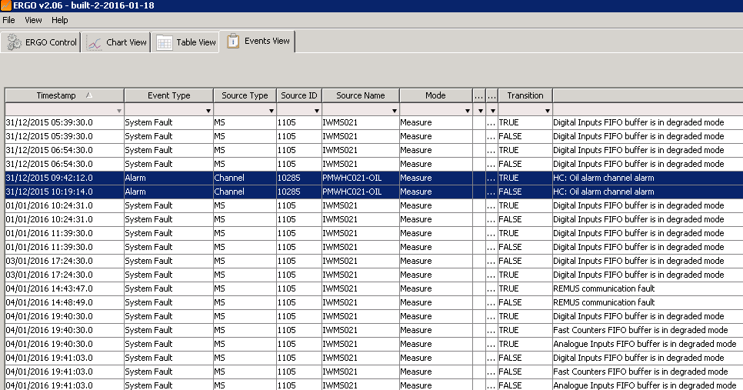
Event View

Slide 17



Installation
Manufacturing Cost:
10 K€ max.
Installation Needs:
SCADA based on the Interface Control Document

Slide 18
Thank you for your attention
Any Questions?

