Slide 1
Wainer Lusoli
European Commission
DG Research & Innovation
Open day event: towards the European Open Science Cloud
EMBL, Heidelberg, 20 January 2016

Slide 2
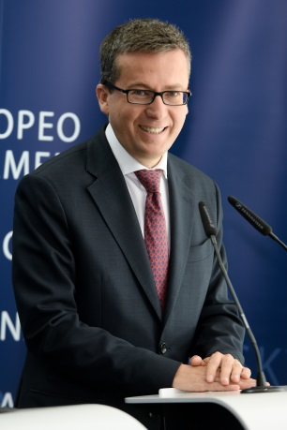
Commissioner view
"There is a revolution happening in the way science works. Every part of the scientific method is nowadays becoming an open, collaborative and participative process”
Speech at "A new start for Europe" Conference, 22 of July, 2015, Brussels

Slide 3
Priorities of Commissioner Moedas
  Open Innovation
  Open Science
  Open to the world

Slide 4

European Open Science Cloud

Slide 5
European Open Science Cloud: history...
DSM strategy (6 May 2015) includes a commitment to launch in 2016 a European cloud initiative, including a ‘research open science cloud’.
Commissioner Moedas announced the ‘European Open Science Cloud’ initiative at the Competitiveness Council (29 May), which was well received by Member States.
On the same date, the Council supported the initiative in its ‘Big Data' Conclusions and at the Policy Debate on Open Science.
The initiative is now one of the Commissioner priority actions for 2016 under 'Open Science'.

Slide 6
Extensive stakeholder consultation tell us so!
Public consultation and validation workshops on Open Science (July-December 2014)
Final report (February 2015)
HELG EOSC stakeholder workshop (November 2015)
DSM Consultation (closed January 2016)
Research funders' workshop (March 2016)
+ PC meetings, EAG meetings, e-IRG meetings, concertation meetings, info days, conferences, events, ...

Slide 7
Competitiveness Council Conclusions, 29 May 2015
Strong support for the development of a European Open Science Cloud, e.g.
  CALLS for action to remove obstacles to wide access to publicly funded research publications and underlying data.
  WELCOMES the further development of a European Open Science Cloud that will enable sharing and re-use of research data across disciplines and borders, taking into account relevant legal, security and privacy aspects.

Slide 8
Report of the European Parliament 'Towards and Digital Single Market Act' (voted yesterday...)
124. Is concerned that cloud infrastructures for researchers and universities are fragmented; calls on the Commission, in cooperation with all relevant stakeholders, to set up an action plan to lead to the establishment of the European Open Science Cloud by the end of 2016, which should seamlessly integrate existing networks, data and high-performance computing systems and e-infrastructure services across scientific fields, within a framework of shared policies, standards and investments;

Slide 9
European Cloud Initiative
Part of DSM strategy - DG RTD and CNECT (and CABs) working jointly on a COM: 'European Cloud Initiative'.
Strong political support: Juncker, Ansip, Merkel, LUX Presidency, NL Presidency, EP ITRE/IMCO Report on DSM Act.
3 Parts
  European Open Science Cloud.
  European Digital Infrastructure.
  Widening the user base (e-gov & industry) and building trust (certification and standards).

Slide 10
European Open Science Cloud
A trusted, open environment for storing, sharing and re-using scientific data and results and supporting Open Science practices
A virtual environment for all European researchers to store, manage, analysis and re-use data.
Strongly stated needs: cost-effective, user-driven, privacy and IPR-conscious.
Bringing together existing and emerging data infrastructures.
Added value: scale, data-driven science, inter-disciplinarity, data to knowledge to innovation.

Slide 11
European Open Science Cloud: What?
The cloud will federate existing and emerging horizontal and thematic data infrastructures, effectively bridging todays fragmentation and ad-hoc solutions.
It will provide all EU researchers an environment with free, open services for data storage, management, analysis and re-use across disciplines.
It will add value (scale, data-driven science, inter-disciplinarity, data to knowledge to innovation) and leverage current and past infrastructure investment (10b per year by MS, two decades EU investment).
Governance is a key issue

Slide 12
Key requirements
Cloud-based services for Open Science, enabling researchers to openly share and analyse research data across technologies, disciplines and countries.
Governance platform for policy development on infrastructure and services, mechanisms for global data stewardship, decision making on funding and long-term sustainability.

Slide 13
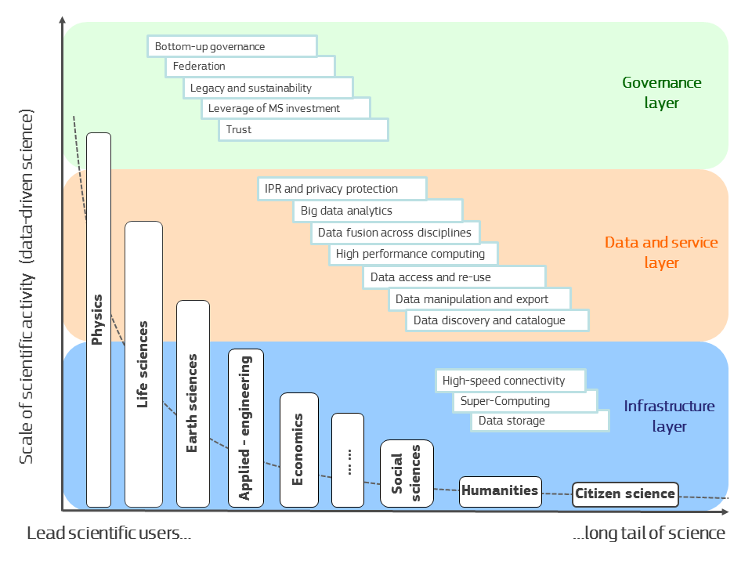

Slide 14
Where do main challenges lie?
Still a lack of widespread awareness of the value of data and of incentives for data sharing.
Lack of common standards to ensure inter-operability of data.
Not enough hardware capacity for a particular technical enabler.
Fragmentation and lack of coordination over different scientific communities and countries.
Need to translate recent changes in privacy, data protection and copyright rules to the research data domain.

Slide 15
European Open Science Cloud: next steps.
RIA calls for a "European Open Science Cloud" (€10 M) and "Data and Distributed Computing e-infrastructures for Open Science" (€40 M).
High Level Expert Group activities – workshops, report, advice.
2016 will be busy:
  Action plan on 'standards' for research data;
  Roadmap on EOSC governance;
  Harnessing H2020 and FP9 rules;
  Council , Dutch presidency and RWP;
  EP ITRE/IMCO;
  Continuous, extensive stakeholder engagement.

Slide 16
INFRADEV-04-2016
Why a cloud topic under the RI part of the WP?
    To ensure the broadest possible approach at the design stage – both for governance and for services;
    to ensure that the needs of all scientific communities are taken into account;
    to engage the scientific communities in this initiative and its governance;
    to build on the existing solutions deployed by advanced science communities.

Slide 17
INFRADEV-04-2016
European Open Science Cloud for Research
  Pilot action to demonstrate how wide availability of scientific data and data-analysis services for European researchers can be ensured through a cloud infrastructure.
  Total budget 10 M€ -- EU contrib. per proposal (RIA) between 5 and 10 M€
  Interrelated to EINFRA-12-2017
  Proposals will:
    Address the federation, networking and coordination of existing research infrastructures and scientific clouds to increase findability, accessibility and interoperability of data, and facilitate re-use of data.
    Design a stakeholder driven governance framework.
    Build on existing e-infrastructures and thematic data infrastructures.

Slide 18
Nov '15 | Stakeholder workshop (e-infrastructures and scientific data infrastructures).
Feb '16 | High Level Expert Group final report on governance, funding and services of the cloud initiative.
March '16 | European Cloud Initiative, including EOSC.
March '16 | INFRADEV-04-2016 call on data federation, governance and services of the future cloud initiative (€10 M).
April '16 | Conference under Dutch Presidency on Open Science and the European Open Science Cloud (announcement).
Sept '16 | Open Science Policy Platform report on cloud initiative implementation, including WP 2018-19.
Winter '16 | Engagement with the European Parliament and with the Council concerning implementation of the initiative.
Dec '16 | EINFRA-12-2017 implementation of data preservation, access and interoperability of scientific data (€40 M).
Sept '17 | Initial results from INFRADEV-04-2016.
March '18 | Initial results from EINFRA-12-2017.

