Slide 1


An introduction to Magnets for Accelerators
Attilio Milanese
John Adams Institute
Accelerator Course
20 – 21 Jan. 2016

Slide 2
This is an introduction to magnets as building blocks of a synchrotron / transfer line
//
// MADX Example 2: FODO cell with dipoles
// Author: V. Ziemann, Uppsala University
// Date: 060911
TITLE,'Example 2: FODO2.MADX';
BEAM, PARTICLE=ELECTRON,PC=3.0;
DEGREE:=PI/180.0; // for readability
QF: QUADRUPOLE,L=0.5,K1=0.2; // still half-length
QD: QUADRUPOLE,L=1.0,K1=-0.2; // changed to full length
B: SBEND,L=1.0,ANGLE=15.0*DEGREE; // added dipole
FODO: SEQUENCE,REFER=ENTRY,L=12.0;
QF1: QF, AT=0.0;
B1: B, AT=2.5;
QD1: QD, AT=5.5;
B2: B, AT=8.5;
QF2: QF, AT=11.5;
ENDSEQUENCE;
Notes:
This introduction is a first description of magnets commonly found in synchrotron and transfer lines, so to give a physical / technological meaning to the magnetic elements that populate lattice codes.
Taking for example that FODO sequence in MAD-X:
* what is the field in the dipole? (is it reasonable?)
* what is the difference between an SBEND and an RBEND?
* is the quadrupole length the actual physical length? from where to where?
* could we use a higher k₁ (normal quadrupole coefficient) / shorter length?

Slide 3
These are a few choices for further reading
N. Marks, Magnets for Accelerators, J.A.I. Jan. 2015
D. Tommasini, Practical Definitions & Formulae for Normal Conducting Magnets, Sept. 2011
Lectures about magnets in CERN Accelerator Schools
Special CAS edition on magnets, Bruges, Jun. 2009
Superconducting magnets for particle accelerators in U.S. Particle Accelerator Schools
J. Tanabe, Iron Dominated Electromagnets
P. Campbell, Permanent Magnet Materials and their Application
K.-H. Mess, P. Schmüser, S. Wolff, Superconducting Accelerator Magnets
M. N. Wilson, Superconducting Magnets
Notes:
Below the web links (Jan. 2016) or ISBN for these references:
http://indico.cern.ch/event/357378/session/2/#all
https://edms.cern.ch/document/1162401/3
http://cas.web.cern.ch/cas/CAS%20Welcome/Previous%20Schools.htm
http://cdsweb.cern.ch/record/1158462/files/cern2010-004.pdf
for example, http://etodesco.web.cern.ch/etodesco/uspas/uspas.html
ISBN 9789812563811
ISBN 9780521566889
ISBN 9789810227906
ISBN 978-0198548102
A heartfelt thank you to the many colleagues which guided (are guiding) me in this land… in particular to the ones from which I borrowed much of the material for this short course.

Slide 4
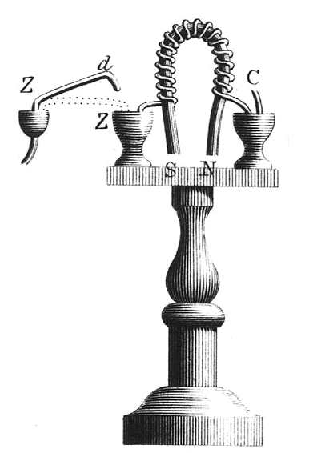
According to history, the first electromagnet (not for accelerators!) was built in England in 1824 by William Sturgeon
Notes:
sources:
Wikipedia
http://physics.kenyon.edu/EarlyApparatus/Electricity/Electromagnet/Electromagnet.html
In 1820 Hans Christian Oersted discovered that a current-carrying wire set up a magnetic field.
In the same year, André-Marie Ampère discovered that a helix of wire acted like a permanent magnet, and Dominique François Jean Arago found that an iron or steel bar could be magnetized by putting it inside the helix of current-carrying wire.
In 1824 William Sturgeon found that leaving the iron inside the coil greatly increased the resulting magnetic field. Sturgeon also bent the iron core into a U-shape to bring the poles closer together, thus concentrating the magnetic field lines. The electromagnet was made of 18 turns of bare copper wire (insulated wire had not yet been invented), with mercury cups acting as switches. He displayed its power by lifting nine pounds (4.1 kg) with a seven ounce (200 g) piece of iron wrapped with wire through which a current from a single battery was sent.

Slide 5
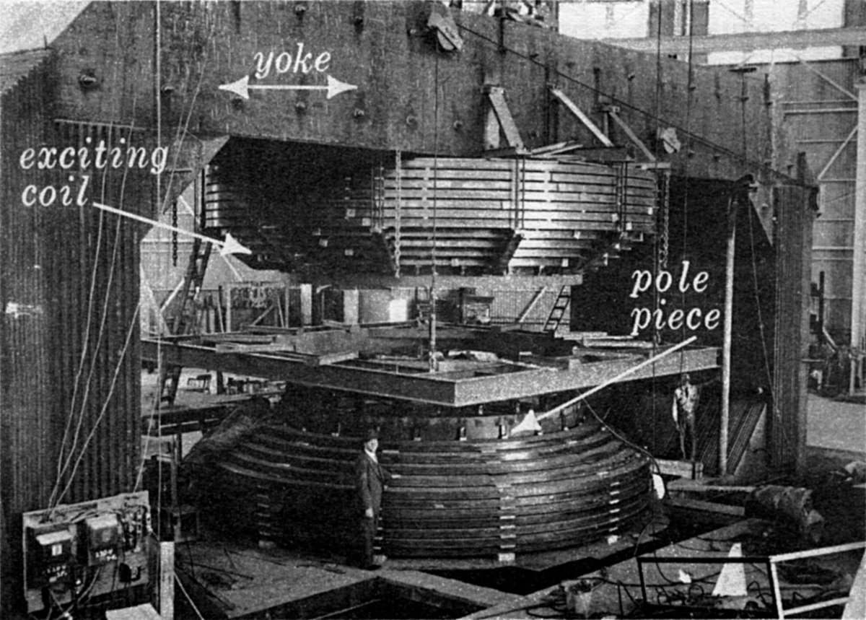
The working principle is the same as this large magnet, of the 184’’ (4.7 m) cyclotron at Berkeley (picture taken in 1942)
Notes:
This cyclotron magnet was built with 4000 tons of iron and 300 tons of copper. It provided a maximum field of 2.34 T, for a dissipated power of 2.5 MW.
We will not look into this kind of accelerator magnets, sticking to the ones found in synchrotron and related transfer lines.

Slide 6
This short course is organized in several blocks
Introduction
Jargon and mathematical concepts
Thought experiment
Basics for the design of resistive magnets
A glimpse on the design of superconducting magnets
Guided magnetic design (with 2D FEM simulations)

Slide 7
- 1 -
Introduction

Slide 8
There are several types of magnets found in synchrotrons (and transfer lines) – based on what they do to the beam
dipole
solenoid
quadrupole
combined function bending
sextupole
corrector
octupole
skew magnet
kicker
undulator / wiggler
Notes:
In brief:
* dipoles bend the beam
* quadrupoles focus the beam
These are usually considered the main magnets in synchrotrons and transfer lines and we will mainly focus on them.
Combined function bending magnets are a superposition of a dipole and a quadrupole, thus they bend and focus the beam at the same time. They are less popular now with respect to the early days of synchrotrons; still, they can be found in new light sources.

Slide 9
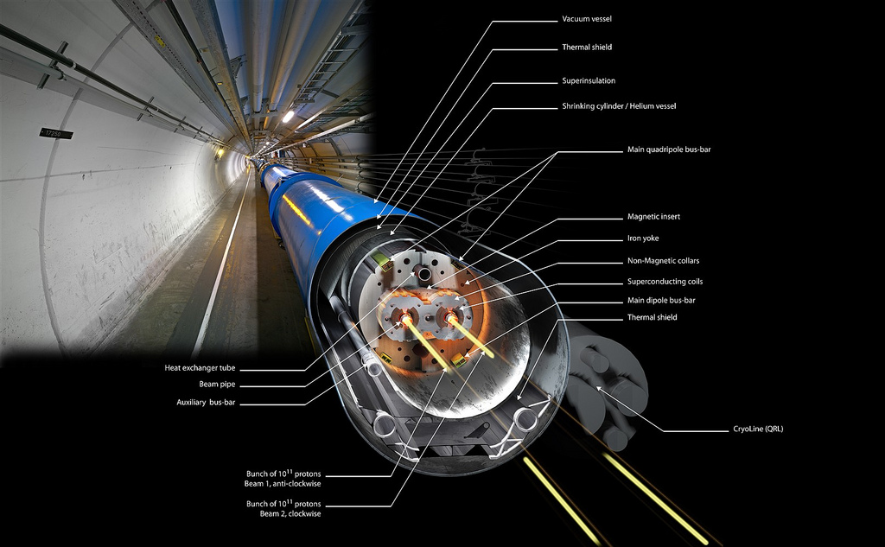
This is a main dipole of the LHC at CERN: 8.3 T × 14.3 m
Notes:
The LHC main dipoles (MB = Main Bending) are superconducting magnets.
The coils are wound in Nb-Ti and they are cooled by superfluid helium at 1.9 K.
At the nominal current of 11.8 kA, they provide a dipole field of 8.3 T in a 56 mm diameter circular aperture.
Each dipole bends the beam by 360 / 1232 = 0.29 deg.
They are slowly ramped and then used in dc mode, with the LHC operated as a collider.
These magnets are the fruit of many years of R&D and they can be considered the state of the art of what can be achieved with Nb-Ti superconducting technology.

Slide 10
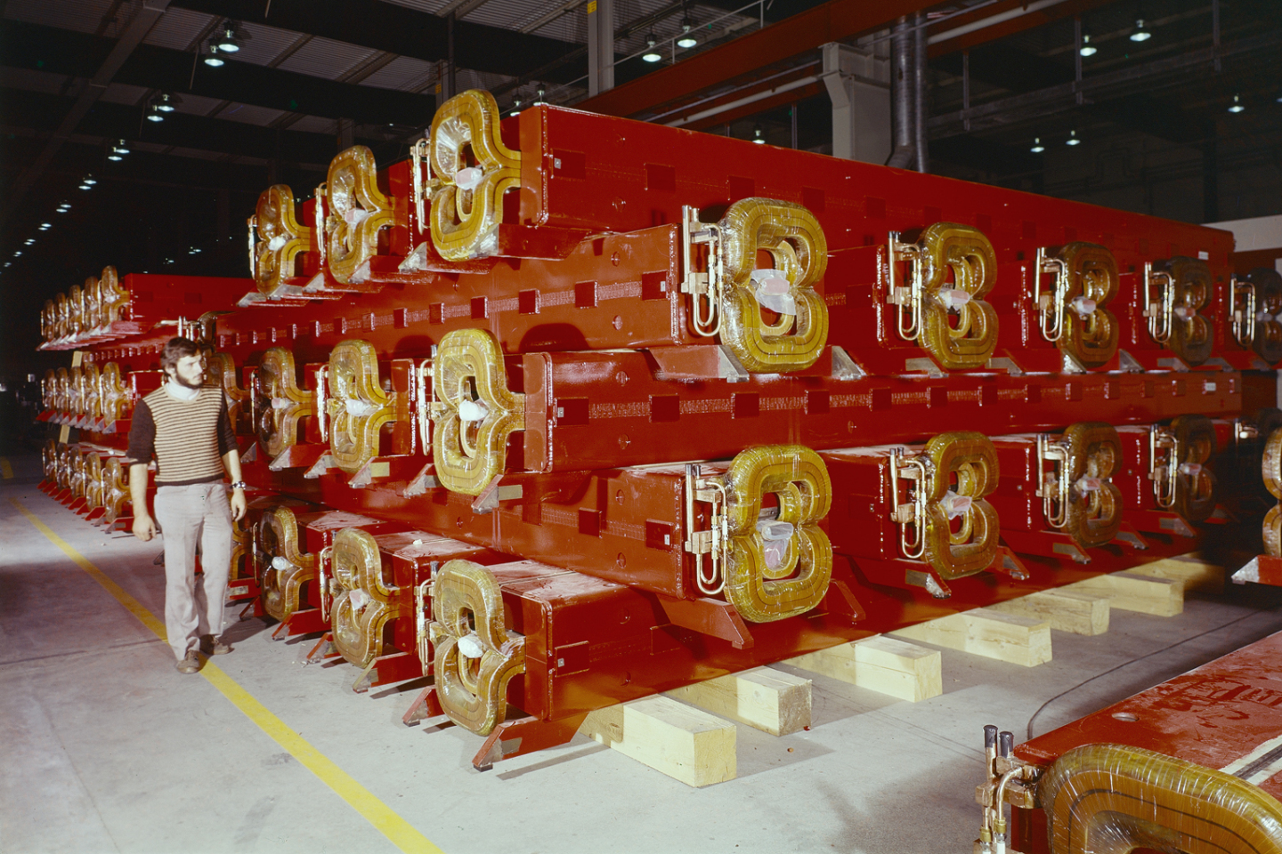
These are main dipoles of the SPS at CERN: 2.0 T × 6.3 m
Notes:
The SPS main dipoles are resistive magnets, with coils in Cu. Demineralized water flows in the conductor to remove the Joule heating.
At the peak current of 5.8 kA, they provide a dipole field of 2.0 T in a rectangular aperture.
Two types of magnets with a larger (52 mm) and smaller (36 mm) vertical aperture are used.
Each dipole bends the beam by 360 / 744 = 0.48 deg.
They now work in a cycled mode and they can be ramped in a few seconds.
In the 70s, also a superconducting option was studied for the SPS, then abandoned.
The main SPS converters are designed for a peak (active) power of 144 MW, which is drawn directly from the 400 kV line. The average (rms) power depends on the duty cycle, though it is usually a factor of 2 less.
The photo was taken in 1974.

Slide 11
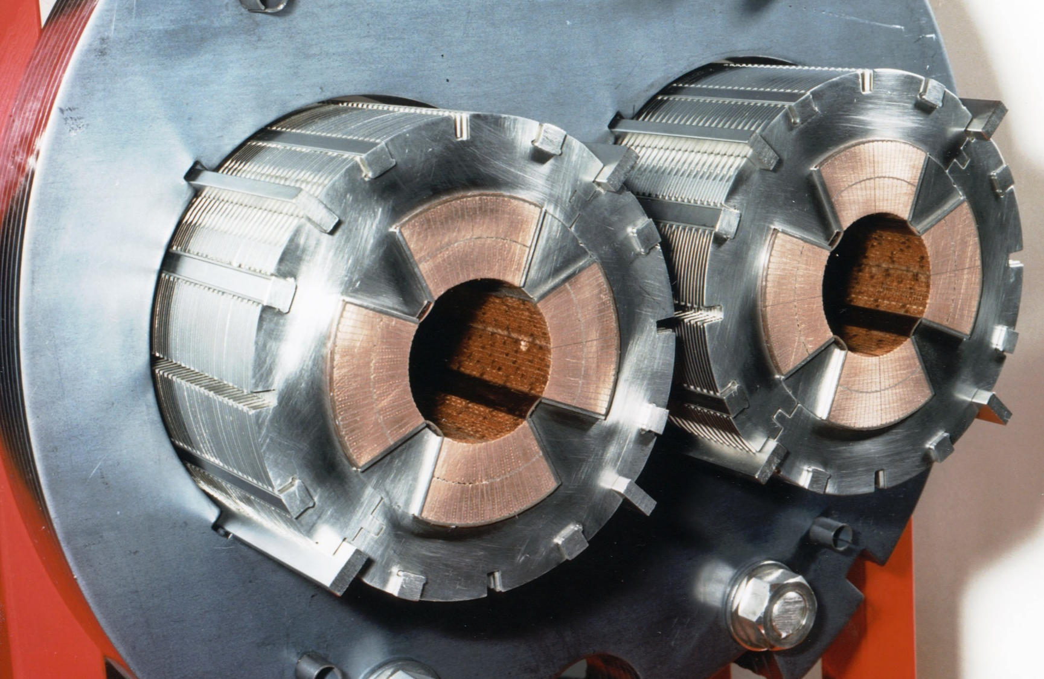
This is a cross section of a main quadrupole of the LHC at CERN: 223 T/m × 3.2 m
Notes:
The LHC main quadrupoles (MQ) are superconducting magnets.
The coils are wound in Nb-Ti and they are cooled by superfluid helium at 1.9 K, like the LHC dipoles.
At the nominal current of 11.8 kA, they provide a gradient of 223 T/m. Considering their aperture of 56 mm diameter, this corresponds to a pole tip field of 6.2 T ( = 223 × 0.028). The peak field in the conductor is 6.8 T.

Slide 12
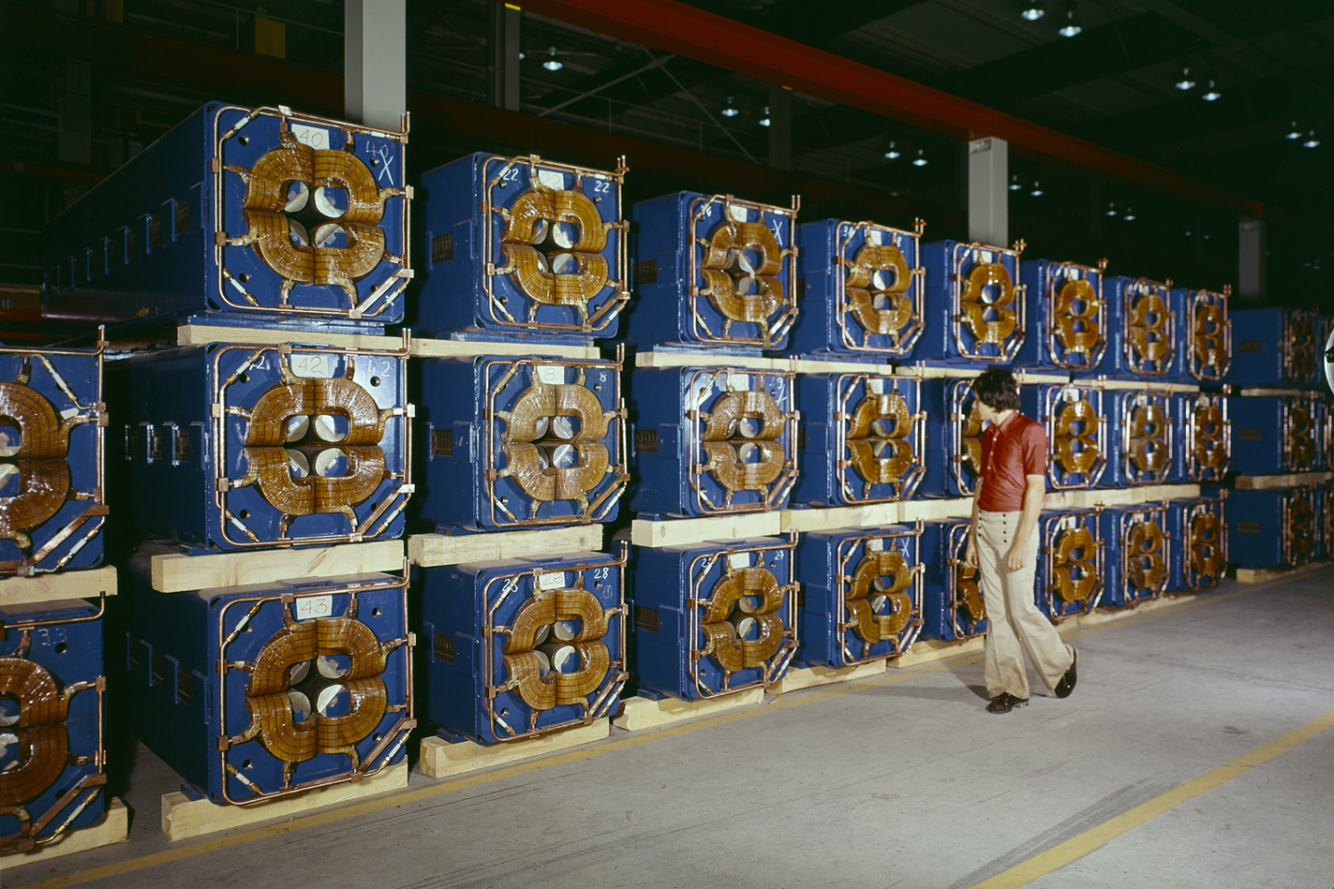
These are main quadrupoles of the SPS at CERN: 22 T/m × 3.2 m
Notes:
The SPS main quadrupoles are resistive magnets, with coils in Cu.
Demineralized water flows in the conductor to remove the Joule heating, as for the SPS dipoles.
At the peak current of 2.1 kA, they provide a quadrupole gradient field of 22 T/m in a 88 mm diameter circular aperture. This corresponds to a pole tip field of 1.0 T ( = 22 × 0.044).

Slide 13
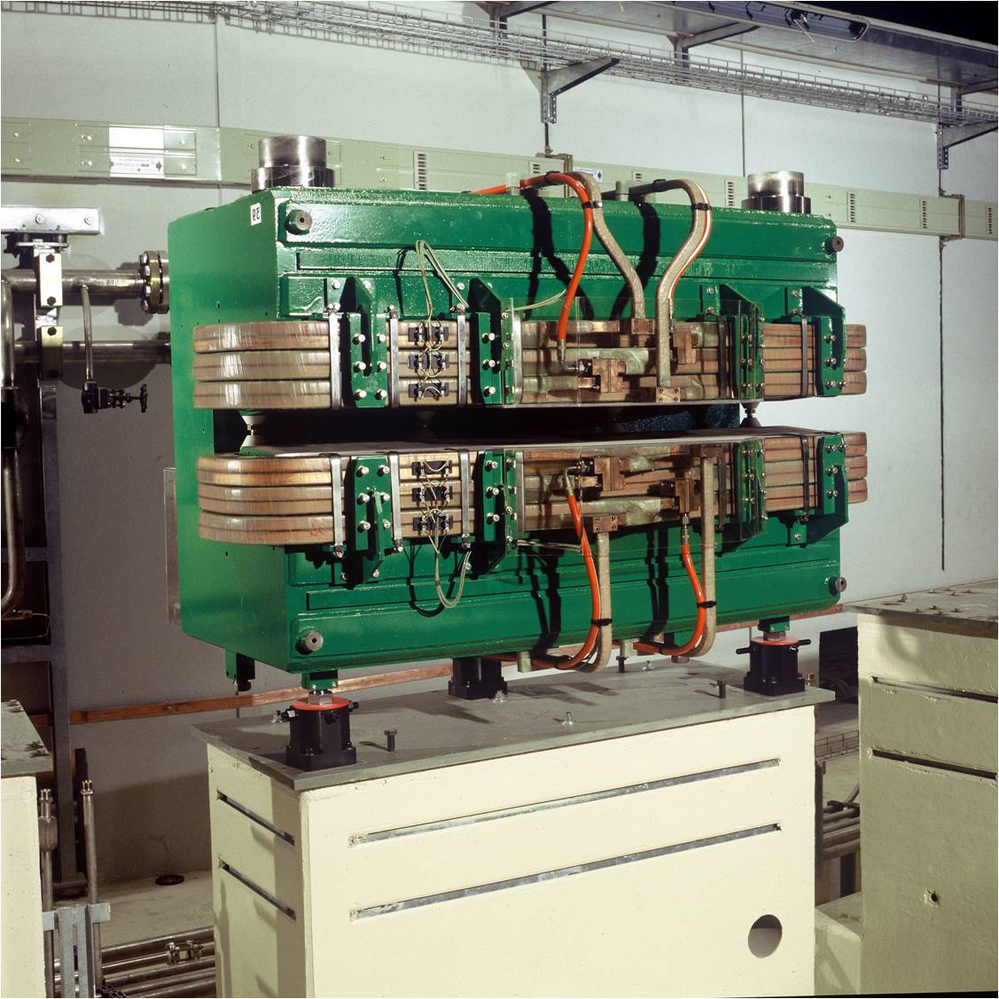
This is a combined function bending magnet of the ELETTRA light source
Notes:
This is an example of a combined function (dipole + quadrupole) bending magnet that can be found in third generation synchrotron light sources. The technology is the same as for the SPS dipoles, with a different design of the ferromagnetic yoke.
For the ELETTRA machine, there are 24 such magnets. At the nominal current of 1420 A, they deliver a dipole field of 1.2 T and a quadrupole gradient of 2.9 T/m in a vertical gap of 70 mm. The bending radius of the machine is 5.5 m.

Slide 14
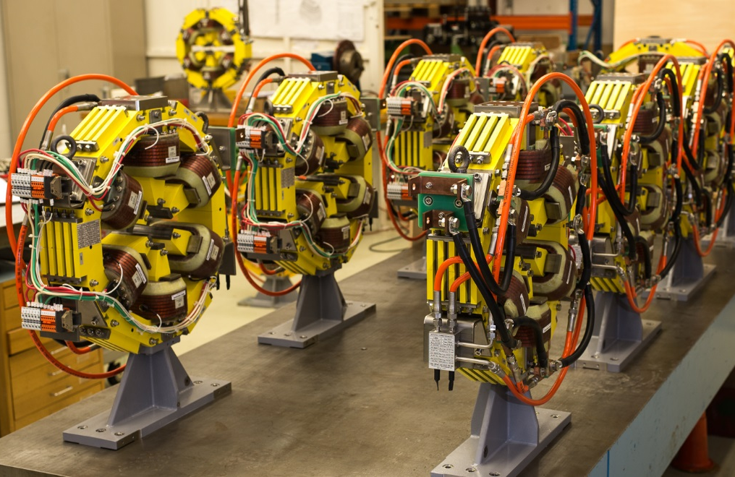
These are sextupoles (with embedded correctors) of the main ring of the SESAME light source
Notes:
This is an example of a common design found in synchrotron light sources, where the (short) sextupoles have additional windings so that they can be used as corrector magnets. In this case, the correctors are a horizontal / vertical dipole – providing up to 0.5 mrad kick at 2.5 GeV – and a skew quadrupole.

Slide 15
There are several types of magnets found in synchrotrons and transfer lines – based on technology
electromagnet
permanent magnet
iron dominated
coil dominated
normal conducting (resistive)
superconducting
static
cycled / ramped slow pulsed
fast pulsed
Notes:
Electromagnets are magnets where the field is produced by electrical currents going through some windings. In permanent magnets the flux is produced by hard magnetic material, such as NdFeB, SmCo₅ or Sm₂Co₁₇.
Iron dominated magnets use a yoke (usually in an iron based alloy) to guide, shape and reinforce the field; the position of the coil (or permanent magnet) is of minor importance for the strength and homogeneity of the field. Coil dominated magnets use the flux directly generated by the electric current flowing in the windings to shape the field; the position of the iron yoke (if any) is of minor importance for the strength and homogeneity of the field.
Normal conductive (or resistive) magnets have resistive coils, usually in copper or aluminum, and they are operated around room temperature. Joule heating has to be taken into consideration. Superconducting magnets have superconducting coils, with no Joule heating. The known technical superconductors need to be cooled at cryogenic temperatures to work.
The mode of operation can be static (dc, ex. main magnets in a collider or synchrotron light source), cycled / ramped / slow pulsed (ex. main magnets ramped in a synchrotron for hadronic therapy) or fast pulsed (ex. kickers).
In some cases, there might be some hybrids, e.g. an electromagnet with some permanent magnet.
We will not talk about permanent magnets and fast pulsed magnets.

Slide 16
- 2 -
Jargon and mathematical concepts

Slide 17
Nomenclature
B magnetic field T (Tesla)
B field
magnetic flux density
magnetic induction
H H field A/m (Ampere/m)
magnetic field strength
magnetic field
μ₀ permeability of vacuum 4π·10⁻⁷ H/m (Henry/m)
μ_{r} relative permeability dimensionless
μ permeability, μ = μ₀μ_{r} H/m
Notes:
The jargon used in particle accelerator magnets is somewhat different from that used in classical electromagnetism.
B is usually referred to as the magnetic field and it is measured in Teslas, or Webers/m². This is the field interacting with the beam as expressed by the Lorentz force.
H is mostly used when dealing with iron dominated magnets, in particular to compute the magnetomotive force, produced in a ferromagnetic material by the electrical current in the coils. This is measured in Amperes/m and usually referred to simply as the H field, or as the magnetic field strength, although the latter can be misleading in this context.

Slide 18
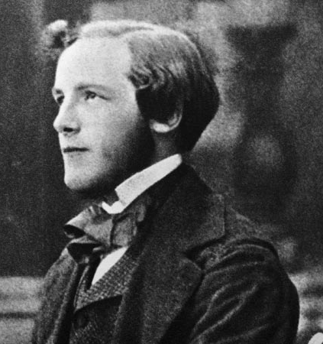

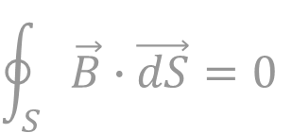
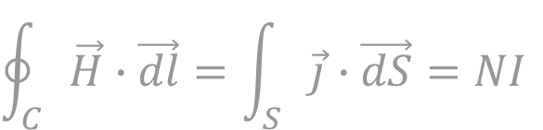


Magnetostatic fields are described by (these versions of) Maxwell’s equations, coupled with a law describing the material
$$\text{div} \vec{B}=0$$
$$\oint_{S}{\vec{B}∙\vec{dS}=0}$$
$$\text{rot} \vec{H}=\vec{J}$$
$$\oint_{C}{\vec{H}∙\vec{dl}}=\int_{S}{\vec{j}}∙\vec{dS}=NI$$
$$\vec{B}=μ_{0}μ_{r}\vec{H}$$
Notes:
(top formulae)
The B field is divergence free, or solenoidal. The total flux entering a bounded region equals the total flux exiting the same region (by Gauss theorem): there are neither sources nor wells.
(middle formulae)
The curl of the H field is generated by currents. Applying Stokes’ theorem, the integral of H around a closed loop equals the total current passing through a surface that has that loop as a boundary. This is also know as Ampere’s law.
(bottom formula)
B and H are related by the permeability μ. The relative permeability can be a function of the field level (ex. saturation) or even of the cycle leading to that H (ex. hysteresis).
All other expressions shown later (harmonic decompositions, Hopkinson’s law, Biot-Savart law) can be derived from these three equations. An exception is the Lorentz force.
The picture shows James Clerk Maxwell as a young man – he was around 30 when he first published those equations.

Slide 19


The Lorentz force is the main link between electromagnetism and mechanics
$$\vec{F}=q\left[\vec{E}+\left(\vec{v}×\vec{B}\right)\right]$$
for the beam
$$\vec{F}=I\vec{ℓ}×\vec{B}$$
for the forces on conductors
Notes:
The Lorentz force is the main link between electromagnetism and mechanics.
The force acting on a beam of charged particles uses the magnetic field because of the (huge) leverage factor of the velocity v: those particles often travel in our accelerators (almost) at the speed of light!
The bottom expression is the one used to get the force F on a conductor carrying a current I in a field B. Especially in superconducting magnets, these forces have to be properly considered at the design stage. For example, the LHC dipoles at nominal field see a horizontal force of approx. 350 tons per m length!

Slide 20

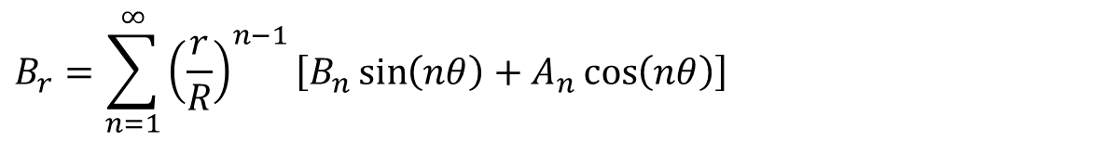



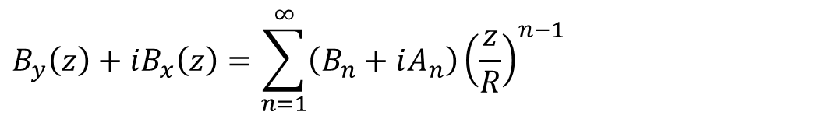


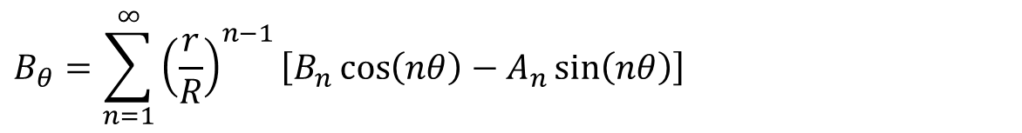

In synchrotrons / transfer lines the B field as seen from the beam is usually expressed as a series of multipoles
$$y$$
$$B_{r}=\sum_{n=1}^{∞}{{\left(\frac{r}{R}\right)}^{n−1}\left[B_{n}\sin\left(nθ\right)+A_{n}\cos\left(nθ\right)\right]}$$
$$B_{θ}$$
$$B_{r}$$
$$r$$
$$B_{θ}=\sum_{n=1}^{∞}{{\left(\frac{r}{R}\right)}^{n−1}\left[B_{n}\cos\left(nθ\right)−A_{n}\sin\left(nθ\right)\right]}$$
$$θ$$
$$x$$
$$B_{y}\left(z\right)+iB_{x}\left(z\right)=\sum_{n=1}^{∞}{\left(B_{n}+iA_{n}\right){\left(\frac{z}{R}\right)}^{n−1}}$$
$$z=x+iy=re^{iθ}$$
Notes:
This 2D decomposition holds in a region of space:
* without currents
* without hard or soft magnetic materials
* where the z component (3rd dimension, longitudinal) of B is constant
B (a 2D vector field) is then simply described by a series of coefficients: B₁, A₁, B₂, A₂, etc. These are the so-called (not-normalized) harmonics, or multipoles. They have units of Tesla. R is a reference radius.
The same decomposition can be used in 3D for integrated fields. Technically, this holds if at the beginning and end of the integration region dB_{z}/dz = 0, which is the case if B is integrated along a straight line all the way through a magnet.
The same decomposition can be expressed also in Cartesian coordinates (bottom equations), using complex variables. The use of complex numbers can be seen as a way of keeping the notation compact – or it can be given a deeper mathematical meaning (analytic function, Cauchy-Riemann conditions).
In some cases, instead of real B_{n} and A_{n} coefficients, complex terms of the form C_{n} = B_{n} + iA_{n} are used, to then talk about magnitude and phase of the harmonics.

Slide 21
Each multipole term has a corresponding magnet type
B₁: normal dipole
B₂: normal quadrupole
B₃: normal sextupole
A₁: skew dipole
A₂: skew quadrupole
A₃: skew sextupole
Notes:
Each term – taken individually – has a sort of specific meaning, both for the magnet designer and for the beam physicist.
The normal family involves a field perpendicular to the y = 0 line, that is, vertical field in the horizontal plane (usually). In the skew family, the field is tangential to y = 0, that is, we have horizontal field in the horizontal plane (usually).
The skew types are obtained from the normal ones with a 360/(2n) deg rotation, ex. 90 deg for dipole, 45 deg for quadrupole, 30 deg for sextupole.
We consider from now on only magnets in the normal family.

Slide 22



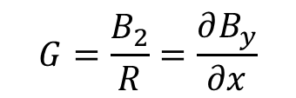




The field profile in the horizontal plane follows a polynomial expansion
$$B_{y}\left(x\right)=\sum_{n=1}^{∞}{B_{n}{\left(\frac{x}{R}\right)}^{n−1}}=B_{1}+B_{2}\frac{x}{R}+B_{3}\frac{x^{2}}{R^{2}}+…$$
$$B_{y}$$
$$B_{y}$$
$$B_{y}$$
$$x$$
$$x$$
$$x$$
B₁: dipole
B₂: quadrupole
B₃: sextupole
$$G=\frac{B_{2}}{R}=\frac{∂B_{y}}{∂x}$$
Notes:
The field expansion along x – that is, in the horizontal plane (usually) – is a polynomial in x/R, with the same coefficients B_{n} of the multipole expansion.
The dipole is the B₁ term, which provides a field constant in space.
The quadrupole is connected to the B₂ term. A quadrupole has a linear variation of B_{y} vs. x. In the centre, there is no field. The gradient of a quadrupole is the slope of the B_{y} vs. x line and it is measured in T/m. It turns out that B_{x} is also linear vs. y – in the vertical plane – with the same gradient.
The B₃ term corresponds to a sextupole. Here the field dependency is quadratic in x. In the centre, there is no field and no field gradient. A sextupole is usually characterized by the second derivative of B_{y} vs. x, possibly divided by 2. The sextupole can be thought of as a quadrupole where the gradient (slope) changes linearly with the radial displacement x.

Slide 23
Usually, for optics calculation, the field or multipole component is given, together with the (magnetic) length; these are a few definitions from MAD-X
Dipole
bend angle α [rad] & length L [m]
k₀ [1/m] & length L [m] obsolete
k₀ = B / (Bρ) B = B₁
Quadrupole
quadrupole coefficient k₁ [1/m²] × length L [m]
k₁ = (dB_{y}/dx) / (Bρ)
G = dB_{y}/dx = B₂/R
Sextupole
sextupole coefficient k₂ [1/m³] × length L [m]
k₂ = (d²B_{y}/dx²) / (Bρ)
(d²B_{y}/dx²)/2! = B₃/R²
Notes:
In a lattice code, usually magnetic elements are described as a uniform dipole / quadrupole / sextupole (or other) field times a magnetic length. The product of the 2D field (or gradient) times the length is the integrated strength.
In many cases, the quadrupoles and sextupoles can be considered as thin lenses, so basically only the integrated strengths matters.
MAD-X normalizes the coefficients by dividing by the beam rigidity Bρ. The length definitions for an SBEND (sector bending magnet) and an RBEND (rectangular bending magnet) can be found in the MAD-X documentation.
For quadrupole, sextupole and higher order magnets, to avoid ambiguity it is good to quote the pole tip field, or the field at the reference radius. The pole tip field is
quadrupole: B_{pole} = G*r = B₂*(r/R)
sextupole: B_{pole} = B₃ *(r/R)²
where r is the radius at the pole tip, and R the reference radius for the harmonics. In a dipole, B_{pole} = B, since the field is uniform.
Note: for MAD-X, B₀ is a dipole, B₁ is a quadrupole, B₂ is a sextupole, etc.

Slide 24
We can now translate the MAD-X entries into (purposeful) magnetic quantities
BEAM, PARTICLE=ELECTRON,PC=3.0;
DEGREE:=PI/180.0;
QF: QUADRUPOLE,L=0.5,K1=0.2;
QD: QUADRUPOLE,L=1.0,K1=-0.2;
B: SBEND,L=1.0,ANGLE=15.0*DEGREE;
(Bρ) = 10⁹/c*PC = 10^9/299792485*3.0 = 10.01 Tm
dipole (SBEND)
B = |ANGLE|/L*(Bρ) = (15*pi/180)/1.0*10.01 = 2.62 T
quadrupole
G = |K1|*(Bρ) = 0.2*10.01 = 2.00 T/m
Notes:
The BEAM command has several possible entries. In this case, PC is specified, which is the particle momentum times the speed of light, in GeV. The CHARGE is not specified, so the program assumes the default of 1 proton charge. Then the beam rigidity can be computed as
BRHO = PC / ( |CHARGE| * c * 1.e-9)
For an SBEND, the declared length is the arc length of the reference orbit, so the dipole magnetic field is computed as shown; by the way, 2.62 T is rather an uncommon value for the field.
For an RBEND, some trigonometry is needed as (normally) the length is taken along a straight line joining the entry and exit point, so in that case
B = 2/L*sin(|ANGLE|/2)*(Bρ).
The gradient of a quadrupole per se does not mean much: what matters is gradient and aperture. In this case, for example, if we had a 100 mm bore diameter, then we would have 0.1 T ( = 2.0*0.050) as B_{pole}. This is relatively low also for resistive magnets, so maybe the possibility of getting the same integrated field with a shorter though stronger magnet could be envisaged.

Slide 25

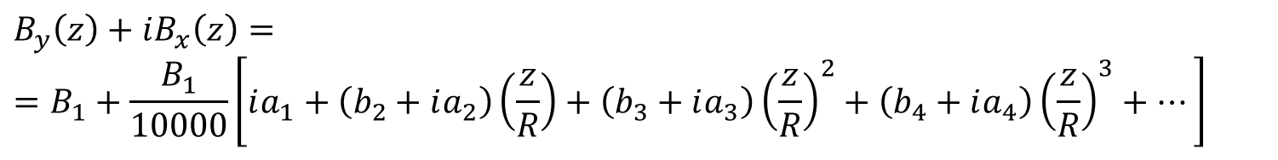
The harmonic decomposition is very handy to describe the field quality, that is, deviations of the actual B vs. the ideal one
(normal) dipole
$${\vec{B}}_{id}\left(x,y\right)=B_{1}\vec{j}$$
$$B_{y}\left(z\right)+iB_{x}\left(z\right)==B_{1}+\frac{B_{1}}{10000}\left[ia_{1}+\left(b_{2}+ia_{2}\right)\left(\frac{z}{R}\right)+\left(b_{3}+ia_{3}\right){\left(\frac{z}{R}\right)}^{2}+\left(b_{4}+ia_{4}\right){\left(\frac{z}{R}\right)}^{3}+…\right]$$
$$b_{2}=10000\frac{B_{2}}{B_{1}} b_{3}=10000\frac{B_{3}}{B_{1}} a_{1}=10000\frac{A_{1}}{B_{1}} a_{2}=10000\frac{A_{2}}{B_{1}} …$$
Notes:
The simulated or measured field is often decomposed in multipole coefficients. Again, this decomposition holds in 2D, or in 3D for the integrated field along the longitudinal direction, and it is valid up to a radius within which no current or magnetic material is present. As before, R is a reference radius. A typical value for R is 2/3 of the physical aperture radius. This is often referred to as the good field region (GFR).
Taking for example a dipole, in the ideal case only one term – B₁ – is present in the series. In reality, all other terms are present, though most often only the lower order ones give a somehow significant contribution to the field. It is customary to express these unwanted components (errors) normalized to the fundamental (or main) component, and multiplied by 10000. Usually the upper case letters B_{n}, A_{n} are used for the not normalized coefficients – measured in Tesla – while the lower case letters b_{n}, a_{n} are reserved for the normalized terms, expressed in units of 10⁻⁴.
The b_{n}, a_{n} terms are typically a few units for well designed and well built dipoles and quadrupoles. Higher values are usually found (and accepted) for sextupoles and correctors, whose strength is anyway much smaller than the accompanying bending and focusing magnets in the lattice.
Note: some terms can also come from a misalignment of the magnet, for example for a dipole the a₁ (skew dipole, or horizontal dipole) term is connected to a roll angle misalignment.

Slide 26
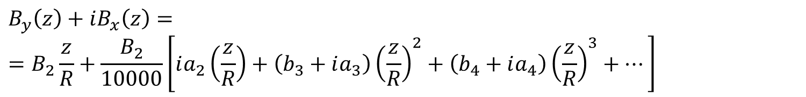
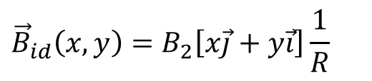
The same expression can be written for a quadrupole
(normal) quadrupole
$${\vec{B}}_{id}\left(x,y\right)=B_{2}\left[x\vec{j}+y\vec{i}\right]\frac{1}{R}$$
$$B_{y}\left(z\right)+iB_{x}\left(z\right)==B_{2}\frac{z}{R}+\frac{B_{2}}{10000}\left[ia_{2}\left(\frac{z}{R}\right)+\left(b_{3}+ia_{3}\right){\left(\frac{z}{R}\right)}^{2}+\left(b_{4}+ia_{4}\right){\left(\frac{z}{R}\right)}^{3}+…\right]$$
$$b_{3}=10000\frac{B_{3}}{B_{2}} b_{4}=10000\frac{B_{4}}{B_{2}} a_{2}=10000\frac{A_{2}}{B_{2}} …$$
Notes:
For a quadrupole, the relative multipole errors are a₂, b₃, a₃, b₄, a₄, etc., and they are obtained by normalizing the upper case coefficients by B₂.
Usually no dipole errors (b₁, a₁) are considered in a quadrupole, as these correspond to a transverse shift of the magnetic centre (axis in 3D); in that case, the harmonic decomposition is re-expressed taking as the centre of the circle the point where there is no field (no integrated field in 3D).
Note: also for a quadrupole, some multipole errors can come from a misalignment of the magnet, for example a roll angle gives rise to an a₂ (skew quadrupole) term.

Slide 27
The so-called allowed / not-allowed harmonics refer to some terms that shall / shall not cancel out for design symmetries
fully symmetric dipoles
allowed: b₃, b₅, b₇, b₉, etc.
not-allowed: all the others
half symmetric dipoles
allowed: b₂, b₃, b₄, b₅, etc.
not-allowed: all the others
fully symmetric quadrupoles
allowed: b₆, b₁₀, b₁₄, b₁₈, etc.
not-allowed: all the others
fully symmetric sextupoles
allowed: b₉, b₁₅, b₂₁, etc.
not-allowed: all the others
Notes:
It is customary to divide the multipole errors in two families: allowed and not-allowed (or random).
The not-allowed (or random) terms are the ones that should not be there thanks to symmetries in the design. They arise due to asymmetries introduced during the fabrication.
The allowed multipoles are the terms that still remain even when perfect symmetries hold. Part of the magnetic design is devoted to optimize the geometry so to cancel out these terms.
The SPS (H-shape iron) main dipoles are fully symmetric dipoles. The HERA or Tevatron superconducting magnets are also fully symmetric.
Half symmetric dipoles are resistive magnets with a C-shape yoke, for example the ones of the ANKA light source, or the LEP dipoles. The LHC main dipoles are also – technically speaking – in this family, since there is a double aperture breaking the full (left/right) symmetry, though the design of each aperture separately is fully symmetric.

Slide 28
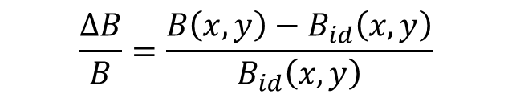
The field quality is often also expressed by a ΔB/B plot
$$\frac{ΔB}{B}=\frac{B\left(x,y\right)−B_{id}\left(x,y\right)}{B_{id}\left(x,y\right)}$$
Notes:
The field quality is also often expressed in terms of ΔB/B, where ΔB is the difference between the actual field B and the ideal distribution B_{id}, normalized by the ideal distribution B_{id}.
The plots on graph paper are measured field error curves (1970) inside the CERN PSB (PS Booster) prototype bending magnet inner gap. The abscissa is the radial position in the magnet aperture in mm. [The magnet has a (wide) pole of 460 mm width, for 70 mm of vertical gap]

Slide 29

ΔB/B can (usually) be expressed from the harmonics, this is the expansion for a dipole
$$B_{y,id}\left(x\right)=B_{1}$$
$$B_{y}\left(x\right)=B_{1}+\frac{B_{1}}{10000}\left[b_{2}\left(\frac{x}{R}\right)+b_{3}{\left(\frac{x}{R}\right)}^{2}+b_{4}{\left(\frac{x}{R}\right)}^{3}+…\right]$$
$$\frac{ΔB}{B}(x)=\frac{1}{10000}\left[b_{2}\left(\frac{x}{R}\right)+b_{3}{\left(\frac{x}{R}\right)}^{2}+b_{4}{\left(\frac{x}{R}\right)}^{3}+…\right]$$
Notes:
The ΔB/B can be built up starting from the harmonics. Going the other way around – from ΔB/B to multipoles – is not (mathematically speaking) really possible, but it is often done anyway.
In the case of a dipole, we consider the vertical field along the midplane, that is, B_{y}(x) along the y = 0 line. Using the various definitions, it can be seen that the ΔB/B plot is made up of several contributions coming from b₂ (quadrupole, linear), b₃ (sextupole, quadratic), b₄ (octupole, cubic) and so on.
Note 1: strictly speaking, the harmonic expansion is valid only within a circle not containing current or magnetic material. For resistive dipoles in particular – with wide poles – the same polynomial expansion is used with the coefficients of the powers in x/R still called “quadrupole”, “sextupole” and so on.
Note 2: deriving the multipoles from the ΔB/B is (mostly) done using some polynomial fitting, though the base functions are now not orthogonal…

Slide 30
- 3 -
Thought experiment

Slide 31
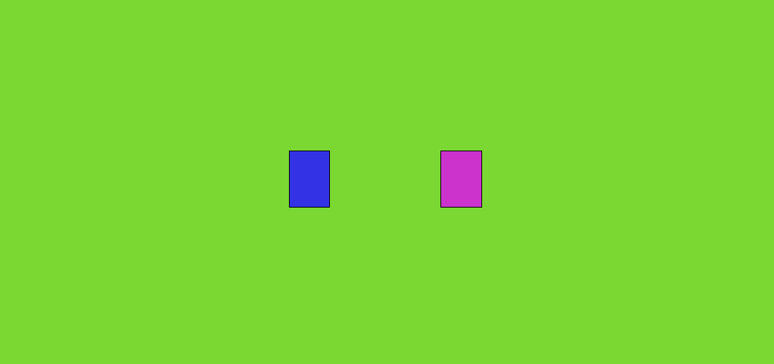

Let’s make a thought experiment, simulating in 2D two busbars without (top figure) / with (bottom figure) iron
39×74 mm²
106 mm
50 mm
100 mm
Notes:
The two busbars carry a uniform current density, with opposite signs.
When the iron is added, this becomes a (so-called) H-shape dipole. The material properties for the iron are those of a common low Si electrical steel.
Note: the simulation is done with OPERA-2D, this can be repeated as an exercise.

Slide 32
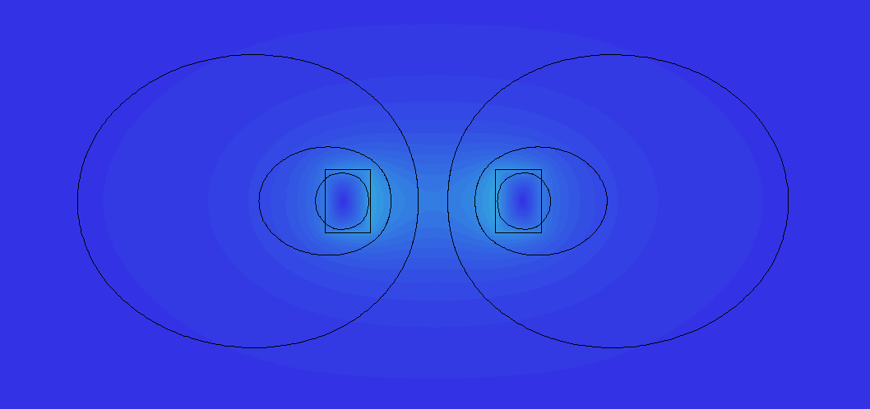
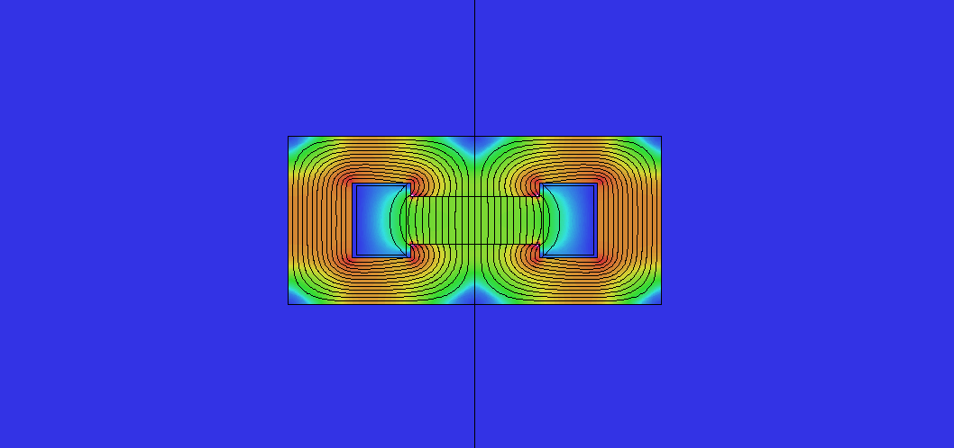
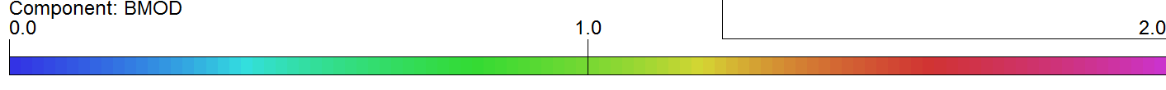
This is the situation with 40 kA in each busbar
40 kA
13.9 A/mm²
0.20 T
40 kA
13.9 A/mm²
1.00 T
Notes:
First we imagine to put 40 kA in each busbar.
Without iron (top figure) this current yields 0.20 T in the centre. The flux looks like what we would expect from Biot-Savart, with concentric lines around the current carrying conductors. In principle, this is very much how a (high field) superconducting dipole works. In that case though the coil is given a shape to get a better field quality in the aperture. Usually a magnetic yoke is added anyway on the outside to catch the return flux and to add (not so much) strength to the central field.
Now, with an iron yoke (bottom figure) the same 40 kA provide 1.00 T in the gap. This is basically a factor of 5 more. The iron in a way acts as a funnel for the flux lines – which like to go where the permeability is higher – plus its own magnetization adds to the strength of the field coming directly from the windings.

Slide 33
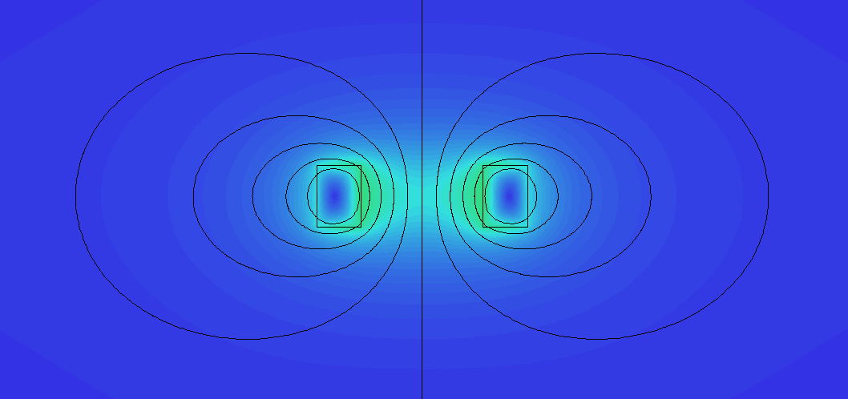
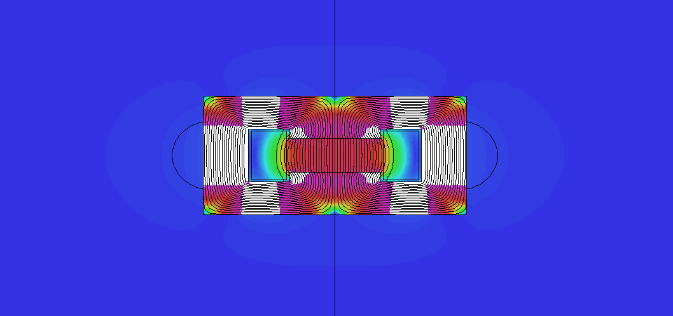
This is the situation if we double the Ampere-turns: 80 kA instead of 40 kA in each busbar
80 kA
27.7 A/mm²
0.41 T
80 kA
27.7 A/mm²
1.70 T
Notes:
Doubling the current – from 40 to 80 kA in each busbar – in our thought experiment shows two interesting features.
In the case without iron (top figure) the flux lines have the same shape as before, there are just more: the flux density – the B field – is doubled everywhere. In particular, in the centre we now have 0.41 T, twice as much with respect to before. This is a completely linear behavior.
However, in the case with iron (bottom figure), there is saturation. The flux is still mostly caught in the ferromagnetic material, though we now have 1.70 T in the aperture, which is not quite twice the 1.00 T we had with half the current. In a way, once all magnetic domains in the iron are aligned to provide the maximum magnetization, then we cannot squeeze out more from the ferromagnetic material. The white regions are where B is above 2 T. Also the pattern of the flux line is (slightly) different, see for example the corners of the iron, which are now filled with flux too. In the gap there is a slightly different distribution of the flux, which is anyway very hard to appreciate in this scale.
Note: the current density is reported as it is a main parameter for both normal and superconducting magnets; the actual values though are not representative of what it is most commonly used.

Slide 34
These two curves are the transfer functions – B field vs. current – for the two cases
Notes:
The different behavior of the two cases (with / without iron) can be seen also in the transfer function curves, where the central B field is plotted as a function of the Ampere-turns.
An iron yoke introduces a non-linearity – the B-H response of the yoke material – though it greatly enhances the field up to about 2 T. After this, the saturation becomes predominant and additional field becomes (much) more expensive in terms of current. This is why resistive dipoles in the great majority of cases are meant to work till about 1.8 – 2.0 T. For example, the SPS MBB dipole (52 mm full vertical gap) has 5750 A x 16 turns for a nominal field of 2.0 T, that is, 92 kA (for a current density of about 6.2 A/mm²).
At low field the permeability of the material is not well behaved and very low field magnets are special in their own way too.
Above 2 T, since many Ampere-turns are needed, it is interesting to pack a lot of current in a compact space close to the gap and to make the Ampere-turns cheap: this is when superconducting magnets are used. For example, in the LHC there are 40 cables per pole (per aperture), for a nominal current of 11850 A to get to 8.3 T: that makes 40 x 2 x 11850 = 948 kA (for an average current density of about 400 A/mm²).
There is also a hybrid family of super-ferric magnets: these are iron-dominated, but they have superconducting coils to magnetize the iron. We will not cover this category.

Slide 35
In this though experiment, the field quality is quite different with / without iron
 | b₃ | b₅ | b₇
without iron, 40 kA | 401.9 | 10.1 | 0.0
without iron, 80 kA | 401.9 | 10.1 | 0.0
with iron, 40 kA | -16.7 | -6.2 | -0.9
with iron, 80 kA | -38.5 | -10.6 | -0.9
with iron, 500 kA | 120.4 | 0.6 | -0.1
(harmonics in units of 10⁻⁴ at 17 mm radius)
Notes:
To have a look at the field quality, we look at the (first) allowed harmonics. The design is not optimized at all – it is just an example.
In the case without iron, there are a large sextupole (4%!) and decapole (1‰) components. These numbers depend only on the geometry of the coil and are the same at 40 or 80 kA, or at any other current (neglecting the effects of mechanical deformations due to Lorentz forces, which go quadratically with the current).
On the other hand, with iron the field quality is much better till the saturation starts playing an important role. Then in a way the iron becomes transparent and we go towards the previous case. As long though as the yoke guides the flux, the flux lines come out of the pole nicely perpendicular. In this regime, it is the width of the pole and its termination (shims, round-off) that are used at the design stage to optimize the field quality.
Note: When talking about multipoles, it is always necessary to state the reference radius. Here we use 17 mm, which is roughly 2/3 of the physical aperture of 50 mm (total); the factor 2/3 is a popular choice in many magnets.

Slide 36
- 4a -
Basics for the design
of resistive magnets
2D

Slide 37
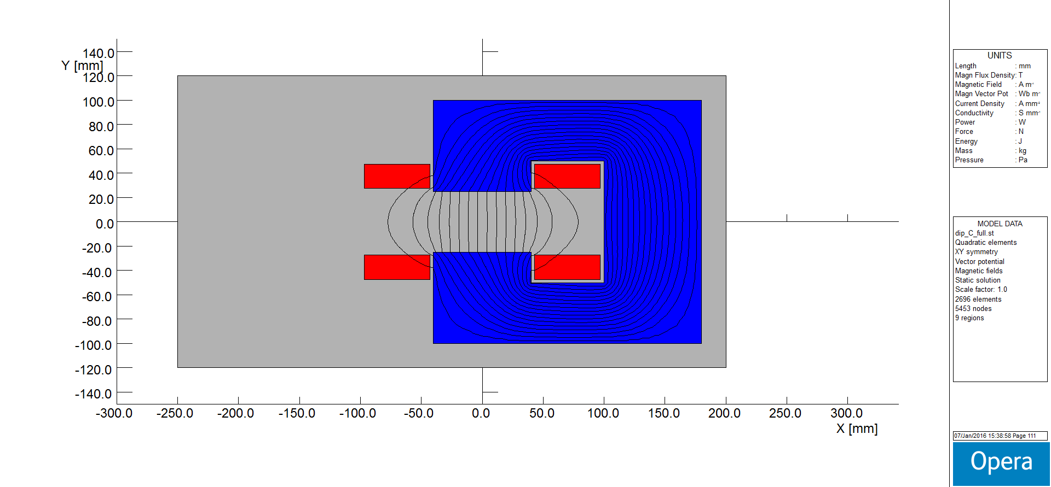
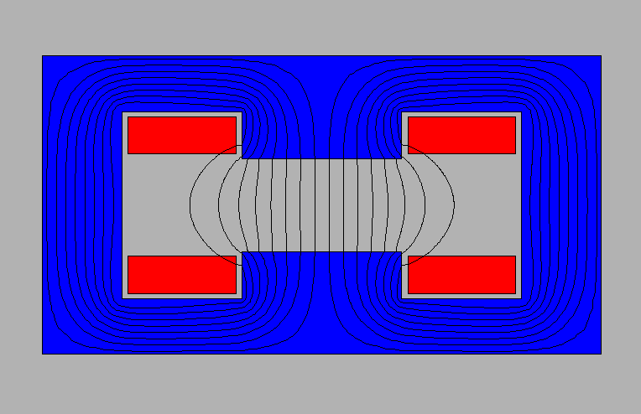
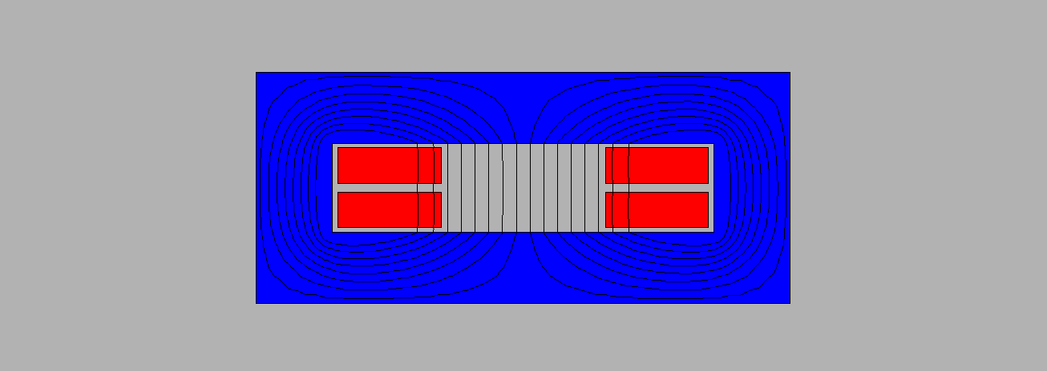
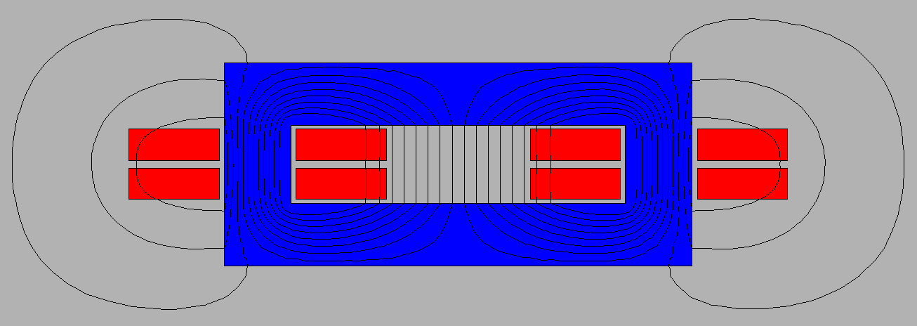
These are the most common types of resistive dipoles
“C” dipole
“H” dipole
window frame dipole (“O” dipole)
window frame dipole (“O” dipole)
Notes:
The C-shaped provides easy access to the gap for the vacuum chamber – for this it is often found in light sources – at the cost of a (slight) asymmetry, which introduces the even terms in the allowed multipoles, in particular the quadrupole (gradient).
The H-shaped is symmetric, at the cost of some access problems to the gap. The coils can extend till the midplane – like in the SPS case – though then they need to be bent up in the ends to clear the gap region. If the coil gets close to the aperture, then its position can have an impact on field quality.
The window frame provides the best field quality, which comes from the extra wide pole; it has the same access problems of the H, plus there has to be enough room to dimension the coil properly. As for the other cases, the position of the windings can impact the field quality if the coil gets very close to the gap. This type is often used for correctors, where the field is lower, with the coils wound on the return legs (figure on the bottom right). In this latter configuration, it is somehow inefficient in 2D – the outer conductors are useless to create field in the gap. In practice, this layout is still convenient for short magnets. The return current on the outside adds flux in the side legs of the magnets, so more material is needed if the working point becomes close to saturation – which is not an issue if the magnet works at low field, like a corrector.

Slide 38




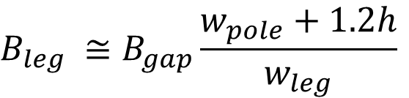
The magnetic circuit is dimensioned so that the pole is wide enough for field quality, and there is enough room for the flux in the return legs
$$w_{leg}$$
$$w_{leg}$$
h
$$w_{pole}$$
$$w_{pole} ≅w_{GFR}+2.5h$$
$$B_{leg} ≅B_{gap}\frac{w_{pole}+1.2h}{w_{leg}}$$
Notes:
Simply speaking, we need to dimension the width of the magnetic circuit in 2D so that:
* the pole is wide enough for the good field region; its actual width depends if we have (or not) pole shims, if the magnet is saturated, if we want a field uniformity in the 10⁻², 10⁻³ or 10⁻⁴, etc. though the formula above provides a good first guess in many cases
* to dimension the legs, we have to consider that the flux in the yoke includes the flux in the gap, but also some stray flux. The stray flux extends approximately one gap width on either side of the aperture. The width of the legs is chosen to limit the B in the yoke, usually below saturation, so to have a high permeability.
Note: the density of the flux lines in the figure is – well – the flux density, that is, the B field (Faraday); in this example, B is higher in the top / bottom legs than in the back one.

Slide 39
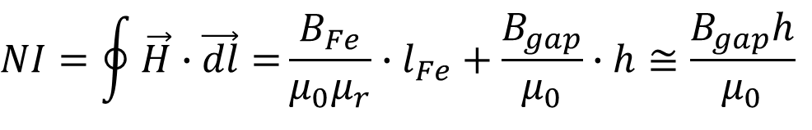
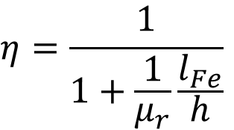
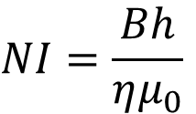

The Ampere-turns are a linear function of the gap and of the B field
$$l_{Fe}$$
NI/2
h
NI/2
$$NI=\oint{\vec{H}∙\vec{dl}=}\frac{B_{Fe}}{μ_{0}μ_{r}}∙l_{Fe}+\frac{B_{gap}}{μ_{0}}∙h≅\frac{B_{gap}h}{μ_{0}}$$
$$NI=\frac{Bh}{ημ_{0}}$$
$$η=\frac{1}{1+\frac{1}{μ_{r}}\frac{l_{Fe}}{h}}$$
Notes:
The basic formula to derive the Ampere-turns needed for a given field and vertical gap can be derived from the circulation of H around a flux line (Ampere’s law).
The term with B_{Fe}, l_{Fe} and μ_{r} is difficult to expand exactly – those variables can actually be interpreted as average ones along the integral – however it does not matter. In fact, B_{Fe} is similar to B_{gap}, while μ_{r} has a high value (thousands, unless the iron is into heavy saturation) which makes that contribution small. For this reason, the simple formula on the bottom, with just B, can be used.
The concept of magnetic efficiency η can also be introduced. Typical values are above 95%.

Slide 40
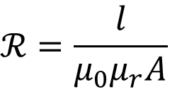
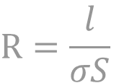
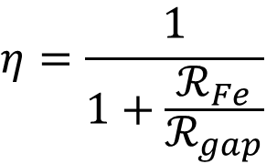
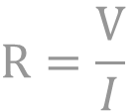
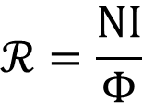
The same can be solved using magnetic reluctances and Hopkinson’s law, which is a parallel of Ohm’s law
$$ℛ=\frac{\text{NI}}{Φ}$$
$$R=\frac{\text{V}}{I}$$
$$ℛ=\frac{l}{μ_{0}μ_{r}A}$$
$$R=\frac{l}{σS}$$
$$η=\frac{1}{1+\frac{ℛ_{Fe}}{ℛ_{gap}}}$$
Notes:
There is a simple parallel between magnetic circuits and electrical ones:
* voltage drop ---> magnetomotive force
* resistance ---> reluctance
* current ---> flux
* Ohm’s law ---> Hopkinson’s law
NI – the Ampere-turns – is the magnetomotive force.
A and l are the cross section of the magnetic circuit and its length. In 2D, the area A is the width of the magnetic circuit * 1 m.
The B field (flux density) is then the flux Φ divided by the section A.
The Ampere-turns spent in the yoke are like the voltage drop spent in connection wires in an electric circuit.
For a C dipole, there are two magnetic reluctances in series: the one for the air gap (usually predominant) and the one for the iron.

Slide 41
The same Ampere-turns can be provided by different coils, for example 10 kA can be arranged as
250 A ×40 turns, water cooled
1000 A ×10 turns, water cooled
250 A ×40 turns, air cooled (outside)
1000 A ×10 turns, air cooled (outside)
250 A ×40 turns, air cooled (outside)
1000 A ×10 turns, air cooled (outside)
Notes:
Once the Ampere-turns are determined, the coil design involves the choice of:
* the conductor, usually rectangular copper (or aluminum)
* the current density, determining the total conductor area
* the number of turns
* whether direct cooling – with demineralized water flowing in a hole in the conductor – is needed or air cooling (by natural convection around) is ok
A main parameter is the current density: j = NI / A_{cond}. Low j w.r.t. high j means lower power consumption, but bigger coils (and magnets). That is, usually low j implies lower operation costs, but a higher capital investment. Typical values are around 5 A/mm² for water cooled dipoles, more for smaller magnets like quadrupoles or sextupoles, and not much above 1 A/mm² for air (natural convection) cooled ones.
The number of turns dictates the resistive voltage drop and impedance, of interest for the power converters. Generally speaking, in dc, since the power P = VI is constant (for a given field, gap and current density):
* many turns N ---> low current I, high voltage V
* few turns N ---> high current I, low voltage V
Cabling and connections need to be considered too: 1000 A are not the same as 250 A.
Note: in the bottom figures, the insulation becomes thinner just for convenience of scaling the pictures, in reality this is often not the case.

Slide 42
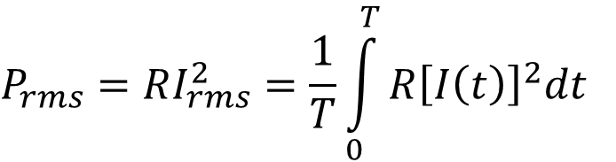
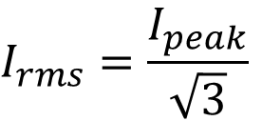
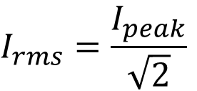
If the magnet is not dc, then an rms power / current has to be considered, for the most demanding duty cycle
$$P_{rms}=RI_{rms}^{2}=\frac{1}{T}\int_{0}^{T}{R{\left[I\left(t\right)\right]}^{2}dt}$$
$$I_{rms}=\frac{I_{peak}}{\sqrt{2}}$$
for a pure sine wave
$$I_{rms}=\frac{I_{peak}}{\sqrt{3}}$$
for a linear ramp from 0
Notes:
The subscript rms stands for root mean square. I_{rms} is the effective current, that is, the one which is equivalent w.r.t. the losses per Joule heating in a cycle.
If the magnet is operated in dc, then peak and rms values are the same thing.
The same concept is used routinely in electrical systems working in ac. Duty cycles of synchrotrons often involves linear ramps up / down – rather than pure sinusoidal oscillations – so the corresponding rms values have to be computed case by case.

Slide 43
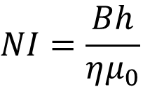
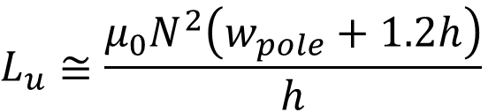
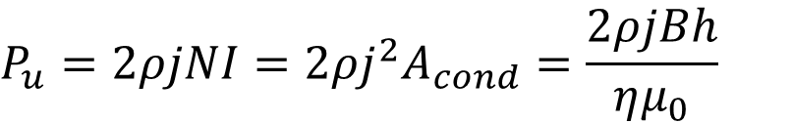
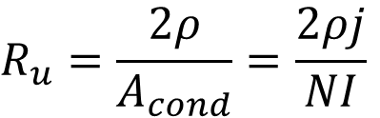
These are common formulae useful to compute the main electric parameters of a resistive dipole
$$NI=\frac{Bh}{ημ_{0}}$$
Ampere-turns
total
$$R_{u}=\frac{2ρ}{A_{cond}}=\frac{2ρj}{NI}$$
Resistance per m length
$$P_{u}=2ρjNI=2ρj^{2}A_{cond}=\frac{2ρjBh}{ημ_{0}}$$
Power per m length
$$L_{u}≅\frac{μ_{0}N^{2}\left(w_{pole}+1.2h\right)}{h}$$
Inductance per m length
Notes:
The Ampere-turns NI are directly proportional to the field B and the gap h.
The resistance (per unit length) depends on the resistivity ρ of the conductor and its cross section. At 20 °C, ρ_{Cu} = 1.72·10⁻⁸ Ωm, ρ_{Al} = 2.65·10⁻⁸ Ωm.
The resistive power (per unit length) is directly proportional to the field B, the vertical aperture h and the current density j. This formula can be used for the peak power and for the rms power as well. In the latter case, B (or NI, or j) should be the rms (or effective) value over the cycle.
The inductance (per unit length) depends quadratically on the number of turns. For the same gap, L is larger for a wider pole.
These expressions can be used for long magnets; for short ones, the effects of the ends – also for the coil returns – have to be evaluated separately.
The formulae for the hydraulic parameters, for water cooled coils, are not reported here and they can be found in the references.
Note 1: in these formulae, NI are the total Ampere-turns, i.e., not the Ampere-turns per pole, and A_{cond} is the area of the conductor considering only the current in (or out) of the plane.
Note 2: the expressions (but the one for NI) hold for C and H dipole, though they need to be modified for the window frame layout.

Slide 44
The table describes the field quality for the different layouts of these examples
 | C-shaped | H-shaped | O-shaped
b₂ | 1.4 | 0 | 0
b₃ | -88.2 | -87.0 | 0.2
b₄ | 0.7 | 0 | 0
b₅ | -31.6 | -31.4 | -0.1
b₆ | 0.1 | 0 | 0
b₇ | -3.8 | -3.8 | -0.1
b₈ | 0.0 | 0 | 0
b₉ | 0.0 | 0.0 | 0.0
multipoles in units of 10⁻⁴ at R = 17 mm
NI = 20 kA
h = 50 mm
w_{pole} = 80 mm
Notes:
The allowed harmonics for the C and H designs show rather large sextupoles and decapoles, which would make these magnets likely unfit for a synchrotron. Pole shims (discussed later) can help, and so does a wider pole. Still the differences between the asymmetric C and the symmetric H layouts are rather small.
The window frame – as expected – is better, as the pole is indeed much wider.
Note 1: in these examples, w_{pole} does not follow the rule w_{pole} ≈ w_{GFR} + 2.5h, as here it is rather w_{pole} ≈ w_{GFR} + h; this returns a field quality in the 10⁻² region.
Note 2: it is possible to take the centre of the C (for the beam) not in the middle of the pole, but where the good field region is wider. The improvement is minor.

Slide 45
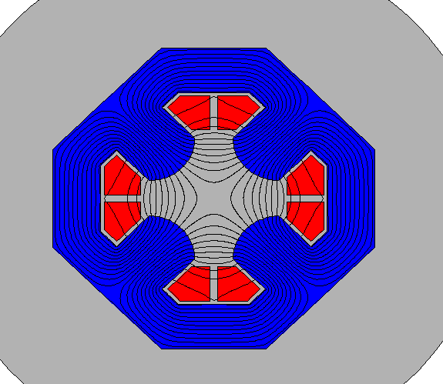
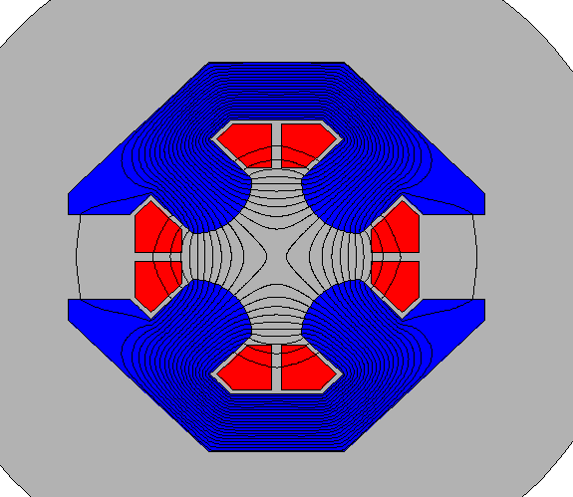
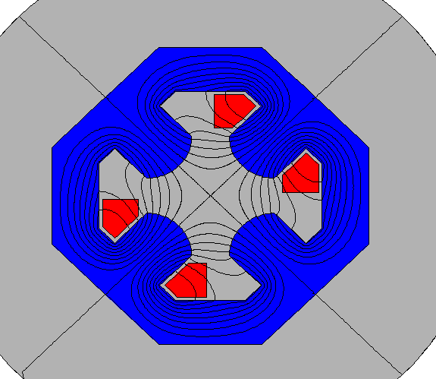
These are the most common types of resistive quadrupoles
standard quadrupole
figure-of-8
quadrupole
quadrupole with half the coils
Notes:
Resistive quadrupoles are most often of the standard type shown in the central top figure, with four symmetrical quadrants.
Sometimes figure-of-8 (referred to also as Collins) quadrupoles are used, where the magnetic circuit is split in two halves. This might be needed in very crowded regions, as there is not enough space. For example, some quadrupoles in light sources are of this kind, to make room for outgoing photon beam lines. This layout breaks the symmetry, somehow like the C-shape does in dipoles.
A quadrupole with only half the coils would also work fine and this could be interesting for weak strengths, though it is seldom used to my knowledge.
Note: in the simulations, the same current density is applied to the various configurations, corresponding to a pole tip field (for the standard quadrupole in the top) of 0.8 T. This value starts to be on the high side for quadrupoles, as extra flux is then collected in the yoke from the pole sides. The SPS quadrupoles have 1.0 T on the pole tip.

Slide 46
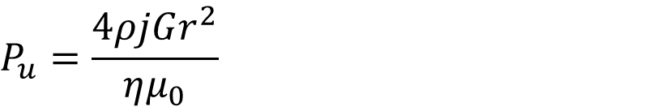
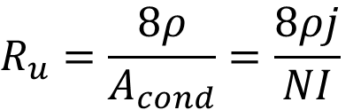


These are useful formulae for standard resistive quadrupoles
Pole tip field
$$B_{pole}=Gr$$
$$NI=\frac{Gr^{2}}{2ημ_{0}}$$
Ampere-turns
per pole
$$R_{u}=\frac{8ρ}{A_{cond}}=\frac{8ρj}{NI}$$
Resistance per m length
total (4 quadrants)
$$P_{u}=\frac{4ρjGr^{2}}{ημ_{0}}$$
Power per m length
Notes:
The Ampere-turns NI are directly proportional to the field G and quadratically proportional to the aperture radius r.
The resistance (per unit length) is similar to the dipole case.
The resistive power (per unit length) is now quadratic with the aperture radius r, though still linear with the gradient G.
Note 1: in these formulae, NI are the Ampere-turns per pole, and A_{cond} is the area of the conductor (per pole) considering only the current in (or out) of the plane.
Note 2: the expressions hold for a classical quadrupole; for resistance and power, they hold for long magnets, as otherwise the coil ends become important.

Slide 47






The ideal poles for dipole, quadrupole, sextupole, etc. are lines of constant scalar potential
dipole
$$ρ\sin\left(θ\right)=±h/2$$
$$y=±h/2$$
straight line
quadrupole
$$ρ^{2}\sin\left(2θ\right)=±r^{2}$$
$$2xy=±r^{2}$$
hyperbola
sextupole
$$ρ^{3}\sin\left(3θ\right)=±r^{3}$$
$$3x^{2}y−y^{3}=±r^{3}$$
Notes:
It can be shown that the ideal pole profiles are curves of constant scalar potential. This follows from the definition of the scalar potential itself (not covered here) and from the fact that the flux lines are perpendicular to the iron pole, if the iron permeability is infinite.
The expressions are quite neat in polar coordinates, though they become cumbersome – already for a sextupole – in Cartesian coordinates.
The ideal pole profile for a dipole is simply a straight line.
The ideal pole profile for a quadrupole is a hyperbola.
In my opinion, these formulae are more of academic interest, as anyway the pole is of finite width and its profile is optimized using some simulation tools. My preference is for simple profiles – i.e., profiles that can be described with line segments and circular arcs. This is often possible without any detrimental effect on field quality, especially when the pole is not very wide.
All these profiles can be derived also using conformal mapping. There is quite a bit of elegant complex mathematics in it, details can be found in some of the references.

Slide 48
This is the real pole used for example in the SESAME quadrupoles vs. the theoretical hyperbola
Notes:
As an example of theoretical vs. real pole tip profile, we consider the quadrupoles for the SESAME light source.
The hyperbola extends till infinity, without space for the coils: this is impractical. The real pole shape is not far from the theoretical one, and then it is terminated with shims, which are used at the design stage to minimize the allowed harmonics, that is, to improve field quality. In a way, those shims carry extra material, which is the one going all the way to infinity in the theoretical profiles.
In this specific case, the central part of the real pole tip is not a hyperbola and the profile is described with lines and circular arcs – with no compromise on field quality. When the pole tip was designed in 2D (with OPERA), the starting point for the radius of the central part of the pole was the curvature radius of the theoretical hyperbola – which turns out to be simply equal to the aperture radius, 35 mm in this case.

Slide 49

This is the lamination of the LEP main bending magnets, with the pole shims well visible
Notes:
The ideal poles for a dipole are two infinite parallel lines. Wide poles indeed help for field quality – though they need to be terminated somewhere. At the extremes, shims are then introduced. For long magnets, their size and shape can be simulated in 2D to optimize the on paper field quality (basically, the expected allowed harmonics). The real field quality will depend also on the mechanical tolerances and the possible asymmetry in the magnetic properties of the material.
Here the lamination for the LEP magnets is shown, where about ¼ of the pole width is actually used for shims.
These magnets were rather particular – see the right picture. Since the top field was only 110 mT, the yoke was made in steel / concrete, with the steel being 30% in volume. This is referred to as dilution. We say that the stacking factor is 0.30. In the great majority of cases, the stacking factor is above 97%; the few % unoccupied by iron is taken up by insulation in within the laminations and voids.

Slide 50
- 4b -
Basics for the design
of resistive magnets
3D

Slide 51



In 3D, the longitudinal dimension of the magnet is described by a magnetic length
$$l_{m}B_{0}=\int_{−∞}^{∞}{B\left(z\right)dz}$$
Notes:
Looking along the longitudinal (z) direction, the field B is maximum at the centre (z = 0) of the magnet, it is more or less constant till reaching the ends, where it rolls off to reach a 0 value outside. The magnetic length l_{m} is defined as that length which – multiplied by the central field value B₀ – returns the same integrated field.
The same holds substituting the field B with the gradient G, or with any multipoles B_{n}, A_{n}. In this case, the integrals have to be performed on the not-normalized (upper case) coefficients, and the normalized terms (lower case) are then obtained by dividing by the integral of the fundamental harmonic.
For long magnets – where the longitudinal dimension is much larger than the gap – the behavior is dominated by the (long) central part, so taking the values of 2D simulations and multiplying by a length yields good results. For short magnets, the behavior is intrinsically 3D.

Slide 52



The magnetic length can be estimated at first order with simple formulae
$$l_{m}>l_{Fe}$$
dipole
$$l_{m}≅l_{Fe}+h$$
quadrupole
$$l_{m}≅l_{Fe}+0.80r$$
Notes:
In all cases the magnetic length is larger than the iron length: there is some stray flux, that is, there is still some field left after the iron yoke is finished, since B rolls off in a continuous way.
The actual value of l_{m} depends mainly on the termination of the end poles – abrupt, with shims, with chamfers, with some rounded (Rogowski-like) profile – and on the iron saturation. The same magnet can actually have slightly different magnetic lengths when the excitation current – hence, the field level – is different. All these effects can be assessed precisely only by 3D simulations and measurements.
In most cases, though, it is possible to estimate at first order the length with the given simple formulae. For a dipole, l_{m} is the iron length l_{Fe} plus one gap h. For a quadrupole, l_{m} is again the iron length l_{Fe} plus one aperture radius (or half a gap) r. In general, the higher the order of a magnet (quadrupole, sextupole, octupole, etc), the less stray field is found on the axis at the ends, and the closer are the values of l_{m} and l_{Fe}.
Note: since in lattice codes l_{m} is used, crowded regions – with many nearby magnets – have to be looked in detail, to make sure there is enough physical space for the magnets, and their coil ends.

Slide 53
There are many different options to terminate the pole ends, depending on the type of magnet, its field level, etc.
inner
z
central
outer
Notes:
One option is to have square ends – the pole profile is simply extruded in 3D and then terminated abruptly (left figure). This introduces some field amplification in the end of the iron, that has to carry also the stray field that extends after l_{Fe}. This might lead to saturation and possible non-linear behavior at different excitation currents.
Another possibility is to have end shims. These are also used to trim the actual iron length so to have a closer magnet-to-magnet reproducibility of the field integrals. The right figure shows the design used for the SESAME combined function bending magnets, with three separate stacks to control integrated dipole, quadrupole and sextupole component (if needed).
Popular options are also 45 deg chamfers, which are often used for quadrupoles and sextupoles.
In some cases, a rounded Rogowski-like profile (not detailed here), is used, to avoid flux concentration in the ends.
In all cases, there is an impact on the integrated field quality, and optimization of the end poles is a main reason to set up 3D simulations.

Slide 54
Usually two dipole elements are found in lattice codes: the sector dipole (SBEND) and the parallel faces dipole (RBEND)
SBEND
top views
RBEND
Notes:
A sector dipole and a parallel faces one both provide a region of space with constant field, though they have different focusing effects on the beam.
Other cases are possible, if the dipole ends are shaped with another angle with respect to the incoming / outgoing beam. This is not treated here.
Note: the curvature has no effect, it is just for saving material, otherwise the pole would have to be wider. In jargon, people talk about the sagitta of the beam going through a dipole and then evaluate whether to curve the magnet or not. The LHC dipoles are actually bent. The SPS dipoles are not. In most light sources, the main dipoles are curved.

Slide 55
The two types of dipoles are slightly different in terms of focusing, for a geometric effect
Notes:
In a dipole, particles are deviated according to the same bending radius – given by the field and the beam rigidity.
In a sector dipole, there is a difference in how much space is travelled within the uniform field depending on the transverse position: a sector dipole focuses horizontally.
This effect is not there in parallel ended dipoles. However, these have a edge effect. Actually, the edges are defocusing, but the overall magnet has zero focusing horizontally. Still it remains some vertical focusing at the edges. Most often, parallel ended dipoles are more convenient to manufacture, as the yoke is built stacking up sheets of laminations (like a deck of cards).
These effects are handled differently in the various lattice codes, according to some assumptions on the field roll-off in the ends, that somehow gradually goes from a constant value (inside the dipole) to zero (outside). Some details about what MAD-X does are given in its documentation, in the section Bending Magnet.

Slide 56
- 5 -
A glimpse on the design of superconducting magnets
(thanks to Luca Bottura
for the material of the slides)

Slide 57
Superconductivity makes possible large accelerators with fields well above 2 T
Nb-Ti
conventional iron electromagnets
Notes:
Superconductivity implies zero electrical resistance, so that there is no power dissipated as Joule heating (in dc). The drawback is that refrigeration power is needed, as known superconductors work at cryogenic temperatures.
The figure shows a typical example of how much current density j can be sustained by Nb-Ti, the most widespread technical superconductor at the moment, vs. the B field: j goes up by order of magnitudes with respect to normal conductors, and the wall of 2T field is breached.
We often say that the Ampere-turns are then cheap: no power consumption, no need of large coils.

Slide 58

This is a history chart of superconductors, starting with Hg all the way to HTS (High Temperature Superconductors)
Notes:
Superconductivity was discovered in the lab of Heike Kamerlingh-Onnes in Leiden (Netherlands) in 1911:
… the mercury at 4.2 K has entered a new state, which, owing to its particular electrical properties, can be called the state of superconductivity …
Since then, many superconducting material have been found, but only a few of them have some practical interest. The quest is (will ever be?) not over yet!
Note: the most used superconductor, Nb-Ti, is not shown on this plot… It was discovered in 1961 and it has a critical temperature of 9.2 K.

Slide 59
This is a summary of (somehow) practical superconductors
 | LTS |  |  | HTS
material | Nb-Ti | Nb₃Sn | MgB₂ | YBCO | BSCCO
year of discovery | 1961 | 1954 | 2001 | 1987 | 1988
T_{c} [K] | 9.2 | 18.2 | 39 | ≈93 | 95 / 108
B_{c} [T] | 14.5 | ≈30 | 36…74 | 120…250 | ≈200
Notes:
Nowadays, we have basically two families of superconductors.
LTS (low temperature superconductors)
* Nb-Ti is the workhorse of superconductors, not only for accelerator magnets. It has the lowest critical current of the family, though it is convenient to make into wires and cables ready for winding.
* Nb₃Sn also works around liquid helium temperatures. It can sustain higher field w.r.t. Nb-Ti, thought it is brittle. It often requires a heat treatment at high temperature (650 °C) after winding. It will be used for some magnets of the HL-LHC upgrade. This is also being used in the ITER tokamak.
* MgB₂ is a more recent material, with a higher critical temperature than the classical LTS, but still low enough to be listed in this family. This has not been used for accelerator magnets (yet), though mostly for power transmission cables, including superconducting links for the HL-LHC upgrade.
HTS (high temperature superconductors)
These materials have much higher critical currents / temperatures / field, but – due also to their cost – they have seen limited application so far. For example, a type of BSCCO is used in the LHC current leads, to carry the current from the copper (room temperature) side to the Nb-Ti (liquid helium temperature) part. These materials open up possibilities, on paper, to reach even higher fields; some prototype magnets are being proposed.

Slide 60







The field in the aperture can be derived using Biot-Savart law (in 2D)
$$B_{θ}=\frac{μ_{0}I}{2πρ}$$
Biot-Savart law for an infinite wire
$$B=\frac{2μ_{0}\sin{φ }}{π}jw$$
$$φ$$
for a sector coil
$$r$$
$r$+w
$$B=\frac{\sqrt{3}μ_{0}}{π}jw$$
$$j$$
for a 60 deg sector coil
Notes:
Since the iron plays a secondary role for the central B field, instead of reasoning with magnetic reluctances and Hopkinson’s law (as for resistive magnets), it is possible to integrate the field in 2D given by the coils directly with the familiar Biot-Savart law.
There are several coil layouts that can be used. Besides personal preferences of the designers, the choice depends mainly on magnetic efficiency (how much B can you gen with a given amount of superconductor), field quality in the bore and mechanical considerations (for the forces when cooling down / powering the magnet).
Here we give the formula for sector dipoles, which are representative of the accelerator magnets built so far. The choice of the 60 deg angle (formula on the bottom) is such to cancel the first allowed harmonic, that is, the sextupole.
The aperture radius r does not enter into the equation. Besides a geometric factor, the field is simply a product
B ∝ j × w
field ∝ current density (overall) × coil width.

Slide 61


This is how it would look like one aperture of the LHC dipoles at 8.3 T, with two different current densities (without iron)
116 mm
656 mm
j = 400 A/mm²
w = 30 mm
NI = 1.2 MA
P = 14.9 MW/m (if Cu at room temp.)
j = 40 A/mm²
w = 300 mm
NI = 4.5 MA
P = 6.2 MW/m (if Cu at room temp.)
Notes:
You can get 8.3 T with
400 A/mm² × 30 mm coil width (left figure, similar to LHC)
or
40 A/mm² × 300 mm coil width (right figure, very hypothetical).
Besides the Ampere-turns, the power dissipation – if it were in normal conducting Cu at room temperature – would be prohibitive, without counting the amount of conductor needed, and the large stray field on the outside, as much more flux is generated.

Slide 62


This is the actual coil of the LHC main dipoles (one aperture), showing the position of the superconducting cables
Coil blocks
Magnet bore
Spacers
Superconducting cable
Notes:
The sector layout in practice is modified to a configuration with several blocks, 6 per quadrant in the case of the LHC (in its final version). Each coil is wound with superconducting cable, that is usually slightly tapered (keystone angle) so to help follow the azimuthal angle as the turns pile up. Spacers (wedges) are inserted in between the blocks. The overall geometry is optimized to improve the design field quality and maximize magnetic efficiency, which in this case implies avoiding field concentration on the coil w.r.t. the bore.
In the LHC dipoles the inner and outer layer are electrically in series, though they are wound with a slightly different conductor (grading): the current density is higher in the outer shell, where the field is lower.

Slide 63

Around the coils, iron is used to close the magnetic circuit
gap between coil and yoke
coil
Notes:
Also in this case the LHC dipole is taken as an example. The figure though is not the final design, it is actually among the very first ones: it dates back from 1987… 21 years before first beams in the machine!
The gap between the coil and the yoke is space reserved for collars, made in stainless steel (not magnetic) material. The collars are meant to counteract the Lorentz force on the coils when the magnet is powered.
The main function of the iron is to provide a return path for the flux, although it does contribute a little to the strength in the bore.

Slide 64

The current density is high – though finite – and it depends on the temperature and the field
J_{c} [A/mm²]
T=1.9 K
T=4.2 K
B = 5 [T]
100,000
10,000
1,000
100
B [T]
T [K]
5
5
10
10
15
Notes:
Superconductors carry a high current density, but they have an upper limit: this is described by the so-called critical surface. The 3D plot is the critical surface of an LHC Nb-Ti wire. Generally speaking, this depends on temperature T and field B, and it is monotonically decreasing for increasing T and B.
To give an order of magnitude, the critical density at 5 T, 4.2 K as shown on the graph is about 3000 A/mm².
Note: the plot actually describes the current density in the superconductor itself. The current density that we used before – for example 400 A/mm² – is more an engineering current density, that includes the stabilizer in the superconducting wire, the insulation, the voids (filled by helium), etc.

Slide 65


The maximum achievable field (on paper) depends on the amount of conductor and on the superconductor’s critical line
Nb-Ti critical surface
I_{C} = J_{C} x A_{SC}
Nb-Ti critical current I_{C} (B)
7
6
5
4
3
Current density [kA/mm²]
5 T bore field
quench!
2
1
2
peak field
4
2
4
Temperature [K]
6
6
8
8
10
10
Field [T]
12
14
Notes:
The critical surface of the superconductor (the 3D plot for Nb-Ti on the left) is reduced to 2D fixing the temperature, 4.2 K in this case (I_{c} plot on the right). For convenience, the current is given instead of the current density, just multiplying by the superconductor area A_{sc}.
On the magnet side, there are two curves, which are very close to straight lines: the peak field on the conductor, at different currents, and the bore field (in the aperture). There is usually a 10% difference between the two. The intersection of the peak field line with the critical curve gives the maximum (theoretical) field that can be reached by the magnet. In jargon, this is often referred to as the short sample limit. There we expect the magnet to go resistive, i.e. to quench. In practice magnets are trained (training) to get close to that limit, with successive powering and quenches.
Note: short samples refer to performance of the superconducting wire (or cable) measured, well, in short samples… Often in the computation one accounts also for a few % lost with the so-called cabling degradation.

Slide 66

In practical operation, margins are needed with respect to this ultimate limit
current quench I_{Q}
loadline quench I_{max}
field quench B_{Q}
temperature quench T_{CS}
Notes:
The margin needed depends – among other things – on the superconducting material, the design (for example, coils epoxy impregnated or not), the operating temperature.
Margins are ratios between an operating point (temperature, field, current) and the limit on the critical surface of the superconductor. Typical values for Nb-Ti at its limits (LHC main magnets) for the various margins are:
* margin along the loadline I_{op}/I_{max} ≈ 85%
* critical current margin I_{op}/I_{Q} ≈ 50%
* critical field margin B_{op}/B_{Q} ≈ 75 %
* temperature margin T_{CS} - T_{op} ≈ 1…2 K
The most used margin is probably the margin along the loadline, which is typically just referred to as margin. Other definitions are possible (and meaningful), for example the enthalpy margin, which is the integral of the heat capacity from the operating temperature up to the T_{CS}.
Note: the subscript CS refers to current sharing temperature, because superconductivity is lost and the current starts to be shared with the resistive matrix of the stabilizer.

Slide 67

This is the best (Apr. 2014) critical current for several superconductors
Applied Superconductivity Center at NHMFL
Notes:
source:
https://nationalmaglab.org/magnet-development/applied-superconductivity-center/plots
Not only there is a range of superconducting materials, but also the technological route along which they are produced makes quite a difference in their performance. Some materials already show on a laboratory scale the possibility of further enhancing their critical current density, others (in particular, Nb-Ti) have already reached industrial maturity.
Nb-Ti provides useful current density till about 10 T: this is basically what set the limit for LHC.
Nb₃Sn can be pushed a little further. The records for prototype magnets (not yet accelerator magnets) today is 16 T.
HTS open theoretically the way to even higher fields, entering a region where the mechanical aspects – the containment of Lorentz forces and their stress on the materials – will become even more predominant.

Slide 68

The coil cross sections of several superconducting dipoles show a certain evolution; all were (are) based on Nb-Ti
Tevatron
HERA
RHIC
LHC
Notes:
The cross sections (to scale) of four superconducting colliders show different design choices, such as single or double layers, wedges, coil blocks, in an effort to achieve high magnetic efficiency and field homogeneity.
All these designs are of the so-called cos-theta family. A cos-theta distribution of the current density with the azimuthal (theta) is known to yield a perfect dipolar field. These windings – which wrap around a cylindrical mandrel – are imagined to approximate this distribution, hence the name.

Slide 69




Different choices were made for the iron, the mechanical structure and the operating temperature
Tevatron
76 mm bore
B = 4.3 T
T = 4.2 K
first beam 1983
HERA
75 mm bore
B = 5.0 T
T = 4.5 K
first beam 1991
RHIC
80 mm bore
B = 3.5 T
T = 4.3-4.6 K
first beam 2000
LHC
56 mm bore
B = 8.3 T
T = 1.9 K
first beam 2008
Notes:
All these machines are cooled with He. LHC is the only one to work with superfluid helium. These extra 2 K mean a lot – the cryogenic system becomes at once more complex and less thermodynamically efficient – though the heat transfer between the bath and the coil is much improved. From a magnetic viewpoint, working at 1.9 K instead of 4.2 K shifts the critical current curve of Nb-Ti enough to make operation at 8.3 T (or almost, we are at 7.7 T now in the machine) possible with margin.
LHC is the only twin bore layout of these four.
The Tevatron is the only one with a warm iron yoke, that is, the iron is not in the cold (liquid He) mass.

Slide 70




These are the same magnets in the respective tunnels
Tevatron @ FNAL
(Chicago, IL, USA)
RHIC @ BNL
(Upton, NY, USA)
HERA @ DESY (Hamburg, D)
LHC @ CERN (Geneva, CH/FR)
Notes:
In most superconducting machines, not much can be seen of the magnets once installed if not the cryostats. An exception is the Tevatron, with its warm iron yokes.
There are also resistive magnets in the pictures:
* at HERA, for the electron ring, below the proton machine (C dipoles)
* at Tevatron, on top of the superconducting machine (H dipoles), for the main ring, which was a normal conducting synchrotron built before the superconducting one, for which it also served as an injector at the beginning, before the construction of a separate machine

