Slide 1
Linear Colliders
Linear Colliders
4 lectures
1: Introduction, Overview, Scaling, ILC/CLIC
2: Subsystems: source, DR, BC, main linac
3: Subsystems: linac, wakefields, RF, alignment
4: Parameters, NC/SC, CLIC

Slide 2
Preface
Complex topic --- but: DON’T PANIC!
Approach:
  Explain the fundamental layout of a linear collider and
  the specific designs based on SuperConducting (SC)
  and normal conducting (NC) technology
  I will not go much into technical details
  Try to avoid formulae as much as possible
Goal: You understand
  Basic principles
  Some driving forces and limitations in linear collider design
  The basic building blocks of CLIC
Ask questions at any time! Any comment is useful! (e-mail: tecker@cern.ch)

Slide 3
Linear Colliders
Lecture 1:
Introduction and Overview
Path to higher energy
Cost scaling
Luminosity
Generic LC layout
ILC / CLIC

Slide 4
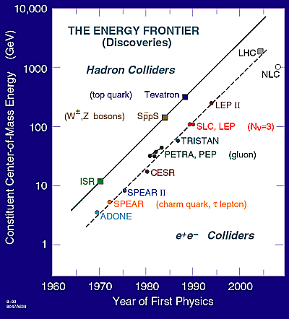
Path to higher energy
History:
  Energy constantly increasing with time
  Hadron Colliders
  at the energy frontier
  Lepton Colliders
  for precision physics
LHC has found the Higgs
with m_{H} = 126 GeV/c²
A future Lepton Collider would complement LHC physics

Slide 5
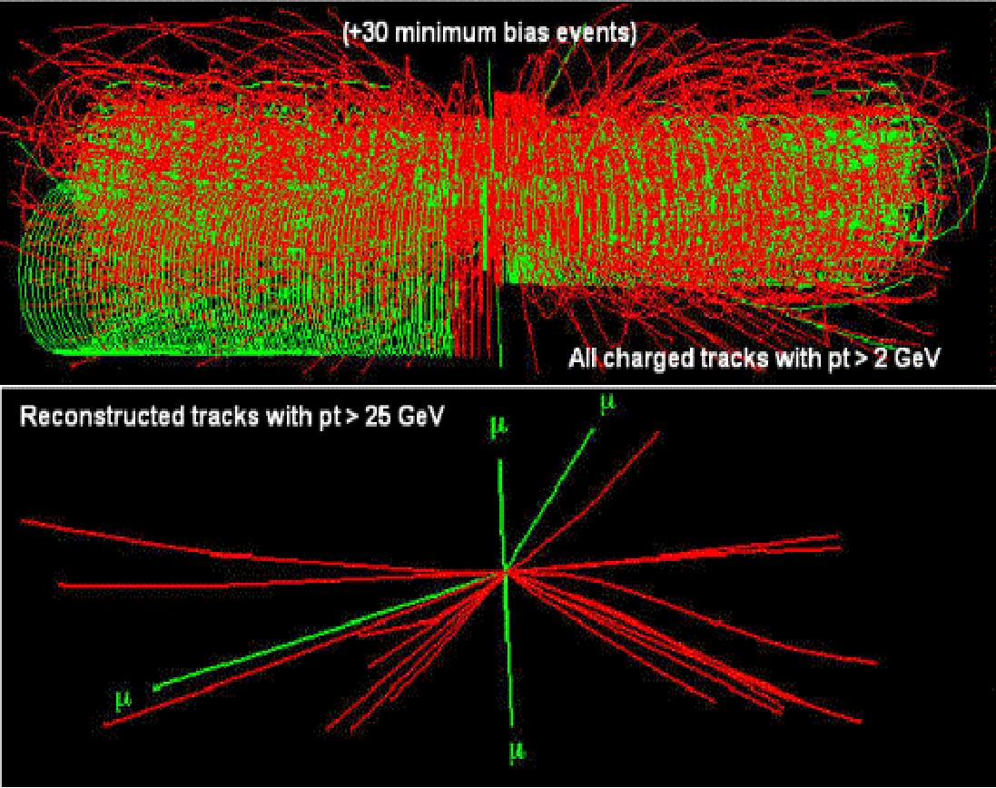
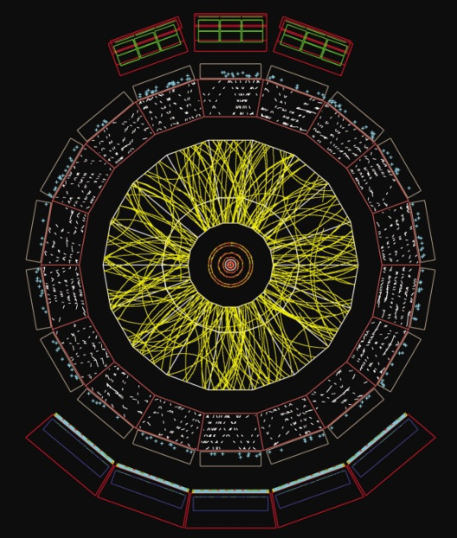
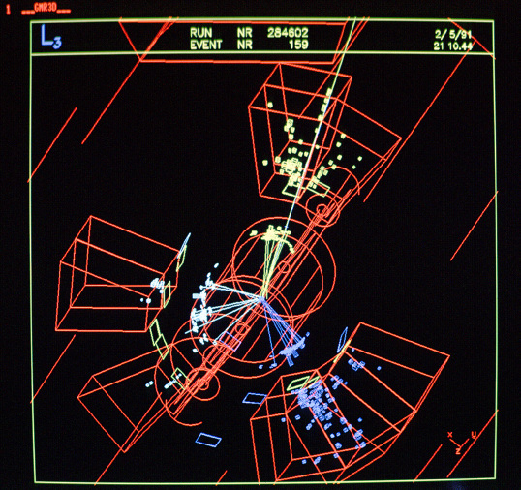
Lepton vs. Hadron Collisions
LHC: H → ZZ → 4µ
Hadron Collider (p, ions):
  Composite nature of protons
  Can only use p_{t} conservation
  Huge QCD background
Lepton Collider:
  Elementary particles
  Well defined initial state
  Beam polarization
  produces particles democratically
  Momentum conservation eases decay product analysis
p
p
e+
e-
ALICE:
Ion event
LEP event:
Z⁰ → 3 jets

Slide 6
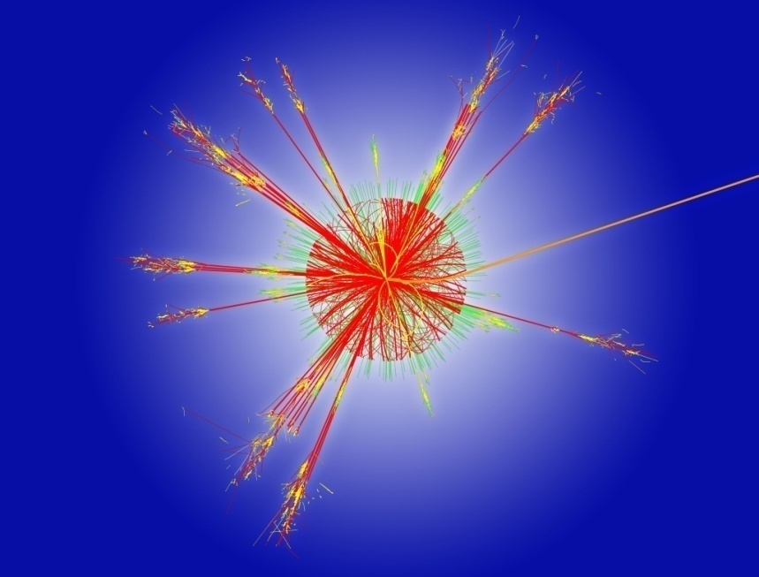
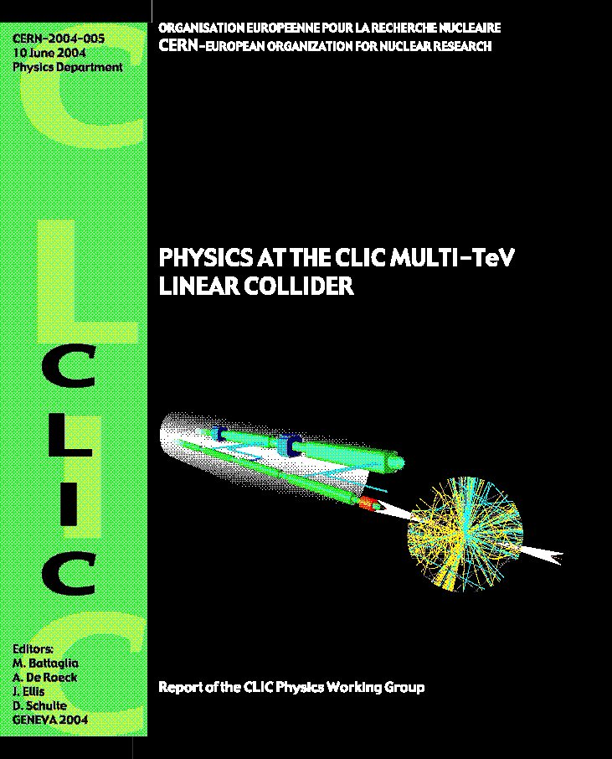
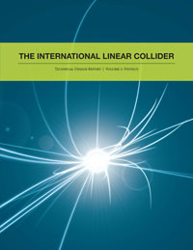
TeV e+e- physics
Higgs physics
  LHC has discovered the Higgs particle
  LC explore its properties in detail
Supersymmetry
  LC will complement the
  LHC particle spectrum
Extra spatial dimensions
New strong interactions
. . .
=> a lot of new territory to discover
beyond the standard model
“Physics at the CLIC Multi-TeV Linear Collider”
CERN-2004-005
“CLIC Conceptual Design Report– Vol.2”
http://lcd.web.cern.ch/LCD/CDR/CDR.html
“ILC Technical Design Report – Vol.2 – Physics at the ILC”
www.linearcollider.org/ILC/Publications/Technical-Design-Report

Slide 7
The next lepton collider
Larger lepton storage ring? LEP-3?? (LEP L = 27 km, E_{cm}= 200 GeV)
Remember: Synchrotron radiation
  Emitted power: scales with E ⁴ !!
  Energy loss/turn: must be replaced
  by the RF system !!
RF costs: €_{RF} ∝ U₀ ∝ E⁴/ρ
Linear costs (magnets, tunnel, etc.) : €_{lin} ∝ ρ
=> Optimum when: €_{lin} ∝ €_{RF} ⇒ ρ ∝ E²
Increase radius quadratically with energy
=> The size and the optimized cost scale as E²
as well as the energy loss per turn (was already 3% at LEP)
2
r
c
E
4
P
=
(
e
)
3
m
c
2
3
ρ
2
o
4
r
E
4
U
=
π
(
e
)
0
3
m
c
2
3
ρ
0

Slide 8
The solution: a Linear Collider
NO bending magnets ⇒ NO synchrotron radiation
but: A lot of accelerating structures !!!
Cost scaling linear with E
damping ring
e+
e-
source
main linac
beam delivery
Storage rings:
  accelerate +
  collide every turn
  ‘re-use’ RF +
  ‘re-use’ particles
=> efficient
Linear Collider:
  one-pass acceleration + collision
  => need
  high gradient
  small beam size σ and emittance
  to reach high luminosity L (event rate)
much less limited by beam-beam effect

Slide 9
Luminosity: LC vs Storage Ring
Collider luminosity L (cm⁻² s⁻¹) is
approximately given by
where:
n_{b} = bunches / train
N = particles per bunch
f_{rep} = repetition frequency
σ_{x,y} = transverse beam size at IP
H_{D} = beam-beam enhancement factor (linear collider: typical value ~2)
LHC ring f_{rep} = 11 kHz
LC f_{rep} = few-100 Hz (power limited)
⇒ factor ~100-1000 in L already lost for the LC!
Must push very hard on beam cross-section at collision:
factor of 10⁶ gain! needed
to obtain high luminosity
of a few 10³⁴ cm⁻²s⁻¹
LEP: σ_{x}σ_{y} ≈ 130×6 µm²
LC: σ_{x}σ_{y} ≈ (60-550) × (1-5) nm²

Slide 10
Luminosity: RF power
Introduce centre-of-mass Energy E_{cm}
η_{RF} is RF to beam power efficiency
Luminosity is proportional to the RF power and efficiency for a given E_{cm}
Some numbers: E_{cm} = 500 GeV
N = 10¹⁰
n_{b} = 100
f_{rep} = 100 Hz
Need to include efficiencies:
RF→beam: range 20-60%
Wall plug→RF: range 28-40%
AC power: a few hundred MW to accelerate beams for a high luminosity
this limits the practically achievable energy and luminosity

Slide 11
Luminosity: IP effects
choice of technology
(NC vs SC):
  efficiency
  available power
Strong focusing needed for small beam size
  optical aberrations
  stability issues and tolerances
Beam-Beam effects:
  strong self focusing (pinch effect) ⇒ increases Luminosity
  beamstrahlung ⇒ photon emission
    dilutes Luminosity spectrum
    creates detector background

Slide 12
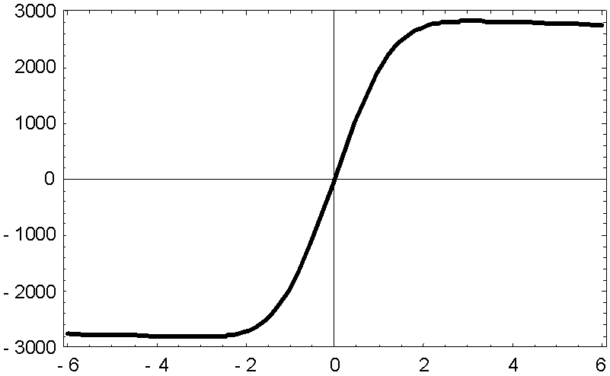
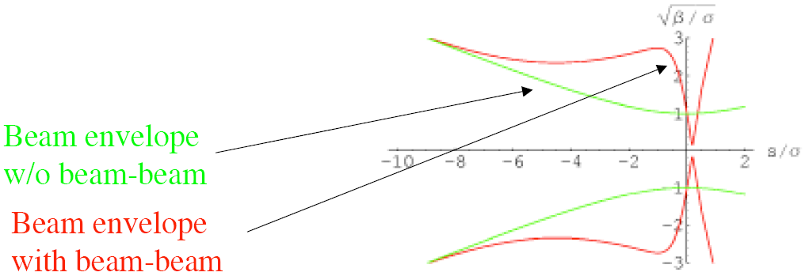
Beam-Beam effects: pinch
Strong electromagnetic field of the opposing bunch:
  deflects the particles
  “beam-beam kick”
  focuses the bunches
  “pinch effect”
  Luminosity enhancement factor H_{D}
E_{y} (MV/cm)
y/σ_{y}

Slide 13
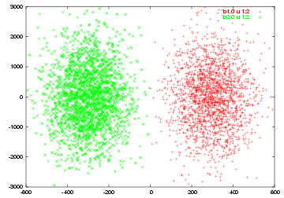
Collision Simulation
D.Schulte
beams strongly focused during collision ⇒ Luminosity!
large divergence after collision ⇒ beam extraction difficult

Slide 14

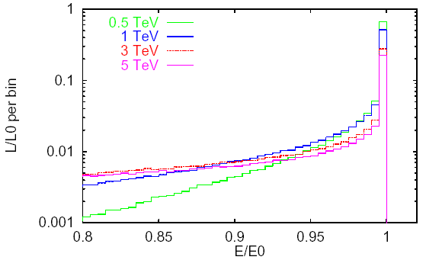

Beamstrahlung
“synchrotron radiation” in the field of the opposing bunch
smears out luminosity
spectrum
creates e⁺e⁻ pairs
background in detector
quantified by
Disruption parameter

Slide 15
Beamstrahlung: energy loss
RMS relative energy loss
beamstrahlung energy loss
we want
  σ_{x} and σ_{y} small for high luminosity
  (σ_{x}+ σ_{y}) large for small δ_{BS} (=> better luminosity spectrum)
use flat beams with σ_{x} ≫ σ_{y}
Can increase luminosity by small σ_{y}
and minimise δ_{BS} by big σ_{x}

Slide 16
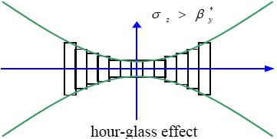
Limit on beam size: Hour-glass effect
β-function at the interaction point follows
Luminosity has to be calculated in slices
desirable to have σ_{z} ≤ β_{y} ⇒ short bunch length for high luminosity
σ_{z}=β_{y}
σ_{z}=3β_{y}
N.Walker

Slide 17
Luminosity: more scaling …
substitute into
we get
now use
then
~1 (hour glass effect)

Slide 18
The ‘final’ scaling for LC
we want high RF-beam conversion efficiency η_{RF}
need high RF power P_{RF}
small normalised vertical emittance ε_{n,y}
strong focusing at IP (small β_{y} and hence small σ_{z})
could also allow higher beamstrahlung δ_{BS} if willing to live with the consequences (Luminosity spread and background)
  Above result is for the low beamstrahlung regime where δ_{BS} ~ few %
  Slightly different result for high beamstrahlung regime

Slide 19
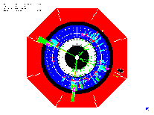
Generic Linear Collider
C.Pagani
Main Linac
Accelerate beam to IP energy without spoiling DR emittance
Collimation System
Clean off-energy and off-orbit particles
Final Focus
Demagnify and collide beams
Bunch Compressor
Reduce σ_{z} to eliminate hourglass effect at IP
Damping Ring
Reduce transverse phase space (emittance) so smaller transverse IP size achievable
Electron Gun
Deliver stable beam current
Positron Target
Use electrons to
pair-produce positrons
will see the different elements in the following…

Slide 20
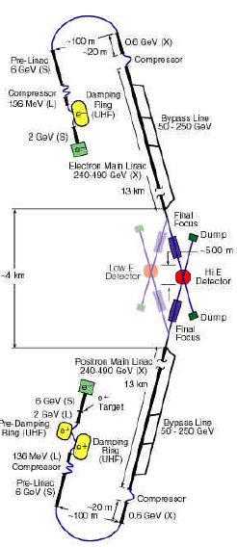
The real designs: JLC/NLC
NLC (Next Linear Collider)
JLC (Japanese Linear Collider):
  500 – 1000 GeV
  Normal conducting RF
  11.4 GHz
  65 MV/m gradient
not followed up any more
technology decision in Aug 2004 for superconducting technology

Slide 21
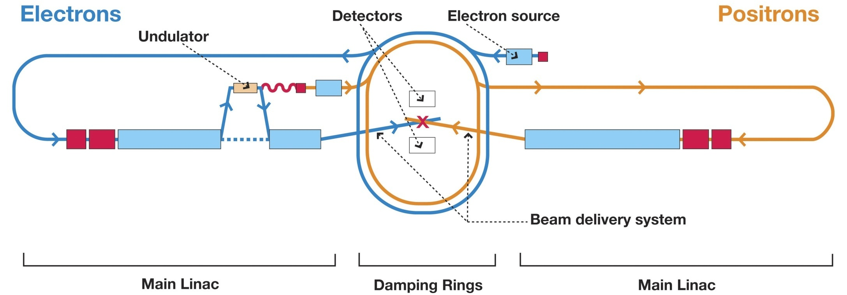
The real designs: TESLA -> ILC
TESLA:
  Superconducting cavities
  1.3 GHz
  35 MV/m gradient
  500 – 800 GeV
ILC (Internat. Linear Collider):
  Superconducting cavities
  31.5 MV/m gradient
  500 GeV
  Upgrade to 1000 GeV possible
~31 km total length (500 GeV)

Slide 22
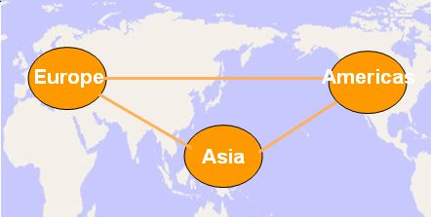
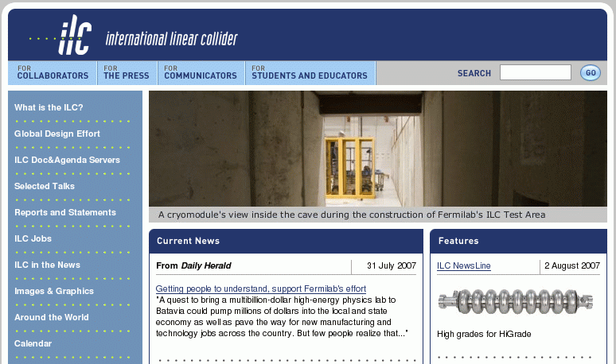
ILC - Global Design Effort - LCC
Reference Design Report 2007
Technical Design Report 2013
Web site: www.linearcollider.org
Linear Collider Collaboration (LCC) continues design effort until project approval
Japan has expressed interest in hosting ILC
preferred candidate site selected: Kitakami (north Japan)

Slide 23
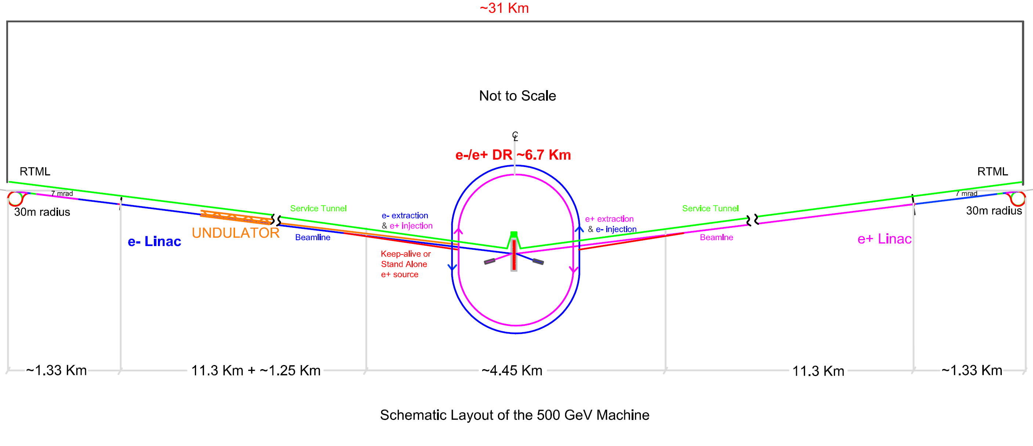
ILC Schematic
Two 250 Gev linacs arranged to produce nearly head on e+e- collisions
  Single IR with 14 mrad crossing angle
Centralized injector
  Circular 6.5 km / 3.2 km
  damping rings
  Undulator-based
  positron source
Dual tunnel configuration 11x5.5m
  3.5m shield wall
  reduction being investigated
Beam Tunnel
RF Service Tunnel
Concrete
Shield-Wall
Slide 23

Slide 24
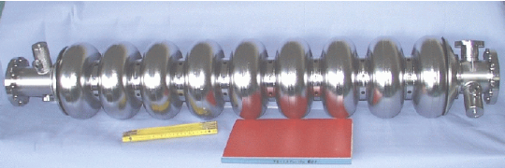
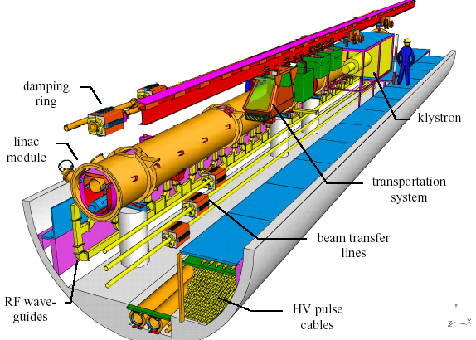
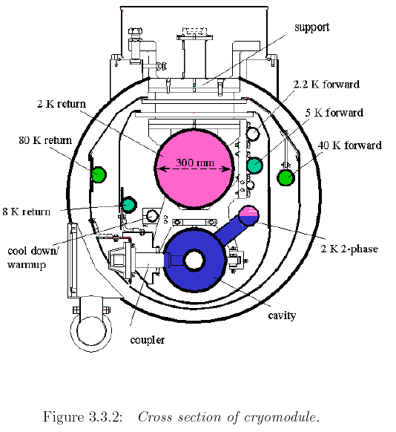
ILC Super-conducting technology
The core technology for the ILC is 1.3GHz superconducting RF cavity intensely developed in the
TESLA collaboration, and recommended for the ILC by the ITRP on 2004 August.
The cavities are installed in a long cryostat cooled at 2K, and operated at gradient 31.5MV/m.
14560 cavities
1680 modules
Slide 24

Slide 25
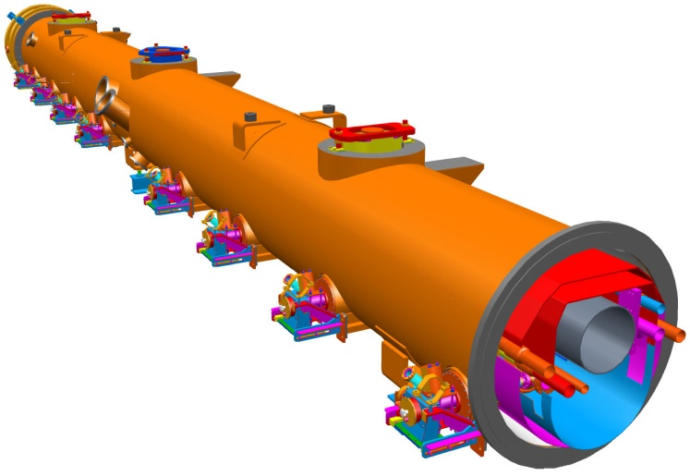
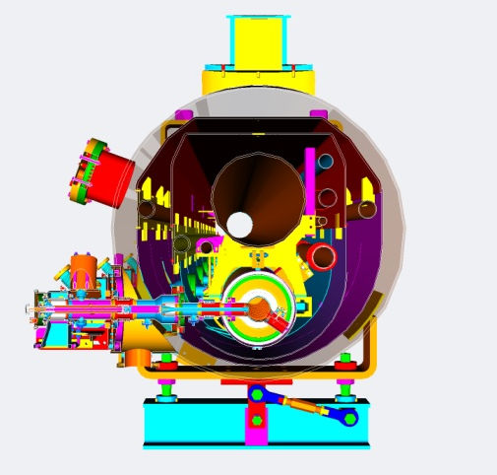
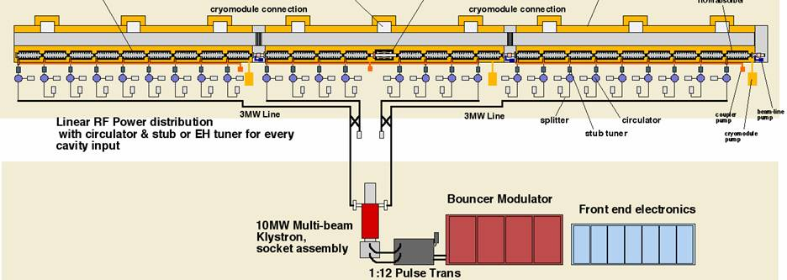
ILC Main Linac RF Unit
560 RF units each one composed of:
1 Bouncer type modulator
1 Multibeam klystron (10 MW, 1.6 ms)
3 Cryostats (9+8+9 = 26 cavities)
1 Quadrupole at the center
Total of 1680 cryomodules and 14 560 SC RF cavities
Slide 25

Slide 26
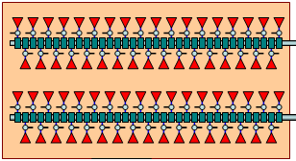

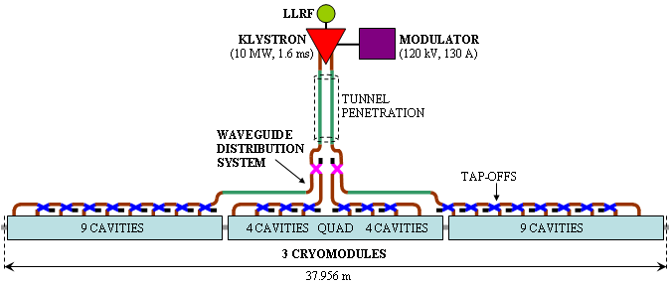
ILC Main Linac RF distribution
Either many small klystrons in the tunnel
or few clusters of higher power klystrons
O(10TW) instantaneous power
surface rf power cluster building
surface
service tunnel eliminated
underground heat load greatly reduced
shaft
~1.06 km
upstream
downstream
~1.06 km
accelerator tunnel
CTO
TE₀₁ waveguide

Slide 27
CLIC – overall layout – 3 TeV
CLIC (Compact Linear Collider): only multi-TeV design
3 TeV, 100 MV/m, warm technology, 12 GHz, two beam scheme
Slide 27

Slide 28
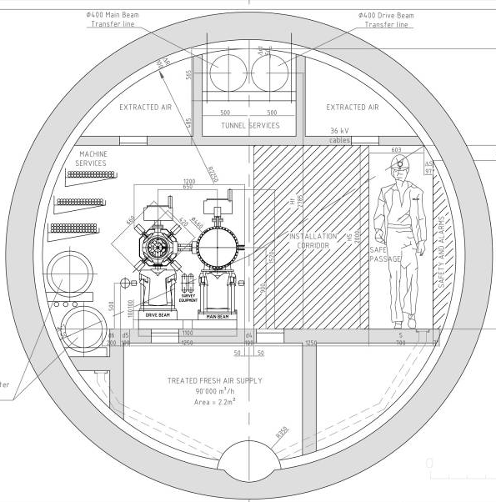
CLIC two beam scheme
High charge Drive Beam (low energy)
Low charge Main Beam (high collision energy)
=> Simple tunnel, no active elements
=> Modular, easy energy upgrade in stages
380 GeV => 1.5 TeV => 3 TeV
CLIC TUNNEL
CROSS-SECTION
Drive beam - 101 A, 240 ns
from 2.4 GeV to 240 MeV
Transfer lines
Main beam – 1 A, 156 ns
from 9 GeV to 1.5 TeV
Drive Beam
Main Beam
5.6 m diameter

Slide 29
CLIC two-beam scheme
RF power is produced by drive beam
Drive beam:
100 A current, 2.4 GeV
Main beam:
1 A, 1500 GeV
RF Power per structure ~ 65MW
No of structures ~140,000
Total instantaneous power ~ 9.1 PW

Slide 30
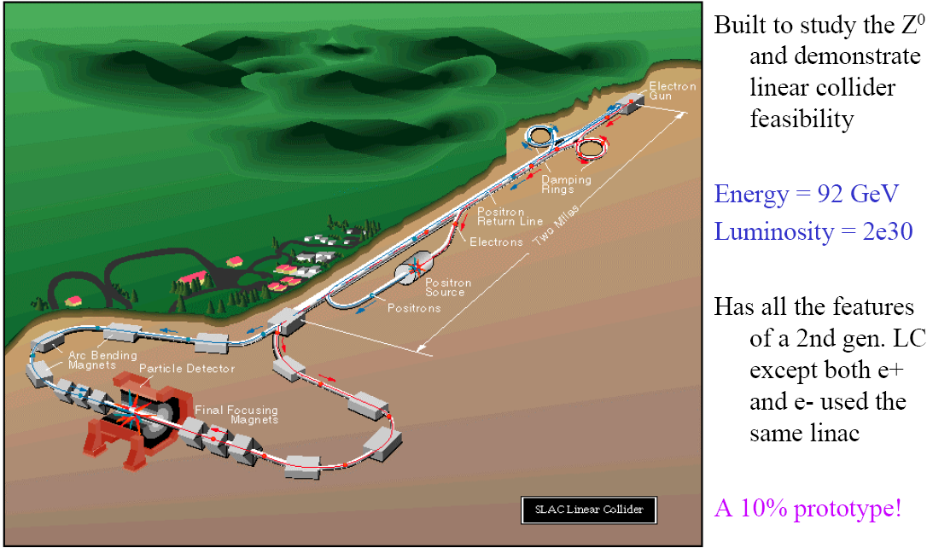
First LC: SLC
T.Raubenheimer

Slide 31
Parameter comparison
 | SLC | TESLA | ILC | J/NLC | CLIC
Technology | NC | Supercond. | Supercond. | NC | NC
Gradient [MeV/m] | 20 | 25 | 31.5 | 50 | 100
CMS Energy E [GeV] | 92 | 500-800 | 500-1000 | 500-1000 | 500-3000
RF frequency f [GHz] | 2.8 | 1.3 | 1.3 | 11.4 | 12.0
Luminosity L [10³³ cm⁻²s⁻¹] | 0.003 | 34 | 20 | 20 | 23
Beam power P_{beam} [MW] | 0.035 | 11.3 | 10.8 | 6.9 | 4.9
Grid power P_{AC} [MW] |  | 140 | 230 | 195 | 270
Bunch length σ_{z}* [mm] | ~1 | 0.3 | 0.3 | 0.11 | 0.07
Vert. emittance γε_{y} [10⁻⁸m] | 300 | 3 | 4 | 4 | 2.5
Vert. beta function β_{y}* [mm] | ~1.5 | 0.4 | 0.4 | 0.11 | 0.1
Vert. beam size σ_{y}* [nm] | 650 | 5 | 5.7 | 3 | 2.3
Parameters (except SLC) at 500 GeV

Slide 32
Documentation about ILC/CLIC
Linear Collider Collaboration http://linearcollider.org
General documentation about the ILC: http://linearcollider.org/ILC
General documentation about the CLIC study: http://cern.ch/clic-study
Int. Linear Collider Workshop 2015 (most actual info) http://lcws15.triumf.ca
CLIC Workshop 2016 http://indico.cern.ch/event/449801
International school for Linear Colliders: http://linearcollider.org/school
Linear Collider Detector: http://cern.ch/lcd
CLIC conceptual design report: http://clic-study.web.cern.ch/content/conceptual-design-report
CLIC scheme description: http://preprints.cern.ch/yellowrep/2000/2000-008/p1.pdf
CERN Bulletin article:http://cdsweb.cern.ch/journal/article?issue=28/2009&name=CERNBulletin&category=News%20Articles&number=1&ln=en
CLIC Test Facility: CTF3 http://ctf3.home.cern.ch/ctf3/CTFindex.htm
CLIC technological challenges (CERN Academic Training)
http://indico.cern.ch/conferenceDisplay.py?confId=a057972
CLIC project meetings http://indico.cern.ch/category/3589/
CLIC notes http://cdsweb.cern.ch/collection/CLIC%20Notes

